Slide 1
Why intel for your vdi deployments?
Solution Overview
October 2020

Slide 2

How IT Leaders are Responding to the Pandemic
COVID-19 has changed how and where we work …
organizations are facing the reality that on average only 23% of their workforce needs to be in the office for their business to be fully operational
of ITDMs report increasing operational efficiency as a digital business objective
64%
of ITDMs report a desire to increase security as a digital business objective
58%
Source: CIO Pandemic Business Impact Survey, 2020
Notes:
Talking Points:
COVID-19 has forever changed us. It’s created a massive change in human behavior at scale. This crisis is happening during exponential technology change, driving a whole new way of how we do business. The combination of these two factors is creating unprecedented change, acceleration in how we use technology, and pivoting us to somewhere new.
COVID has become a forcing function that breaks us out of old processes where adaptability and velocity is paramount.

Slide 3






VDI is More Important Than Ever
Industry Trends:
Government and enterprise customers seeking a more agile and flexible workforce
Working, caring, and educating people is shifting from traditional venues to the home
Remote work is an example of create cost savings to minimize business disruptions from Covid-19
Businesses and Enterprises are turning to VDI for the answer:
Enable / Support Remote Workforce
Ease of Access to Applications for Improved Workforce Productivity
Increased Security & Centralized Management
Cost Savings & Lower Endpoint Device HW Requirements
Healthcare
Financial Services
Education
Government
Manufacturing
Retail
Notes:
Use Case Examples by Vertical:
Healthcare: clinicians use various devices per day, need secure/central access to EMR
Manufacturing: simplify mgmt of endpoint devices, ease of access for factory shift workers
Financial services: allow for business agility and flexibility, compliance w/ data regulations
Public Sector: improve efficiency & security and better user experience with lower opex
Education: enable secure, flexible learning space, support student BYOD (bring your own device)
Retail: centralize admin functions like HR, accounting or provide remote help desk for IT operations vs in every store

Slide 4
Virtual Desktop Infrastructure Use Cases
HEALTHCARE
clinicians use various devices per day, need secure/central access to EMR
FINANCIAL SERVICES
allow for business agility and flexibility, compliance w/ data regulations
EDUCATION
enable secure, flexible learning space, support student BYOD (bring your own device)
GOVERNMENT
improve efficiency & security and better user experience with lower opex
MANUFACTURING
simplify management of endpoint devices, ease of access for factory shift workers
RETAIL
centralize admin functions or provide remote help desk for IT operations vs in every store
Notes:
Use Case Examples by Vertical:
Healthcare: clinicians use various devices per day, need secure/central access to EMR
Manufacturing: simplify mgmt of endpoint devices, ease of access for factory shift workers
Financial services: allow for business agility and flexibility, compliance w/ data regulations
Public Sector: improve efficiency & security and better user experience with lower opex
Education: enable secure, flexible learning space, support student BYOD (bring your own device)
Retail: centralize admin functions like HR, accounting or provide remote help desk for IT operations vs in every store

Slide 5
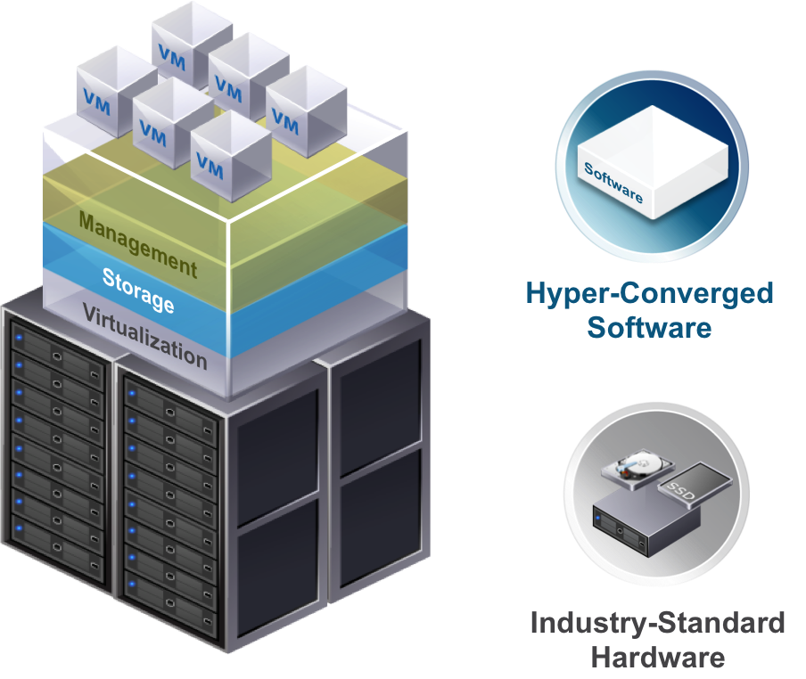
HCI Efficiently Supports VDI Performance & Scaling
From simple to complex, worker types can help define the requirements of your solution
Power workers
Content creators, CAD/CAM, video, power users; heaviest memory, CPU and graphic usage
Knowledge workers
Complex tasks, document, spreadsheet, slide preparation, heavy browser usage, moderate VM size
Task workers
Single task, minimal applications; small VM sizing
The benefits of HCI are magnified in a VDI environment: they complement each other
to deliver simplicity, scalability, cost-effectiveness, and operational efficiency*.
* https://www.cio.com/article/3546433/finding-a-silver-lining-enable-your-remote-workforce-with-vdi.html
Notes:
Virtual desktop infrastructure (VDI) is defined as the hosting of desktop environments on a central server. It is a form of desktop virtualization, as the specific desktop images run within virtual machines (VMs) and are delivered to end clients over a network. Those endpoints may be PCs or other devices, like tablets or lightweight terminals.
VDI solutions are based on scaled virtualization models. Blending scalable compute, networking and storage offer flexibility in services and meet differing worker type models. There are a few types of worker types that can help define the requirements of your solution. Starting with basic, and growing in complexity.
Task workers: single task, minimal applications; small VM sizing
Knowledge workers: complex tasks, document, spreadsheet, slide preparation, heavy browser usage, moderate VM size
Power workers: content creators, CAD/CAM, video, power users; heaviest memory, cpu and graphic usage
…all the great things about HCI are magnified in a VDI environment. It’s as if they were made for each other, working together to deliver simplicity, scalability, cost-effectiveness, and operational efficiency*.

Slide 6
Key Considerations for VDI Deployments
Traditional 3-tier architecture
Hyperconverged
Best for small deployments (<300 users)
Manage storage and compute separately
Can start with a single server
May utilize existing servers and SAN,
but limited scalability
Difficult to deploy and provision to
meet need for rapid service delivery
Best for larger or scalable deployments, or for small, mixed workload environments
Clusters compute, storage and networking into a pool of virtualized resources on standard servers
Simplified deployment and management using familiar virtualization tools and resources for lower OpEx
Easily scales performance with capacity
Allows incremental investment as needed, reducing CapEx
Key considerations
Identify number of virtual users/desktops required
Determine use cases of workers from basic task to knowledge to power users
Examine work patterns based on time zones and other peaks
Size infrastructure to meet these requirements, ensuring adequate compute and I/O resources
Scale as needed over time
COMPUTE SERVERS & SAN
A
A
A
A
HYPERCONVERGED CLUSTER
Notes:
Hyperconverged solutions enable customers to run applications on the same servers providing storage services. Operationally, a hyperconverged solution helps to enable IT to provision and manage storage at a virtual machine (VM) level, using the same tools employed for VM management. This approach can be an efficient use of both infrastructure and human resources. Co-locating latency-sensitive applications with storage may also prove advantageous. Hyperconverged storage is often the best fit for workloads such as real-time collaboration, databases, virtual desktop infrastructure and multi-workload clusters.
Specifics will vary across customers, and broad guides should always be weighed against company-specific circumstances.

Slide 7
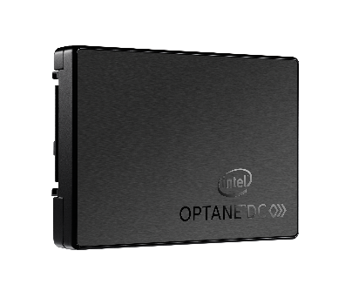
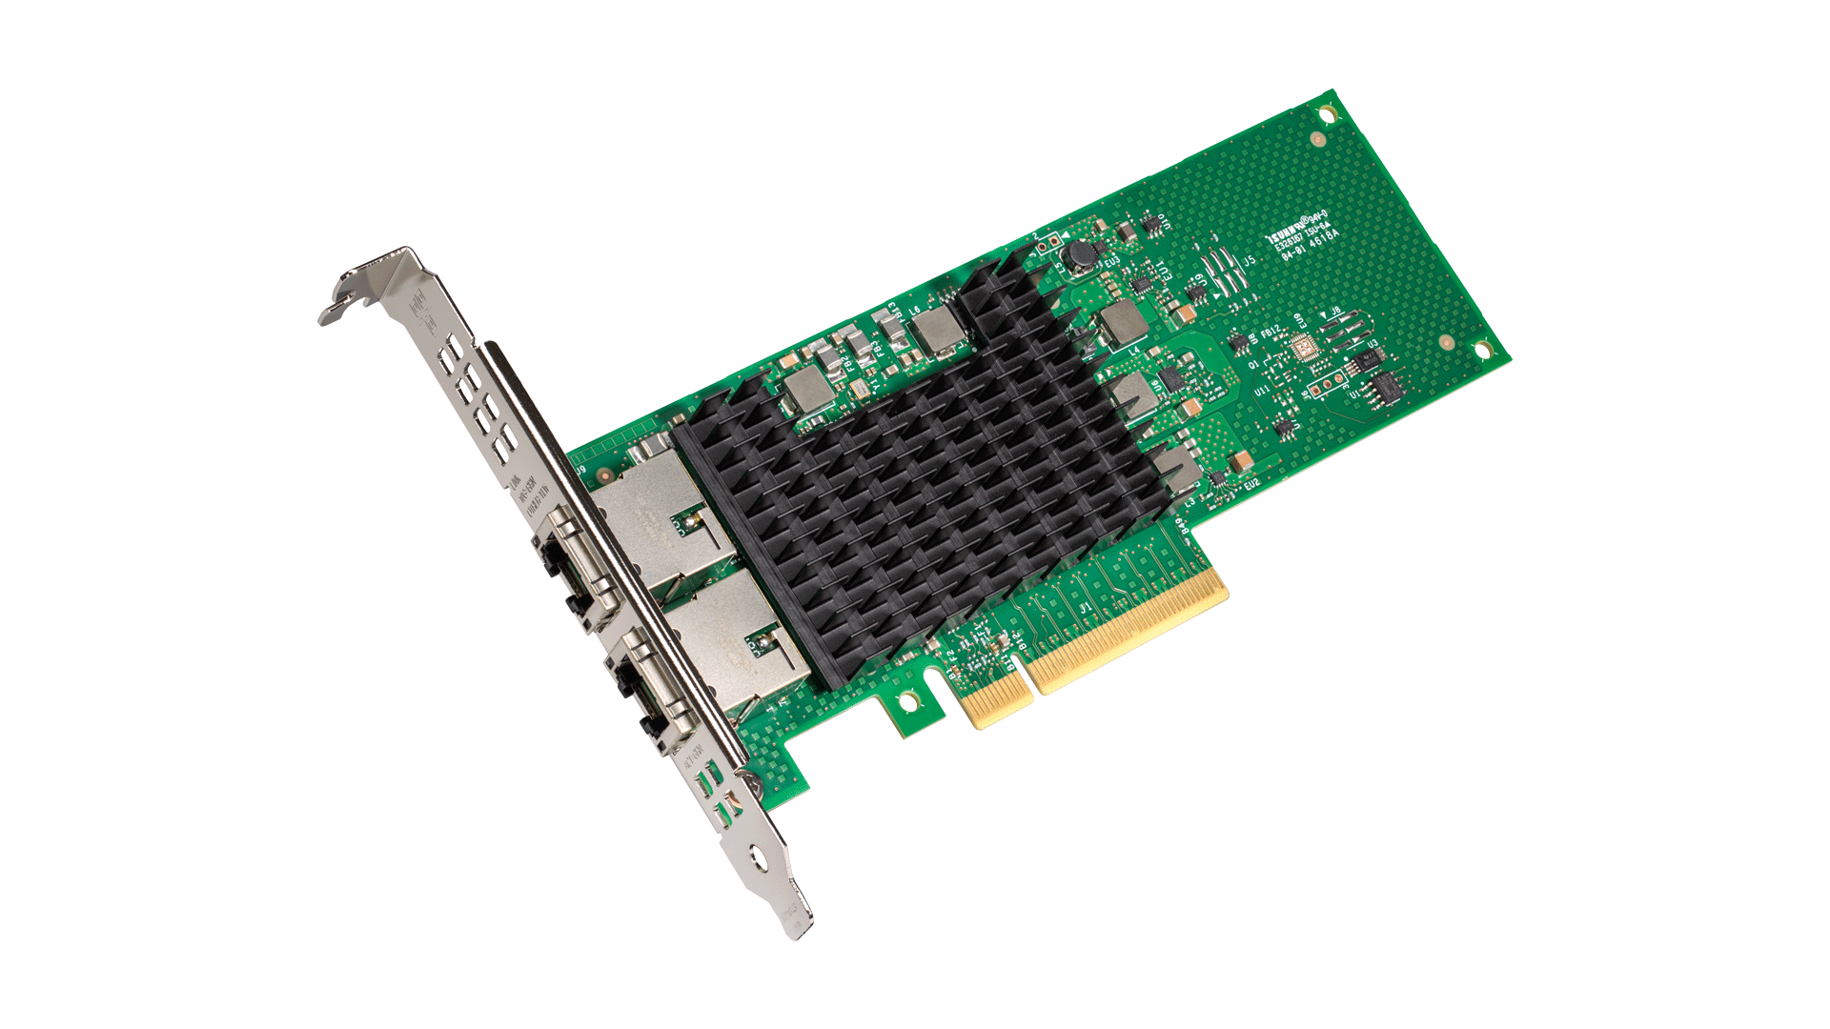
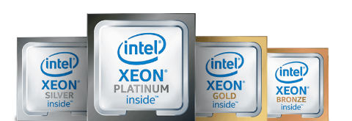
Intel portfolio for Hyperconverged VDI Solutions
Supporting Intel Products
2nd Gen Intel® Xeon® Scalable Processors
Intel® Optane™
persistent memory
Intel® Optane™ SSDs
Intel® Ethernet 700 series
compute
virtualization
memory
virtualization
storage
virtualization
network
virtualization
Wide range of SKUs to tailor cores and frequency to workload requirements
Integrated virtualization technologies
Intel VMD enables hot swap of NVMe SSDs
Intel Optane™ persistent memory to affordably increase memory capacity
HW security mitigations & automatic data encryption on Intel Optane PMem
Intel Data Center SSDs designed for low latency and high performance
Intel Optane SSDs deliver high endurance, low latency, and high QoS for the cache tier
Extend capacity with 2nd Gen Intel 3D NAND SSDs:
Greater intelligence and performance for virtualization with network packet processing
Flexible and scalable I/O virtualization
Intelligent offloads for improved performance and efficiency
RDMA streamlines and accelerates node-to-node network traffic
Notes:
INTEL® HARDWARE STACK FOR HCI:
2nd Gen Intel® Xeon® Scalable Processors:
Customers demand scalable and flexible compute infrastructure to support their increasing and changing workload demands
With the new second gen Intel Xeon Scalable processors, customers will realize outstanding improvements in performance across a broad range of data centric use cases, whether investing in new infrastructure or refreshing to the latest generation.
Intel has long delivered hardware-enhanced security to thwart malicious exploits and maintain workload integrity, with reduced performance overhead. Now we have integrated the security mitigations for side channel methods.
Intel® Volume Management Device (Intel® VMD) enables hot swap of NVMe* SSDs while LED management helps simplify SSD status
Last, but far from least, Intel Optane data center persistent memory – our biggest innovation – a new memory tier!
Intel® Solid State Drive Data Center Family:
Intel® SSD technology with VMware vSAN delivers an optimal solution with low latency and next-level performance
Intel® SSDs provide 256-bit AES encryption and power-loss data protection
Intel® Optane™ SSDs combine the attributes of memory and storage to deliver the industry leading combination of low latency, high endurance, QoS, and high throughput, optimized to break through storage bottlenecks
The second generation of Intel® 3D NAND SSDs include:
Intel® SSD DC P4500 Series, optimized for reads, enables data centers to get more value out of servers and store more data
Intel® SSD DC P4600 Series, designed for mixed workloads, accelerates writes and enables more workloads per server
Intel® Ethernet 700 Series:
10 Gigabit Intel® Ethernet Converged Network Adapters offer a 45 percent reduction in power per rack, a significant reduction in infrastructure costs, and twice the server I/O bandwidth¹
Hardware optimizations for I/O virtualization and native VMware vSphere storage networking support deliver outstanding performance while maintaining compatibility with integrated VMware vSphere quality-of-service (QoS) and teaming features
Intel® Ethernet 700 Series Key Messages:
Network Packet Processing
Greater Intelligence and Performance for NFV
The Intel® Ethernet 700 Series uses a combination of hardware and software acceleration features such as Application Device Queues and Dynamic Device Personalization to enable customizable packet filtering. These along with enhanced Data Plane Development Kit (DPDK) support for advanced packet forwarding and high efficient packet processing for both Cloud and Network Functions Virtualization (NFV) workloads.
Network Virtualization
Enhanced Network Virtualization Overlays (NVO) Performance
Network Virtualization Overlay (NVO) acceleration and intelligent offload support for VXLAN, NVGRE, GENEVE, MPLS, VXLAN-GPE with NSH to enable Software Defined Infrastructure (SDI). These stateless offloads preserve application performance for overlay networks and the network traffic can be distributed across CPU cores increasing the network throughput.
Server Virtualization
Flexible and Scalable I/O Virtualization
With Intel® Virtualization Technology (Intel® VT), the Intel® Ethernet 700 Series delivers outstanding I/O performance in virtualized server environments. I/O bottlenecks are reduced through intelligent offloads such as Virtual Machine Device Queues (VMDq) and Flexible Port Partitioning using SR-IOV for networking traffic per Virtual Machine (VM), enabling near-native performance and VM scalability.
Intelligent Offloads
Improved Performance and Efficiency
The Intel® Ethernet 700 Series LAN engine also implements performance optimizations for traditional LAN traffic. Intelligent offloads leverage the computing power of the Intel Xeon processor where appropriate, and implement complementary accelerations in the network controller. By employing a balanced hybrid of compute and offload, intelligent offloads are able to achieve the optimized point of performance and efficiency. This includes packet checksum offloads, Transmission Control Protocol/User Datagram Protocol (TCP/UDP Segmentation Offload), Receive Side Scaling (RSS) and others.

Slide 8


Meet the growing demands of today’s vdi user
Support More Users
Same User
Experience
Lower TCO
More Memory per VM
Maximize cpu & memory resources
Meet end user latency
sla requirements with Optane PMem
Support more vdi users
per node
Affordable alternative
to dram
Notes:
We know that our customers are facing a lot of pain points, ….DRAM is just too expensive, and limited in capacity size, and that has a lot of impact as they try to turn their data in valuable insights. The current situation means that scaling up is expensive and CPUs get underutilized as we encounter IO bottlenecks and limitations at the system level that prevent efficiencies and growth. Traditional memory just doesn’t get to the capacities needed for IMDB and certain memory-demanding workload applications. This April, in the second-most hotly anticipated arrival of the month, the first being season six of Game of Thrones, we have Intel Optane DC persistent memory!!!
Just kidding. The first is Cascade Lake ☺
We believe this will go to the heart of solving some of our customers deeper issues and launch a revolution in the data center. Finally an affordable alternative to expensive DRAM, that can deliver HUGE capacity that can accommodate demanding workloads and emerging tools like in-memory databases (IMDB). When deployed, Intel Optane DC PM can help improve TCO via not just memory savings, but broadly via reduced SW licensing costs, node reduction, power efficiencies,, and other operational efficiencies. I call this ‘SAVE MORE’, and I know that speaks to our customers.
But it isn’t just a cost play, as important as that is…. I’m really excited about infrastructure consolidation, aka the ability to ‘DO MORE’. We have seen customers how have jumped on the opportunity for Intel Optane DC PM to spur major infrastructure consolidation; the increase in memory size from Intel Optane media provide the opportunity to consolidate workloads that have been spread across several nodes, leaving CPUs underutilized, to concentrating and consolidating workloads on fewer nodes, ultimately saving on the deployments necessary and maximizing CPU utilization. Each Node does more, and the CPU can do more.
Saving and doing don’t mean much if it isn’t done well. And here Intel Optane DC persistent memory doesn’t slack off. Actually this is where the product truly shines, and were we expect to see huge innovation going forward. We have an entirely new memory tier that has new properties of performance and persistence, and architects and developers are using it as a springboard for innovation taking advantage of new usages around restart and replication, groundbreaking performances from breaking system bottlenecks that used to severely constrain workloads, and making use of what could be considered the world’s tiniest, but fastest storage device sitting on a memory bus.

Slide 9
Horizon on ESXi
VDI Solution with Intel® Optane™ Persistent Memory

Slide 10
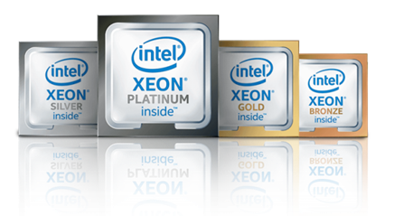

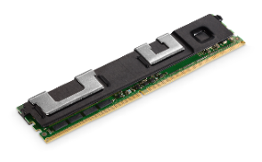

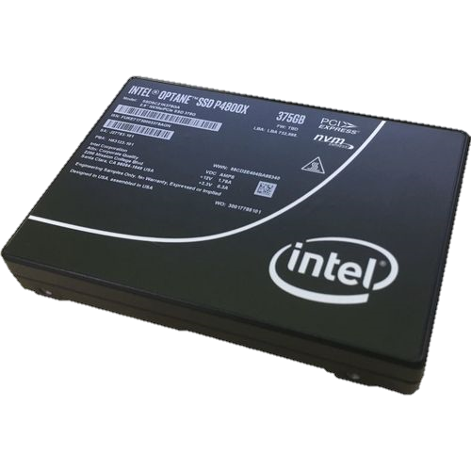

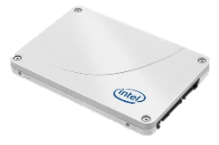
Intel Technology Works Together in VMware vSAN
CPU
vSphere
vSAN
INTEL® XEON®
SCALABLE PROCESSORS
Compute
vSphere ESXi
Managed by vCenter
MEMORY (DRAM+PMEM)
expanded
memory
Writes
Reads
cache
tier
Storage
vSAN
CACHE
CAPACITY
capacity
tier

Slide 11
VMware Horizon on VMware vSAN for ViewPlanner “Power” User
Support up to 87% more VDI users with up to 16% reduction in $/vdi¹
Number of VDI users
Total Cost per VDI User
$1,200
$1,172
16% reduction
in $/VDI
300
300
$1,096
250
$1,000
$979
6% reduction
in $/VDI
200
200
$800
10% reduction
in $/VDI
Users
$600
150
160
TCO $/VDI
100
$400
50
$200
0
0
with 384GB
DDR DRAM only
with 512GB Intel
Optane PMem +
96GB DDR DRAM
with 1024GB Intel
Optane PMem +
192GB DDR DRAM
with 384GB
DDR DRAM only
with 512GB Intel
Optane PMem +
96GB DDR DRAM
with 1024GB Intel
Optane PMem +
192GB DDR DRAM
4-server cluster of Intel® Xeon® Gold 6258R processor (28C)
with Intel Optane SSD as cache drive
4-server cluster of Intel® Xeon® Gold 6258R processor (28C)
with Intel Optane SSD as cache drive
See backup for configuration details. For more complete information about performance and benchmark results, visit www.intel.com/benchmarks.

Slide 12
VMware Horizon on VMware vSAN for LoginVSI “Knowledge” User
Support up to 2.2x more VDI users with up to 12% reduction in HW Cost/user¹
Number of VDI users
Total HW Cost per VDI User
300
250
$800
$761
$668
200
$600
12% reduction
in $/VDI
Users
200
150
TCO $/VDI
$400
100
72
$200
50
0
0
with 384GB
DDR DRAM only
with 1024GB Intel
Optane PMem +
192GB DDR DRAM
with 384GB
DDR DRAM only
with 1024GB Intel
Optane PMem +
192GB DDR DRAM
4-server cluster of Intel® Xeon® Gold 6230 processor (20C)
with Intel Optane SSD as cache drive
4-server cluster of Intel® Xeon® Gold 6258R processor (28C)
with Intel Optane SSD as cache drive
See backup for configuration details. For more complete information about performance and benchmark results, visit www.intel.com/benchmarks.

Slide 13
Citrix on Nutanix
VDI Solution with Intel® Optane™ Persistent Memory

Slide 14


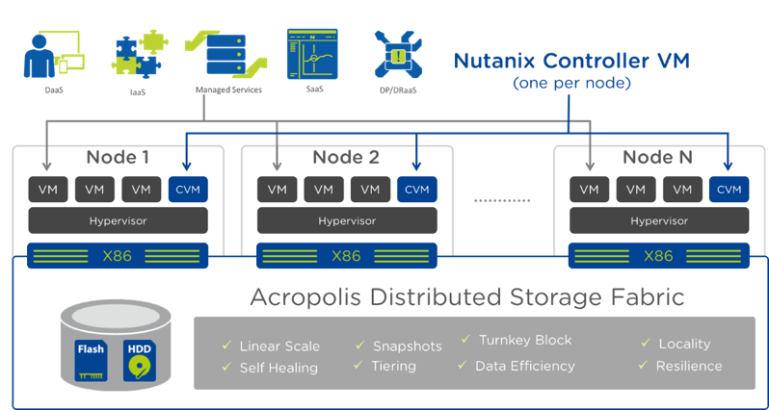
VDI on Nutanix : Advantages of adding Intel® Optane™ persistent memory
Customer pain points
Drastic increase in need/usage of VDI while IT Budgets are the same or reducing.
Solution
The introduction of Intel® Optane™ Persistent Memory allows for your Citrix on Nutanix VDI software to utilize an increased memory footprint, exercising more of your CPU power at a similar overall hardware system cost. This helps you to run more sessions with an overall savings per VDI user, without sacrificing performance.
Value proposition
Increase the number of VDI sessions on a Nutanix AHV* server by 33% at a LOWER server cost while reducing the data center server footprint¹
Reducing server footprint also drives lower power, space cooling and network infrastructure costs in the data center
High Level Architecture
Support more virtual desktops per server¹
System cost is same or lower¹
Similar responsiveness to all-DRAM¹
1.33x more VDI sessions with PMem 100 Series vs. DRAM¹
  ¹Performance results are based on testing or projections as of August 20, 2020 and may not reflect all publicly available security updates. See configuration disclosure for details. No product or component can be absolutely secure.
  Software and workloads used in performance tests may have been optimized for performance only on Intel® microprocessors. Performance tests, such as SYSmark* and MobileMark*, are measured using specific computer systems, components, software, operations, and functions. Any change to any of those factors may cause the results to vary. You should consult other information and performance tests to assist you in fully evaluating your contemplated purchases, including the performance of that product when combined with other products. For more information go to intel.com/benchmarks.
Notes:
Here is a simplified diagram of the High performance computing environment. In general it consists of Local Compute Nodes, Storage and everything in-between often called I/O nodes.
(Memory Expansion) Flexible configuration on demand, where Optane can easily switch between storage and memory mode. Historically %5 of HPC cluster includes Fat Memory nodes and between %5 and 10% I/O Nodes. Flex Memory Node solution covers both scenarios, delivering more Memory Expanded nodes than customer can afford within DRAM budget, while expanding use cases to the storage needs (temp/scratch) of certain I/O intensive HPC codes. Real performance delta between All-DRAM configuration and IMDT is not crucial, due to the fact customer must run codes completely in memory and remaining savings can cover additional nodes to improve the performance.
Typical usage of that scenario is integrating provisioning into workload scheduler (example SLURM), which scripts Optane either for IMDT installation or file system setup. Also important to note, when IMDT is not used, user gets full compute performance and original DRAM bandwidth unlike with AEP which always stays in the slot and drops a memory bandwidth.

Slide 15


VDI PMem Value Prop for Citrix on Nutanix
Increase VDI Sessions (3 node cluster)
Goal: Deliver Similar
HW System Costs
  WORKLOAD: Login VSI w/ Citrix Virtual Desktops running on Nutanix AOS 5.15 and AHV hypervisor
Available System
Memory
768 GB DDR4 DRAM
1 TB Intel® Optane® persistent memory
88 VMs
117 VMs
up to
VM density/
server
VMs/Node
33%
Estimated
Hardware System
Cost per VM
up to
~$255 USD per VM¹
^{(Total System Cost ~ $67,300)}
~$172 USD per VM¹
^{(Total System Cost ~ $60,700)}
Lower per VDI VM cost
33%
  CPU: 2x Intel® Xeon® Gold 6238R processor
  MEMORY: 768 GB DDR4 DRAM (24 x 16GB x 2 Sockets)
  CPU: 2x Intel® Xeon® Gold 6238R processor
  MEMORY: 1 TB Intel® Optane™ persistent memory + 192 GB DDR4 DRAM (6 x 16GB x 2 Sockets)
  ¹Performance results are based on testing or projections as of August 20, 2020 and may not reflect all publicly available security updates. See configuration disclosure for details. No product or component can be absolutely secure.
  Software and workloads used in performance tests may have been optimized for performance only on Intel® microprocessors. Performance tests, such as SYSmark* and MobileMark*, are measured using specific computer systems, components, software, operations, and functions. Any change to any of those factors may cause the results to vary. You should consult other information and performance tests to assist you in fully evaluating your contemplated purchases, including the performance of that product when combined with other products. For more information go to intel.com/benchmarks.

Slide 16
VDI PMem Value Prop for Citrix on Nutanix
Increase VDI Sessions (3 node cluster)
Goal: Deliver Similar
HW System Costs
  WORKLOAD: Login VSI w/ Citrix Virtual Desktops running on Nutanix AOS 5.15 and AHV hypervisor
Available System
Memory
768 GB DDR4 DRAM
1 TB Intel® Optane® persistent memory
88 VMs
117 VMs
up to
VM density/
server
VMs/Node
33%
User Response Latency
1082 mS (260 VMs)
Failed (354 VMs)
1166 mS (260 VMs)
1439 mS (354 VMs)
User Response Acceptable across expanded VMs
  CPU: 2x Intel® Xeon® Gold 6238R processor
  MEMORY: 768 GB DDR4 DRAM (24 x 16GB x 2 Sockets)
  CPU: 2x Intel® Xeon® Gold 6238R processor
  MEMORY: 1 TB Intel® Optane™ persistent memory + 192 GB DDR4 DRAM (6 x 16GB x 2 Sockets)
  ¹Performance results are based on testing or projections as of August 20, 2020 and may not reflect all publicly available security updates. See configuration disclosure for details. No product or component can be absolutely secure.
  Software and workloads used in performance tests may have been optimized for performance only on Intel® microprocessors. Performance tests, such as SYSmark* and MobileMark*, are measured using specific computer systems, components, software, operations, and functions. Any change to any of those factors may cause the results to vary. You should consult other information and performance tests to assist you in fully evaluating your contemplated purchases, including the performance of that product when combined with other products. For more information go to intel.com/benchmarks.

Slide 17
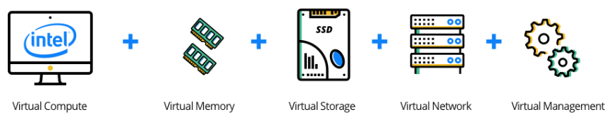
Building Your HCI VDI Solution
Focus | Intel® Architecture (minimum) | Comments
Compute | 2nd Generation Intel® Xeon® Gold 6230R or 5218R Processors | Minimum 20 cores, 2.1GHz speed; scale up as needed*
Total Available Memory: | 384GB minimum TAM (Includes DRAM & PMem size) | Adopt Intel® Optane™ persistent memory for improved TCO for 512GB – 1.5TB capacities
Network | Intel® 700 & 800 Series Ethernet | Minimum 10GbE, scales up to 100GbE
Single-Tier Storage | Intel® NVMe Datacenter Drives in flat tier | Not all solutions support single-tier architectures
Two-Tier Storage | Intel® Optane™ SSD for cache and Intel® SSD Data Center Family (NVMe/SATA) for storage | 3D NAND or QLC drives offer high-capacity storage with better endurance than HDD
GPU | Usually recommended for content creation workers | Reduces the effective number of workers per server at a higher per-user cost.
VDI SW Options | Citrix Virtual Apps & Desktops, Microsoft Remote Desktop Services, VMware Horizon, Xi Frame
HCI Options | Microsoft Azure Stack HCI, Nutanix HCI, VMware vSAN | Recommended for enterprises requiring > 300 virtual desktops
Key Considerations | Correctly sizing your VDI solution requires knowing the workload demands your workforce. Latest Purley platforms offer security and performance improvements that are not available on prior generation (legacy) hardware. VDI solutions are generally CPU-heavy applications, meaning a server will run out of CPU resources first. Memory requirements are growing – e.g. Windows10 requires much more memory. Intel Optane PMem offers affordable large memory capacity to maximize HCI resources. Data storage does not generally have a heavy I/O requirement. Networking solutions scale with HCI model requirements, in general, >10GbE is required, but faster is preferred.
* Recommended Processors: https://ark.intel.com/content/www/us/en/ark/compare.html?productIds=199350,199351,199342,199346,199345,199343,199352

Slide 18

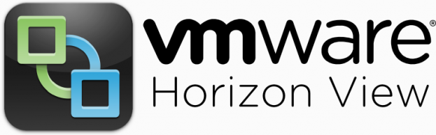
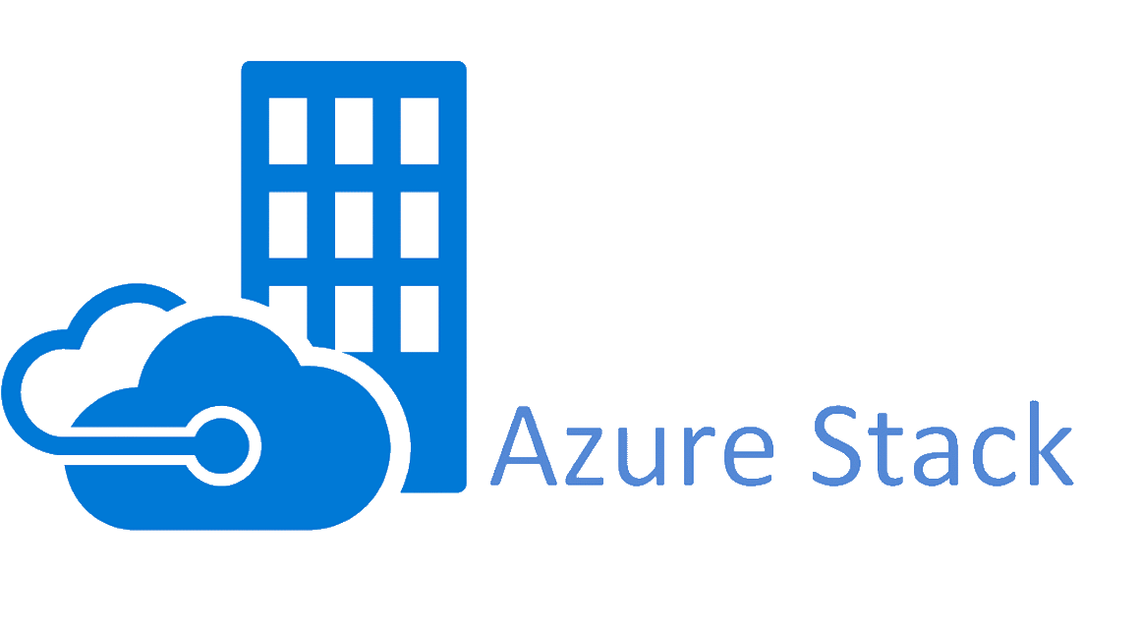


Accelerate Time to Value with Pre-Tested,
Verified Solutions
Intel recommends hosting VDI environments on Hyper-Converged Infrastructure to enable consistent desktop experiences for users, regardless of device, and provides administrators the ability to spin up new desktops as quickly as virtual machines.
Optimized for
Virtual Desktop
Infrastructure
Workload Optimized
on vSAN
Optimized for
Hyper Converged
Infrastructure (HCI)
Premium Configurations
Verified by Intel
HCI
HCI
vSAN
We’ve Spent Months So You Don’t Have To
more at www.intel.com/selectsolutions

Slide 19
Notices & Disclaimers
Intel technologies may require enabled hardware, software, or service activation.
Performance results are based on testing as of dates shown in the configurations and may not reflect all publicly available security updates. See backup for configuration details. No product or component can be absolutely secure.
Software and workloads used in performance tests may have been optimized for performance only on Intel microprocessors.
Performance tests, such as SYSmark and MobileMark, are measured using specific computer systems, components, software, operations and functions. Any change to any of those factors may cause the results to vary. You should consult other information and performance tests to assist you in fully evaluating your contemplated purchases, including the performance of that product when combined with other products. For more complete information visit www.intel.com/benchmarks.
Your costs and results may vary.
Intel does not control or audit third-party data. You should consult other sources to evaluate accuracy.
Results have been estimated or simulated.
© Intel Corporation. Intel, the Intel logo, and other Intel marks are trademarks of Intel Corporation or its subsidiaries. Other names and brands may be claimed as the property of others.

Slide 20
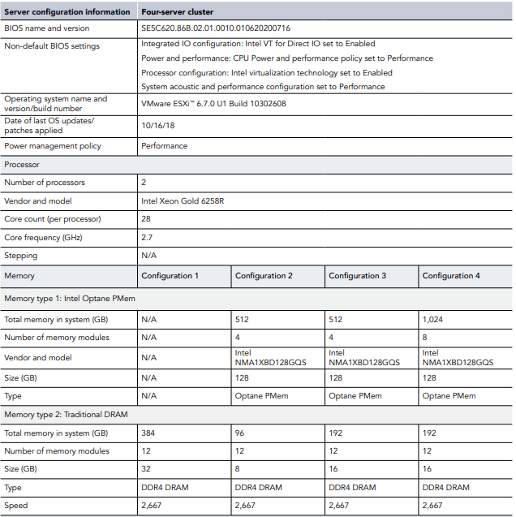
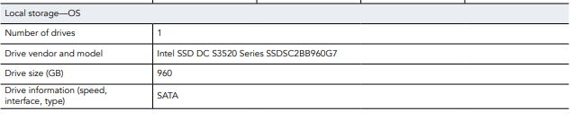
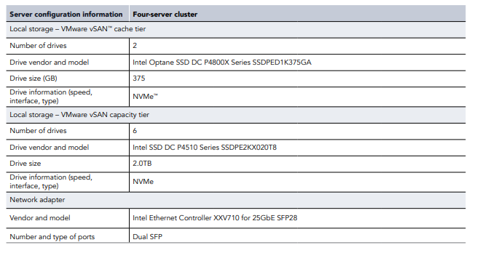
VMware Horizon on VMware vSAN for ViewPlanner “Power” User
Configuration Details
Source: https://www.principledtechnologies.com/VMware/VMware-HCI-Intel-Optane-VDI-science-0520-v2.pdf

Slide 21
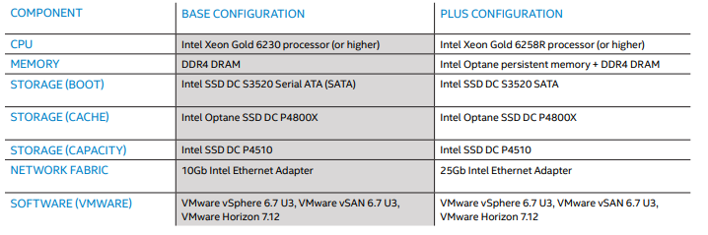
VMware Horizon on VMware vSAN for LoginVSI “Knowledge” User
Configuration Details
Intel® Optane™ persistent memory pricing & DRAM pricing referenced in TCO calculations is provided for guidance and planning purposes only and does not constitute a final offer. Pricing guidance is subject to change and may revise up or down based on market dynamics. Please contact your OEM/distributor for actual pricing.
BASE: Intel Xeon Gold 6230 Processor – 384 GB DRAM: 4 Node, 2x Intel® Xeon® Gold 6230 Processor,1x Intel® Server Board S2600WFT,Total Memory: 384 GB DDR4, 12 slots/32 GB/2666 MT/s,HyperThreading: Enable,Turbo: Enabled,Intel® VMD: Enabled,Storage (boot): 1x 960 GB Intel® SSD 3520 Series SATA,Storage (cache): 2x 375 GB Intel® Optane™ DC SSD P4800X Series,Storage (capacity): 6x 2 TB Intel® SSD DC P4510 Series PCIe NVMe,Network devices: 1x Intel® Ethernet CNA XXV710-DA2 at 10 GbE,Network speed: 10 GbE, OS/Software: VMware 6.7.0 U3
Tested between 15 May – 10 Jun, 2020 using LoginVSI Knowledge worker profile: 290 VSIMax (2 vCPUs, 4GB, 40 GB Disk space), Baseline(ms): 1200ms
PLUS: Intel Xeon Gold 6258R Processor – 1024 GB PMEM :4 Node, 2x Intel® Xeon® Gold 6258R Processor,1x Intel® Server Board S2600WFT,Total Memory: 1024 GB Intel® Optane™ PMEM, 8 slots/128 GB/2666 MT/s and 192GB DDR4, 12 slots/16 GB/2666 MT/s,HyperThreading: Enabled,Turbo: Enabled,Intel® VMD: Enabled,Storage (boot): 1x 960 GB Intel® SSD 3520 Series SATA,Storage (cache): 2x 375 GB Intel® Optane™ SSD P4800X Series,Storage (capacity): 6x 2 TB Intel® SSD DC P4510 Series PCIe NVME,Network devices: 1x Intel® Ethernet CNA XXV710-DA2 at 25GbE,Network speed: 25GbE,OS/Software: VMware 6.7.0 U3
Tested between 15 May – 10 Jun, 2020 using LoginVSI Knowledge worker profile: 640 VSIMax (2 vCPUs, 4GB, 40 GB Disk space), Baseline(ms): 1000ms

Slide 22
System Configuration 768GB & 1TB
 | Baseline DRAM Config (768GB DRAM) | PMem Config (Memory Mode, 2-2-1, 1TB)
Test by | Intel | Intel
Test Date | 06/2020 | 06/2020
Platform | Intel® Server Board S2600WF ​ | Intel® Server Board S2600WF ​
CPU | Intel® Xeon® Gold 6238R Processor @ 2.2GHz​ | Intel® Xeon® Gold 6238R Processor @ 2.2GHz​
Cores/socket, Threads/socket | 28 / 56​ | 28 / 56
uCode | 0500002C | 0500002C
Memory | 2.2 TB Total Cluster memory 768 GB per node 24x 32GB DDR4 2666 MHz​ | 3 TB Total Cluster memory 1 TB​, (192GB DRAM cache) per node 8x 128GB PMem T1 Interleaved​ 12x 16GB DDR4 2666 MHz​
Network | 10 GbE Intel X710 NIC​ | 10 GbE Intel X710 NIC​
Storage Datastore | 4x Intel SSD D3-S4610 Series (960GB, 2.5in)​ 2x Intel SSD DC P4610 Series (1.6TB, 2.5in) | 4x Intel SSD D3-S4610 Series (960GB, 2.5in)​ 2x Intel SSD DC P4610 Series (1.6TB, 2.5in)
BIOS | SE5C620.86B.02.01.0010.CNX02.010620200716 | SE5C620.86B.02.01.0010.CNX02.010620200716
HT | ON​ | ON​
Turbo | ON | ON
NVM Performance Setting | BW Optimized | BW Optimized
OS | Nutanix 5.15 with redundancy factor 2 on AHV | Nutanix 5.15 with redundancy factor 2 on AHV
WL Version | LoginVSI 4.1.40, Citrix XenDesktop 1903.1 | LoginVSI 4.1.40, Citrix XenDesktop 1903.1
DataSet Size | Dependent on # of VMs​ | Dependent on # of VMs​
LoginVSI Config | Power Worker Profile | Power Worker Profile

