Slide 1
IntelⓇ Xe Super Sampling (XeSS)— an AI-based Super Sampling for Real-time Rendering
Game Developers Conference
March 24th 2022
Robert Kawiak, Intel Corporation
Hisham Chowdhury, Intel Corporation
Rense de Boer, Art by Rens
Gabriel Neves Ferreira, Massive Work Studio
Lucas Xavier, Massive Work Studio

Slide 2
Legal Disclaimer
INFORMATION IN THIS DOCUMENT IS PROVIDED IN CONNECTION WITH INTEL® PRODUCTS. NO LICENSE, EXPRESS OR IMPLIED, BY ESTOPPEL OR OTHERWISE, TO ANY INTELLECTUAL PROPERTY RIGHTS IS GRANTED BY THIS DOCUMENT. EXCEPT AS PROVIDED IN INTEL'S TERMS AND CONDITIONS OF SALE FOR SUCH PRODUCTS, INTEL ASSUMES NO LIABILITY WHATSOEVER, AND INTEL DISCLAIMS ANY EXPRESS OR IMPLIED WARRANTY RELATING TO SALE AND/OR USE OF INTEL PRODUCTS, INCLUDING LIABILITY OR WARRANTIES RELATING TO FITNESS FOR A PARTICULAR PURPOSE, MERCHANTABILITY, OR INFRINGEMENT OF ANY PATENT, COPYRIGHT, OR OTHER INTELLECTUAL PROPERTY RIGHT.
A "Mission Critical Application" is any application in which failure of the Intel Product could result, directly or indirectly, in personal injury or death. SHOULD YOU PURCHASE OR USE INTEL'S PRODUCTS FOR ANY SUCH MISSION CRITICAL APPLICATION, YOU SHALL INDEMNIFY AND HOLD INTEL AND ITS SUBSIDIARIES, SUBCONTRACTORS AND AFFILIATES, AND THE DIRECTORS, OFFICERS, AND EMPLOYEES OF EACH, HARMLESS AGAINST ALL CLAIMS COSTS, DAMAGES, AND EXPENSES AND REASONABLE ATTORNEYS' FEES ARISING OUT OF, DIRECTLY OR INDIRECTLY, ANY CLAIM OF PRODUCT LIABILITY, PERSONAL INJURY, OR DEATH ARISING IN ANY WAY OUT OF SUCH MISSION CRITICAL APPLICATION, WHETHER OR NOT INTEL OR ITS SUBCONTRACTOR WAS NEGLIGENT IN THE DESIGN, MANUFACTURE, OR WARNING OF THE INTEL PRODUCT OR ANY OF ITS PARTS. Intel may make changes to specifications and product descriptions at any time, without notice. Designers must not rely on the absence or characteristics of any features or instructions marked "reserved" or "undefined". Intel reserves these for future definition and shall have no responsibility whatsoever for conflicts or incompatibilities arising from future changes to them. The information here is subject to change without notice. Do not finalize a design with this information. The products described in this document may contain design defects or errors known as errata which may cause the product to deviate from published specifications. Current characterized errata are available on request. Contact your local Intel sales office or your distributor to obtain the latest specifications and before placing your product order. Copies of documents which have an order number and are referenced in this document, or other Intel literature, may be obtained by calling 1-800-548-4725, or go to: http://www.intel.com/design/literature.htm.
All information provided related to future Intel products and plans is preliminary and subject to change at any time, without notice. Intel and the Intel logo are trademarks or registered trademarks of Intel Corporation or its subsidiaries in the United States and other countries.
Other names and brands may be claimed as the property of others. All materials in, and discussions of, this presentation are covered under MSFT140000_C and are subject to the Non-Disclosure Agreement between Microsoft Corporation and Intel Corporation dated October 24, 1990. Copyright © 2021, Intel Corporation. All rights reserved.

Slide 3
The Significance of Resolution Upscaling
Render Quality Trade-off
Xe Super Sampling (XeSS) goals
Game developers have to constantly balance image quality with rendering performance
High-resolution displays, and new rendering techniques, such as ray tracing, further increase the pixel workload
Upscaling techniques were developed to reconstruct high-resolution images from fewer pixels
These technologies can come with their own problems, however, and may not provide the performance boost needed
Significantly increase performance
Allow to upscale from 1080p to 4K
Preserve the original image quality
Even when upscaling by 2x
Provide a generic solution that does not require per-title tuning

Slide 4
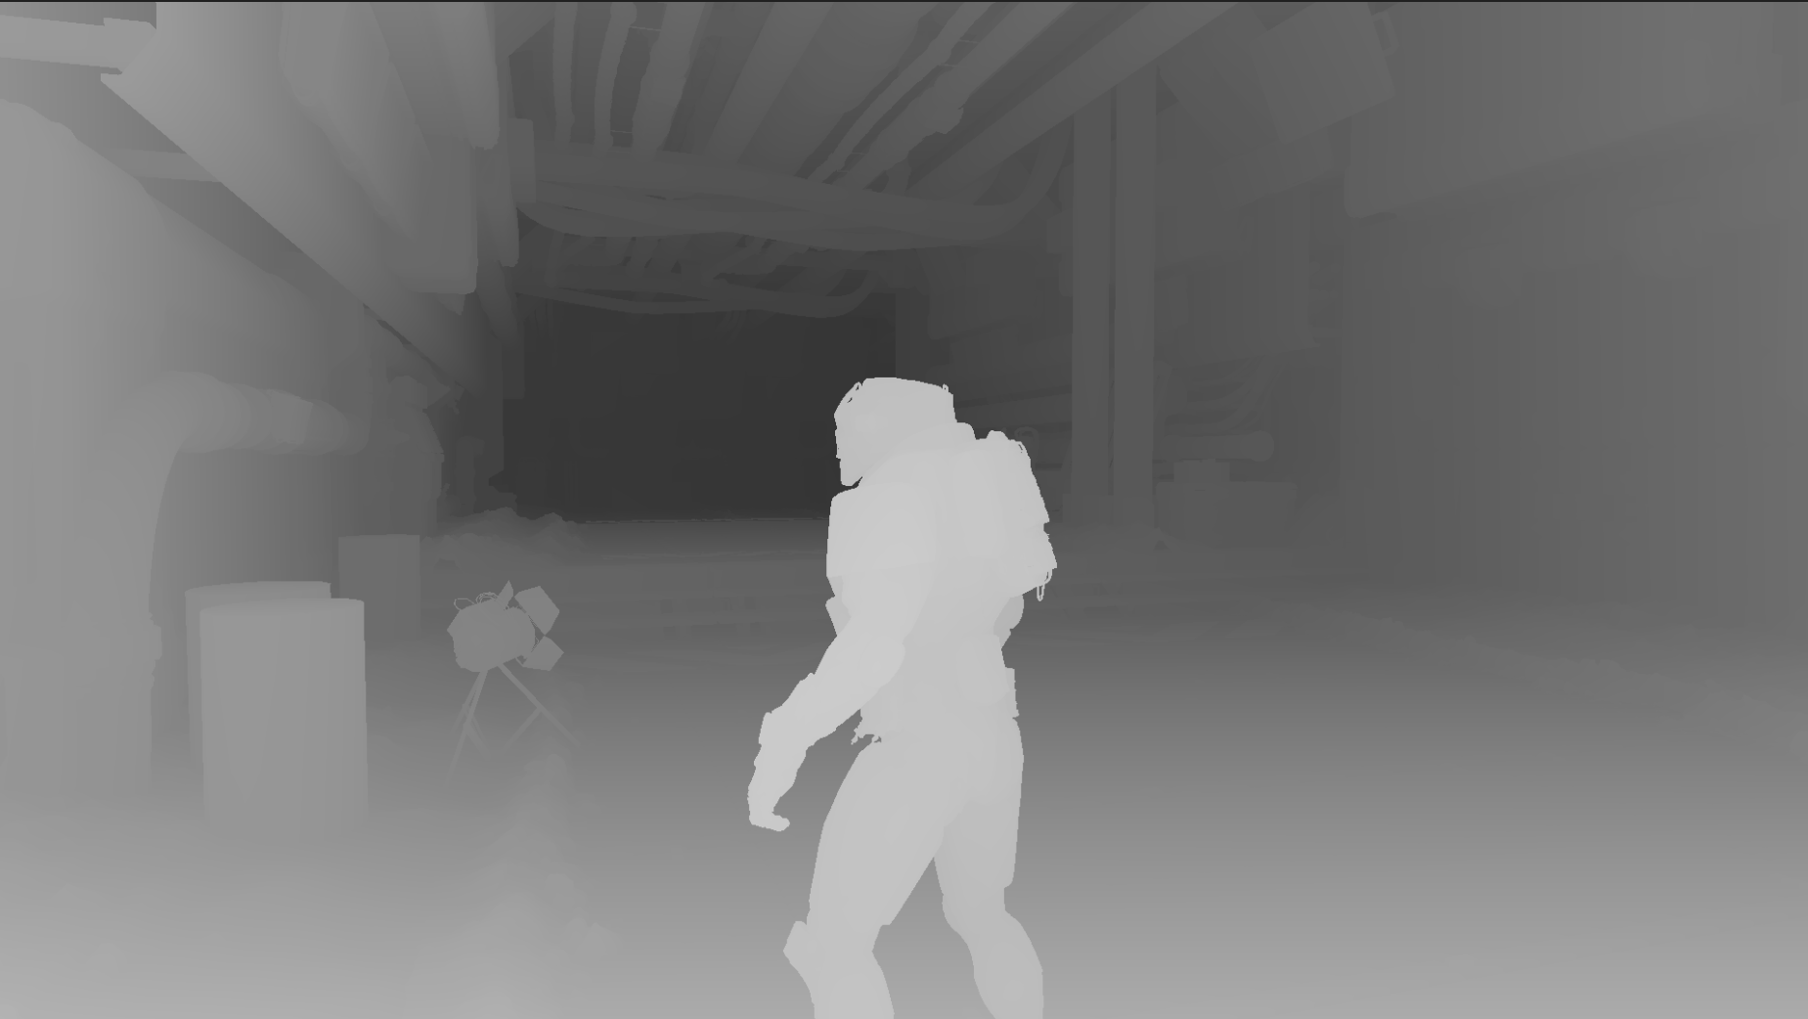
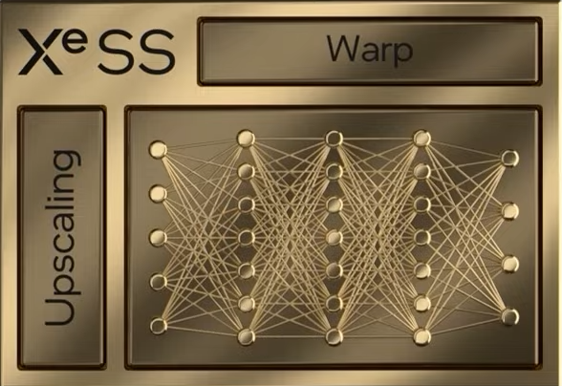
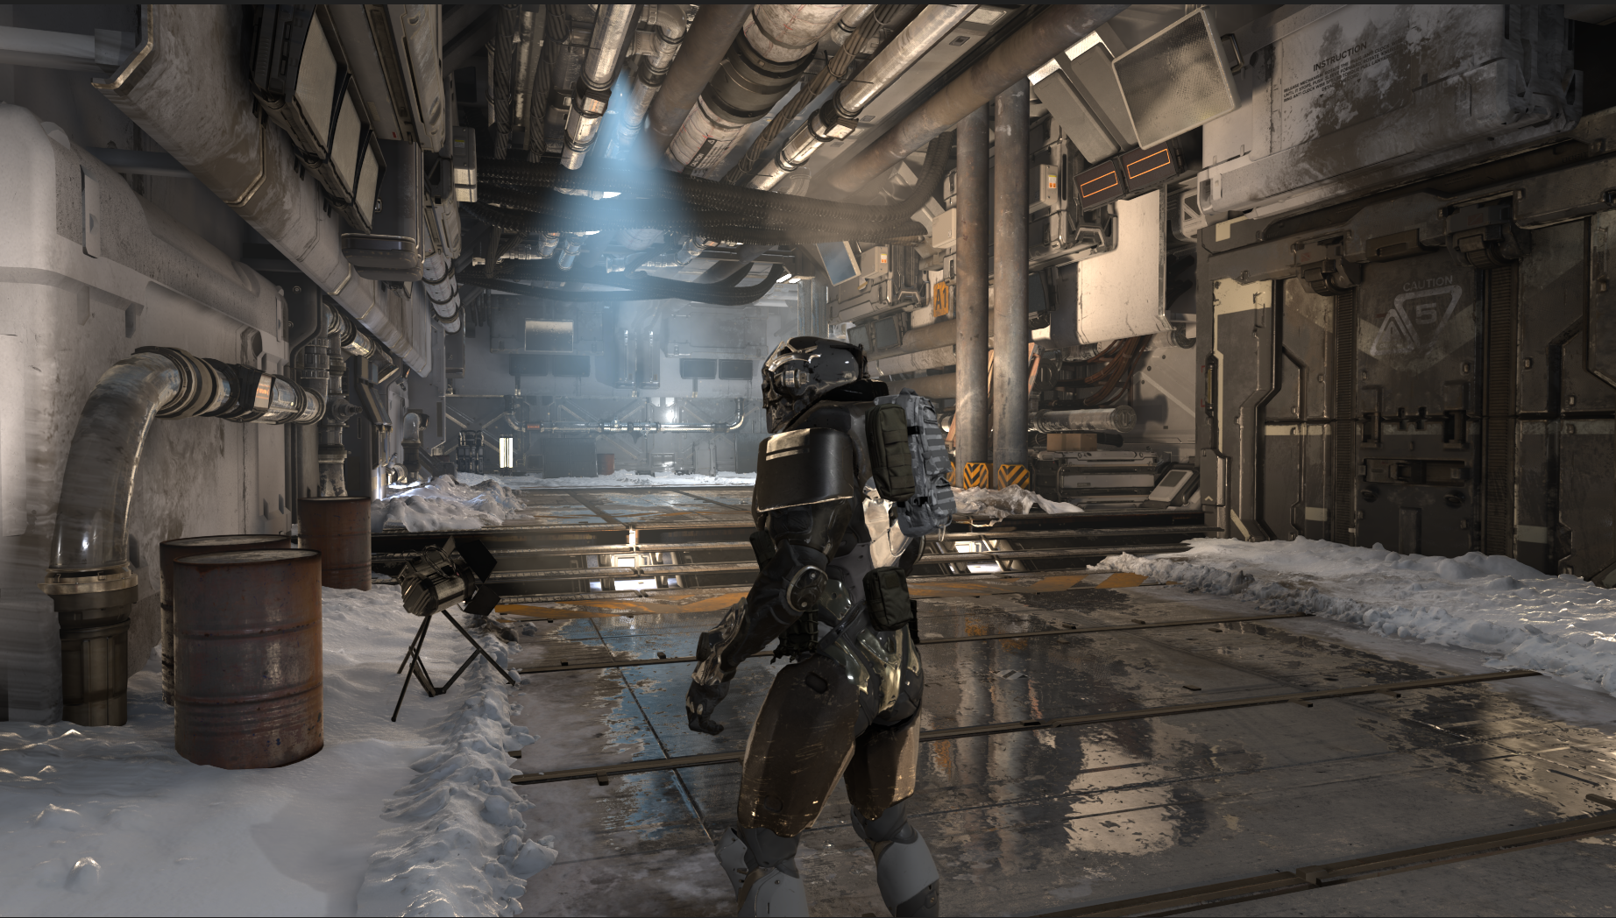
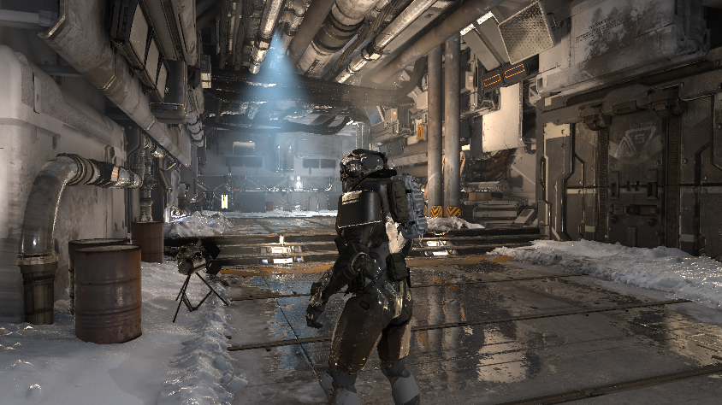
What is Intel® Xe Super Sampling (XeSS)?
DL-based Temporally Amortized Super Sampling Technique
Replaces the TAA stage in the rendering pipeline
Cross-platform and generic solution that does not require per-title training
Internally-stored history
Depth
Raster & Lighting (low resolution)
Post-processing
Velocity
Anti-aliased 4K output
Jitter
Aliased 1080p image

Slide 5
Demo by Rens
5 min video from Rens, including new videos from the Outpost demo.
Rens talks about creating the Outpost demo and the work he did to capture high quality assets, showing the benefits of Xe Super Sampling (XeSS).

Slide 6
Overview of Upscaling Techniques
Spatial upscaling
Super sampling
Looks at a single frame at a lower resolution, and upscales it to the target resolution
Usually invoked after the anti-aliasing pass
Detect well-defined features, such as edges; try to approximate missing details
Input information limited to data from a single, low-resolution frame
Image quality will quickly degrade with larger scaling factors
Easiest upscaling technique to integrate into the engine
Use data from current and previous frames, increasing the amount information for the upscaler
Treat anti-aliasing and upscaling as a single problem
Use motion vectors to correlate the current pixel location with its history
Preserve quality at higher scaling factors, compared to spatial upscaling
State-of-the-art super-sampling techniques (e.g. TAAU) introduce their own challenges
Use of anti-aliasing before the upscaling step further reduces the amount of detail
Ghosting
Blurring
Flickering or shimmering artifacts

Slide 7
Temporal SS Challenges: Ghosting
TAAU 1080p -> 4K
Intel® Xe Super Sampling (XeSS) 1080p -> 4K

Slide 8
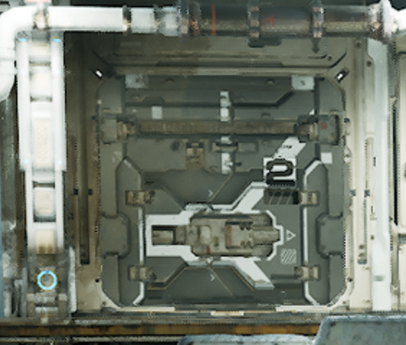
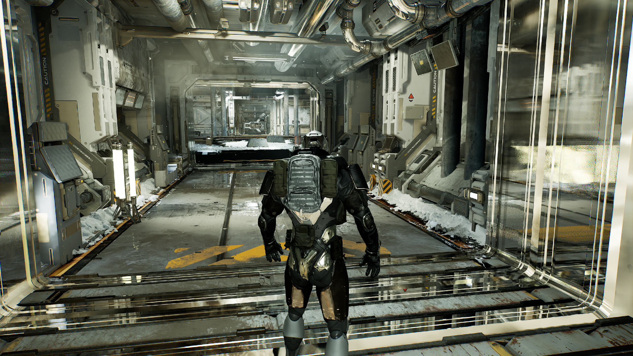
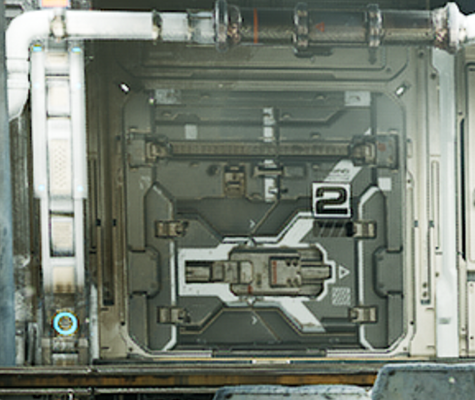
Temporal SS Challenges: Blurring
TAAU 1080p -> 4K
Xe Super Sampling (XeSS) 1080p -> 4K

Slide 9
Best Usage for Each Upscaling Technique
60 fps
Xe Super Sampling (XeSS) can achieve higher scaling ratios—without compromising quality—than Temporal SS or Spatial Upscaling
Next-Gen
(Ray Tracing, μ-polygons)
Base performance without upscaling
Xe Super Sampling (XeSS)
Xe Super Sampling (XeSS) has a fixed execution time, based on the output resolution
It gives the highest performance boost when used in games with pixel-heavy Raster and Lighting stages
Temporal SS
Rendering Quality
Spatial Upscaling
Prev-Gen
Frame Rate

Slide 10
Massive Work Studio Video
Introduction to one of the early Xe Super Sampling (XeSS) adaptors
Showcases their title Dolmen*, and Xe Super Sampling (XeSS) usage

Slide 11
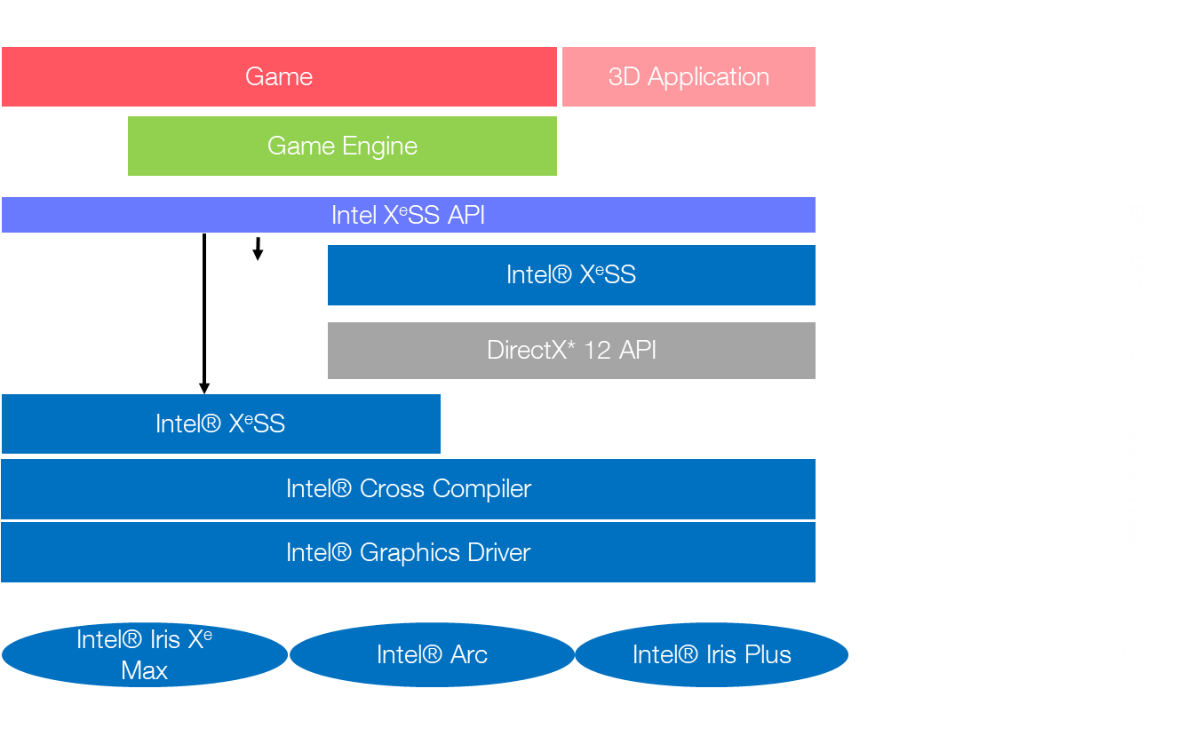
Xe Super Sampling (XeSS) SDK
Will support all GPU vendors
The SDK will be open-sourced
Game developers will interface with single Xe Super Sampling (XeSS) API, platform detection managed internally
Will leverage Xe Matrix Extensions (Intel XMX) acceleration when running on Intel® Arc™ Graphics (codename Alchemist)
Cross-vendor version requires DX12 SM6.4+ and DP4a intrinsic support

Slide 12
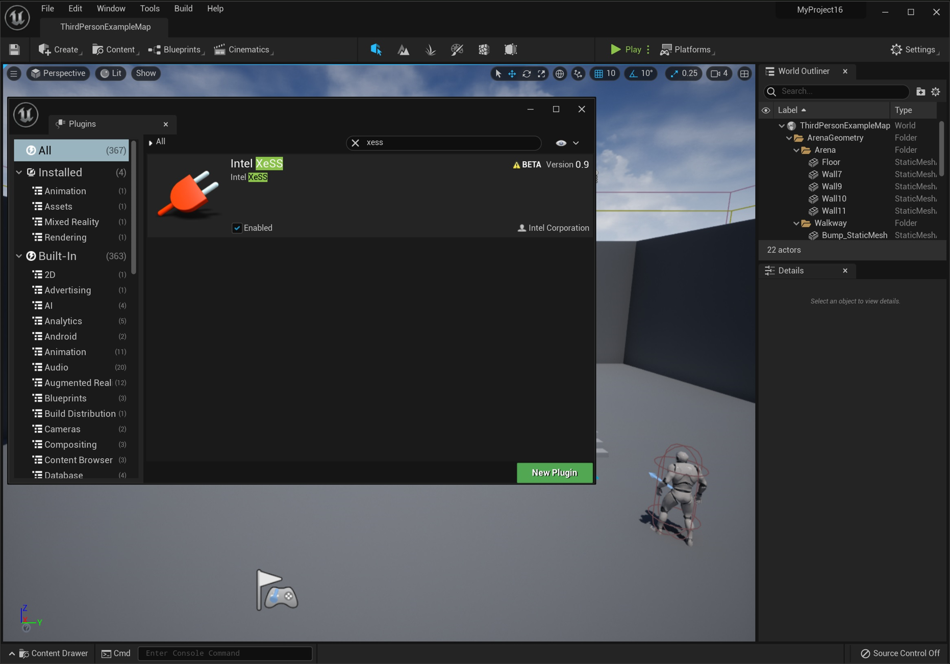
Unreal Engine* Xe Super Sampling (XeSS) Plugin
Unreal Engine* 4.26+ and Unreal Engine 5 plugin available, as part of closed Beta
Simplifies integration of Xe Super Sampling (XeSS) into Unreal projects
Code patch available for Unreal Engine* 4.25

Slide 13
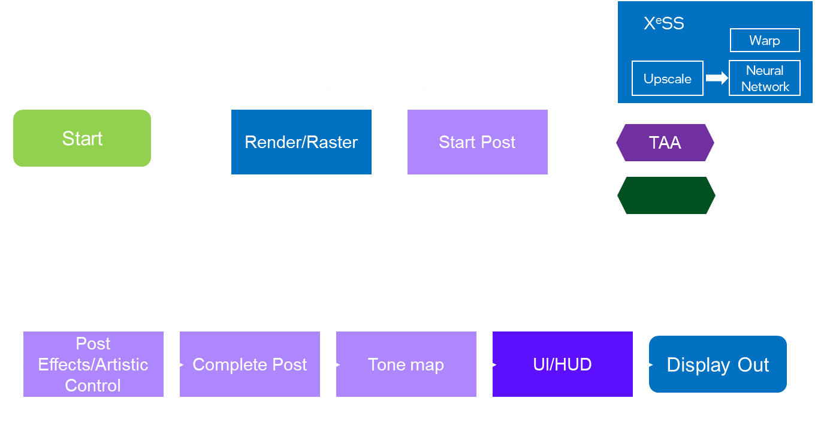
Xe Super Sampling (XeSS) Rendering Engine Integration
Inputs
Xe Super Sampling (XeSS) requires a minimum set of inputs every frame:
Alternatively, if high-resolution motion vectors are not provided:
Xe Super Sampling (XeSS) substitutes TAA in the rendering pipeline
After raster and lighting is complete
Should be inserted at the beginning of the post-processing stage
Jitter offset—sequence length of 32. Preferably Halton(2,3)
Input color—SDR and HDR linear color input
Exposure (texture or CPU variable)
Dilated high-resolution motion vectors
Resolution controls
Un-dilated, low-resolution motion vectors
Depth texture
Outputs
Output texture at the target resolution
History color managed internally in the Xe Super Sampling (XeSS) library

Slide 14
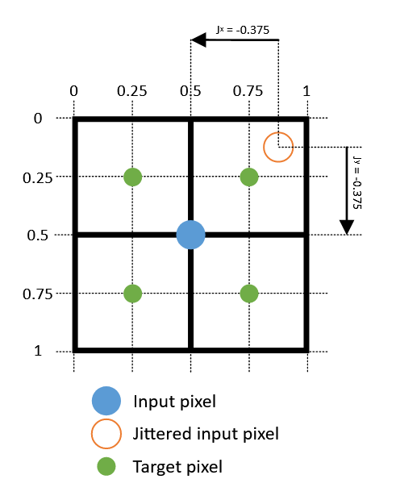
Xe Super Sampling (XeSS) Rendering Engine Integration
Jitter
Xe Super Sampling (XeSS) requires a sub-pixel jitter offset (Jx,Jy) to be applied to every frame
Jitter values are in the range (−0.5,0.5), preferably for a Halton(2,3) sequence
Can be applied by adding a shear transform to the camera projection matrix:
Mipmap Bias
To preserve texture details at the target resolution, Xe Super Sampling (XeSS) requires a mipmap bias of:
Recommend to initially set x = 0, this can be fine tuned based on title
For example, a mipmap bias of -1 should be applied for 2x resolution scaling (x = 0)

Slide 15
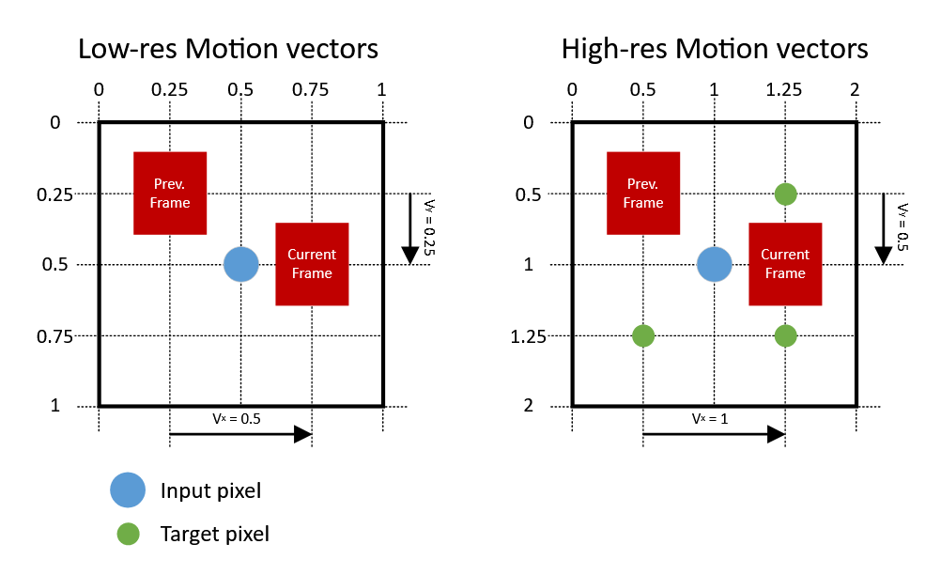
Xe Super Sampling (XeSS) rendering engine integration
Motion vectors
Specify the screen-space motion in pixels from the current frame to the previous frame
Combines velocity of dynamic objects and camera movement
Motion vector dilation
Xe Super Sampling (XeSS) SDK allows to pass an un-dilated low-res motion vector along with the depth buffer; it will then upsample and dilate it internally
If a high-res motion vector is passed to Xe Super Sampling (XeSS) it must be dilated
Simple approach is to take front most velocity in a small neighborhood of input pixels (e.g. 3x3)

Slide 16
The Technology Behind
Xe Super Sampling (XeSS): Go Deeper

Slide 17
Agenda
Continue from Robert’s overview…..
Xe Super Sampling (XeSS) runtime flow
Xe Super Sampling (XeSS) stack
Software and hardware building blocks behind IntelⓇ Xe Super Sampling (XeSS)
Accelerating Xe Super Sampling (XeSS) via Intel® Arc* AI accelerator

Slide 18
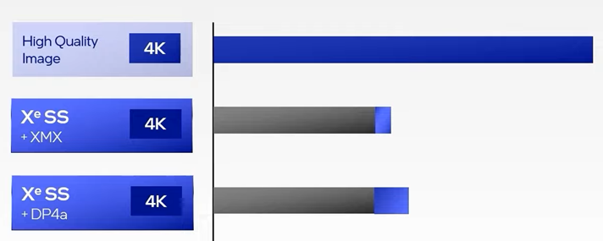
The Technology Behind Xe Super Sampling (XeSS)
Super-sampling technique to reconstruct a low-res frame into a high-res frame, running at a fraction of the cost of rendering at high-res (ex. 4K)
Machine-learning based
Optimized neural network and operator fusing
Accelerated through Intel® XMX AI acceleration. NN especially designed for Intel XMX hardware.
DirectX* 12 based
Intel® vector shading language based NN running on Intel® Arc™ SIMD architecture

Slide 19
Game Runtime Flow with Xe Super Sampling (XeSS)
Inputs
Low-res color
History color
Motion vectors
Jitter offset
(Depth)
Resolution controls
Outputs
Upscaled RGBA Float16 color
History color for next frame
Xe Super
Sampling (XeSS)
Warp
Upscale
Neural Network
Render Resolution
Start
Render/Raster
Start Post
TAA
Post Effects/Artistic Control
Complete Post
Tone map
UI/HUD
Display Out
Notes:
Temporal
Film Grain, color grading, screen space effects (motion blur, distortion, environmental effects)

Slide 20
Xe Super Sampling (XeSS) Stack
Game
3D Application
Application Layer
Game Engine
IntelⓇ Xe Super Sampling (XeSS) API
Effect Library
IntelⓇ Xe Super Sampling (XeSS)
DirectX* 12 API
Gfx API
Intel® Xe Super Sampling (XeSS)
Intel® Cross Compiler
Graphics Driver
Intel® Graphics Driver
Intel® Iris Xe Max
Intel® ArcTM
Intel® Iris Plus
Graphics Hardware

Slide 21
DirectX* 12 (DX 12) Flow
Xe Super Sampling (XeSS) Init
Application/Game Engine
Intel® Cross Compiler
Intel® Vector Shader-> DX12 PSO
DX12 PSO
Xe Super Sampling
(XeSS) Execute
DX12 PSO
DX Run Time
DX12 UMD
Intel® GPU
Application Execution Flow with Xe Super Sampling (XeSS)
XeSS-Init
Create resources
XeSS PSO = Create ComputePipelineState(Intel® Vector Shader)
…………………………
App(D3D12): …
App(D3D12): Record render commands to commandList
XeSS(D3D12) : commandList->Dispatch(XeSS PSO )
App(D3D12): Record render commands to commandList
App(D3D12): commandQueue-> ExecuteCommandLists(…)
…………………………
SubmitToGPU()
GPU task N
GPU task N+1
CPU
Init
Buffer Allocation
PSO Creation
NeuralNetwork init
……………………
Execute
Record GPU Commands
Execute
Record Xe Super Sampling (XeSS) Commands
Execute
Record GPU Commands
Submit to GPU
…..
…..
…..
GPU
…………….
Execute GPU Task N - 1
Execute GPU Task N
Xe Super Sampling (XeSS)
Game
GPU

Slide 22
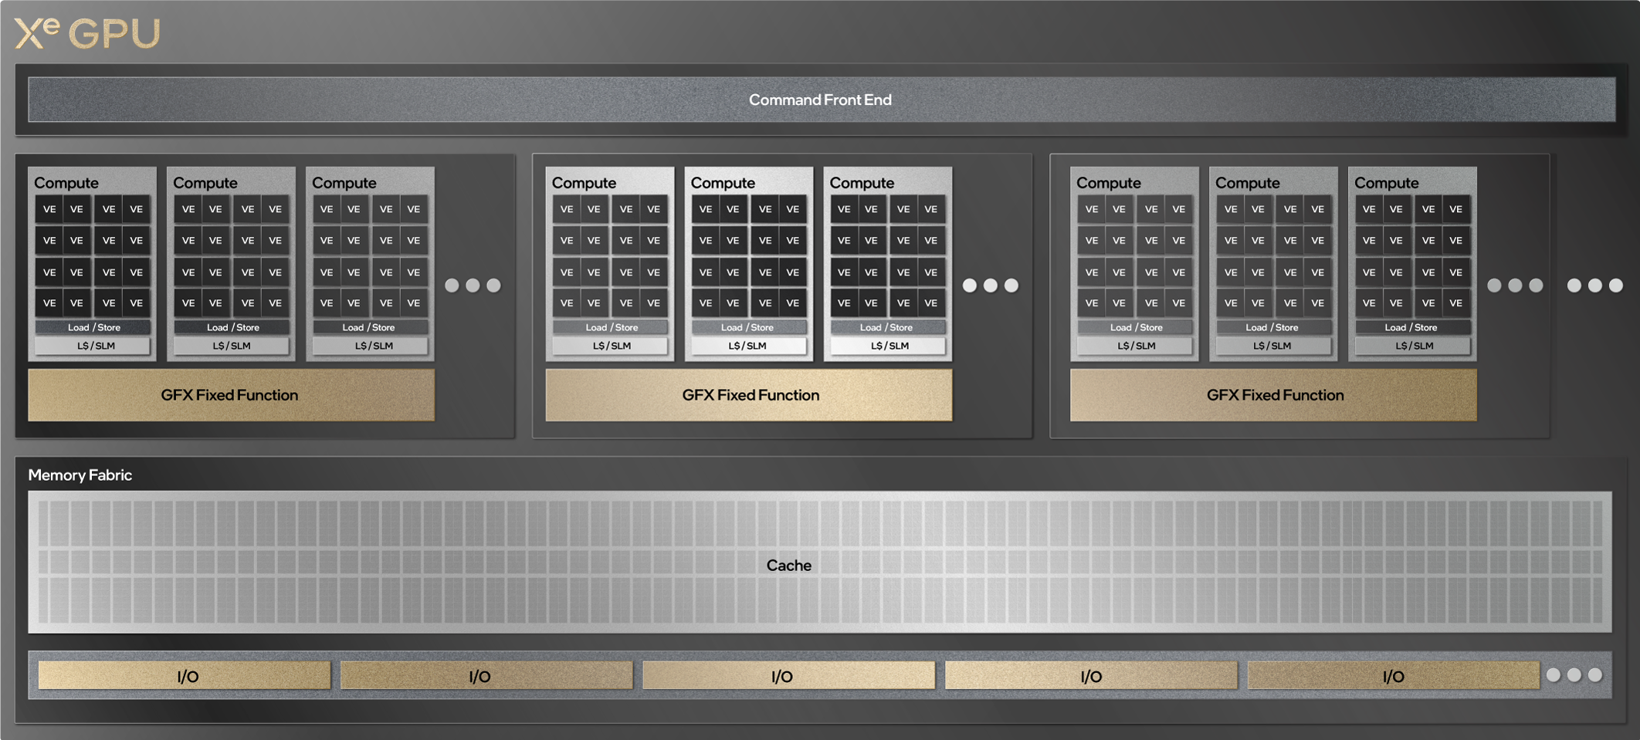
Xe Super Sampling (XeSS) with Intel® GPU AI Accelerators
Modular and Scalable GPU IP
dp4a
SIMD8 x 4Int8
MAC
XMX
4x SIMD8 x 4Int8
MAC
Xe-core with vector and matrix engines

Slide 23
Xe Super Sampling (XeSS) Across Intel® GPUs
Game Application 1
Intel® Xe Super Sampling (XeSS)
…….
XMX()
……….
Dp4a()
……….
Intel® Cross Compiler (Intel® Vector Shading Language)
Intel® Graphics Driver
Intel® IRIS Plus
Intel® Arc™
Intel® IRIS Xe Max

Slide 24
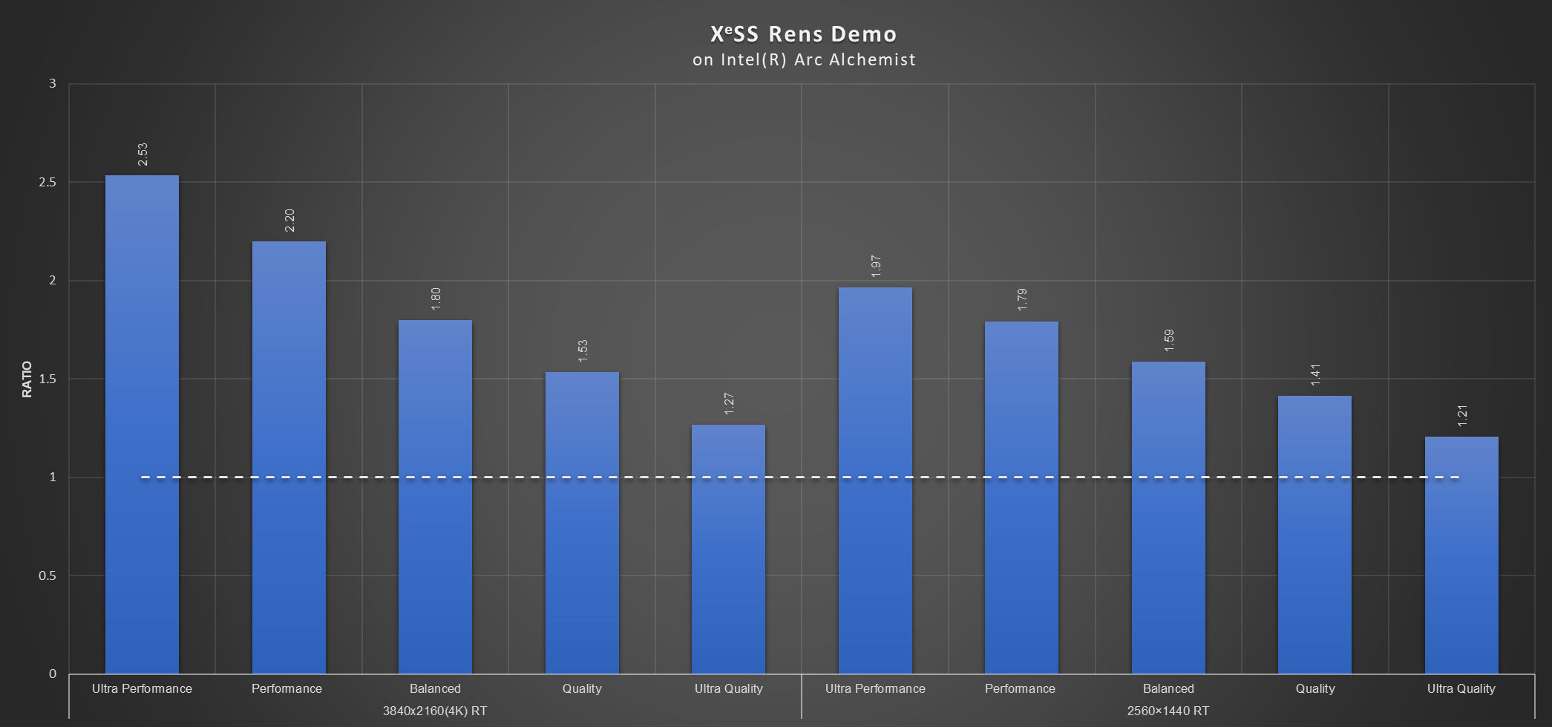
Performance Upside
Mode | Scale Factor
Ultra Performance | 2.3*
Performance | 2.0
Balanced | 1.7
Quality | 1.5
Ultra Quality | 1.3
Disclaimer
Intel technologies’ features and benefits depend on system configuration and may require enabled hardware, software or service activation. Performance varies depending on system configuration. Configurations used for this test and this perf data: Intel® Alchemist Arc™ running at fixed frequency
All testing was performed at Intel® Folsom. Numbers may differ based on actual hardware used and/or based on how the benchmark is written. Intel® makes no guarantee on the specific numbers and it is intended for providing reference
Actual release configuration(s) and quality setting(s) available at Xe Super Sampling (XeSS) launch is subject to change, the above is for reference and work in progress data and software

Slide 25
Thank you

Slide 26
ALIASED INPUT @ 720p
Xe Super Sampling (XeSS) 720p 🡺 2K
XeSS 720p 🡺 2K
Can we do zoom in of comparison between Native and XeSS generated for couple of good and base cases? eg

Slide 27
Native 2K
Xe Super Sampling (XeSS)

