Slide 1
A Quick Guide to Intel’s Ray Tracing Architecture
GDC 2022
Holger Gruen: AXG/GRO, Principal Graphics Engineer
Joshua Barczak: IAGS SW Architect, Ray tracing

Slide 2
Legal Disclaimer
INFORMATION IN THIS DOCUMENT IS PROVIDED IN CONNECTION WITH INTEL® PRODUCTS. NO LICENSE, EXPRESS OR IMPLIED, BY ESTOPPEL OR OTHERWISE, TO ANY
INTELLECTUAL PROPERTY RIGHTS IS GRANTED BY THIS DOCUMENT. EXCEPT AS PROVIDED IN INTEL'S TERMS AND CONDITIONS OF SALE FOR SUCH PRODUCTS, INTEL ASSUMES
NO LIABILITY WHATSOEVER, AND INTEL DISCLAIMS ANY EXPRESS OR IMPLIED WARRANTY RELATING TO SALE AND/OR USE OF INTEL PRODUCTS, INCLUDING LIABILITY OR
WARRANTIES RELATING TO FITNESS FOR A PARTICULAR PURPOSE, MERCHANTABILITY, OR INFRINGEMENT OF ANY PATENT, COPYRIGHT, OR OTHER INTELLECTUAL PROPERTY
RIGHT.
A "Mission Critical Application" is any application in which failure of the Intel Product could result, directly or indirectly, in personal injury or death. SHOULD YOU PURCHASE OR USE INTEL'S PRODUCTS FOR ANY SUCH MISSION CRITICAL APPLICATION, YOU SHALL INDEMNIFY AND HOLD INTEL AND ITS SUBSIDIARIES, SUBCONTRACTORS AND AFFILIATES, AND THE DIRECTORS, OFFICERS, AND EMPLOYEES OF EACH, HARMLESS AGAINST ALL CLAIMS COSTS, DAMAGES, AND EXPENSES AND REASONABLE ATTORNEYS' FEES ARISING OUT OF, DIRECTLY OR INDIRECTLY, ANY CLAIM OF PRODUCT LIABILITY, PERSONAL INJURY, OR DEATH ARISING IN ANY WAY OUT OF SUCH MISSION CRITICAL APPLICATION, WHETHER OR NOT INTEL OR ITS SUBCONTRACTOR WAS NEGLIGENT IN THE DESIGN, MANUFACTURE, OR WARNING OF THE INTEL PRODUCT OR ANY OF ITS PARTS. Intel may make changes to specifications and product descriptions at any time, without notice. Designers must not rely on the absence or characteristics of any features or instructions marked "reserved" or "undefined". Intel reserves these for future definition and shall have no responsibility whatsoever for conflicts or incompatibilities arising from future changes to them. The information here is subject to change without notice. Do not finalize a design with this information. The products described in this document may contain design defects or errors known as errata which may cause the product to deviate from published specifications. Current characterized errata are available on request. Contact your local Intel sales office or your distributor to obtain the latest specifications and before placing your product order. Copies of documents which have an order number and are referenced in this document, or other Intel literature, may be obtained by calling 1-800-548-4725, or go to: http://www.intel.com/design/literature.htm.
All information provided related to future Intel products and plans is preliminary and subject to change at any time, without notice. Intel and the Intel logo are trademarks or registered trademarks of Intel Corporation or its subsidiaries in the United States and other countries.
Other names and brands may be claimed as the property of others. All materials in, and discussions of, this presentation are covered under MSFT140000_C and are subject to the Non-Disclosure
Agreement between Microsoft Corporation and Intel Corporation dated October 24, 1990. Copyright © 2021, Intel Corporation. All rights reserved.

Slide 3
Agenda
An overview of Intel’s raytracing hardware architecture
Why is our architecture built with divergent raytracing workloads in mind?
DirectX Raytracing shader execution on Intel® Arc™
Ray Queries
Acceleration structures/Bounding volume hierarchies
Q&A

Slide 4
Intel® Arc™ Ray Tracing Architecture Overview
Building a mental model

Slide 5
RT Architecture Overview for Intel® Arc™ (1/3)
Intel® Arc™ features a complete, fixed-function HW RT pipeline
HW Bounding Volume Hierarchy (BVH) traversal
HW Ray transforms for instancing
HW automatically transforms rays and forwards them to Bottom Level Acceleration Structures ( BLAS)
HW supports up to 8 nesting levels
Can support “traversal shaders” - a potential future DirectX Raytracing (DXR) feature
HW Ray-Box and Ray-Tri intersection
All types of culling (instance masking, ray-flag culling)

Slide 6
RT Architecture Overview for Intel® Arc™ (2/3)
Independent scalar RT traversal pipeline
RT traversal deals with each ray independently
No need to worry about SIMD lanes taking different traversal paths
RT and other shaders execute concurrently on vector engines
The vector engines (VEs) execute DXR shaders in SIMD8 or SIMD16 mode
Compute shaders that use RayQueries run in SIMD8 or SIMD16 mode as well

Slide 7
RT Architecture Overview for Intel® Arc™ (3/3)
Focus on an Async raytracing mode for DXR 1.0
Designed towards a future with divergent ray-tracing workloads
Like path-tracing, and the execution of lots of divergent material shaders
Hardware “sorts” for coherent shader execution, and data access
Sorted hit shader dispatch directly from HW
Sync raytracing mode for DXR 1.1
Ray queries return to originating thread (like a texture fetch)
Programmer is responsible for extracting (SIMD+data) coherency within a compute wave

Slide 8
Why did we focus on divergent ray-tracing workloads? Let’s talk about why ray tracing workloads are divergent …

Slide 9
RT’s Most Common Coherency & SIMD Utilization Issues
BVH traversal can lead to divergent code paths and data access
e.g. across the lanes of a compute wave
Traversal units keep the divergent code paths away from the VEs
This means the SIMD lane-code execution on the VEs is not encumbered by divergent traversal
Traversal units also keep divergent data access away from the VEs
to some degree, as traversal units have a cache of their own
Let’s assume for now that traversal is a solved problem ☺

Slide 10
RT’s Most Common Coherency & SIMD Utilization Issues
Divergent ray traversal duration/steps for rays
All SIMD lanes blocked until the ray with the highest number of traversal steps returns
Lane 0 | Lane 1 | Lane 2 | Lane 3
Assumed SIMD4 GPU
with four lanes per wave

Slide 11
RT’s Most Common Coherency & SIMD Utilization Issues
Divergent ray traversal duration/steps for rays
All SIMD lanes blocked until the ray with the highest # of traversal steps returns
Camera rays from a DXR games

Slide 12
RT’s Most Common Coherency & SIMD Utilization Issues
Divergent ray traversal duration/steps for rays
All SIMD lanes blocked until the ray with the highest # of traversal steps returns
AO rays from a DXR games

Slide 13
RT’s Most Common Coherency & SIMD Utilization Issues
Divergent ray traversal duration/steps for rays
All SIMD lanes blocked until the ray with the highest # of traversal steps returns
Shader path divergence
SIMD lanes may need to execute different hit shaders
Lane 0 | Lane 1 | Lane 2 | Lane 3
Different colors
depict different hit
shaders

Slide 14
RT’s Most Common Coherency & SIMD Utilization Issues
Divergent ray traversal duration/steps for rays
All SIMD lanes blocked until the ray with the highest # of traversal steps returns
Shader path divergence
SIMD lanes may need to execute different hit shaders
Divergent texture access
SIMD lanes may need to fetch from diverging resources
Lane 0 | Lane 1 | Lane 2 | Lane 3

Slide 15
Typical Software Solutions to Fight Divergence
Sort rays for more traversal coherency/less SIMD latency
e.g., by origin + direction, Morton code ...
Sort hit points for coherent shading
e.g., by material ID, shading model, etc.
Expensive for multiple bounces
Hit point streaming can consume considerable bandwidth
High local shared memory footprints may limit your occupancy

Slide 16
Our Solution

Slide 17
Asynchronous Raytracing and Shader Dispatch
Raygen
Spill
Trace
Reload
Continue Raygen
Thread termination
Sorted Hit shader execution
RT traversal
TSU
Cache Hierarchy
TSU =
Thread
Sorting
Unit

Slide 18
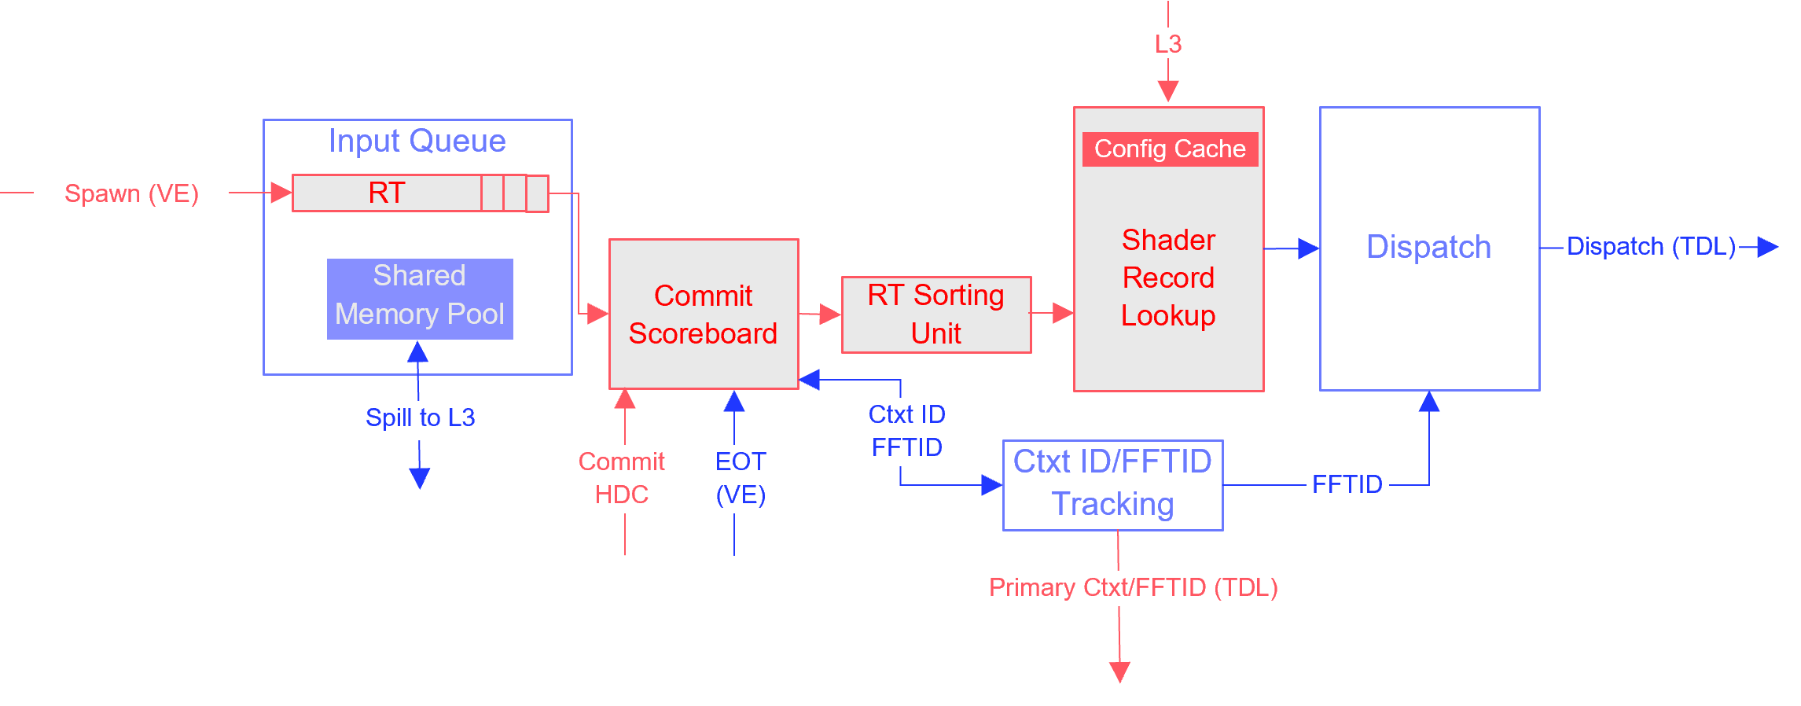
Thread Sorting For Ray Tracing
Independent Rays
Coherent Hit Shader Execution
2
7
4
6
HW sorting by Shader Record
0
2
4
6
8
9
10
13
0
3
10
1
13
15
9
11
12
1
3
5
14
15
17
18
19
27
14
22
16
5
8
20
21
24
27
29
31
32
33
36
19
23
25
17
21
18
24
37
28
29
30
31
7
11
12
22
23
35
37
39
26
38
39
20
25
26
28
30
34
38
32
33
34
35
36

Slide 19
Asynchronous Raytracing
Synchronous Raytracing
Async RT With Sorted Hit Shader dispatch
RT
Stall
Shader
RT
Shader
Async Compute
RT
Shader
RT
Shader
RT
Stall
Shader
RT
Shader
RT
Stall
Shader
RT
Shader
RT
Stall
Shader
RT
Shader
Async Compute
RT
Shader
RT
Shader
RT
Stall
Shader
RT
Shader
RT
Stall
Shader
RT
Shader
RT
Stall
Shader
RT
Shader
RT
Stall
Shader
RT
Shader
RT
Stall
Shader
RT
Shader
RT
Shader
RT
Shader

Slide 20
Thread Sorting For Callable Shaders
Divergent Threads
Coherent Hit Shader Execution
0
1
2
3
4
5
6
7
HW sorting by Shader Record
0
2
4
6
8
9
10
13
8
9
10
11
12
13
14
15
1
3
5
14
15
17
18
19
16
17
18
19
20
21
22
23
21
24
27
29
31
32
33
36
24
25
26
27
28
29
30
31
7
11
12
22
23
35
37
39
32
33
34
35
36
37
38
39
20
25
26
28
30
34
38

Slide 21
Does it Work?

Slide 22
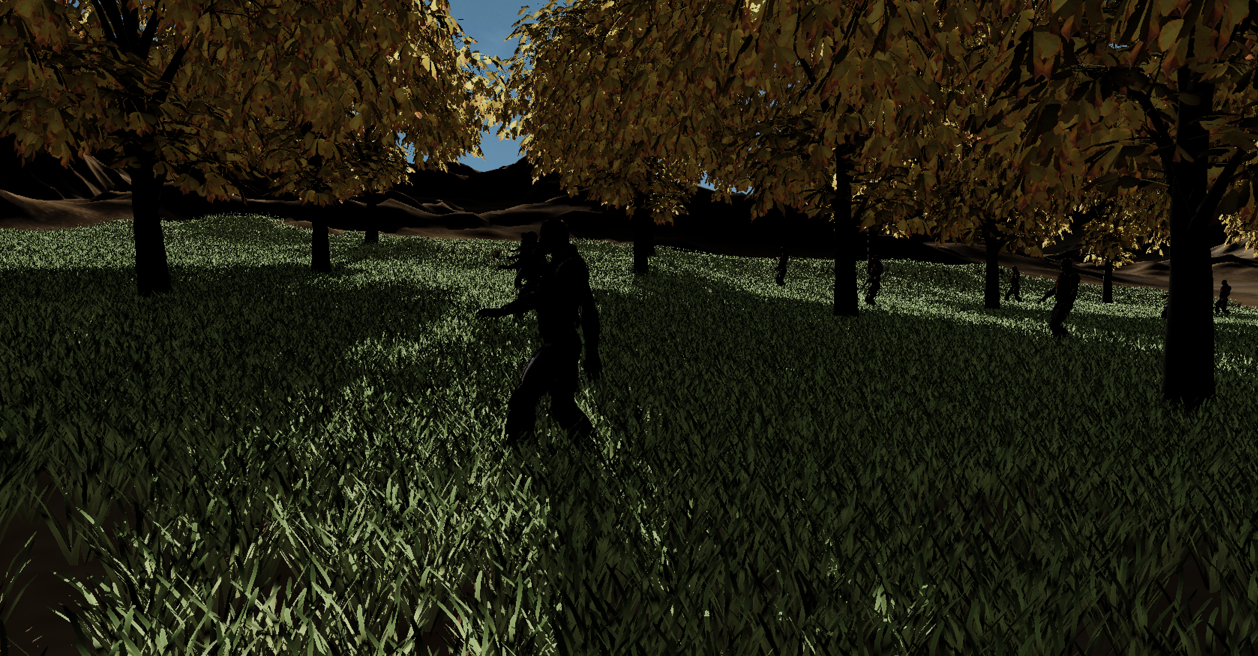
Moving towards
a path-traced
future with many
divergent shaders!
Intel® Arc™: Designed to deal with divergent ray tracing workloads
Shadow rendering sample, foliage with any hit shaders
App modified to generate a different number of distinct hit groups with distinct anyhit shader code
Measured on a Win10-x64 Pro (21H1) system with a Intel® Core™ i9-7920X CPU @ 2.90 Ghz, 64 GB of Ram using pre-production Intlel®drivers and Intel® Arc™ graphics pre-production
silicon on the 9th of November 2021 by an Intel employee

Slide 23
DXR Shader Execution
Some guidelines

Slide 24
Hit Shaders From An App’s Perspective
What you think happens …
Do things …
TraceRay()
Do more things
What actually happens …
Do things …
Spill
Trace
Reload
Do more things
Thread termination
Sorted hit shader execution
Continuation execution
RT traversal
TSU
Cache Hierarchy

Slide 25
RT Shader Execution: Guidelines
Minimize AHS/IS invocations (use the flags)
Prefer tail-recursive TraceRay() calls to minimize spills
Our ray payload lives in cache
Don’t initialize payloads if you can prevent it (use miss and chs)
Only touch/modify payloads if necessary
Keep ray payloads small, don’t store what you can re-compute
Shader compiler will try to rematerialize payloads if it can detect what to recompute
Better to do more work in hit/miss shaders and pass a smaller payload back
Do UAV writes directly from hit shaders

Slide 26
RT Shader Execution: Guidelines
Good Shader:
void AnyHit( … )
{
if( alpha < 0.3f )
IgnoreHit();
}
void ClosestHit( … )
{
Payload.HitT = RayTCurrent();
}
Bad Shader:
void AnyHit( … ) {
if( alpha < 0.3f )
IgnoreHit();
else // redundant payload modification
Payload.HitT = RayTCurrent();
}
void ClosestHit( … )
{
Payload.HitT = RayTCurrent();
}

Slide 27
Local RS Arguments Are Uniform: Exploit this
Good Shader:
…
TraceRay()
…
void HitShader( Texture2D myTexture ) {
// uniform fetch ☺
myTexture.Sample();
}
Bad Shader:
struct Payload { uint materialID; }
Texture2D textures[];
…
TraceRay(payload);
…
void HitShader( Texture2D myTexture ) {
// divergent fetch ☹
textures[payload.materialID].Sample()
}

Slide 28
Create Space For Interprocedural Optimization
The ideal/most performant RT-PSO is:
One RayGen shader containing one TraceRay call
RecursionDepth == 1
All shaders added directly to the pipeline
Avoid pre-compiled collections and mutable PSOs unless necessary
Specialized per effect:
e.g.: Shadows RTPSO does not reference shaders from reflection pass
RGS
RGS
CHS
CHS+
RGS
RGS
Compiler will attempt to hoist continuation code
into hit shaders and optimize across the boundary

Slide 29
Ray Queries
Why their disadvantages are bigger than their advantages …

Slide 30
Things You May Have Been Told (By Other IHVs ... About Other Platforms)
RayQueries are just as good as RT-PSOs …
Ignoring questions with respect to ease of implementation
RT-PSOs are lots of complexity for no benefit
Intel® Arc™ GPUs can sort divergent shading requests
RayQueries are “more low level” …
But force you to deal with low level issues like SIMD lane divergence
RayQueries give the programmer more control …
But, also, a lot more responsibilities !

Slide 31
RayQuery relative perf vs. DXR 1.0 perf
Intel® Arc™ graphics pre-production silicon | 0.775 x
Experiment
RayQuery vs. RT-PSO
Here are our reasons …
Measured on a Win10-x64 Pro (21H1) system with a Intel® Core™ i9-7920X CPU @ 2.90 Ghz, 64 GB of Ram using pre-production Intlel®drivers and Intel® Arc™ graphics pre-production
silicon on the 9th of November 2021 by an Intel employee

Slide 32
Ray Queries Lead to Idle Compute Resources
Proceed()
TraceRay()
RGS
Stalled RGS
CHS
RGS
Other Threads
CHS
RT
RT
RayQuery Scheduling
TraceRay() Scheduling

Slide 33
Ray Queries Create Stalls
RT
Stall
Shader
Ray tracing time within a SIMD group is highly variable
Even if you have pre-sorted your rays
RayQuery forces all lanes to wait for the long pole
RT
Shader
RT
Stall
Shader
RT
Stall
Shader
RT
Stall
Shader
RT
Shader
RT
Stall
Shader
RT
Stall
Shader
RT
Stall
Shader
RT
Stall
Shader
RT
Stall
Shader
RT
Shader

Slide 34
Ray Queries Prevent Shader Repacking
No Repacking
With Repacking
RT
Stall
Shader
RT
Shader
Async Compute
RT
Shader
RT
Shader
RT
Stall
Shader
RT
Shader
RT
Stall
Shader
RT
Shader
RT
Stall
Shader
RT
Shader
Async Compute
RT
Shader
RT
Shader
RT
Stall
Shader
RT
Shader
RT
Stall
Shader
RT
Shader
RT
Stall
Shader
RT
Shader
RT
Stall
Shader
RT
Shader
RT
Stall
Shader
RT
Shader
RT
Shader
RT
Shader

Slide 35
Ray Queries Performance Tips
Code to support waves with non-standard lanes counts
Don’t assume a 32 wide wave
Be careful with barriers in multi-wave workgroups
Try to avoid barriers straight after issuing ray queries
A barrier may force all waves to wait for the longest ray in all waves
Try to keep data within a wave as long as possible
Inside a wave, use wave intrinsics instead of barriers

Slide 36
Acceleration Structures on Intel® Arc™

Slide 37
Ray-Triangle Intersection
Ray-Quad Intersection
V2
V0
V1
V2
V0
V1
V2
V3
Intersection Gates
Intersection Gates
Other Gates
Answer
Answer
Our pipeline operates on pairs of edge-adjacent triangles.
A single triangle is represented as a degenerate pair.

Slide 38
Automatic Quad Formation
Just keep doing what you’ve been doing:
Always use indexed meshes
Run index locality optimization
Optimize for a 16-triangle window if you can

Slide 39
BVH Builds
Driver coalesces consecutive builds, and executes them concurrently
Coalescing fails if:
Builds are in different command lists SOLUTION: Perform all builds in a few command lists
Builds are interleaved with Barriers on input or output resources SOLUTION: Avoid barriers between builds
Timestamp queries are inserted SOLUTION: Don’t try to time individual builds

Slide 40
Thank you

