Slide 1
Building Beautiful Worlds with Gaia ML and OpenVINO™ Toolkit
GDC Spring 2022
Game enablement with the Intel Game Dev AI Toolkit

Slide 2
Legal Disclaimer
INFORMATION IN THIS DOCUMENT IS PROVIDED IN CONNECTION WITH INTEL® PRODUCTS. NO LICENSE, EXPRESS OR IMPLIED, BY ESTOPPEL OR OTHERWISE, TO ANY INTELLECTUAL PROPERTY RIGHTS IS GRANTED BY THIS DOCUMENT. EXCEPT AS PROVIDED IN INTEL'S TERMS AND CONDITIONS OF SALE FOR SUCH PRODUCTS, INTEL ASSUMES NO LIABILITY WHATSOEVER, AND INTEL DISCLAIMS ANY EXPRESS OR IMPLIED WARRANTY RELATING TO SALE AND/OR USE OF INTEL PRODUCTS, INCLUDING LIABILITY OR WARRANTIES RELATING TO FITNESS FOR A PARTICULAR PURPOSE, MERCHANTABILITY, OR INFRINGEMENT OF ANY PATENT, COPYRIGHT, OR OTHER INTELLECTUAL PROPERTY RIGHT.
A "Mission Critical Application" is any application in which failure of the Intel Product could result, directly or indirectly, in personal injury or death. SHOULD YOU PURCHASE OR USE INTEL'S PRODUCTS FOR ANY SUCH MISSION CRITICAL APPLICATION, YOU SHALL INDEMNIFY AND HOLD INTEL AND ITS SUBSIDIARIES, SUBCONTRACTORS AND AFFILIATES, AND THE DIRECTORS, OFFICERS, AND EMPLOYEES OF EACH, HARMLESS AGAINST ALL CLAIMS COSTS, DAMAGES, AND EXPENSES AND REASONABLE ATTORNEYS' FEES ARISING OUT OF, DIRECTLY OR INDIRECTLY, ANY CLAIM OF PRODUCT LIABILITY, PERSONAL INJURY, OR DEATH ARISING IN ANY WAY OUT OF SUCH MISSION CRITICAL APPLICATION, WHETHER OR NOT INTEL OR ITS SUBCONTRACTOR WAS NEGLIGENT IN THE DESIGN, MANUFACTURE, OR WARNING OF THE INTEL PRODUCT OR ANY OF ITS PARTS. Intel may make changes to specifications and product descriptions at any time, without notice. Designers must not rely on the absence or characteristics of any features or instructions marked "reserved" or "undefined". Intel reserves these for future definition and shall have no responsibility whatsoever for conflicts or incompatibilities arising from future changes to them. The information here is subject to change without notice. Do not finalize a design with this information. The products described in this document may contain design defects or errors known as errata which may cause the product to deviate from published specifications. Current characterized errata are available on request. Contact your local Intel sales office or your distributor to obtain the latest specifications and before placing your product order. Copies of documents which have an order number and are referenced in this document, or other Intel literature, may be obtained by calling 1-800-548-4725, or go to: http://www.intel.com/design/literature.htm.
All information provided related to future Intel products and plans is preliminary and subject to change at any time, without notice. Intel and the Intel logo are trademarks or registered trademarks of Intel Corporation or its subsidiaries in the United States and other countries.
Other names and brands may be claimed as the property of others. All materials in, and discussions of, this presentation are covered under MSFT140000_C and are subject to the Non-Disclosure Agreement between Microsoft Corporation and Intel Corporation dated October 24, 1990. Copyright © 2021, Intel Corporation. All rights reserved.

Slide 3
Speaker Bios
Adam Goodrich Procedural Worlds
Adam is an award-winning technologist with over 30 years of commercial experience, more than half of this spent in technology start-ups in Australia and Silicon Valley. He is a commercially-oriented visionary who thrives on challenge, is people-focused, and loves leading teams to envision, create, and operate solutions that deliver value.
Peter Cross Intel
Peter, a 20+ year Intel veteran, has been involved in developing/architecting numerous software projects. Most recently he has moved into the graphics/game dev community-engagement realm, working tirelessly to give devs the tools they need to accelerate their projects. Outside of Intel, he has been an enthusiastic game developer for the last eight years, releasing VR titles on Steam*.
Image Caption

Slide 4
Game Dev AI Toolkit Pioneer
Christian Mills AI/ML Specialist, and Intel Innovator
Christian is passionate about using technology to unlock human potential, and focuses on projects that help democratize AI. He wants to lower the barriers to leveraging the power of deep learning in real-time creation tools, such as Unity* and Unreal* Engine.

Slide 5
Build Intelligence into Your Games
Key areas where AI/machine learning can create value for game/experience developers
Intelligent Tools for Partitioning Game Workloads Across CPU/GPU
High-performance Speech Recognition and Translation
Accelerated Creation of Massively Open Worlds
Assistance for the Hearing- impaired and/or Visually-impaired
Creation of Realistic in-game NPCs
Notes:
AI is just getting started in its use in gaming > most to date has been around the player experience – but for development AI is just starting to be into this area…
Quickly identify bottlenecks
Improve visual quality
Achieve high-performance across different platforms & architectures
Deliver the ultimate gaming experience
Reach ~1B Intel-based gaming systems
Supports integrated and discrete graphics
Supports DX, Vulkan,…??
Supports Windows, Linux

Slide 6
Deliver High-Performance Deep Learning Inference Intel® Distribution of OpenVINO™ toolkit
Fast, accurate, real-world results with AI and computer vision inference deployed into production across Intel XPUs (CPU, GPU, FPGA, VPU), from edge to cloud
High-Performance, Deep Learning Inference
Ease of Use, Streamlined Development
Write Once,
Deploy Anywhere
Learn More: intel.com/openvino
Speeds time-to-market through an easy-to-use library of CV functions and pre-optimized kernels.
Includes optimized calls for CV standards, including OpenCV* and OpenCL™.
Notes:
It is a tool suite for high-performance, deep learning inference, targeted at faster, more accurate real-world results.
Besides, the path to inferencing is simplified with a streamlined development workflow.
With a write once, deploy anywhere approach, developers can write an application or algorithm once and deploy it across Intel architecture, including CPU, iGPU, Intel Movidius VPU, FPGA, and GNA (Gaussian & Neural Accelerator).
Supports heterogeneous execution across Intel accelerators, using a common API for the Intel® CPU, Intel® Integrated Graphics, Intel® Gaussian & Neural Accelerator, Intel® Neural Compute Stick 2, Intel® Vision Accelerator Design with Intel® Movidius™ VPUs.

Slide 7
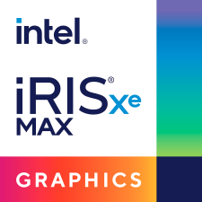
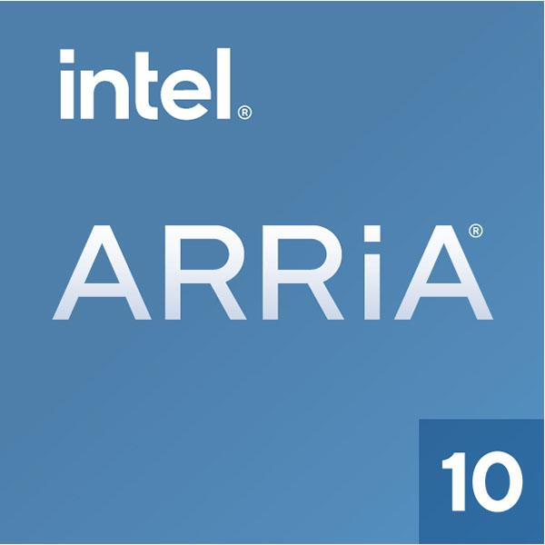
Deep Learning Inference Optimization Workflow Intel® Distribution of OpenVINO™ toolkit
1
Build
2
Optimize
3
Deploy
Read, Load, Infer
Model Server
gRPC/ REST Server with C++ backend
Model Optimizer
Converts & optimizes trained model using a supported framework
IR Data
Intermediate Representation (.xml, .bin)
Inference Engine
Common API that abstracts low-level programming for each hardware
Deployment Manager
Trained Model
Deep Learning Streamer
Post-Training Optimization Tool
Reduces model size into low-precision without re-training
OpenCV
OpenCL™
Deep Learning Workbench
Visually analyze & fine-tune
Code Samples & Demos
Open Model Zoo
100+ open sourced & optimized pre-trained models
Intel®
GNA
(IP)
Learn More: intel.com/openvino
For workloads and configurations visit www.Intel.com/PerformanceIndex. Results may vary .
Notes:
NEED TO REVIEW NOTES AND APPLY FOR GAMING
Here’s the summarized view of the deployment with OpenVINO Toolkit.
Firstly, you need to prepare a DL model that you want to use in your game. You can use widely known public or pre-trained Intel DL models available in Open Model Zoo, or you can create a model yourself tailored specifically for your goals and needs.
OpenVINO accepts pre-trained frozen models from frameworks like Tensorflow, Caffe, MXNet, ONNX and others listed in the slide.
Secondly, the prepared input model gets optimized and converted to OpenVINO Intermediate Representation format and this IR format is used at inference stage. OpenVINO has a powerful inference engine that uses highly optimized plugins for various Intel supported architectures like CPUs, GPUs, accelerator devices like Movidius VPUs, Intel FPGAs and Intel GNAs.
Lastly, OpenVINO optimized model and inference application can be deployed and run on all Intel supported hardware devices without a change in code, thanks to the single write and deploy anywhere feature of OpenVINO’s inference engine. In other words, the same inference application can run on CPU, on GPU, on VPU or even on all of them at the same time if you have all these devices available on your system. By running on multiple hardware devices at the same time, you will be able to increase the performance of your DL inference.

Slide 8
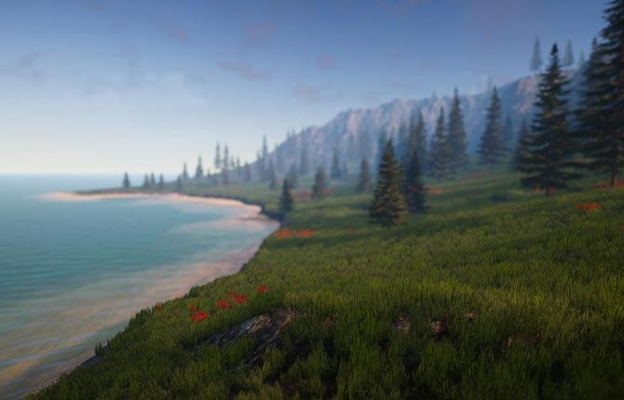
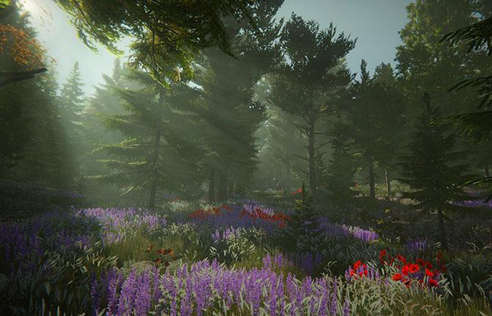
Intel’s Game Dev AI Toolkit What is it?
An opportunity to bring game devs a brand new set of open-source AI tools that:
1) Accelerate game-dev creation
2) Provide amazing new AI-driven capabilities, previously unavailable to the average game-dev
3) Run on a wide-range of hardware
The First version is targeted for Unity* developers, later versions to include UE5 support
It is different from Intel’s other offerings in the game-dev space
It is not necessarily focused on improving graphics quality for games (i.e. Denoiser, XeSS)
It is not focused on performance-tuning aspects, as with IntelⓇ GPA
It is sourced from our external graphics innovator dev community
Version 1.0 style transfer and object detection functionality is based on Christian Mill’s popular IntelⓇ Developer Zone ML tutorials
Integration with Procedural World’s popular Gaia tools

Slide 9
AI Usages in Game Dev
Content Creation
Materials/textures generation
Style transfer
3D object reconstruction
High-resolution 3D human digitization
Facial animation
Character control/motion
Design terrain/map/level
Game physics
Reinforcement Learning
Deepmind/OpenAI, StarCraft* II and Dota* 2 AI
Smarter NPC for better player experience
Auto-test
Game Assistant
Graphics Quality
New features to facilitate players/streamers
Style transfer for fun
Anti-cheat for better player experience
Anti-toxicity to protect players
Super-resolution
DLAA
DLSS/XeSS
Denoiser

Slide 10
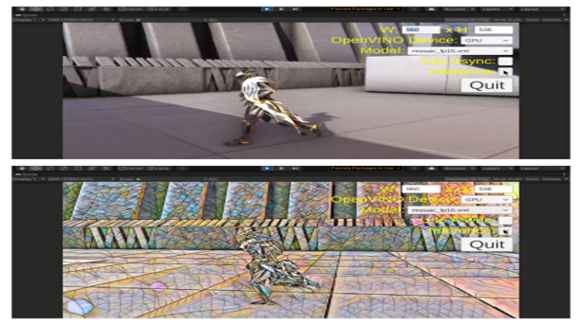
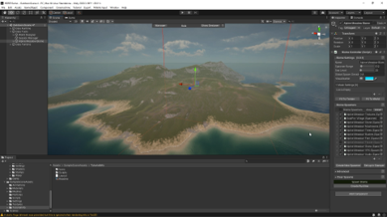
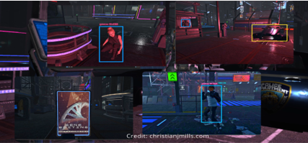
Intel’s Game Dev AI Toolkit 1.0
Style Transfer
World Creation
Object Detection
Adjust styles and textures of specific assets, or the entire game—on the fly.
Allows gamers to stylize parts of games
Allows developers to quickly update, or refresh, styles and looks to games—without redevelopment
Based on the award-winning Gaia system, this enables accelerated 3D world creation in minutes rather than months
Includes complex terrain, and aquatic, features
Complete with lush vegetation
Environmental systems (wind, clouds, sun)
Real-time object detection for 1000s of in-game objects (easily integrated by devs or modders)
Opens gaming up to visually impaired/ hearing-impaired audience
Useful for target identification to boost scores
Can be combined with other AI components (e.g. style transfer) to augment only certain game objects (holiday stylization on building windows, storefronts etc.)

Slide 11
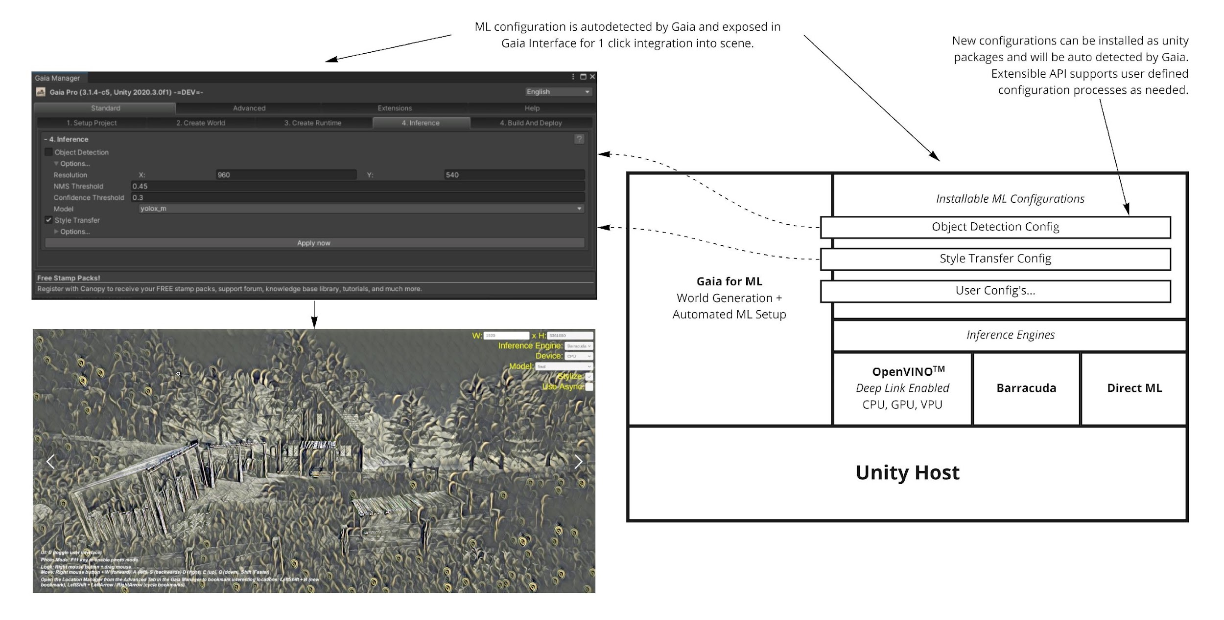
Intel Game Dev AI Toolkit—High-level Architecture

Slide 12
- Unity* and Intel partner - Procedural generation specialist - Work with industry, studios & indies - Rich environments for games and sims - Real world, iot, and mapping

Slide 13
Gaia ML - Creates working ML scenes - Config driven, extensible - Supported by PW - FREE! Gaia Pro 2021+ - Big brother to Gaia ML - Creates working ML scenes - Large world & streaming - More biomes & systems
Gaia –World Creation System
Gaia - Automates world creation - Creates worlds in minutes - Stamps shape the world - Biomes populate world - Customizable biomes
- Launched 2015 - Best-selling terrain tool ever - Best artistic tool 2020
- 1000+ 5* reviews

Slide 14
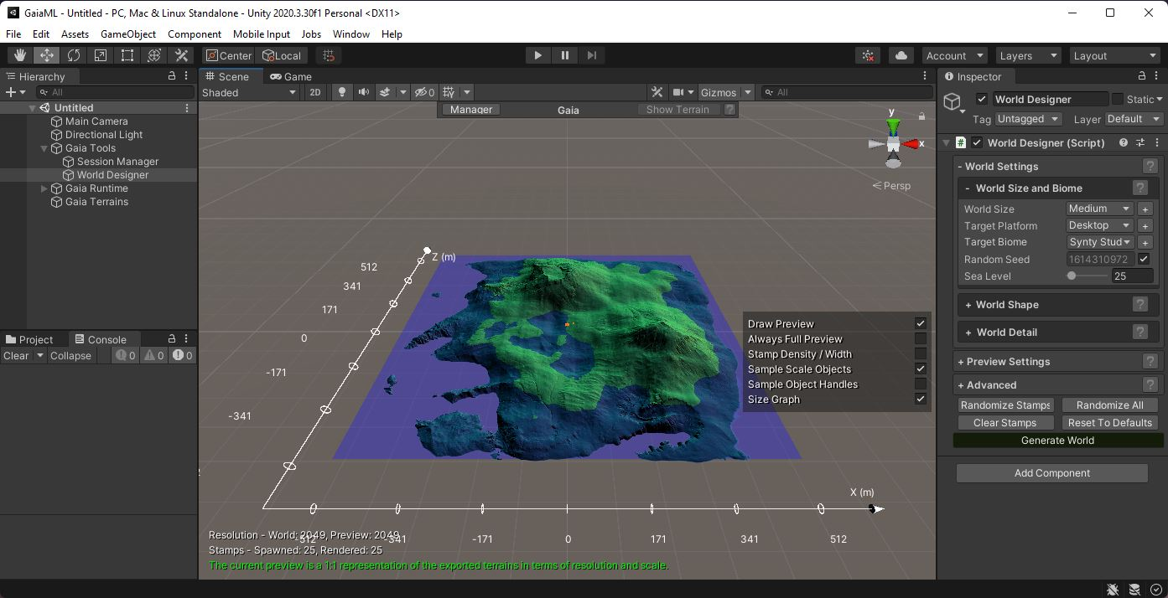
- Create a world with Gaia ML - Add custom terrain features - Add roads and rivers - Press Play!
Gaia ML – World Creation

Slide 15
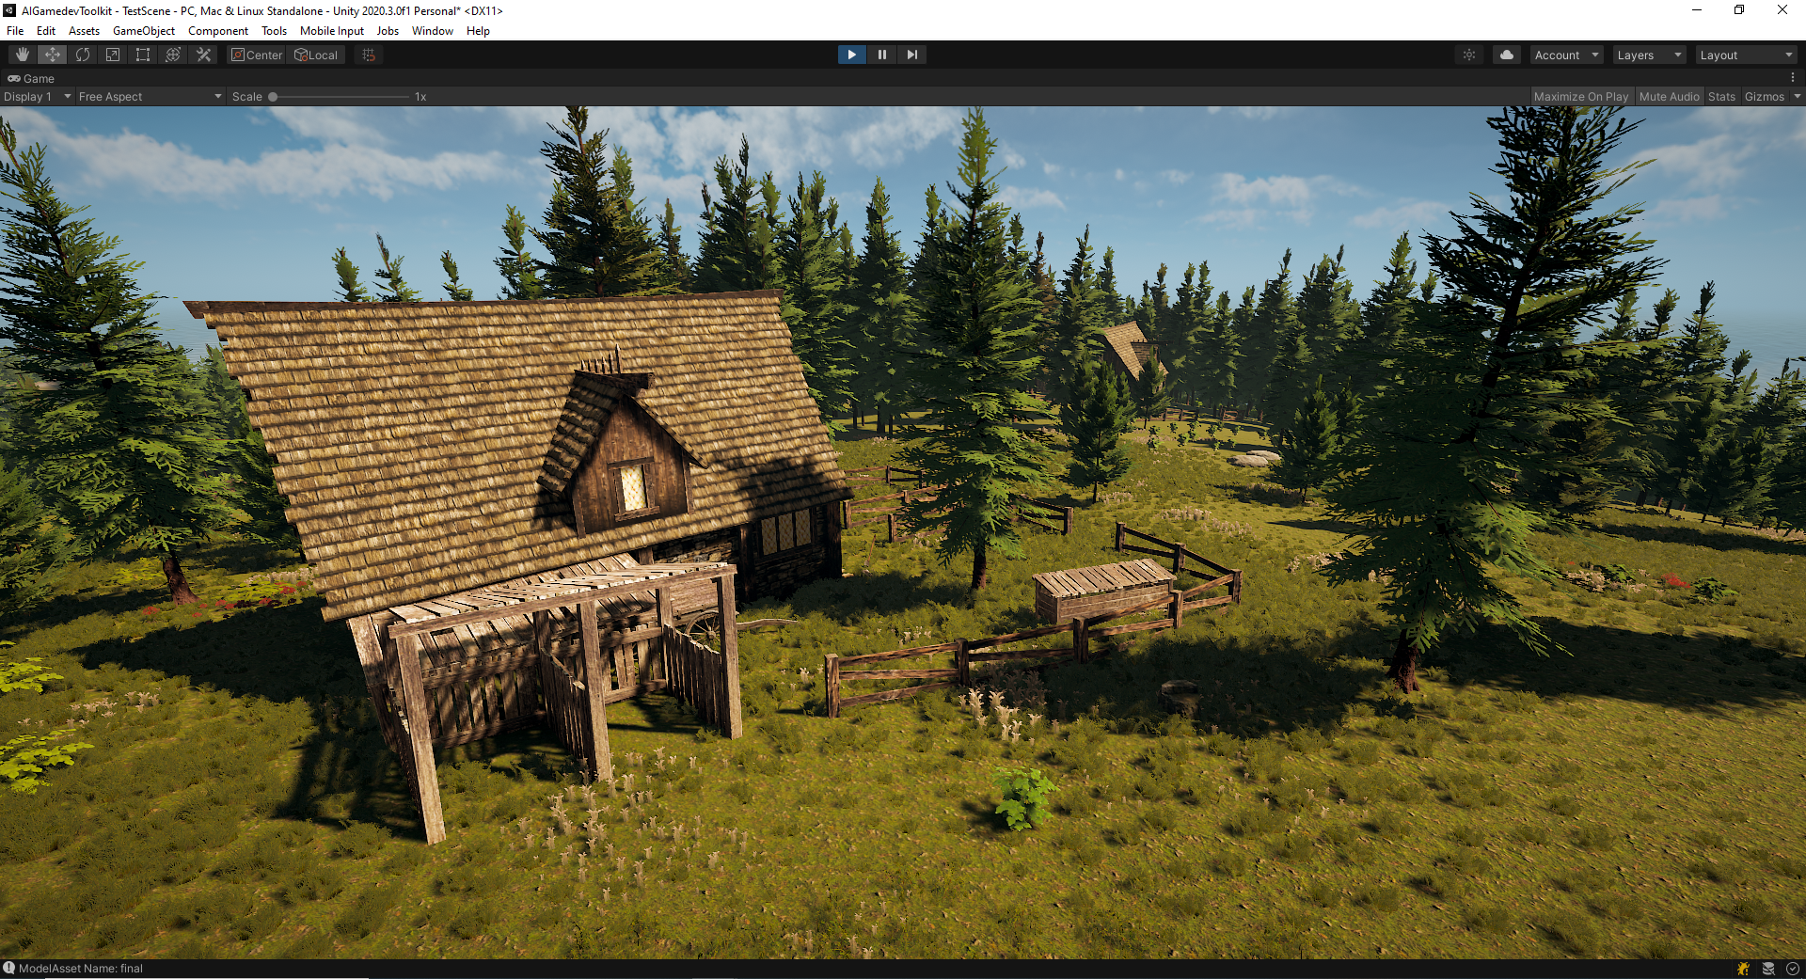
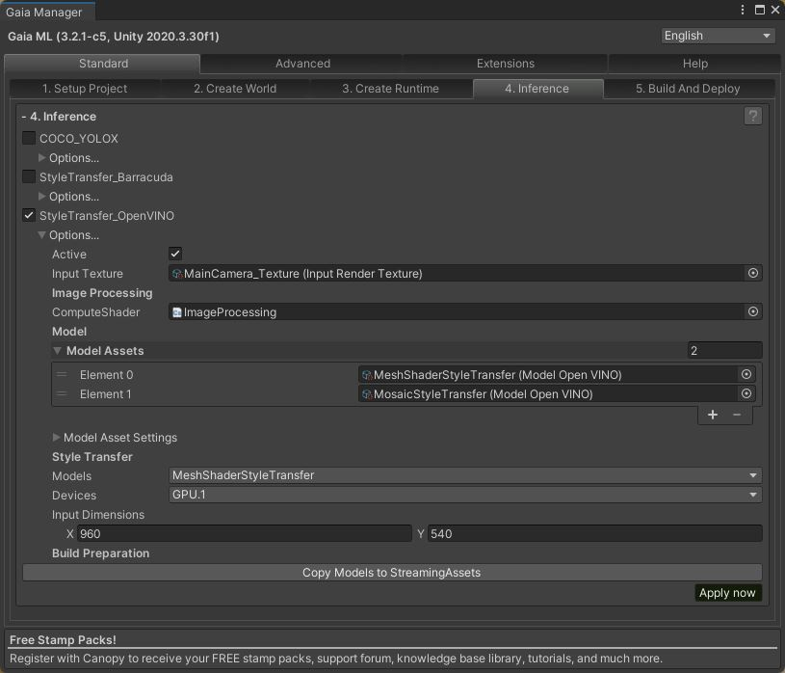
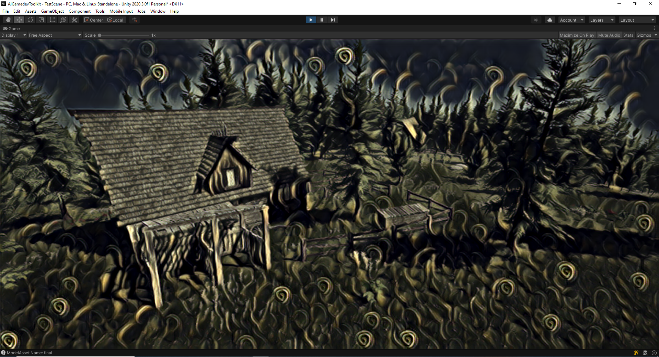
Gaia ML – Style Transfer
- Add Style Transfer

Slide 16
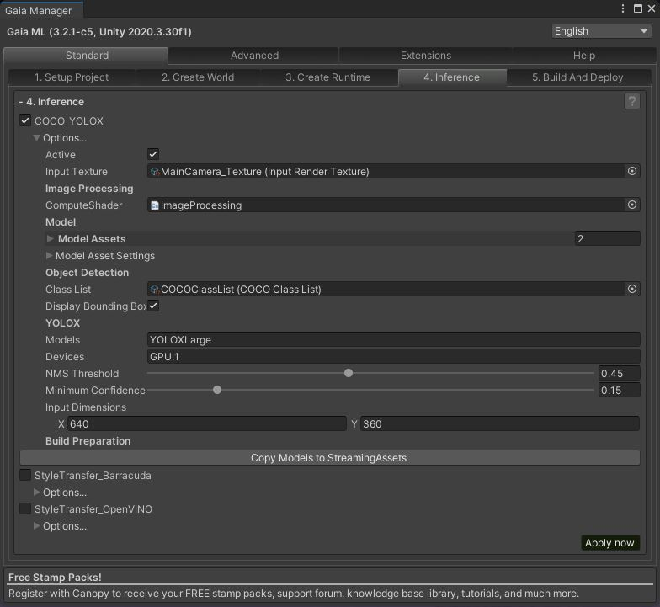
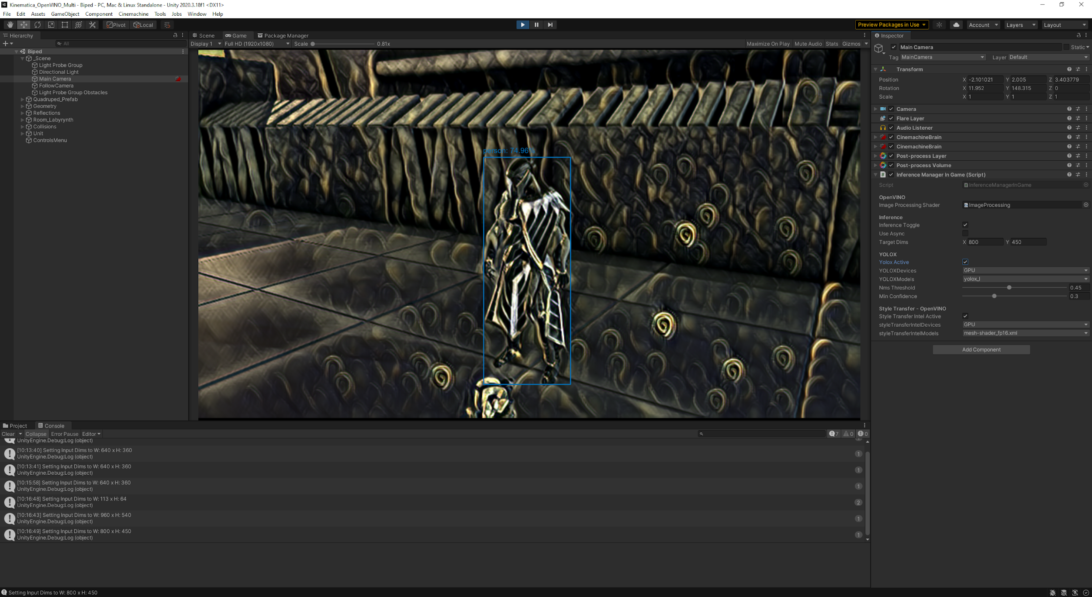
Gaia ML – Object Detection
- Add Object Detection

Slide 17
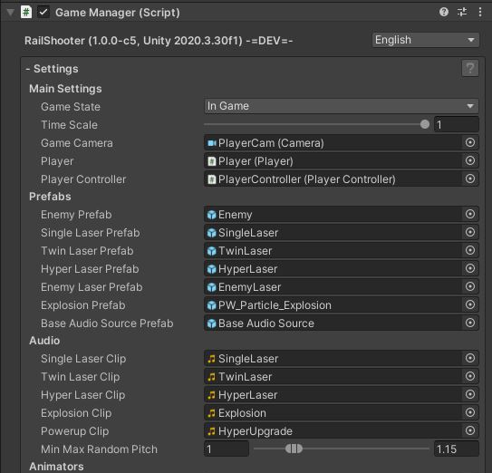
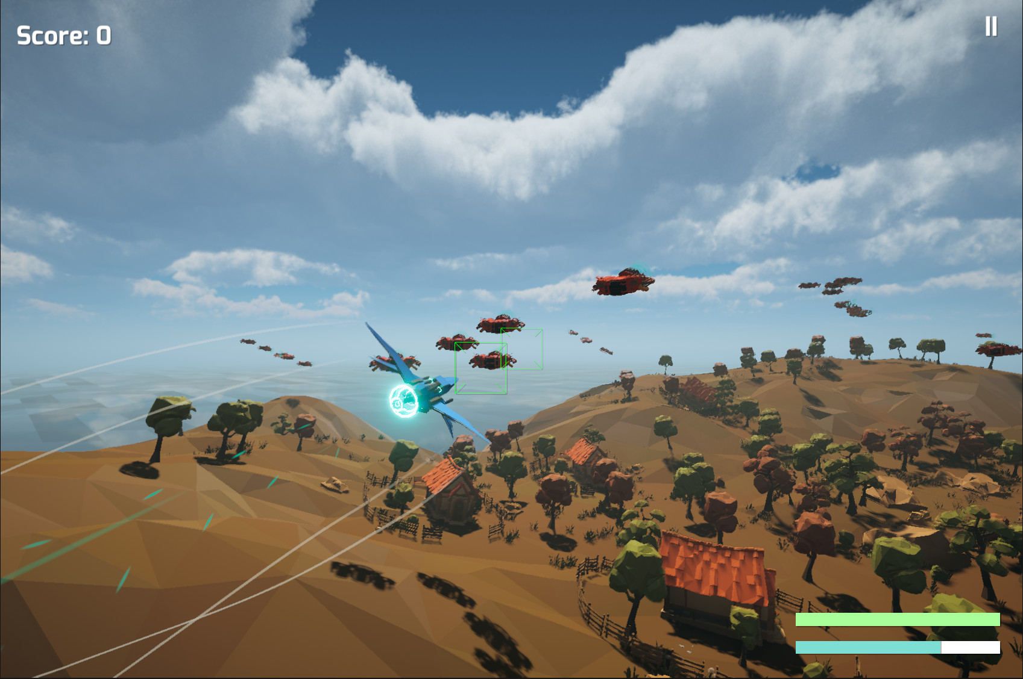
Gaia ML – Rail Shooter Game Template
- Add Rail Shooter Template

Slide 18
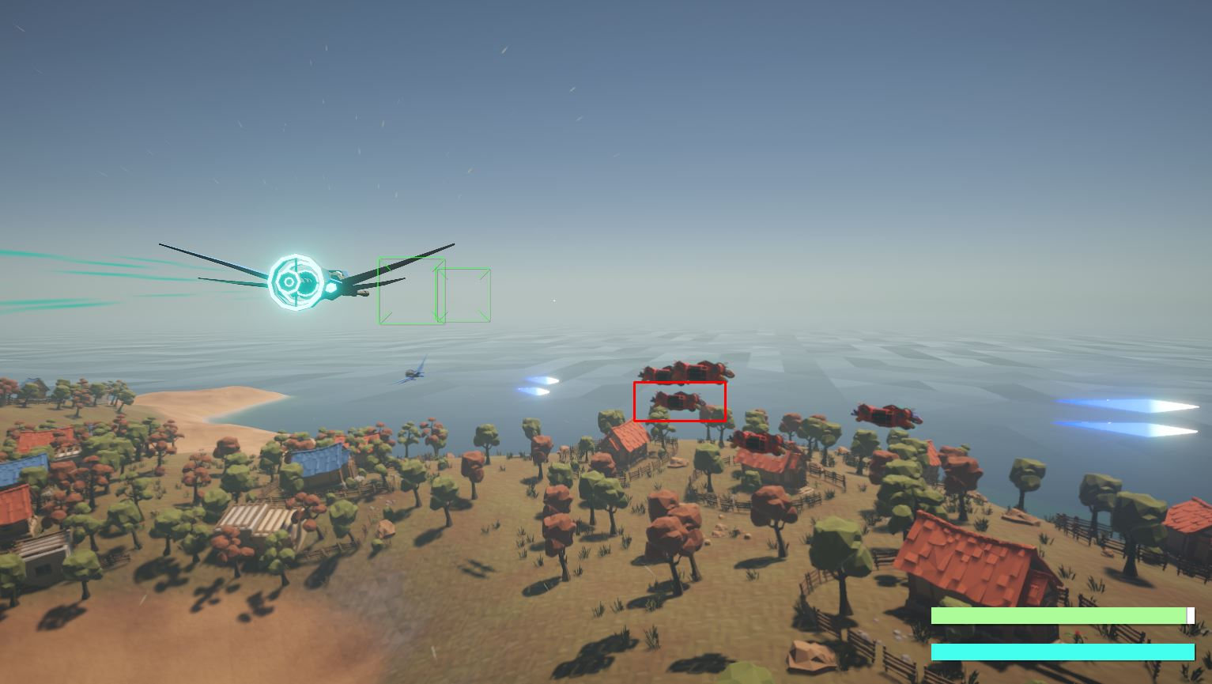
Gaia ML – Rail Shooter Loyal Ally
- Add AI Controlled Loyal Ally

Slide 19
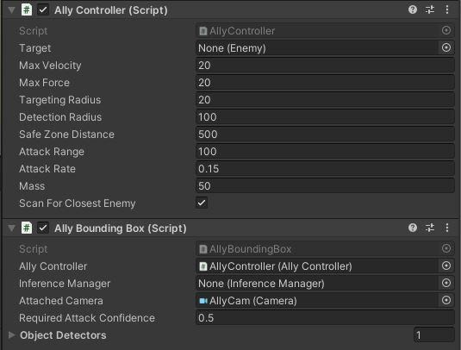
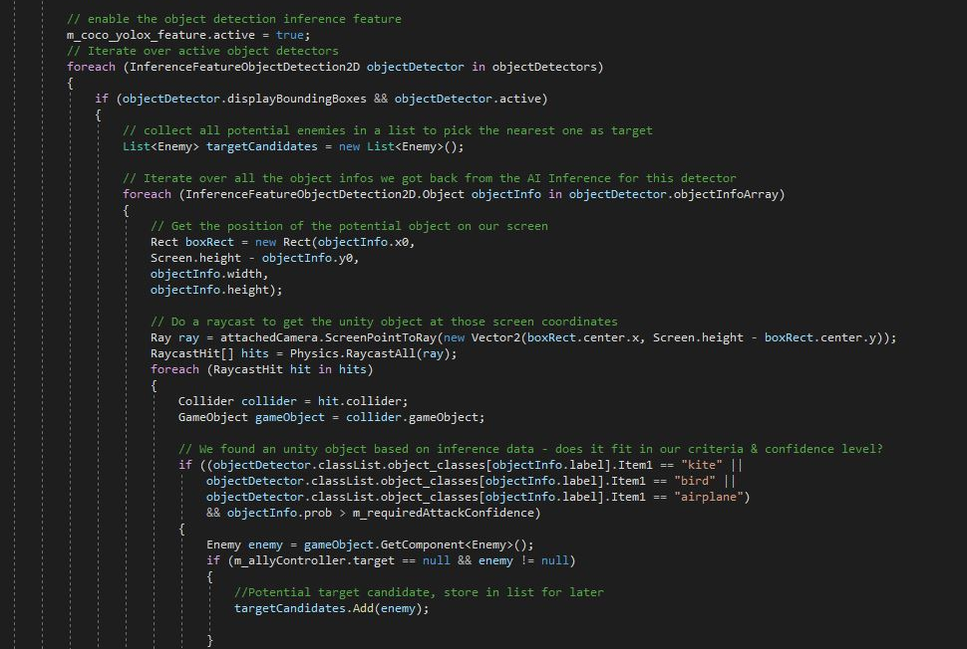
Gaia ML – AI Based Target Detection
- Object Detection Targeting

Slide 20
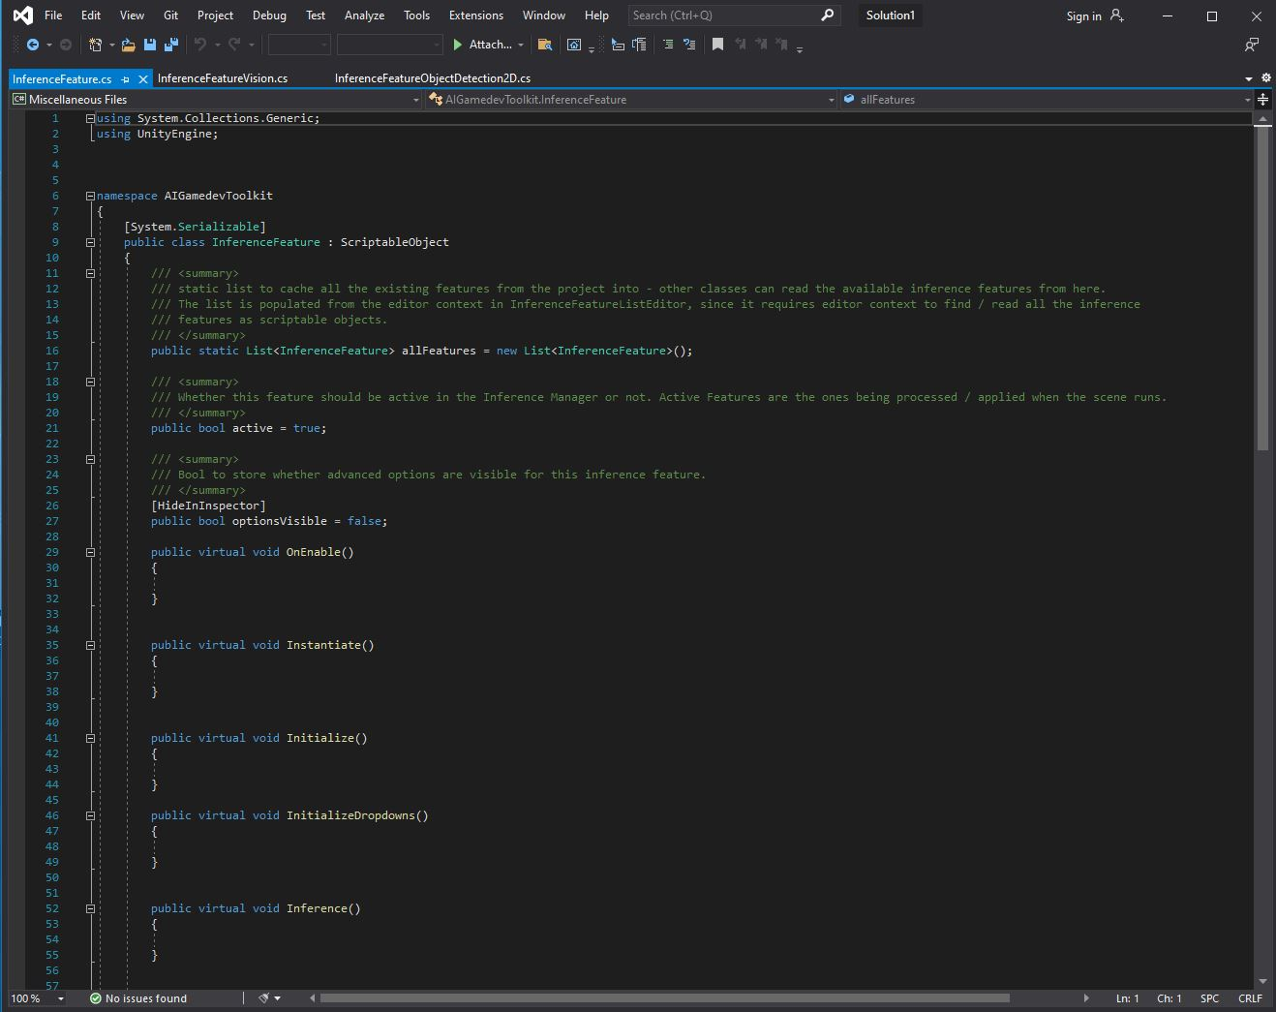
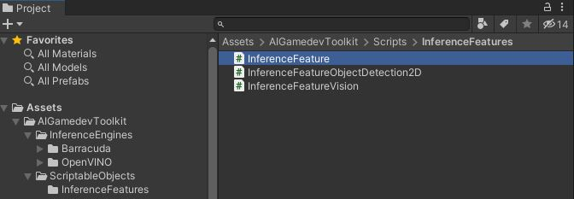
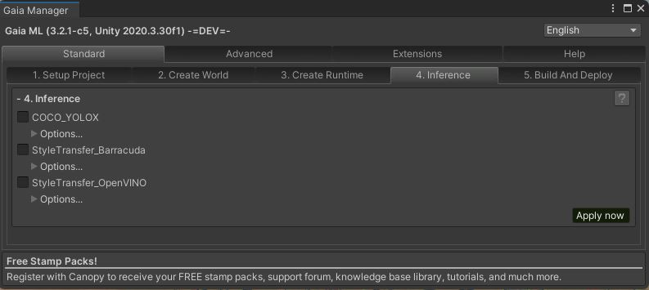
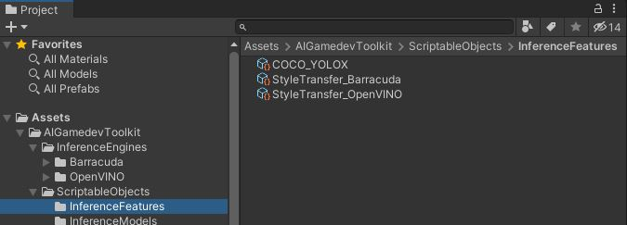
Gaia ML – AI/ML Extensions
- Derive from InferenceFeature - Implement Methods - Instantiate ScriptableObject - Exposed in Gaia ML

Slide 21
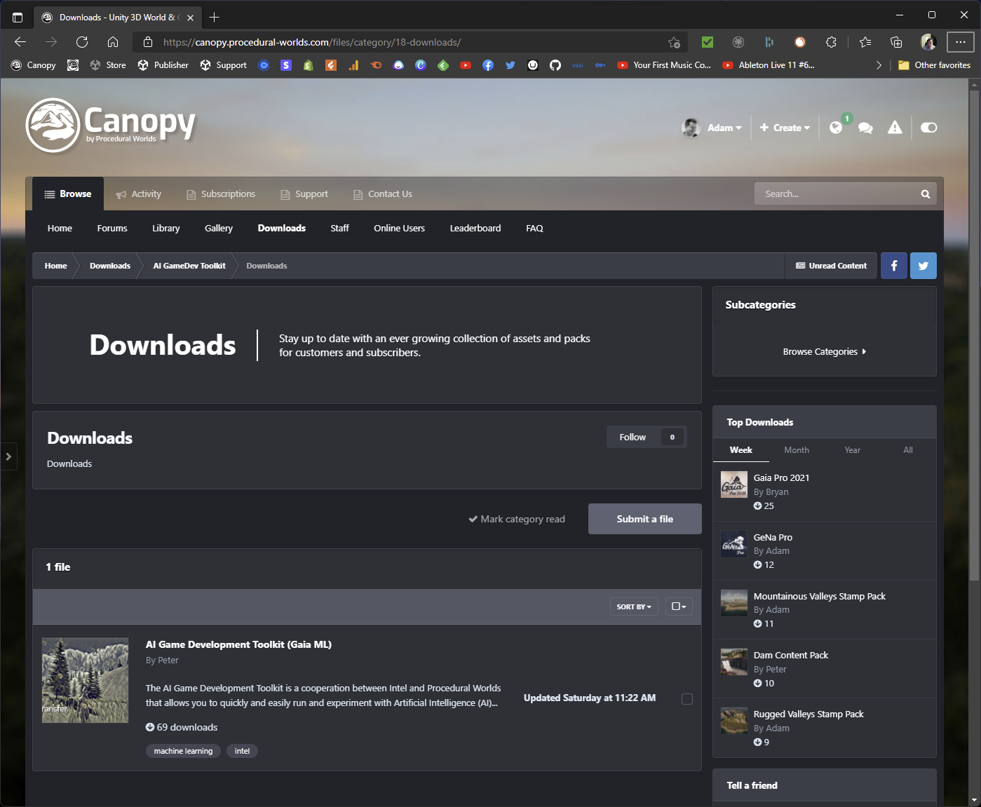
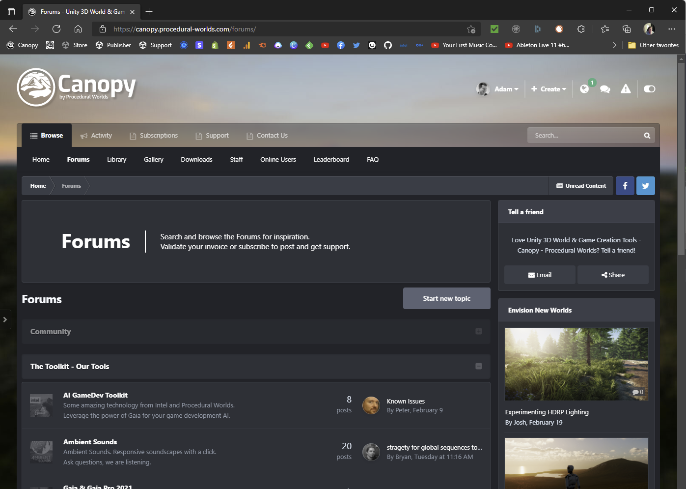
Gaia ML – Download, Tutorials & Support
- Gaia ML Download - Free - AI GameDev Toolkit Forum - AI GameDev Toolkit Tutorials - Support from PW https://canopy.procedural-worlds.com

Slide 22
Intel Game Dev AI Toolkit- Get it Today!
Links Base Game Dev AI Toolkit (Source Code):
https://github.com/IntelSoftware/AIGamedevToolkit
Game Dev AI Toolkit Starter Projects: https://github.com/IntelSoftware/aigamedevtoolkit-starter-demos
Game Dev AI Toolkit + Gaia ML: https://canopy.procedural-worlds.com/files/file/32-ai-game-development-toolkit-gaia-ml
Thank you for joining us & we can’t wait to see what you do with the power of AI in your game projects!

