Slide 1
Elevate Your Game Profiling
GDC 2022
Advanced Graphics Analysis
Pamela Harrison Software Technical Consulting Engineer, Intel® GPA
Stanislav Volkov Software Architect, Intel® GPA
Eugene Krasichkov Product Owner, Intel® GPA

Slide 2
Legal Disclaimer
INFORMATION IN THIS DOCUMENT IS PROVIDED IN CONNECTION WITH INTEL® PRODUCTS. NO LICENSE, EXPRESS OR IMPLIED, BY ESTOPPEL OR OTHERWISE, TO ANY INTELLECTUAL PROPERTY RIGHTS IS GRANTED BY THIS DOCUMENT. EXCEPT AS PROVIDED IN INTEL'S TERMS AND CONDITIONS OF SALE FOR SUCH PRODUCTS, INTEL ASSUMES NO LIABILITY WHATSOEVER, AND INTEL DISCLAIMS ANY EXPRESS OR IMPLIED WARRANTY RELATING TO SALE AND/OR USE OF INTEL PRODUCTS, INCLUDING LIABILITY OR WARRANTIES RELATING TO FITNESS FOR A PARTICULAR PURPOSE, MERCHANTABILITY, OR INFRINGEMENT OF ANY PATENT, COPYRIGHT, OR OTHER INTELLECTUAL PROPERTY RIGHT.
A "Mission Critical Application" is any application in which failure of the Intel Product could result, directly or indirectly, in personal injury or death. SHOULD YOU PURCHASE OR USE INTEL'S PRODUCTS FOR ANY SUCH MISSION CRITICAL APPLICATION, YOU SHALL INDEMNIFY AND HOLD INTEL AND ITS SUBSIDIARIES, SUBCONTRACTORS AND AFFILIATES, AND THE DIRECTORS, OFFICERS, AND EMPLOYEES OF EACH, HARMLESS AGAINST ALL CLAIMS COSTS, DAMAGES, AND EXPENSES AND REASONABLE ATTORNEYS' FEES ARISING OUT OF, DIRECTLY OR INDIRECTLY, ANY CLAIM OF PRODUCT LIABILITY, PERSONAL INJURY, OR DEATH ARISING IN ANY WAY OUT OF SUCH MISSION CRITICAL APPLICATION, WHETHER OR NOT INTEL OR ITS SUBCONTRACTOR WAS NEGLIGENT IN THE DESIGN, MANUFACTURE, OR WARNING OF THE INTEL PRODUCT OR ANY OF ITS PARTS. Intel may make changes to specifications and product descriptions at any time, without notice. Designers must not rely on the absence or characteristics of any features or instructions marked "reserved" or "undefined". Intel reserves these for future definition and shall have no responsibility whatsoever for conflicts or incompatibilities arising from future changes to them. The information here is subject to change without notice. Do not finalize a design with this information. The products described in this document may contain design defects or errors known as errata which may cause the product to deviate from published specifications. Current characterized errata are available on request. Contact your local Intel sales office or your distributor to obtain the latest specifications and before placing your product order. Copies of documents which have an order number and are referenced in this document, or other Intel literature, may be obtained by calling 1-800-548-4725, or go to: http://www.intel.com/design/literature.htm.
All information provided related to future Intel products and plans is preliminary and subject to change at any time, without notice. Intel and the Intel logo are trademarks or registered trademarks of Intel Corporation or its subsidiaries in the United States and other countries.
Other names and brands may be claimed as the property of others. All materials in, and discussions of, this presentation are covered under MSFT140000_C and are subject to the Non-Disclosure Agreement between Microsoft Corporation and Intel Corporation dated October 24, 1990. Copyright © 2021, Intel Corporation. All rights reserved.

Slide 3
Agenda
Intel® Graphics Performance Analyzers (Intel® GPA) Overview
Intro to the Case Study Workload
Bottleneck Analysis
Raytracing Profiling
Intel® XeSS – Xe-Super Sampling
Resources
Notes:
Before this slide:
ISTV: Ideally, an ARC background slide (27?) when Pamela starts speaking – with all 3 speakers showing, their names and titles below them – maybe Pamela centered and larger with Eugene and Stas on either side.
You can use a solid color or some other background if the shapes are wonky behind us.
Pamela:
Hello. Welcome to our GDC session - “Elevate Your Game Profiling, using Intel® GPA on Alchemist” I am Pamela Harrison. I’m a Software Technical Consulting Engineer for Intel® Graphics Performance Analyzers (Intel® GPA).
I am here with Stanislav Volkov. <<Stas acknowledges.>> Stas is the Intel® GPA Software Architect. Stas? . . .
<<pause here for Stas’ intro (which he will record when he records his other parts – and will be inserted here)>>
Also, we are joined by Eugene Krasichkov. <<Eugene acknowledges.>> Eugene is the Intel® GPA Tools Product Owner. Eugene? . . .
<<pause here for Eugenes’ intro (which he will record when he records his other parts – and will be inserted here)>>
Throughout the session, we will be responding to virtual attendees via GDC’s chat mechanism.
<< Here the camera zoom to Pamela?>>
Performance is key.
Higher performance allows your game to run smoothly on your target platforms. But if you are able to increase performance, you might be able to expand to other platforms, giving you a bigger market.
So, you want good performance. That means sufficient FPS. But what about other data? How about Real-Time Ray Tracing HW acceleration and how that relates to shader execution efficiency on the GPU?
Pamela continues on the Agenda slide:
In this talk, our experts, Stas and Eugene, will guide you through several performance data elements and their relationships to each other so that you will know how to interpret that data to find your hottest bottlenecks. . . . and why do you care what your hottest bottlenecks are? . . . so you will know what to work on first to get the most performance improvement for your time and effort.
We will take you in-depth into Bottleneck Analysis, show you our RT capability, then demonstrate what GPA can do with XeSS.
Now I will hand off to Eugene who will talk a bit about Intel® Graphics Performance Analyzers and introduce our use case.

Slide 4
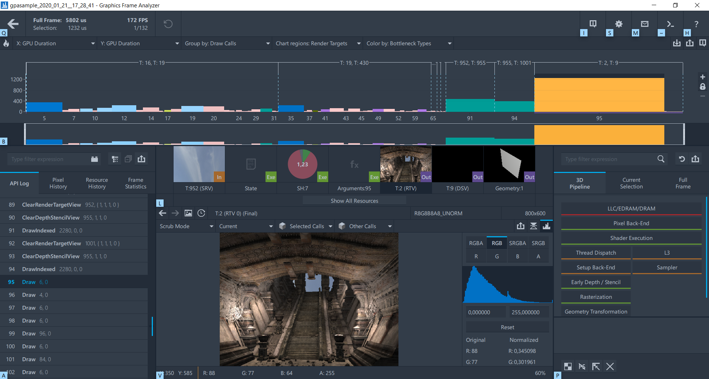
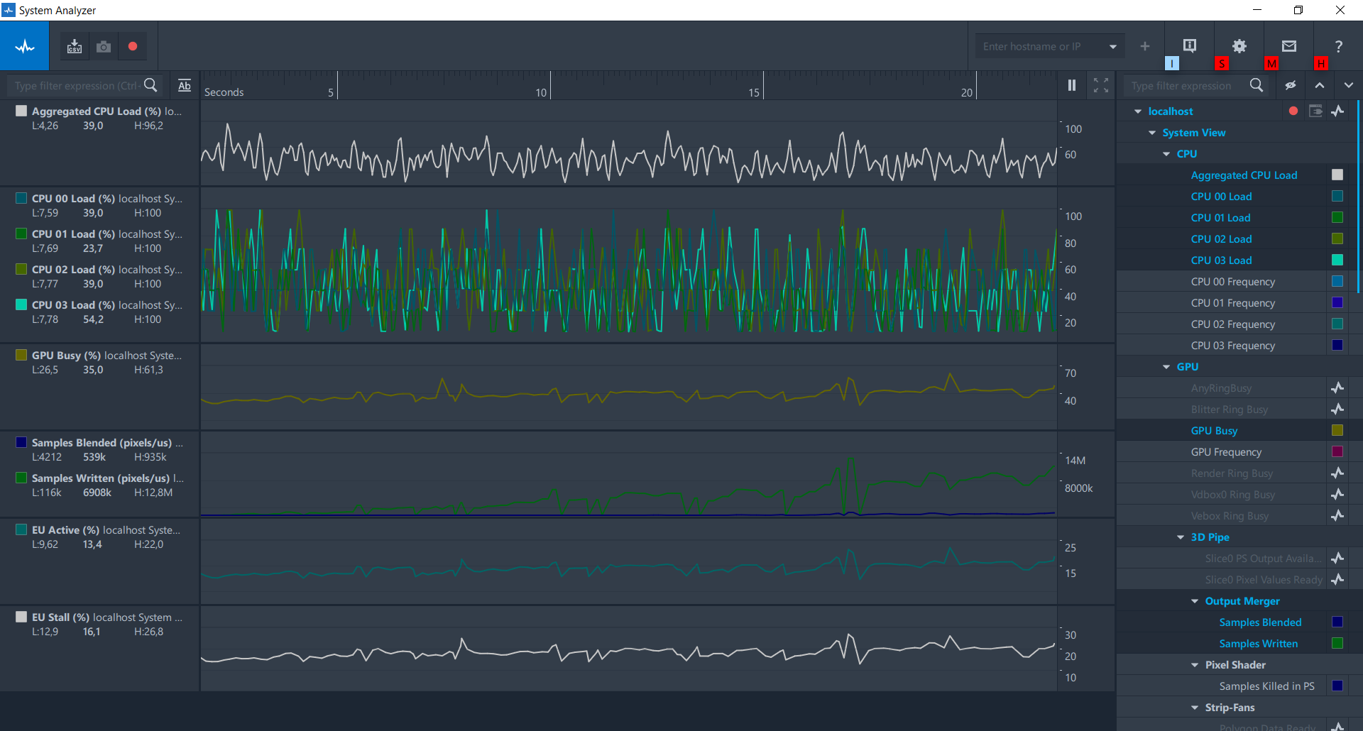
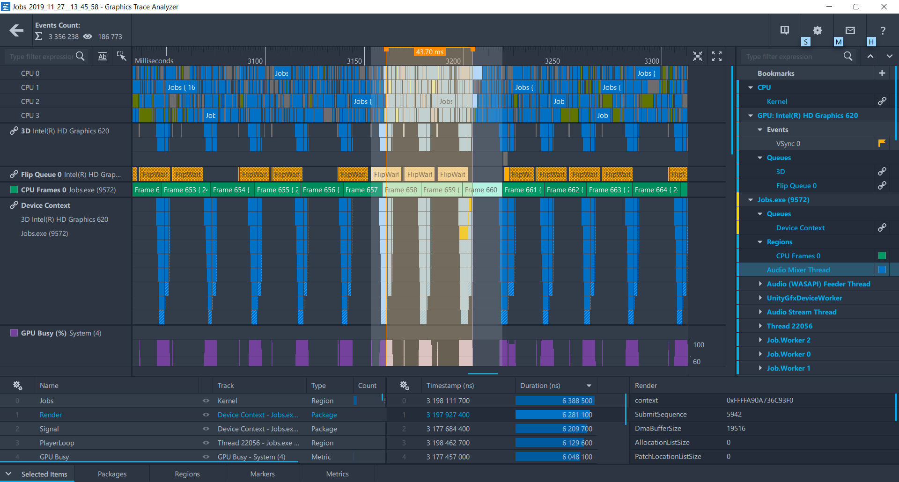
Intel ® Graphics Performance Analyzers Overview
Intel® Graphics Performance Analyzers (Intel® GPA) is a toolset for graphics performance analysis and optimization of games and other graphics-intensive Microsoft* DirectX*, Vulkan*, and OpenGL* applications.
System Analyzer
Graphics Trace Analyzer
Graphics Frame Analyzer
Notes:
Thanks, Pamela for the introduction.
Let me start with a brief description of Intel® GPA before we switch to a case study. Intel GPA is a set of GUI and CLI profiling tools for games and other graphics intensive apps which use Microsoft DirectX 9, 11, and 12, Vulkan, or OpenGL graphics APIs. In addition to this, Graphics Trace Analyzer, our timeline analysis tool, also visualizes OpenCL, Intel Media SDK, and Intel one VPL work.
There are three profiling tools in our toolset – System Analyzer, Graphics Frame Analyzer, and already mentioned Graphics Trace Analyzer. Each tool has its own purpose and covers its own use-cases, but all of them should be used together to maximize the efficiency of profiling.

Slide 5
Intel® GPA General Workflow
Notes:
A single starting point for analysis is GPA's Graphics Monitor – the hub of GPA. You can configure options, launch real-time analysis, capture frame, stream, or trace files and open these files in the corresponding tools.
When you start an application for profiling, GPA automatically shows a Heads-up display with FPS overlaid in the top corner of your application window. In many cases, this is enough to find obvious performance drops, but when you need to dig deeper to catch a problematic scene, System Analyzer will be your first assistant. It shows various GPU, CPU, and graphics API metrics on a single timeline and enables you to capture a frame or trace file from within this tool.
Graphics Trace Analyzer gives an overview of application execution on the CPU and GPU. It shows GPU and CPU utilization, graphics and compute API calls, supports ETW events, visualizes dependencies between events and synchronization primitives on the CPU thread, UMD queue and GPU queue levels and has many other features. Among other things, this tool allows you to determine with certainty, at a glance, whether your app is GPU-bound or not. If an application is GPU-bound then you need to capture a multi-frame stream or single-frame and switch to Graphics Frame Analyzer, otherwise your analysis should be continued in Graphics Trace Analyzer, or another Intel tool designed for deep CPU profiling – such as Intel Vtune Profiler or Intel Advisor.
Graphics Frame Analyzer is designed for GPU-bound application profiling. It supports two types of files – single frames for scenes where FPS is equivalent, and multi-frame streams for effects or complex algorithms. Multi-frame streams add an additional step to the workflow – allowing you to select a frame, a range of frames, or a range of DirectX12 ExecuteCommandLists calls for in-depth analysis. Graphics Frame Analyzer shows a list of (frame structure with) graphics API calls, a list of resources, shows GPU performance metrics, performs automatic bottleneck analysis, allows you to profile shaders, apply state and shader code modification experiments as well as perform other analysis work.
Today’s talk will be dedicated to the section highlighted in the red rectangle on the slide. We show an in-depth analysis of our new Intel Alchemist features such as DirectX Raytracing and XeSS in Graphics Frame Analyzer.
Here at the end of this toolset overview, we’d like to highlight that it is highly desired to follow our workflow, but it is not mandatory – you can always start with any tool if you know what the tool is designed for and what information it can give you.

Slide 6
Case study: Scope
Hardware | Intel® Alchemist
Application | Intel® Rens Demo created with Unreal Engine 4
Graphics API | DirectX* 12
Highlighted Features | Bottleneck analysis, DXR shader execution analysis, XeSS
Intel® GPA | Continuous ‘Stream’ capture profiling in Graphics Frame Analyzer
Notes:
Now it is time to start our case study. We’ll use the Intel Rens Demo sample created with Unreal Engine 4 running on a new Intel® Alchemist platform. It is a DirectX12 sample which uses many modern graphics technologies such as Raytracing, Variable Rate Shading, and Intel® Xe super-sampling (XeSS). We’ll mostly cover how Graphics Frame Analyzer can be used for Raytracing profiling and just a shallow dive of how XeSS is visualized in the tool. But there is an in-depth overview of XeSS which is based on the same Intel Rens Demo sample - “Intel XeSS – an AI based Super Sampling solution for Real-time Rendering - (XeSS Deep Dive)” by Robert & Hisham

Slide 7
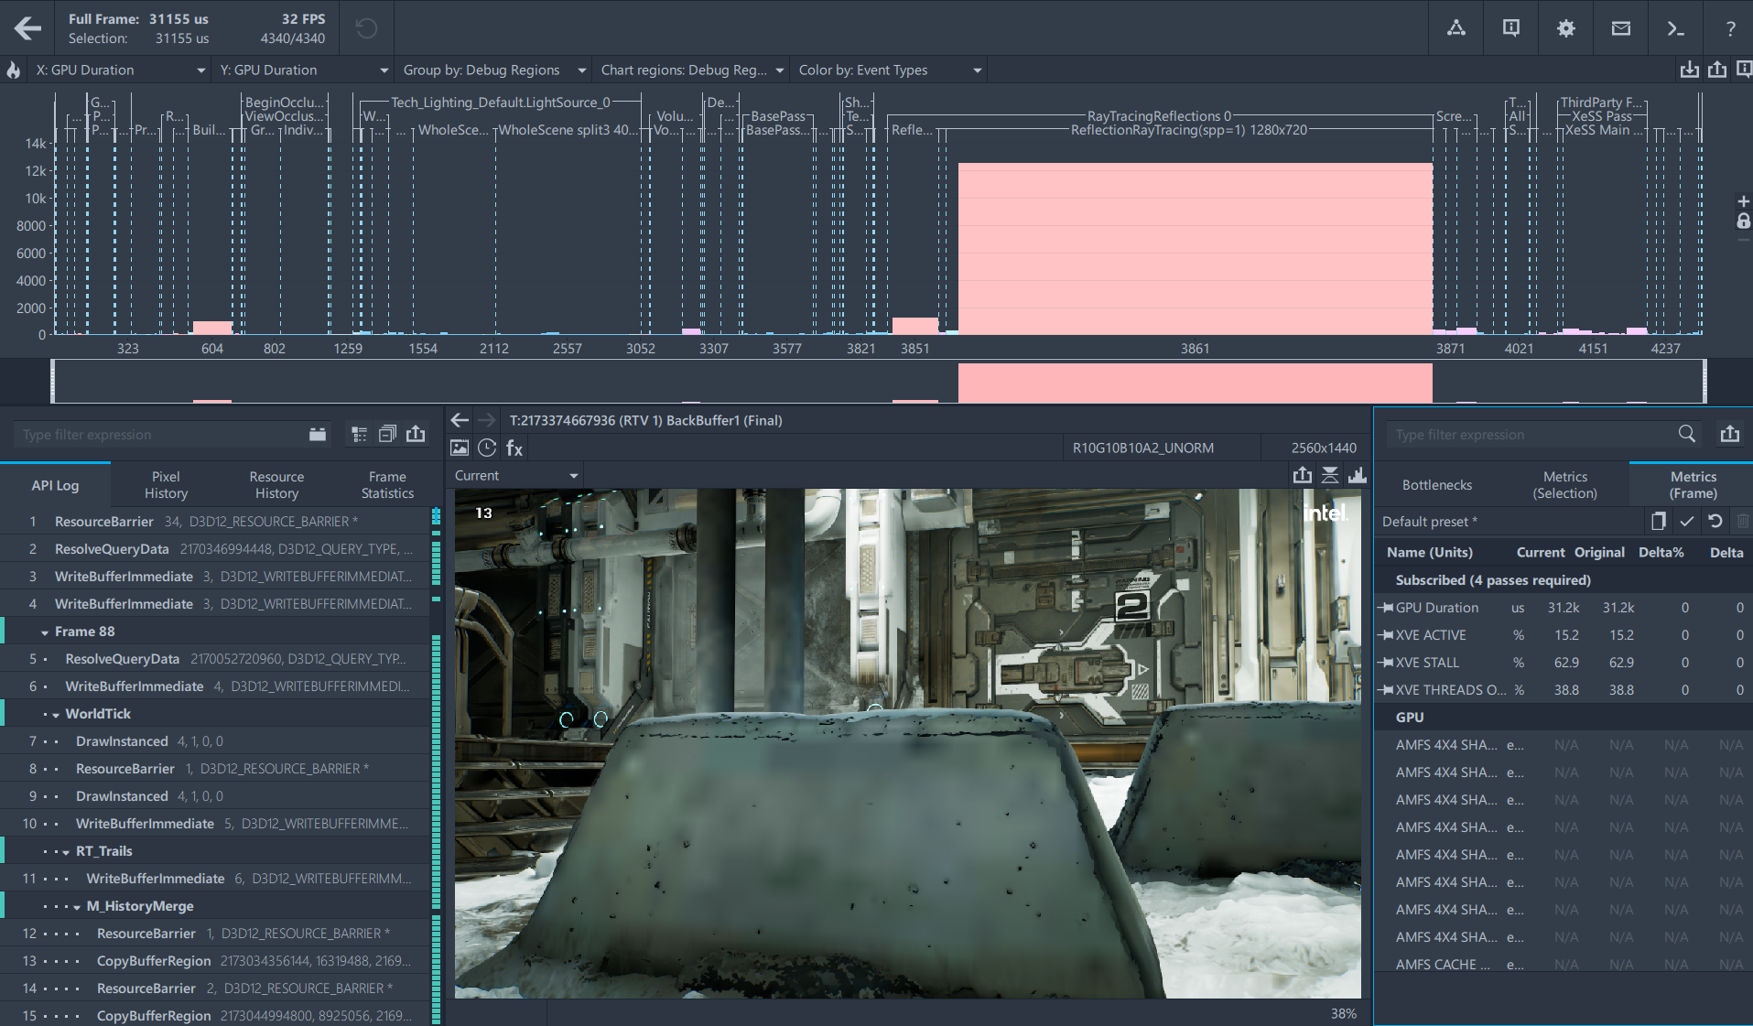
Application Overview
Notes:
We are assuming that a stream is already captured, the frame of interest is selected, and we are ready for in-depth analysis. After the frame opening, we immediately see a few things.
Looking into the left-hand top corner, we can easily understand generic characteristics of a frame:
there are about 4k graphics events, meaning calls which produce GPU work, such as Draw/Copy/Dispatch/etc.
the frame takes slightly more than 31milliseconds, which results in 32 FPS
The top Bar Chart panel visualizes metrics for all the events in a frame for both X and Y axes. One of useful combinations for the first look is selection of “GPU Duration” for both axes. It allows to visually understand an impact of every event. We’ll use this combination on a current and subsequent slides.
In the Rens Demo which we are looking at now, there is the graphics event which is significantly larger than the other events in the frame – it is DispatchRays #3861.

Slide 8
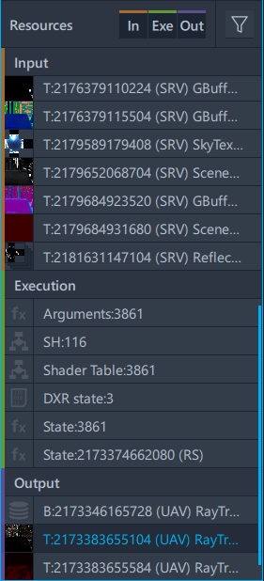
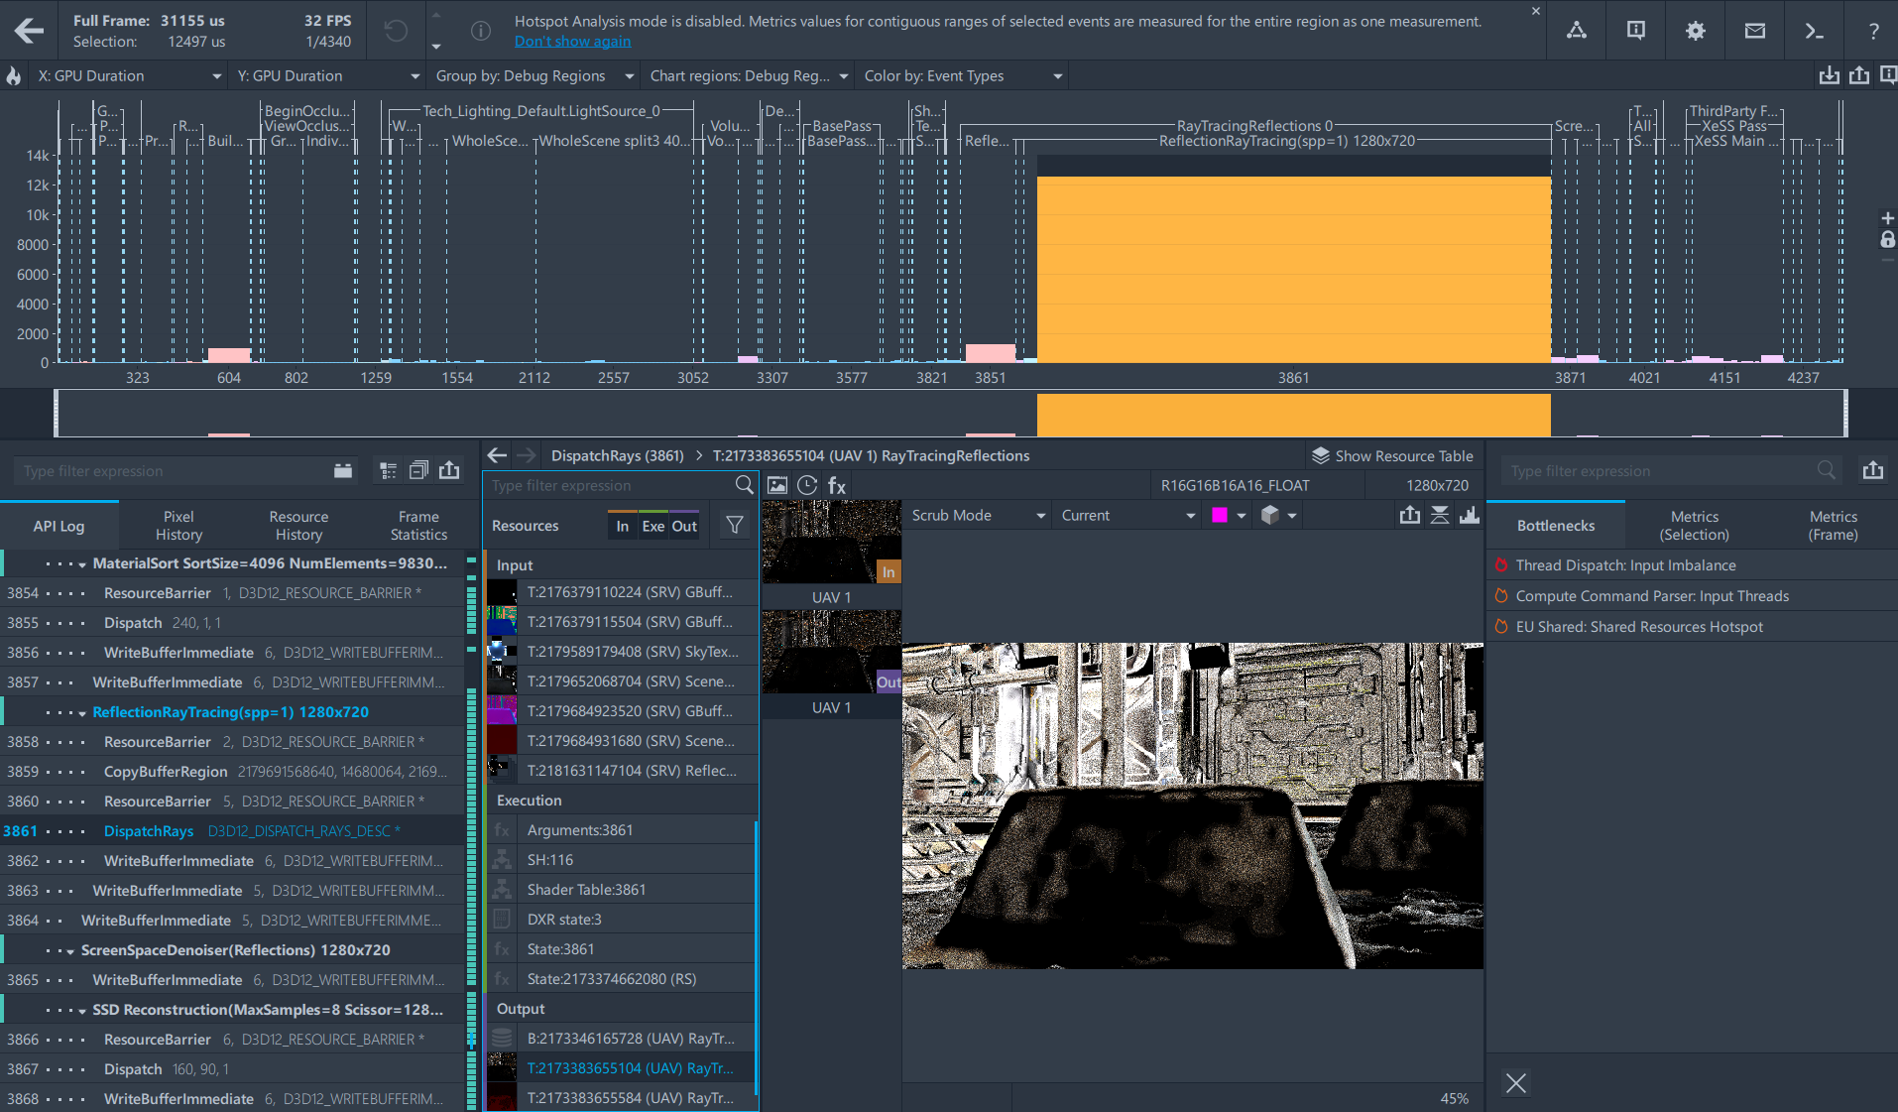
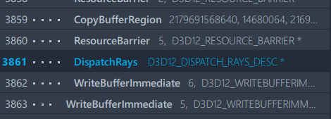
Application Overview
Notes:
If we select it, we can see that it takes 12,5milliseconds which is 40% of the frame.
Frame Analyzer also visualizes its resources, shaders, and output results.
But before we continue looking into details, the important question to ask would be – is this call a primary problem in the frame and should we immediately jump in and optimize it?

Slide 9
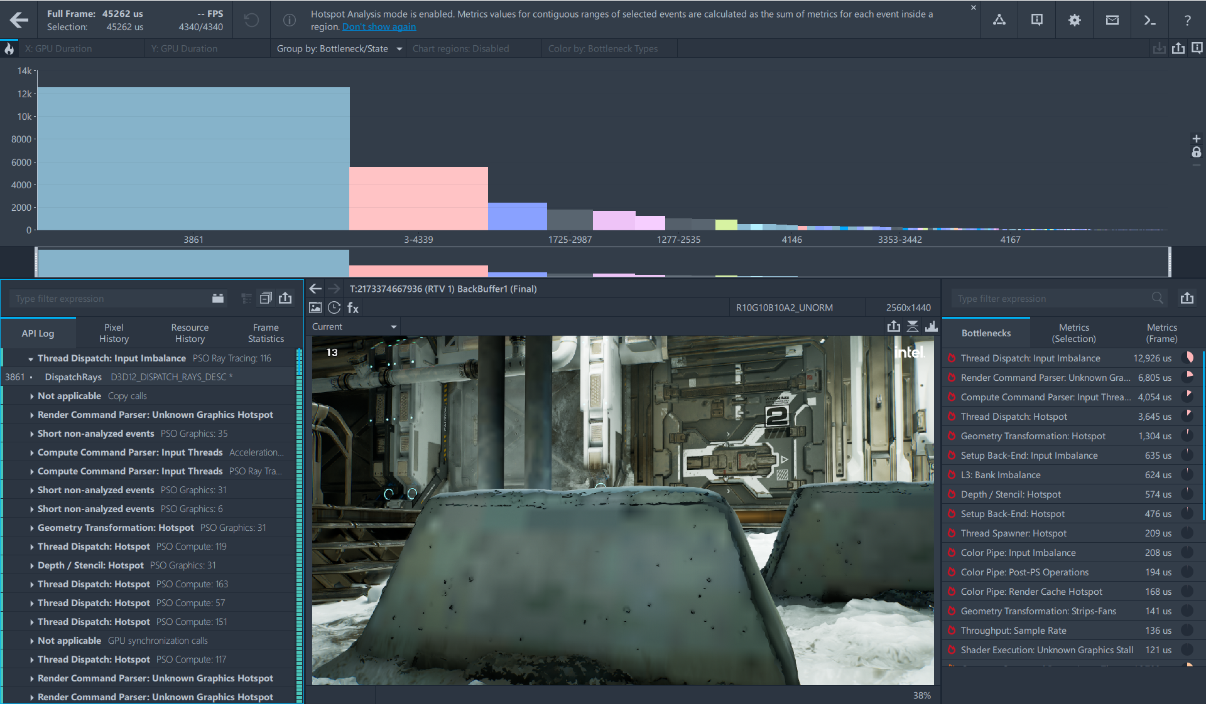
Advanced Profiling Mode
Notes:
The small “fire” icon in the top left-hand corner allows us to answer the question. When you press on this button, Frame Analyzer changes visualization and metrics measurement mode to be able to group events by hardware bottlenecks and then order the groups by their impact into frame duration.

Slide 10
How to Select Graphics Events for Profiling?
Should it be the largest event?
What if small calls with the same state
spend more of frame budget?
But calls with the same state can have different performance problems
Notes:
Let’s look at how GPA implements Advanced Profiling Mode and how this feature can help to answer the question – which events affect performance the most?
So, a typical application could have several thousands of graphic calls per frame and the first step of performance analysis is to identify which one of them should be the optimization target. The most straightforward strategy would be to choose 2 or 3 of them with the largest duration. This could be a valid approach in some cases. However, there could be large sequences of rather small graphics calls, but they share the same state, as well as shader and they take significantly more time combined than one of the largest calls. Because they share the same code and state it could mean that optimizing one of them can potentially lead to optimization of all of them. But! there is a catch – there could be different types of performance inefficiencies even between calls with the same state. For example, they can have differences in resources they use, which in turn would introduce differences in their access latencies. Or another example is when shader execution diverges, meaning different shader instances choose a different code branch. Therefore, it’s not sufficient to analyze calls together just because they share the same state. It’s also necessary to classify what types of performance problems they have. And this is where a bottleneck signature comes into play.

Slide 11
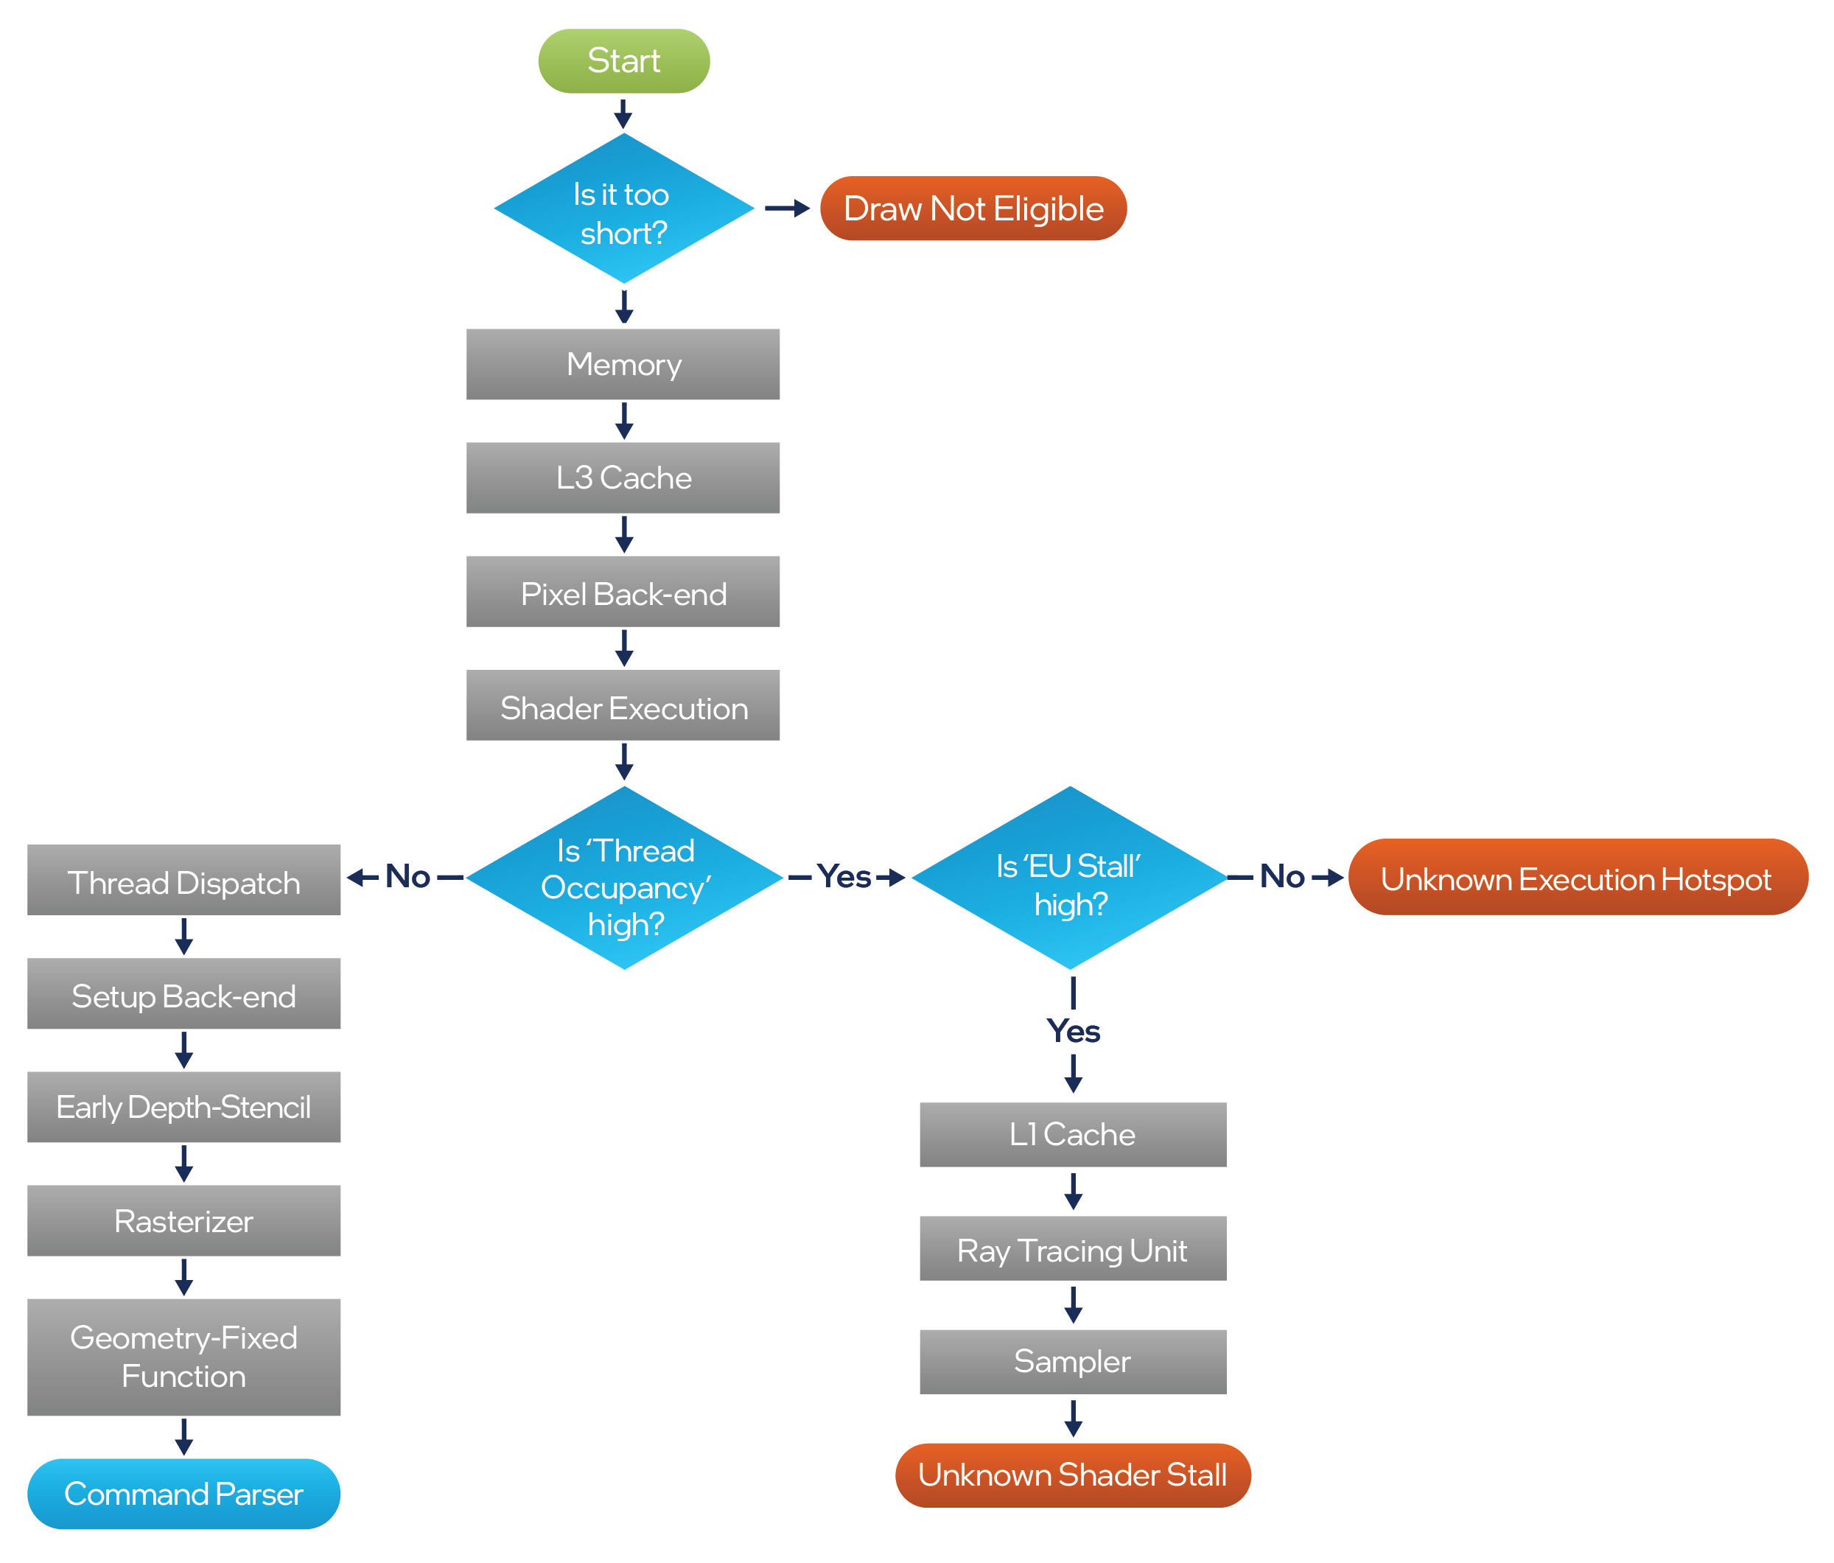
Bottleneck Signature
Field | Value
Filtered | 0
Memory | 0
L3 Cache | Primary
Pixel Back-End | 0
Shader Execution | 0
L1 Cache | Secondary
Ray Tracing | 0
Sampler | Secondary
Thread Dispatch | 0
Setup Back-End | 0
Early Depth-Stencil | 0
Rasterizer | 0
Geometry | Secondary
Command Parser | Secondary
Notes:
The primary purpose of a bottleneck signature is characterization of a class of the performance problem which happens on the GPU for a particular graphics event or their sequence. It’s implemented as an output of a bottleneck detection flow, which was significantly updated in GPA for Intel Alchemist in order to cover all the major architectural changes introduced by the new discrete GPU.
This flow does two primary things – it calculates how efficiently (or inefficiently) each GPU block operates and then among inefficiently working blocks it identifies which one of them is a primary limiting factor for application performance. The result is organized into a bottleneck signature, which is essentially a table with each HW block marked as non-bottleneck (zero on the table), a primary bottleneck, which is a main performance limiting GPU unit and a secondary bottleneck, which indicates that that a particular GPU block also has a high load and is likely to become a primary bottleneck when the current one is resolved. In general, it’s good to inspect secondary bottlenecks as well for at least two reasons:
They could give more information about performance problems. For example, if the primary bottleneck is L3 cache and the secondary one is Sampler, it’s highly likely that a sampler unit generates a lot of requests to L3.
Another reason is that sometimes possible optimizations for primary bottlenecks are limited, and so effort could be concentrated on secondary bottlenecks which could allow you to still squeeze out some performance.
Also, before we move to the next slide, I want to highlight the Filtered field in the bottleneck signature table. This field doesn’t correspond to any GPU unit and therefore can’t be marked as a primary or secondary bottleneck. Instead, its purpose is to mark graphics calls which are too short to have a whole GPU pipeline utilized during the analysis and therefore, their analysis is unreliable. However, there is a way to still deal with them. So let’s see how.

Slide 12
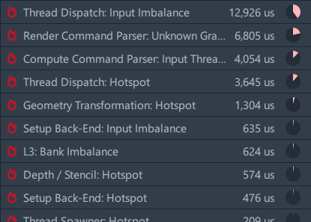
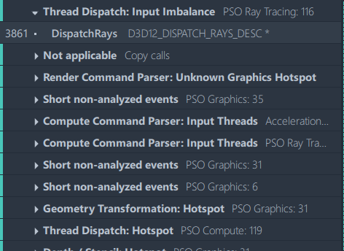
Advanced Profiling Mode on Intel® Rens Demo
Notes:
Thanks, Stas! Knowing how Advanced Profiling Mode works, let’s enable it for our application and check the results.
In the right panel we can see a summary of bottleneck types across the whole frame along with their weights
In the left panel we have a list of Graphics Events grouped by their bottleneck type and pipeline state object
And across the top, the same grouping in Bar Chart, where you can visually compare weights of bottleneck groups.
We’d like to look at the top three bottlenecks today, try to understand a root cause for each of them and give performance advises or suggest further steps of analysis.

Slide 13
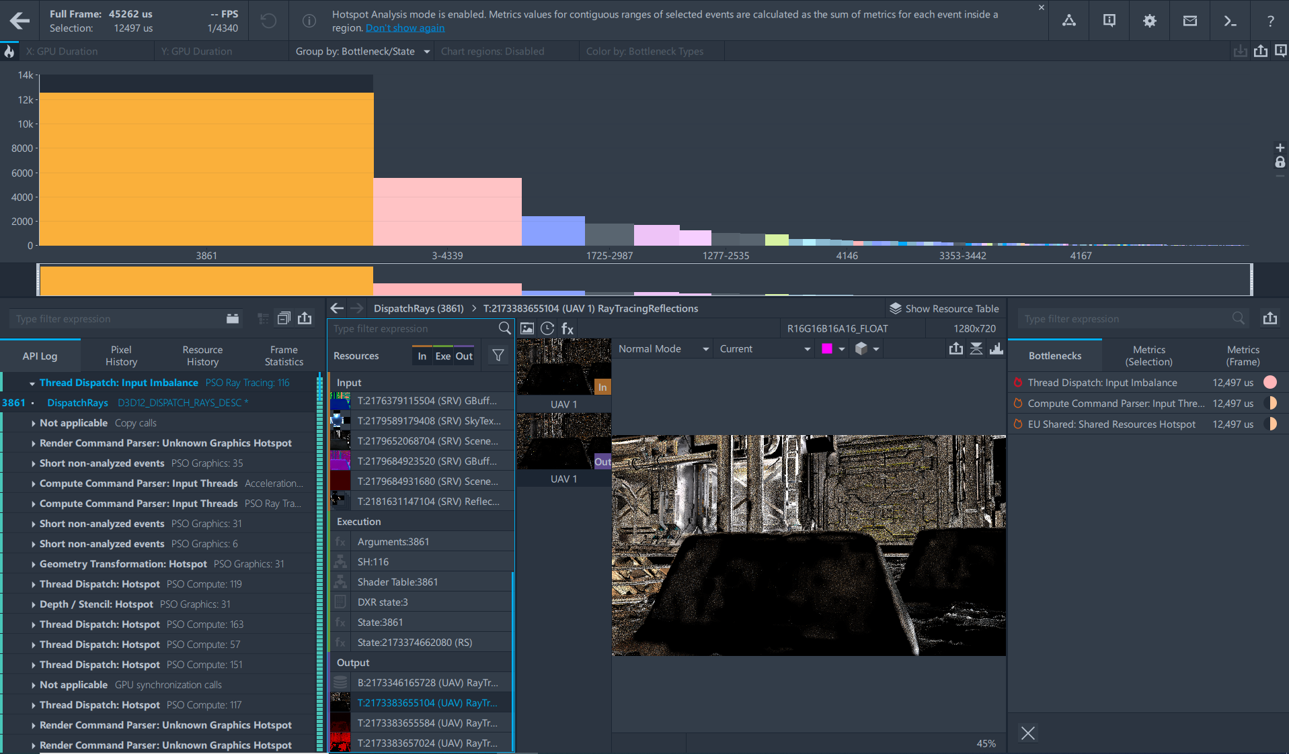
Thread Dispatch Group
Notes:
Previously, in the default Frame Analyzer mode, we noticed the largest DispatchRays call #3861 and now we can confirm that it is the top bottleneck in the frame. It means that we need to concentrate our efforts on profiling of this event, and we’ll definitely do it today. It is the main goal of our presentation.
But let’s look at two other bottlenecks which can also be important.

Slide 14
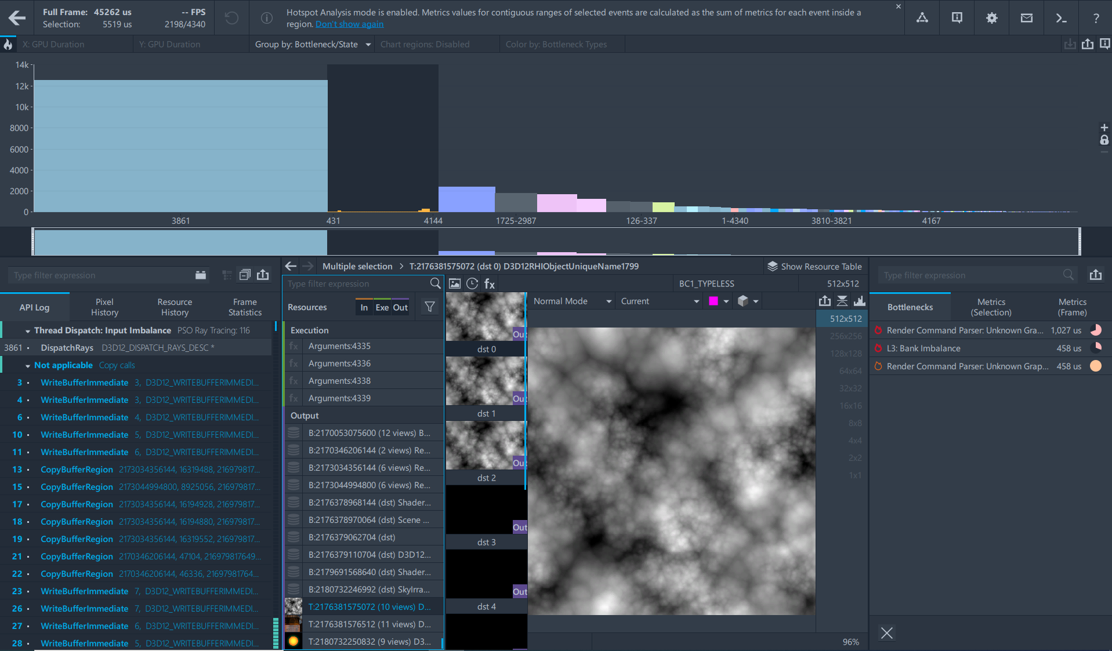
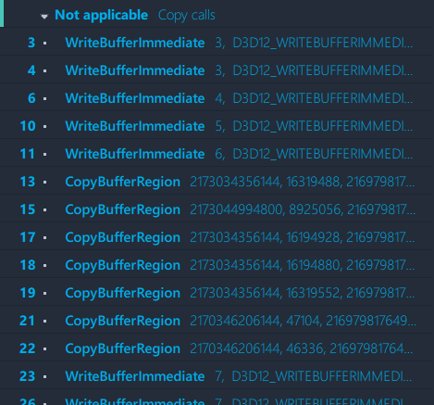
Not Applicable Group
Notes:
The second group is marked as “Not applicable copy calls”. If we expand it in the left panel, we’ll see it containing WriteBufferImmediate and Copy calls. Frame Analyzer don’t do detailed analysis for such types of calls but having this group on the second place is a potential issue.
The sum of durations of individual copy events is 5,5 milliseconds but the question is: what is the real impact and duration of Copy commands? It would be nice to measure them as a single region but unfortunately, it is not possible because these calls are not in contiguous region, they are interleaved with some draw commands. It is easy to make sure in it switching back to Default mode.
There is no strong advice what to do in such case, but at least it can be considered as a performance warning. It is also a good idea to regroup these Copy command to allow Frame Analyzer to measure them together and show the actual duration for the whole group.

Slide 15
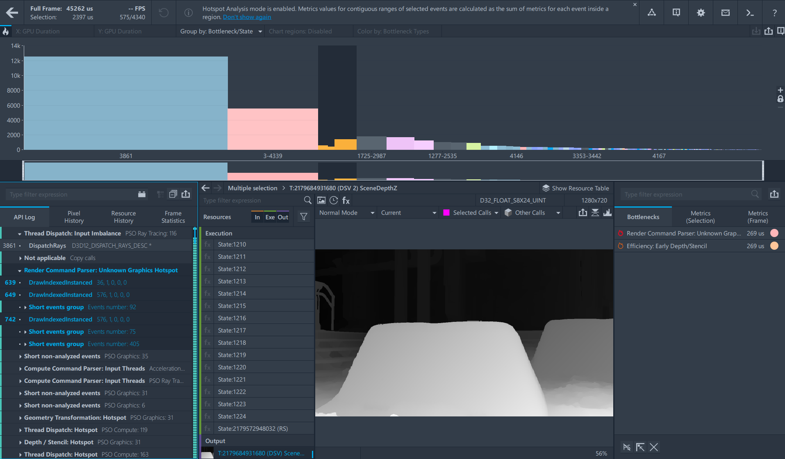
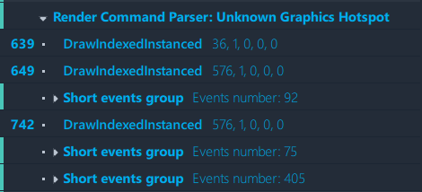
Render Command Parser Group
Notes:
The third group contains draw commands with a bottleneck in Render Command Parser. This hardware component is responsible for parsing commands which came from cpu though command queues. Usually, such issue can be resolved by reducing a number of commands, using instancing for example.
The group takes 2,4 millseconds but again, it is a sum of durations of individual events. Need to switch back into Default mode to try to measure the events in a group with a minimal possible number of metric queries.

Slide 16
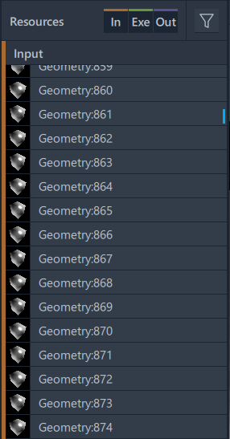
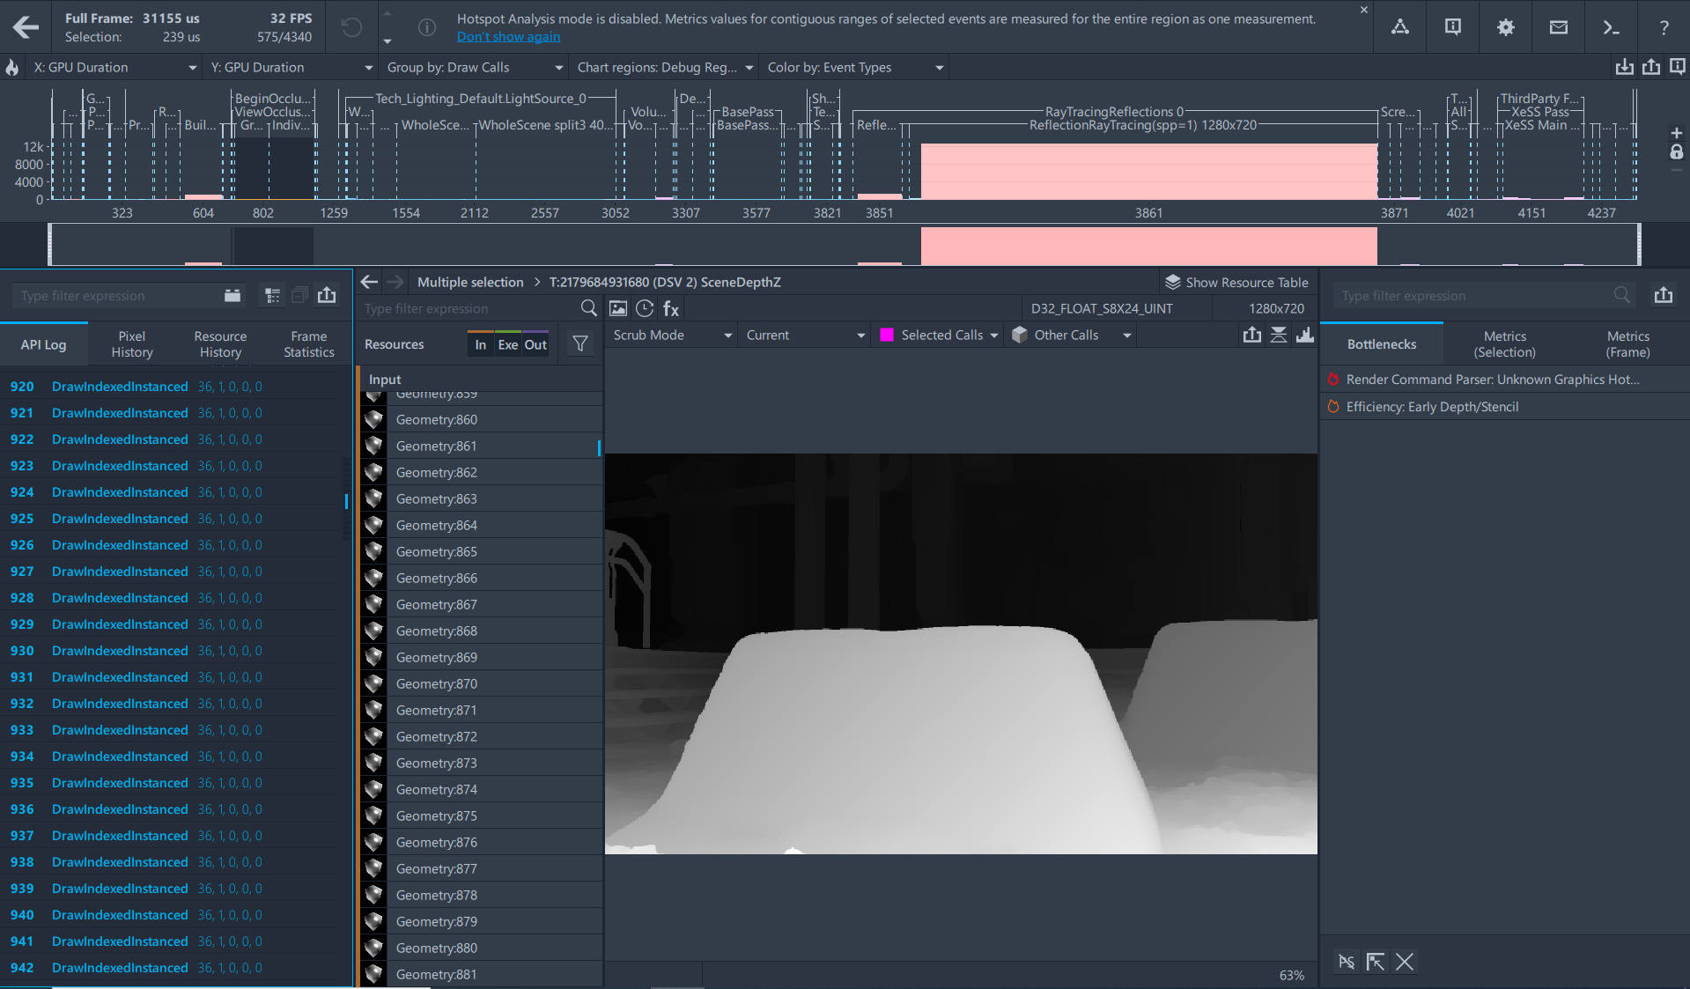
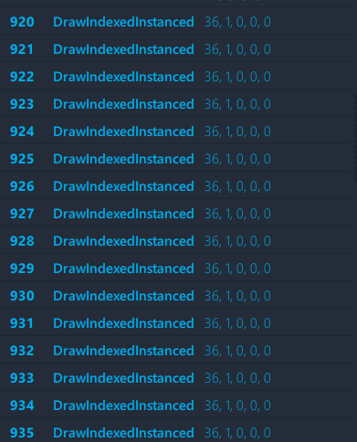
Render Command Parser Group
Notes:
The duration of the group is just 239microseconds. It doesn’t mean that our initial suggestion to use instancing won’t work.
Moreover, if we look at the calls themselves and into the resource panel, we can see that these calls have similar input geometry and mostly contain only 36 vertices which is too small to be efficiently processed by the HW: The GPU spends most of the time processing batch buffer commands rather than doing the actual rasterization and depth test. Batching of these calls could allow reduction of the processing time.
To conclude our Advanced Mode profiling, DispatchRays with 12,5milliseconds duration is still the largest operation in the frame, which to be honest is usually the case. However, Advanced Profiling Mode allowed us to identify other regions in the frame, and they also could be a target for optimization which would be easy to miss otherwise.

Slide 17
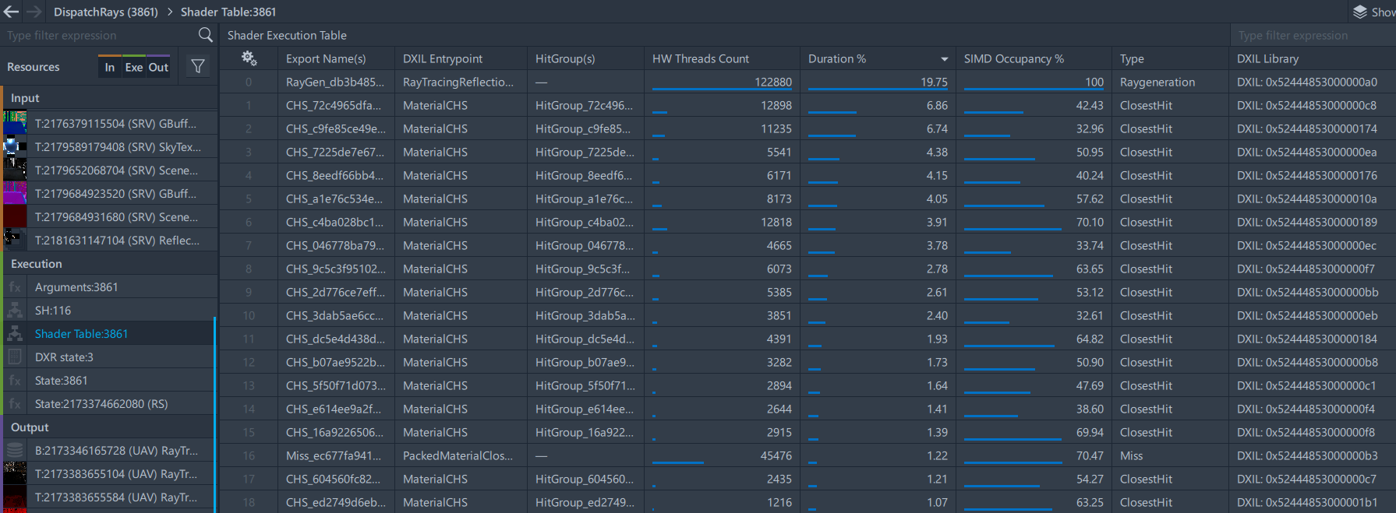
DXR Shader Execution Table
Notes:
Now we are ready to concentrate all the efforts on the largest DispatchRays event. The most powerful tool for Raytracing analysis is “Shader Execution Table”. It is a premier Frame Analyzer feature available starting from Intel® Alchemist which allows you to dig deeper into a raytracing execution black-box which can take up to 50% of a frame budget, like happened in our case.
The idea of the table is to visualize all the shaders which can theoretically be used in DispatchRays call and give performance metrics for every shader. Saying “theoretically used” I mean that Shader Execution table contains all the shaders whose shader records are defined in Hit, Miss and Callable tables and the Ray Generation shader for a corresponding record. It also means that some shaders in a table may not be executed at all.
The Shader Execution table is available in the Resource List as a separate item. When you click on it, Frame Analyzer shows the following information about shaders:
Export Name – the name of a shader which is exported from Raytracing Pipeline State Object and used for generation of shader identifier
DXIL Entrypoint – the name of the shader in HLSL code
Hit Group – name of a hit group where a shader is used. It is applicable for Closest Hit, Any Hit, and Interception shaders only. Ray Generation, Miss, and Callable shaders will have it empty.
HW Threads Count – number of Hardware Threads executed instances of a shader. A maximal number of shaders in a hardware thread depends on SIMD width and can be 8, 16, or 32. When the number is zero, it means that the shader is bound but was not executed.
Duration – relative duration of a shader. Sum of durations for all shaders is 100%.
SIMD Occupancy – an average percent of SIMD lanes used across all the threads executing a shader.
Type – shader type as defined in DXIL library.
DXIL Library – ID of DXIL library where a shader is declared. It can be used to find shader code in a separate resource. In future, it will be a clickable link that will automatically redirect to a proper shader code.
We’d like to stop on one of the key Raytracing performance metrics from the list - SIMD Occupancy which requires more background to understand.

Slide 18
Xe-Core Performance Characterization
XVE Thread Occupancy, %
Number of Hardware threads which are available as input for shader
engines in percentage of possible max value.
XVE Active, %
Percentage of time when shader engines execute instructions..
XVE Stall, %
Percentage of time when shader engines have HW threads as input
but are not executing instructions.
Notes:
XeCores are a central part of the Intel Alchemist GPU and its efficiency can be characterized by the following metrics:
Vector Engine (XVE) THREADS OCCUPANCY - this is a number of HW threads which are available as input for shader engines. Higher occupancy is better, because data access latency of a thread could be hidden by execution of another thread.
Vector Engine (XVE) ACTIVE – this is a percent of time when the shader engines actually execute instructions. Higher is better.
Vector Engine (XVE) STALL, % - it’s the percent of time when there are HW threads available, but they are all waiting for some dependency to resolve, such as waiting for the data.
However, these metrics characterize the whole RayDispatch call, and for Ray Tracing with its possible hundreds of shaders inside a singe call, this granularity is not enough. So we introduce a SIMD occupancy metric, which has a per-shader granularity, and characterizes a class of problems which is unique to ray tracing execution.

Slide 19
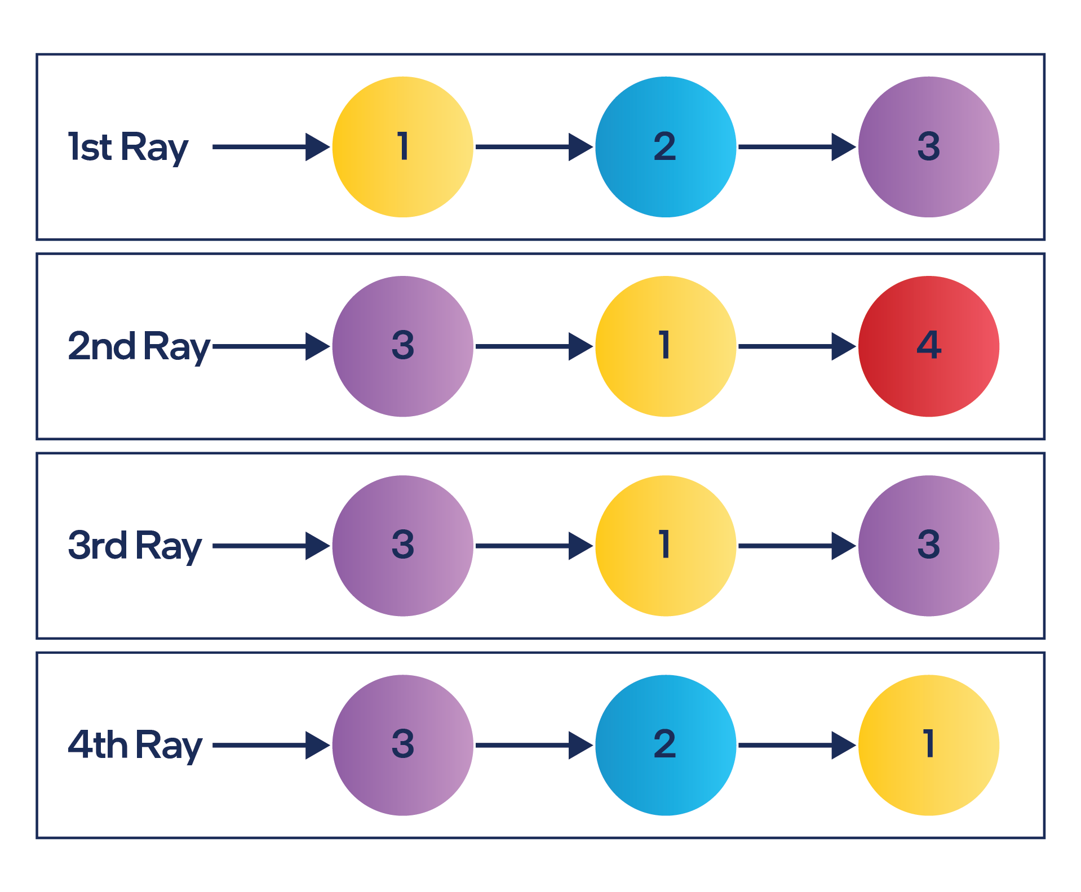
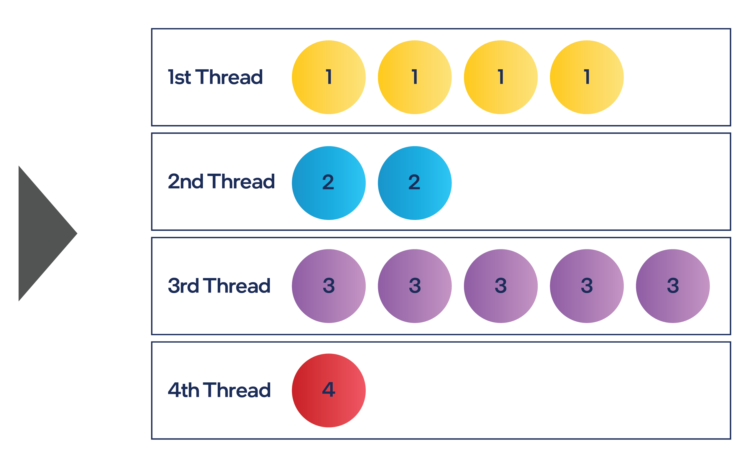
Hardware Work Repackaging on Intel® Arc™ Graphics
Logical Shader Record Execution
Shader Record Execution on HW
SIMD Width
Notes:
So, logically ray tracing is executed as follows: the ray is cast, it hits the object, a shader record is invoked. It potentially also casts a ray, which then hits another object, which invokes another shader record. And so on.
Each primary ray which is cast << called from? >> inside Generation Shader can eventually invoke a different sequence of shaders. However, this execution flow doesn’t process well on the GPU as is. The problem comes from the fact that each Vector Engine in Intel® Alchemist is a SIMD unit with a SIMD width of 8. So, if a ray hit invokes a shader record, then it’s immediate execution will result in a dispatch of a SIMD8 HW thread with only a single active SIMD-lane out of 8. Therefore, it’s very important to batch the same 8 shader record invocations into a single SIMD-8 HW thread. This is where dedicated HW support for this comes into play, where Intel® Alchemist is responsible for accumulating shader record invocations, batching them into groups of 8 and then scheduling them as a single HW thread.
There are some cases where Intel Alchemist is not able to batch 8 invocations and has to schedule a HW thread earlier, which results in only a portion of SIMD lane inside the thread doing a useful work. And this is what shown as SIMD Occupancy in Graphics Frame Analyzer for each shader. For example, on this slide in case of SIMD8-width, the 1st thread will execute with 50% SIMD occupancy as it has only 4 shader invocations packed out of 8. The second thread will have 25% SIMD occupancy and so on.

Slide 20
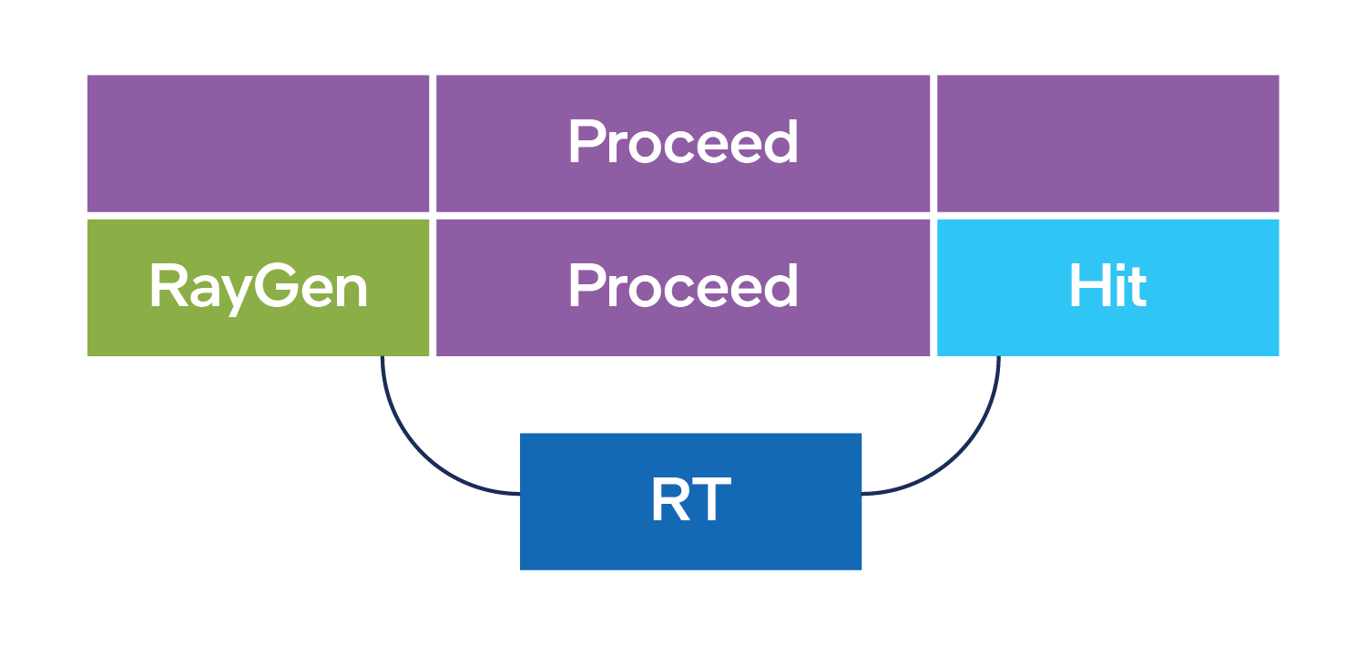
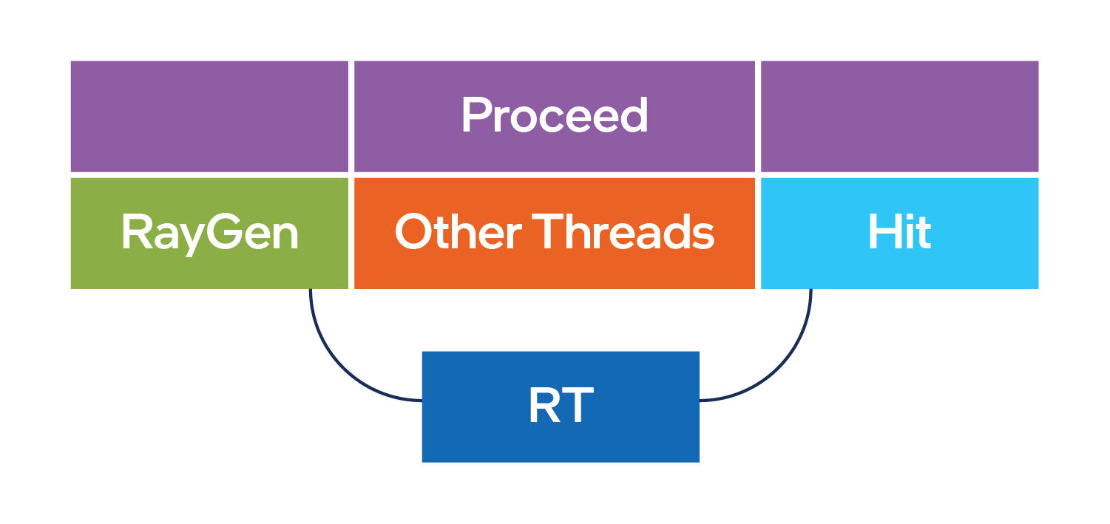
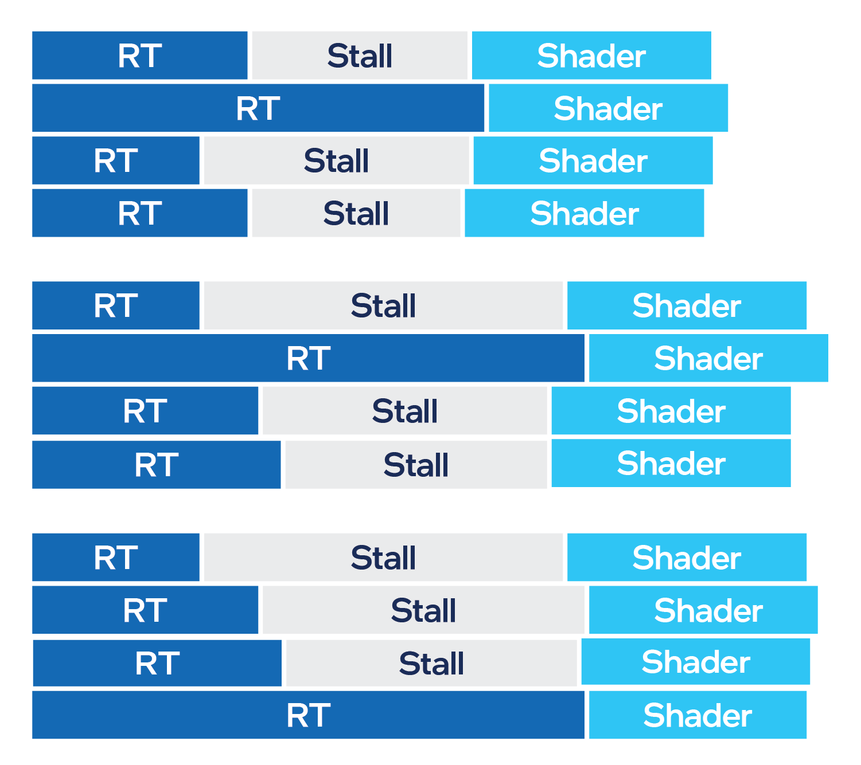
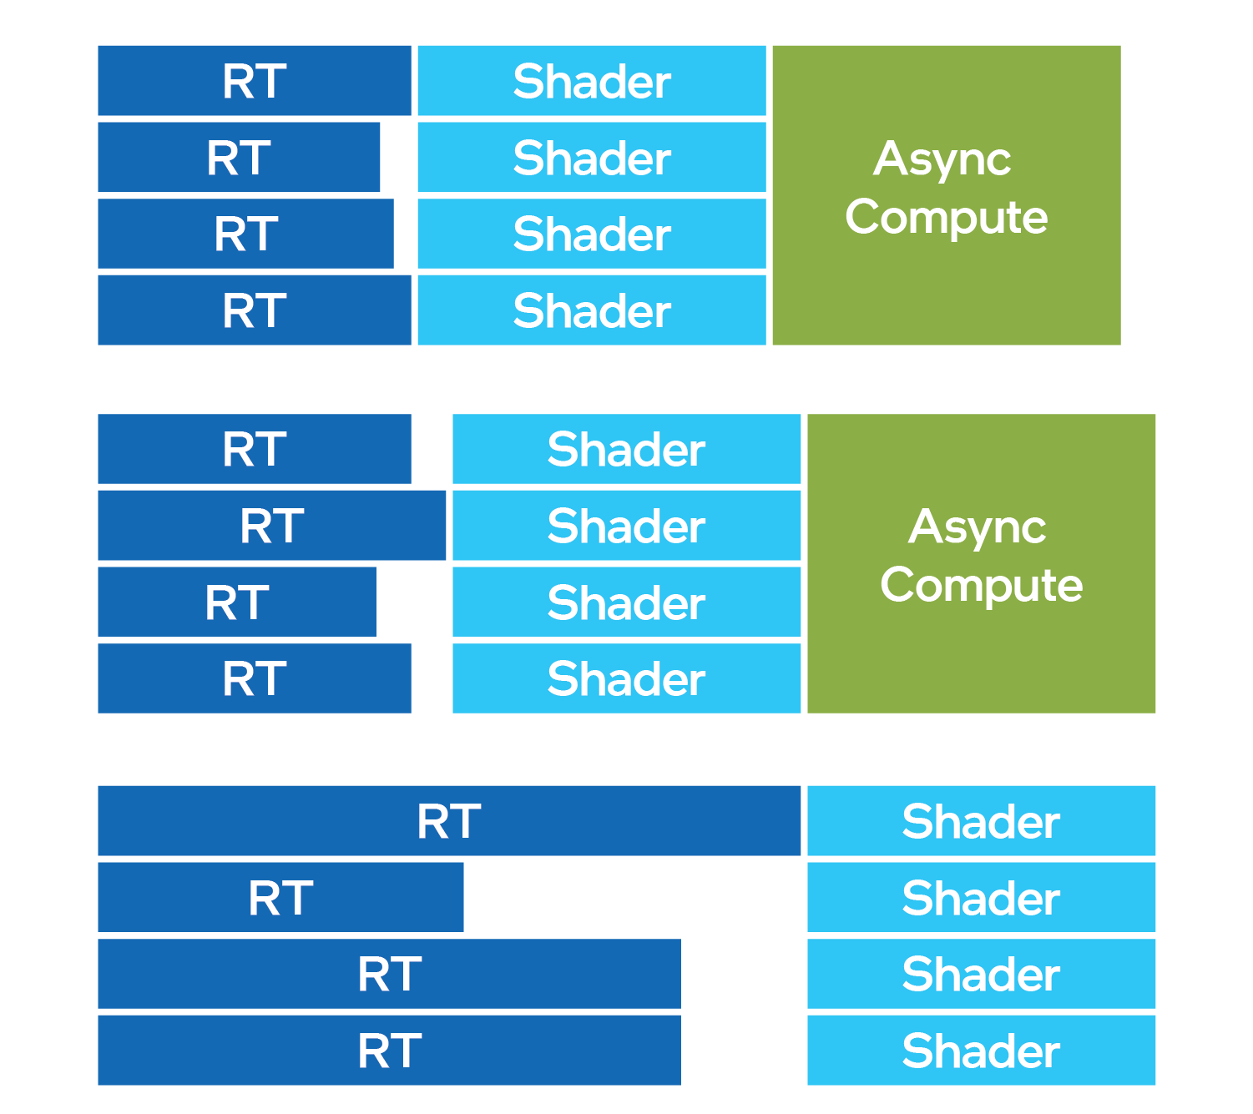
Hardware Load Balancing on Intel® Arc™ Graphics
Ray Query Scheduling
TraceRay Scheduling
RT
Notes:
At the same time this repackaging approach also facilitates the asynchronous execution of work. Without it, the HW thread which starts from the Ray Generation shader, will cast a ray, and then will stall waiting for the Ray Tracing Unit to process the ray cast and find a shader record which needs to be invoked when execution returns to the HW thread. The problem with this is that Stall will be very large, significantly larger than accessing any other data in a shader, such as texture reads, and
<show rayquery below image>
..eventually there will be multiple HW threads which occupy Vector Engines not allowing any other work to be executed while just stalling.
<show RayQuery scheduling title>
This is how, by the way, DX12 Ray Queries work on Intel® Alchemist, so it’s highly advised to reduce its usage in your applications and use the TraceRay intrinsic instead.
<show Trace Ray top image>
Now because Intel Alchemist already accumulates requests for shader record execution, to repack them, it now can free the Vector Engine while doing so, so other HW threads can be executed.
<show Trace Ray bottom image>
This reduces the stall time as you may see on the slide.
<show low occupancy>
While interestingly enough you also may notice a reduction of Vector Engine Thread Occupancy. As I mentioned, lower Thread Occupancy is usually bad for rasterization shaders, but is a necessary trade-off for ray tracing in order to increase overall execution efficiency.

Slide 21
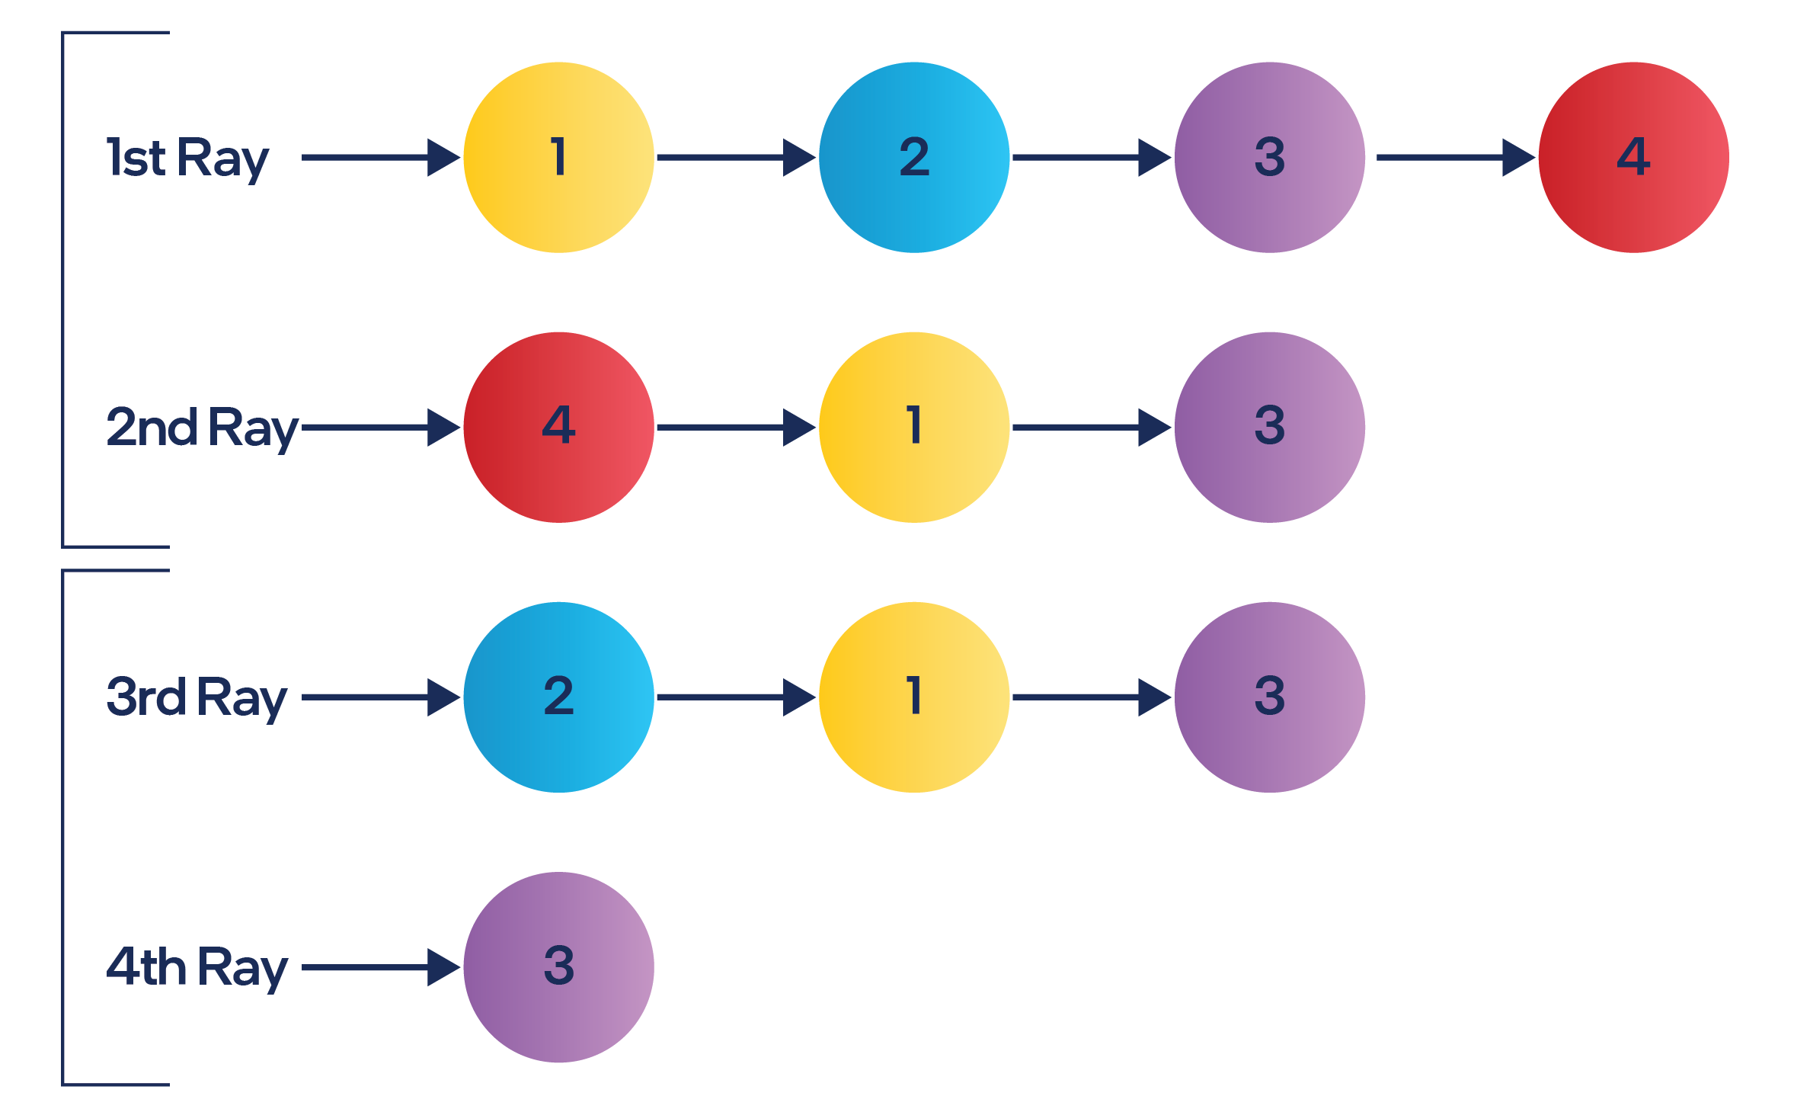
Repackaging and Load Balancing Limitations
1
(1) Can’t group if shader invocations are too spread over time.
(2) Can’t group across Xe-Cores
(3) Can’t balance work across Xe-Cores
1st Ray
Xe-Core 1
1
2
2nd Ray
3rd Ray
Xe-Core 2
4th Ray
3
This results in low SIMD-lane utilization
Notes:
To summarize, Intel® Alchemist tries to balance the work – simultaneously keeping the Vector Engines busy, while also delaying execution to pack more shader record invocations into a single HW thread, which as you may guess in many cases can contradict each other. So, there are some limitations to how efficiently GPU can achieve a high SIMD occupancy, such as:
Shader Records can’t be grouped if they are too spread out over time, as HW can’t accumulate invocations infinitely and eventually needs to free the internal space for other shader records, and also may need to dispatch threads earlier to keep the GPU occupied.
The HW block (Bucketed Thread Dispatch) which is responsible for repackaging and grouping is local to the XeCore, so the grouping is possible only in the scope of a single Xe Core, which will affect SIMD occupancy.
For the same reasons the work can’t be balanced between Xe Cores. And this may affect Vector Engine Thread Occupancy.
The more in-depth overview of Ray Tracing execution on HW is out of scope of the presentation, but there is another GDC talk “A Quick Guide to Intel’s Ray Tracing Architecture“ by Holger Gruen, which I advise you to take a look at if you want to know more. Find it on Intel’s GDC page today or in the GDC Vault after the conference.
Now, understanding what SIMD Occupancy is and what class of problems it characterizes, let’s go back to analysis of our workload.

Slide 22
Case Study: DispatchRays Analysis Results
Notes:
Now we can select Shader Execution Table for our DispatchRays and check the information it gives us. The Bottleneck panel on the right as well as Advanced Profiling Mode detects input unbalancing in Thread Dispatch block as a primary bottleneck.
Having SIMD Occupancy metric and knowing how to read it, we can easily make sure that it is true. All the shaders except the first Ray Generaton have SIMD Occupancy less than 80 % which is very low. Some shaders even have 35% or 45%. We don’t show the full list on a slide since it contains about 200 shaders and we selected the longest shaders, but you can trust us. Overall duration of such shaders is more than 80% of DispatchRays execution time.
The recommendation here will be to look at the problematic closest hit shaders and try to reduce thread payload – number of bound resources, temporal variables etc.

Slide 23
Case Study: DispatchRays Analysis Results
Notes:
Let’s not skip the largest Rey Generation shader. Its hardware threads count is exactly a size of ray grid divided on 8 which is SIMD width in this case. And it matches with 100% SIMD occupancy.
Next step for Ray Generation shader analysis should be shader profiling. Frame Analyzer has already supported Shader profiler for rasterization and compute shaders, and we are very close to release it for raytracing shader too.

Slide 24
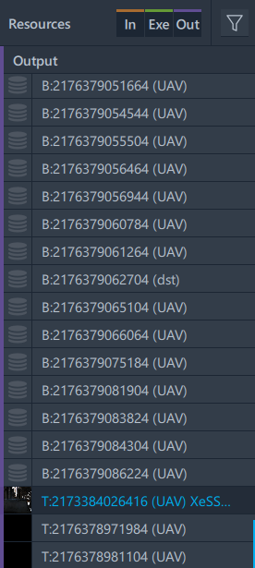
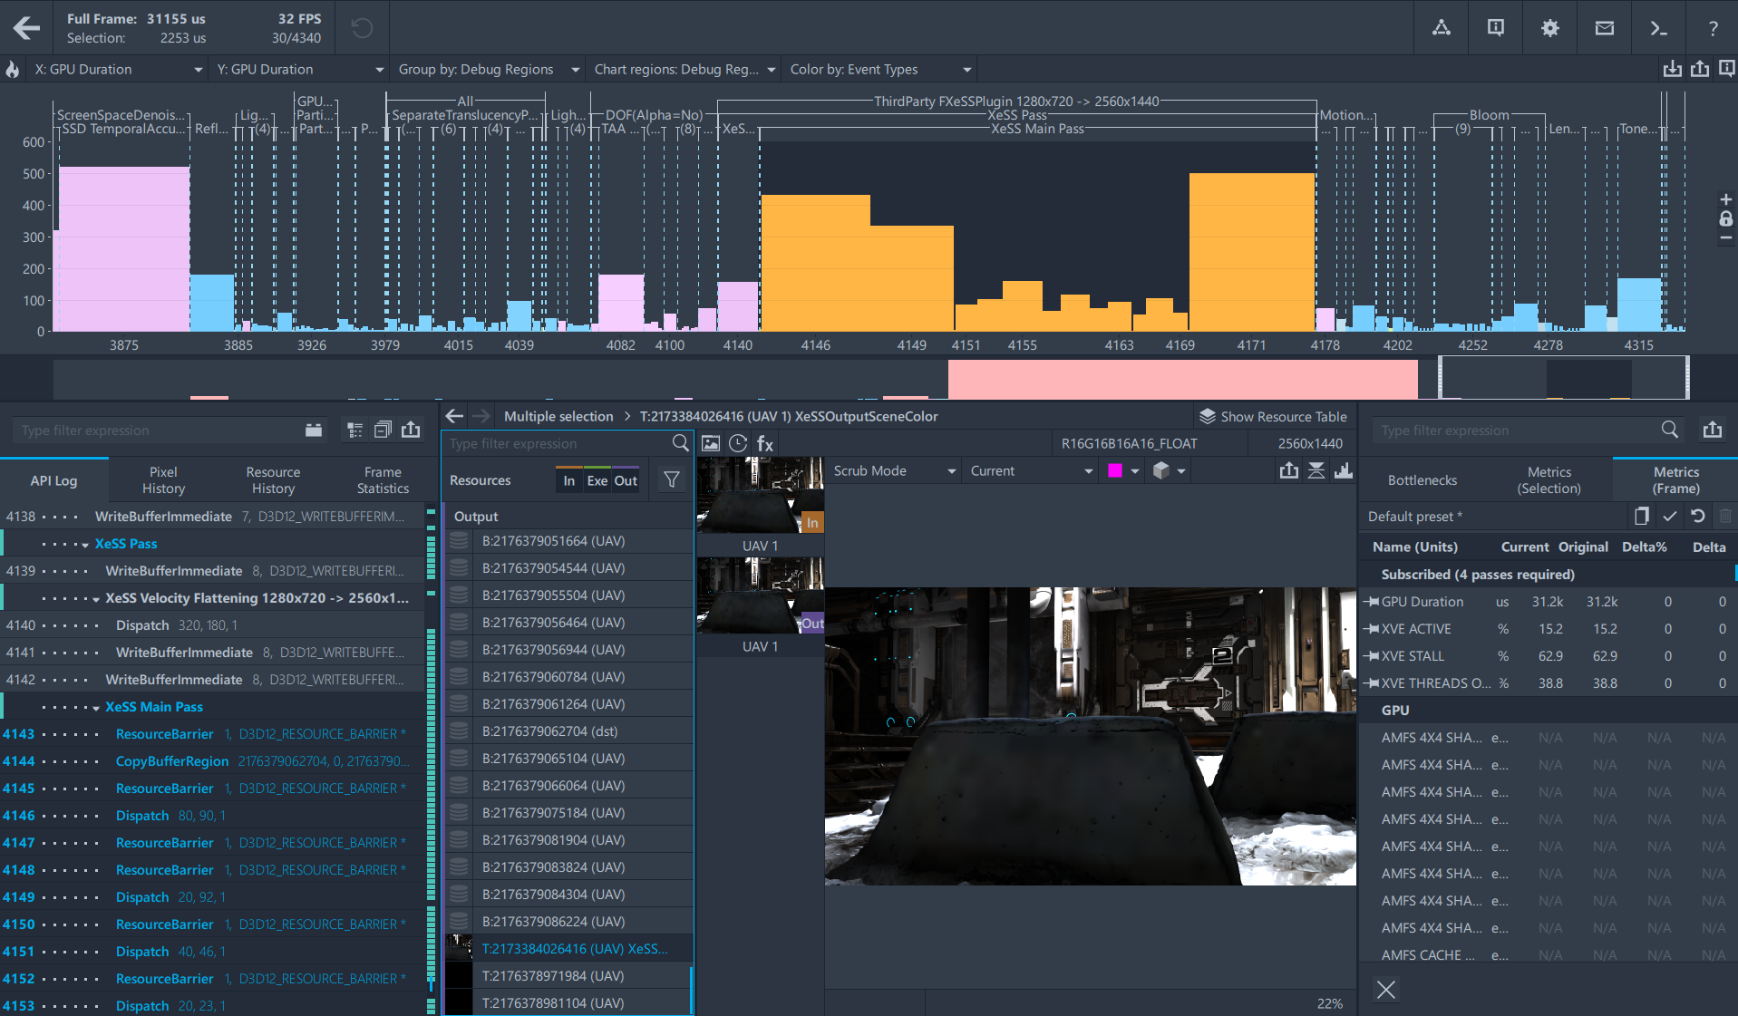
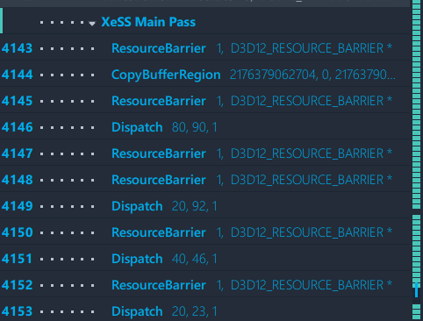
XeSS Analysis
Notes:
As we mentioned at the beginning of our talk, the Intel® Rens Demo also uses XeSS to upscale a render target. XeSS produces a sequence of Dispatch calls which are now shown as events in Frame Analyzer. It is possible to check the metrics for XeSS calls to see whether it is a performance bottleneck or understand how XeSS usage fits into a frame budget. In addition to metrics Frame Analyzer shows the resources used with XeSS to visually evaluate a quality of an upscaled image.
Rens Demo also has PIX markers around XeSS calls which simplifies finding them in a tool.

Slide 25
Resources
Intel® Graphics Performance Analyzers
Product site – Overview, features, what’s new…
Training – Tutorials, quick tips, articles, workshops
Holger Gruen’s Talk – A Quick Guide to Intel’s Ray Tracing Architecture
Intel XeSS – An AI Based Super Sampling Solution for Real-time Rendering
Free Download – software.intel.com/gpa
Notes:
Thank you for attending. Download Intel® GPA for free and check out our tutorials at software.intel.com/gpa.
If you are interested in the 2 talks Stas mentioned, you will find those at Intel’s GDC 2022 site.
Need to insert a link to Robert/Hisham talk. We have a reference in a script. << Done >>

Slide 27
Notes:
ISTV: Ideally, this will be the background when Pamela starts speaking – with all 3 speakers showing, their names and titles below them – maybe Pamela centered and larger with Eugene and Stas on either side.
You can use a solid color or some other background if the shapes are wonky behind us.
Pamela:
Hello. Welcome to our GDC session - “Elevate Your Game Profiling, using Intel® GPA on Alchemist” I am Pamela Harrison. I’m a Software Technical Consulting Engineer for Intel® Graphics Performance Analyzers (Intel® GPA).
I am here with Stanislav Volkov. <<Stas acknowledges.>> Stas is the Intel® GPA Software Architect. Stas? . . .
<<pause here for Stas’ intro (which he will record when he records his other parts – and will be inserted here)>>
Also, we are joined by Eugene Krasichkov. <<Eugene acknowledges.>> Eugene is the Intel® GPA Tools Product Owner. Eugene? . . .
<<pause here for Eugenes’ intro (which he will record when he records his other parts – and will be inserted here)>>
Throughout the session, we will be responding to virtual attendees via GDC’s chat mechanism.
<< Here the camera zooms to me.>>
Performance is key.
Higher performance allows your game to run smoothly on your target platforms. But if you are able to increase performance, you might be able to expand to other platforms, giving you a bigger market.
So, you want good performance. That means sufficient FPS. But what about other data? How about Real-Time Ray Tracing HW acceleration and how that relates to shader execution efficiency on the GPU?

Slide 28
BACK UP

Slide 29
Color Palette

Slide 30
Agenda
Intel® Graphics Performance Analyzers (Intel® GPA) Overview
Intro to the Case Study Workload
Bottleneck Analysis
Raytracing Profiling
Intel® XeSS
Resources
Notes:
Pamela continues:
In this talk, our experts, Stas and Eugene, will guide you through several performance data elements and their relationships to each other so that you will know how to interpret that data to find your hottest bottlenecks. . . . and why do you care what your hottest bottlenecks are? . . . so you will know what to work on first to get the most performance improvement for your time and effort.
We will take you in-depth into Bottleneck Analysis, show you our RT capability, then demonstrate what GPA can do with XeSS.
Now I will hand off to Eugene who will talk a bit about Intel® Graphics Performance Analyzers and introduce our use case.

Slide 31
Latency vs Stall
Hidden Latency
Stall
Hidden Latency
Shader Profiler measures latencies between instructions
Notes:
Analysis type is designed so latency of TraceRay which is hidden by execution of other threads doesn’t contribute into a measurement.

Slide 32
What’s new in GPA?
Support for Intel® Alchemist and Intel® Alder Lake platforms
‘Stream’ and ‘Trace’ analysis for DirectX12 Ultimate features, XeSS, and DirectML
Graphics Frame Analyzer
DXR Shaders Execution
Updated Bottleneck analysis
Improved metrics collection
New resource panel
Graphics Trace Analyzer
CPU thread to UMD queue relations
Support for OpenGL, OpenCL, Intel® Media SDK, and Intel® oneVPL APIs
Shader Breakdown track

Slide 33
Chart Example
Source text goes here

