Slide 1
Performance Tuning Games for Hybrid Architectures
Game Developers Conference
2022
Pete Brubaker
Sheng Guo

Slide 2
Notices & Disclaimers
Intel technologies may require enabled hardware, software or service activation.
No product or component can be absolutely secure.
Your costs and results may vary.
© Intel Corporation. Intel, the Intel logo, and other Intel marks are trademarks of Intel Corporation or its subsidiaries. Other names and brands may be claimed as the property of others. Copies of documents which have an order number and are referenced in this document may be obtained by calling 1-800-548-4725 or visiting www.intel.com/design/literature.htm. ​
Altering clock frequency or voltage may void any product warranties and reduce stability, security, performance, and life of the processor and other components. Check with system and component manufacturers for details​.​
Includes the effect of Intel Thermal Velocity Boost, a feature that opportunistically and automatically increases clock frequency above single-core and multi-core Intel Turbo Boost Technology frequencies based on how much the processor is operating below its maximum temperature and whether turbo power budget is ​available. The frequency gain and duration is dependent on the workload, capabilities of the processor and the processor cooling solution.​​​
Code names are used by Intel to identify products, technologies, or services that are in development and not publicly available. These a​​re not "commercial" names and not intended to function as trademarks.​​​​
© Intel Corporation. Intel, the Intel logo, and other Intel marks are trademarks of Intel Corporation or its subsidiaries. Other names and brands may be claimed as the property of others​.
​No license (express or implied, by estoppel or otherwise) to any intellectual property rights is granted by this document, with the sole exception that code included in this document is licensed subject to the Zero-Clause BSD open source license (0BSD), https://opensource.org/licenses/0BSD.

Slide 3
Agenda
Intel Hybrid Processors
Core Topology
ISAs
Performance Characteristics
Hybrid Topology Detection
Hybrid Thread Scheduling
Other Changes
MSR/LBR Changes
CPUID
Best Practices
Resources

Slide 4
Core Topology

Slide 5
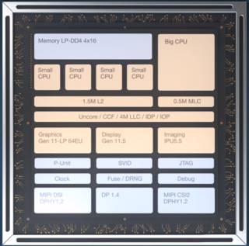
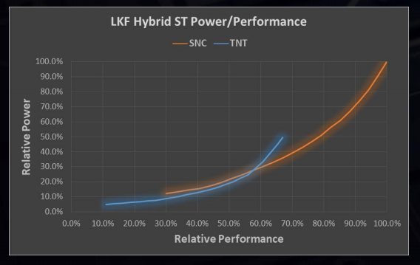
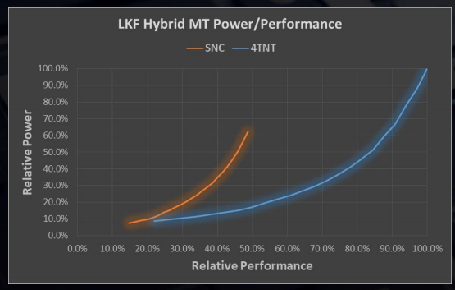
12th Gen Intel® Core ™ Processors (Alder Lake) with Intel® Hybrid Technology
Launched in 2021 with multiple hybrid SKUs
High-level goals
Balance performance and power efficiency, in a small footprint
Enable design flexibility for mobile form factors, such as foldable
Offer multiple SKU configurations to support a range of markets, including desktop
GOLDEN COVE
GRACEMONT
Concentrate on single and limited threading scenarios
Performance focused (P-Core)
Concentrate on throughput and power-limited scenarios
Efficiency focused (E-core)
Area of 4 E-cores = 1 P-core
Intel® Thread Director
Hardware Accelerated Performance/Efficiency Load Balancing
Operating System Support with Microsoft Windows 11
Previous generation Intel Lakefield hybrid processor
Notes:
Intel’s 12th generation hybrid processor Alder Lake is a mix of “Big” and “Little” cores with different performance characteristics.
In 2019 Intel launched it’s first hybrid processor known as Lakefield.
The Lakefield processor had one performance core and four efficiency cores which was designed for mobile markets.
With Alderlake we’ve extended our hybrid architectures being offered.
The Performance cores offered in Alderlake SKUs are based on our Golden Cove Performance architecture
While the little cores are based on our Gracemont Efficiency Core Architecture.
The high level goal for mixing architectures in a single package were to balance performance and power efficiency in a small footprint to enable a broader range of PC form factors.
Along with the updated architectures we’ve also introduced Intel Thread Director; Based on Lakefield Hardware Guided Scheduling
Intel Thread Director is a hardware accelerated Performance and Efficiency load balancer
Which is supported by Windows 11 and newer.

Slide 6
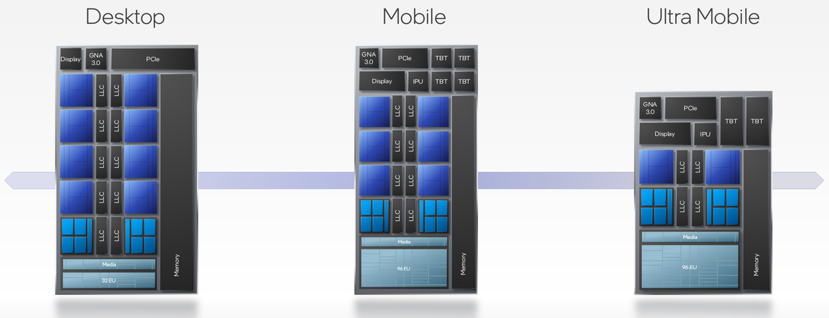
Intel Alder Lake with Intel® Hybrid Technology
Notes:
We’ve differentiated our hybrid processors into a series of SKUs for different markets ranging from Ultra Mobile to Desktop
Each SKU will use the same core architectures.
The difference here is the number of Performance and Efficiency cores contained in each package
Our Ultra Mobile SKU offers 2 hyperthreaded performance cores and 8 single threaded efficiency cores for 12 logical processors.
The mid range mobile sku offers 6 hyperthreaded performance cores and 8 efficiency cores totalling 20 logical processors.
While the high end desktop SKU has 8 hyperthreaded performance cores and 8 efficiency cores for 24 logical processors.
Developers should be aware of the asymmetric topologies being released with Alderlake.
Design your thread scheduling algorithms to be as adaptive as possible to achieve the greatest possible Total Available Market.

Slide 7
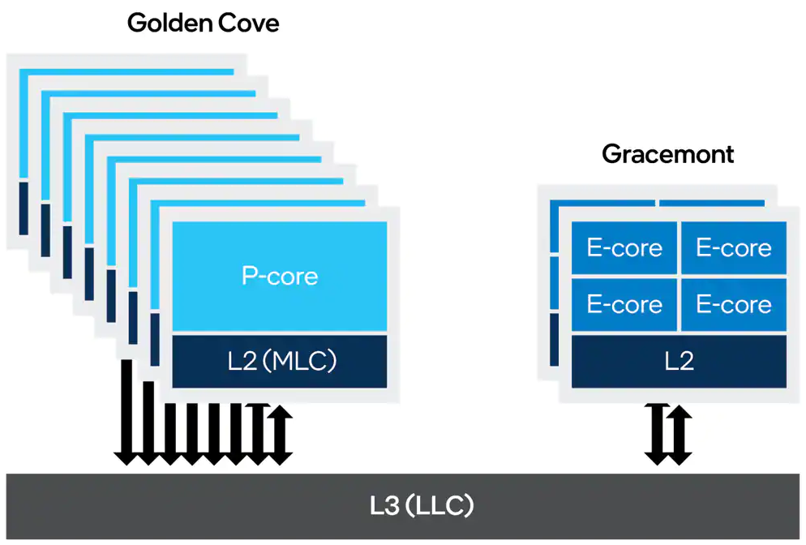
Performance and Efficient Cores
Higher Frequencies
Designed for higher frequencies, but less power-efficient
Hyper-Threading
Performance Cores may have additional logical processors, known as SMT cores.
P-cores will have a different Efficiency Class than Efficient Cores
Cache Topology
Dedicated 80KB L1 cache
Dedicated 1.25MB L2 cache
Shared (3MB/P-core) L3/LLC cache with Efficient Cores
Notes:
Because of the architecture differences between the Goldencove and Gracemont there are a few concepts to keep in mind while developing for hybrid CPUs.
Performance cores are designed for higher frequencies but are less power efficient.
Additionally they also offer hyperthreading which splits a single physical core into two logical cores.
Efficient cores are designed with power efficiency in mind and operate at lower frequencies than performance cores.
To reduce fragmentation in the developer eco-system we have opted to offer a symmetric instruction set architecture for both.
We have added parity features to the efficiency cores but most notably we have disabled AVX512 on the performance cores.
Cache topology for Performance cores and efficiency cores do differ,
Physical Performance Cores and their logical hyper thread counterpart will share an L1/L2 cache
This differs for the Efficient cores, where each physical efficiency core has a dedicated L1 and an L2 cache shared by banks of 4 efficiency cores.
Last level cache will be shared between all performance and Efficient cores.

Slide 8
Performance and Efficient Cores
Efficient Cores
Power Efficiency
Designed to use less power at lower frequencies
Instruction Set Architecture
Symmetrical ISA with Performance Cores
AVX512 disabled on Performance and Efficient Cores
Cache Topology
Dedicated 96KB L1 cache
2.0MB L2 cache shared in banks of 4 Efficient Cores
Shared (3MB/4 E-cores) L3/LLC cache with Performance Cores
Notes:
Because of the architecture differences between the Goldencove and Gracemont there are a few concepts to keep in mind while developing for hybrid CPUs.
Performance cores are designed for higher frequencies but are less power efficient.
Additionally they also offer hyperthreading which splits a single physical core into two logical cores.
Efficient cores are designed with power efficiency in mind and operate at lower frequencies than performance cores.
To reduce fragmentation in the developer eco-system we have opted to offer a symmetric instruction set architecture for both.
We have added parity features to the efficiency cores but most notably we have disabled AVX512 on the performance cores.
Cache topology for Performance cores and efficiency cores do differ,
Physical Performance Cores and their logical hyper thread counterpart will share an L1/L2 cache
This differs for the Efficient cores, where each physical efficiency core has a dedicated L1 and an L2 cache shared by banks of 4 efficiency cores.
Last level cache will be shared between all performance and Efficient cores.

Slide 9
Core ISAs
To simplify the programming model and provide flexibility, Intel made the following design decisions:
All core types have the same base instruction set (AVX2).
TSX is disabled on the package.
AVX512 is disabled on P-cores.
AVX512 not supported on E-cores (Gracemont)
Golden Cove Core | Gracemont Core
AVX512 | Disabled in P-cores when E-cores enabled
TSX | Disabled in P-cores and E-cores
AVX-VNNI | Enabled through symmetric ISA
vAES | Enabled through symmetric ISA
vCMUL | Enabled through symmetric ISA
UMWAIT/TPAUSE | Enabled through symmetric ISA

Slide 10
Core ISAs
AVX-VNNI is a VEX-coded variant of AVX512-VNNI, limited to 256-bit registers.
Doesn’t support any additional features of the EVEX encoding (mask registers/additional vector registers).
CMUL (Carry-less multiplication)
PCLMULQDQ
Useful in the multiplication of polynomials.
Potential uses include compression (LZ77), and CRC/hashing.
Golden Cove Core | Gracemont Core
AVX512 | Disabled in P-cores when E-cores enabled
TSX | Disabled in P-cores and E-cores
AVX-VNNI | Enabled through symmetric ISA
vAES | Enabled through symmetric ISA
vCMUL | Enabled through symmetric ISA
UMWAIT/TPAUSE | Enabled through symmetric ISA

Slide 11
Core ISAs
TPAUSE/UMONITOR/UMWAIT
For short waits on the order of tens to hundreds of microseconds, programmers typically resort to busy loops to avoid calling into the kernel. Use these new instructions (_umonitor, _uwait, _tpause) to replace those busy loops and calls
These are unprivileged instructions and avoid the kernel. They are effectively the same as the _mm_monitor and _mm_mwait instructions in SSE3.
UMONITOR takes an address and a size, informing the CPU that this thread is interested in any writes to that range of memory. UMWAIT tells the CPU to halt instruction until a write to that range occurs or a timeout is reached.
Golden Cove Core | Gracemont Core
AVX512 | Disabled in P-cores when E-cores enabled
TSX | Disabled in P-cores and E-cores
AVX-VNNI | Enabled through symmetric ISA
vAES | Enabled through symmetric ISA
vCMUL | Enabled through symmetric ISA
UMWAIT/TPAUSE | Enabled through symmetric ISA

Slide 12
Core ISAs
TPAUSE/UMONITOR/UMWAIT
This allows the CPU to switch to another SMT sibling, or enter a lower power state (C0.1) that can be exited quickly.
Keep waits short, on the order of 100-200 microseconds. This will avoid the CPU switching to a lower power state that may take longer to exit.
The TPAUSE instruction is almost identical to UMONITOR/UMWAIT, except the CPU will not monitor for any writes (it will just wait for the timeout).
Golden Cove Core | Gracemont Core
AVX512 | Disabled in P-cores when E-cores enabled
TSX | Disabled in P-cores and E-cores
AVX-VNNI | Enabled through symmetric ISA
vAES | Enabled through symmetric ISA
vCMUL | Enabled through symmetric ISA
UMWAIT/TPAUSE | Enabled through symmetric ISA

Slide 13
Changing Our Assumptions …
Significant performance delta between cores
There may be one, two, or more, faster cores
The fastest core may move around the package
Hyperthreading may be available on only some cores in a package
Even identical cores may run at different frequencies
Logical core count may not equal 2x physical core count
The core topology layout may not be simple
ISA may be identical, but specific performance of an instruction may vary
Running efficiently, or slower, may be faster overall
Power may be shared between GPU/CPU/Other -> frequency impact
Performance, ordering, or relationship between logical processors may change
Notes:
The topology of the package may be complex.
Do not make simplifying assumptions when writing your code.
The OS Topology Detection API’s returns a rich set of data about the system.
Lower performing CPUs may have a different micro-architecture or microcode which could run slow.
And running efficiently reduces heat, which may make the overall system faster.

Slide 14
Performance Characteristics

Slide 15
Performance Characteristics
Integer and scalar floating-point instructions
Performance and efficiency cores are very similar in performance, with E-cores operating at about 0.7x of a P-core.
SSE
E-cores operate on 4-wide floating-point, at about 0.4x the performance of a P-core.
AVX/AVX2
E-cores operate on 8-wide floating-point data, at about 0.4x the performance of a P-core.
Many jobs that typically get scheduled in game job systems make moderate-to-heavy use of SIMD.
This means we need to be selective about which jobs run on which cores. HGS+/Thread Director will help here on Windows* 11+, but we also need a solution for Windows* 10 and earlier.
Given the cache differences (shared L2 on E-cores), some workloads might perform better if they are allocated to cores that share L2.

Slide 16
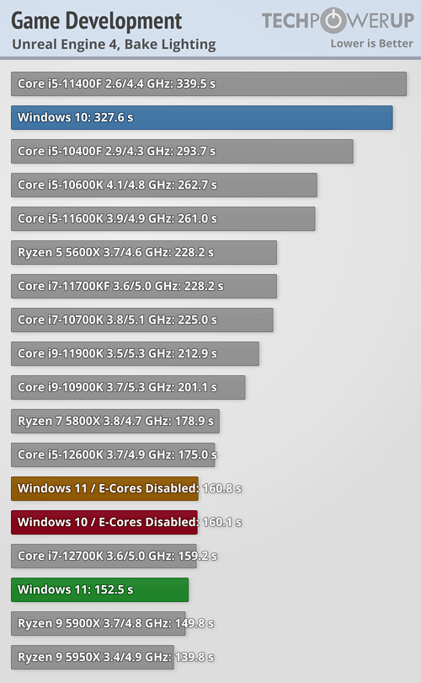
Performance Characteristics
What if we just throw all low-priority threads on E-cores?
On Windows* 10, low-priority, or below-normal priority, threads are scheduled on E-cores by default.
Here, Unreal* creates two thread-pools sized by (LogicalCoreCount – 2); one above normal priority, and one pool at normal priority. 44 threads are, therefore, fighting over 8 P-cores & 8 E-cores.
That means on Windows* 10 we are over-subscribing the E-cores, and performance is much less than ideal.
It’s also possible that SIMD-heavy work is being scheduled to E-cores on Windows 10.
Source: https://www.techpowerup.com/review/alder-lake-windows-10-performance/2.html

Slide 17
Performance Characteristics
Intel® Thread Director solves this issue on Windows* 11 and beyond.
Intel® Thread Director will also favor scheduling threads with AVX/AVX2 instructions on P-cores, which can cause issues—even on Windows* 11.
The OS has to choose which thread to schedule on P-cores when the system is oversubscribed. Occasionally, tasks on the critical path can get scheduled to E-cores, especially if all the P-cores are busy executing SIMD-heavy threads.
TO DO: INCORPORATE SHENG’S SUGGESTIONS HERE
Source: https://www.techpowerup.com/review/alder-lake-windows-10-performance/2.html

Slide 18
Performance Characteristics
We need to be careful choosing what work we put on E-cores, and we also need to be careful not to oversubscribe them.
We can’t assume something that works well on desktop (8+8) will work well on mobile (6+8), or ultra mobile (2+8), platforms.
Intel® Thread Director on Windows* 11 helps mitigate this issue, as we see that Windows* 11 with E-cores enabled beats Windows 10 with E-cores disabled.
So what is Intel® Thread Director?
Source: https://www.techpowerup.com/review/alder-lake-windows-10-performance/2.html

Slide 19
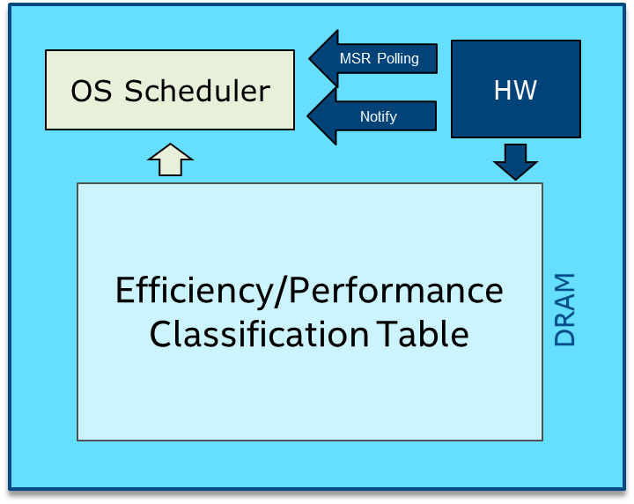
Intel® Thread Director/HGS+
Hardware-guided scheduling helps the OS schedule the right thread on the right core.
When the number of threads exceeds the number of cores, sets priority between threads.
The goal is to achieve the best energy, power-saving, and performance.
Based on thread class-type (VNNI, AVX2, FP32 etc.)
Windows* 11+ only.

Slide 20
Intel® Thread Director/HGS+
Core vs. Atom PnP depends on power/thermal, efficiency constraints and management
Hardware dynamically generates core capability based on power and thermal limits.
Scheduler then determines the best core for specific ISA.
Thread Director will also favor scheduling threads with AVX/AVX2 instructions on P-cores.

Slide 21
Intel® Thread Director/HGS+
OS scheduler will move threads based on their priority, QoS, and performance/efficiency HW metrics.
P-Cores are scheduled first.
Spill-over multi-threaded work uses E-cores.
SMT siblings are used last to avoid any contention impacting performance.

Slide 22
CPUID Intrinsic
GetLogicalProcessorInformation
Requires thread-pinning to read from each logical processor
May return invalid data in Windows* Compatibility mode
Support for x86 & x64, Windows*, and Linux*
Useful for determining supported ISAs/frequency
Reads Hybrid/Core type from the hybrid leaf
Possible issues with anti-cheat/anti-tamper
middleware if CPUID used to generate GUIDS.
Enumerate logical processors/caches without pinning
Uses 64-bit Affinity Masks as identifiers for cores and caches ⦁ Masks compatible with SetThreadAffinityMask
CPUID
GLPI
Works with up to 64 logical cores by default
Can work with 64+ cores using Groups
General purpose solution for topology detection
Hybrid Topology Detection
Works with over 64 logical cores by default
Shows which cores share an LLC.
Returns Efficiency Class and Parking flags
Only available on Windows* 10, or newer
Use in combination with GLPI/GLPIEX
Uses integer-based identifiers instead of Affinity Masks
PROCESSOR_RELATIONSHIP structure returns Efficiency Class
Uses Group Masks with a group ID, and 64-bit Affinity Mask
GSCSI
GLPIEX
Masks are compatible with SetThreadAffinityMask
Works with more than 64 logical cores by default
Use instead of GetLogicalProcessorInformation
GetSystemCPUSetInformation
GetLogicalProcessorInformationEx

Slide 23
Hybrid Thread Scheduling
Quality of Service APIs
Static Partitioning APIs
SetThreadIdealProcessor
SetThreadAffinityMask
More likely to be scheduled on the ideal processor
Not guaranteed to execute on the ideal processor
Useful for targeting IntelⓇ Turbo Boost Max Technology 3.0 cores
Guaranteed contract with the operating system
Useful for application-controlled thread scheduling
May cause context switching and cache flushing when called; don’t call in tight loops
May require bit manipulation to create affinity masks
Supports up to 64 logical processors, unless using Group Masks
SetThreadPriority
Weak
Useful for creating critical path threads with above-normal priority
Use to create background worker threads with THREAD_MODE_BACKGROUND_BEGIN priority
Strong
SetThreadSelectedCPUSets
Similar to SetThreadAffinityMask, but does not use bit-masks
Supports more than 64 logical processors without Group Masks
OS Power Management can override CPU sets
SetThreadInformation
Disable Power Throttling to maximize performance
Enable Power Throttling to maximize power efficiency
Set Memory Priority for more efficient cache utilization

Slide 24
Other Changes

Slide 25
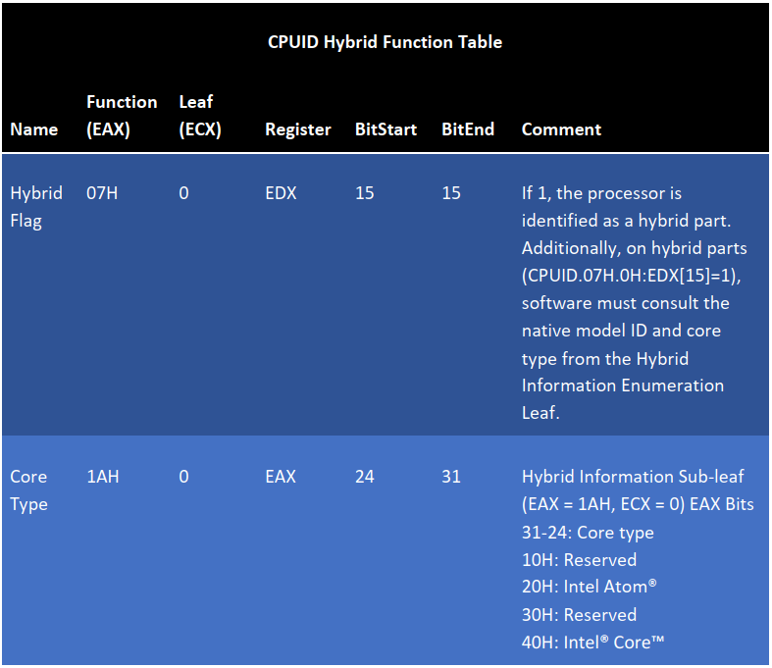
CPUID
Two new flags have been added:
The Hybrid flag—readable by calling CPUID with 07H in the EAX register and reading the 15th bit of the EDX register.
The core type flag—readable by calling CPUID on each logical processor with a value of “1AH” in the EAX register. The core type will be returned in bits 24-31 of the EAX register.
It is important to note CPUID will return different values for the core-type flag for P and E cores. If this is used for creating a machine GUID, take care that the core you’re using to create this is deterministic.

Slide 26
CPUID
Architectural Last Branch Records (LBRs) enable recording of software path history by logging taken branches, and other control flow transfers, within processor registers. Each LBR record or entry is comprised of three MSRs:
IA32_LBR_x_FROM_IP − Holds the source IP of the operation.
IA32_LBR_x_TO_IP − Holds the destination IP of the operation.
IA32_LBR_x_INFO − Holds metadata for the operation, including mis-predict, TSX, and elapsed cycle time information.
Check for this using CPUID.
CPUID.(EAX=07H, ECX=0):EDX[19] is set to 1, the processor supports Architectural LBRs and does not support legacy LBRs.
LBRs are typically used in anti-cheat, DRM, and anti-tamper code in games.
While they have been model-specific, LRBs haven’t changed in a long time.
Intel has introduced “Architectural LBRs” for Alder Lake, and beyond.
This could present an issue for legacy code relying on legacy behavior.
Fully documented in Chapter 7 of the March 2020, and newer, IntelⓇ Architecture Instruction Set Extensions Programming Reference.

Slide 27
Best Practices
Profile your workload
Use QueryPerformanceCounter () for micro-benchmarking
Use Intel® VTune™ Profiler for in-depth CPU performance analysis
Avoid pinning threads to a single logical processor
Don’t oversubscribe your thread pool
Don’t use hyperthread cores if your workload can’t benefit from hyper-threading
Avoid unnecessary context switches and cache flushes
Avoid scheduling lower priority tasks on the same cores as your critical path
Use Quality of Service APIs for OS and Intel® Thread Director optimizations
Understand how your middleware uses threads
QoS APIs can be used in combination with Static Partitioning APIs based on application architecture
Avoid static partitioning; allow cores to steal work from other cores
Job systems need to dynamically balance based on core characteristics
Work stealing allows idle threads to take tasks from cores that may be overworked, increasing throughput

Slide 28
Best Practices (Game Subsystem Scheduling)
Critical Path (P-Cores)
Distributed Systems (E-Cores)
Main and Rendering Threads
IO/Compression/Decompression
Texture Streaming
Shader Compilation
Input
UI
Networking / VOIP
Game AI
Audio
Submit draw calls to the GPU as quickly as possible
Disable Power Throttling to get maximum performance
Use SetPriorityBoost for opportunistic priority increases
Time-critical jobs/jobs with heavy use of FP
Collision Detection, Physics, Animation, etc.
Scene Visibility and CPU Occlusion Culling
Maximize triangle throughput using performance cores
Use SIMD to increase data parallelism

Slide 29
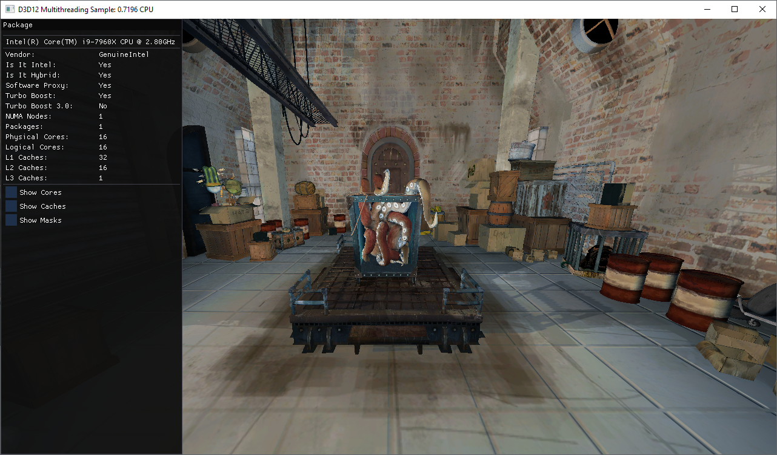
Hybrid Detect
Package Information
Win32 / DX12
Is Intel, is Hybrid
Component Counters
Intel® Turbo Boost Max Technology 2.0/3.0

Slide 30
Hybrid Detect
Bit Masks
System/Process Masks
Custom Masks
Logical Processor Masks
Logical Cache Masks
Useful For Debugging

Slide 31
Hybrid Detect
Architecture Details
Logical Processors
Base Frequency
Current Frequency
Max Frequency
Core Frequency
Cache Sizes
Supported ISAs
Associated Cores/Caches

Slide 32
Wrapping Up
Plan ahead for future hybrid architectures.
Use a work-stealing thread scheduler if possible.
Allocate just enough threads for your workload.
Understand the trade-offs between performance and efficiency cores, and take advantage of the performance deltas by putting the right work on each core.

Slide 33
Resources
Developer Guide
Intel® VTune™ Profiler
Sample Code: https://github.com/GameTechDev/HybridDetect
Intel® Architecture Instruction Set Extensions Programming Reference
Microsoft Windows API References
https://docs.microsoft.com/en-us/windows/win32/procthread/getsystemcpusetinformation
https://docs.microsoft.com/en-us/windows/win32/api/sysinfoapi/nf-sysinfoapi-getlogicalprocessorinformation
https://docs.microsoft.com/en-us/windows/win32/api/sysinfoapi/nf-sysinfoapi-getlogicalprocessorinformationex
https://docs.microsoft.com/en-us/windows/win32/api/processthreadsapi/nf-processthreadsapi-setthreadidealprocessor
https://docs.microsoft.com/en-us/windows/win32/api/processthreadsapi/nf-processthreadsapi-setthreadpriority
https://docs.microsoft.com/en-us/windows/win32/api/processthreadsapi/nf-processthreadsapi-setthreadinformation
https://docs.microsoft.com/en-us/windows/win32/api/winbase/nf-winbase-setthreadaffinitymask
https://docs.microsoft.com/en-us/windows/win32/api/processthreadsapi/nf-processthreadsapi-setthreadselectedcpusets

Slide 34
Thank you

