Slide 1
PinPlay: Reproducible Execution Analysis with Intel Software Development Emulator Harish Patil (Intel Corporation)
25th October 2022

Slide 2
PinPlay: User-level Record and Deterministic Replay + Analysis
Binary + Input
PinPlay: logger
Normal Program Output
Logs (pinballs)
+
record
OS (Linux® or Windows®)
No binaries/inputs
No application setup
No license checking
Log once, analyze multiple times, anywhere
Logs (pinballs)
PinPlay: replayer
Analysis Tools
replay
OS (Linux® or Windows®)
Upside : It works! Large OpenMP / MPI programs, Oracle
Downside : High run-time overhead: ~100-200X for capture ➔ Cannot be turned on all the time
http://www.pinplay.org

Slide 3
Intel SDE : Intel Software Development Emulator
The Intel® Software Development Emulator is a functional user-level (ring 3) emulator for x86 (32b and 64b) new instructions built upon Pin and XED (X86 encoder/decoder)
Goal: New instruction/register emulation between the time when they are designed and when the hardware is available
Used for compiler development, architecture and workload analysis, and tracing for architecture simulators
New instruction
Legacy instruction
N
O
O
N
N
O
O
O
N
SDE emulation functions
Host state
Emulated state
Instrument new instructions
Add call to emulation routine /Delete original instruction
Emulation routine:
Update native state with emulated state
http://www.intel.com/software/sde

Slide 4
SDE Emulation-based Features
SDE comes with many emulation-based features
Mix histogram tool
Debug-trace ASCII tracing tool
Memory footprint tool
Extended debugging (via PinADX)
PinPlay support for generating/replaying pinballs
Dynamic Control Flow Graph (DCFG) generation
Use –long-help to get detailed help on all features
New: SDE 9.* distribution : Allows writing your own Pin tools with emulation, PinPlay, and DCFG

Slide 5
Example: Multi-threaded Program with a Data Race
Test case: 4-threaded program with a data race for incrementing sharedVar
Extracted from ThreadChecker demo examples
Different runs → different values of sharedVar
% data_race All threads joined sharedVar = 201022
% data_race All threads joined sharedVar = 204097
% data_race All threads joined
sharedVar = 197983
// each thread
for (i=0; i<N; i++)
{
// data race here
local = sharedVar + 1;
sharedVar = local;
}
// main thread, after join
printf(“All threads joined\n”);
printf(“sharedVar = %d\n”,
sharedVar);

Slide 6
PinPlay Captures and Replays the Data Race
Logger captures one possible resolution of the data race which gets replayed again and again ➔ Same value of sharedVar
Logging
% sde –log –log:basename pinball/foo -- data_race All threads joined sharedVar = 259568
Replaying
% sde -replay –replay:basename pinball/foo -- nullapp All threads joined sharedVar = 259568
% sde -replay –replay:basename pinball/foo -- nullapp All threads joined sharedVar = 259568

Slide 7
PinPlay: How it works

Slide 8
Deterministic Replay Basics
Focus on replaying user-level code
What changes across runs (w/ same program input)?
Need to record the above during original execution and inject during replay
Single-threaded Programs
Text locations (dyn. libs)
Shared library code
System calls – memory and register side-effects (e.g. gettimeofday)
Special instructions (e.g RDTSC)
Stack and Heap locations
Signals
Multi-Threaded and Multi-Process Programs
Access order to shared-memory locations (due to things like system load, etc)
+

Slide 9
Pinball (ST) = Initial memory/register + injections
foo.reg
Internal states initialized
Arch. state
Replayer + PinTool
Initial memory image
Replay 50
instructions
100
250
Syscall A
RDTSC
Signal
Inject events: based on instruction counts
foo.sel / foo.reg
(injections)
foo.text
System calls : skipped by injecting next rip/ memory changed
CPUID, RDTSC : affected registers injected
Signals/Callbacks : New register state injected

Slide 10
Recording Memory and System Call Side-effects
User-Level Code
Copy of User Memory
Monitors every
load and store
Analysis
Code
changes
memory
System Code
Memory
Keeps track of page touched for first time
Keeps copy up-to-date for loads and stores
Logs data pages that were not touched
Only Analysis code updates copy; system calls only update memory
For loads, compare copy with memory; logs on mismatches (system calls side effect)

Slide 11
Recording Memory and System Call Side-effects
Log a loaded value if:
Load is the first access the memory location (un-initialized read)
Loaded location changed due to an external effect (system call)
Store A; (A ← 111)
CopyAppMem
time
addr
seen
value
Store B; (B ← 55)
Load C; (C = 9)
A
111
B
55
0
C
99
Load D; (D = 10)
9
D
10
=
System call or
remote thread
≠
Application’s Memory
≠
Load A; (A = 111)
=
addr
value
Load B; (B = 0)
A
111
B
55
Logged
0
Load C; (C = 99)
C
99
9
Not Logged
Load D; (D = 10)
D
10

Slide 12
Capturing Shared-Memory Order with Multi-Threaded Programs
Detecting: Emulate a directory structure
Track readers/writers to memory regions
Logging: Use Netzer transitive optimization
T1
T2
X: Wa
T2 logs:
(Y, T1, X)
Shared memory
order log entry
Y: Ra
Program execution
Thread T2 cannot execute read from “a”
(inst. Y) until inst. X from T1 writes to it

Slide 13
Pinball (MT) : Pinball (ST) + Thread-dependencies
foo.reg (per-thread)
Initial registers: T0
Initial registers: T1
Initial registers: T(n-1)
foo.text
Application Memory (common)
Event injection works only if same behavior (same instruction counts) is guaranteed during replay
foo.reg (per-thread)
foo.sel (per-thread)
[T1] 2 T2 2
[T2] 5 T4 1
Thread T2 cannot execute instruction 5 until T4 executes instruction 1
[T1] 3 T2 3
foo.race (per-thread)
Thread T1 cannot execute instruction 2
until T2 executes instruction 2

Slide 14
Results (old)
Benchmark/Application | Average Icount (Billions) | Size (MB)
SPEC2006 (single-threaded) | 924 | 39
SPECOMP2001 (4-threaded openmp) | 307 | 91
McBench (4-threaded RMS) | 156 | 396
MILC-8p (numerical simulator/MPI) | 109 | 2140
POP-8p (ocean circulator model/MPI) | 952 | 1116
WRF-8p (Weather Prediction/MPI) | 755 | 5222
EnergyApp-8p (Energy Exploration/MPI) | 693 | 1996

Slide 15
Dealing with slow-downs : 3 Mantras
Get Attached
% $SDEHOME –attach-pid PID
Be Selective
Specify “region of interest” : See https://software.intel.com/en-us/articles/pintool-regions
Focus on a specific ‘thread of interest’ % sde ..-log:focus_thread TID …
Practice Exclusion
% sde … -log:exclude_image IMG …
% sde … -log:exclude_code –log:exclude:control REGION-SPECIFICATION..

Slide 16
What is a “region of interest”?
Points in execution where analysis such as PinPlay recording “starts” and “ends”.
Fast Forward
Record
Fast Forward
Thread 0
Thread 1
Thread 2
Analysis ON
Analysis OFF
“Region”
Use SDE’s “Controller” module : Search “Pintool regions”
Representative Region Methodology : Pin + SimPoint == PinPoints

Slide 17
Single-threaded PinPoints ➔ SPEC2006/2017 pinballs publicly available
University of California (San Diego), Intel Corporation, and Ghent University https://www.spec.org/cpu2006/research/simpoint.html
University of Texas at Austin https://www.spec.org/cpu2017/research/simpoint.html
Northwestern University
Public Release and Validation of SPEC CPU2017 PinPoints
(Multi-threaded “LoopPoint” SPEC2017 speed/openMP pinballs coming soon…)

Slide 18
PinPlay: How to use it with SDE

Slide 19
Resources
Basic examples: SDE build kit (version 9.0 or higher) from Intel http://www.intel.com/software/sde
Single-source file examples using ‘make’
See the following slides for sample tool build and use
More examples: pinplay-tools from Intel https://github.com/intel/pinplay-tools
Multi-source-file tools with both ‘make’ and ‘mbuild’
Example: Global LoopPoint toolchain build and use
cd GlobalLoopPoints
sde-build-GlobalLoopPoint.sh
cd ../dotproduct-omp/
make
sde-run.looppoint.global_looppoint.basic.sh

Slide 20
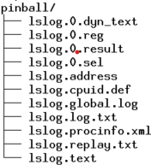
Getting started
setenv SDE_BUILD_KIT <path to SDE 9.* kit>
cd $SDE_BUILD_KIT/pinkit/sde-example/example
$SDE_BUILD_KIT/sde -log -log:basename pinball/lslog -- /bin/ls
$SDE_BUILD_KIT/sde -replay -replay:addr_trans -replay:basename pinball/lslog -replay:playout -- $SDE_BUILD_KIT/intel64/nullapp
grep inscount pinball/lslog.0.result inscount: 534543

Slide 21
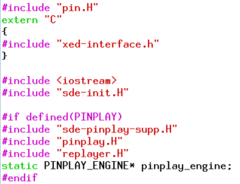
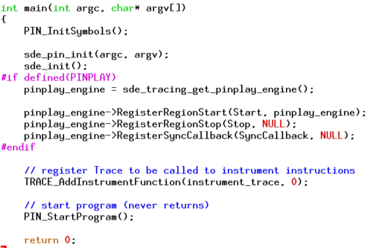
Inside example-replay.cpp
Include PinPlay-specific headers
main(): do PinPlay-specific initialization

Slide 22
DCFG Generation with SDE
Dynamic Control-Flow Graph (DCFG)
Directed graph extracted for a specific execution:
Nodes ➔ basic blocks
Edges ➔control-flow : augmented with per-thread execution counts
pinball
Replay: w/custom PinPlay tool using DCFG API
Record: sde -dcfg
DCFG JSON file
Search “Intel DCFG”

Slide 23
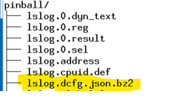
loop-profiler.cpp
Create DCFG during logging
Use it during replay
$SDE_BUILD_KIT/sde -dcfg -log -log:basename pinball/lslog -- /bin/ls
$SDE_BUILD_KIT/sde64 -t64 obj-intel64/loop-profiler.so -loop_profiler:dcfg_file pinball/lslog.dcfg.json.bz2 -replay:addr_trans -replay:basename pinball/lslog -- $SDE_BUILD_KIT/intel64/nullapp
cat loop-profile.csv

Slide 24
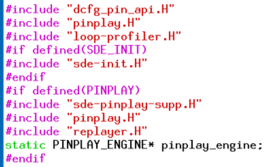
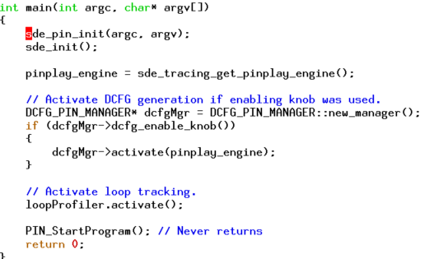
Inside loop-profiler.cpp
Include PinPlay&DCFG-specific headers
main(): do PinPlay/DCFG-specific intialization

Slide 25
Related projects
ELFie : an executable checkpoint: See pinball to ELF converter at http://www.pinelfie.org
LoopPoints: Simulation region selection methodology for multi-threaded applications: See
ISCA 2022 tutorial: https://looppoint.github.io/isca2022/
LoopPoint code: https://github.com/intel/pinplay-tools/tree/main/GlobalLoopPoint

Slide 26
SDE+PinPlay: A framework for Deterministic Replay and Reproducible Analysis
PinPlay is an easy-to-use, flexible, and effective framework for reproducible analysis of multi-threaded programs
1.Attach 2.Select 3.Exclude
http://www.pinplay.org

Slide 27
Backup

Slide 28
Logging Shared Memory Access Ordering - See FDR paper in “Related Publications”]
Emulate a Directory (as in Cache Coherence)
Every DirEntry maintains:
Thread id of the last_writer
A timestamp == # of memory references for the thread
Vector of timestamps of last access for each thread entry
On Loads: update the timestamp for the thread in the entry
On Stores: update the timestamp and the last_writer fields
Program execution
Dir Entry
Store A
Dir Entry
Dir Entry
Load B
hash
Dir Entry
DirEntry: [A:D]
Last writer id:
T1
T1:
1
T2:
2
Vector

Slide 29
Example
Thread T1
Thread T2
DirEntry: [A:D]
Last writer id:
T2
1: Store A
1: Load F
T1
WAW
T1:
1
2
T2:
2
Program execution
2: Store A
RAW
DirEntry: [E:H]
2: Load A
3: Load F
Last writer id:
T1
3: Store F
WAR
3
1
T1:
T2:
3
Last_writer
SMO logs:
Last access to the DirEntry
Thread T2 cannot execute memory
reference 2 until T1 executes its
memory reference 1
T1 2 T2 2
T2 2 T1 1
T1 3 T2 3
Thread T1 cannot execute memory reference 2
until T2 executes its memory reference 2

