Slide 1

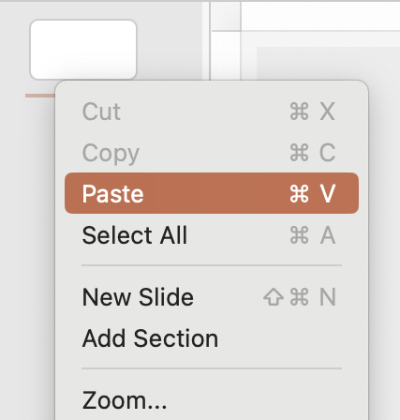

How to copy into another Intel presentation
Internal Use ONLY – remove before presenting
1
2
3
Select slides that you want to copy from.
Paste into a new template or an existing presentation.
Most important step is to ensure you “keep source formatting” when pasting. You can find this icon in the lower right corner of slides you pasted. Click the icon for options.

Slide 2
Presentation Notes
Internal Use ONLY – remove before presenting
Presentation Name | Cloud Gold Deck
Version | 3.0
Abstract | This presentation provides an overview and details of the Intel cloud technology enablement. It includes an overview of the market, key pain points, enabling hardware and software, use cases by segment and key technology ingredients.
Target Audience | Buyers of Cloud Services – organizations that consume cloud services public, private, or hybrid cloud. Inclusive of PaaS and SaaS consumption. Persona: IT Datacenter Manager, Cloud Solutions Architect, Infrastructure Architect, CTO, CIO, Business Units Builders of Cloud Services – organizations that build cloud services public, private, hybrid, PaaS, and SaaS environments. Persona: Cloud Solutions Architect, DevOps, CTO, CIO
CCV Buying Cycle Phase | Awareness of needs: Customer recognizes the need to change an existing product or solution. Salesperson should use this content to identify possible opportunities and navigate the “sweet spots” between the customer’s needs and the product or solution’s capabilities. The salesperson also needs to help the customer build urgency around addressing their needs, quantify the value that a solution would create, and overcome barriers to change.
Key Words | Cloud, Public Cloud, Private Cloud, Infrastructure, Multi-Cloud, Cloud Services
Content Categories | PRESENTATIONS – DPG GOLD DECK
Classification | Customer Facing; NDA not required except when noted
Owner | Martin Hendess
File Size | TBD
Posted/ Last Edited | April 2023
Shelf Life | 3-6 months
Legal Review | Susan Adams

Slide 3
Recommended Resources
Intel.com Cloud Hub
Intel Cloud Performance Portal
Intel Cloud Insider Program
Intel Cloud University
4th gen Cloud animated video
4th gen AI animated video
4th gen Security animated video
4th gen Cloud Solution Brief
4th gen AI Solution Brief
4th gen Security Solution Brief
5 Challenges to Microservices whitepaper
Related Gold Decks
DCAI Security Gold Deck
Confidential Computing 30-3-30
SPR AI Gold Deck
AI Gold Deck

Slide 4
Accelerate. Innovate. Automate.
New possibilities for your business.
Presenter Name
Presenter Title

Slide 5
Customer Challenges
9 in 10 organizations back AI to give them a competitive edge over rivals (MIT Sloan Management)
One survey found that 87% of global organizations believe that AI technologies will give them a competitive edge.
79% of critical infrastructure organizations didn’t employ a zero-trust architecture.
45% of the data breaches were cloud-based.
The average cost of a data breach increased by 2.6% to $4.35 million in 2022 from $ 4. 24 million dollars in 2021.
2X
Worldwide public cloud spending will grow 20.7% to total $591.8 billion, up from $490.3 billion in 2022.
Global Wholesale avg electricity prices¹
Cloud Efficiency
& Performance
Sustainability
Artificial Intelligence
Security
Built-in performance acceleration
Need a data point on key workloads to demonstrate
  Granulate software autonomously and continuously optimizes workloads to improve application performance and reduce carbon footprint.
Built-in AI acceleration
Portfolio of products (Habana, FPGA)
Software
Confidential Computing
Project Amber
Intel Delivers
Source IEA: 2X-First half 2022 vs 2016-2021 avg; 2. Source: WEF/Global Carbon Project Nov 2022; 3. Source: LiquidStack 2023, based on avg WUE of 1.8
https://www.getastra.com/blog/security-audit/data-breach-statistics/#:~:text=Top%20Data%20Breach%20Statistics%20for%202023,-Here%20are%20the&text=79%25%20of%20critical%20infrastructure%20organizations,24%20million%20dollars%20in%202021.
https://www.deccanherald.com/brandspot/pr-spot/2023-the-year-of-ai-a-closer-look-at-the-statistics-and-trends-in-artificial-intelligence-1193471.html

Slide 6
The Intel advantage
Rich value from a unique relationship
A relationship with Intel brings you …
A front-row seat to where technology is heading
Input and insights to apply to your technology road map
Our vast global partner ecosystem
Subject matter experts for answers and planning
A unique relationship—
no direct sales and
tech agnostic in working with your existing infrastructure

Slide 7














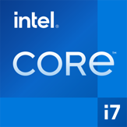






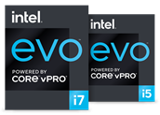
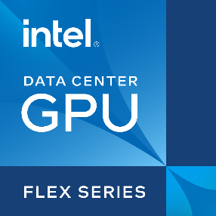
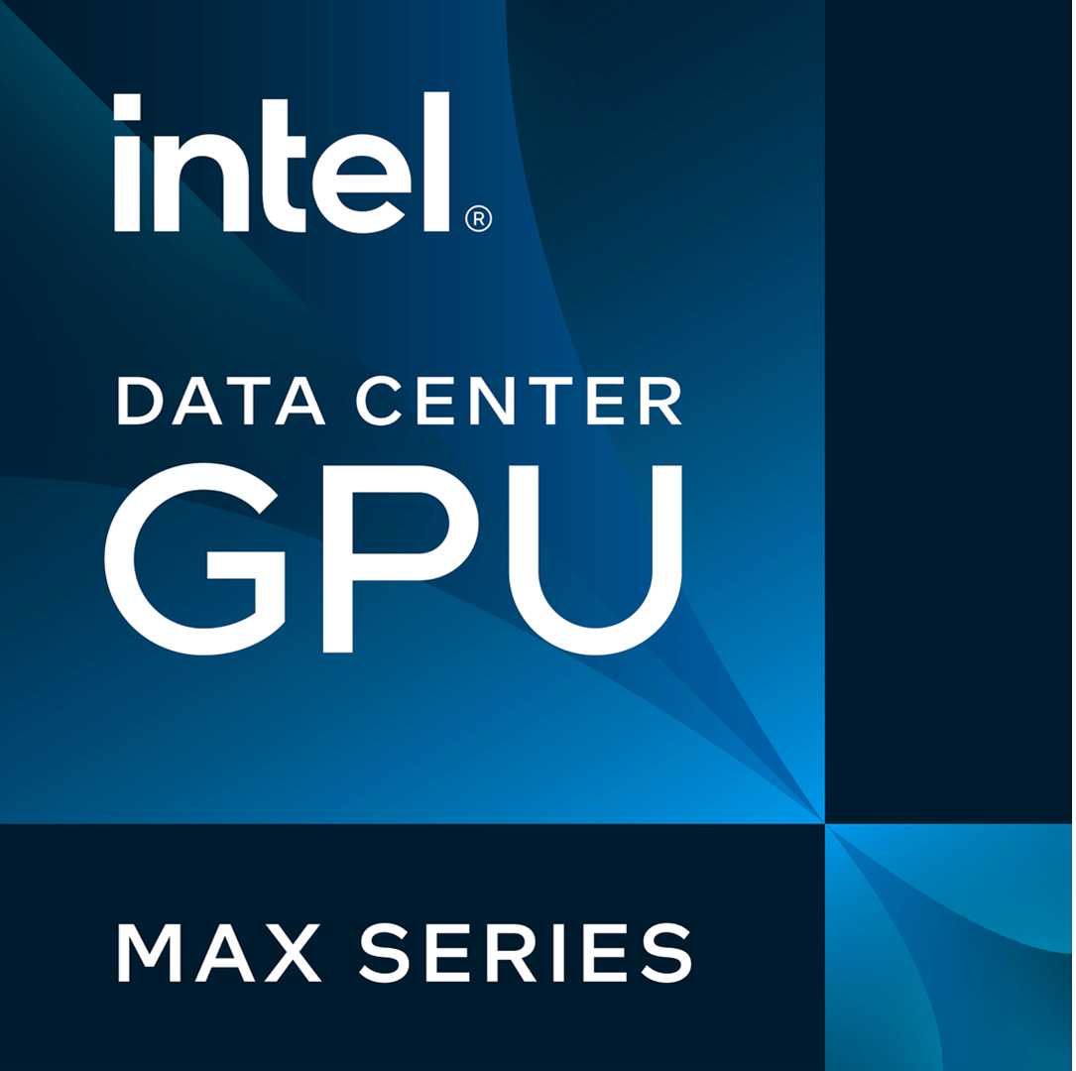





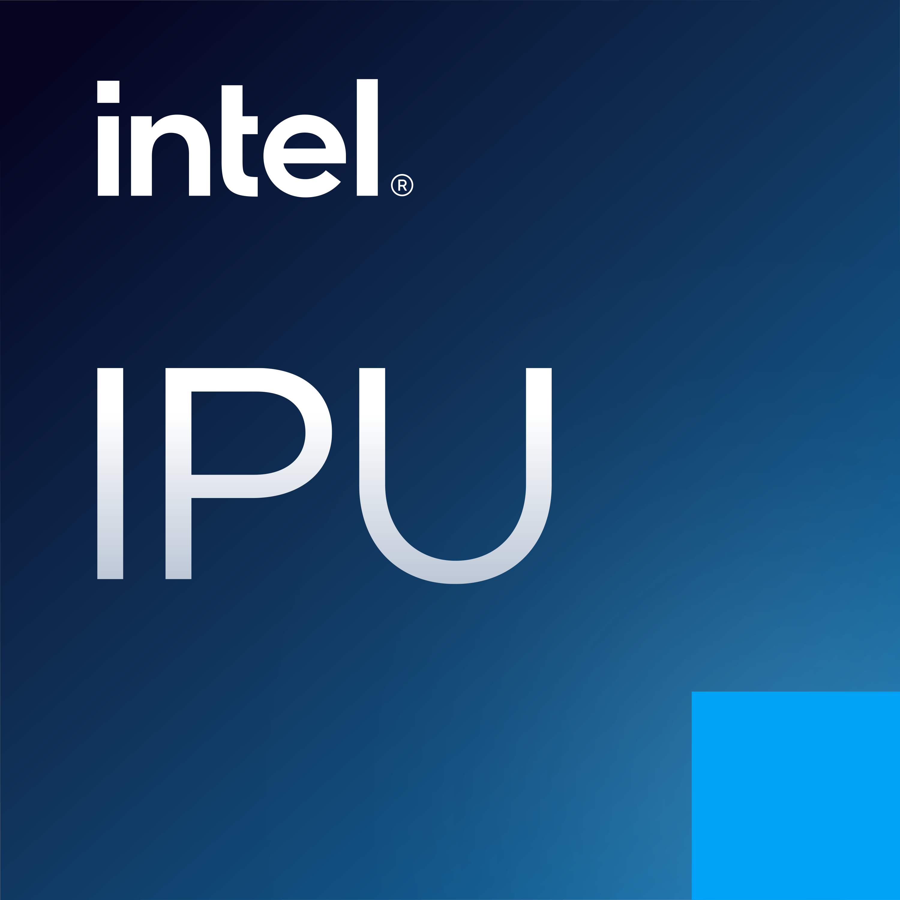


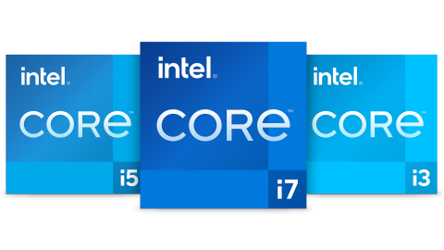

Shaping the future of technology
Intel’s end-to-end product portfolio
5G Network
Client
Connectivity
Cloud
IoT
Edge
AI and
Analytics
Autonomous
Driving
Connectivity
Software
Intel® Wireless Bluetooth®
Intel® Wi-Fi 6 solutions
Base Toolkit
HPC Toolkit
DLFD Toolkit
Rendering Toolkit
AI Analytics Toolkit
IoT Toolkit
Notes:
Intel's end-to-end product portfolio.
Every generation of products improves in user experience, performance, power, cost, connectivity, security, and form factor.
Our silicon and software are essential for moving, storing, and processing data faster and more securely than ever before. Advancing these technologies allows us to help our customers solve their greatest challenges.

Slide 8

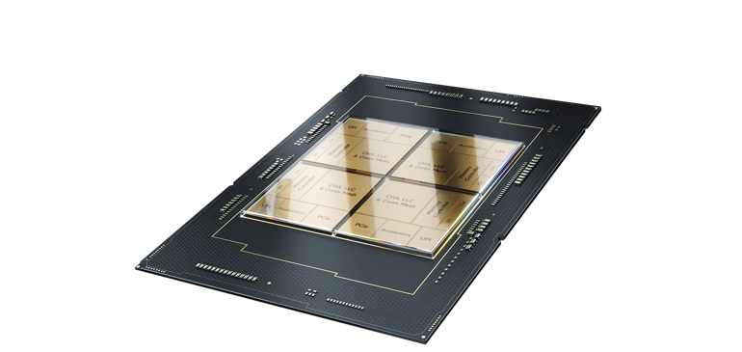
Leading performance with the most built-in accelerators
Accelerate performance across the fastest-growing workload types in AI, data analytics, networking, storage, and HPC with Intel® Accelerator Engines.
Help bring a zero trust security strategy to life while unlocking new opportunities for business collaboration and insights—even with sensitive or regulated data—with advanced hardware-enabled security technologies.
Scale with the most choice and flexibility—Intel® Xeon® Scalable processors offer the greatest cloud choice and application portability, with features that virtually eliminate the downtime of migrating VMs from generation to generation.
Accelerate your fastest-growing workloads. 4th Gen Intel® Xeon® Scalable processors have the most built-in accelerators of any CPU on the market to improve performance in AI, data analytics, networking, storage, and HPC. Drive power efficiency with a 2.9x average performance per watt improvement for targeted workloads utilizing built-in accelerators compared to the previous generation.¹
1. See [E1] at intel.com/processorclaims: 4th Gen Intel® Xeon® Scalable processors. Results may vary.
Availability of accelerators varies depending on SKU. Visit the Intel Product Specifications page for additional product details.
See notices on slide 40.
Note: Use performance claims exactly as written. If you would like to adjust wording, please seek guidance from the Xeon Messaging Strategist.

Slide 9

Cloud Efficiency & Performance

Slide 10
4th Gen Intel® Xeon® Processors Move Data Faster
With Efficient Data Movement and Data Transfer Operations Accelerator
Intel® Data Streaming Accelerator (Intel® DSA)
Optimizing streaming data movement
and transformation operations
Intel® QuickAssist Technology (Intel® QAT)
Accelerating Cryptography
and Data De/compression
Intel® Dynamic Load Balancer (Intel® DLB)
Increases performance related to network data handling
Notes:
To help address the inefficiencies and intense resource requirements, which drive up the costs of moving data we’ve introduced a new accelerator called Intel Data Streaming Accelerator. (DSA)…
You’ll hear a lot about QAT today, in this case we’ll share with you how the compression/decompression acceleration help with Data Backup
Let’s click into both of these..
--------------
Intel® Data Streaming Accelerator (DSA) is targeted to support the performance of applications reliant on data movement.
What Is It?
Integrated accelerator IP accelerates common data mover operations
Up to 4 instances per socket for up to 120GB/s (240GB/s bi-directional) bandwidth
Advanced offload optimizations such as support for AIA instructions and SVM
Scalable-IOV support for seamless sharing from application user-process, containers and/or virtual machines
Value Prop
Improves performance of applications reliant on data movement
Cores offload data movement operations to DSA, freeing CPU cycles for higher priority work
Target Workloads/Usages
Network: vSwitch network virtualization
Storage: Fast replication across non-transparent bridge (NTB)
Application usage examples: Messaging, ERP, In-Memory Databases, Analytics

Slide 11
Intel® Data Streaming Accelerator (Intel® DSA)
Faster Data Movement In and Out of Storage
Memory Copy without Intel® DSA
Memory Copy with Intel® DSA
Boost I/O speed with NVMe-over-TCP using Intel® DSA
Memory/Cache
Memory/Cache
Up To
dog
x00
dog
x00
60%
…
Cycle 0: Ask DSA to move x00-x63 to y00-y63
…
DSA Device
Higher IOPS
…
Cycle 0: move x00 to y00
Cycle 1: move x01 to y01
.
.
.
Cycle 63: move x63 to y63
cat
x01
cat
x01
1234
1234
Core
mice
Core
mice
and Up To
6789
6789
37%
Latency
Reduction*
0000
0000
dog
dog
0000
0000
* for large packet sequential read using integrated Intel® Data Streaming Accelerator (Intel® DSA) vs. the prior generation
cat
cat
0000
x63
0000
x63
Customer Usages: High Perf Enterprise/Distributed Storage, Data Analytics
See backup for workloads and configurations. Results may vary
Notes:
Intel DSA…
Accelerates data movement and transformation operations for common storage functions, such as data integrity checks and deduplication by offloading almost all data movement processing from the CPU cores
This in turn improves performance and power efficiency for numerous data movement use cases like storage replication, VM boot time, live migration and checkpoint analysis, vSwitch acceleration, Data Copy in packet processing pipelines, and many other data use cases that are happening all day and night in every data center
As an example
We see 60% higher IOPS as we’re able to boost I/O speed with NVME over TCP using intel DSA for CRC calculations
At the same time we’re seeing a 37% reduction in latency for large packet sequential reads vs prior gen Xeon.
Higher throughput with lower latency, using less cores
DSA is integrated into industry leading frameworks SPDK and DPDK making deployment for storage and networking use cases simple, and we have created a new library called Data Mover Library for Applications, aimed to simplify adoption
-------------------
Accelerates data movement and transformation operations for common storage functions, such as data integrity checks and deduplication by offloading almost all data movement processing from the CPU cores
Improves power efficiency for high volume use cases such as Storage, VM and container migration, vSwitch, Deduplication, Data Copy in packet processing pipelines, etc.
Intel DSA - Accelerates data movement and data transformation operations, by offloading almost all data movement processing from the CPU cores
Improves power efficiency for high volume use cases such as Storage, VM and container migration, vSwitch, Deduplication, Data Copy in packet processing pipelines, etc.
How End Customers (e.g. Smart Cities) Can Benefits from Acceleration with Intel® DSA
Data needs to be analyzed and acted upon faster.​
For entities like city governments and urban service providers, faster data means making smarter decisions.
City government can take advantage of large data sets that often require data transparency, which results in wider community engagement. ​
Utility companies (e.g. electricity and lighting providers) can analyze user needs and reduce wastage.​
Transport and mobility sector can use traffic data to provide faster, greener navigation management for urban residents. ​
For faster data analysis and analytics, moving data in and out of data storage is critical. ​That’s where Intel® DSA comes in.

Slide 12

Intel® QuickAssist Technology (Intel® QAT)
Hardware Acceleration of Data Compression
Intel® QuickAssist Technology (QAT)
Up To
Intel® QAT Gen 4
Cores
UPI
2.3x
Speedup
(de) Compression
PKE
Mem Controller
In Database Backup Time¹
Integrated into
SQL Server
2022 Backup
Bulk Crypto
Dynamic Load Balancer
PCIe
DMI Gen 4
Intel® Ethernet 800 Series Network Adapter
Emmitsburg PCH
Inline Crypto
Customer Usages: Network Secure Gateway, CDN, Data Compression (L1/L9)
Source: https://www.intel.com/content/www/us/en/architecture-and-technology/intel-quick-assist-technology-overview.html
See backup for workloads and configurations. Results may vary.
Notes:
OneIntel QAT…
Provides a compression technology that integrates hardware acceleration of compute-intensive workloads on Intel platforms.
High-level message is that SQL Server on Intel is optimized to deliver breakthrough performance and flexibility for all types of data and analytics in any kind of environment. This slide is one of the proof points of that message. There are two main benefits around performance, faster backup and business transactions.
SQL SVR –BACKUP
Microsoft and Intel collaborated to achieve the 2.3x faster back-up performance by using Intel® QuickAssist Technology or QAT. With QAT, downtime allocated for back-ups is cut in half so Database Administrators (DBAs) or Devops engineers can get to production quicker.
and 4th gen results are even better…we’re just waiting for MSFT approval before we can share those.
Intel QAT also delivers faster transactions and online transaction processing (OLTP) operations by offloading data compression on SQL Server bare-metal platforms or VMs, while reducing the impact on the system’s transaction throughput. There is minimal impact to workloads while existing data is safeguarded and compressed. Reducing the storage needed also means a faster and smoother backup.
---------------------------
QAT - Improves performance across applications, including symmetric encryption and authentication, asymmetric encryption, digital signatures, RSA, DH, and ECC, and lossless data compression.
Provides a compression technology that integrates hardware acceleration of compute-intensive workloads on Intel platforms.
High-level message is that SQL Server on Intel is optimized to deliver breakthrough performance and flexibility for all types of data and analytics in any kind of environment. This slide is one of the proof points of that message. There are two main benefits around performance, faster backup and business transactions.
Microsoft and Intel collaborated to achieve the 2.3x faster back-up performance by using Intel® QuickAssist Technology or QAT. With QAT, downtime allocated for back-ups is cut in half so Database Administrators (DBAs) or Devops engineers can get to production quicker.
Intel QAT also delivers faster transactions and online transaction processing (OLTP) operations by offloading data compression on SQL Server bare-metal platforms or VMs, while reducing the impact on the system’s transaction throughput. There is minimal impact to workloads while existing data is safeguarded and compressed. Reducing the storage needed also means a faster and smoother backup.
Note that this is on Intel Xeon 3rd generation processor and SQL Server 2022 which is in public preview mode and not a fully shipping release. Most customers will be on SQL Server 19 or 16 so position this as a future capability of SQL Server.

Slide 13
Microservice Performance
Benefits of 4th Gen Intel® Xeon® with Built-In Accelerators
Improved Observability, Orchestration, and Communication
Scalable Performance and Predictable Tail Latencies
Lower Infrastructure Overhead
Up to 56% Latency Reduction on NGINX with Intel® Dynamic Load Balancer (DLB)
Load Balancer,
API Gateway
Orchestration
and
Scheduling
Service 1
Computation
Service 2
Recommendation System
Up to 3.5x higher DLRM inferences with Intel® Advanced Matrix Extensions (AMX)
Up to 2.5x higher requests/sec on Envoy Istio with Intel QAT
Service
Mesh
Networking,
gRPC
Service 3…N
Data Services
and Storage
Up to 3x higher operations/sec on RocksDB with Intel IAA
Up to 1.16x Improved gRPC latency (P99) per core
Ease of Use and
Developer Productivity
Up to 1.6x higher Server-Side Java Critical JOPs
See backup for workloads and configurations. Results may vary
Notes:
(build from previous)
Acceleration on 4th Gen Xeon improves different components across the microservices design patterns. As examples, we have used the following workloads to show the SPR performance benefits -
For Web server/proxy:
NGINX TLS 1.3 Webserver: AES128-GCM-SHA256 - Up to 1.52x higher TLS1.3 https throughput with 4th Gen Intel Xeon compared to 3rd Gen Intel Xeon on TLS 1.3 AES128-GCM-SHA256.
For Service Mesh:
Up to 2.5x higher throughput (RPS), 74% lower P99 latency and 12% lower cpu utilization on 4th Gen Intel Xeon Platinum 8480+ with 2 QAT devices compared to solution with no acceleration
Up to 96% lower latency at the same throughput (RPS) with 4th Gen Intel Xeon Scalable processor and Intel DLB vs. software for Istio ingress gateway
For Communication:
gRPC:
For AI Inference as a service example:
Up to 3.5x higher batch Recommendation System inference performance (DLRM) on 4th Gen Intel Xeon Platinum 8480+ with AMX INT8 vs. prior generation with INT8
For Data Service:
RocksDB- Up to 3x higher RocksDB performance with 4th Gen Intel Xeon Platinum 8490H using integrated Intel IAA vs. prior generation.

Slide 14
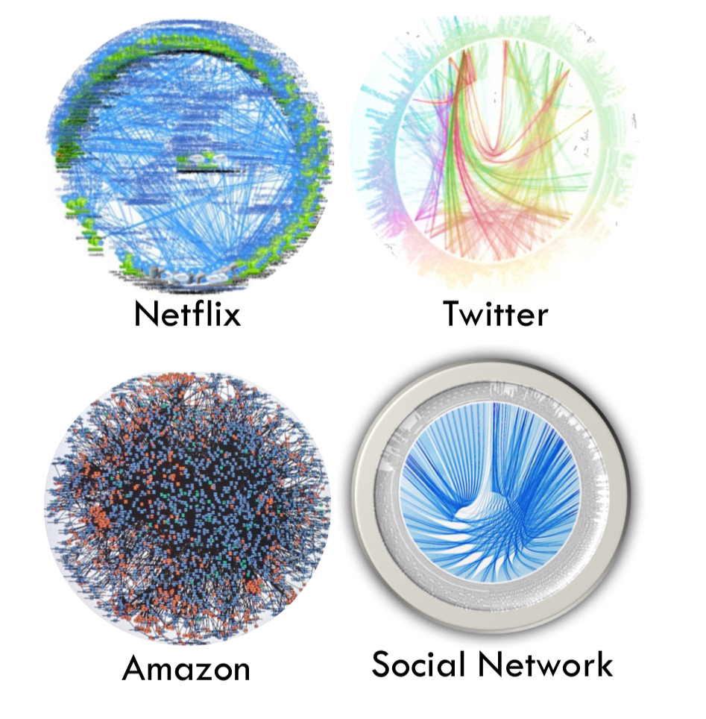
Microservice Performance
Benefits of 4th Gen Intel® Xeon® Processors
End-to-End Microservices Performance
Death Star Bench throughput within latency SLA
See backup for workloads and configurations. Results may vary
Notes:
Taken together and using DeathStarBench, An Open-Source End-to-End Microservices Benchmark Suite
as end-to-end microservices perf improvements, we’re seeing up to 1.9X improvement from 3rd gen Xeon to 4th Gen.

Slide 15




Cloud Instance Performance Gains with 4th Gen Intel® Xeon® Processors
Google C3 (4th Gen Intel Xeon processors) vs.
Google C2 (2nd Gen Intel Xeon processors)¹
Higher is Better
Google Cloud new C3 Machine Series²
Observing a 20% increase in
performance of C3 over C2 in testing
with one of our key workloads.
As much as 10x quicker for about
the same computational cost for weather research and forecasting
on C3 clusters.
4 vCPU
4 vCPU
4 vCPU
4 vCPU
Per vCPU
Seeing up to 3x performance gains over C2 VMs due to higher memory bandwidth and lower network latency.
See backup for workloads and configurations. Results may vary.​
The ratio for LAMMPS assumes that the LAMMPS workloads scale linearly with the number of cores for both the platforms compared.
* Results measured by Intel using preview version of Google C3-highcpu, including pre-production processors, systems, and software, vs Google C2-standard.
** Source: Google Cloud blog post October 11, 2022, cloud.google.com/blog/products/compute/introducing-c3-machines-with-googles-custom-intel-ipu
Notes:
Here are some examples of the performance benefits in common cloud applications compared to Google’s previous generation of compute-optimized instances, which uses 2nd Gen Intel Xeon Scalable processors. The C3 instances offer:
More than double the performance for NGINX
Around 40% performance improvement for MySQL, Wordpress, and media transcoding
… And Google’s customers are seeing great results when using the preview instances

Slide 16

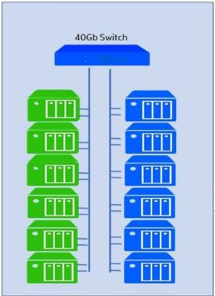

Delivering Results for Customers Through
Deep Engineering
68%
Performance boost improvement by detecting perf changes during the development cycle.
“Zero-touch” profiling scales performance regressions, finding opportunities to improve database code efficiency.
Intel Lab
Pull from stream of
benchmarks and
execute tests.
1
2
3
Push results to the cloud for storage and creation of visualization dashboards.
  Results may vary
  Source: netflixtechblog.com/seeing-through-hardware-counters-a-journey-to-threefold-performance-increase-2721924a2822
  Source: redis.com/blog/redis-intel-performance-testing/
Notes:
We also work closely w/ customers to understand their real-world problems, even in the cloud
Intel has a unique set of counters exposing rich system performance data
We have worked with CSPs to expose these counters to their end customers,
And we have used this to help instance operators break through performance bottlenecks
This has had dramatic results, as Netflix and Redis both shared in recent engineering blogs

Slide 17

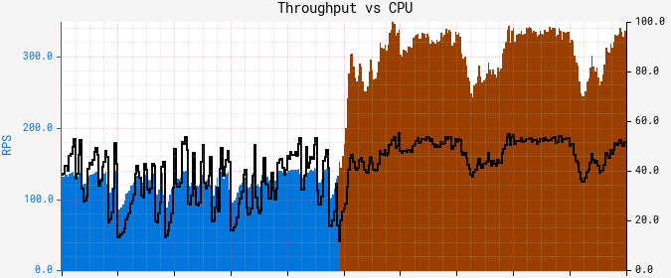
Delivering Results for Customers Through
Deep Engineering
3.5x
Throughput improvement with a
verage and tail latency reduction.
By leveraging exposed PMU
counters for visibility into
performance bottlenecks.
“…the ability to introspect the execution at the level of CPU microarchitecture proved to be the only solution.”
Axis 0: RPS
Axis 1: Utilization %
  Results may vary
  Source: netflixtechblog.com/seeing-through-hardware-counters-a-journey-to-threefold-performance-increase-2721924a2822
  Source: redis.com/blog/redis-intel-performance-testing/
Per-instance RPS before the fix
CPU
Per-instance RPS after the fix
Notes:
We also work closely w/ customers to understand their real-world problems, even in the cloud
Intel has a unique set of counters exposing rich system performance data
We have worked with CSPs to expose these counters to their end customers,
And we have used this to help instance operators break through performance bottlenecks
This has had dramatic results, as Netflix and Redis both shared in recent engineering blogs

Slide 18
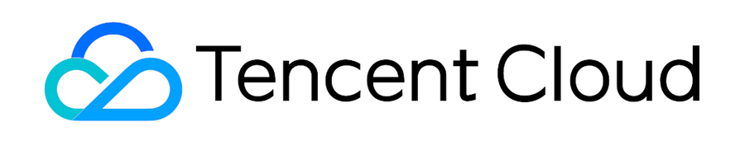


4th Gen Intel® Xeon® Scalable Processor AI Inference Performance Results with Customers & Partners
2-3x
3.4x
1.8x
AI throughput for BERT models used by Tencent Search application with Intel® AMX vs previous generation.
AI throughput with Bfloat16 optimizations for Meituan’s Compute Vision Platform with Intel AMX vs. without AMX optimizations.
more image inferences per second over previous gen at int8 precision with TensorFlow running on VMware vSAN with Intel AMX.
Case Study Here
See backup for workloads and configurations. Results may vary.
Notes:
​
Cloud customers are using 4th Gen Xeon Scalable processors to improve performance on their higher-level services:
Tencent seeing 2-3x AI throughput improvement on their search application compared to previous generation
Meituan seeing AMX and BFloat16 delivering tangible benefits, more than tripling AI throughput compared to tests of stock PyTorch without those feature enabled
VMware-based environments have also seen 1.8x more image inferences using 4th Gen Intel Xeon Scalable processors with AMX enabled when compared to the previous generation

Slide 19

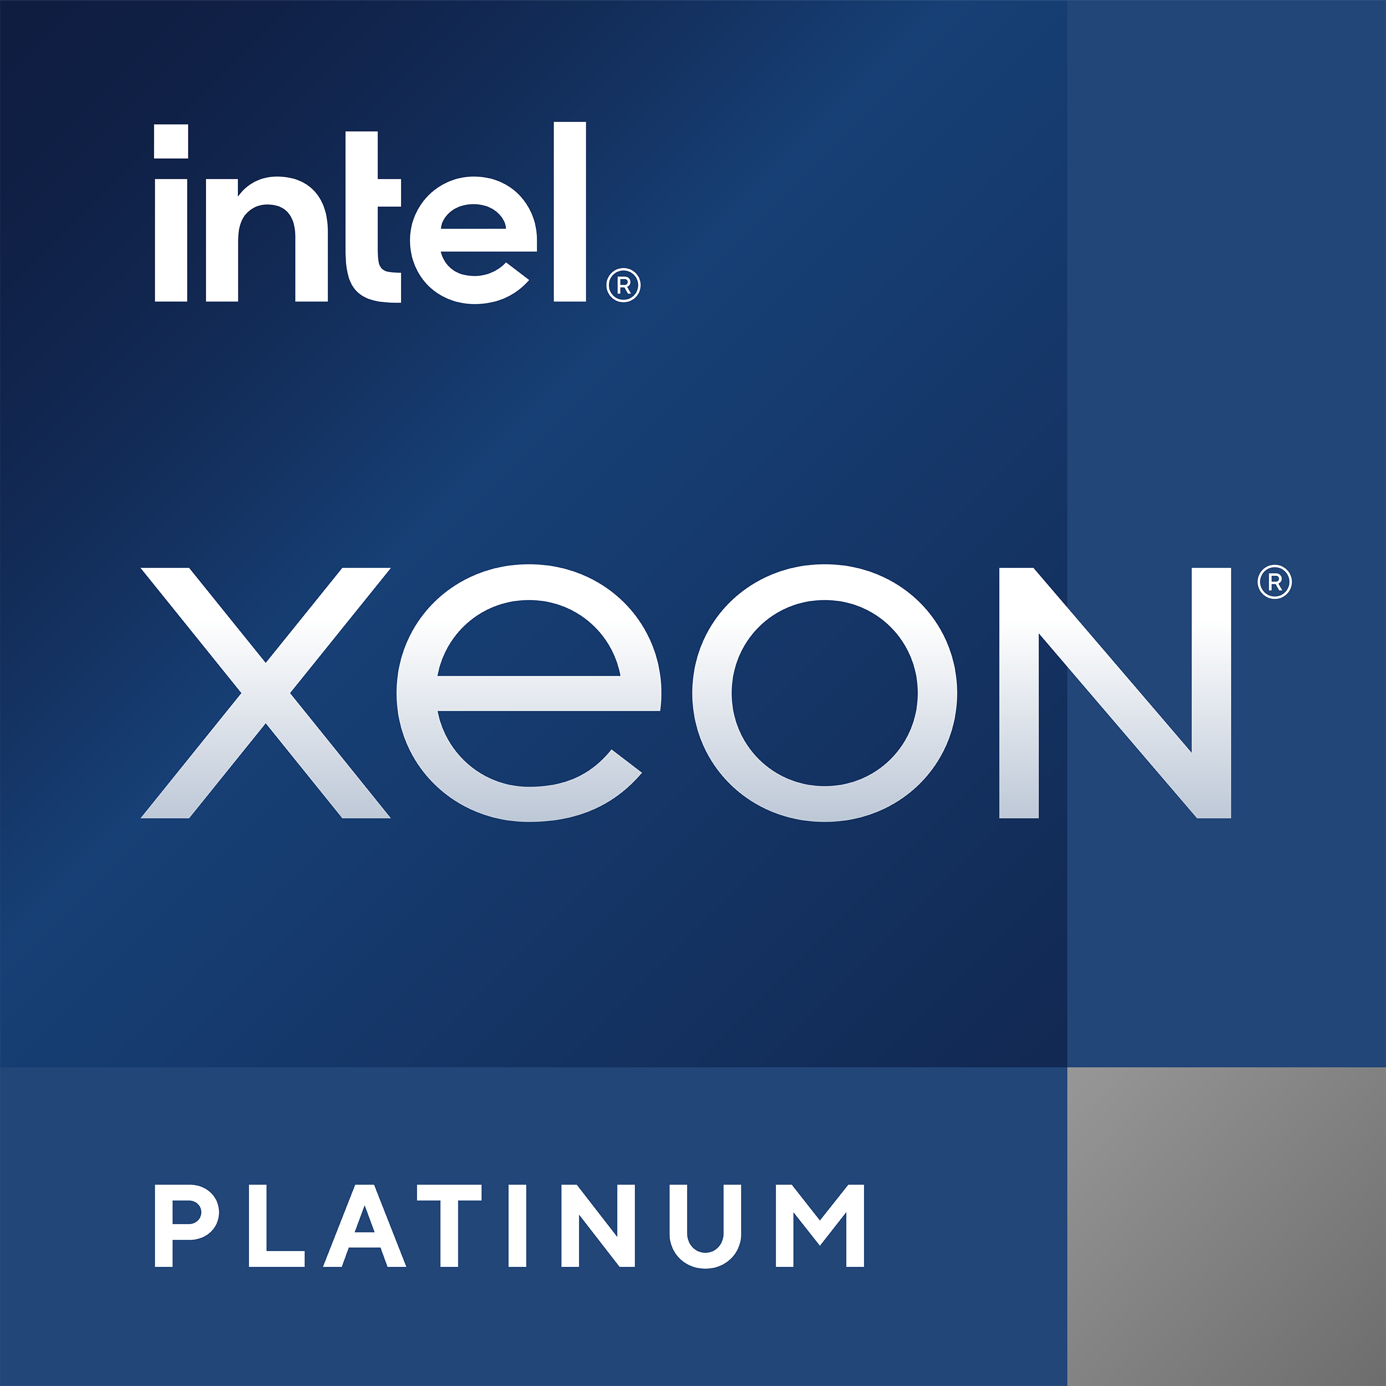
Meeting Mission Critical Business Needs with 4th Gen Intel® Xeon® Scalable Processors
Better Performance
Larger Databases
Built to Scale Up to 16S
Up to
Up to
Up to
2.3x
1.5 TB
32 TB
OLAP Performance¹
Memory/Socket (OLAP)
Memory/Server (OLTP)
via more cores balanced with memory bandwidth, AVX-512, TSX, and VBMI
Increased HANA database size
from 768 GB/socket via more DIMMS/Socket – 8 channel DDR5
For 16S server, w/ 2 TB/Socket
4 UPI Links/socket for scale up performance; larger PAVA
Up to
Intel Xeon CPU is the only x86 CPU certified
for SAP HANA
Up to
2:1
480
8S-4L
Consolidation Gen vs. Gen-2²
cores per server (8S)
Intel UPI 2.0, Perf Optimized Topology
See backup for workloads and configurations. Results may vary.
Notes:
We can’t talk about software optimizations without talking about the software that runs business….CRM, ERM, SCM…These are what many consider to be “Mission Critical” workloads…and as such they are some of the most demanding workloads, requiring the best performance, maximum resiliency and up time.
Amongst the Industry leaders in this space is SAP…and SAP HANA. We’re proud to work very closely with SAP to ensure their products run best on Xeon and have for decades. In fact Intel Xeon CPUs are the only x86 processors certified for SAP Hana.
4th Gen Xeon was built for Mission Critical Workloads…it delivers Better Performance; Larger Databases and is Built to Scale up to 16S (something our competitors don’t do)
4th Gen Xeon is built to deliver:
Better Performance – With increased cores and taking advantage of increased memory bandwidth, AVX-512, TSX and VBMI, we’re able to deliver up to 2.3X higher Query per Hours in SAP Business Warehouse Scenarios (OLAP) performance vs Gen-2 (2nd Gen Xeon Scalable)
Larger Databases – For 4th Gen Xeon, we doubled the size of system memory from 768GB/Socket on 2nd Gen Xeon to 1.5TB/ Socket for a total of 3TB/2 socket system. This provides companies a great TCO opportunity, where they can choose to consolidate their workload into fewer systems (2:1 consolidation.) or Double their data size for the same cost. For example if a user has 3TB of Hana data on a 2nd Gen Xeon based systems, that would have required a 4S system. Because we’ve doubled the memory on 4th Gen, companies today can replace that 4S system with a single 2S system that supports 3TB. Or they can stay with a 4S system and have headroom for growth.​
Built to Scale Up – One of the 4 pillars of our approach to SW is that we build HW for SW. This is the case with 4th Gen Xeon and delivering a platform that SCALEs up to the demands of these mission critical workloads. 4th Gen Xeon architecture provides an optimized topology for system scaling from 2S to 4/8S and up to 16S and beyond. One of the differentiators vs our competitors is that we provide 4 UPI Links /socket for scale up performance with more interconnects and balanced systems performance. Additionally, we’ve provided for larger PAVA – Bigger Physical address space extension (from x to y) – enables support for higher than 24TB database. In a 16S Server we support up to 32TBmemory for OLTP in a single server.​
No doubt, businesses trust their mission critical workloads to SAP and to Intel. More to come in this space as our OEM partners will be bringing 20+ systems to market in 2023. We’ll have more to share with exciting details on energy efficiency gains and real world performance results, so stay tuned.
Other Details – ZBB’d for simplicity of the story
-------------------------------------------
Time to Value
Boost your agility, time to value, with SAP HANA
HANA on 4th Gen Xeon delivers up to2.6x higher Query Execute Rate in Datawarehouse Scenarios (OLAP) compared to Xeon E7
High dense, high performance SAP HANA with up to 2TB Memory per Socket
Utilize up to 1.5TB / Socket SAP Core to Memory Ratio at outstanding OLAP Performance
Utlize up to 2TB / Socket – SAP Core to Memory Ratio at outstanding OLTP Performance
PA/VA – SPR has larger Physical address space extensions - CLX had 46 physical address bits 48 virtual address bits. SPR has 52 physical address bits and 57 virtual address bits. (source - Priyalal)
Performance
4'th Gen Xeon delivers up to 2x higher SAPS performance compared to 2'nd​
Up to 2.3x higher Query per Hour rate in SAP Business Warehouse Scenarios​
Performance boosts from Intel AVX-512, PCIe 5.0
Uptime
Up to 25% faster SAP HANA Data Load Times over 2'nd gen​
Improved Intel 4th Gen Xeon ​
RAS and Telemetry Capabilities
Security (Intel SGX)
TCO
4th Gen Intel® Xeon® Scalable Processors provide 2S to 8S+ capacity that enables SAP HANA to scale up to 32TB/System.
Intel SPR support of DDR5 ​
Sustainability:
Intel Performance Test based on SAP BW4HANA scenario
At constant Query Rate, SPR allows up to 38% power savings
Intel 4th Gen Xeon delivers 38% improved QpH / Watt
Intel Performance Test based on SAP SD scenario
Intel 4th Gen Xeon delivers 28% improved SD User / Watt
At constant SD User Rate, power savings of 28% can be achieved

Slide 20






Accelerating Scientific Discovery with 4th Gen Intel® Xeon® Scalable Processors
# of Genomes Completed/Node/Day
2018-2022
Up To
Higher
2x Intel® Xeon® Platinum 8460Y Processor
GATK 4.2.6, Single Node
35%
2022
Genomes/day¹, single node
Up To
2x Intel® Xeon® Platinum 8358 Processor
GATK 4.2.6, Single Node
2021
35%
Lower Cost
Per Genome²
2x Intel® Xeon® Gold 6252 Processor
GATK 4.1
2019
Up To
2x Intel® Xeon® Gold 6152 Processor
GATK 4.0
2.7x
2018
More
Genomes/node/day
vs. 4 years ago³
See backup for workloads and configurations. Results may vary.
WGS – Whole Genomes Sequencing
GATK - The Genome Analysis Toolkit is a set of programs developed by the Broad Institute, perform much of the analysis required for calling genomic variants
Notes:
As we think about our mission to unlock the value of data, perhaps there is no other data set more valuable and more complex than the Human Genome.
This is an area where we’ve invested heavily to support scientific discoveries and make those discoveries more affordable and the benefits more accessible to all people. We’re proud to have been working the Broad Institute for many years.
Starting in 2018 when we introduced our 1st Gen Xeon Scalable processors, our optimization work with the esteemed Broad Institute and GATK enabled us to support calculating 4 genomes per node per day….that was exciting and represented a significant break though at that time. Over time we continued to work closely to optimize the GATK software to run better on Xeon and take advantage of all of our features, reducing latency and improving throughput and a year later we we’re able to increase the # of Genomes/node/day from 4 to 6.4 on our 2nd Gen Xeon Scalable processors. Fast forward to 2021 on our 3rd Gen Xeon platforms and GATK 4.2.6 we achieved 8.1 Genomes/node/day. With the introduction of 4th Gen Xeon we continue our march and close partnership with Broad and we’re excited to demonstrate a further 35% improvement over 3rd Gen.
With 4th Gen Xeon CPU performance, we’re now able to deliver nearly 11 genomes/node/day (10.94 measured). That represents a roughly 2.7x improvement in genomes/node/day vs just 4 years ago…and assuming a 3yr depreciation on a $12,500 server, we’re now approaching $1/WGS (Actual is $1.04) which as you can imagine completely changes the economics of Human Genome research and brings us just that much closer to unlocking personal medical insights, truly precision medicine and treatments and making it accessible for more and more people, not to mention even great understanding of human biology and the benefits that will bring. No doubt the value of data is only fully realized when we’re able to delivery timely and affordable analysis and insights to improve decision making. We’re looking forward to continue our work to provide scientists, researchers and medical professionals the compute power they need to accelerate their work of discovery.
Back up Notes – For Reference only…includes calcs , etc.
-------------------------------------
The Genome Analysis Toolkit (GATK) is a set of programs developed by the broad institute with an extensive website. As mentioned in the final presentation, it has the ability to perform much of the analysis required for calling genomic variants as well as many many other things. Why you may ask yourself did this magical tool only appear on the final day of the class? GATK uses read mappers, read aligners, variant callers, and all the other things (or similar things) that you have been introduced to throughout the course so we have actually been going over what you needed to know in smaller more digestible chunks.
PMR #00082257 was completed on 10/05/2021. The Broad Institute did not specific any restrictions or time limits for the use of their logo for use in amplification or promotion of the details/use case captured in the case study. The case study was also used in a PR push when the case study was published: https://www.intel.com/content/www/us/en/newsroom/news/broad-institute-intel-google-advance-biomedical-research.html.
https://www.intel.com/content/www/us/en/products/docs/select-solutions/select-solutions-for-genomics-analytics-brief-v3.html
https://www.intel.de/content/dam/www/public/us/en/documents/white-papers/accelerate-genomics-research-with-the-broad-intel-genomics-stack-paper.pdf
# of human genomes/node/day that we’re able to calculate. We’re able to show a 5yr refresh story here too…where it looks like 28% improvement gen to gen, SPR vs SKL is more like 27X improvement. BUT…we’re still 2-3 weeks away from PDT approval.
Lower Cost/Genome Calculations –
In looking at our older numbers, we used 8.0 WGS/node/day and this gave us a cost per genome over a 3-year depreciation period of $1.43. Raising the number to 10.94 WGS/node/day provides a cost per WGS of ~$1.04.
As a percent difference, (($1.04-$1.43)/$1.04) you get -36.8% difference which is the same as ((8.0-10.94)/8.0).
The costs assume a single node costs ~$12.5K and that it is depreciated over 3 years. So you do the following:
8.0 WGS/node/day x 365 days x 3 years = 8,760 WGS over 3 years. $12,500 divided by 8,760 = $1.43, so for the SPR case:
:
10.94 WGS/node/day x 365 days x 3 years = 11,979 WGS over 3 years. $12,500 divided by 11,979 = $1.04
I hope this helps. We’ve done this comparison with DRAGEN (Illumina) and with Parabricks (Nvidia) but their costs include 3-years of software license that when added into the calculation makes their unit cost per genome much higher
DRAGEN: $9.60/WGS
Parabricks: $2.71/WGS
Intel (SPR): $1.04/WGS

Slide 21





Optimized Performance:
Driving best price/per dollar
LB/Webtier
TLS connections
Web Services
Artificial Intelligence
Analytics
Search
Databases
Up to
Up to
Up to
Up to
Up to
Up to
1.52x
1.47x
10x
3x
1.57x
1.56x
Higher
Higher
Higher
Higher
Higher
Higher
NGINX web server connections/s with Intel Crypto Acceleration vs prior gen
transactions per second on WordPress vs prior gen
inference and training performance vs prior gen
performance vs prior gen
Elasticsearch indexing throughput performance than vs prior gen
MySQL transactions per minute vs prior gen
See [N12, W9, A17, D1, X, D3] at intel.com/processorclaims: 4th Gen Intel Xeon Scalable processors. Results may vary
See www.intel.com/3gen-xeon-config for workload and configurations. Results may vary​.
Notes:
We believe in transparency and data. That’s why we provide benchmarks of performance across cloud workloads.
Here are some examples of our latest benchmarks on 4th gen Intel Xeon Scalable processors.
These show the gen over gen improvements. A move to the latest generation of Intel Xeon processors can improve your performance and perhaps even adjust the number of virtual machines you need for your workload.
Workload Benchmarking: With decades of experience in workload benchmarking, Intel helps reduce the time to do baseline performance analysis on public cloud instances for comparisons across Xeon generations and competitive architectures.

Slide 22
Breadth and Depth of Intel Software Investments
End-to-End Cloud to Edge
Services and Solutions
Data Services
Media
Web Apps uServices
Artificial Intelligence
Applications
Microservices
Middleware and Frameworks
Compilers, GCC, LLVM
Transcode Libraries
Java, GoLang, Python
OneDNN, TensorFlow, Pytorch
Tools, Languages, and Libraries
Virtualization and Orchestration
Hypervisors, Containers, Scheduling, Cloud Native
Operating System
Windows, Linux
Firmware, Bios, Drivers
Universal Scalable Firmware, OpenBMC, and more
Notes:
KEY MESSAGE: PURPOSE OF WHY WE INVEST IN SW…. TO DELIVER VALUE TO OUR DEVELOPERS/USERS (& TO INTEL).
· We mobilize these investments to deliver Business Value for our Developers & Intel customers, as well as back to Intel – whether that’s in the form of exposing hero features or PnP, optimizing and differentiating to run best on Intel or generating pull-through at the top of stack for new business growth/opportunities.
· The SW stack continues to grow in complexity & diversity.
· Developers are everywhere in the value chain & at every level of the stack.
· A successful SW strategy is dependent on a broad and deep portfolio of investments that puts the needs of the Developer FIRST.
· Intel is uniquely positioned, like no other company in the industry, with the breadth & depth of SW investments and competence to address this evolving landscape.
· Across the full spectrum of ubiquitous compute, pervasive connectivity, and cloud to edge infrastructure & AI, Intel is embedded at every layer.
· From development to deployment, workloads & applications run on Intel.
· This is what I refer to as Intel driving a SW-First approach.
· I’m sharing a visual representation of some of our investments in:
o 1) Intel’s proprietary software assets;
o 2) partner tools/assets enabled for Intel platforms;
o 3) Intel & partner deep co-engineering investments; and4) open-source software projects, communities that we either lead or contribute to.

Slide 23









































Runtimes and Languages
Cloud,
Edge, and
Data Center
We Participate
at All Levels of the Stack*
Media
Machine Learning
and AI
SVT
Networking, Storage, and Database
MySQL
Libraries/Tools
(compiler, oneMKL, oneDNN, oneDAL)
Virtualization
Kernel / OS
Linux
Firmware
Tools
and SDKs
*a non-exhaustive sample
© Intel Corporation. Intel, the Intel® logo, and other Intel® marks are trademarks of Intel® Corporation or its subsidiaries. Other names and brands may be claimed as the property of others.
Notes:
KEY POINT: We are renown for our hardware but many people don’t know how deep our software roots run. We’re a microprocessor company with more than 15,000 software engineers, there are a trillion lines of code optimized for Intel, we have optimized more than 100 different operating systems
For over two decades, Intel has driven innovation—from data center to cloud to edge—through open technologies and communities.. Intel is the #1 corporate contributor to the Linux kernel. Many processor-level features require OS enabling. Intel’s Linux engineers tune performance and activate new platform features for the kernel, test them with rigor, and then upstream them to the kernel maintainers. And we don’t stop there, we led the CPU optimizations with Google on Tensorflow, and we’re one of the original tech leaders for Kubernetes. And now with Pat at the helm, we are increasing our investments in open source even more.
Winning Developers and Delivering better products with our commitemnt to open ecosystems.
Open. Choice. Trust.
Enable developers
Foster Choice
Build confidential compute
We participate at every level in the software ecosystem… at varying levels of engagement.
Also reference key differentiators Intel offers (Suleyman’s input)
By doing so, Intel makes the optimizations accessible to a broader developer community. We can combine the backporting and multiversioning and say that by owning these together Intel shoulders the burden of upgrading to/validating new versions
Back-porting to LTS versions
cloud doesn’t upgrade all at once – many generations of software at work at one time…
Intel has worked on providing for apps to run on multiple generations and to take advantage of whatever microarchitecture
Allows software to run on blend of cloud instances
FMV “Function Multiversioning.”
(are the following words describing FMV or something different? ) Better custodians of complex multigenerational environments – support multiple microarchitectures through tool chain: compiler/ linker / Intel has been very thoughtful in this area: good history

Slide 24







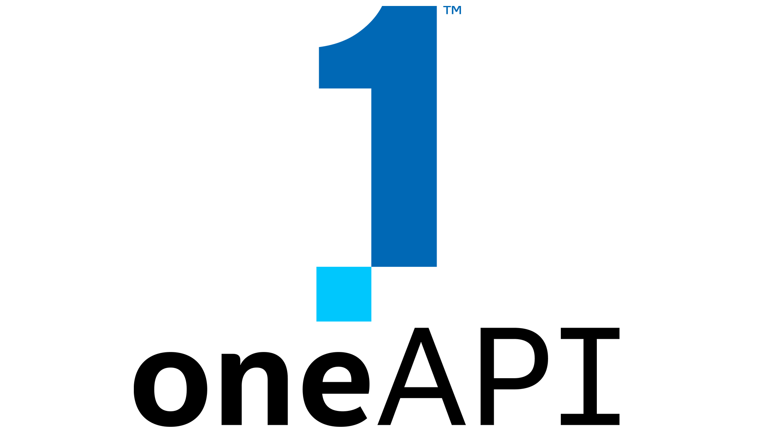



Intel® Optimize Software & Tools
Continuous Delivery
Software Delivery Value Stream
Customer
Need
Plan and Create
Integrate and Verify
Deploy and Operate
Monitor and Improve
Customer Value
Security and Compliance
Team Collaboration
Value Stream Metrics
Platform Governance
Continuous Improvement
Intel® Optimization Software
Intel® Migration Advisor
Intel® Cloud Optimizer
Intel® Cloud Optimization Modules
by
by
for
Inventory and Business Case
Performance, Cost, SLA
Real-Time, Autonomous
Application Optimization
Intel® Optimization Hub
Repository of hardware and software optimizations
Intel® Performance Hub
SaaS platform to determine health and optimizations for your environment

Slide 25
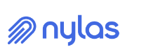



35%
Cost reduction on AWS
Autonomous optimization for 80%
of cloud workloads
Examples: Python, Java, Go, Ruby, Node.js, Spark, Kafka…
Autonomously learns app resource
usage patterns
Reduces response time and
increases throughput
Reduces costs through
resource optimization
45%
Cost reduction
45%
Cost Reduction,
resulting in $7M savings
Granulate Solution Brief
Cloud Optimization Ecosystem Activation Kit
gCenter data taken, 22 February 2022. For more information see Granulate disclaimer. Your costs and results may vary​.
Other names and brands may be claimed as the property of others.=
Notes:
With Granulate, all organizations – whether using Intel or not – can improve application performance across 80% of cloud workloads, including those using Java, Golang, Python for data analytics or EMR for big data.

Slide 26










Innovating with software
Developing leading-edge concepts and creating the future
Intel-Optimized
Open Source Software Business Value
1.8x higher average* PyTorch real-time BF16/FP16 inference performance on 4th Gen Intel Xeon Scalable processor with built in Intel AMX vs. Nvidia A10.
367%
40%
three-year ROI
more efficient IT infrastructure teams
Up to 10.5x higher batch ResNext101 inference performance on 4th Gen Intel Xeon Scalable processor with built in Intel AMX (BF16) vs. AMD EPYC 7763 (FP32).
5.7x end-to-end real-time inference performance speedup using 4th Gen Intel Xeon Scalable processor with Intel AMX (bf16) compared with prior generation (fp32) on Document Level Sentiment Analysis (DLSA) with Hugging Face (IMDB).
85%
49%
less unplanned downtime
faster to deliver new applications
Up to 1.56x higher queries per hour with the 4th Gen Intel® Xeon® Platinum 8490H processor vs. prior generation
19%
91%
lower IT infrastructure costs
more new features per year
#1 corporate contributor
Intel features frequently enabled in Linux kernel at platform time-to-market
Up to 1.61x higher throughput with the 4th Gen Intel Xeon Scalable Processor vs. prior generation
NLP Bert
4x faster gen-to-gen NLP inferencing
Source: IDC Doc. #US48232221. Results may vary.
See Intel Performance Index [D11, A216, A218, A2, P5 ]

Slide 27

Sustainability

Slide 28
Sustainability: An Enterprise Imperative
Energy
Environmental
Regulatory
40.5
European Sustainability Reporting Standards (ESRS) Approved (2024-2026)
2x
GtCO2
Total Global Carbon Emissions 20222
China PUE 1.2-1.25 for data centers
SEC: Proposed Rules for Enhanced and Standardize
Climate-Related Disclosures
Nov 2022
Global Wholesale avg electricity prices¹
1.1M
gallons of water used per day by a 100MW data center3
1. Source IEA: 2X-First half 2022 vs 2016-2021 avg; 2. Source: WEF/Global Carbon Project Nov 2022; 3. Source: LiquidStack 2023, based on avg WUE of 1.8
Notes:
Sustainability—we’ve often thought of Sustainability as a nice to have, but that has changed. It has become a must do for enterprise.
Three major factors driving this change:
Energy costs: Wholesale electricity prices are skyrocketing in many countries. In the first half of 2022, gas prices in Europe rose fourfold and coal more than threefold from the same period in 2021, resulting in wholesale electricity prices more than tripling in many markets. Our price index for major global electricity wholesale markets reached levels that were twice the first-half average from 2016 to 2021.
Environmental concerns: Carbon emissions, while leveling off in 2022, need to be reduced 45% before 2030 to meet the UN Climate Panel recommendations. Not only carbon emissions, water is a precious resource. Data centers are large users of water—in fact 1.1M gallons of water are used EVERY day by a 100MW data center. On average 1.8L of water is used for every 1 KWH consumed.
Regulatory: European has established new reporting standards –these go into effect in 2024. In the US, the SEC has proposed new rules on climate related disclosures . In China, the government has established PUE targets for data centers.
With these three factors, sustainability has become a must do for the enterprise
https://asia.nikkei.com/Spotlight/Caixin/Five-things-to-know-about-China-s-mega-east-west-data-center-plan#:~:text=The%20government%20has%20also%20called,those%20in%20the%20western%20hubs.
The government has also called for average power usage effectiveness (PUE) of data centers -- a measurement of how efficiently a center uses its power -- to below 1.25 for data centers in the eastern hubs, and to below 1.2 for those in the wester
45%
UN: Antonio Guterres 2023 WEF
https://www.weforum.org/agenda/2022/11/global-co2-emissions-fossil-fuels-hit-record-2022/
n hubs.

Slide 29
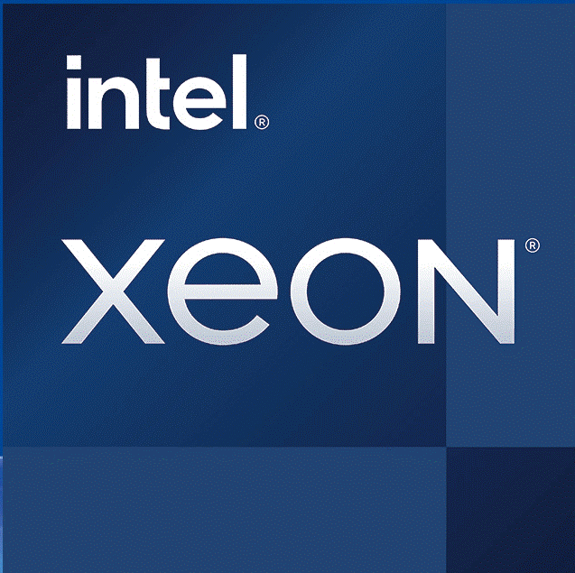
4th Gen Intel® Xeon® Scalable Processors
Intel’s most sustainable data center processor ever
Integrated AI
Up to 14x perf / watt boost¹
AI inference workloads with Intel AMX accel vs no accel
Made with 90-100%
renewable electricity⁴
for lower carbon footprint
Built in accelerators provide an avg 2.9X improvement in perf/watt²
Manufactured at Sites with State-of-the-art Water Reclamation
2.8 billion gallons of water recycled in20214
Up to 20% CPU power saving at less than 5% performance impact
with Optimized Power Mode³
Built with circular economy strategies for waste
5% total waste to landfill ⁴
55% Lower TCO and power consumption while reducing 524K kg of CO2 emissions*
AI Real Time Inferencing Workload, ResNet50
Built in advanced telemetry enables monitoring and control of electricity consumption and carbon emissions
1 See backup for config details.
2 See intel.com/processorclaims: 4th Gen Intel® Xeon® Scalable processors. Claim E1 . Results may vary.
3 On select workloads. See intel.com/processorclaims: 4th Gen Intel Xeon Scalable processors Claim E6.Results may vary​.
4 Intel 2021-22 CSR Report and internal reporting
Notes:
Architecture and built-in accelerators increase perf/watt on workloads that matter. The combination of Intel architecture and built in accelerators drive better performance per watt for workloads that matter – workloads that represent real-world deployment and not synthetic benchmarks like SPEC_INT. Built in accelerators are blocks of logic in processors that speed up compute functions and ultimately deliver better performance / watt. In addition, the underlying architecture enables strong performance/watt. Both of these provide better performance on workloads that matter such as security, network workloads, high-performance computing workloads, and more. Built in accelerators are available in current 3rd Gen Intel Xeon processors and more will be integrated into upcoming 4th Gen processors, codenamed Sapphire Rapids.
Integrated AI for 14x perf / watt boost. A great example of integrated acceleration is Intel Deep Learning Boost., Intel Deep Learning Boost can accelerate the workload by up to 14x. Less time to run the workload equals less electricity consumed. ​
Built in telemetry. By using AI to analyze electricity use through telemetry information produced by Xeon processors, you can intelligently control electricity use through Intel P-state and C-state controls which dynamically reduce frequency and power down cores during lower utilization periods. We had a large communications service provider in Japan named KDDI who use AI to reduce electricity usage by 20% across their 5G data center. Think about the impact worldwide if everyone employed AI to take advantage of the telemetry information produced by Xeon processors?
(Additional detail) Reduce energy consumption and increase data center and network TCO by dynamically reducing frequencies or core usage through Intel Power Management tools (P-states and C-states) integrated into 3rd Generation Intel Xeon Scalable Processors
P-states can be used to dynamically reduce frequency per core, reducing the power consumption of the server
C-states can be used to move individual cores or the full CPU to an idle state, reducing the power consumption of the server
Made with 90% renewable electricity: In 2022, factories and sites that produced 4th Gen Intel Xeon processors were at least 90% renewable electricity.
Built with circular economy strategies for waste. During 2021, we sent approximately 5% of our total waste to landfill and continue to work toward our goal of zero total waste to landfill by 2030. Through the end of 2021, circular economy practices were applied to 65% of our manufacturing waste streams via reuse, recovery, or recycling.

Slide 30
A More Cost-Efficient Server Architecture
Deploy fewer 4th Gen Intel® Xeon® processor-based servers to meet the same performance requirement
Comparisons to deploying 50 servers with 3rd Gen Intel Xeon processor | Artificial Intelligence (Real time Inferencing, RSN50 w/ Intel® AMX) | Database (Rocks DB w/Intel® IAA) | HPC (OpenFOAM)
Number of Intel Xeon processor-based servers | 17 servers with 4th Gen Intel® Xeon processors | 18 servers with 4th Gen Intel® Xeon processors | 16 servers with Intel® Xeon® CPU Max Series
Lower Fleet Power (kilowatts) | 22.1 kW | 15.4 kW | 25.7 kW
Reduced CO2 emissions (kg)* | 524,000 kg | 366,000 kg | 611,000 kg
TCO savings ($)* | $1.3M | $1.2M | $1.5M
 | 55% Lower TCO | 52% Lower TCO | 66% Lower TCO
This offering is not approved or endorsed by OpenCFD Limited, producer and distributor of the OpenFOAM software via www.openfoam.com, and owner of the OPENFOAM® and OpenCFD® trademark
* Estimated over 4 years
See backup for workloads and configurations. Results may vary.
Notes:
The combination of the improved performance and power efficiency combine to offer compelling opportunity to improve TCO by purchasing 4th Gen Xeon
Comparison here is situation where user is buying for specific overall performance capability on a workload needing to deploy a new fleet of servers
Instead of deploying 50 3rd Gen Intel Xeon servers to meet a target performance, you can deploy fewer 4th Gen Intel Xeon based servers with built in accelerators and save money, save power and reduce carbon footprint.
Shown 3 buying situations . One for AI, one for Database and one for HPC su.
TCO savings is result of Capex, Opex and Power savings.

Slide 31
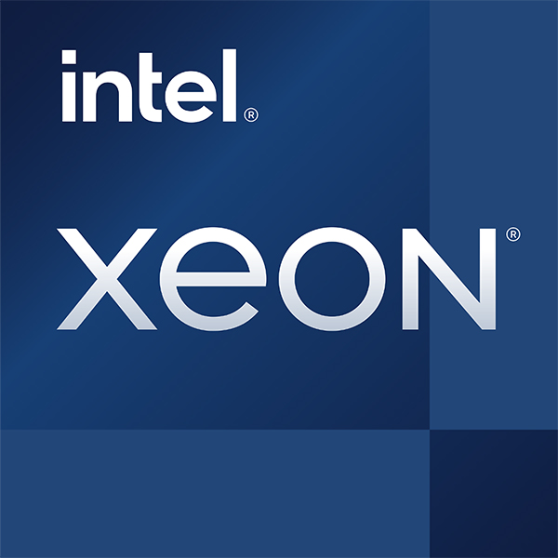
Energy Savings a Click Away
Optimized Power Mode
Save up to
20%
power*
Save up to
140W
per 2-socket
Real-world Zone:
80% of use
Enabled in BIOS
Provides savings on select workloads with a negligible performance impact* at CPU utilization less than 40%
Workloads most likely to benefit:
non latency sensitive, such as AI & database
Low to Intermediate
CPU utilization
(below ~40%)
High/Peak
CPU utilization
Source: Intel
* Performance degradation estimated to be 2-5% on select tested workloads; see intel.com/performanceclaims : 4th Gen Intel Xeon Scalable processors Claim E6.
Notes:
Key message: Improve power consumption without compromising performance.
For sustainability we want to get the green line lower. On Sapphire Rapids, we will focus on 1 & 2.
1. Power reduction up to ~70W per socket for low (Idle) to intermediate (40%) SPECpower load levels while “Active Idle” state is detected and uncore is pulled down to 1.4GHz
2. Power reduction of 25W or less when out of “Active Idle”, but uncore limited to 2.2GHz.
3. No power savings near peak perf where “Active Idle” no longer detected and uncore is running under 2.2GHz

Slide 32
A More Energy Efficient Server Architecture
Intel® Accelerator Engines Raise Performance Per Watt Ceilings
28.85
14.21
13.53
Average of ~2.9X
Improvement
Perf/Watt
8
9.76
Relative Perf/W
Higher is Better
Baseline is
4th Gen Intel Xeon processor with
No Acceleration
IAA
AVX-512
DSA
AMX
QAT
See intel.com/processorclaims: 4th Gen Intel® Xeon® Scalable processors. Claim E1 . Results may vary.
Notes:
This chart shows the perf/watt improvement of 4th Gen Intel Xeon with accelerators on/off on a variety of workloads

Slide 33

AI

Slide 34


The Universal AI Platform
Intel® AI Platform
Any AI code, every workload
Build and deploy everywhere​
Implement pre-built solutions
4th Gen Intel® Xeon® Scalable Processor
Intel AI software suite of optimized open-source frameworks and tools
Extensive Intel AI products
and partnership
The flexibility of Xeon with the built-in DL performance of an AI accelerator
Enables out of the box AI performance and E2E productivity
Accelerate end customer time to market
Up to 10x gen-to-gen model performance¹
Up to 7.7x performance/watt²
Up to 6.7x E2E application performance³
400+ models validated
Example:
Meet 10ms SLA with an order-of-magnitude throughout gains⁴
1,2,3 See [A2, A16, A17, A33] at intel.com/processorclaims: 4th Gen Intel Xeon Scalable processors. Results may vary.
4 See backup for workloads and configurations. Results may vary.
Notes:
We have been working for two years to develop this universal Intel AI Platform to build and deploy AI everywhere
The reason we had to approach this at the platform level is AI requires massive data processing. Therefore, to be practical to bring AI to production the full stack must be optimized from chip to system to libraries to SW to the application. There are three components:
HW: Any code, every workload, built into one GP platform, E2E. 10x DL, 7.7x perf/w, …and now training.
SW: Build and deploy AI everywhere, every developer, open source, python, DL; portable → E2E 6.7x
Partners: Pre-built solutions. In the real world, AI is NOT a benchmark. Customers have SLAs for throughput, latency and flexible in a single platform. …how we are bringing HW and SW together with…
Transition: What does it mean to be a universal AI platform….
************************************************
Any AI code, any workload: The flexibility of Xeon with the built-in DL performance of an AI accelerator
Up to 10x gen-to-gen model performance
MLPerf model training in <30 mins
Up to 7.7x performance/watt
Intel AI software suite of optimized open-source frameworks and tools enables out of the box AI performance and E2E productivity
Up to 6.7x E2E application performance
400+ models validated out-of-box
oneDNN integration into TensorFlow and PyTorch
Extensive Intel AI products and partnership accelerates end customer time to market
62x higher gen-to-gen throughput with 10ms SLA
1.6x faster GNN training for SPR Katana Graph vs NVIDIA A100
2x faster time-to-insight when training multiple DL and ML models
​

Slide 35
4th Gen Intel® Xeon® Processors Improve AI
Advanced Insights with Artificial Intelligence
5.7x
to
10x
Higher Real-time Inference Performance
With built-in Intel AMX (BF16) vs. the prior generation (FP32) with PyTorch ⁵
3.5x
to
10x
Higher Training
Performance
With built-in Intel AMX (BF16) vs. the prior generation (FP32) with PyTorch ⁶
5-See [A17] at intel.com/processorclaims: 4th Gen Intel® Xeon® Scalable processors. Results may vary.
6-See [A16] at intel.com/processorclaims: 4th Gen Intel® Xeon® Scalable processors. Results may vary
*available through select Cloud Service Providers in 2023

Slide 36
Real Workloads:
SLA Compliance with Outstanding Performance Per Watt
30x Vision Throughput Improvement
ResNet-50 Batch Inferencing, TensorFlow, INT8
>12,000 images/sec
441 watts
Power per images/sec (watts)
(Lower is better)
per 1,000 images/sec
85 watts
>400 images/sec
per 1,000 images/sec
Intel® AVX2 [INT8]
Intel® AVX-512 [INT8]
Intel® AVX-512 VNNI [INT8]
Intel® AMX [BF16 and INT8]
Intel® Xeon®
processor
(codenamed Broadwell)
24 cores
Intel® Xeon®
Scalable Processor
(codenamed Sky Lake)
28 cores
2nd Gen Intel® Xeon®
Scalable Processor
(codenamed Cascade Lake)
28 cores
3rd Gen Intel® Xeon®
Scalable Processor
(codenamed Ice Lake)
40 cores
4th Gen Intel® Xeon®
Scalable Processor
(codenamed Sapphire Rapids)
56 cores
See backup for workloads and configurations. Results may vary.
Notes:
Key point is that this G2G comparison uses the same software stack at the same precision (INT8), so the improvements are highly rooted in hardware enhancements
Built-in accelerators are delivering significantly more perf than cores alone – cores increased 2x from SKX to SPR, but perf jumped >10x. Power required for a given SLA has significantly dropped, and again, this is hardware only
The other point is not that customers should run 12k i/s on Xeon. It is that for the majority of customers, Xeon has performance and headroom to run DL along with rest of the workflow.
But since ResNet is the oldest AI benchmark, we went back 6 years to Broadwell era and ran the same code. As you can see images/second has improved 42-fold!! This is simply an unprecedented CAGR for any CPU, perhaps any processor, and way more than the performance-doubling every 18 months often associated best-case with non-AI workloads
As you will hear soon, this observation of ours is not just restricted to a benchmark like ResNet, but extends to E2E complex workflows.

Slide 37
Real Workloads:
Train With Fine Tuning in Less Than 4 Minutes
Fine tuning time-to-train performance
Intel® Xeon® Platinum 8480+ processor vs. Nvidia A100 GPU
In the lab: Intel optimizations to shorten
TTT for large natural language models
(Lower is better)
>1 min faster
than A100
Intel® Tensor Processing Primitives (TPP) Extension for PyTorch
Xeon 8480+ [Intel® Extension for PyTorch
NVIDIA A100 [Stock PyTorch]
Xeon 8480+ [Intel® Optimization for TensorFlow]
NVIDIA A100 [Stock TensorFlow]
NVIDIA A100 [Stock PyTorch]
See backup for workloads and configurations. Results may vary.
Notes:
Most customers are not training from scratch but fine tuning. In other words, more incremental and ongoing training to keep the model up-to-date during deployment.
This can now be done in a matter of minutes on a CPU – which further means more frequent model updates as there is no offload overhead to compensate for short training runs.
In fact, CPUs can train within seconds or a couple of minutes compared to an A100 GPU, which increases productivity without the need for a GPU offload
<build> On the right, Intel lab optimizations which are open-sourced, but haven’t been upstreamed yet show Xeon can also outperform a GPU for fine-tuning with large natural language models
To sum up what you heard from me so far: SPR’s AI goodness in both perf and perf/W terms is unprecedented in both historic CAGR and contemporary competitive terms.
However, all said and done, AI is not a benchmark. Performance matters, but real-world developers and applications matter more. So, now let us move on to talk this

Slide 38








Intel® AI Software Suite
DATA
MODEL
DEPLOY
E2E productivity Intel tools and kits
Intel Developer Catalog
Intel® Dev.Cloud
Early access
Cnvrg.io
MLOPs
Intel AI Kit
Python
BigDL
SPARK
Optimization
Deployment
55+ pre-trained models
NEW
MetaCloud
v2022.3
XGBoost Integration
v2.2
v2022.3
Any framework; optimized for Xeon
1.5.1
0.17
Intel Ext 3.2
v1.4.3
Intel Ext v2023.0
v2.11
IPEX 1.14
Intel oneAPI programming model
oneDAL
oneDNN
oneCCL
oneMKL
V2022.6
v2.7
V2022.7
2022.2
Hypervisors
KVM 5.17
Hyper-V 1H’22
ESXi /vSphere 8.0
OS & Kernel
WinServer22
Linux 5.16
RedHat 8.6
Ubuntu 22.04
SLES15 SP4
*Versions identified are minimum versions that support Intel® AMX
Notes:
Our mantra is help developers use any tools and focus on their model. There is a misnomer around the concept of no-code. There is no way to pre-program AI. We want to help data scientists innovate; we want them to code. Though, we want to make them more productive and automate non-essential tasks
AI SW suite must:
Meet the customers where they are in their AI journey E2E and bottom of the stack to the top of the stack
Allow the DS & developer to use any open source industry library & FW. No walled off gardens
Provide AI tools and services to increase productivity and speed time to develop & expand accessibility
SW suite: Full set of OS/VVM support
oneAPI Programming model. goal OOB perf. 99% of developers do not need to know about what is under the hood
FW/Libs: the performance is native in the popular industry libs. Validated w/400+ DL/ML models. Most developers
Finally, our data science team has worked with customers to develop tools and services– walk through some OV DL up 85% year on year, INC up to 200%
Transition: Suite delivers productivity & performance on any stage or across E2E pipeline. Let’s look at examples

Slide 39




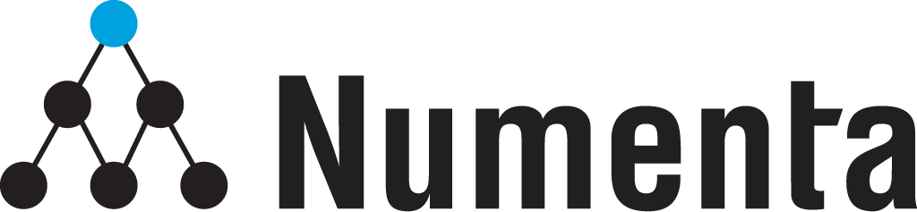
Customer Solutions Realize a Diverse Set of SLAs with the Universal Intel® AI Platform
Real-time
conversational AI
Achieved 10ms
latency SLA
Big data
precision medicine
16x distributed graph analytics
speed up on 8-nodes
No code/low code
AI platform
Augmented analytics
on a single AutoML platform
Sentiment
analysis
E2E AI “test drive” platform,
cloud to edge
AI inference
platform
Hardware aware
AI models
Powerful neuroscience-based solutions
In-memory distributed graph engine
Customer Impact
from AI in 30 days
Digital transformation platform
Scale AI inference
with accuracy
62x
higher gen-to-gen
throughput with
Numenta adaptations
1.6x
faster GNN training (FP32)
for SPR Katana Graph vs
NVIDIA A100
2x
further speed up in
time to insight
4x
faster gen-to-gen
NLP inferencing
3x
higher average perf on
BERT-Large and ResNet50
w/ accuracy gain1
1 Based on geomean of BERT-large and ResNet-50 performance
See backup for workloads and configurations. Results may vary.
Notes:
General speaker notes:
Five of many companies that Intel has worked with before 4th gen has launched to develop Ai services and solutions.
People often ask which use models run best on Xeon. Answer is all models can run on Xeon. The choice to do so depends on the use case. You see here a diversity of models from conversational AI to massive Graph analytics to sentiment analysis.
The use cases exemplified here are two kinds 1) achieve the customers SLA. Numenta and Katana Graph. 2) providing a single platform for Data, ML, DL in the DC and on the factory floor
Numenta: 62x higher gen-to-gen throughput with Numenta value-add based on 3rd Gen Intel® Xeon® Scalable Processor (AVX512) without Numenta optimization compared to 4th Gen Intel® Xeon® Scalable Processor (AMX) with Numenta optimizations.
Aible: Aible is one of our partners that exclusively uses Xeon for TRAINING as part of their automated augmented analytics solution, and the reason they chose Xeon is they are using a mix of shallow and deep neural networks, along with machine learning algorithms, so Xeon makes perfect sense to meet the performance for all their compute needs – no GPU required.
Katana Graph: Distributed E2E GNN training perf using Katana Graph on SPR as compared against stock distDGL on MNMG configurations. Katana software (FP32) on distributed 8 [2s-SPR56c] is 1.6x faster than stock distDGL on distributed 8 [2s-ICX36c + 2 NVIDIA A100-PCIE-40GB] configuration. 16x faster distributed graph partitioning powered by KG’s enterprise SW (multi-node cluster of 8 nodes)
Fujitsu: Fujitsu chose Intel Xeon to be the technology partner for their digital transformation platform. They wanted this platform to have the flexibility to run a variety of ML and DL models with high performance but also cost effectively. With SPR and OpenVino, they have seen a 4X performance improvement G2G for a BERT Large model used in a recommendation engine
Deci: Automatic model acceleration process on SPR – reduces data scientist effort and reduces Xeon inference cost. 3x perf improvement w/ DeciNet & DeciBert over Resnet-50 & BERT using Deci automatic Neural architecture search, no accuracy loss.
Additional notes on each partner:
NUMENTA (NUMENTA
Sparsity workload with BERT 10x faster.
Run BERT in 10 ms for conversational AI -- no CPU could hit the 10 ms latency until now.
Hit critical 10ms customer latency requirement
Achieved transition from ICX to SPR in a matter of days thanks to opensource performant libraries
Ease of use and seamless OpenVINO integration
AIBLE
Aible is one of our partners that exclusively uses Xeon for TRAINING as part of their automated augmented analytics solution, and they guarantee customer impact in 30 days.
In a typical customer scenario there are multiple iterations of training over their dataset - and they may choose to join a new table to the dataset as needed - to get from a state of overwhelming data to converge on the business insights they need. And since their process is automated, reducing the time it takes for individual training iteration directly correlates to a reduction in time-to-insight.
The reason they chose Xeon is they are using a mix of shallow and deep neural networks, along with machine learning algorithms, so only Xeon makes sense to meet the performance for all their compute needs.
4th Gen Xeon with AMX and BF16 support can deliver on average 2.79x gen-to-gen speedup with higher gains on deeper models. Again, this is an average as some shallower models won’t see as much of a speedup. Additionally on the machine learning side, they’re seeing LightGBM model speedup of 1.56x with 4th Gen Xeon and XGBoost optimizations.
When you put it all together, Aible is able deliver up to 2x faster time-to-solution using a single flexible AI platform with 4th Gen Xeon.
KATANA GRAPH
Distributed E2E GNN training performance using Katana Graph on SPR as compared against stock distDGL on MNMG configurations
Katana software (FP32) on distributed 8 [2s-SPR56c] is 1.6x faster than stock distDGL on distributed 8 [2s-ICX36c + 2 NVIDIA A100-PCIE-40GB] configuration
16x faster distributed graph partitioning powered by KG’s enterprise SW (multi-node cluster of 8 nodes)
FUJITSU
Chose Intel as its partner for their digital transformation innovation platform, which features an AI Test Drive for clients to build and experiment with AI technologies.
Used Intel hardware (SPR), software (OpenVino) and partner (Brainpool, an AI data science consultancy) to build a NLP model for sentiment analysis
Fujitsu wanted a all purpose but also cost effective platform that can handle the many AI use cases that their customers and partners will need, and chose Xeon over other specialized compute systems.
DECI.AI
Automatic model acceleration process on SPR – reduce data scientist effort
Reduce Xeon inference cost
Shows best Intel Xeon SPR perf using DeciAI hardware-aware neural architecture search technology and Intel IPEX runtime
3x perf improvement w/ DeciNet & DeciBert over Resnet-50 & BERT using Deci automatic Neural architecture search, no accuracy loss.

Slide 40
4th Gen Intel® Xeon® Processors Advance Data Analytics
With a New Low-Power Offload Engine for In-Memory Data Services Performance
Increases query throughput and decreases memory footprint
Intel® In-Memory Analytics Accelerator (IAA)
Up To
Higher
3x
1
Deeper
compression
Compress
RocksDB
Performance
LLC or memory
using integrated Intel® In-Memory Analytics Accelerator (Intel® IAA) vs. the prior generation¹
Decompress
Scan/Filter
Up To
LLC or memory
2.2x
Higher
2
More effective
bandwidth
3
Core offload
RocksDB
Performance/Watt
Customer Usages: In-Memory Databases, Big Data Analytics, Databases
Notes:
What Is It?
Integrated accelerator IP that accelerates analytics primitives (scan, filter, etc.), CRC calculations, compression, decompression, and more
Up to 4 IAA instances per socket
Advanced offload optimizations such as support for AIA instructions & SVM
Scalable-IOV support for seamless sharing from application user-process, containers and/or virtual machines
Value Prop
Increases query throughput for in-memory database and analytics workloads
Decreases memory footprint for analytics workloads
Target Workloads/Usages
Commercial in-memory databases
Open-Source in-memory database/data stores: RocksDB, Redis, Cassandra, MySQL, PostgreSQL, MongoDB, Memcached and more
Columnar Formats for Big Data Analytics: Apache Parquet, Apache ORC

Slide 41

Security

Slide 42
Your Hardware Platform is a Foundational
Security Decision
Applications
Security Software
Container
No matter how secure your software, there’s always something underneath
Guest OS
Hypervisor/Host OS
Firmware
Hardware
Unless you start here
Notes:
Sometimes people wonder what Intel has to do with security. After all, we’re the company that delivers the microprocessors that power their PCs and servers.
Security solutions is often viewed as software, with companies like CrowdStrike, McAfee, Juniper and Palo Alto coming to mind.
No matter how many layers of strong software security you have, there is always something underneath. An OS or hypervisor vulnerability can compromise an application. Corrupted firmware could compromise an OS or the security software.
The hardware is the foundation of stack that runs your data centers and is key to protecting everything up the stack.
Your hardware platform vendor is your FIRST security decision.

Slide 43



Confidential Computing
Protect Data In Use with a Hardware-based Trusted Execution Environment (TEE)
Activate confidential or regulated data in your Digital Transformation while remaining compliant, even if collaborating with others
Migrate workloads with sensitive data to the cloud with confidence
Add technological controls and safeguards to data sovereignty and governance programs
Strengthen application and data security in data center or edge deployments
Isolation
Encryption and Control
Verification

Slide 44
4th Gen Intel® Xeon® Processors Improve Data Security with Accelerated Cryptography, Enhanced Data Protection, and Platform Security Features
Intel® Software Guard Extensions (Intel® SGX)
Intel® Trust Domain Extensions (Intel® TDX)
Most deployed, researched, and
hardened TEE for the data center
Application or function-level isolation minimizes trust perimeter
Supports virtualized, containerized and bare-metal deployments
Extensive solution provider ecosystem
Available for on-prem or cloud today
VM-level isolation keeps cloud provider & admins outside trust boundary
More straightforward deployment of existing apps into a TEE
Will support cloud management features like VM live migration
Available through select cloud providers in 2023
Notes:
SGX – Software Guard Extensions
What is It?
Provides enhanced security protections for application data independent of operating system
or hardware configuration, and added integrity provides greater resistance against physical attacks
Designed to extend SGX encryption (application isolation), including Integrity, for better security within non-trusted environments
Value Prop
Provides a trusted execution environment for increased protection for confidential data; helps protect against SW attacks and physical integrity attacks
Target Workloads/Usages
Multi party compute
Blockchain
Trusted multi-party compute
Federated learning / Secure analytics
Secure native application hosting
Secure database
Key management
Secure networking
Intel Trust Domain Extensions (Intel TDX)
Intel TDX is a new capability available through select cloud providers in 2023 that
offers increased confidentiality at the virtual machine (VM) level, enhancing privacy
and control over your data. Within an Intel TDX confidential VM, the guest OS and
VM applications are designed to be isolated from access by the cloud host, hypervisor and other
VMs on the platform.

Slide 45

Intel Offers a Range of Protection Options
Any malicious insiders and software across the stack could have access to data in use
Without Confidential Computing
Cloud
Admin
BIOS
Platform
Firmware
Host OS/
Hypervisor
Guest VM
Admin
Guest OS
App
Confidential
Data
Intel TME limits what you have to trust
Protected
with Intel® Total Memory Encryption
Cloud
Admin
BIOS
Platform Firmware
Host OS/
Hypervisor
Guest VM
Admin
Guest OS
App
Confidential
Data
Intel TDX further limits what you have to trust
Protected
with Intel® TDX
Cloud
Admin
BIOS
Platform Firmware
Host OS/
Hypervisor
Guest VM
Admin
Guest OS
App
Confidential
Data
Intel SGX has the least software with potential access to confidential data and vulnerability window limits trust
Protected
with Intel® SGX
Cloud
Admin
BIOS
Platform Firmware
Host OS/
Hypervisor
Guest VM
Admin
Guest OS
App
Enclave
Confidential
Data
Notes:
Key Point: Intel will offer customers the widest range of data protection options to fit the wide range of customer needs.
With the addition of TDX to our data protection technology line-up, Intel will offer customers an unmatched range of options on which to deploy confidential computing solutions. Each solution offers unique security properties and balances data protection with ease-of-deployment.
Intel TME encrypts all the memory on the system with a master key. It is very simple to deploy with just a BIOS switch and provides effective protection against physical attacks on memory, such as cold-boot attack and purpose-built memory probes. TME requires the user to trust all the software in the stack.
Intel TDX encrypts each VM with a tenant-specific key and can be configured with just a few clicks during VM stet-up. With TDX, only the Guest OS and the applications inside the VM are inside the trust boundary. For cloud providers seeking software config uniformity across their fleet, TDX will be the most straight-forward Confidential Computing technology to deploy.
For cloud providers looking for high-security differentiation today and tomorrow, Intel SGX offers the tightest trust boundary and greatest data isolation of any solution in the market, with only the SGX enclave inside the trust boundary. No other software can gain access to the data. Deploying SGX does take more planning and enabling than TME or TDX, but is not the excruciatingly difficult task the competition claims. Several SGX-compatible library OS’s are available today that enable deployment of unmodified apps in SGX enclaves, including Gramine (open source), “Scone” from Scontain, and “Runtime Encryption” from Fortanix.
With these three options, you now have the ability to open up detailed conversations with customers about which best fits their needs.
With Intel, you will have the most comprehensive line-up of confidential computing solutions to sell -- More than AMD and more than AWS’ Graviton & Nitro products.

Slide 46
Intel® Crypto Acceleration Instructions Increase Performance of Encryption Operations
Gen-to-gen encryption improvements on 4th Gen Intel® Xeon® Scalable processor
Encryption improvements on 4th Gen Intel® Xeon® Scalable processor vs. 5-year-old platform
3.85X
Relative Performance
(Higher is Better)
Relative Performance
(Higher is Better)
1.47X
1.52X
2.5X
1.31X
1.34X
Comparable 3rd Gen Intel® Xeon® Scalable processor
Comparable 1st Gen Intel® Xeon® Scalable processor
NGINX TLS 1.3 ECDHE-X25519-RSA2K ^{[N14]}
AES-GCM 128 encode ^{[N62]}
WordPress TLS 1.3 ^{[W9]}
TLS 1.3 AES128-GCM-SHA256 ^{[N12]}
WordPress TLS 1.3 ^{[W9]}
AES-GCM 128 encode^{[N62]}
Please visit https://edc.intel.com/content/www/us/en/products/performance/benchmarks/4th-generation-intel-xeon-scalable-processors/ and use the corresponding performance reference number [#] to access full system configuration and performance details. Performance varies by use, configuration, and other factors. Learn more at www.Intel.com/PerformanceIndex​.
Notes:
This chart shows a gen-to-gen performance comparison across a range of crypto workloads between 3rd Gen and 4th Gen Xeon Scalable (left chart), and the performance gain versus a 5-year-old installed base platform (Skylake).
Gen-to-gen performance improvement ranges from 1.3 to over 1.5X
Performance improvement over an installed base platform range from 2.5X to over 3.8X

Slide 47

Customer Case Studies

Slide 48


RESULTS:
Up to 4.13x improvement in inference performance of conventional vision models from converting models from FP32 to BF16.¹
3x increase in overall efficiency of online
resources and saved 70% on service costs.²
Meituan Accelerates Vision AI Inference Services and Optimizes Costs
For Meituan, vision AI has become the key to driving business model innovation, delivering more accurate and personalized services to users, andenhancing competitive advantages. However, Meituan's vision of AI inference also faces various challenges in computing power and costs. Meituan needs to improve the throughput of its vision AI inference without compromising accuracy to support more intelligent operations. While discrete GPUs can meet performance requirements, their price is relatively high. For low-traffic long-tail model inference services, CPUs are often more cost-effective. To accelerate AI inference, Meituan utilizes advanced hardware capabilities such as 4th Gen Intel® Xeon® Scalable processors and the built-in Intel® Advanced Matrix Extensions (Intel® AMX). By combining these technologies with header service optimization strategies such as dynamic scaling, Meituan has increased the overall efficiency of its online resources.
Products and Solutions 4th Gen Intel® Xeon® Scalable Processors Intel® Advanced Matrix Extensions Intel® Integrated Performance Primitives | Industry Internet, E-commerce | Organization Size 10,001+ | Country China | Partners Ant Group | Learn more Case Study
Link to Deeper Content

Slide 49


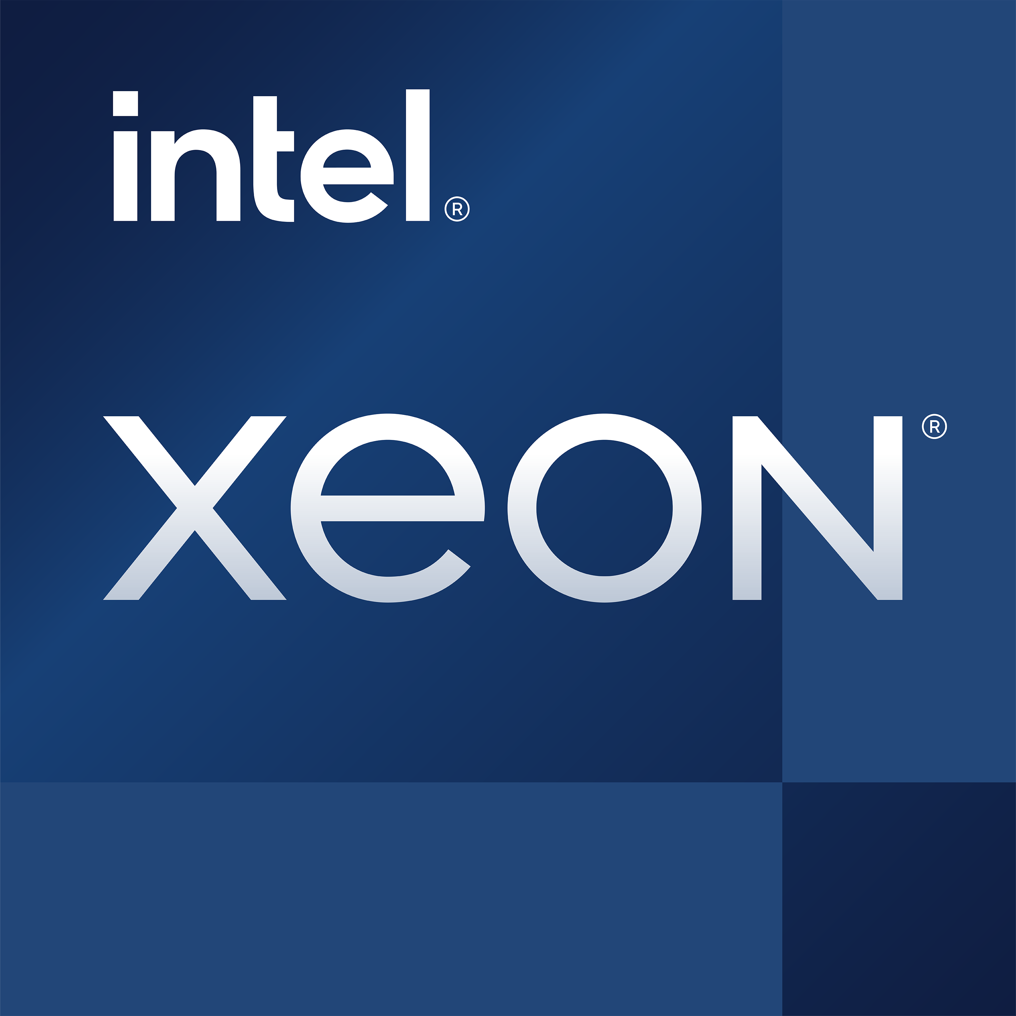
RESULTS:
UP TO
1.775X more performance
on ResNet-50 with Analytics Zoo using bfloat16 vs. FP32. ¹
Accelerating AI Applications on Alibaba Cloud with Analytics Zoo and Bfloat16
Salesforce, a global customer relationship management leader, empowers companies of every size and industry to digitally transform and create a 360° view of their customers. Salesforce infrastructure teams worked with Intel to build a proxy workload with characteristics that match its production workload behavior. This proxy workload helped Salesforce to choose next-generation hardware such as 3rd Generation Intel Xeon Scalable processors for the company’s production environment. By developing a proxy workload, Salesforce was able to explore SKU selection and validation and perform accurate performance analysis without any dependency on early hardware availability or sensitive customer data. Salesforce found that the proxy workload aligns almost exactly to the production workload performance (within ~5 percent), providing a far more accurate prediction for workload behavior than provided by the industry-standard benchmarks.
Products and Solutions 3rd Gen Intel® Xeon® Scalable processors Intel® Deep Learning Boost Analytics Zoo | Industry Cloud | Organization Size 10,001+ | Country China | Learn more White Paper
Link to Deeper Content

Slide 50


RESULTS:
UP TO
53% performance gain
gain on raw input, compared to the previous generation of processors.¹
Collaborating to Optimize Hardware for Real-World Workloads
Salesforce, a global customer relationship management leader, empowers companies of every size and industry to digitally transform and create a 360° view of their customers. Salesforce infrastructure teams worked with Intel to build a proxy workload with characteristics that match its production workload behavior. This proxy workload helped Salesforce to choose next-generation hardware such as 3rd Generation Intel Xeon Scalable processors for the company’s production environment. By developing a proxy workload, Salesforce was able to explore SKU selection and validation and perform accurate performance analysis without any dependency on early hardware availability or sensitive customer data. Salesforce found that the proxy workload aligns almost exactly to the production workload performance (within ~5 percent), providing a far more accurate prediction for workload behavior than provided by the industry-standard benchmarks.
Products and Solutions 3rd Generation Intel® Xeon® Scalable Processors Intel® oneAPI toolkits Intel® VTune™ Profiler | Industry CRM, Internet | Organization Size 10,000+ | Country United States | Learn more White Paper
Link to Deeper Content

Slide 51


Wasabi Delivers Simple, Predictable, and Affordable Hot Cloud Storage
Wasabi is revolutionizing the economics of data storage by pioneering the concept of the bottomless cloud. Simply put, the bottomless cloud is the ability to store everything in a cost-effective way via a single storage tier that treats all data as hot data. One of the ways Wasabi accomplishes this is with 3rd Gen Intel® Xeon® Scalable processors and hardware-enabled Intel® Crypto Acceleration to help eliminate the performance overhead of data encryption. Intel® processors with Intel Crypto Acceleration reduce the performance impact of highly performant encryption while maintaining maximum connections per second to satisfy service level agreements. Customers benefit from a simple, predictable, highly durable cloud storage service with full end-to-end encryption.
“Our value to customers
is price, performance,
and protection. Our
ability to deliver on
those promises is made
on the components we
choose, and Intel helps
with that.”
— Jim Donovan,
SVP of Product,
Wasabi Technologies
Products and Solutions 3rd Gen Intel® Xeon® Scalable Processors Intel® Crypto Acceleration | Industry Cloud Storage | Organization Size 201–500 | Country United States | Learn more Case Study
Link to Deeper Content

Slide 52


Deep Learning Recommender System for personalized marketing business services
Mastercard, as a leading global provider of payment solutions, is integrating artificial intelligence (AI) into its platform to serve its customers better. Running Analytic Zoo, which supports BigDL on Spark running on large Intel® Xeon® Scalable processor clusters, is an ideal solution that meets enterprise requirements for deep learning, as it allows users to develop and run deep learning applications in production directly on existing big data (Apache Hadoop/Spark) infrastructure.
Products and Solutions Intel® Xeon® Scalable processors | Industry Financial Services | Organization Size ~ 21000 | Country United State | Partners Mastercard | Learn more Case Study
Link to Deeper Content

Slide 53

RESULTS:
UP TO
60% greater accuracy
Versus previous system ¹
A More Proactive, Intelligent Way of Helping Protect Customers from Fraud
China UnionPay specializes in banking services and payment systems. It is the third-largest payment network in the world. China UnionPay wanted to detect fraudulent credit card transactions with more coverage and accuracy, so the company deployed an intelligent artificial neural network risk-control system based on Apache Spark computing clusters and BigDL. China UnionPay deployed the system with a Cloudera CDH compute cluster running on Intel® Xeon® processors. China UnionPay delivered up to 60 percent greater accuracy versus its rules-based risk-control systems when using the new system1. The new platform uses machine learning to deliver greater consistency and efficiency while significantly reducing person-hours for user development, deployment, and maintenance.
Products and Solutions Intel® Xeon® Scalable processors | Industry Financial Services | Organization Size 1,001-5,000 | Country People’s Republic of China | Partners Cloudera | Learn more Case Study
Link to Deeper Content

Slide 54


Privacy Preserving Machine Learning powered by Intel SGX and DL Boost
Ant Group has collaborated with Intel to build a PPML platform on top of Intel® Software Guard Extensions (Intel® SGX) and Occlum, Ant Group’s memory-safe, multi-process library OS for Intel SGX. This blog provides an overview of the solution, which runs on Analytics Zoo. We also show the solution’s performance benefits when accelerated with Intel® Deep Learning Boost (Intel® DL Boost) on 3rd Gen Intel® Xeon® Scalable processors.
Products and Solutions Intel® Xeon® Scalable processors | Industry Financial Services | Organization Size ~ 21000 | Country United State | Partners Ant Group | Learn more Case Study
Link to Deeper Content

Slide 55

RESULTS:
30% improvement in end-user application performance
50% improvement in processing batch jobs
&
IRSAP Group
IRSAP Boosts Business Agility to Pace Trends
The IRSAP Group is a market-leading, family-owned, Italian business and a core protagonist in the European heating and ventilation sectors. Founded in 1963 in Rovigo, Italy, IRSAP achieves worldwide sales of ca. EUR110 million in over 60 countries and employs more than 1,000 people. The group operates two manufacturing sites for designer radiators and towel rails: Arquà Polesine (Rovigo, Italy) and Cluj Napoca (Romania), spanning ca. 500,000 m2 of automated and manned production facilities.
“Cutting the time taken to complete planning process in half helps our teams to work more efficiently and ensure we always have the right materials at the right time to meet customer demand,” says Marco Monesi, CFO. “Since migrating SAP ERP to the SAP HANA platform on Lenovo HCI, batch processing jobs are 50% faster on average.¹ Thanks to the Intel Xeon Scalable processors, end-user application performance has also improved by around 30%², empowering employees to work more productively.”
— Marco Monesi, CFO, Eurosystem & Estecom
CHALLENGE
Upgrade SAP ERP to SAP HANA with consistent production, quality assurance, and development systems.
SOLUTION
Lenovo ThinkAgile HX Solution for SAP HANA, powered by Intel® Xeon® Scalable processors and Nutanix Enterprise Cloud software, was developed in collaboration with SAP and specifically engineered and optimized for SAP HANA workloads in hyperconverged clusters. The Intel Xeon Scalable processors support high main-memory capacities—crucial for running SAP HANA workloads, as the platform keeps all data in-memory—and boast an increase in in core-count over previous generations of Intel® processors. IRSAP found that the Lenovo ThinkAgile HX solution delivers up to a 50% performance boost over IRSAP’s legacy infrastructure.1 The HCI consolidates storage and compute into a single virtual pool with a simple management interface.
Link to Deeper Content

Slide 56
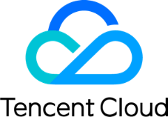
RESULTS:
Intel® Deep Learning Boost built-in 2nd gen Intel® Xeon® Scalable processors accelerated deep learning model for Tencent Cloud’s intelligent video analysis by 3.26x.
2nd gen Intel Xeon Scalable processor and Intel® Optane™ persistent memory enabled Tencent Cloud to increase a single-instance memory capacity of cloud database services for Redis by up to 1.34x under the same SLA and corresponding cost.
Creating Diverse and Efficient Cloud Services
With more than 10 years of rapid development, cloud services have become the cornerstone for many organization to work with data and support business development. At the same time, the types of services they cover and the improvement of their service capabilities have also gone broader and deeper. Especially when innovative applications like cloud-based artificial intelligence (AI) and big data analysis are getting mature, a new generation of diverse cloud services, represented by Database as a Services (DBaaS) or Data Analysis as a Services (DaaS) and AI as a Services (AIaaS), has become an enabler for enterprises to implement digital transformation. As a leader in China’s cloud services industry, Tencent Cloud takes innovation as its mission and is committed to providing users with these cloud services with higher agility, efficiency, reliability and diversity.
“It has been Tencent Cloud’s vision and mission to provide users with a better service experience on its industry-leading hardware architecture. Through In-depth collaboration with Intel, especially with the introduction of the 2nd gen Intel® Xeon® Scalable processor and Intel® Optane™ persistent memory, Tencent Cloud is able to take the lead continuously in innovation such as AI-based cloud services and data base cloud services, providing users with more diversified, differentiated and efficient cloud services.
— Ying Lui, Vice President, Tencent Cloud
CHALLENGE
Innovate new cloud services offerings for AIaaS, DBaaS, and DaaS
SOLUTION
Customized 2nd gen Intel® Xeon® Scalable processors with built-in Intel® Deep Learning Boost (DL Boost) for intelligent video analysis
2nd gen Intel® Xeon® Scalable processors and Intel® Optane™ persistent memory
Link to Deeper Content

Slide 57
Notices and Disclaimers
Legal Notices and Disclaimers
Performance varies by use, configuration and other factors. Learn more on the Performance Index site.
Performance results are based on testing as of dates shown in configurations and may not reflect all publicly available updates. See backup for configuration details. No product or component can be absolutely secure.
Your costs and results may vary.
Intel technologies may require enabled hardware, software or service activation.
Intel does not control or audit third-party data. You should consult other sources to evaluate accuracy.
© Intel Corporation. Intel, the Intel logo, and other Intel marks are trademarks of Intel Corporation or its subsidiaries. Other names and brands may be claimed as the property of others.

Slide 59
Configuration Details – Intel DSA, QAT, and IAA
Intel® Data Streaming Accelerator (Intel® DSA) Faster Data Movement In and Out of Storage
8490H: 1-node, 2x pre-production 4th Gen Intel Xeon Scalable processor (60 core) with integrated Intel Data Streaming Accelerator (Intel DSA), DSA device utilized=1(1 active socket), on pre-production Intel platform and software with 1024GB DDR5 memory (16x64 GB), microcode 0xf000380, HT On, Turbo On, SNC Off, Ubuntu 22.04.1 LTS, 5.15.0-47-generic, 1x 1.92TB Intel® SSDSC2KG01, 4x 1.92TB Samsung PM1733, 1x Intel® Ethernet Network Adapter E810-2CQDA2, 2x100GbE, FIO v3.30, SPDK 22.05, tested by Intel September 2022.
8380: 1-node, 2x production 3rd Gen Intel Xeon Scalable Processors( 40 cores) on Coyote Pass platform, DDR4 memory total 1024GB (16x64 GB), microcode 0xd000375, HT On, Turbo On, SNC Off, Ubuntu 22.04.1 LTS, 5.15.0-47-generic, 1x 1.92TB Intel SSDSC2KG01, 4x 1.92TB Samsung PM1733, 1x Intel Ethernet Network Adapter E810-2CQDA2, 2x100GbE, FIO v3.30, SPDK 22.05, tested by Intel October 2022.
Intel® QuickAssist Technology (Intel® QAT) Hardware Acceleration of Data Compression
Software Baseline: Test by Intel as of 10/26/2021. 1-node, 2x Intel® Xeon® Platinum 8358 Processor on Wilson City (ref. platform), 32 cores with 1024 GB (16 slots/ 64GB/ 3200[3200]) total DDR4 memory, ucode 0xD000323, HT on, Turbo on, Windows Server 2019,10.0.17763.1999, [Hyper-V VM], 1x Intel X550, SQL Server 2022 CTP1.1 private test build, 525GB Database, Database Backup with Compression​. With Intel® Quickassist Adapter 8970 Technology: Test by Intel as of 10/26/2021. 1-node, 2x Intel® Xeon® Platinum 8358 Processor on Wilson City (ref. platform), 32 cores with 1024 GB (16 slots/ 64GB/ 3200[3200]) total DDR4 memory, ucode 0xD000323, HT on, Turbo on, with Intel® QuickAssist Adapter 8970, 1.70.16.4 driver version, Windows Server 2019,10.0.17763.1999, [Hyper-V VM], 1x Intel X550, SQL Server 2022 CTP1.1 private test build, 525GB Database, Database Backup with Compression​. With Intel® Intelligent Storage Acceleration Library: Test by Intel as of 10/26/2021. 1-node, 2x Intel® Xeon® Platinum 8358 Processor on Wilson City (ref. platform), 32 cores with 1024 GB (16 slots/ 64GB/ 3200[3200]) total DDR4 memory, ucode 0xD000323, HT on, Turbo on, with Intel® Intelligent Storage Acceleration Library v2.30.0.0, Windows Server 2019,10.0.17763.1999, [Hyper-V VM], 1x Intel X550, SQL Server 2022 CTP1.1 private test build, 525GB Database, Database Backup with Compression​. Results may vary.
Intel® In-Memory Analytics Accelerator (Intel® IAA) Delivers Faster Data Services Performance – 3X Rocks DB Performance & Rocks DB 2.2X Perf/Watt Claim
8490H: 1-node, pre-production Intel platform with 2x 4th Gen Intel Xeon Scalable Processor (60 cores) with integrated Intel In-Memory Analytics Accelerator (Intel IAA), HT On, Turbo On, Total Memory 1024GB (16x64GB DDR5 4800), microcode 0xf000380, 1x 1.92TB INTEL SSDSC2KG01, Ubuntu 22.04.1 LTS, 5.18.12-051812-generic, QPL v0.1.21,accel-config-v3.4.6.4, ZSTD v1.5.2, RocksDB v6.4.6 (db_bench), tested by Intel September 2022.
8380: 1-node, 2x 3rd Gen Intel Xeon Scalable Processors( 40 cores) on Coyote Pass platform, HT On, Turbo On, SNC Off, Total Memory 1024GB (16x64GB DDR4 3200), microcode 0xd000375, 1x 1.92TB INTEL SSDSC2KG01, Ubuntu 22.04.1 LTS, 5.18.12-051812-generic, ZSTD v1.5.2, RocksDB v6.4.6 (db_bench), tested by Intel October 2022.

Slide 60
SAP Configuration Details
2.3X OLAP Claim
4th Gen Xeon (SPR) Config: Test by Intel as of November 7,2022 Platform: Archer City; Processor: pre-production 8490H 60C, 1.9GHz, 350W; BIOS: SE5C6200.86B.0022.D64.2105220049; Microcode: 0xAB0000C0; Memory: 2TB (32x64GB DDR5 4800 MT/s – running at 4400MT/s); OS SLE 15 SP4; Linux Kernel: 5.14.21-150400.22-default Score 7893 Queries/Hour (QpH)
2nd Gen Xeon (CLX) Config: Test by Intel as of March 2021 Platform: Wolf Pass; Processor: 8280L 28C, 2.7GHz, 205W; BIOS: SE5C620.86B.02.01.0013.121520200651; Microcode: 0x5003006; Memory: 1.5TB (24x64GB DDR4 2667 MT/s); OS SLE 15 SP2; Linux Kernel: 5.3.18-22-default Score 3376 Queries/Hour (QpH)
CLX/SPR Benchmark Config - HANA: HANA2 SP05 Rev52; NetWeaver 7.50; Benchmark kit: V3.17 (20200804); Dataset size: 2 (2.6 billion initial records)
4th Gen Xeon (SPR) of score of 7893 QpH divided by 2nd Gen Xeon (CLX) score of 3376 QpH = 2.34X
2:1 Consolidation Claim
Note: SAP Hana is a regulated workload. SAP defines the configuration details for Top Performance for each generation
Per SAP Documentation:
2nd Gen Xeon (CLX) supports 768GB/Socket for analytical workloads = 1.5TB/ 2 Socket System
4th Gen Xeon (SPR) supports 1.5TB/Socket for analytical workloads = 3TB/ 2 Socket System
A typical scenario using 3TB of Hana Data would have required a 4 Socket System on a 2nd Gen Xeon (CLX)
For 4th Gen Xeon (SPR), that same amount of data (3TB) can now be managed on a single 2 Socket Platform = 2:1 Consolidation
Notes:
4th Gen Config 3: Tested by Intel on November 2022, 1-node, 2x Intel® Xeon® 8490H, E3 stepping, 60 cores, 80KB L1 cache and 2MB L2 cache per core, 112MB L3 cache per processor, HT On, Turbo On, SNC disabled, Total Memory 2048 GB (32 x 64GB 4800 MHz [run @ 4400 MHz] ), BKC WW41->BIOS: EGSDCRB1.SYS.8901.P01.2209200243, ucode: 0xAB0000C0, OS: SLES15 SP4, kernel: 5.14.21-150400.22-default, HANA: 2.00.052.00.1599235305, NetWeaver: 7.50, Benchmark kit: 3.17, Score 7893 Queries/Hour

Slide 61
Broad Institute GATK Configuration Details
4th Generation Intel® Xeon® Scalable Processors : Test by Intel as of November 7,2022. Single-node (compute and front-end node combined) 2x Intel® Xeon® Platinum 8460Y+, 160 cores, HT On, Turbo On, Total Memory 512GB (16 slots/ 32GB/ 4800 MT/s), BIOS version 3A05, Microcode 0x2b000070, Rocky Linux 8.6, Kernel 4.18.0-372.32.1.el8_6.x86_64, Workload: WholeGenomeGermlineSingleSample 3.1.6, gatk 4.2.6.1, java-1.8.0-openjdk & java-11-openjdk, Cromwell v. 84, Picard 2.27.4, Samtools 1.11, bwa 0.7.17, VerifyBamID 2.0.1, MariaDB 10.3.35
3rd Generation Intel® Xeon® Scalable Processors : Test by Intel as of November 7,2022. Single-node (compute and front-end node combined) 2x Intel® Xeon® Platinum 8358 CPU @ 2.60GHz, 128 cores, HT On, Turbo On, Total Memory 512GB (16 slots/ 32GB/ 3200 MT/s), BIOS version WLYDCRB1.SYS.0021.P25.2107280557, Microcode 0xd000363, Rocky Linux 8.6, Kernel 4.18.0-372.32.1.el8_6.x86_64, Workload: WholeGenomeGermlineSingleSample 3.1.6, gatk 4.2.6.1, java-1.8.0-openjdk & java-11-openjdk, Cromwell v. 84, Picard 2.27.4, Samtools 1.11, bwa 0.7.17, VerifyBamID 2.0.1, MariaDB 10.3.35
2nd Generation Intel® Xeon® Scalable Processor Configuration: Test by Intel as of November 14, 2019. One front-end node and four compute nodes, all using Intel® Server Board S2600WFT. Front-end node configuration: 2x Intel® Xeon® Gold 6252 processor (24 cores, 2.10 GHz); total memory 64 GB (4 slots/16 GB/2933 MHz); 1x 960 GB Intel® SSD D3-S4510 Series (2.5 in SATA 6 Gb/s, 3D2,TLC); 1x 1.6 TB Intel® SSD DC P4610 Series (2.5 in PCIe 3.1 x4, 3D2, TLC); Microcode: 0x500002c, BIOS: SE5C620.86B.02.01.0009.092820190230; CentOS Linux Installation ISO (minimal or full) 7.7 build 1910; Intel® oneAPI Runtimes 2019.4; Intel® Cluster Checker 2019.3.5; Intel® Select HPC Solution for RPM packages for EL7 2018.0; OpenHPC 1.3.8. 4x compute nodes configuration: 2x Intel® Xeon® Gold 6252 processor (24 cores, 2.10 GHz); total memory 384 GB (12 slots/32 GB/2933 MHz); 1x 960 GB Intel SSD D3-S4510 Series (2.5 in SATA 6 Gb/s, 3D2, TLC); 1x 1.6 TB Intel SSD DC P4610 Series (2.5 in PCIe 3.1 x4, 3D2, TLC); Network devices: 1x Intel® C620 Series Chipset Ethernet Connection; Intel® Ethernet Adapter X722 onboard 10 GbE; Microcode: 0x500002c, BIOS: SE5C620.86B.02.01.0009.092820190230; CentOS Linux Installation ISO (minimal or full) 7.7 build 1910; 1x distributed 10 GB Lustre 2.10 ZFS system, 6 OST, 3 OSS, Lnet Router with single 10 GB link for all I/O traffic clients to Lustre servers.
1st Generation Intel® Xeon® Scalable Processor Configuration: Test by Intel as of October 15, 2018. Single-node (compute and front-end node combined) configuration: 2x Intel® Xeon® Gold 6152 processor (22 cores, 2.10 GHz); Intel® Server Board S2600WFT; total memory 192 GB (12 slots/16 GB/2666 MHz); boot storage: 2x 480 GB Intel® SSD DC S3520 Series; cache storage: 4x 4 TB Intel® SSD DC P4600 Series PCIe HHHL; capacity storage: 16 TB of 4x 4 TB Intel® SSD DC P4510 Series; Intel Hyper-Threading Technology = ON, Intel Turbo Boost Technology = ON; Microcode: 0x043; CentOS Linux installation 7.6.
2.7X - Comparing 4 genome/node/day in 2018 using Intel® Xeon® Gold 6152 & GATK 4.0 vs 10.94 Genomes/node/day suing using Intel Xeon Platinum 8460Y and GTK 4.2.6
Cost /Genome Calculation details
The costs assume a single node costs ~$12.5K and that it is depreciated over 3 years. CLX case is 8.0 WGS/node/day x 365 days x 3 years = 8,760 WGS over 3 years.
$12,500 divided by 8,760 = $1.43, so for the SPR case: 10.94 WGS/node/day x 365 days x 3 years = 11,979 WGS over 3 years. $12,500 divided by 11,979 = $1.04
As a percent difference, (($1.04-$1.43)/$1.04) you get -36.8%
Notes:
3rd Generation Intel® Xeon® Scalable Processor Configuration: Test by Intel as of August 8, 2021. One front-end node and four compute nodes, all using Intel® Server Board M50CYP2SB-003. 1x front-end configuration: 2x Intel® Xeon® Gold 6348 processor (28 cores, 2.60 GHz); Intel® Hyper-Threading Technology = ON, Intel® Turbo Boost Technology = ON, total memory 256 GB (16 slots/16 GB/3200 MHz); BIOS version: 22D08; BMC 2.66, SDR 0.31, CPLD 3p0; Microcode: 0x0b000280; CentOS Linux installation ISO (minimal or full) 8 build 2011; storage – boot drive 1x Intel® SSD P4610 1.6 TB (3D NAND PCIe 3.1 x4, 3D1, TLC); high-performance network: 1x Intel® Ethernet Converged Network Adapter X550-T2 (10 GbE), model X550T2. 4x compute nodes configuration: 2x Intel® Xeon® Gold 6348 processor (28 cores, 2.60 GHz); Intel Hyper-Threading Technology = ON, Intel Turbo Boost Technology = ON, total memory 512 GB (16 slots/32 GB/3200 MHz); BIOS version: 22D08; BMC 2.66, SDR 0.31, CPLD 3p0; Microcode: 0x0b000280; CentOS Linux installation ISO (minimal or full) 8 build 2011; storage – scratch drive: 1x Intel SSD P4610 1.6 TB (3D NAND PCIe 3.1 x4, 3D1, TLC); high-performance network: 1x Intel Ethernet Converged Network Adapter X550-T2 (10 GbE), model X550T2.

Slide 62
Microservices and Accelerators Configuration Details
Up to 56% latency reduction on NGINX with DLB: compares 4th Gen Intel Xeon processor with DLB (IDXD-CONFIG-ACCEL-CONFIG-V3.4.1) versus without. Test by Intel as of 11/18/2021 1-node, 2x Intel® Xeon® 2S 96core HT /Off, Turbo Off?, Total Memory 512 GB (12 slots/ 16 GB/ 4400 MHz [run @ 2200 MHz] ), EGSDCRB1.86B.0065.D15.2109172316, 0x8d0002f0, CentOS Linux 8, 5.12.0-0507.intel_next.08_16.2_po.36.x86_64+server, gcc (GCC) 8.4.1 20200928 (Red Hat 8.4.1-1), Open Vswitch- OVS 2.16, DPDK 21.11-rc1, 1.17mpps, with 10KB packets and 40k connections.
Up to 2.5x higher throughput (RPS) on 4th Gen Intel Xeon Platinum 8480+ (8c/16t) with 2 QAT devices compared to solution with no acceleration on Istio Envoy Ingress. 8480+: 1-node, pre-production platform with 2x Intel® Xeon® Platinum 8480+ with Intel QAT on Intel ArcherCity with GB (16 slots/ 32GB/ DDR5 4800) total memory, ucode 0x2b0000a1, HT on, Turbo off, Ubuntu 22.04.1 LTS, 5.17.0-051700-generic, 1x 54.9G INTEL SSDPEK1A058GA, 1x Ethernet Controller I225-LM, 4x Ethernet Controller E810-C for QSFP, 2x Ethernet Controller XXV710 for 25GbE SFP28, Nighthawk, gcc version 11.2.0, Docker 20.10.17, Kubernetes v1.22.3, Calico 3.21.4, Istio 1.13.4. DLB SW v 7.8, qatlib is 22.07.1, Nighthawk POD’s with response size: 25 PODs each with 1kB/10kB/1MB/mixed size, test by Intel on 10/27/2022.
Up to 1.16 improved 999 patency per core on gRPC on 4th Gen Intel Xeon Platinum 8480+ vs. prior generation.
8480+: Test by Intel as of Oct 24 10:29:20. 1-node, 2x Intel(R) Xeon(R) Platinum 8480+, 56 cores, HT Off, Turbo Off, Total Memory 1024GB (32x32GB DDR5 4800 MT/s [4400 MT/s]), BIOS EGSDCRB1.SYS.8901.P01.2209200243, microcode 0x2b0000a1, 1x Ethernet Controller I225-LM, 4x Ethernet Controller E810-C for QSFP, 2x Ethernet Controller XXV710 for 25GbE SFP28, 1x 54.9G INTEL SSDPEK1A058GA, 2x 372.6G INTEL SSDPF21Q400GB, Ubuntu 22.04.1 LTS, 5.15.0-52-generic, g++ (Ubuntu 11.3.0-1ubuntu1~22.04) 11.3.0, go version go1.17.5 linux/amd64, Ghz v0.110.0, gRPC v1.49, 5496.879167 and 5557.79 throughput/core for C++ and Go for Echo message, and 4392.733333 and 4396.638333 throughput/core for C++ and Go for B1M1 message
8360Y: Test by Intel as of Oct 27 10:34:23. 1-node, 2x Intel(R) Xeon(R) Platinum 8360Y CPU @ 2.40GHz, 36 cores, HT Off, Turbo Off, Total Memory 512GB (32x16GB DDR4 3200 MT/s [3200 MT/s]), BIOS SE5C620.86B.01.01.0004.2110190142, microcode 0xd000375, 1x Ethernet Controller E810-C for QSFP, 2x BCM57416 NetXtreme-E Dual-Media 10G RDMA Ethernet Controller, 2x 1.8T INTEL SSDPE2KX020T8, Ubuntu 22.04.1 LTS, 5.15.0-52-generic, g++ (Ubuntu 11.3.0-1ubuntu1~22.04) 11.3.0, go version go1.17.5 linux/amd64, Ghz v0.110.0, gRPC v1.49, 4838.819 and 4868.116 throughput/core for C++ and Go for Echo message, and 3773.04 and 3785.163 throughput/core for C++ and Go for B1M1 message.
Up to 1.6X higher Server-side Critical JOPs on 4th Gen Intel Xeon Platinum 8480+ vs prior generation (Geonmean of 10ms, 25ms, 50ms, 75ms, and 100ms response times)
Server-side Java* 1-node, preproduction platform with 2x Intel® Xeon® Platinum 8480+ on ArcherCity with 1024 GB (16 slots/ 64GB/ DDR5 4800[4800]) total memory, ucode 0x2b0000a1, HT on, Turbo on, Ubuntu 22.04 LTS, 5.15.0-52-generic, Server-side Java* (Critical JOPS), JDK17, test by Intel on 10/31/2022.
1-node, preproduction platform with 2x Intel® Xeon® Platinum 8380 on Intel Rack Mount Chassis with 512 GB (16 slots/ 32GB/ DDR4 3200[3200]) total memory, ucode 0xd000375, HT on, Turbo on, Ubuntu 22.04.1 LTS, 5.15.0-52-generic, Server-side Java* (Critical JOPS), JDK17, test by Intel on 11/2/2022.
Up to 3.5x higher batch Recommendation System inference performance (DLRM) on 4th Gen Intel Xeon Platinum 8480+ with AMX INT8 vs. prior generation with INT8.
8480: 1-node, pre-production platform with 2x Intel Xeon Platinum 8480+ on Archer City with 1024 GB (16 slots/ 64GB/ DDR5-4800) total memory, ucode 0x2b0000a1, HT on, Turbo on, CentOS Stream 8, 5.15.0, 1x INTEL SSDSC2KW256G8 (PT)/Samsung SSD 860 EVO 1TB (TF), DLRM, Inf: bs=n [1socket/instance], Inference: bs: fp32=128, amx bf16=128, amx int8=128, Training bs:fp32/amx bf16=32k [1 instance, 1socket], Criteo Terabyte Dataset, Framework: https://github.com/intel-innersource/frameworks.ai.pytorch.private-cpu/tree/d7607bdd983093396a70713344828a989b766a66; Modelzoo: https://github.com/IntelAI/models/tree/spr-launch-public, PT:1.13, IPEX: 1.13, OneDNN: v2.7, test by Intel on 10/24/2022.
8380: 1-node, 2x Intel Xeon Platinum 8380 on M50CYP2SBSTD with 1024 GB (16 slots/ 64GB/ DDR4-3200) total memory, ucode 0xd000375, HT on, Turbo on, Ubuntu 22.04 LTS, 5.15.0-27-generic, 1x INTEL SSDSC2KG960G8, DLRM, Inf: bs=n [1socket/instance], Inference: bs: fp32=128, int8=128, Training bs:fp32=32k [1 instance, 1socket], Criteo Terabyte Dataset, Framework: https://github.com/intel-innersource/frameworks.ai.pytorch.private-cpu/tree/d7607bdd983093396a70713344828a989b766a66; Modelzoo: https://github.com/IntelAI/models/tree/spr-launch-public, PT:1.13, IPEX: 1.13, OneDNN: v2.7, test by Intel on 10/24/2022.
Up to 3x higher RocksDB performance with 4th Gen Intel Xeon Platinum 8490H using integrated Intel IAA vs. prior generation.
8490H: 1-node, pre-production Intel platform with 2x 4th Gen Intel Xeon Scalable Processor (60 cores) with integrated Intel In-Memory Analytics Accelerator (Intel IAA), HT On, Turbo On, Total Memory 1024GB (16x64GB DDR5 4800), microcode 0xf000380, 1x 1.92TB INTEL SSDSC2KG01, Ubuntu 22.04.1 LTS, 5.18.12-051812-generic, QPL v0.1.21,accel-config-v3.4.6.4, ZSTD v1.5.2, RocksDB v6.4.6 (db_bench), tested by Intel September 2022.
8380: 1-node, 2x 3rd Gen Intel Xeon Scalable Processors( 40 cores) on Coyote Pass platform, HT On, Turbo On, SNC Off, Total Memory 1024GB (16x64GB DDR4 3200), microcode 0xd000375, 1x 1.92TB INTEL SSDSC2KG01, Ubuntu 22.04.1 LTS, 5.18.12-051812-generic, ZSTD v1.5.2, RocksDB v6.4.6 (db_bench), tested by Intel October 2022.

Slide 63
Deathstar Bench Configuration Details
1.61X and 1.88X higher results with 4th gen Intel Xeon processors vs prior generation on DeathstarBench for Hotel Reservation and Social Network models respectively.
Hotel Reservation
8480+: 4 (1master, 3worker)-node, each-node, pre-production platform with 2x Intel® Xeon® Platinum 8360Y on Intel M50CYP2SBSTD with GB (32 slots/ 16GB/ DDR4 3200) total memory, ucode 0xd000375, HT on, Turbo on, Ubuntu 22.04 LTS, 5.15.0-52-generic with intel_iommu=off, 1x 223.6G KINGSTON SA400M8, 8x 2.9T INTEL SSDPE2KE032T8, 2x Ethernet Controller E810-C for QSFP, 2x BCM57416 NetXtreme-E Dual-Media 10G RDMA Ethernet Controller, DeathStarBench hotelReservation 1.0 [ lianhao/dsbpp_hotel_reserve:1.0], Golang 1.17.3, GNU C Library 2.31-13+deb11u2, ice 5.15.0-52-generic, Kubernetes 1.23.6, Containerd 1.6.6 CRI-RM 0.7.0, Cilium: 1.11.7, gRPC-go 1.1, Consul 1.9.2, Memcached 1.6.8, MongoDB 4.4.3, Traffic generator open loop wrk2 included in DSB: mixed-workload_type_1.lua, 4 instance, 6 replica/instance, 4 wrk2 instance, 32 wrk2 thread/instance, 1920 wrk2 connection/instance, 44.5k wrk2 input rate/instance., test by Intel on 11/9/2022.
8360Y: 4 (1master, 3worker)-node, each-node, 2x Intel® Xeon® Platinum 8480+ on Intel ArcherCity with GB (32 slots/ 32GB/ DDR5 4800) total memory, ucode 0x2b0000a1, HT on, Turbo on, Ubuntu 22.04 LTS, 5.15.0-52-generic with intel_iommu=off, 1x 54.9G INTEL SSDPEK1A058GA, 4x Ethernet Controller E810-C for QSFP, 2x Ethernet Controller XXV710 for 25GbE SFP28, DeathStarBench hotelReservation 1.0 [ lianhao/dsbpp_hotel_reserve:1.0], Golang 1.17.3, GNU C Library 2.31-13+deb11u2, ice 5.15.0-52-generic, Kubernetes 1.23.6, Containerd 1.6.6 CRI-RM 0.7.0, Cilium: 1.11.7, gRPC-go 1.1, Consul 1.9.2, Memcached 1.6.8, MongoDB 4.4.3, Traffic generator open loop wrk2 included in DSB: mixed-workload_type_1.lua, 4 instance, 6 replica/instance, 4 wrk2 instance, 48 wrk2 thread/instance, 1920 wrk2 connection/instance, 70k wrk2 input rate/instance., test by Intel on 11/9/2022. https://github.com/delimitrou/DeathStarBench#publications
Social Network
8480+:4 (1master, 3worker)-node, each-node, pre-production platform with 2x Intel® Xeon® Platinum 8480+ on QuantaGrid D54Q-2U with GB (16 slots/ 64GB/ DDR5 4800) total memory, ucode 0x2b000081 , HT on, Turbo on, CentOS Linux release 8.4.2105, 6.0.6, 1x 2.9T INTEL SSDPE2KE032T7, 1x 893.8G AVAGO JBOD, 2x Ethernet Controller X710 for 10GBASE-T, 2x Ethernet Controller E810-C for QSFP, DeathStarBench Social Network, wrk2 - load generator, ICE driver (CVL): 6.0.6, Cilium CNI - 1.11.4, Kubernetes - 1.21.14, ContainerD - 1.4.12, deathstarbench/social-network-microservices:0.0.8, nginx-thrift: yg397/openresty-thrift:xenial, memcached:1.6.7, mongo:4.4.6, redis 7.0.5, dataset: DeathStarBench/socialNetwork/datasets/social-graph/socfb-Reed98/ , test by Intel on 11/2/2022.
8360Y:4 (1master, 3worker)-node, each-node, 2x Intel® Xeon® Platinum 8360Y on Intel Whitley with GB (16 slots/ 32GB/ DDR4 3200) total memory, ucode 0xd000375, HT on, Turbo on, CentOS Linux release 8.4.2105, 6.0.6, 1x 894.3G INTEL SSDSC2KG96, 2x Ethernet Controller X710 for 10GBASE-T, 1x Ethernet Controller E810-C for QSFP, DeathStarBench Social Network, wrk2 - load generator, ICE driver (CVL): 6.0.6, Cilium CNI - 1.11.4, Kubernetes - 1.21.14, ContainerD - 1.4.12, deathstarbench/social-network-microservices:0.0.8, nginx-thrift: yg397/openresty-thrift:xenial, memcached:1.6.7, mongo:4.4.6, redis 7.0.5, dataset: DeathStarBench/socialNetwork/datasets/social-graph/socfb-Reed98/ , test by Intel on 11/2/2022. https://github.com/delimitrou/DeathStarBench#publications

Slide 64
Configuration: Google C3 (4th Gen Intel Xeon processors) vs. Google C2 (2nd Gen Intel Xeon processors)
MySQL / HammerDB:
Google c2-standard-4 instance based on 2nd Generation Intel Xeon Scalable processor (Cascade Lake), Ubuntu 20.04.4 LTS, Kernel 5.15.0-1017-gcp, HammerDB-v4.3, MySQL 8.0.30, VU=10, Warehouses=100, Measured by Intel September 22, 2022
Google c3-highcpu-4 private preview instance based on 4th Generation Intel Xeon Scalable processor (Sapphire Rapids), Ubuntu 20.04.4 LTS, Kernel 5.15.0-1017-gcp, HammerDB-v4.3, MySQL 8.0.30, VU=10, Warehouses=100, Measured by Intel September 22, 2022 using preview version of Google C3-highcpu, including pre-production processors, systems, and software.
NGINX:
Google c2-standard-4 instance based on 2nd Generation Intel Xeon Scalable processor (Cascade Lake), Ubuntu 20.04.5 LTS, Kernel 5.15.0-1017-gcp, NGINX 1.18.0 QAT cipher AES128-GCM-SHA256, NGINX_QAT_clients=2000, Measured by Intel September 16, 2022
Google c3-highcpu-4 private preview instance based on 4th Generation Intel Xeon Scalable processor (Sapphire Rapids), Ubuntu 20.04.5 LTS, Kernel 5.15.0-1017-gcp, NGINX 1.18.0 QAT cipher AES128-GCM-SHA256, NGINX_QAT_clients=2000, Measured by Intel September 21, 2022 using preview version of Google C3-highcpu, including pre-production processors, systems, and software.
Wordpress:
Google c2-standard-4 instance based on 2nd Generation Intel Xeon Scalable processor (Cascade Lake), WordPress Single-Tier GCP: TLSv1.3, WPv5.6.5, PHPv8.0, 10 server threads, 300 client threads, Measured by Intel September 22, 2022
Google c3-highcpu-4 private preview instance based on 4th Generation Intel Xeon Scalable processor (Sapphire Rapids), WordPress Single-Tier GCP: TLSv1.3, WPv5.6.5, PHPv8.0, 10 server threads, 450 client threads, Measured by Intel September 22, 2022 using preview version of Google C3-highcpu, including pre-production processors, systems, and software.
Media Transcode X.265-1080P
Google c2-standard-4 instance based on 2nd Generation Intel Xeon Scalable processor (Cascade Lake), Ubuntu 20.04.5 LTS, Kernel 5.15.0-1017-gcp, FFMPEG v2.3.1-2-g45492669, X265 Release_3.5, Measured by Intel September 27, 2022
Google c3-highcpu-4 private preview instance based on 4th Generation Intel Xeon Scalable processor (Sapphire Rapids), Ubuntu 20.04.5 LTS, Kernel 5.15.0-1017-gcp, FFMPEG v2.3.2-beta, X265 Release_3.5, Measured by Intel September 23, 2022 using preview version of Google C3-highcpu, including pre-production processors, systems, and software.
LAMMPS-Geomean (8WLs):
Google c2-standard-60 instance based on 2nd Generation Intel Xeon Scalable processor (Cascade Lake), Centos7, 3.10.0-1160.62.1.el7.x86_64, version 29 Oct 2020, Intel C Compiler icc (ICC) 2021.5.0, Intel(R) MPI Library, Version 2018 Update 4, Measured by Intel August 26, 2022
Google c3-highcpu-176 private preview instance based on 4th Generation Intel Xeon Scalable processor (Sapphire Rapids), Centos7, 3.10.0-1160.76.1.el7.x86_64, version 29 Oct 2020, Intel C Compiler icc (ICC) 2021.5.0, Intel(R) MPI Library, Version 2018 Update 4, Measured by Intel September 13, 2022 using preview version of Google C3-highcpu, including pre-production processors, systems, and software.

Slide 65
Customer/Partner Examples: Meituan, Tencent, VMware Configuration Details
Meituan 3.4X AI throughput with Bfloat16 optimizations for Compute Vision Platform with Intel AMX. Test by Intel as of 10/20/2022. Comparing ViT-p32 with Intel-Extension-for-PyTorch v1.12.300 (BF16) and OneDNN 2.6 versus Stock PyTorch v1.12.0 (FP32) on the same platforms. 2-node, 2x Intel® Xeon® 8468V, 48 cores, HT On, Turbo On, Total Memory 256 GB (16 slots/ 16 GB/ 4800 MHz [run @ 4800 MHz] ), EGSDCRB1.SYS.8901.P01.2209200243, 0x2b0000a1, CentOS Stream 8, 5.16.0-intel-next-01783-g51456e, gcc 11.2.1.
Tencent Cloud 2-3X gen/gen AI throughput for BERT models used by Tencent Search application with Intel AMX versus prior generation. 2X on INT8 and 3X on BF16.
    BERT-base16 INT8 Throughput Comparison
    Baseline: Tencent TriRivers; BIOS version 1.08.00; OS CentOS Linux release 8.5.2111; kernel 4.18.0-348.7.1.el8_5.x86_64; microcode 0xd000375; IRQ balanced: Enabled; CPU Intel® Xeon® Platinum 8374C CPU; Base frequency 2.7 GHz; Maximum frequency 3.5 GHz; All-core maximum frequency 3.3 GHz; CPUs 144; Threads per core 2; Cores per socket 36: Sockets 2: NUMA nodes 2; Prefetchers L2 HW, L2 Adj., DCU HW, DCU IP; Turbo Enabled; PPINs b59090a6f33f7966,b591426010edf86a; Power and Performance Policy: Performance; TDP 270 watts; Frequency driver intel_pstate; Frequency governor performance; Frequency (MHz) 2701; Max C-State 9; Installed memory 960GB (15x64GB DDR4 3200 MT/s [3200 MT/s])); Hugepagesize 2048 kB; Transparent Huge Pages always; Automatic NUMA balancing: Enabled; NIC 2x MT2892 Family [ConnectX-6 Dx], 1x device, 1x Ethernet interface; Driver summary 1x 111.8G INTEL SSDSCKHB12 Workload and version: BERT optimization for INT8; compiler GCC 8.5; libraries oneDNN-master-0721; Date tested 8/5/2022.
    New: Intel Corporation ArcherCity; BIOS version EGSDCRB1.SYS.0090.D03.2210040200; OS CentOS Linux 8; kernel 5.16.0; microcode 0x2b0000c0; IRQ balanced: Enabled; CPU Intel® Xeon® Platinum 8476C; Base frequency 2.6 GHz; Maximum frequency 3.8 GHz; All-core maximum frequency 3.1 GHz; CPUs 192; Threads per core 2; Cores per socket 48: Sockets 2: NUMA nodes 2; Prefetchers L2 HW, L2 Adj., DCU HW, DCU IP; Turbo Enabled; PPINS 31461920530bed98,3143931fcf7f6036; Power and Performance Policy: Performance; TDP 350 watts; Frequency driver intel_pstate; Frequency governor performance; Frequency (MHz) 2494; Max C-State 9; Installed memory 512GB (16x32GB <OUT OF SPEC> 4800 MT/s [4800 MT/s]); Hugepagesize 2048 kB; Transparent Huge Pages always; Automatic NUMA balancing: Enabled; NIC 1x Ethernet Controller I225-LM, 1x Ethernet Controller E810-C for QSFP ; Driver summary 1x 349.3G INTEL SSDPE21K375GA, 1x 1.5T INTEL SSDPEDMD016T4, 1x 1.9T INTEL SSDPEKNW020T8 Workload and version: BERT optimization for INT8; compiler GCC 8.5; libraries oneDNN-master-0721; Date tested 10/19/2022.
    BERT-base16 BF16 Throughput Comparison
    Baseline: Tencent QinghaiLake; BIOS version 1.02.00; OS Red Hat Enterprise Linux 8.2 (Ootpa); kernel 4.18.0-193.el8.x86_64; microcode 0x7002502; IRQ balance Enabled; CPU Intel® Xeon® Platinum 8361HC CPU; Base frequency 2.6GHz; Maximum frequency 2.6GHz; All-core maximum frequency 3.2GHz; CPUs 208; Threads per core 2; Cores per socket 26; Sockets 4: NUMA nodes 4; Prefetchers L2 HW, L2 Adj., DCU HW, DCU IP; Turbo Enabled; PPINs 07ab90bc7f220116,07be7bc039fedc8f,07abcfbe92ff7f9b,07aba8bff01f278d; Power and Performance Policy: Performance; TDP 175 watts; Frequency driver acpi-cpufreq; Frequency governor performance; Frequency (MHz) 2695; Max C-State 9; Installed memory 1536GB (24x64GB DDR4 3200 MT/s [3200 MT/s]); Hugepagesize 2048 kB; Transparent Huge Pages always; Automatic NUMA balancing: Enabled; NIC 1x Ethernet interface; Driver summary: 1x 447.1G SSSTC ER2-GD480, 1x 894.3G Micron_5100_MTFDWorkload and version: BERT optimization for BF16; compiler GCC 8.3; libraries oneDNN-master-0721; Date tested 8/8/2022.
    New: Intel Corporation ArcherCity; BIOS version EGSDCRB1.SYS.0090.D03.2210040200; OS CentOS Linux 8; kernel 5.16.0; microcode 0x2b0000c0; IRQ balanced: Enabled; CPU Intel® Xeon® Platinum 8476C; Base frequency 2.6 GHz; Maximum frequency 3.8 GHz; All-core maximum frequency 3.1 GHz; CPUs 192; Threads per core 2; Cores per socket 48: Sockets 2: NUMA nodes 2; Prefetchers L2 HW, L2 Adj., DCU HW, DCU IP; Turbo Enabled; PPINS 31461920530bed98,3143931fcf7f6036; Power and Performance Policy: Performance; TDP 350 watts; Frequency driver intel_pstate; Frequency governor performance; Frequency (MHz) 2552; Max C-State 9; Installed memory 512GB (16x32GB <OUT OF SPEC> 4800 MT/s [4800 MT/s]); Hugepagesize 2048 kB; Transparent Huge Pages always; Automatic NUMA balancing: Enabled; NIC 1x Ethernet Controller I225-LM, 1x Ethernet Controller E810-C for QSFP ; Driver summary 1x 349.3G INTEL SSDPE21K375GA, 1x 1.5T INTEL SSDPEDMD016T4, 1x 1.9T INTEL SSDPEKNW020T8 Workload and version: BERT optimization for BF16; compiler GCC 8.5; libraries oneDNN-master-0721; Date tested 10/19/2022.
Vmware vSAN: 1.8x more image inferences per second over previous gen at int8 precision with TensorFlow running on VMware vSAN with Intel AMX.
    BASELINE: Intel Xeon Gold 6348 (ICX Config): 4-node cluster. Each node: 2x Intel® Xeon® Platinum 6348 Processor, 1x Server Board M50CYP2UR, Total Memory 512 GB (16x 32GB DDR4 3200MHz), HyperThreading: Enable, Turbo: Enabled, NUMA noSNC, Intel VMD: Enabled, BIOS:SE5C620.86B.01.01.0006.2207150335 (ucode:0xd000375), Storage (boot): 2x 80 GB Intel SSD P1600X, Storage (cache): 2x 400 GB Intel® Optane™ DC SSD P5800X Series, Storage (capacity): 6x 3.84 TB SSD P5510 Series PCIe NVMe , Network devices: 1x Intel Ethernet E810CQDA2 E810-CQDA2, fw 4.0, at 100 GbE RcCE, Network speed: 100 GbE, OS/Software: VMware 8.0, 20513097, Test by Intel as of 11/18/2022 using Ubuntu Server 22.04, Kernel 5.19, intel-optimized-tensorflow:2.10.0, ResNet50v1.5, Batch size=128, VM=56vCPU+96GBRAM, Baseline INT8: 2319 images/sec
    SPR Plus: Intel Xeon Gold 6454S. 4-node cluster. Each node, 2x Intel® Xeon® Gold 6454S Processor, 1x Server Board M50FCP2SBSTD, Total Memory 512 GB (16x DDR5 32GB 4800MHz), HyperThreading: Enable, Turbo: Enabled, NUMA noSNC, Intel VMD: Enabled, BIOS: SE5C7411.86B.8805.D02.2209220021 (ucode:0x2b000081), Storage (boot): 2x240GB S4520, Storage (cache): 2x 400 GB Intel® Optane™ DC SSD P5800X Series, Storage (capacity): 6x 3.84 TB SSD P5510 Series PCIe NVMe , Network devices: 1x Intel Ethernet E810CQDA2 E810-CQDA2, fw 4.0, at 100 GbE RcCE, Network speed: 100 GbE, OS/Software: VMware 8.0, 20513097, Test by Intel as of 11/18/2022 using Ubuntu Server 22.04, Kernel 5.19, intel-optimized-tensorflow:2.10.0, ResNet50v1.5, Batch size=128, VM=64vCPU+96GBRAM, Baseline amx-INT8: 4255 images/sec, Baseline amx-bfloat16: 2678 images/sec, Baseline fp32: 744 images/sec

Slide 66
Granulate Disclaimer
All information provided here is subject to change without notice. Contact your Granulate representative to obtain the latest Granulate product specification and roadmaps.
Cost reduction scenarios described are intended as examples of how a given Granulate-based customer, in the specified circumstances and configurations, may affect future costs and provide cost savings. Circumstances will vary. Granulate an Intel Company does not guarantee any costs or cost reduction.
Granulate technologies’ features and benefits depend on system configuration and may require enabled hardware, software or service activation. Performance varies depending on system configuration. No computer system can be absolutely secure. Check with your system manufacturer or retailers or learn more at intel.com.
The information provided is to be general in nature and is not specific guidance. Recommendations (including potential cost savings) are based upon Granulate’s gCenter database and based upon Granulate customers’ experiences, as reported to Granulate, and are estimates only. Granulate an Intel Company does not guarantee or warrant others will obtain similar results.
Information in this document is provided in connection with Granulate product and service. No license, express or implied, by estoppel or otherwise, to any intellectual proper rights is granted by this document. Except as provided in Granulate and Intel company’s Terms and Conditions of sales for such product or service. Intel assume no liability whatsoever and Intel disclaims any express or implied warranty, related to sale and/or use of Granulate product and services including liability or warranties relating to fitness for a particular purpose merchantability, or infringement of any patent, copyright, or other intellectual property right.

Slide 67
Real workloads: Meet SLA compliance with outstanding performance per watt
Hardware and Software Configurations
​Intel® Xeon® Scalable processor hardware and software configurations (measured):
  Software: TensorFlow ResNet50-v1.5, Inference: BS=116 (INT8), 1 instance/socket. oneDNN v2.7, Intel optimized TensorFlow 2.10. Tested by Intel on 11/21/2022.
  4th Gen Intel Xeon Scalable Processor (Sapphire Rapids) hardware configuration:
  Pre-production platform with 2S Intel Xeon Platinum 8480+ (56C, TDP 350W), with 1TB (8 channels/ 64GB/ 4800) total DDR5 memory, using BKC#01, using AMX/int8 and BF16, CentOS Stream 8, AMX kernels (5.15), measurements will vary.
  3rd Gen Intel Xeon Scalable Processor (Ice Lake) hardware configuration:
  1 node, 2x Intel Xeon Platinum 8380 (40C/2.3GHz, 270W TDP) processor on CoyotePass with 1TB (8 slots/ 64GB/ 3200) total DDR4 memory, ucode 0xd0002f2, HT on, Turbo on, Ubuntu 20.04.2 LTS (Focal Fossa), 5.4.0-73-generic, 1x INTEL SSDSC2CW480A3 OS drive
  2nd Gen Intel Xeon Scalable Processor (Cascade Lake) hardware configuration:
  1 node, 2 socket Intel® Xeon® Platinum 8280 Processor, 28 cores HT On Turbo ON Total Memory 384 GB (12 slots/ 32GB/ 2933 MHz), BIOS: SE5C620.86B.02.01.0013.12152020065 (ucode: 0x500320a), CentOS Stream 8, 4.18.0-383.el8.x86_64
  Intel Xeon Scalable Processor (Sky Lake) hardware configuration:
  1 node, 2 socket Intel® Xeon® Platinum 8180 Processor, 28 cores HT On Turbo ON Total Memory 384 GB (12 slots/ 32GB/ 2666 MHz), BIOS: SE5C620.86B.0X.01.0117.021220182317 (ucode: 0x2006b06), Ubuntu 20.04.2 LTS, 5.4.0-73-generic
Intel® Xeon® Processor (Broadwell) hardware and software configurations (measured):
  Software: TensorFlow ResNet50-v1.5, Inference: BS=128 (INT8), 1 instance/socket. oneDNN v2.7, Intel optimized TensorFlow 2.10. Tested by Intel on 1/6/2023.
  Hardware: 1 node, 2 socket Intel® Xeon® Platinum E5-2699 Processor, 22 cores HT On Turbo ON Total Memory 256 GB (8 slots/ 32GB/ 2400MHz), BIOS: SE5C610.86B.01.01.3029.022420221031 (ucode: 0xb000040), Ubuntu 20.04.2 LTS, 5.15.0-53-generic

Slide 68
Real workloads: Fine tune time-to-train in less than 4 minutes
20-min time-to-train on a SINGLE NODE
DLSA fine-tuning configuration details
DistilBert results
SPR: Test by Intel as of 10/21/2022. 1-node, 2x Intel(R) Xeon(R) Platinum 8480+ ,56 cores, HT On, Turbo On, Total Memory 1024 GB (16 slots/ 64 GB/ 4800 MHz [run @ 4800 MHz] ), EGSDREL1.SYS.8612.P03.2208120629 , 0x2b000041 , Ubuntu 22.04.1 LTS, 5.15.0-48-generic, n/a, DLSA fine tuning pipeline with Distilbert-base-uncased (256MB : 66 Million Param), PyTorch 1.12, IPEX 1.12, Transformers 4.21.1, oneDNN 2.6.0, OneCCL 2021.5.2
NVIDIA-A100: Test by Intel as of 10/26/2022. 1-node (DGX-A100), 2xAMD EPYC 7742 64-Core Processor, 64 cores, HT On, Turbo On,, Total 1024GB (16 slots/64GB/3200 MHz) [run @ 3200MHz] ), Nvidia A100 GPU, BIOS 1.1, 0x830104d ,Ubuntu 20.04.2 LTS , 5.4.0-81-generic, n/a, DLSA fine tuning pipeline with Distilbert-base-uncased (256MB : 66 Million Param), PyTorch 1.12, Transformers 4.21.1, oneDNN 2.6.0, OneCCL 2021.5.2
Vision transfer learning:
SPR: Test by Intel as of 10/21/2022. 1-node, 2x Intel(R) Xeon(R) Platinum 8480+ ,56 cores, HT On, Turbo On, Total Memory 1024 GB (16 slots/ 64 GB/ 4800 MHz [run @ 4800 MHz] ), EGSDREL1.SYS.8612.P03.2208120629 , 0x2b000041 , Ubuntu 22.04.1 LTS, 5.15.0-48-generic, n/a, Vision Transfer Learning Pipeline, Intel-tensorflow-avx512 2.10.0, resnet50v1_5, OpenMPI 4.1.2, Horovod 0.25, n/a.
NVIDIA-A100: Test by Intel as of 10/26/2022. 1-node (DGX-A100), 2xAMD EPYC 7742 64-Core Processor, 64 cores, HT On, Turbo On,, Total 1024GB (16 slots/64GB/3200 MHz) [run @ 3200MHz] ), Nvidia A100 GPU, BIOS 1.1, 0x830104d ,Ubuntu 20.04.2 LTS , 5.4.0-81-generic, n/a, Vision Transfer Learning Pipeline, Tensorflow 2.10, resnet50v1_5, n/a.
BERT-Large results
ICX: Test by Intel as of 10/21/2022. 1-node, 2x Intel® Xeon® Platinum 8380, 40 cores, HT Off, Turbo On, Total Memory 1024 GB (16 slots/ 64 GB/ 3200 MHz [run @ 3200 MHz] ), SE5C620.86B.01.01.0005.2202160810, 0xd000375, Ubuntu 22.04.1 LTS, 5.15.0-48-generic, n/a, DLSA fine tuning pipeline with Bert-large-uncased (1.3GB : 340 Million Param), PyTorch 1.12, IPEX 1.12, Transformers 4.21.1, oneDNN 2.6.0, OneCCL 2021.5.2
SPR: Test by Intel as of 10/27/2022. upto 4-nodes, 2x Intel(R) Xeon(R) Platinum 8480+ ,56 cores, HT On, Turbo On, Total Memory 1024 GB (16 slots/ 64 GB/ 4800 MHz [run @ 4800 MHz] ), Ethernet Controller E810-C for QSFP, SE5C7411.86B.8424.D04.2208040243 BIOS, 0x2a0000a0, Rocky Linux 8.6 (Green Obsidian), 4.18.0-372.26.1.el8_6.x86_64, n/a, DLSA fine tuning pipeline with Bert-large-uncased (1.3GB : 340 Million Param), PyTorch 1.12, IPEX 1.12, Transformers 4.21.1, oneDNN 2.6.0, OneCCL 2021.5.2
NVIDIA-A100: Test by Intel as of 10/26/2022. 1-node (DGX-A100), 2xAMD EPYC 7742 64-Core Processor, 64 cores, HT On, Turbo On,, Total 1024GB (16 slots/64GB/3200 MHz) [run @ 3200MHz] ), Nvidia A100 GPU, BIOS 1.1, 0x830104d ,Ubuntu 20.04.2 LTS , 5.4.0-81-generic, n/a, DLSA fine tuning pipeline with Bert-large-uncased (1.3GB : 340 Million Param), PyTorch 1.12, Transformers 4.21.1, oneDNN 2.6.0, OneCCL 2021.5.2

Slide 69
Customer Solutions
Numenta configuration details
62x higher gen-to-gen throughput with Numenta value-add based on 3rd Gen Intel® Xeon® Scalable Processor (AVX512)) without Numenta optimization compared to 4th Gen Intel® Xeon® Scalable Processor with Numenta optimizations.
Numenta: BERT-Large: Sequence Length 64, Batch Size 1, throughput optimized
3rd Gen Intel® Xeon® Scalable: Tested by Numenta as of 11/28/2022. 1-node, 2x Intel® Xeon®8375C on AWS m6i.32xlarge, 512 GB DDR4-3200, Ubuntu 20.04 Kernel 5.15, OpenVINO 2022.3, Numenta-Optimized BERT-Large, Sequence Length 64, Batch Size 1
Intel® Xeon® 8480+: Tested by Numenta as of 11/28/2022. 1-node, 2x Intel® Xeon® 8480+, 512 GB DDR5-4800, Ubuntu 22.04 Kernel 5.17, OpenVINO 2022.3, Numenta-Optimized BERT-Large, Sequence Length 64, Batch Size 1

Slide 70
Customer Solutions
Aible configuration details
Claims:
2x further speed up in time to insight based on average performance on training mixed shallow and deep neural networks and ML models
​Intel® Xeon® Platinum 8480+ w/AMX delivers up to 2.79x faster NN model training than Intel® Xeon® Platinum 8380​
Intel® Xeon® Platinum 8480+ delivers up to 1.56x faster LightGBM model training than Intel® Xeon® Platinum 8380
Configurations:
3rd Gen Xeon Scalable Processor: Test by Intel as of November 10, 2022. 1-node with 2x Intel(R) Xeon(R) Platinum 8380 CPU @ 2.30GHz, 40 cores/socket, 2 sockets, HT On, Turbo On, Total Memory 512 GB (16 slots/ 32 GB/ 3200 MHz [run @ 3200 MHz] ), Dell® PowerEdge R750, 1.6.5, 0xd000375, Rocky Linux 8.6 (Green Obsidian)​, 4.18.0-372.32.1.el8_6.x86_64​, gcc 8.5.0, Sapphire Rapids AI DL Software Package Customer Preview III (NDA Release) Tensorflow 2.10, intel/intel-optimized-ml:xgboost 1.4.2, Python 3.8.10 [NN Models], Intel® Distribution for Python 3.7.10 [LightGBM Models] Intel Numpy1.22.4, LightGBM 3.3.3, Kubespray 2.20.0, Multus 3.8, Calico 3.23.3, containerd 1.6.8, Docker Registry 2.8.1, Kubernetes 1.24.6 (TopologyManager-Enabled), Kubeflow 1.6.1, DirectPV 3.2.0, Minio 4.5.2, Prometheus 2.39.1, Aible’s Propietary AI Workload for Enterprise Insights – NN Models [HiddenLayers/Batchsize/Epochs=5/Probability=0.5], LightGBM Models [Num_Estimators/Probability]. Model Training Time for Aible’s NN Models [FP32]: 519s. ​
4th Gen Xeon Scalable Processor: Test by Intel as of November 10, 2022. 1-node with 2x Intel(R) Xeon(R) Platinum 8480+ CPU @ 2.00GHz, 56 cores/socket, 2 sockets, HT On, Turbo On, Total Memory 512 GB (16 slots/ 32 GB/ 4800 M Hz [run @ 4800 MHz] ), Quanta Cloud Technology Inc., QuantaGrid D54Q-2U, 3A06, 0x2b000081, Rocky Linux 8.6 (Green Obsidian)​, 4.18.0-372.32.1.el8_6.x86_64​, gcc 8.5.0, Sapphire Rapids AI DL Software Package Customer Preview III (NDA Release) Tensorflow 2.10, intel/intel-optimized-ml:xgboost 1.4.2, Python 3.8.10 [NN Models], Intel® Distribution for Python 3.7.10 [LightGBM Models] Intel Numpy1.22.4, LightGBM 3.3.3, Kubespray 2.20.0, Multus 3.8, Calico 3.23.3, containerd 1.6.8, Docker Registry 2.8.1, Kubernetes 1.24.6 (TopologyManager-Enabled), Kubeflow 1.6.1, DirectPV 3.2.0, Minio 4.5.2, Prometheus 2.39.1, Aible’s Propietary AI Workload for Enterprise Insights – NN Models [HiddenLayers/Batchsize/Epochs=5/Probability=0.5], LightGBM Models [Num_Estimators/Probability]. Model Training Time for Aible’s NN Models [BFloat16]: 185.67s. Geomean of performance speedup for Aible LightGBM models on 4th Gen Xeon Scalable Processor over 3rd Gen Xeon Scalable Processor is 1.56.

Slide 71
Customer Solutions
Katana Graph configuration details
Distributed GNN Training:
8-node each with: 2x 4th Gen Intel Xeon Scalable processor (pre-production Sapphire Rapids >40cores) on Intel pre-production platform and software with 512 GB DDR5 memory, microcode 0x90000c0, HT on, Turbo off, Rocky Linux 8.6, 4.18.0-372.26.1.el8_6.crt1.x86_64, 931 GB SSD, 455 TB Luster filesystem with HDR fabric, Katana Graph 0.4.1 vs. DGL 0.9, test by Intel Corporation on 09/19/2022.
Single node Graph Partitioning:
1-node, 2x 4th Gen Intel Xeon Scalable processor (pre-production Sapphire Rapids >40cores) on Intel pre-production platform and software with 1024 GB DDR5 memory, microcode 0x90000c0, HT on, Turbo off, Rocky Linux 8.6, 4.18.0-372.26.1.el8_6.crt1.x86_64, 894 GB SSD, 105 TB Luster filesystem with OPA fabric, DGL 0.9.0 random graph partition on single node, test by Intel Corporation on 08/17/2022.
Distributed GNN Training with GPU:
8-node, 2x 3rd Gen Intel Xeon Scalable processor with 256 GB DDR4 memory, microcode 0xd000270, HT on, Turbo on, Rocky Linux4.18.0-372.26.1.el8_6.crt1.x86_64, 931 GB SSD, 455 TB Luster filesystem with HDR fabric, 2 A100-PCIE-40GB per node, DGL 0.9, test by Intel Corporation on 09/19/2022.

Slide 72
Customer Solutions
Fujitsu configuration details
BASELINE(ICX): Tested by Intel as of October 2022. 2 socket Intel(R) Xeon(R) Platinum Ice Lake 8380 CPU @ 2.30GHz Processor(ICX), 40 cores/socket, HT On, Turbo ON, Total Memory 384GB (12slots/32GB/3200 MT/s DDR4), BIOS: SE5C6200.86B.0022.D64.2105220049, ucode 0xd000375​, Ubuntu 20.04.5 LTS, 5.4.0-126-generic ​,GCC 9.4.0 compiler, Inference Framework: Pytroch 1.12.0, Sentiment analysis in NLP eCommerce Recommender, Topology: HuggingFace :German-Sentiment-Bert model, Multiple streams, Datatype: FP32.
Config1(ICX): Tested by Intel as of October 2022. 2 socket Intel(R) Xeon(R) Platinum Ice Lake 8380 CPU @ 2.30GHz Processor(ICX), 40 cores/socket, HT On, Turbo ON, Total Memory 384GB (12slots/32GB/3200 MT/s DDR4), BIOS: SE5C6200.86B.0022.D64.2105220049, ucode 0xd000375​, Ubuntu 20.04.5 LTS, 5.4.0-126-generic ​,GCC 9.4.0 compiler, Inference Framework: OpenVINO 2022.2.0, Sentiment analysis in NLP eCommerce Recommender, Topology: HuggingFace :German-Sentiment-Bert model, Multiple streams, Datatype: FP32.
BASELINE(SPR): Tested by Intel as of October 2022. 2 socket Intel(R) Xeon(R) Platinum 8480+(SPR), 56 cores/socket, HT On, Turbo ON, Total Memory 512GB(16slots/32GB/4800 MT/s DDR4), BIOS: SE5C6200.86B.0022.D64.2105220049, ucode 0x2b000041​, Ubuntu 22.04.1 LTS, 5.15.0-48-generic ​, GCC 9.4.0 compiler, Inference Framework: Pytorch 1.12.0, Sentiment analysis in NLP eCommerce Recommender, Topology: HuggingFace :German-Sentiment-Bert model, 1 instance/2 socket, Multiple stream, Datatype: FP32.
Config1(SPR): Tested by Intel as of October 2022. 2 socket Intel(R) Xeon(R) Platinum 8480+(SPR), 56 cores/socket, HT On, Turbo ON, Total Memory 512GB(16slots/32GB/4800 MT/s DDR4), BIOS: SE5C6200.86B.0022.D64.2105220049, ucode 0x2b000041​, Ubuntu 22.04.1 LTS, 5.15.0-48-generic ​, GCC 9.4.0 compiler, Inference Framework: OpenVINO 2022.2.0, Sentiment analysis in NLP eCommerce Recommender, Topology: HuggingFace :German-Sentiment-Bert model, 1 instance/2 socket, Multiple stream, Datatype: FP32.
OPTIMIZED(Config2:SPR): Tested by Intel as of October 2022. 2 socket Intel(R) Xeon(R) Platinum 8480+(SPR), 56 cores/socket, HT On, Turbo ON, Total Memory 512GB(16slots/32GB/4800 MT/s DDR4), BIOS: SE5C6200.86B.0022.D64.2105220049, ucode 0x2b000041​, Ubuntu 22.04.1 LTS, 5.15.0-48-generic ​, GCC 9.4.0 compiler, Inference Framework: Intel OpenVINO toolkit 2022.2.0, Sentiment analysis in NLP eCommerce Recommender, Topology: HuggingFace :German-Sentiment-Bert model, 1 instance/2 socket, Multiple stream, Datatype: AMX_BF16.

Slide 73
Customer Solutions
Deci.ai configuration details
ResNet50: Test by Intel as of 11/29/22. 1-node, 2x Intel® Xeon® Platinum 8480+, 56 cores, HT On, Turbo On, Total Memory 512 GB (16 slots/ 32 GB/ 4800 MT/s),BIOS 3A03, ucode 0x2b000021, OS Ubuntu 20.04.5 LTS, kernel 5.15.0-52-generic, ImageNet Benchmark, IPEX==1.13.0, Resnet50, pytorch==1.13.0, intel-openmp==2022.2.1, score 9838 ips @ BS1, 13310 ips @ BS116
DeciNet: Test by Intel as of 11/29/22. 1-node, 2x Intel® Xeon® Platinum 8480+, 56 cores, HT On, Turbo On, Total Memory 512 GB (16 slots/ 32 GB/ 4800 MT/s),BIOS 3A03, ucode 0x2b000021, OS Ubuntu 20.04.5 LTS, kernel 5.15.0-52-generic, ImageNet Benchmark, IPEX==1.13.0, DeciNet, pytorch==1.13.0, intel-openmp==2022.2.1, score 28998 ips @ BS1, 46288 ips @ BS116
BERT-Large: Test by Intel as of 11/29/22. 1-node, 2x Intel® Xeon® Platinum 8480+, 56 cores, HT On, Turbo On, Total Memory 512 GB (16 slots/ 32 GB/ 4800 MT/s),BIOS 3A03, ucode 0x2b000021, OS Ubuntu 20.04.5 LTS, kernel 5.15.0-52-generic, SQuADv1.1 Benchmark, IPEX==1.13.0, BERT-Large, sequence length 384, pytorch==1.13.0, intel-openmp==2022.2.1, score 322 ips @ BS1, 380 ips @ BS56
DeciBERT: Test by Intel as of 11/29/22. 1-node, 2x Intel® Xeon® Platinum 8480+, 56 cores, HT On, Turbo On, Total Memory 512 GB (16 slots/ 32 GB/ 4800 MT/s),BIOS 3A03, ucode 0x2b000021, OS Ubuntu 20.04.5 LTS, kernel 5.15.0-52-generic, SQuADv1.1 Benchmark, IPEX==1.13.0, DeciBERT, sequence length 384, pytorch==1.13.0, intel-openmp==2022.2.1, score 1052 ips @ BS1, 1296 @ BS56

