Slide 1
Path to CXL™
Maximizing Business Value for Data Centers
January 2023

Slide 2
Notices & Disclaimers
Performance varies by use, configuration and other factors. Learn more at www.Intel.com/PerformanceIndex​​.
Performance results are based on testing as of dates shown in configurations and may not reflect all publicly available ​updates. See backup for configuration details. No product or component can be absolutely secure.
Your costs and results may vary.
Intel technologies may require enabled hardware, software or service activation.
Intel does not control or audit third-party data. You should consult other sources to evaluate accuracy.
© Intel Corporation. Intel, the Intel logo, and other Intel marks are trademarks of Intel Corporation or its subsidiaries. Other names and brands may be claimed as the property of others. ​

Slide 3
Agenda
Overview
Today: Intel® Optane™ Technology Use Cases
The Open Standards Solution
of CXL
Moving from Intel Optane Technology to CXL
Summary
Notes:
Overview (2 slides)
Intel Optane Transition/Discontinuation Announcement
“Executive Summary” slide discussing transition to CXL
Optane Use-cases prevalent today (3-4 slides)
Slide showing tiers of memory with Optane as SCM as well SSD
Slides showing the 3 (or 4) Use cases of Optane
CXL Overview & Timeline (3-4 slides)
Slide showing CXL timeline (from v1.0, v1.1, to v2.0) & CPUs which support it (for 2.0 : Say ‘Future CPU’ – no mention of GNR)
Slide showing CXL-attached memory use cases
Transition from Optane (DDRT/DDRT2) use cases to CXL attached use cases (4 slides)
Summary & Call to Action (2 slides)
We should include the slide which shows Optane going over to CXL over that arrow going up to the right

Slide 4
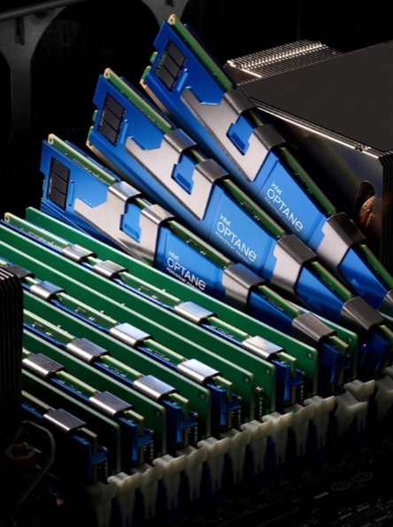
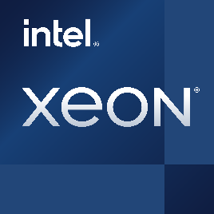
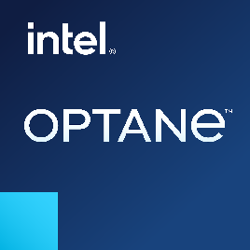
Memory and Data Tiering of Today and the Near Future
There is a significant business value with Intel® Optane™ technology today and the near future
TCO Optimization, Capacity Expansion, Persistent Memory/Fast Storage
Existing Intel® Optane™ persistent memory modules and Intel® Optane™ SSDs still for sale
Notes:
Establishing Optane-based data tiering has been a multi-year strategy
10+ years of SW programming models, application SW optimization
Initial entry with SSD and PMem over DDR-T
Standards body creation, participation, and influence
Ecosystem building for ISV/ISV/OEM/CSP adoption
Development of CXL attach device solutions
As CXL develops, Intel is committed to supporting Intel Optane technology customers and ecosystem co-travelers with existing memory and storage product lines through end-of-life.
Existing Intel Optane PMem modules and Intel Optane SSDs are still for sale, including Intel Optane PMem 100 series and 200 series, as well as the Intel Optane DC P4800X SSD and the Intel Optane P5800X SSD.
Intel also plans to continue the development of the Intel Optane PMem 300 series on 4th Gen Intel Xeon Scalable processors, engaging with key customers to determine their plans to deploy this product.
There is no change to the warranty terms for Intel Optane products, and such products will still include their normal 5-year warranty terms and technical support during the warranty period.

Slide 5


Memory and Data Tiering of the Future
The eventual transition from
Intel® Optane™ technology to CXL™ is logical and widely supported
Computing demands require a more efficient interconnect between CPU and traditional I/O interface
TCO Optimization adding Memory Pooling, Bandwidth and Capacity Expansion, Persistent Memory/Fast Storage
CXL Consortium–Industry-wide focus on the future (200+ member companies)
Compute Express Link
Notes:
Intel is making it easy to adopt CXL attach data tiering in the system
SW optimizations transferrable
SNIA open programming model still applies
System level optimizations implemented and validated with Xeon for seamless integration
CXL brings new possibilities for memory tiering and pooling usages
Ecosystem has matured significantly, enabling CXL capabilities

Slide 6
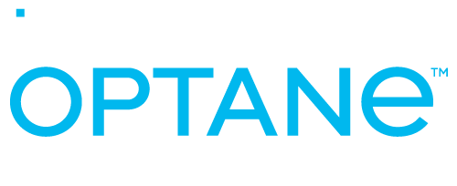

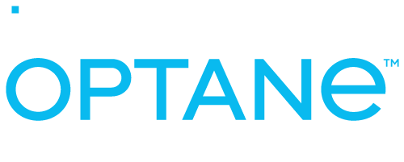
Data Center Memory and Storage is Evolving
Traditional
Today
Future
Traditional Workload Dynamics Have Changed
Intel® Optane™ PMem delivers faster access to more data
Real-time data access
high costs
DRAM
DRAM
DRAM
MEMORY
Fast access to data workloads
Unavailable
Fast, low latency,
high endurance
Continued Hardware Innovations
PMem fills the latency gap while CXL is in development
Unavailable
NAND SSD
NAND SSD
NAND SSD
High capacity and
low-cost tiering/caching
STORAGE
Traditional
HDD
Traditional
HDD
Traditional
HDD
Software Ecosystems
are Responding
Software has evolved to respond to PMem and moving toward CXL
Infrequent or no access,
low cost, high endurance
TAPE
TAPE
TAPE
Notes:
So, what does memory tiering and storage mean for workloads. The way business is done is evolving and so are the underlying workloads that make business results possible.
Customers have such a variety of workloads and corresponding requirements that it only makes sense that they leverage different technologies to optimize capacity, performance and cost across their needs. For example – you do you not want to pay a premium for real-time data access when your business workloads do not all require this, so this forces you to understand the needs of customer workloads and which technologies can benefit them the most. We recommend Intel Optane persistent memory in business-critical workloads to support fast data access and in-memory computing. In addition, we see Optane playing a role in delivering high performance storage for storage workloads.
Overall workload dynamics are changing – customers want faster access rates and more real-time analytics, access to larger amounts of data than ever before, locality – or where the data is generated and processed is also evolving
Also, infrastructure ROI is a top customer concern and cost continues to be front and center in customer conversations especially in a post COVID, hyper digital environment. In addition, memory and storage, especially memory as mentioned earlier is a significant portion of the cost of the BOM.
Lastly, the software ecosystem is transitioning, and we are seeing customers rethink their approach to memory, including memory pooling and the transition to CXL including new business models built on these types of optimizations.
Ultimately, Optane enables memory and tiering and let's see how this is gaining traction across segments.

Slide 7
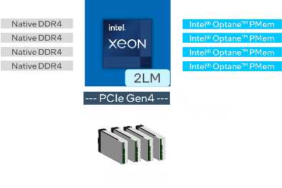
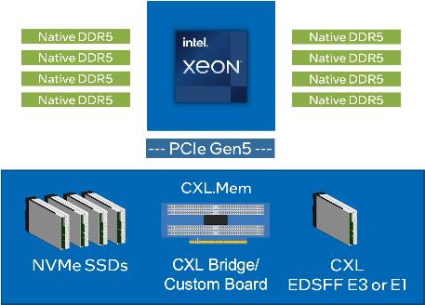
Data Center Migration to CXL
Today’s Configuration
Intel® Xeon® and Optane™ Technology on DDRT
Future Hybrid Configuration
Intel® Xeon® and Optane™ Technology on DDRT and CXL
CRM APP
CRM APP
Relational Database
Relational Database
Hypervisor or Orchestrator
Hypervisor or Orchestrator
Servers running
Intel® Xeon® and Optane™ Technology
Servers running
Intel® Xeon® and Optane™ Technology
*Depends on OEM and ISV support plans for processor, memory, and software configurations on released generations of platforms.
Directional Plan – Subject to change

Slide 8
Today: Use Cases for
Intel® Optane™ Technology

Slide 9
Today’s Data Center Workload Challenges
Compute Performance Growth Is Accelerating¹
Scaling of DRAM Density Is Slowing²
Memory Is a Growing Percent of Server Costs³
Exponential
32 GB
~4x every
3 Years
~2x every
3 Years
16 GB
4 GB
8 GB
CPU Core Growth
2 GB
62%
1 GB
512 MB
of Server Costs is Memory
256 MB
Projected
128 MB
2x
64 MB
32 MB
16 MB
4 MB
Every 4 years
1 MB
2017 2018 2019 2020 2021 2022 2023
1985
1996
2011
2025
Current cost percentage of server memory compared to other components
CPU Core Growth Projection Over Time¹
DRAM Density Over Time²
Memory Density and Costs are not Scaling to Meet Data Center
Workloads and Infrastructure Cost Requirements
1 Source: Intel. Results may vary.
2 Source: https://flashmemorysummit.com/English/Collaterals/Proceedings/2018/20180809_NEWM-301A-1_Gervasi.pdf
3 Source: Intel Internal. Estimates – based on large scale deployments and does not include software costs.

Slide 10
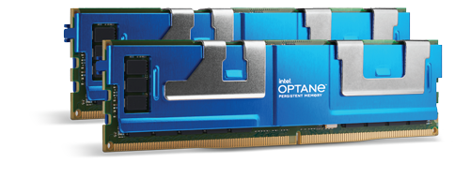
Intel® Optane™ Still Solves Customer Problems Today!
Save More
Displace DRAM for systems more than 512 GB
Improve TCO for workloads that need large and/or persistent memory
Continuing Pain Points
DRAM is too expensive
Scale-up is expensive
Not enough capacity
Operational inefficiencies
Poor workload performance
Storage is too slow
Do More
Increase memory size for large memory or software license fees per core
Consolidate workloads for more VMs with lower CPU utilization
Go Faster
Break the I/O bottlenecks
Add high-speed storage using tiered storage subsystems

Slide 11

Optane Use Cases Today
 | Storage Storage and RDMA Replication | Infrastructure VM, Container, and Density | Databases In-Memory DB, and Persistent Caching | AI/Analytics Recsys and ML Analytics | HPC Large Memory Tech Computing | Comms Expanded Memory for cached content
SSD | Faster Storage VAST CSAL | Nutanix HCI (+) VMWare vSAN RedHat OpenShift |  | RecSys OCP DLRM
App Direct Mode | RDMA/Replication Oracle Exadata | VMware vSphere Lightbits MemVerge Pelikan Segcache | SAP HANA OracleDB 21C Aerospike RocksDB TieredMemDB Kx Systems | RecSys Similarity Search: Ref Code ML Analytics Databricks: Spark Datastax: Cassandra | DAOS
Memory Mode |  | Nutanix HCI MSFT Hyper-V KVM VDI Horizon, Citrix Memcached | Redis Redis Enterprise In-Memory DB | ML Analytics oneAPI AI Analytics Toolkit Katanagraph |  | Content Delivery Network (CDN)
Notes:
Picking up on the theme of SW enabling, I wanted to reflect on the amount of enabling we’ve already done and are continuing to do to mature the ecosystem around data tiering with these new memory models. I know personally from the NVMe enabling experience just how long it takes system and software architecture to change and adopt to a new tier being available- to extract the value the new capabilities. All of the analysis, characterization, and optimization work done today, these changes will all carry forward to the CXL enabled world and just get better.
Our enabling work to date has covered several usage models, enabling faster storage in appliances and HPC, expanded memory for better TCO in scaling up infrastructure, and accelerating performance while scaling with larger growing data sets in databases, big data analytics, and AI.
We’ve been focused on partnering and collaborating on ISVs and vendors that have publicly available products, as well as larger cloud customers for custom infrastructure use cases.
And as we’ve been highlighting all along, the effort and thought leadership going into these Optane based solutions will enable them to be first movers on CXL adoption.

Slide 12
Example 1: Oracle Database on VMware vSphere
2x Intel® Xeon® Platinum 8358 processor, 2 TB DRAM
2x Intel® Xeon® Platinum 8358 processor, 512 GB DRAM + 2 TB Intel® Optane™ PMem 200 series
Up to
35%
Cost savings¹
Save More
Reduce costs while providing similar runtime performance¹
Lower-cost Intel Optane PMem enables quantities of memory beyond traditional 1 TB limitations¹
  1 Tested with a tiered four-database system and 2 TB of memory. Performance results are based on testing by Intel as of February 24, 2022, and may not reflect all publicly available updates. See reference slide 29 for workloads and configurations. Results may vary.

Slide 13
Example 2: VMware Horizon VDI on VMware vSphere
2x Intel® Xeon® Platinum 8358 processor, 1 TB DRAM
2x Intel® Xeon® Platinum 8358 processor, 256 GB DRAM + 1 TB Intel® Optane™ PMem
Up to
18%
Lower cost with
same capacity and similar performance¹
Save More
Total hardware cost per VDI user: 1
DRAM-only: $322
DRAM + PMem: $265
Savings: 18%
  1 Performance results are based on testing as of September 2021 and may not reflect all publicly available updates. See backup for additional costs, workloads and configurations. Results may vary.
  Equivalent performance equals +/–10 percent. Test results reflect high-stress online analytical processing (OLAP) workload. See reference slide 30 for workloads and configurations.

Slide 14
Example 3: Citrix on Nutanix
2x Intel® Xeon® Gold 6342 processor, 1 TB DRAM
2x Intel® Xeon® Gold 6342 processor, 256 GB DRAM + 1 TB Intel® Optane™ PMem 200 series
Up to
30%
Lower cost
per node
Do More
Support same number of users with similar latency at a lower cost with similar end-user experience¹
  1 Performance results are based on testing by February 24, 2022 and may not reflect all publicly available updates. See reference slide 31 for workloads and configurations. Results may vary.

Slide 15
The Open Standards Solution of CXL

Slide 16
CXL™ Consortium – Industry-Wide Focus on the Future
Directional Plan – Subject to change

Slide 17

CXL™ Memory Ecosystem
Intel proactively supports open standards development and the developer community (e.g. USB, NFV, SDN, oneAPI, etc.)
To Date in 2022
  Intel works with eight ecosystem partners
We have engineering samples and so far have developed and tested
  2 CXL controllers
  1 CXL module
Currently, development and testing is under way
  2 more CXL controllers and
  2 more CXL modules
In Q1 2023, work on 1 more CXL Module is scheduled
Intel makes no claims that any Silicon/Modules listed above will progress to production​. Contact IHVs directly for risk factors, schedules, potential product errata, and full product availability details.
Directional Plan – Subject to change
Notes:
Above roadmap is Type 3 devices only

Slide 18
CXL 2.0 Intelligently Supports Memory Tiering
CPU
Go Faster: CXL 2.0 Specification
Builds on CXL 1.0/1.1 standard memory expansion and tiering with full backward compatibility
Native persistent memory support, hot-plug support, security features, switching and pooling
CXL 1.0/CXL1.1
MEMORY
DRAM
CXL 2.0 and
Flash Memory (DRAM, NAND)
Performance SSD
Capacity HDD
Benefits
CXL switches and interfaces make pools of memory or storage available system-wide instead of to a single host.
Support for pooling multiple devices allows servers to assign and relinquish resources based on workload needs.
Removes dependency of a shared DDR bus for DRAM and persistent memory, resolves performance impacts.
Enables standardized management of the memory and interfaces.
STORAGE
Traditional HDD
TAPE
Source: Compute Express Link 2.0 White Paper, November 2020
Directional Plan – Subject to change
Notes:
CXL 1.1 (which is avail on SPR) also supports Tiering. One can use Optane (BP/CP) as a tiered Memory buffer but one which is only volatile - cant use Persistent mode in CXL 1.1 but some customers of PSG are using BP in volatile mode on CXL1.1
Starting with CXL 2.0, Persistent memory pools can be accessed either in ‘App Direct’ mode as a separate super fast storage tier, or as a ‘Memory Direct’ mode which expands the host DRAM pool
Working towards the new features that CXL 2.0 will bring to Xeon.
Fully backward compatibility with 1.1 and 1.0
Switching and pooling
Hot-Plug Support
Fabric Manager API
Security; Built in Compliance and Interop program.
Large Model AI/IMDB, IMC – what data sits where, etc….

Slide 19
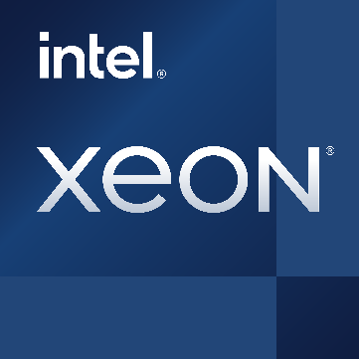
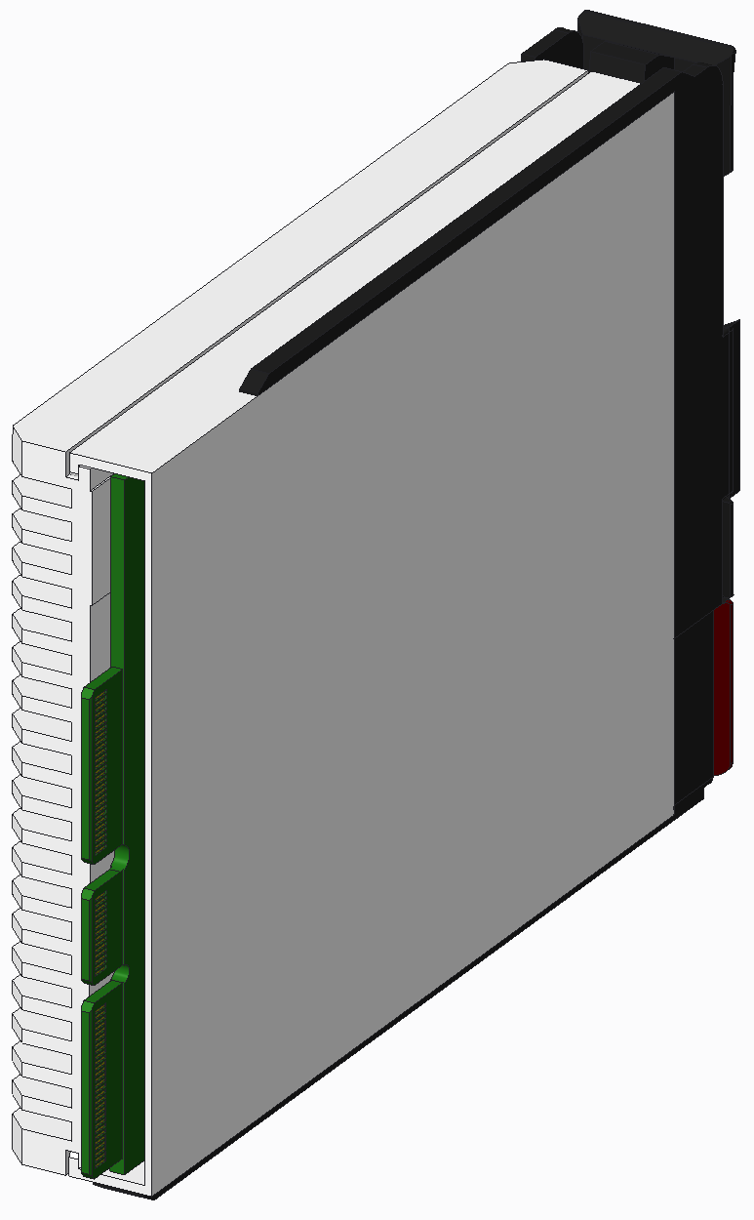


Core CXL Usage:
Two-Tier Memory for Bandwidth or Capacity Expansion
Native DDR5
ICX
Native DDR5
Scale performance or enable use of higher core counts
CXL will lower bandwidth and increase latency vs. direct attach DDR but at lower TCO
Software Considerations: kernel, VMM, library or application manages separate NUMA node
Native DDR5
Native DDR5
Native DDR5
Native DDR5
Native DDR5
Native DDR5
--- PCIe Gen5 ---
CXL.Mem
NVMe SSDs
CXL Bridge/
Custom Board
CXL
EDSFF E3 or E1

Slide 20

The Open Standards ̶ CXL™ is The Future
Go Faster
Improves data handling and reduces I/O bottlenecks
Solve these challenges with CXL
Scaling challenges: latency, bandwidth, capacity
Increase of heterogenous computing + massive datasets + demanding workloads = need for more accessible data, faster
These computing demands require a more efficient interconnect between CPU and traditional I/O interface
Do More
Memory bandwidth and capacity expansion, efficient access across shared memory
Enables CPU and accelerators to share memory resources for higher performance
Save More
Improves TCO
Sources: Introduction to Compute Express Link White Paper, March 2019 and https://www.computeexpresslink.org/
Notes:
CXL™: A Processor-to-Accelerator Link
we should add that CXL also allows Processor to Memory expansion buffer link especially since we are touting it as a future substitute for Optane
Sits atop and co-exists with PCIe Gen 5 infrastructure created by an industry-supported consortium
CXL is designed to address the growing high-performance computational workloads by supporting heterogeneous processing and memory systems with applications in Artificial Intelligence, Machine Learning, Analytics, Cloud Infrastructure, Cloudification of the Network and Edge, communication systems, and High-Performance Computing.
CXL has 200+ member companies, board includes representation from Alibaba Group, AMD, arm, Cisco, Dell EMC, Facebook, HPE, Huawei, Google, IBM, Intel, Microchip, Microsoft, Xlinx – from CXL website

Slide 21
Moving from
Intel® Optane™ Technology to CXL

Slide 22
Server Memory Architectures
Will Adapt to CXL
Today
Intel® Xeon® CPU + DDR4 +
Intel® Optane™ Technology on DDRT
CXL Future
Intel® Xeon® CPU + DDR5 +
Third-Party CXL Memory Products
Native DDR5
ICX
Native DDR5
Native DDR5
Native DDR5
Native DDR4
Intel® Optane™ PMem
Native DDR5
Native DDR5
Native DDR4
ICX
Intel® Optane™ PMem
Native DDR5
Native DDR5
Native DDR4
Intel® Optane™ PMem
Native DDR4
Intel® Optane™ PMem
--- PCIe Gen5 ---
--- PCIe Gen4 ---
CXL.Mem
DDRT
NVMe SSDs
CXL Bridge/
Custom Board
CXL
EDSFF E3 or E1
NVMe SSDs
*Depends on OEM and ISV support plans for processor, memory, and software configurations on released generations of platforms.
Directional Plan – Subject to change
Notes:
What is the CXL transition plan going forward?
Let’s look at how Optane is used today to improve memory performance and lower TCO
Then we’ll show examples of how individual servers, data center server clusters, and other use cases could migrate or transition to CXL over time

Slide 23



Possible Usage Model Transition Examples
DDRT
Native DDR5
ICX
Native DDR5
Native DDR4
ICX
Native DDR5
Native DDR5
Native DDR4
PMem
Native DDR5
Native DDR5
Native DDR4
PMem
Native DDR5
Native DDR5
Native DDR4
PMem
PMem
-PCIe Gen5-
-PCIe Gen4 -
CXL.Mem
NVMe SSDs
CXL Bridge/
Custom Board
CXL EDSFF E3 or E1
NVMe SSDs
 | Today: Intel® Optane™ Technology Intel® Xeon® CPU + DDR4 + Intel® Optane™ Technology on DDRT | Future: CXL 2.0 Intel® Xeon® CPU + DDR5 + Third-Party CXL Memory Products
Memory Mode | Cost-effective memory to meet workload needs and expanded memory capacity for workload scale-up. | Adds industry standard protocol for software to cache or tier memory.
Memory Expansion, Augmentation | Path for higher capacity than DRAM for workloads to scale-up. | Adds additional memory capacity and memory bandwidth to existing DDR attached DRAM.
Persistent Memory | Fast storage for meta data storage, fast write logs, and caching/tiering acceleration of other storage. | Adds persistence support (non-volatile memory over CXL).
High-Endurance, Performant SSDs | Very fast storage “replacement” for meta data storage, fast write logs, caching/tiering acceleration. | Adds persistence support (memory-semantic storage over CXL).
Directional Plan – Subject to change

Slide 24

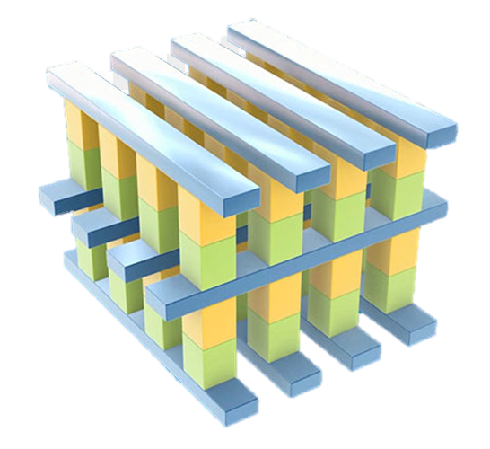
Intel® Optane™ Technology and CXL™ Timeline
CXL 2.0
Compatible Products*
CXL 3.0
Future
CXL 2.0
2022
CXL 1.1
2019
Introduced
2017
2015
3D XPoint
* CXL 2.0 Compatible Products developed by 3rd parties. Release dates are unknown. Currently, engineering samples are available
Directional Plan – Subject to change
Notes:
How did we get here and where are we going?
Let’s look at the histories of Intel Optane and CXL and at future developments.
Then we’ll discuss to build now with Optane in a logical and cost-effective progression to CXL

Slide 25
Memory and Data Tiering are the Way Forward
Today
There is a significant business value with Intel® technology today and the near future
Tomorrow
The eventual transition from
Intel® Optane™ technology to CXL™ is logical and widely supported
Compute Express Link
Save More
Improve TCO
Displace DRAM
Do More
Increase Memory Size
Consolidate Workloads
Go Faster
Break the I/O Bottlenecks
Add High-Speed Storage

Slide 26
Notes:
Summary and Call to Action
We continue to rationalize our portfolio in support of our IDM 2.0 strategy. This includes evaluating divesting businesses that are either not sufficiently profitable or not core to our strategic objectives.
After careful consideration, Intel plans to cease future product development within its Optane business.
While we believe Optane is a superb technology, it has become impractical to deliver products at the necessary scale as a single-source supplier of Optane products.
We are committed to supporting Optane customers and ecosystem partners through the transition.
We continue to support development of CXL on our platforms as we believe it will be the future and standard of tiered-memory solutions.​

Slide 27
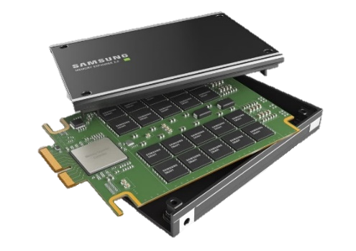
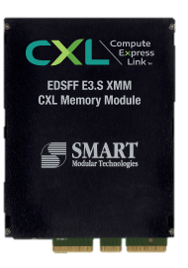
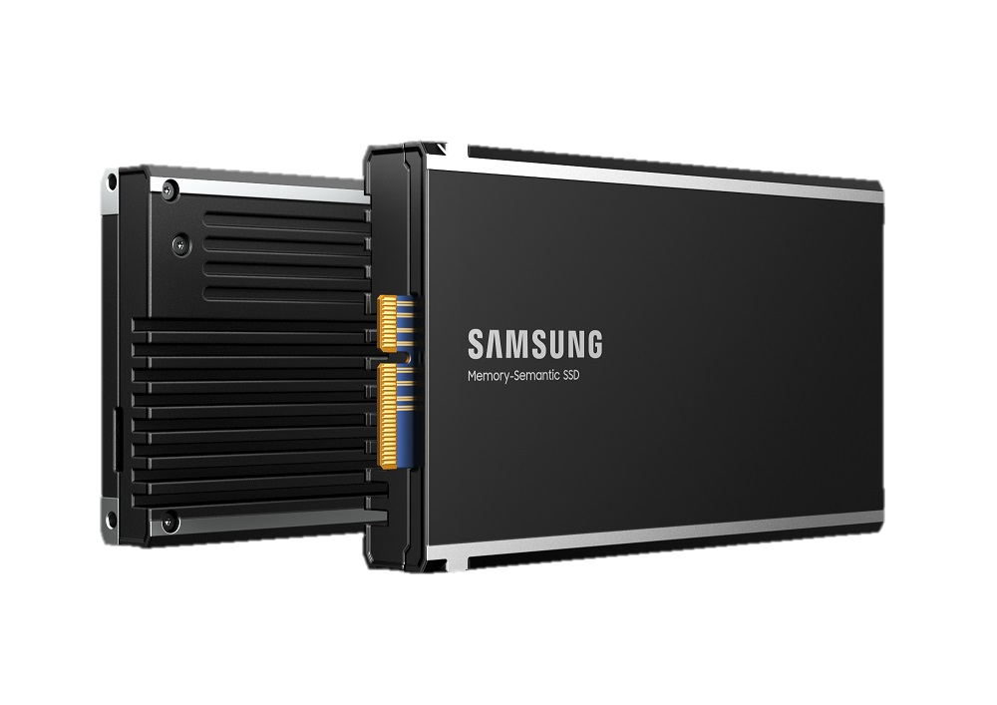
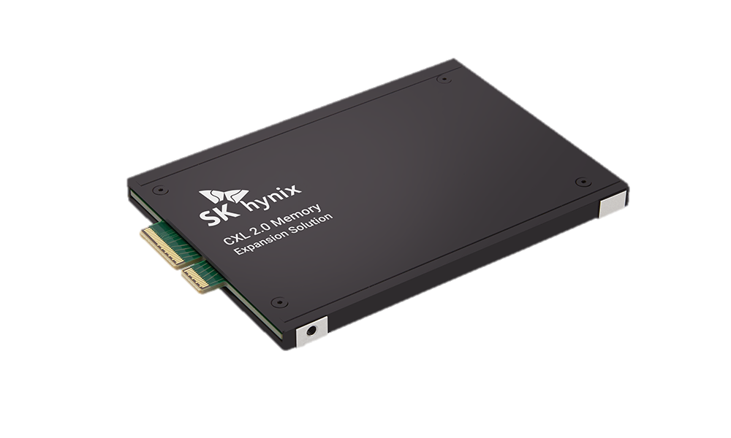
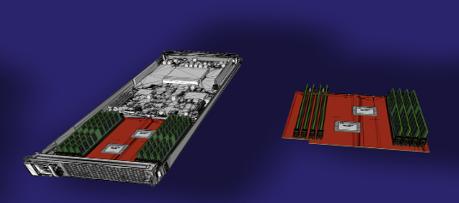
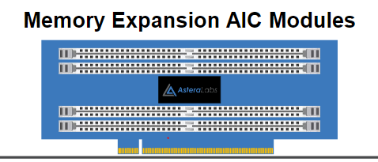
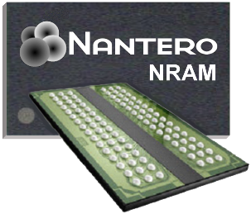
Public Examples 1: Growing CXL™ Ecosystem
Vendor | Type | Info/website
Astera Labs | LEO CXL Memory Accelerators | CXL Memory Accelerators
Nantero | A Different Form of Intel® Optane™ PMem media | Nantero Home Page
Samsung | CXL DDR5 Module | First 512 GB CXL Memory Module Introduced
Samsung | CXL Memory-Semantic SSD | Next-Gen Memory Solutions at Flash Memory Summit 2022
SKhynix | CXL2.0 DDR5 Module | DDR5 DRAM to Expand the CXL Ecosystem
Smart Modular | XMM (E3.S CXL2.0 DDR5 module) | First CXL Memory Module Introduced
Marvell/Tanzanite | SLIC Memory Expansion and Pooling SoC | Memory Pooling Demo
Astera Labs
Tanzanite SLIC^{TZ}
Directional Plan – Subject to change

Slide 28
Public Examples 2: Growing CXL™ Ecosystem
 | Vendor | Name and Contact
CXL IP | Cadence | Arif Khan: arif@cadence.com
 | FLC Technologies Group | Weili Dai: weili@flctechnologygroup.com
 | Mobiveil | Gopa Periyadan: gopa@mobiveil.com
 | Rambus | Brian Breiling: bbreiling@rambus.com
 | Synopsys | Gary Ruggles: Gary.Ruggles@synopsys.com
 | Wolley | Bernard Shung: cbshung@wolleytech.com
CXL Memory Expansion ASIC | Astera Labs | Ezekiel Harvey: ezekiel.harvey@astera.com
 | Intelliprop | Erich Hanke: ehanke@intelliprop.com
 | Microchip | Jeremiah Tussey: jeremiah.tussey@microchip.com
 | Montage Technologies | Robert Jin: robert.jin@montage-tech.com
 | Rambus | Mark Orthodoxou: morthodoxou@rambus.com
 | Renesas | Sam Patel: sam.patel.df@renesas.com
 | SK Hynix | Keith Jangryul Kim: jangryul.kim@sk.com
 | Marvell Technology | Supriya Madan: smadan@marvell.com
 | Wolley | Bernard Shung: cbshung@wolleytech.com
CXL Memory Module | Astera Labs | Ezekiel Harvey:ezekiel.harvey@astera.com
 | Micron | Ryan Baxter: rrbaxter@micron.com
 | Samsung | Kapil Sethi: kapil.sethi@samsung.com
 | SK Hynix | Keith Jangryul Kim: jangryul.kim@sk.com
 | Smart Modular | Arthur Sainio: Arthur.Sainio@smartm.com
Intel is continuing to work with the industry ecosystem in enabling:
CXL IP
CXL Memory Expansion ASIC
CXL Memory Module solutions
CXL is clearly the future
* Companies that are part of Intel enabling efforts and have provided permissions to be listed.
Directional Plan – Subject to change

Slide 29
Intel® Optane™ Persistent Memory (PMem) 200 Series with Oracle Database on VMware vSphere (slide 12)
Configuration details:
2 TB DRAM-only configuration (baseline new orders per minute [NOPM], 787 watts power usage): 2x Intel® Xeon® Platinum 8358 processor ($7,900), 2 TB DRAM ($61,966), for a system total of $69,866. Workload: HammerDB TPC-C workload with Oracle Database running on Oracle Enterprise Linux (OEL) inside of VMware virtual machines (VMs). Tested February 24, 2022.
2 TB Intel Optane PMem 200 Series + 512 GB DRAM configuration (–3 percent NOPM, 803 watts power usage): 2x Intel Xeon Platinum 8358 processor ($7,900), 512 GB DRAM ($13,982), 2 TB Intel Optane PMem ($23,392) for a system total of $45,274. Workload: HammerDB TPC-C workload with Oracle Database running on OEL inside of VMware VMs. Tested February 24, 2022.
Intel Optane PMem pricing and DRAM pricing referenced in total cost of ownership (TCO) calculations is provided for guidance and planning purposes only and does not constitute a final offer. Pricing guidance is subject to change and may revise up or down based on market dynamics. Please contact your original equipment manufacturer (OEM)/distributor for actual pricing. DRAM pricing as of February 2022.

Slide 30
VMware Horizon VDI on VMware vSphere
Configuration and Cost Details (slide 13)
Tested by Evaluator Group as of September 2021. Capacity of virtual desktop infrastructure (VDI) users supported was 889 for the DRAM-only configuration and 897 for the configuration with Intel® Optane™ persistent memory (PMem), representing less than 1 percent difference. Performance as the average response time was measured at 1.514 seconds for the DRAM-only configuration and 1.664 seconds for the configuration with Intel Optane PMem, representing less than 10 percent difference.
Comparing the 4-node hardware costs of a common configuration with 1 TB DDR4 DRAM only (USD $286,086) to a common configuration with 256 GB DDR4 DRAM plus 1 TB Intel Optane PMem (USD $237,359). Total costs divided by the number of VDI users supported by each system ($889 and $897, respectively) yields the cost per VDI user of $322 and $265, an 18 percent lower cost for the system with Intel Optane PMem.
Common configuration: 4-node, Each node, Intel Software Development Platform, 2x Intel® Xeon® Platinum 8358 processor (32 cores, 2.6 GHz, 250 W thermal design power [TDP]), Intel® Hyper-Threading Technology (Intel HT Technology) on, Intel Turbo Boost Technology on, sub-NUMA cluster (SNC) off, ucode: x280, 2x 25 gigabit Ethernet (GbE) Intel Ethernet Network Adapter E810-XXVDA2, Gen4 x8, per-node cache tier: 2 x 400 GB Intel Optane SSD P5800X, per-node capacity tier: 6x 3.84 TB Intel SSD D7-P5510 series, VMware ESXi 7.0u2 17630552, VMware vCenter 7.0u2 17694817, VMware Horizon 8 2106, LoginVSI 4.1.40. Knowledge worker profile 2 vCPU/4 GB. Windows 10 1909 Enterprise x64 with Microsoft Office 2019, Acrobat Reader 11, Internet Explorer 11, DoroPDF. Tested by Evaluator Group as of September 2021.
DRAM-only configuration: Total system memory: 1 TB (16 slots/64 GB/3,200 MHz DRAM). Supported 889 VDI users in testing.
DRAM+Intel Optane PMem: Total system memory: 1 TB (16 slots/16 GB/3,200 MHz DRAM) + 8 slots/128 GB/Intel Optane PMem). Supported 897 VDI users in testing.
Intel Optane PMem pricing and DRAM pricing referenced in total cost of ownership (TCO) calculations is provided for guidance and planning purposes only and does not constitute a final offer. Pricing guidance is subject to change and may revise up or down based on market dynamics. Please contact your OEM/distributor for actual pricing. Pricing as of October 2021.

Slide 31
Citrix on Nutanix with Intel® Optane™ PMem 200 Series:
Greater Capacity, Scalability, and Cost Savings (slide 14)
1 TB DRAM-only configuration (150 VMs, 785 ms average latency under max load, USD $257 per VM): 2 sockets, 2x Intel® Xeon® Gold 6342 processor ($2,706), 512 GB DRAM (8x 64 GB) per socket (1,024 GB total, $30,983), storage estimated at $2,543, RBOM estimated at $2,300 for a system total of $38,532. Workload: Login VSI with Citrix Virtual Apps and Desktop service (CVAD) 7 running on Nutanix AOS 6.0.2 on VMware ESXi 7.0. U3. Tested February 24, 2022.
1 TB Intel Optane persistent memory (PMem) 200 Series + 256 GB DRAM configuration (150 VMs, 795 ms average latency under max load, USD $178 per VM): 2 sockets, 2x Intel® Xeon® Gold 6342 processor ($2,706), 512 GB Intel Optane PMem per socket (4 x 128 GB) and 128 GB DRAM per socket (8x 16 GB) (1 TB Intel Optane PMem total and 256 GB DRAM total, $19,057), storage estimated at $2,543, RBOM estimated at $2,300 for a system total of $26,606. Workload: Login VSI with Citrix Virtual Apps and Desktop service (CVAD) 7 running on Nutanix AOS 6.0.2 on VMware ESXi 7.0. U3. Tested February 24, 2022.
Intel Optane PMem pricing and DRAM pricing referenced in total cost of ownership (TCO) calculations is provided for guidance and planning purposes only and does not constitute a final offer. Pricing guidance is subject to change and may revise up or down based on market dynamics. Please contact your original equipment manufacturer (OEM)/distributor for actual pricing. DRAM pricing as of February 2022.

