Slide 1
Confidential
Computing
30-3-30

Slide 2
Data Protection, Compliance & Sovereignty with Intel Confidential Computing
Release date December 2024
Presenter name

Slide 3
Confidential Computing 30-3-30
About this Presentation
Title | Data Protection, Compliance & Sovereignty with Intel Confidential Computing
Author | Mike Ferron-Jones Go-to-Market Lead for Data Center Security Technologies
Last Revision Date Original Publication Date | January 15, 2025 (Major revision)
Sensitivity | All slides are approved for customer and public use. No NDA required.
Topics & Technologies Covered | Confidential Computing, Intel SGX, Intel TDX, Intel Trust Authority.
Related Content | SMR Data Center Security resource page https://www.intel.com/content/www/us/en/secure/internal/resources-documentation/sales-marketing/data-center/security.html Confidential Computing Competitive Response Guide (SMR and Seismic asset ID 764105)

Slide 4
Important Legal Information
Intel technologies may require enabled hardware, software or service activation.
No product or component can be absolutely secure.
Performance varies by use, configuration and other factors. Learn more on the Performance Index site.
Performance results are based on testing as of dates shown in configurations and may not reflect all publicly available updates. See backup for configuration details.
Your costs and results may vary.
© Intel Corporation. Intel, the Intel logo, and other Intel marks are trademarks of Intel Corporation or its subsidiaries. Other names and brands may be claimed as the property of others.

Slide 5
Presentation Guide:
30-Second Pitch Slide
(Also effective as a closing slide)

Slide 6




Confidential Computing Outcomes
Confidently Migrate to the Cloud, Knowing You’re in Control
Even with confidential or regulated data
Activate Confidential or Regulated Data and Realize its Value
While maintaining privacy & compliance
Strengthen Compliance & Data Sovereignty Programs
With technological controls
Harden Cybersecurity Against Difficult-to-Defend Threats
Hardware-based isolation & access controls
Notes:
This slide is intended as the “attention grabber” if you want to go straight to the benefits messages and explain the technology later.
(upper left) Confidential computing puts you in control of your data and how it can be accessed in the cloud. Even confidential or regulated data can be protected when in-use in the public cloud, so you can take advantage of the economics and scale of the cloud while remaining compliant.
(upper right) Confidential computing enables you to put data to work that previously had been judged to be “too sensitive or regulated to activate.” With privacy-preserving workspaces enabled by Confidential Computing, you can open up data silos and realize the full value of you data assets, including multi-party analysis collaborations. You can realize the benefits of shared analysis without losing privacy and compliance.
(lower left) Regulatory compliance and data sovereignty are all about maintaining control of data and making sure its only used appropriately. Often compliance relies exclusively on processes and procedures, and sovereignty on geo-location. But data is highly liquid and can escape even the best procedures. Confidential computing adds technological controls that help ensure data will be handled in compliance with proper procedures and your preferred regulatory framework.
(lower right) Confidential computing “armors-up” your workloads, helping protect sensitive data, content and software IP from advanced attack, tampering and theft, even from many types of privileged software or users that can be difficult to defend.

Slide 7
Presentation Guide
3 Minute Pitch (two options)

Slide 8
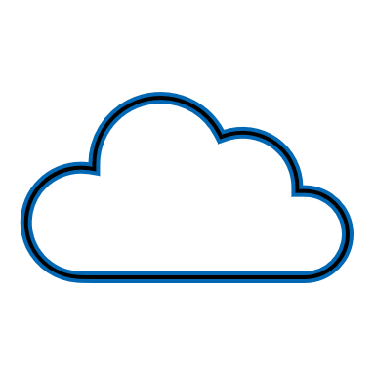



Intel’s Confidential Computing Portfolio
App Isolation
Intel® SGX
VM Isolation
Intel® TDX
Trust Services
Intel® Tiber™Trust Authority
Trust Boundary
Confidential Data
Confidential Data
Intel Trust Authority SaaS
Enclave
Applications
Trust Boundary
Applications
Guest OS
Guest OS
VM Admin
VM Admin
Hypervisor
Hypervisor
BIOS & Firmware
BIOS & Firmware
Public Clouds
On-Prem
Network
Edge
Cloud Stack & Admins
Cloud Stack & Admins
Smallest trust boundary for greatest data protection & code integrity
Most straightforward path to greater security for legacy apps
Uniform, independent attestation of trustworthy environments
Founded on Intel’s Security-First Development & Lifecycle Support
Notes:
Only Intel offers such an extensive confidential computing portfolio to meet the diverse needs of our customers.
For over five years, we’ve pioneered Confidential Computing and offered application isolation with Intel SGX.
In 2023, we brought our initial offering of Intel TDX, our VM isolation technology, to market with Alibaba, Azure and Google Cloud. IBM Cloud is expected to launch in 2024.
In September 2023, we launched our new independent, cloud-based trust verification service called Intel Trust Authority, formerly code-named Project Amber.
These products and services are backed by Intel’s unmatched ecosystem and solution provider enabling, as well as our “security first” development practices and our best-in-class lifecycle security support. We are committed to keeping our customers protected long after their initial purchase of an Intel-based platform.

Slide 9
Presentation Guide
Confidential Computing Need and
Technology Fundamentals

Slide 10



Confidential Computing Closes a Major Gap in the Data Protection Continuum
Data at Rest
Data in Transit
Data in Use
Storage Encryption
Network Encryption
Confidential Computing
Notes:
Technologies have developed over time to protect data and ease these privacy, security and compliance concerns, but there was always a gap.
Storage and disk encryption evolved and matured to protect data at-rest.
Network encryption is strong and getting stronger to protect data in-transit.
But those techniques didn’t help when data was actively in-use in the processor and memory. Away from storage and off the network, it was vulnerable. This is the gap in the data protection continuum that Confidential Computing is designed to address, helping protect data from end to end.

Slide 11



Confidential Computing
Essential Functions
Sensitive Data
Trusted Software
Trusted Admins
Isolation
Trusted Execution Environment (TEE) separates sensitive data and code from underlying software, admins, and other cloud tenants
Verification (Attestation)
Cryptographic confirmation that TEE is genuine, correctly configured, and software is exactly as expected
Encryption and Control
Workload owner holds key to decrypt data, retaining control and preventing access by cloud provider or other entities
Untrusted Software
Cloud Stack
Cloud Admins
Notes:
Confidential computing delivers three essential functions.
ISOLATION: Confidential computing uses silicon-based technology to create a hardware-enforced Trusted Execution Environment (TEE). Sensitive data should only be decrypted inside the TEE. Only software inside the TEE’s trust boundary can access sensitive data. This creates a technological separation from all the software and admins outside the trust boundary. This includes the cloud provider’s management stack, hypervisor and infrastructure admins.
ENCRYPTION & CONTROL: With Confidential Computing, authorized data owners hold the keys to their data. Outside the TEE, the data is encrypted and inside the TEE, only the authorized software or parties can view it. The cloud provider or other cloud tenants cannot access your data in plaintext.
VERIFICATION (aka ATTESTATION): How do you know your TEE is genuine and functioning properly? Confidential computing technology includes cryptographic verification that the TEE is genuine, updated within policy, and, depending on the technology and attestation service, can verify the software running in the TEE is exactly what’s expected. This process is often called “Attestation”. Other security technologies that don’t use remote attestation have to be taken on faith that they are genuine and functioning properly.

Slide 12
Intel TEE Options
VM-level Isolation: Intel® TDX
Application-level isolation: Intel® SGX
Advantages
  Separation from cloud provider & other tenants
  Lowest code porting
  Simple instance configurator setting
Considerations
  Larger trust boundary
  Less granular attestation*
  Requires virtualization
Advantages
  Smallest trust boundary
  Attestation of confidential application code out-of-the-box
  Virtualized or bare-metal deployment
Considerations
  Higher development or tuning effort
  May incur higher performance impact
Confidential Data
Confidential Data
Applications
Enclave
Applications
Guest OS
Guest OS
VM Admin
VM Admin
Host OS / Hypervisor
Host OS / Hypervisor
Cloud Stack & Admins
Cloud Stack & Admins
* Attestation services like Intel Trust Authority may extend TDX attestation scope and granularity
Notes:
This slide compares Intel’s two trusted execution environment technologies, TDX and SGX. In addition to the trust boundary differences discussed above, TDX is a more straightforward environment for porting large existing applications into a confidential environment. Because of this and its relatively simple set-up, TDX is the more likely technology to be deployed as an Enterprise-wide VM policy versus SGX. However, TDX has a larger trust boundary, so applications with very high security requirements or that require multiple parties to review and sign-off on the code may prefer the smaller code footprint of SGX. TDX requires an enabled hypervisor and Guest OS, so if existing VMs run on non-enabled versions, VMs will need to be revalidated for the confidential environment. Also, VM isolation technologies like TDX only attest that the VM environment launched correctly on a genuine platform. They do not attest to the accuracy of the software load inside the VM. (Third-party attestation services may offer more granular attestation of the VM contents as a value-added service, but this is not an “out-of-the-box” capability of TDX)
Application isolation with Intel SGX has a much smaller trust boundary and attack surface than a confidential VM with TDX, making it attractive to security-focused usages. The smaller trusted code base is easier to review, monitor and inspect, which can be valuable in multi-party use cases. Unlike VM isolation technologies, only SGX can be deployed virtualized, on bare-metal, or with cloud-native containers running on a single host OS. Because of the highly isolated code and potential performance impacts, SGX is usually used for purpose-built, privacy-preserving applications; It is rarely used to “lift and shift” large, existing apps, and will likely be deployed on a targeted basis, not as a widespread IT policy.
With both TDX and SGX, performance can be impacted by heavy traffic on I/O buses, with SGX being somewhat more sensitive. The more I/O traffic, the more entry/exits from the confidential environment, resulting in more latency.

Slide 13
Confidential Computing Outcomes
Confidently Migrate to the Cloud, Knowing You’re in Control
Even with confidential or regulated data
Activate Confidential or Regulated Data and Realize its Value
While maintaining privacy & compliance
Strengthen Compliance & Data Sovereignty Programs
With technological controls
Harden Cybersecurity Against Difficult-to-Defend Threats
Hardware-based isolation & access controls
Notes:
This slide is intended as the “attention grabber” if you want to go straight to the benefits messages and explain the technology later.
Confidential computing puts you in control of your data and how it can be accessed in the cloud. Even confidential or regulated data can be protected when in-use in the public cloud, so you can take advantage of the economics and scale of the cloud while remaining compliant.
Confidential computing enables you to engage in multi-party analysis collaborations but do so in a way that keeps each parties’ data private. You can realize the benefits of shared analysis without losing privacy and compliance.
Regulatory compliance and data sovereignty are all about maintaining control of data and making sure its only used appropriately. Often compliance relies exclusively on processes and procedures, and sovereignty on geo-location. But data is highly liquid and can escape even the best procedures. Confidential computing adds technological controls that help ensure data will be handled in compliance with proper procedures and your preferred regulatory framework.
And Confidential computing “armors-up” your workloads, helping protect sensitive data, content and software IP from advanced attack, tampering and theft.

Slide 14







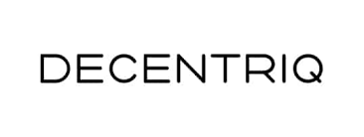
Confidential Computing Deployable at Scale
$25 Billion
processed to date in Intel SGX-based, PCI-DSS compliant credit card payment solution
2 Million
prescriptions processed per day in Germany using Intel SGX-based, GDPR-compliant electronic prescription solution
Top Media Brands
using confidential “data clean rooms” to target advertising without third-party cookies
Notes:
To many people, Confidential Computing is still relatively new. They wonder if it’s really ready for scale deployments.
Several of our key customers are clearly saying “yes” and voting with their dollars and data.
At Microsoft Ignite in November, Microsoft announced that they’ve moved all their credit card payment processing into a cloud-based, Confidential Computing system based on Intel SGX. To date, this Payment Card Industry-compliant solution has processed over $25B in payments while increasing their scalability and lowering the Cap and OpEx.
One of Germany’s largest health insurance providers, AOK partnered with Gematik and IBM to create a privacy-compliant electronic prescription system based on Intel SGX that is now processing over 2 million prescriptions per day.
Changing regulations also mean Media and Ad firms cannot rely on third party cookies to gather data. To create effective targeting profiles, they will need to combine first-party data inside a data clean room while keeping that data private and compliant. Decentriq is a leader in this area and partnering with major media brands like Barron’s, Goldbach and Publicis to create privacy-preserving advertising solutions.
Confidential Computing is ready to scale.
(Note, none of these are Conf AI. If someone asks about that, we should acknowledge and say that many of our current adopters deploy confidential analytics, but as AI permeates business analytics, we expect more deployment of AI. We have some AI early adopters like Bosch but their scale is smaller than these three examples.)

Slide 15







Confidential Computing Helps Mitigate
Difficult-to-Defend Attacks
Escalated Privileges
Attested TEEs Can Defend Against Privileged Attacks
Including:
Malicious SysAdmins
Compromised Admin Software
Privilege Escalation Attacks
Ring 0 Exploits
Zero Days
System Admins
Admin Tools
Hypervisor / Host OS
Firmware
Authentication Identity Authorization
Standard Privileges & Governance
Notes:
Confidential Computing is not a substitute for the many tools IT uses today to identify, authenticate and permission users and software. Those remain essential to keeping users and software “in their lane” for workload access. They can detect and contain entities that are malicious but not permissioned. Where Conf Computing can add additional layers of protection is the risk vectors that are both malicious and privileged. These risks include malicious insiders and system admins, compromised admin or management tools, attacks on unprivileged software that exploit vulnerabilities and escalate their privileges, Ring Zero exploits in the OS or hypervisor, and new previously-unknown vulnerabilities called Zero Day attacks.
By “walling off” confidential workloads inside hardware-hardened TEE’s, backed by remote attestation, Conf Computing can help defend against entities with escalated privileges. For example, a malicious infrastructure admin has immense access permission to view or change most workloads in a standard cloud. In a Conf Computing environment, this actor would not be able to view or change data or software protected inside a TEE, unless they were explicitly granted permission to do so.
This provides even greater depth to enterprise and cloud defenses.

Slide 16


Popular Confidential Computing Use Cases
Confidential Multi-Party Analytics in a Data Clean Room
Cloud Migration with Confidentiality & Compliance
1
2
3
High-Security Processes or Functions
TEE
Party 1
Data
Party 2
Data
Party 3
Data
High-Security Operation
Confidential Data
TEE
Data
Token
Workload
Data
Data
Data
CALL
RESUME
TEE
Analytics
Standard-Security Business Process
Other Cloud Tenants
CSP Host Stack
CSP Admins
Unpermissioned Access
Shared Results
Financial Fraud Detection,
Healthcare Research & AdTech
Cloud Migration of Sensitive Workloads
Key Management & Payment Processing
Notes:
Use this slide to illustrate several popular Confidential Computing use cases outside of AI. It helps show the broad range of possibilities.
There are many cases where greater insight can be gained by combining sensitive data sets from multiple parties in a comprehensive analysis. However, none of the participants wants any of the others to see their confidential or regulated data. In this use case, each party sends encrypted confidential data to a shared analytics platform hosted inside an isolated, attested TEE. Only inside the TEE is the data decrypted and analyzed. The results of the analysis, but not the data, can be shared with the participants, preserving the confidentiality of everyone’s data. This model is used by bank consortiums for fraud detection, pharmaceutical companies for medical research among multiple hospitals, and advertising companies to create targeting strategies without invasive cookies.
Enterprises can be reluctant to migrate certain workloads to the cloud due to confidentiality, regulatory or security concerns, even though cloud computing offers many advantages. They are uncomfortable with the risk of a breach by another cloud tenant or snooping by the cloud provider. They may also be concerned or prohibited from using clouds subject to legal jurisdictions of other nations (data sovereignty). Confidential Computing and attested TEEs help keep workloads private and under your control, even in the cloud.
Many cloud-based workload have highly-sensitive elements that need elevated security. These include key operations, payment processing or regulated data handling. Many organizations use Confidential Computing to harden protections around these sensitive operations so confidential or private data is processed with elevated security for stronger defense or compliance.

Slide 17
Confidential AI Indicators
Is the data Business Confidential, Regulated, or otherwise Sensitive?
Do the training set, model, or results represent valuable business IP?
YES?
Confidential AI
Will the model be
deployed where there are concerns about its security or sovereignty?
Do regulations require an elevated standard of care or audit record?
Notes:
AI is the hottest topic in computing today, but it often raises questions around data and model security, privacy and compliance. Confidential Computing and AI can be powerful allies if any of the conditions discussed on this slide are true.
Does the customer have a need for Confidential AI in their Artificial Intelligence deployments?
If the answer to any of these questions is “Yes,” then there may be a need.

Slide 18

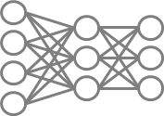
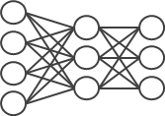
Confidential AI Use Cases
Privacy-Preserving Training with Multiple Confidential Data Sets
Federated Learning Across Locations
1
2
3
Confidential Retrieval Augmented Generation
User Prompt
Party 2
Encrypted Data
Party 1
Encrypted Data
Private Data & Context
Party 1 Data
Party 2 Data
TEE
Augmented Prompt
Confidential Vector Database
TEE
TEE
Party 1
Decrypted Data
Updated parameter weights
Confidential Inference
TEE
y
TEE
TEE
Master Model
Model Response
Notes:
Confidential AI is the combination of AI and Confidential Computing. They can be powerful allies when working with sensitive or regulated data or when the AI model needs elevated security to protect its integrity or IP.
Training an AI model requires lots of data, often more than a single organization has. With Confidential AI, encrypted data can be gathered from multiple parties and decrypted inside a protected, attested TEE, and then used for more effective AI training. The data of the participants is never viewable in plaintext by the others.
In cases where data is too large, sensitive or regulated to move away from the organization that possesses it, Federated Learning is an AI technique that processes the data in-place without exposing data or the completed model to the participants. A working copy of the model is sent to each participant in the federation, where it processes the data locally. Updates to the model parameters are sent to the master model, where all updates are combined and use to create a more accurate master model.
Some organizations are concerned about merging their private data with a public model, and only want to do so inside a protected, confidential environment using Retrieval Augmented Generation (RAG). By operating a RAG system inside an attested TEE, customers strengthen the security and privacy of their data, queries and responses. In this simple diagram, all the private data and context is handled within a TEE, including the process of embedding the confidential data into the Vector Database and augmentation of the user prompt. Since the Augmented Prompt carries confidential data, prudence dictates that the Augmented Prompt be handled by the LLM inside a TEE. (If you want to take it even further, you could put the original query and response delivery inside TEEs, as well.)

Slide 19
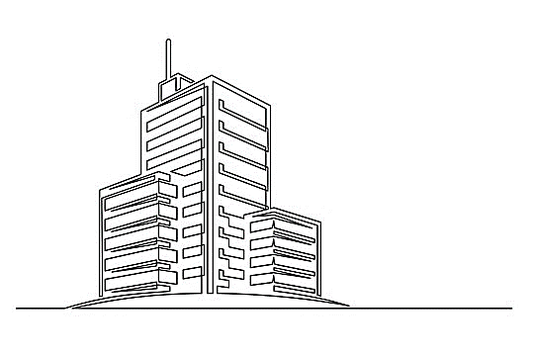


Confidential Computing in On-Prem Infrastructure
Security & Privacy Advantages Even When It’s Your Cloud
1
Defense Through Compartmentalization
Reduce the risk of damage spreading when a breach occurs
2
Unlock Data Silos and Deliver New Services or Insights
Put sensitive data to work while remaining protected and compliant
3
Protect Against Difficult-to- Defend Enterprise Threats
Including privilege escalation attacks or malicious insiders
Sensitive Workload & Data
Encrypted Regulated Data
Encrypted Private
Data
Encrypted “Insider” Data
Sensitive Workload & Data
Breached 3rd Party App
Plaintext Data + Analysis
Malicious
Insider
Compromised Admin Tool
Compromised Software with Escalated Privileges
Sensitive Workload & Data
Sensitive Workload & Data
Output & Insights
Protected
Compliant
Confidential
Notes:
Confidential Computing has been used on-prem for years, particularly high-security operations in governments, content protection and payment processing based on SGX. With the improved ease-of-use delivered by TDX, as well as support from Enterprise host OS leaders in 2025 like VMware, we can substantially grow the Confidential Computing category in on-prem deployments. Some IT and security decision-makers concede the benefits of using Confidential Computing in the cloud to defend against threats coming from other cloud tenants or the cloud provider. However, for their on-prem infrastructure, they are the cloud provider, and the other tenants are all within their Enterprise. They also built up layers of security and access control systems and procedures that are designed to keep the Enterprise protected and secure. What’s the benefit of Confidential Computing when it takes place inside an on-prem Enterprise?
Modern enterprises are aggregations of dozens, perhaps hundreds of, internally-developed, licensed and third-party software and services. A vulnerability and breach is practically inevitable. Widely-used third party apps with security vulnerabilities are one example frequently in the news. Confidential Computing can help limit the damage a breached application or service can do to other workloads or sensitive data by protecting them inside TEEs, much like the watertight compartments in a ship or submarine prevent flooding in one compartment from sinking the whole vessel.
Enterprises often have data silos where data deemed too sensitive or regulated to activate is locked down, generating no value. These include repositories of customer’s regulated personal data, employee data, private market research, sensitive sales or financial data accessible only to “insiders”. Much like the multi-party collaboration scenarios outlined previously, Confidential Computing allows Enterprises to open up their own data silos and use their assets to create value and insights.
Even with extensive software-based security and access control measures, some threats remain. These are the “privileged and malicious” threats that are extremely difficult to defend with software permissioning alone, such as a malicious system admin, a compromised administrative tool, a “zero-day”, or software vulnerability that allows unprivileged software to escalate its privileges. Confidential Computing can help protect sensitive data and workloads from these types of threats, adding depth to the overall Enterprise security posture.

Slide 20

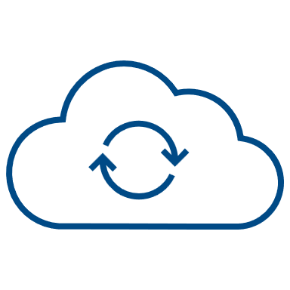

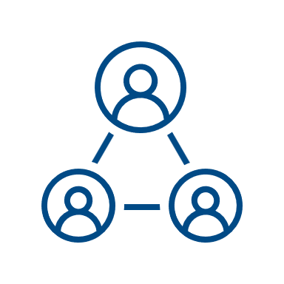
Intel® Trust Authority
Platform Attestation & Integrity Verification Service
Deployment Flexibility
Zero Trust Independent Verification
Compatible across Public, Private,
On-Prem and Edge
Unified Attestation with Nvidia and Intel TDX
Platform Verification (TPM/vTPM)
MSP option designed for SI's Sovereign Cloud Operators and Cloud Service Operators
Turn-Key SaaS
On-Prem Packaged Software
(Single or Multi-Tenant)
Service Connector Plug-in for Relaying Parties
Public Cloud Flexibility –Private Cloud Security

Slide 21
Attestation Service Options
 | Intel® Trust Authority Service | Cloud Provider’s Attestation Service | Application Vendor’s Attestation Service | Build-Your-Own Service with Intel Library
Separation of responsibilities between verifier and infrastructure provider | Yes | No | Yes | Yes
Consistency across Intel SGX and Intel TDX | Yes | Yes if both Intel SGX and TDX offered | No | Yes
Consistent service across on-prem, hybrid, multi-cloud, and edge deployments | Yes | No | Possible but limited to specific application | Yes
Development effort | Low | Low | Low | High
Notes:
This slide compares the different attestation options across multiple relevant decision criteria.
Is the attestation of the Trusted Execution Environment delivered by an entity independent of the infrastructure provider? (Analogy: Would you take a used car dealer’s word that the car is reliable? No, you’d take it to be checked out by an independent mechanic.)
Does the service provide consistent attestation across an organization’s SGX and TDX deployments, regardless of where they reside?
Does the service provide consistency across cloud vendors, on-prem, hybrid and edge deployments?
How much development effort is involved for the end user?
Attestation from the cloud provider that also provides the infrastructure violates the separation of responsibilities best practice. If the cloud provider only offers TDX, not SGX (or vice versa) they will not be able to provide consistent service. CSPs only provide attestation for workloads deployed in their cloud.
ISV-based attestation provides separation of responsibilities but are generally limited to just the one application. Their ability to support hybrid/multi-cloud & edge is limited to where the application is deployed.
Building your own attestation service can deliver on all the vectors but will involve more development and maintenance effort.
Intel Trust Authority delivers on all four vectors.

Slide 22
Intel TEE Enabling
VM-level Isolation: Intel® TDX
Application-level isolation: Intel® SGX
Intel Server Platforms | 5th Gen Intel® Xeon® Scalable & later*
Cloud Providers | Alibaba Cloud, Google Cloud, Microsoft Azure, ByteDance, PhoenixNAP, IBM Cloud (preview Q4’24)
Guest OS | Canonical Ubuntu 22.04 & later Red Hat RHEL 9.2 & later SUSE Enterprise Server 15 & later
Host OS / Hypervisor | Canonical Ubuntu 24.04 Red Hat CentOS 9 Stream SUSE Ent. 15-SP5 & openSUSE Leap 15.5 VMware vSphere 9
Attestation Providers | Intel® Trust Authority Cloud Service Providers
Intel Server Platforms | 3rd Gen Intel® Xeon® Scalable & later*
Cloud Providers | Alibaba Cloud, Microsoft Azure, Baidu, ByteDance, IBM Cloud, IONOS, OVH, PhoenixNAP, T-Systems & more
Guest OS | Linux distros based on Kernel 5.13 & later Windows Server 2019 & later
Host OS / Hypervisor | Distributions supporting KVM 5.13 & later VMware vSphere 8 Windows Hyper-V 2019 & later
Application Providers & Services | Intel® Trust Authority Select application providers Cloud Service Providers
* Select cloud service providers are equipped with TDX-capable 4th Gen Xeon Scalable processors

Slide 23
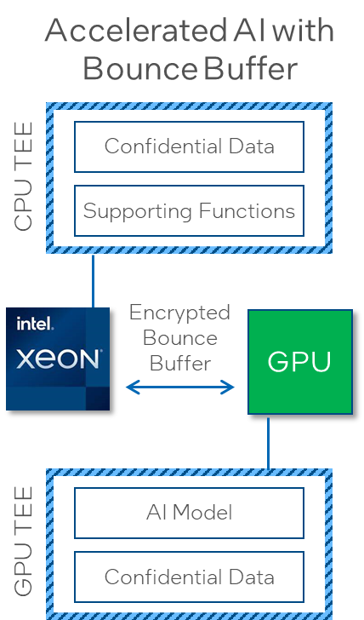
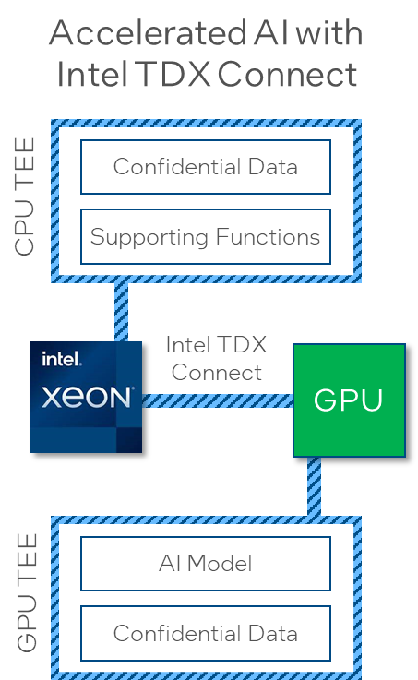
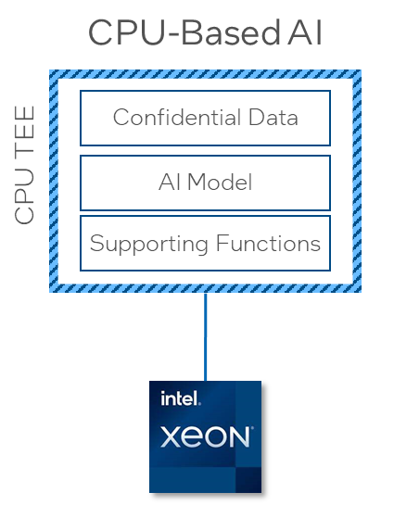
Confidential AI Options & Evolution
Most inference workloads
Training <10B parameters
Intel® AMX acceleration
Models >10B parameters
Data passed via encrypted “bounce buffer”
Models >10B parameters
Single logical TEE across CPU & GPU (performance)
Notes:
This slide illustrates three possible architectures for Confidential AI and shows how GPU-accelerated Confidential AI evolves over time.
CPU-based Confidential AI relies solely on the Xeon CPU. It is appropriate for most inferencing workload, training for models less than 10-billion parameters and benefits from Intel AMX acceleration. All AI functions are protected inside the CPU’s TEE.
The middle option adds GPU acceleration but without the purpose-built secure connectivity of TDX Connect. This intermediate stage uses a bounce buffer to pass encrypted data between the TEEs on the CPU and GPU over an open PCIe link. Here, the model operations happen on the GPU’s TEE while supporting functions like data prep, query management, application interface, etc. remain on the CPU’s TEE. Intel and Nvidia worked together to create a performant solution using this technique based on 5th Gen Xeon (Emerald Rapids) and Nvidia H100 GPUs. We are working we multiple cloud providers to bring it to market in 2025.
The third option is the ultimate evolution of integrated Confidential AI. Here, Intel TDX Connect provides hardware-protected connectivity between the TEEs on the CPU and GPU, enabling end-to-end protection, direct memory sharing and more performance than the bounce buffer. Effectively, TDX Connect enables the CPU and GPU to form one logical TEE, adding flexibility, functionality and performance. TDX Connect hardware is present in Granite Rapids and is expected to be enabled through software updates and emergence of enabled devices such as Nvidia “Blackwell” GPUs.
Note:

Slide 24
Container Deployment Options
TDX HW-isolated VM with confidential clusters
Typical TDX confidential VM
Container 1
Container 2
Data
Data
TDX HW-isolated confidential containers
Data
App
App
Most SW Inside Trust Boundary
(Larger attack surface)
Typical SGX app or service
Container 1
Container 2
App
Container Mgmt System
Purpose-built SGX appliance or app
Data
Data
Full-featured
Guest OS
Full-featured Guest OS
Container
App
App
Data
VMM
VMM
Data
App &
Library OS
Simplified Kernel
Simplified Kernel
HW
HW
HW…
Function
Container Mgmt System
SUSE
Ubuntu
RHEL
Azure CVM
Edgeless Constellation
AKS
GKE
Guest OS
App
Host OS & VMM
VMM
Host OS
HW
HW
HW
Gramine
Occlum
AKS for SGX
Edgeless Marblerun
CoCo
Gramine TDX
Edgeless Contrast
Google Conf Space
Least SW Inside Trust Boundary
(Smaller attack surface)
Intel SGX SDK
A
B
C
D
E
Dedicated Security Service
Flexible Cloud Infrastructure
Intel Confidential

Slide 25
Presentation Guide
Confidential Computing Use Case Examples

Slide 26











Highly Active in Confidential Computing
Sectors
Healthcare
Financial Services
Retail
Government
Industrial and Edge
Usages
Collaborative Analytics
Confidential AI
Privacy-preserving AdTech
Privacy-preserving
Blockchains
Data and Software IP Control
Notes:
Here we see the sectors and usages that are highly active in Confidential Computing. Healthcare and financial services regularly handle high volumes of confidential, regulated information. Retailers often have large databases of business confidential customer data and can use it for advanced analyses but need to keep it private. Government organizations have many highly-sensitive applications and face advanced, persistent threats so confidentiality and security is paramount. Industrial and edge deployments may have valuable data or software IP in distributed locations will less-rigorous physical security, so the technological protection of Confidential Computing is valued.
Specifics of the usages vary widely but we do see some major groups. Confidential multi-party collaborations, such as medical research and fraud detection, allow beneficial analysis without exposing private or regulated data to the other parties. Often, these collaborations involve combining data for more robust AI (both training & inference). The movement toward cookie-less advertising technology has also opened up new usages for advertisers to combine multiple data sets in a privacy-preserving environment to better target customers. Blockchain is a versatile technology for distributed record keeping; It has strong immutability but does not have many privacy protections which Confidential Computing can remedy. Some deployments are using Confidential Computing to protect valuable content or software IP, such as premium video and valuable software deployed in far-flung locations outside the company’s immediate control.

Slide 27



Confidential Computing Use Cases
Business transformation, not just risk mitigation
Government
Digital identity
Critical infrastructure
Anti-corruption
Cyber-crime prevention
Judicial proceedings and case management
Deployed and disconnected operations
Safeguarding / vulnerable population protection (including child exploitation, human trafficking, etc.)
Financial Services
Anti-money laundering
Digital currencies
Secure Payment Processing including Credit Card and Bank Transactions
Fraud prevention
Credit risk assessment and qualification from combined bank records
Capital Markets e.g.: Securing Quantitative Hedge Funds code and models
Proprietary analytics / algorithms
Healthcare
Disease diagnostic
Insurance fraud prevention
Drug development
Contact tracing
Records and evidence management
Insurance fraud, waste, and
abuse prevention

Slide 28


Customer Spotlight
Confidential AI with Regulatory Compliance
Situation
Bosch develops Autonomous Driver Assistance Systems. ADAS AI models are most accurate when trained with unaltered camera footage.
Challenge
Camera footage is loaded with regulated, personal information (faces, license plates, etc.) Under GDPR regulations, Bosch incurs the highest standard of data protection.
Solution
Resolved by handling raw footage only inside Intel SGX enclaves, including data prep and model training stages. Achieved higher model accuracy while maintaining compliance.
Notes:
(Compliance Example) Bosch is a technology and manufacturing leader in many areas, including Autonomous Driver Assistance Systems (ADAS). To train the system, Bosch captures street footage from multiple car-mounted cameras. The most accurate training occurs when they use the raw, unmodified footage but these images are loaded with personally identifiable information (PII) such as faces, license plates and correlated location data that is regulated under GDPR and other laws. This data requires the highest level of care against misuse.
Bosch could solve the PII issue by de-identifying the images with blurs, but that decreases the model’s accuracy and could cause unpredictable vehicle behavior. Instead, Bosch only handles the raw, unencrypted camera footage inside Intel SGX enclaves where software access is limited and even Bosch admins can’t view it. The data prep enclave separates the PII from the rest of the image and stores it securely. The de-identified footage can be used for other analyses. The PII is rejoined to the footage inside a second SGX enclave where it is used to train the ADAS model. The PII is never unencrypted outside an enclave, keeping Bosch compliant the GDPR’s strict privacy regulations.

Slide 29


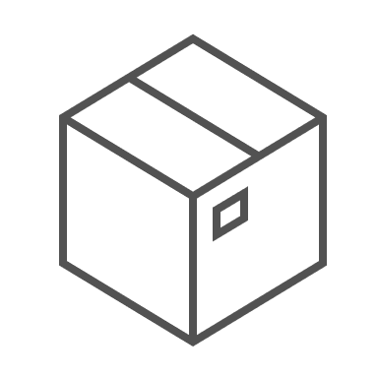
Customer Spotlight
Data Privacy, Control, and Sovereignty
Automated container-based cloud foundation
Situation
Proximus is Belgium’s largest communications service provider. Cloud scalability and advanced analytics are key to their next-generation growth and services strategy.
Challenge
Public Data
Landing Zone
Private Data Landing Zone
Regulated & Sovereign Data Landing Zone
Data at Proximus can be highly regulated with respect to privacy and sovereignty. They require a solution to handle data in the public cloud while remaining compliant and in control of its governance.
Open data, no secrets
Standard cloud deployment
Internal confidential data
Confidential cloud deployment
(VM isolation)
GDPR regulated subscriber data
Confidential cloud deployment
(App isolation + Geo location)
Solution
Three-tier data architecture and automated container packaging where regulated data is protected and controlled in the cloud using Confidential Computing
Notes:
(Compliance & Sovereignty Example) Proximus is the largest communications service and mobile provider in Belgium. Like many CoSPs, Proximus is on a journey to make greater use of public cloud services for workloads outside core network operations, taking advantage of positive economics and scale. Proximus handles data across all levels of confidentiality and regulatory sensitivity, so a one-size-fits-all cloud deployment could leave them exposed to compliance or sovereignty violations.
Proximus worked with Microsoft Azure to develop an automated, container-based data placement system that routes data and workloads to cloud infrastructure with the right level of protection. The “public zone” processes data with no sensitive or regulated data and is the lowest TCO zone. The “private zone” handles Proximus’ business confidential workloads, such as billing and account management, and uses VM-isolation Confidential Computing, often with off-the-shelf software. (VM-isolation uses Azure’s AMD SEV-SNP technology now but may switch to Intel TDX when available). The “regulated & sovereign zone” handles personally identifiable and regulated data that require the highest level of care under GDPR and other laws, including subscriber details and call logs. This zone uses purpose-built, privacy-preserving applications run inside Intel SGX enclaves inside targeted, sovereign European data centers, adding both geo-location and data control enforcement to Proximus’ sovereignty program.

Slide 30

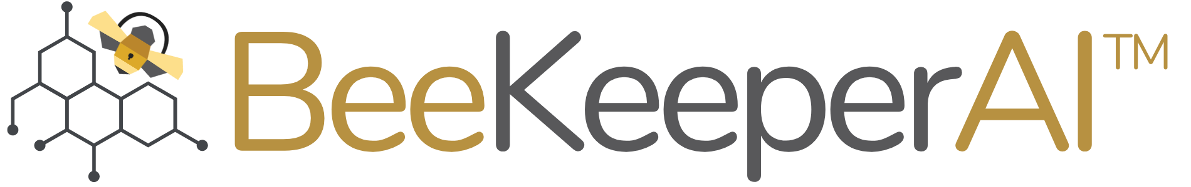




Customer Spotlight
Collaborative Computing with Regulated Data
Hospital 1
Hospital 2
Hospital 3
Situation
Novartis Biome develops diagnostic models and therapies for rare diseases. Rare disease information is sparse and dispersed across multiple hospitals and research institutions.
Regulated Data
Regulated Data
Regulated Data
Challenge
Private Instance w/BeeKeeperAI
Private Instance w/BeeKeeperAI
Private Instance w/BeeKeeperAI
Patient information is private and highly regulated. Hospitals do not want to move data off-prem or disclose private records to BeeKeeperAI or Novartis
BeeKeeperAI
Consolidation Node
Solution
An Intel SGX-enabled BeeKeeperAI instance is integrated within each hospital’s cloud presence that analyzes private data and updates a master model’s weights. Neither Novartis nor BeeKeeperAI personnel ever see or store regulated health records.
Consolidated analysis
Notes:
(Compliance & Multi-Party Example) Novartis Biome is a pharmaceutical and medical device company specializing in rare disease diagnostics and treatments. Since these diseases are rare, data is sparse and spread across multiple hospitals and healthcare institutions. Compiling a sufficiently large data set for accurate analysis requires collecting data from many sources. This data is tightly regulated under HIPAA, GDPR and other laws, and often judged to be too sensitive to be moved off-prem from the institution.
Novartis Biome worked with BeeKeeperAI to develop a federated learning solution that allows multiple institutions to contribute their data to a diagnostic model in a compliant fashion. BeeKeeperAI provisioned a node at each contributing hospital with analytics and models protected inside Intel SGX enclaves. Each node analyzes the local data on-prem then sends updated results and model weights to a master consolidation node in the cloud, which combines results into a single, aggregated model. Inside the SGX enclaves, neither BeeKeeperAI nor Novartis can see the individual health records, and BeeKeeper’s proprietary software is protected from tampering or theft out in the field. This system enables all parties to benefit from a consolidated analysis without every breaking compliance.

Slide 31
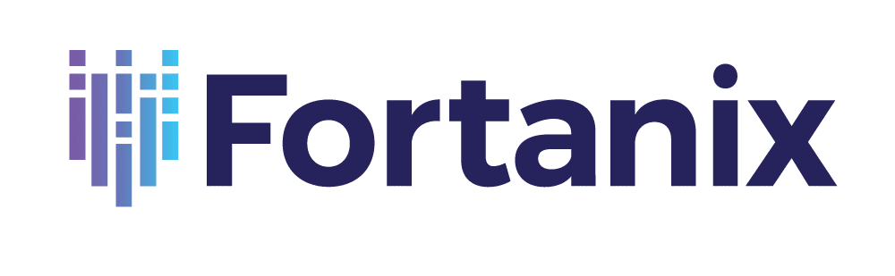

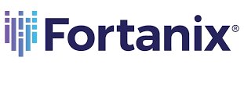
Customer Spotlight
High-Security Key Protection
Situation
Rapidly proliferating keys and certificates require strong protection and centralized management. HSM solutions are expensive and cloud solutions rely on CSP security and compliance.
Self-Defending KMS
Operations Using Unencrypted Keys
On-prem infrastructure
Challenge
Other clouds
Build a scalable, software-based key management system with HSM-like security that is technologically isolated from its cloud host
Operations and Storage of Encrypted Keys
Legacy HSMs
Solution
Host Cloud Provider’s Stack and Admins
Fortanix bases its Self-Defending KMS software on Intel SGX to protect keys and certificates from external adversaries and the cloud provider and helps ensure the owner’s secrets remain under their control.
Notes:
(Security Example) Scalable multi-cloud key management can be complex and expensive, often leveraging dedicated Hardware Security Model (HSM) nodes. Fortanix saw an opportunity to create a software-based key management system (KMS) based on the hardware-based security provided by Intel SGX enclaves.
Fortanix Self-Defending KMS is a software-based solution that provides strong, hardware-hardened key security and management. Installed on an Intel SGX-enabled server on-prem or in the cloud, Fortanix Self-Defending KMS only handles unencrypted key information and processes inside a protected SGX enclave using a minimalistic trusted code base. Outside the enclave, key information is always encrypted. Deployed in the cloud, the SGX enclave creates a technological separation from the cloud provider’s software stack and admins, increasing security and control over the customer’s keys.

Slide 32
Presentation Guide
Confidential Computing and Regulatory Compliance

Slide 33



Innovation & Regulation: An Inevitable Collision Course?
Technology Innovation
Privacy & Security Regulation
Notes:
The tension between Innovation and Regulation can be high. In the case of AI, the market is innovating and evolving rapidly. Customers are in a big hurry to capitalize on this technology that’s coming like a freight train. But on the other hand, new and existing regulations are being put in place to make sure that technology evolves in ways that protects people’s rights and is a net-positive for society.
The standard narrative is that Innovation and Regulation are opposing forces that will crash into each other, creating chaos and slowing customers down. Is that where we’re headed in the new AI age?

Slide 34


Innovation
Compliance
Confidential Computing Can Harmonize Innovation, Privacy & Security
Notes:
No.
With Confidential Computing, organizations can align their innovative business and technology initiatives with their compliance programs. By protecting sensitive or regulated data and helping secure important workloads, compliance and innovation can be force multipliers for each other. Confidential Computing can help get Innovation and Compliance pulling in the same direction.

Slide 35


Confidential Computing Aligns with Key Regulations
European Union Artificial Intelligence Act
  Confidential Computing
  Helps prevent data exposure to unauthorized software or persons while actively in-use
  Protects AI training or inference data from exposure or manipulation during processing
  Protects the AI model from tampering or theft inside an attested TEE
  Strengthens cybersecurity against known and new threats such as unpatched or Zero Day vulnerabilities and malicious insiders
“High-risk AI systems shall be resilient against attempts by unauthorised third parties to alter their use, outputs or performance by exploiting system vulnerabilities”¹
U.S. Executive Order on Safe, Secure & Trustworthy Artificial Intelligence
“Agencies shall use available policy and technical tools, including privacy-enhancing technologies (PETs) where appropriate, to protect privacy and to combat the broader legal and societal risks”²
European Union Digital Operations Resiliency Act (DORA)
Financial entities shall design, procure and implement ICT security policies, procedures, protocols and tools that aim to ensure the resilience, continuity and availability of ICT systems, in particular for those supporting critical or important functions, and to maintain high standards of availability, authenticity, integrity and confidentiality of data, whether at rest, in use or in transit.³
European Union AI Act, Article 15
Executive Order on the Safe, Secure, and Trustworthy Development and Use of AI, Section 2(f)
European Union DORA Chapter 2, Section 2, Article 9, Paragraph 2
Notes:
Let’s look at one example of how the capabilities delivered by Confidential Computing align with the requirements laid out in the regulations from the US and Europe.
The EU AI Act states that applicable AI deployments must be…[read regulation text]. The U.S. Executive Order on AI also says agencies (and those that supply government projects) must…[read text]. The EU regulation for financial systems security and integrity (DORA) specifically calls out protection of data in use.
The confidentiality and security requirements described in these regulations map directly to what Confidential Computing can do. The hardware-enforced Trusted Execution environment helps protect data from exposure to unauthorized parties. Running AI training or inference inside an attested TEE can thwart efforts to take or manipulate the data, as well as protect the model itself from tampering or theft. The isolation of the TEE plus attestation protects the deployment against vulnerabilities or Zero Day attacks on the software outside the TEE. For example, malware in a corrupted Host OS cannot access data and code protected inside a TEE.
With Confidential Computing, you can see how organizations can innovate while enhancing compliance.

Slide 36

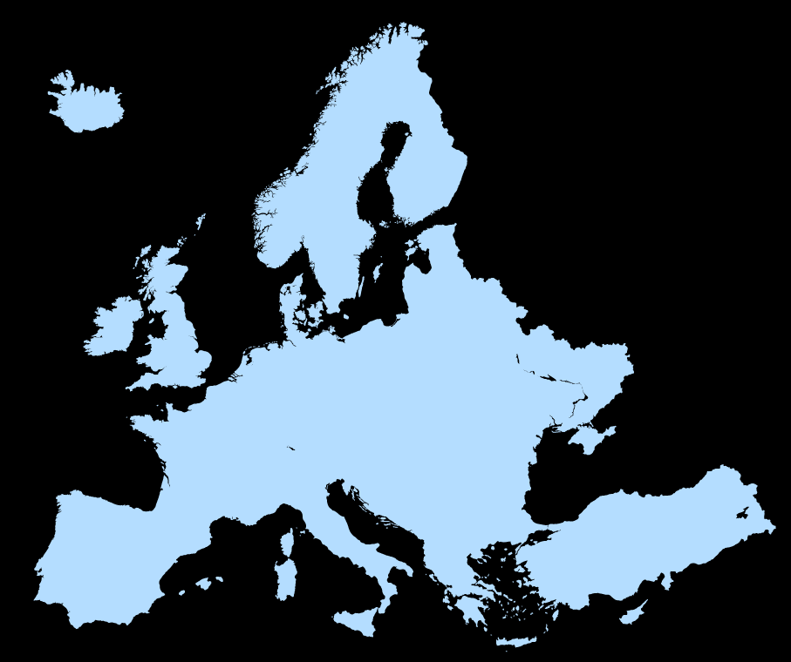


Confidential Computing
Data Controllers & Processors
Strengthens Data Sovereignty Programs
Access Control
Workloads + Data
Confidential Computing TEE
GDPR
Cloud Provider
Local Regulatory Compliance
+
Data Center Geo-Location
+
Technological Protection and Control
Notes:
In much of the world, Data privacy is increasingly viewed as a personal right and national security issue. The data sovereignty movement is rapidly growing in Europe, China, Canada, Australia, and other locations around the world. The idea behind data sovereignty is certain types of personal or sensitive data should be governed under the regulations of the location in which it was generated. For example, data about an Italian citizen would be governed under the laws of Italy and the European Union.
A common data sovereignty strategy combines a compliance regimen with geo-locating the data in a data center in the target region, ideally not with a cloud provider subject to other competing regulatory frameworks. However, data is a very liquid asset and can inadvertently “escape” into other data centers. And disconnecting from multi-national cloud providers may not be practical for global organizations.
Confidential Computing provides an additional technological enforcement mechanism to a data sovereignty strategy. The data in-use is protected inside a TEE, and since the workload owner holds the keys to decrypting the data, it cannot be collected, viewed or accessed without the owner’s knowledge and consent. Combined with storage and network encryption, Confidential Computing empowers workload owners to control access to their data and govern it under their target legal framework.

Slide 37
Presentation Guide
Confidential Computing Performance & Competition

Slide 38
Factors Affecting Confidential Computing Performance
Intel SGX
Intel TDX
Trust Boundary entry/exit cycles are main cause of performance impact
Application optimizations can minimize number of entry/exits and reduce performance impact, including:
Consolidate I/O operations
Increase data batch sizes
Increase Intel SGX enclave size
Increase cores per instance
Bring linked services inside trust boundary
Confidential Data
Trusted Application Code
Confidential Data
Trust Boundary
Trusted Application
Trusted Application
Untrusted Application Code
Trust Boundary
Guest OS
Guest OS
Hypervisor
Hypervisor
I/O devices
Linked services
Other containers or VMs
I/O devices
Linked services
Other containers or VMs
Notes:
This slide is intended to explain why Confidential Computing creates a degree of performance overhead and help customers understand why SGX can be more impacted than TDX.
The main cause of performance impact is entry/exit cycles across the trust boundary. Each of those cycles requires the hardware to perform operations that secure data in cache and memory so non-confidential operations cannot access it while control flow is outside the trust boundary. Entry/exit cycles happen when trusted software requests services outside the trust boundary, such as IO or linked services. For SGX, any call out to untrusted software or the Guest OS imposes an entry/exit cycle, so they tend to happen more often with SGX versus TDX, where everything inside the VM is inside the boundary.
Actions can be taken to reduce the number of entry/exit cycles, which are listed here. Each of these strives to keep the control flow inside the trust boundary as long as possible.

Slide 39
Confidential AI Performance vs. Non-Confidential
Intel TDX
Intel Xeon 6 with P-cores
PyTorch – ResNet50 – Intel AMX
Intel SGX
Intel Xeon 6 with P-cores
PyTorch – ResNet50 – Intel AMX
100%
100%
94%
100%
100%
94%
93%
88%
Intel TDX
Intel TDX
Intel SGX
Intel SGX
Relative Performance
(Higher is better)
Relative Performance
(Higher is better)
Batch Processing
BS=116
INT8
Real-Time Processing
BS=1
INT8
Batch Processing
BS=116
INT8
Real-Time Processing
BS=1
INT8
Results may vary by configuration and workload​. 1-node, 2x Intel Xeon Platinum 6985P processor on AvenueCity with 1.5 TB (24 slots/ 64GB/ 6400) total DDR5 memory, ucode x311, HT on, Turbo on, CentOS Stream 9, 6.6.0-gnr.bkc.6.6.26.5.40.x86_64, PyTorch -intel-extension-for-pytorch 2.4.0+git2731521 (RN50), GCC 8.5.0, MKL, Gramine – Master branch (610830d8e27c81f036f3f401ec7eb3cde7de0966), test by Intel on 12/15/2024.
Notes:
These performance results were generated on a Xeon 6 with P-cores (Granite Rapids-AP) and Intel AMX acceleration. They show the relative performance impact of running an AI image recognition operation confidentially with TDX and SGX.
TDX keeps the entire VM inside the trust boundary, including the application, Guest OS and much of the necessary software. As a result, fewer transitions across the trust boundary are required and the overhead imposed by TDX is just 6% for both batch and real-time processing. The trade-off for lower overhead is the larger trust boundary and more software that’s assumed to be trusted.
With its smaller trust boundary, SGX only trusts the AI application code and runs it inside a protected enclave. Any request for more data outside the enclave or OS services is an exit/entry transition across the trust boundary, and as a result, SGX overhead is a bit higher, especially for real-time processing. However, the amount of software that must be trusted with SGX is much smaller than TDX, which trusts all the software inside the VM.
One other note, these results only compare confidentiality on/off on Granite Rapids-AP. They don’t reflect the absolute performance gain coming from an older instance like an Ice Lake without AMX to Granite Rapids with AMX. With the more powerful cores and AI acceleration instructions, the absolute performance increase coming from an older instance without confidentiality to a Granite Rapids instance with TDX or SGX may be substantial.

Slide 40
Weighing Performance Impact vs. Alternatives
Do not proceed with project; Keep data locked-down
⬇ Opportunity
⬇ Revenue
Without Conf. Computing
With Conf. Computing
Forego protections & proceed
⬆ Risk
Relative Performance
(Illustrative Only)
Versus
Data obfuscation
⬇ Business Velocity
⬇ Data fidelity
Employ a trusted third party or data escrow
⬆ Cost
⬇ Business Velocity
Confidential Computing protections may impact application performance
Wait for alternative Privacy Enhancing Technology
⬇ Performance
⬇ Business Velocity
Notes:
This is the first slide in a 4-slide progression to frame the performance discussion. Often, the performance discussion is framed ENTIRELY around the performance overhead of SGX and TDX. These 4-slides are designed to provide critical context and framing for a more productive performance conversation.
This slide shows allows the conversation to be framed between two alternatives: 1) the small performance trade-off of confidential computing as compared to, 2) the alternative actions the customer could take with the project.
On the left, we show that, yes, Confidential Computing technologies do shave off some performance compared to running the same workload in a non-confidential environment. The amount of overhead varies by technology and the level of optimizations in the implementation. This is the impact on one side of the scale.
On the right, we consider the other side of the scale with the actions the customer could take if the decided to forgo Confidential Computing. They could keep the sensitive data locked in its vault and not proceed with the project at all, which reduces the customers business opportunity and potentially decreases revenue by denying them the valuable insights and services.
They could forgo any Confidential Computing protection at all and just proceed, which increases the risk of a data breach or compliance violation.
They could run the sensitive data through a obfuscation or de-identification process which would likely slow down the velocity of the project or service, and the loss of data fidelity as detail is removed may impact the accuracy of the analysis.
They could employ a trusted third party or data escrow service to handle sensitive data and make sure it isn’t exposed to other parties. This adds cost and slows down the project’s velocity.
Others may say they are more attracted to alternative Privacy Enhancing Technologies like Fully Homomorphic Encryption (FHE) or Secure Multi-party Computing (SMC). Although these techniques have attractive characteristics, their performance slow-down is measured in orders of magnitude, not in a handful of percentage points like Confidential Computing. FHE and SMC also require extensive code changes and application architecture changes. Confidential Computing, on the other hand, is ready to be deployed today with largely unmodified software.

Slide 41
Competitive Comparison
 | Intel SGX | Intel TDX | AMD SEV-SNP | AWS Nitro Enclaves
Isolation Level | Application | VM | VM | VM
Cloud Provider’s Proprietary HW & SW Outside the Trust Boundary | ● | ● | ●
Virtualized Environment | ● | ● | ● | ●
Bare Metal Environment | ●
Attest TEE Authenticity & Measured TEE Launch | ● | ● | ● | ●
Attest TEE Workload Integrity (out-of-the-box) | ●
Multi-Vendor, Multi-Cloud, and On-Prem Availability | ● | ● | ●
Compatible with Nvidia GPU confidential computing |  | ● | ●
Current as of December 2024. Subject to change
Notes:
This chart compares the CPU-based Confidential Computing alternatives most customers will choose from.
Intel TDX and AMD SEV-SNP are essentially a tie. There is very little difference in confidentiality between them and deals will be won or lost on other differentiators like performance, accelerators and price.
Intel SGX offers three main points of differentiation. It is the only technology that isolates at the application or function level, giving it the smallest trust boundary and least amount of software that needs to be trusted. SGX also provides out-of-the-box support for application attestation, providing users the ability to cryptographically verify that the application or function accessing sensitive data has not been modified. None of the other technologies can do this out-of-the-box. It is possible an attestation service could be built to offer this for one of the others, but such as service does not exist at this writing (Dec’2024). SGX is also the only Confidential Computing CPU technology that can run on bare-metal systems with no virtualization.
AWS Nitro Enclaves is AWS’s proprietary technology that creates a “child VM” to run confidential operations for its “parent VM”. The connection between the parent and child VMs is a restricted V-SOCK port created and controlled by the AWS Nitro hypervisor. The fact that the cloud provider’s technology creates and manages the port through which the confidential data passes puts AWS inside the trust boundary. They have made public statements that they do not monitor these connections, but unlike the other technologies, there is no way for a user to technologically prohibit or cryptographically verify this. The other major disadvantage of Nitro Enclaves is it is proprietary to AWS and not offered by any other cloud vendor or usable on-prem, which can lead to vendor lock-in.
With the importance of GPU-accelerated AI, it is also important to know which are compatible with Nvidia’s GPU-based confidential computing technology. So far, Intel TDX and AMD SEV-SNP can be paired with Nvidia H100 GPUs to create confidential AI across the CPU and GPU. There is no insurmountable technological obstacle to using SGX with Nvidia GPUs, but Intel and Nvidia are prioritizing investments in TDX. AWS has not announced plans to support Nvidia GPUs with Nitro Enclaves as of this writing (Dec’24).

Slide 42
Competitive Data Sources
AMD SEV-SNP
    https://www.amd.com/system/files/TechDocs/SEV-SNP-strengthening-vm-isolation-with-integrity-protection-and-more.pdf
    https://techcommunity.microsoft.com/t5/apps-on-azure-blog/announcing-public-preview-of-confidential-containers-on-azure/ba-p/3755623
AWS Nitro Enclaves
    https://docs.aws.amazon.com/enclaves/latest/user/nitro-enclave.html
    https://docs.aws.amazon.com/enclaves/latest/user/security.html
    https://docs.aws.amazon.com/enclaves/latest/user/building-eif.html
Nvidia Confidential Computing on H100 GPU
    https://www.nvidia.com/en-us/data-center/solutions/confidential-computing/
Notes:
Always include this slide with the Competitive Comparison Matrix to show the data sources

Slide 43
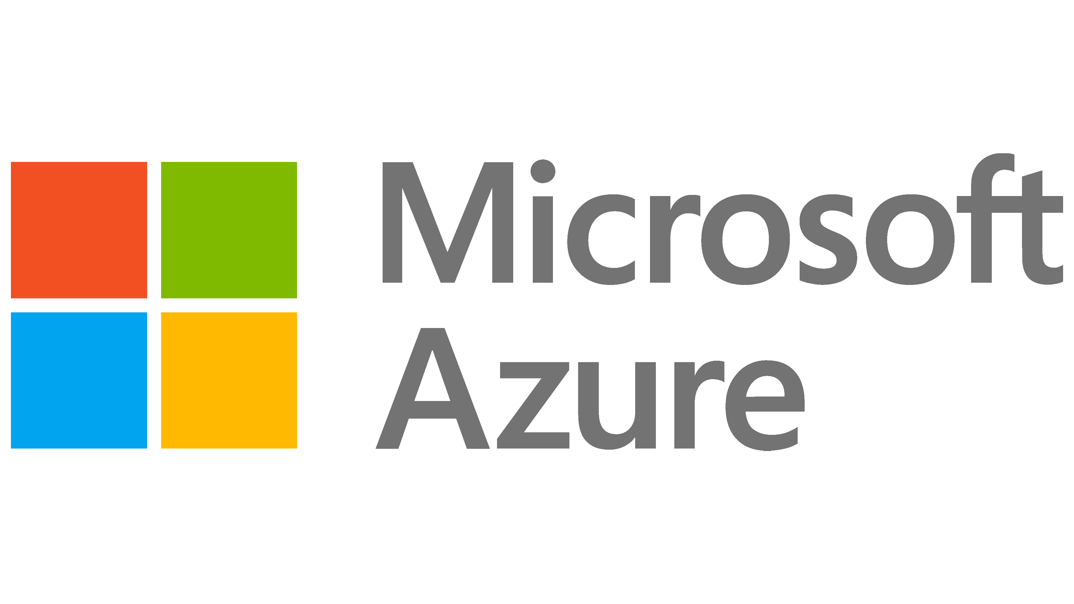

Security Research on Intel Confidential Computing
We encourage offensive research on our products to continuously strengthen our security
Intel collaborated with Google Project Zero in a 9-month evaluation of Intel TDX in 2022 prior to initial availability
Results:
10 potential vulnerabilities discovered
All 10 mitigated before launch of 4th Gen Intel Xeon Scalable platform in 2023
Intel collaborated with Microsoft Offensive Research & Security Engineering to examine 29 attack vectors on Intel TDX in 2024
Results:
6 potential vulnerabilities discovered
All 6 mitigated with updates to Intel TDX in 2024
39% Reduction
in combined hardware & firmware vulnerabilities in 2023 versus 2022
60% fewer Conf. Computing firmware vulnerabilities
in 2023 than closest competitor
Intel’s proactive security assurance accounted for
94% of vulnerabilities disclosed in 2023
2023 Intel Product Security Report:
https://cloud.google.com/blog/products/identity-security/rsa-google-intel-confidential-computing-more-secure
https://www.intel.com/content/dam/www/public/us/en/security-advisory/documents/intel_tdx_joint_security_review_with_microsoft.pdf
https://www.intel.com/content/dam/www/central-libraries/us/en/documents/2024-01/intel-2023-product-security-report.pdf
Notes:
Use this slide if a customer wants additional assurance that TDX has been thoroughly vetted for security.
Intel believes that aggressive, offensive security research is the best way to test our product security and discover any vulnerabilities so they can be addressed. We partnered with two of the most advanced research teams in the business to put TDX to the test, Google Project Zero and Microsoft Offensive Research. Google completed their analysis on pre-production Sapphire Rapids in 2022, finding 10 potential vulnerabilities across dozens of attack vectors. All ten were mitigated pre-production before 4th Gen Xeon (Sapphire Rapids) was launched. Microsoft ran their analysis in 2024 and found 6 possible vulnerabilities across 29 attack vectors. All six were mitigated with updates to 4th Gen Xeon and subsequent processors. Both Google and Microsoft praised the security of TDX and the rapid mitigation of the possible vulnerabilities they found, and both now offer TDX instances.
Highlights from the 2023 Intel Product Security Report:
Hardware and firmware vulnerabilities strike at the heart of the platform and can be the most disruptive. Intel reduced HW and FW vulnerabilities 39% in 2023 versus the prior year.
Intel had 60% fewer vulnerabilities discovered in its Confidential Computing firmware than AMD.
Intel finds and fixes our own vulnerabilities, either with our own Red Teams or by partnering with outside researchers. Our proactive efforts accounted for 94% of the vulnerabilities disclosed in 2023, and these coordinated disclosures were preceded by mitigations to keep customers safe.

Slide 44
Intel Trusted Execution Environments
Trust Boundaries Compared
Trust Boundary: Elements with potential to access confidential data
Without Confidential Computing
Cloud Stack and Admins
BIOS and Firmware
Host OS and Hypervisor
VM Guest Admin
Guest OS
Applications
Confidential Data
VM Isolation with Intel® TDX
Cloud Stack and Admins
BIOS and Firmware
Host OS and Hypervisor
VM Guest Admin
Guest OS
Applications
Confidential Data
App Isolation with Intel® SGX
Cloud Stack and Admins
BIOS and Firmware
Host OS and Hypervisor
VM Guest Admin
Guest OS
Apps
Confidential Data
Enclave
Notes:
This diagram illustrates the differences in the trust boundary between Intel’s different technologies. Without any Confidential Computing technology, everything is inside the trust boundary, notably all of the cloud provider’s firmware, cloud stack, hypervisor and cloud admins. Any of these entities could potentially access confidential data in a tenant’s instance either by design or as a result of an exploited vulnerability.
Confidential Computing with VM Isolation technologies like Intel TDX removes everything out of the trust boundary except what’s inside the tenant’s VM. The cloud provider’s stack and admins are out, as well as other cloud tenants. The VM admins, Guest OS and all the applications are inside the trust boundary. Although the cloud provider is removed, the trust boundary can still contain millions of lines of code, and any software vulnerabilities that come with them. Intel TDX, AMD SEV-SNP and Arm CCA all use VM isolation technology.
Confidential Computing with Application Isolation technology like Intel SGX removes everything from the trust boundary except the application code inside the SGX enclave. The trusted code can be thousands of lines or just a few dozen. Intel SGX is the only Confidential Computing technology that offers this level of isolation. By design, the Guest OS and VM admins are not authorized to view or modify data and code inside the SGX enclave, even if they became malicious. Only Intel offers application isolation with SGX.
Note: Some prefer to talk about the Trust Boundary as “Attack Surface” or “Security Perimeter”. Both are good alternatives if that is your preference.

Slide 45
Presentation Guide
What follows are backup slides and some popular slides from prior editions of the 30-3-30

Slide 46
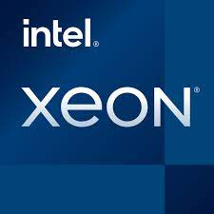
Confidential AI Options & Evolution
This is an original slide provided in case graphics need to be modified.
CPU-Based AI
Accelerated AI with Bounce Buffer
Accelerated AI with Intel TDX Connect
Confidential Data
Confidential Data
Confidential Data
CPU TEE
AI Model
CPU TEE
CPU TEE
Supporting Functions
Supporting Functions
Supporting Functions
Encrypted Bounce
Buffer
GPU
Intel TDX Connect
GPU
AI Model
AI Model
GPU TEE
GPU TEE
Confidential Data
Confidential Data
Most inference workloads
Training <10B parameters
Intel® AMX acceleration
Models >10B parameters
Data passed via encrypted “bounce buffer”
Models >10B parameters
Single logical TEE across CPU & GPU (performance)

Slide 47


Standard, Permissioned Access vs. Privileged Access
Standard Privilege & Permission Governance
Privileged Access
Notes:
(some security professionals and IT leaders believe their existing security protections and procedures are sufficient to keep data protected. This slide and the following are used to focus attention on risks from privileged persons or software that are difficult to defend against)
Modern enterprises and cloud deployments have extensive controls to classify users and software into security levels and assign them to permission groups. These mechanisms and procedures are essential to keeping the vast majority of users and software programs behaving within the appropriate boundaries.
But there is a class of users and software with elevated privileges that have wide access to systems, software and data. These include system administrators, system management tools, security software, hypervisors and certain operating system functions, among others.

Slide 48



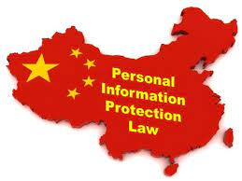



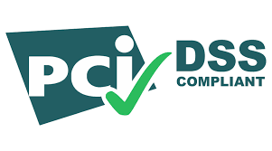



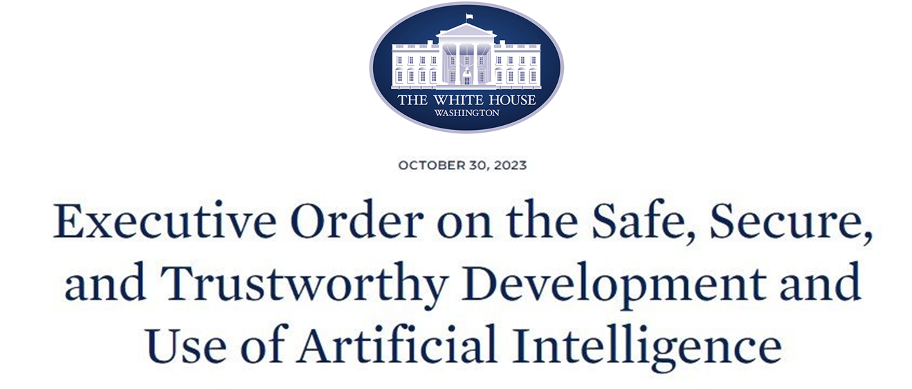

Historically, Compliance Meant Data Lockdown
NEW
REGULATED
DATA
NEW
Notes:
NOTE TO PRESENTER: Be mindful of your claims regarding compliance. Confidential Computing will not automatically make a customer compliant like it is an on/off switch. Think of compliance more as a spectrum from weak to strong encompassing data handling practices, policies, technological safeguards and more. Applied as part of a full-spectrum compliance program, Confidential Computing can help customers move toward a stronger compliance position.
Regulations on data privacy and security are pervasive around the world including well-known laws such as GDPR, HIPAA and PIPL. They describe the responsibilities of organizations to protect the confidentiality data in their possession. Poor data handling practices or sloppy security can lead to data exposures and, consequently, substantial penalties levied by regulators.
With the rise of AI, governments are putting in place additional regulations to help mitigate risks of data breaches or model manipulation. These include the European Union AI Act and the US Executive Order on Safe, Secure and Trustworthy AI.
In general, the easiest and safest path to comply with data privacy and security regulations was to lock the data in silos and “deactivate” it. Don’t use or share it because doing so risks data exposure or loss that could lead to a breach and/or compliance violation.

Slide 49
Outcomes of Applied Confidential Computing
Data Silos Unlocked
Improve collaboration, insights
and data monetization
Confident Cloud Migration
Realize cloud TCO & scale benefits while protecting sensitive data
Defense-in-Depth
Protect against difficult-to-defend threats targeting critical data & systems
Compliance Strengthened
Auditable protection of regulated data security & workload integrity
Notes:
Edge: SGX in Open Visa Network
But these opportunities can be stymied by a number of customer concerns.
New services, such as deep analytics or collaborations can be blocked because the data is private, regulated or otherwise confidential.
Despite potential advantages of using the cloud, Applications that handle sensitive data may be stuck on-prem. Organizations may be concerned about data security risks in the cloud or losing control of their data if the cloud provider is subject to regulatory or legal regimes outside the organization’s preferred framework.
Some applications and sensitive data are just high-value targets for profit-motivated hackers or nation-state actors. Although a service innovation may create new value and convenience for users, the risk of activating the data beyond a locked-down storehouse may be viewed as unacceptable for the project to proceed.

Slide 50

Threats Are Present Across All AI Deployment Phases
Data Ingest & Preparation
Model Creation
& Training
Deployment &
User Interface
Inference
Results
Adversarial data mislabeling or insertion
Training data set theft, misuse or breach
Base model theft
Software provenance risk
Intelligence gathering via query monitoring
Reverse engineering via API abuse
Model or parameter exfiltration
Reverse engineering via adversarial queries
Result theft, misuse or breach
Notes:
AI deployments involve a pipeline of activities from initial data acquisition to final results. At each of these stages, an adversary could take actions that manipulate the model’s behavior or steal valuable intellectual property. Security researchers around the world (including Intel Labs) have documented many threats to AI deployments across the pipelines. These threats include:
Injecting adversarial data into the training set or maliciously mislabeling data
Stealing a valuable training data set or base model
Incorporating malicious software into the model due to poor provenance controls
Gathering intelligence about model behavior, parameter weights and calculations by monitoring queries or abusing the model’s API
Using incremental, repetitive queries to reverse engineer the parameters
Breaches that enable the adversary to view or steal the model’s confidential results

Slide 51
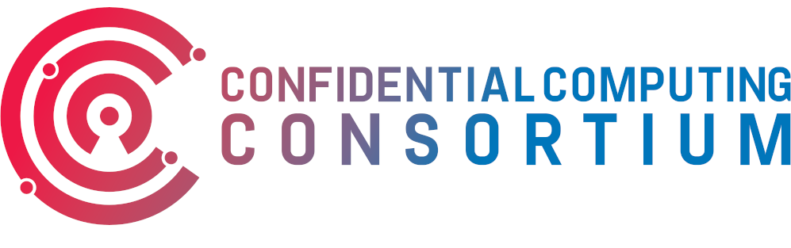
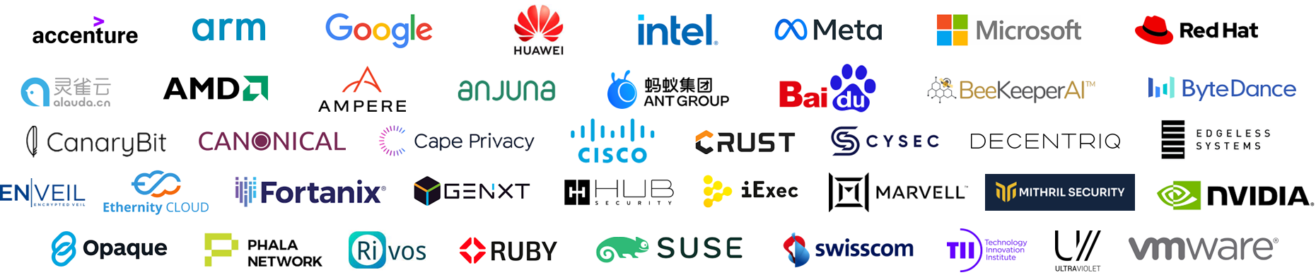
A Community Focused on Protecting Data In-Use
ConfidentailComputing.io
Intel is a founding member of the Confidential Computing Consortium
The Consortium brings together hardware vendors, cloud providers, and software developers to accelerate the adoption of Trusted Execution Environment technologies and standards.
CCC is a project community at the Linux Foundation
Premier Members
General Members

