Slide 1
Confidential
Computing
30-3-30
Includes Confidential AI Module

Slide 2
Data Protection, Compliance & Sovereignty with Intel Confidential Computing
Release date November 3, 2023
Presenter name

Slide 3
Confidential Computing 30-3-30
About this Presentation
Title | Data Protection, Compliance & Sovereignty with Intel Confidential Computing
Author | Mike Ferron-Jones Go-to-Market Lead for Data Center Security Technologies
Last Revision Date Original Publication Date | April 16, 2024 December 9, 2022
Sensitivity | All slides are approved for customer and public use. No NDA required.
Topics & Technologies Covered | Confidential Computing, Intel SGX, Intel TDX, Intel Trust Authority (formerly Project Amber)
Related Content | Seismic Data Center Security resource page https://intel.seismic.com/Link/Content/DCPJDHGGgqd4J8cB3Q8mHdG8DpfV SMR Data Center Security resource page https://www.intel.com/content/www/us/en/secure/internal/resources-documentation/sales-marketing/data-center/security.html Confidential Computing Competitive Response Guide (SMR and Seismic asset ID 764105)

Slide 4
Important Legal Information
Intel technologies may require enabled hardware, software or service activation.
No product or component can be absolutely secure.
Performance varies by use, configuration and other factors. Learn more on the Performance Index site.
Performance results are based on testing as of dates shown in configurations and may not reflect all publicly available updates. See backup for configuration details.
Your costs and results may vary.
© Intel Corporation. Intel, the Intel logo, and other Intel marks are trademarks of Intel Corporation or its subsidiaries. Other names and brands may be claimed as the property of others.

Slide 5
Presentation Guide:
30-Second Pitch Slide

Slide 6




Why Confidential Computing?
Confidently Migrate to the Cloud, Knowing You’re in Control
Even with confidential or regulated data
Collaborate with Multiple Parties on Beneficial Shared Analyses
While maintaining privacy & compliance
Strengthen Compliance & Data Sovereignty Programs
With technological controls
Harden Application Security
& IP Protection
Hardware-based isolation & access controls
Notes:
This slide is intended as the “attention grabber” if you want to go straight to the benefits messages and explain the technology later.
Confidential computing puts you in control of your data and how it can be accessed in the cloud. Even confidential or regulated data can be protected when in-use in the public cloud, so you can take advantage of the economics and scale of the cloud while remaining compliant.
Confidential computing enables you to engage in multi-party analysis collaborations but do so in a way that keeps each parties’ data private. You can realize the benefits of shared analysis without losing privacy and compliance.
Regulatory compliance and data sovereignty are all about maintaining control of data and making sure its only used appropriately. Often compliance relies exclusively on processes and procedures, and sovereignty on geo-location. But data is highly liquid and can escape even the best procedures. Confidential computing adds technological controls that help ensure data will be handled in compliance with proper procedures and your preferred regulatory framework.
And Confidential computing “armors-up” your workloads, helping protect sensitive data, content and software IP from advanced attack, tampering and theft.

Slide 7
Presentation Guide
3 Minute Pitch (two options)

Slide 8
Intel Confidential Computing Portfolio
Portfolio View option 1
Intel® Software Guard Extensions
Application isolation
Intel® Trust Domain Extensions
Virtual machine isolation
Intel® Trust Authority
Independent trust verification services for multi-cloud & hybrid cloud
Software Solutions, Cloud, OEM and System Integrator Ecosystem
Intel Security-First Development & Lifecycle Support
Notes:
Only Intel offers such an extensive confidential computing portfolio to meet the diverse needs of our customers.
For over five years, we’ve pioneered Confidential Computing and offered application isolation with Intel SGX.
In 2023, we brought our initial offering of Intel TDX, our VM isolation technology, to market with Alibaba, Azure and Google Cloud. IBM Cloud is expected to launch in 2024.
In September 2023, we launched our new independent, cloud-based trust verification service called Intel Trust Authority, formerly code-named Project Amber.
These products and services are backed by Intel’s unmatched ecosystem and solution provider enabling, as well as our “security first” development practices and our best-in-class lifecycle security support. We are committed to keeping our customers protected long after their initial purchase of an Intel-based platform.

Slide 9




Intel’s Confidential Computing Portfolio
Portfolio View option 2
App Isolation
Intel® SGX
VM Isolation
Intel® TDX
Trust Services
Intel® Trust Authority
Trust Boundary
Confidential Data
Confidential Data
Intel Trust Authority SaaS
Enclave
Applications
Trust Boundary
Applications
Guest OS
Guest OS
VM Admin
VM Admin
Hypervisor
Hypervisor
BIOS & Firmware
BIOS & Firmware
Public Clouds
On-Prem
Network
Edge
Cloud Stack & Admins
Cloud Stack & Admins
Smallest trust boundary for greatest data protection & code integrity
Most straightforward path to greater security, compliance & control for legacy apps
Uniform, independent attestation of trustworthy environments
Notes:
Only Intel offers such an extensive confidential computing portfolio to meet the diverse needs of our customers.
For over five years, we’ve pioneered Confidential Computing and offered application isolation with Intel SGX.
In 2023, we brought our initial offering of Intel TDX, our VM isolation technology, to market with Alibaba, Azure and Google Cloud. IBM Cloud is expected to launch in 2024.
In September 2023, we launched our new independent, cloud-based trust verification service called Intel Trust Authority, formerly code-named Project Amber.
These products and services are backed by Intel’s unmatched ecosystem and solution provider enabling, as well as our “security first” development practices and our best-in-class lifecycle security support. We are committed to keeping our customers protected long after their initial purchase of an Intel-based platform.

Slide 10
Presentation Guide
Confidential Computing Need and
Technology Fundamentals

Slide 11







Opportunities for Transformation Abound
Cloud Economics and Scale
Service Innovation Enabled by New Data Sources
Multi-Party Collaboration Around Data
Privacy-Preserving Technology
Blockchain-Based Services
AI-Powered Analysis and Services
Distributed and Edge Applications
Notes:
We are in an era where powerful, ubiquitous computing and innovation make business transformation both possible and urgent.
Public cloud resources provide a cost-effective, infinitely scalable alternative to traditional on-prem infrastructure for many applications.
New data sources, both internal and external, open new opportunities for analysis and new services.
Collaboration among multiple parties allow all participants to benefit from shared analysis or solve mutual issues. These collaborations may take advantage of new Privacy Preserving Technologies to keep data confidential and compliant.
Innovations in the areas of Blockchain and AI are inspiring new projects and services, compounded by computing and communications technology to support distributed and edge applications.

Slide 12
Growing Customer Challenges
Projects blocked
due to data privacy or compliance concerns
Cloud migration stalled due to data control and sovereignty concerns
Security worries
due to sophisticated, persistent threats to data and software IP
Confidential Computing is a pathway to help overcome these challenges
Notes:
But these opportunities can be stymied by a number of customer concerns.
New services, analyses or collaborations can be blocked because the data is private, regulated or otherwise confidential. Proceeding could breach confidentiality or create a regulatory compliance violation.
Despite potential advantages of using the cloud, Applications that handle sensitive data may be stuck on-prem. Organizations may be concerned about data security risks in the cloud or losing control of their data if the cloud provider is subject to regulatory or legal regimes outside the organization’s preferred framework.
Some applications and sensitive data are just high-value targets for profit-motivated hackers or nation-state actors. Although a service innovation may create new value and convenience for users, the risk of activating the data beyond a locked-down storehouse may be viewed as unacceptable for the project to proceed.

Slide 13



The Need for Confidential Computing
Closes a Major Gap in the Data Protection Continuum
Data at Rest
Data in Transit
Data in Use
Storage Encryption
Network Encryption
Confidential Computing
Notes:
Technologies have developed over time to protect data and ease these privacy, security and compliance concerns, but there was always a gap.
Storage and disk encryption evolved and matured to protect data at-rest.
Network encryption is strong and getting stronger to protect data in-transit.
But those techniques didn’t help when data was actively in-use in the processor and memory. Away from storage and off the network, it was vulnerable. This is the gap in the data protection continuum that Confidential Computing is designed to address, helping protect data from end to end.

Slide 14



Confidential Computing
Essential Functions
Trusted Execution Environment
Sensitive Data
Trusted Workload Software
Trusted Admins
Isolation
Separation of the TEE from underlying software, admins, and other cloud tenants
Encryption and Control
Workload owner holds key to decrypt data, retaining control and preventing access by cloud provider or other entities
Verification
Cryptographic confirmation that TEE is genuine, correctly configured, and software is exactly as expected
Untrusted Software
Cloud Stack
Cloud Admins
Notes:
Confidential computing delivers three essential functions.
ISOLATION: Confidential computing uses silicon-based technology to create a hardware-enforced Trusted Execution Environment (TEE). Sensitive data should only be decrypted inside the TEE. Only software inside the TEE’s trust boundary can access sensitive data. This creates a technological separation from all the software and admins outside the trust boundary. This includes the cloud provider’s management stack, hypervisor and infrastructure admins.
ENCRYPTION & CONTROL: With Confidential Computing, authorized data owners hold the keys to their data. Outside the TEE, the data is encrypted and inside the TEE, only the authorized software or parties can view it. The cloud provider or other cloud tenants cannot access your data in plaintext.
VERIFICATION: How do you know your TEE is genuine and functioning properly? Confidential computing technology includes cryptographic verification that the TEE is genuine, updated within policy, and, depending on the technology, can verify the software running in the TEE is exactly what’s expected. This process is often called “Attestation”.

Slide 15
Confidential Computing
Value
Activate confidential or regulated data in your Digital Transformation while remaining compliant, even if collaborating with others
Migrate workloads with sensitive data to the cloud with confidence
Add technological controls and safeguards to data sovereignty and governance programs
Strengthen application and data security in data center or edge deployments
Isolation
Encryption and Control
Verification
Notes:
These three essential functions enable you to realize new value in several aspects of your business transformation.
The technological separation of your data from the cloud provider offers a new level of privacy, security and control which can enable you to move more sensitive workloads to the cloud with confidence. Confidential computing offers stronger protections from the cloud provider and other tenants.
The TEE and granular access controls open possibilities for new services or collaborations using sensitive or regulated data. Before, sensitive data was locked away and treated only as a source of risk rather than a source of value. Confidential computing enables you to activate this data while keeping it private, protected, and compliant, even in collaboration with other parties.
Data sovereignty is a growing movement to treat citizen data as a national asset and retain national or regional control over how it’s used. This movement comes from the fluidity of data, today’s multi-national cloud environment, and competing regulatory and privacy frameworks around the world. Organizations implementing a data sovereignty strategy often rely on geo-location of data stores, but Confidential Computing adds a layer of technological enforcement and control to these efforts.
Today, applications can be distributed across data center and edge locations. Edge locations frequently don’t have the strong physical security of a major data center, leaving those deployments more vulnerable to tampering, attack or theft. Confidential computing strengthens the security of confidential data and valuable software IP operating inside hardware-isolated TEEs verified for proper configuration.

Slide 16
Presentation Guide
Confidential Computing Use Case Examples

Slide 17











Highly Active in Confidential Computing
Sectors
Healthcare
Financial Services
Retail
Government
Industrial and Edge
Usages
Collaborative Analytics
Confidential AI
Privacy-preserving AdTech
Privacy-preserving
Blockchains
Data and Software IP Control
Notes:
Here we see the sectors and usages that are highly active in Confidential Computing. Healthcare and financial services regularly handle high volumes of confidential, regulated information. Retailers often have large databases of business confidential customer data and can use it for advanced analyses but need to keep it private. Government organizations have many highly-sensitive applications and face advanced, persistent threats so confidentiality and security is paramount. Industrial and edge deployments may have valuable data or software IP in distributed locations will less-rigorous physical security, so the technological protection of Confidential Computing is valued.
Specifics of the usages vary widely but we do see some major groups. Confidential multi-party collaborations, such as medical research and fraud detection, allow beneficial analysis without exposing private or regulated data to the other parties. Often, these collaborations involve combining data for more robust AI (both training & inference). The movement toward cookie-less advertising technology has also opened up new usages for advertisers to combine multiple data sets in a privacy-preserving environment to better target customers. Blockchain is a versatile technology for distributed record keeping; It has strong immutability but does not have many privacy protections which Confidential Computing can remedy. Some deployments are using Confidential Computing to protect valuable content or software IP, such as premium video and valuable software deployed in far-flung locations outside the company’s immediate control.

Slide 18


Customer Spotlight
Confidential AI with Regulatory Compliance
Situation
Bosch develops Autonomous Driver Assistance Systems. ADAS AI models are most accurate when trained with unaltered camera footage.
Challenge
Camera footage is loaded with regulated, personal information (faces, license plates, etc.) Under GDPR regulations, Bosch incurs the highest standard of data protection.
Solution
Resolved by handling raw footage only inside Intel SGX enclaves, including data prep and model training stages. Achieved higher model accuracy while maintaining compliance.
Notes:
(Compliance Example) Bosch is a technology and manufacturing leader in many areas, including Autonomous Driver Assistance Systems (ADAS). To train the system, Bosch captures street footage from multiple car-mounted cameras. The most accurate training occurs when they use the raw, unmodified footage but these images are loaded with personally identifiable information (PII) such as faces, license plates and correlated location data that is regulated under GDPR and other laws. This data requires the highest level of care against misuse.
Bosch could solve the PII issue by de-identifying the images with blurs, but that decreases the model’s accuracy and could cause unpredictable vehicle behavior. Instead, Bosch only handles the raw, unencrypted camera footage inside Intel SGX enclaves where software access is limited and even Bosch admins can’t view it. The data prep enclave separates the PII from the rest of the image and stores it securely. The de-identified footage can be used for other analyses. The PII is rejoined to the footage inside a second SGX enclave where it is used to train the ADAS model. The PII is never unencrypted outside an enclave, keeping Bosch compliant the GDPR’s strict privacy regulations.

Slide 19


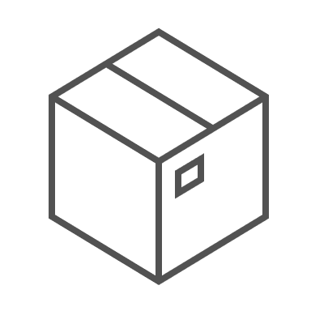
Customer Spotlight
Data Privacy, Control, and Sovereignty
Automated container-based cloud foundation
Situation
Proximus is Belgium’s largest communications service provider. Cloud scalability and advanced analytics are key to their next-generation growth and services strategy.
Challenge
Public Data
Landing Zone
Private Data Landing Zone
Regulated & Sovereign Data Landing Zone
Data at Proximus can be highly regulated with respect to privacy and sovereignty. They require a solution to handle data in the public cloud while remaining compliant and in control of its governance.
Open data, no secrets
Standard cloud deployment
Internal confidential data
Confidential cloud deployment
(VM isolation)
GDPR regulated subscriber data
Confidential cloud deployment
(App isolation + Geo location)
Solution
Three-tier data architecture and automated container packaging where regulated data is protected and controlled in the cloud using Confidential Computing
Notes:
(Compliance & Sovereignty Example) Proximus is the largest communications service and mobile provider in Belgium. Like many CoSPs, Proximus is on a journey to make greater use of public cloud services for workloads outside core network operations, taking advantage of positive economics and scale. Proximus handles data across all levels of confidentiality and regulatory sensitivity, so a one-size-fits-all cloud deployment could leave them exposed to compliance or sovereignty violations.
Proximus worked with Microsoft Azure to develop an automated, container-based data placement system that routes data and workloads to cloud infrastructure with the right level of protection. The “public zone” processes data with no sensitive or regulated data and is the lowest TCO zone. The “private zone” handles Proximus’ business confidential workloads, such as billing and account management, and uses VM-isolation Confidential Computing, often with off-the-shelf software. (VM-isolation uses Azure’s AMD SEV-SNP technology now but may switch to Intel TDX when available). The “regulated & sovereign zone” handles personally identifiable and regulated data that require the highest level of care under GDPR and other laws, including subscriber details and call logs. This zone uses purpose-built, privacy-preserving applications run inside Intel SGX enclaves inside targeted, sovereign European data centers, adding both geo-location and data control enforcement to Proximus’ sovereignty program.

Slide 20

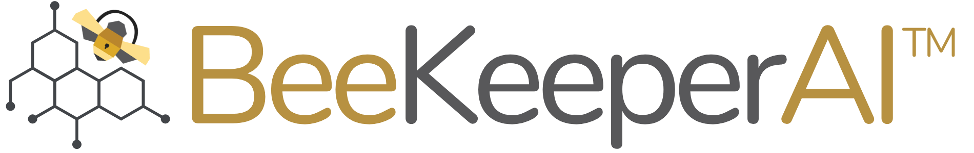




Customer Spotlight
Collaborative Computing with Regulated Data
Hospital 1
Hospital 2
Hospital 3
Situation
Novartis Biome develops diagnostic models and therapies for rare diseases. Rare disease information is sparse and dispersed across multiple hospitals and research institutions.
Regulated Data
Regulated Data
Regulated Data
Challenge
Private Instance w/BeeKeeperAI
Private Instance w/BeeKeeperAI
Private Instance w/BeeKeeperAI
Patient information is private and highly regulated. Hospitals do not want to move data off-prem or disclose private records to BeeKeeperAI or Novartis
BeeKeeperAI
Consolidation Node
Solution
An Intel SGX-enabled BeeKeeperAI instance is integrated within each hospital’s cloud presence that analyzes private data and updates a master model’s weights. Neither Novartis nor BeeKeeperAI personnel ever see or store regulated health records.
Consolidated analysis
Notes:
(Compliance & Multi-Party Example) Novartis Biome is a pharmaceutical and medical device company specializing in rare disease diagnostics and treatments. Since these diseases are rare, data is sparse and spread across multiple hospitals and healthcare institutions. Compiling a sufficiently large data set for accurate analysis requires collecting data from many sources. This data is tightly regulated under HIPAA, GDPR and other laws, and often judged to be too sensitive to be moved off-prem from the institution.
Novartis Biome worked with BeeKeeperAI to develop a federated learning solution that allows multiple institutions to contribute their data to a diagnostic model in a compliant fashion. BeeKeeperAI provisioned a node at each contributing hospital with analytics and models protected inside Intel SGX enclaves. Each node analyzes the local data on-prem then sends updated results and model weights to a master consolidation node in the cloud, which combines results into a single, aggregated model. Inside the SGX enclaves, neither BeeKeeperAI nor Novartis can see the individual health records, and BeeKeeper’s proprietary software is protected from tampering or theft out in the field. This system enables all parties to benefit from a consolidated analysis without every breaking compliance.

Slide 21
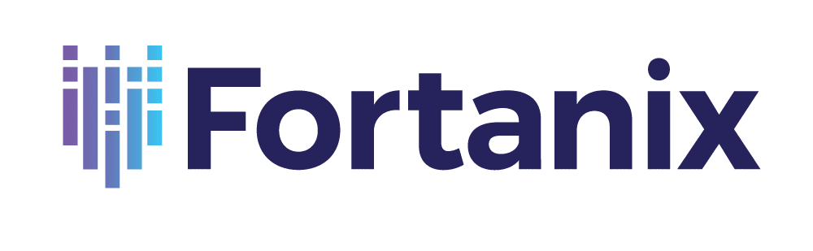

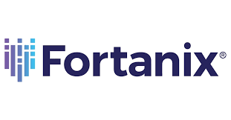
Customer Spotlight
High-Security Key Protection
Situation
Rapidly proliferating keys and certificates require strong protection and centralized management. HSM solutions are expensive and cloud solutions rely on CSP security and compliance.
Self-Defending KMS
Operations Using Unencrypted Keys
On-prem infrastructure
Challenge
Other clouds
Build a scalable, software-based key management system with HSM-like security that is technologically isolated from its cloud host
Operations and Storage of Encrypted Keys
Legacy HSMs
Solution
Host Cloud Provider’s Stack and Admins
Fortanix bases its Self-Defending KMS software on Intel SGX to protect keys and certificates from external adversaries and the cloud provider and helps ensure the owner’s secrets remain under their control.
Notes:
(Security Example) Scalable multi-cloud key management can be complex and expensive, often leveraging dedicated Hardware Security Model (HSM) nodes. Fortanix saw an opportunity to create a software-based key management system (KMS) based on the hardware-based security provided by Intel SGX enclaves.
Fortanix Self-Defending KMS is a software-based solution that provides strong, hardware-hardened key security and management. Installed on an Intel SGX-enabled server on-prem or in the cloud, Fortanix Self-Defending KMS only handles unencrypted key information and processes inside a protected SGX enclave using a minimalistic trusted code base. Outside the enclave, key information is always encrypted. Deployed in the cloud, the SGX enclave creates a technological separation from the cloud provider’s software stack and admins, increasing security and control over the customer’s keys.

Slide 22
Presentation Guide
Compliance & the Opportunity Presented by Confidential Computing

Slide 23



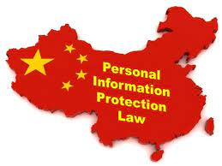



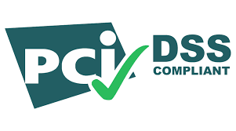





Historically, Compliance Meant Data Lockdown
NEW
REGULATED
DATA
NEW
Notes:
NOTE TO PRESENTER: Be mindful of your claims regarding compliance. Confidential Computing will not automatically make a customer compliant like it is an on/off switch. Think of compliance more as a spectrum from weak to strong encompassing data handling practices, policies, technological safeguards and more. Applied as part of a full-spectrum compliance program, Confidential Computing can help customers move toward a stronger compliance position.
Regulations on data privacy and security are pervasive around the world including well-known laws such as GDPR, HIPAA and PIPL. They describe the responsibilities of organizations to protect the confidentiality data in their possession. Poor data handling practices or sloppy security can lead to data exposures and, consequently, substantial penalties levied by regulators.
With the rise of AI, governments are putting in place additional regulations to help mitigate risks of data breaches or model manipulation. These include the European Union AI Act and the US Executive Order on Safe, Secure and Trustworthy AI.
In general, the easiest and safest path to comply with data privacy and security regulations was to lock the data in silos and “deactivate” it. Don’t use or share it because doing so risks data exposure or loss that could lead to a breach and/or compliance violation.

Slide 24



Innovation & Regulation: An Inevitable Collision Course?
Technology Innovation
Privacy & Security Regulation
Notes:
The tension between Innovation and Regulation can be high. In the case of AI, the market is innovating and evolving rapidly. Customers are in a big hurry to capitalize on this technology that’s coming like a freight train. But on the other hand, new and existing regulations are being put in place to make sure that technology evolves in ways that protects people’s rights and is a net-positive for society.
The standard narrative is that Innovation and Regulation are opposing forces that will crash into each other, creating chaos and slowing customers down. Is that where we’re headed in the new AI age?

Slide 25


Innovation
Compliance
Confidential Computing Can Harmonize Innovation, Privacy & Security
Notes:
No.
With Confidential Computing, organizations can align their innovative business and technology initiatives with their compliance programs. By protecting sensitive or regulated data and helping secure important workloads, compliance and innovation can be force multipliers for each other. Confidential Computing can help get Innovation and Compliance pulling in the same direction.

Slide 26



Example:
Confidential Computing Aligns with New AI Regulations
European Union Artificial Intelligence Act
  Confidential Computing
  Helps prevent data exposure to unauthorized software or persons
  Protects AI training or inference data from exposure or manipulation during processing
  Protects the AI model from tampering or theft inside an attested TEE
  Strengthens cybersecurity against known and new threats such as unpatched or Zero Day vulnerabilities and malicious insiders
“High-risk AI systems shall be resilient against attempts by unauthorised third parties to alter their use, outputs or performance by exploiting system vulnerabilities”
The technical solutions to address AI specific vulnerabilities shall include, where appropriate, measures to prevent, detect, respond to, resolve and control for attacks trying to manipulate the training data set (‘data poisoning’), or pre-trained components used in training (‘model poisoning’), inputs designed to cause the AI model to make a mistake (‘adversarial examples’ or ‘model evasion’), confidentiality attacks or model flaws.¹
U.S. Executive Order on Safe, Secure & Trustworthy Artificial Intelligence
“Agencies shall use available policy and technical tools, including privacy-enhancing technologies (PETs) where appropriate, to protect privacy and to combat the broader legal and societal risks”²
European Union AI Act, Article 15
Executive Order on the Safe, Secure, and Trustworthy Development and Use of AI, Section 2(f)
Notes:
Let’s look at one example of how the capabilities delivered by Confidential Computing align with the requirements laid out in the new AI regulations from the US and Europe.
The EU AI Act states that applicable AI deployments must be…[read regulation text]. The U.S. Executive Order on AI also says agencies (and those that supply government projects) must…[read text].
The confidentiality and security requirements described in these regulations map directly to what Confidential Computing can do. The hardware-enforced Trusted Execution environment helps protect data from exposure to unauthorized parties. Running AI training or inference inside an attested TEE can thwart efforts to take or manipulate the data, as well as protect the model itself from tampering or theft. The isolation of the TEE plus attestation protects the deployment against vulnerabilities or Zero Day attacks on the software outside the TEE. For example, malware in a corrupted Host OS cannot access data and code protected inside a TEE.
With Confidential Computing, you can see how organizations can innovate while strengthen efforts to innovate while remaining

Slide 27
Confidential Computing Strengthens Compliance
Confidential AI
Protects regulated data during training & inference, as well as valuable AI models
e.g., EU AI Act; US Executive Order on Safe Secure… AI
Confidential Collaboration
Conduct beneficial joint analysis while keeping sensitive or regulated data private
e.g., GDPR, HIPAA, California Consumer Privacy Act, etc.
Data or AI Sovereignty & Control
The workload owner must consent to release of encrypted data
Enhance Cybersecurity Around Data
Hardware-enhanced protection of data from unauthorized software & administrators
e.g., EU AI Act; GDPR, PIPL, PCI-DSS, etc.
Notes:
PRESENTER NOTE: This slide summarizes the ways that Confidential Computing can enhance compliance. This slide can be used to summarize the section or as a stand-alone slide.
With Confidential Computing, organizations can proceed with a range of initiatives knowing they’ve put additional protections around their deployment that will strengthen their compliance posture.
Running AI workloads inside a TEE helps protect data from exposure or manipulation, and can help protect the integrity of the model, as well. This enhances compliance with laws like the EU AI Act or US Executive Order on Safe, Secure and Trustworthy AI.
Organizations can also collaborate with others to contribute data to beneficial joint analysis without exposing the data to any other party. These “data clean rooms” allow collaboration while remaining compliance with data privacy laws like GDPR, HIPAA and others.
Building strong cybersecurity around regulated data is viewed favorably by regulators and reduces the likelihood of a compliance violation under a range of laws.
Data residency (sovereignty) is a growing movement that requires data or AI models to be located in particular geographies. Confidential computing itself cannot enforce geo-location of a workload, but since the workload owner holds the encryption keys, the protected data inside the TEE cannot be released to any other party or jurisdiction without the owner’s consent.

Slide 28
Presentation Guide
Deeper Look into Confidential Computing Technology and Enabling Components

Slide 29
Confidential Computing Architecture
Trusted Execution Environment
Confidential Data
Compatible Software
Trusted Execution Environment
Compatible Hypervisor
Attestation Service
Key Management Service
Notes:
(We use this slide several times to guide customers through all the elements of the architecture)
Here is a basic Confidential Computing architecture, consisting of the Trusted Execution Environment (TEE), compatible software inside the TEE, a compatible hypervisor, attestation service and key management service.
Let’s examine the TEE options first.

Slide 30
Confidential Computing Architecture – Intel SGX
Trusted Execution Environment
Confidential Data
App enabled for Intel SGX
Library OS (optional)
ISV applications
Self- developed apps (Intel or third-party SDK)
Library OS allows app to run in Intel SGX enclave without modifications
Compatible OS
Compatible Hypervisor*
Attestation Service
Key Management Service
RHEL 8.6 or later
Ubuntu Server 22.04 or later
SUSE Enterprise Server 15 SP4 or later
VMware vSphere 8 or later
Windows Server 2019 or later
Intel® Trust Authority
Cloud Service Provider
Some ISVs
Build Service Yourself
Entrust
HashiCorp
CSP Key Services (e.g., Azure, Google)
Fortanix Self-Defending KMS
And more….
* Optional. Intel SGX can run on bare-metal or virtualized.
Notes:
This slide lists all the SGX enabling elements on one slide. It is intended to provide a summary rather than stepping through the enabling story one section at a time.

Slide 31
Confidential Computing Architecture – Intel TDX
Trusted Execution Environment
Confidential Data
Applications
Applications do not need to be specifically tuned or packaged for Intel TDX
RHEL 9.2 or later
Ubuntu 22.04 or later
SUSE Ent. Server 15 SP5 or later
SUSE Ent. Server for SAP 15 SP5 or later
Compatible Guest OS
Compatible Hypervisor*
Attestation Service
Key Management Service
Early Preview Linux distros
Cent OS 9 Stream
Ubuntu 23.10
Commercial Host OS/Hypervisor
Next-gen VMware vSphere
Windows Server/Hyper-V TBA
Enterprise Linux distros TBA
Intel® Trust Authority
Cloud Service Provider
Some ISVs
Build Service Yourself
Entrust
HashiCorp
CSP Key Services (e.g., Azure, Google)
Fortanix Self-Defending KMS
And more….
Notes:
This slide lists all the TDX enabling elements on one slide. It is intended to provide a summary rather than stepping through the enabling story one section at a time.
The TDX-enabled Cloud Service Providers have done all the enabling for their customers. Customers interested in consuming TDX in the public cloud can just sign up for instances with compatible stacks at Alibaba, Azure and Google Cloud, with IBM Cloud coming later in 2024.
CSPs and Enterprises interested in building and hosting TDX infrastructure will need to source the enabling elements.
“Early Preview Linux Distributions” are Linux builds that contain fully-upstreamed TDX patches plus additional patches for features still going through the upstreaming approval process. The Early Previews are a way to access to TDX capabilities without waiting for full upstream to complete and be published on kernel.org.

Slide 32
Trust Boundary Defined
Trust Boundary
Without Confidential Computing
Cloud Stack and Admins
BIOS and Firmware
Host OS and Hypervisor
VM Guest Admin
Guest OS
Applications
Confidential Data
  The trust boundary is the perimeter drawn around confidential data
  Code and people inside the trust boundary may access confidential data
  A smaller trust boundary is viewed as more secure and defensible
  Today, most cloud instances have a large trust boundary; Assurances are based on cloud provider technology, SLAs or contracts
Notes:
The TEE is a hardware-enforced protected execution environment that protects data actively in-use in the processor and memory. The main defining characteristic of a TEE is its Trust Boundary, which is the perimeter drawn around the confidential data. People and software inside the trust boundary may have access to confidential data, and those outside are blocked, even if acting maliciously. It’s important to note that security vulnerabilities in the code are not mitigated by bringing them inside the trust boundary. In general, a tighter trust boundary creates a more secure environment since there is less code that needs to be inspected and tested for vulnerabilities, and less code that can access the confidential data.
Today, without any Confidential Computing protection, all the elements are inside the trust boundary, from the low-level firmware, cloud stack and admins, the hypervisor and all the workload software.

Slide 33
Intel Trusted Execution Environments
Trust Boundaries Compared
Trust Boundary: Elements with potential to access confidential data
Without Confidential Computing
Cloud Stack and Admins
BIOS and Firmware
Host OS and Hypervisor
VM Guest Admin
Guest OS
Applications
Confidential Data
VM Isolation with Intel® TDX
Cloud Stack and Admins
BIOS and Firmware
Host OS and Hypervisor
VM Guest Admin
Guest OS
Applications
Confidential Data
App Isolation with Intel® SGX
Cloud Stack and Admins
BIOS and Firmware
Host OS and Hypervisor
VM Guest Admin
Guest OS
Apps
Confidential Data
Enclave
Notes:
This diagram illustrates the differences in the trust boundary between Intel’s different technologies. Without any Confidential Computing technology, everything is inside the trust boundary, notably all of the cloud provider’s firmware, cloud stack, hypervisor and cloud admins. Any of these entities could potentially access confidential data in a tenant’s instance either by design or as a result of an exploited vulnerability.
Confidential Computing with VM Isolation technologies like Intel TDX removes everything out of the trust boundary except what’s inside the tenant’s VM. The cloud provider’s stack and admins are out, as well as other cloud tenants. The VM admins, Guest OS and all the applications are inside the trust boundary. Although the cloud provider is removed, the trust boundary can still contain millions of lines of code, and any software vulnerabilities that come with them. Intel TDX, AMD SEV-SNP and Arm CCA all use VM isolation technology.
Confidential Computing with Application Isolation technology like Intel SGX removes everything from the trust boundary except the application code inside the SGX enclave. The trusted code can be thousands of lines or just a few dozen. Intel SGX is the only Confidential Computing technology that offers this level of isolation. By design, the Guest OS and VM admins are not authorized to view or modify data and code inside the SGX enclave, even if they became malicious. Only Intel offers application isolation with SGX.
Note: Some prefer to talk about the Trust Boundary as “Attack Surface” or “Security Perimeter”. Both are good alternatives if that is your preference.

Slide 34
Intel Trusted Execution Environments
Selection Factors
VM-level Isolation: Intel® TDX
Application-level isolation: Intel® SGX
Advantages
  Separation from cloud provider and other tenants
  Lowest porting effort for existing applications
  More amenable for widespread deployment mandates
  Can be a simple instance configurator setting
Considerations
  Larger trust boundary (guest OS, all apps, VM admins)
  Possible re-validation with enabled guest OS & hypervisor
  Less granular software attestation
  Requires virtualization
Advantages
  Separation from cloud provider and other tenants
  Smallest trust boundary and potential attack surface
  More amenable to code inspection and monitoring
  Deployable in VMs, cloud-native containers and bare-metal
Considerations
  Apps may require specific development, bundling with a Library OS or tailoring
  Frequent calls outside the enclave may impact performance
Notes:
This slide compares Intel’s two trusted execution environment technologies, TDX and SGX. In addition to the trust boundary differences discussed above, TDX is a more straightforward environment for porting large existing applications into a confidential environment. Because of this and its relatively simple set-up, TDX is the more likely technology to be deployed as an Enterprise-wide VM policy versus SGX. However, TDX has a larger trust boundary, so applications with very high security requirements or that require multiple parties to review and sign-off on the code may prefer the smaller code footprint of SGX. TDX requires an enabled hypervisor and Guest OS, so if existing VMs run on non-enabled versions, VMs will need to be revalidated for the confidential environment. Also, VM isolation technologies like TDX only attest that the VM environment launched correctly on a genuine platform. They do not attest to the accuracy of the software load inside the VM.
Application isolation with Intel SGX has a much smaller trust boundary and attack surface than a confidential VM with TDX, making it attractive to security-focused usages. The smaller trusted code base is easier to review, monitor and inspect, which can be valuable in multi-party use cases. Unlike VM isolation technologies, only SGX can be deployed virtualized, on bare-metal, or with cloud-native containers running on a single host OS. Because of the highly isolated code and potential performance impacts, SGX is usually used for purpose-built, privacy-preserving applications; It is rarely used to “lift and shift” large, existing apps, and will likely be deployed on a targeted basis, not as a widespread IT policy.
With both TDX and SGX, performance can be impacted by heavy traffic on I/O buses, with SGX being somewhat more sensitive. The more I/O traffic, the more entry/exits from the confidential environment, resulting in more latency.

Slide 35
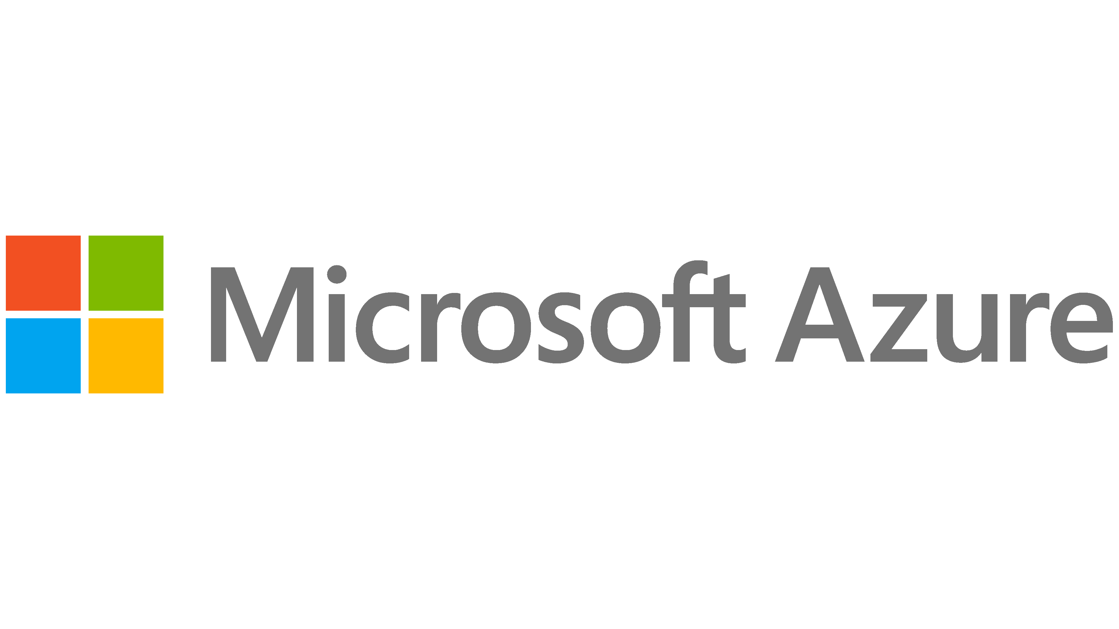
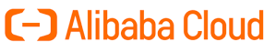
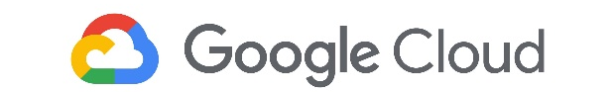
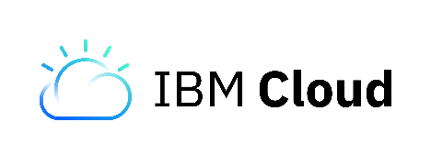
Intel TDX Availability
(Current March 2024)
  Intel TDX was enabled on select 4th Gen Intel Xeon Scalable instances through four leading cloud providers
  Intel TDX is generally available in all 5th Gen Intel Xeon Scalable processors (formerly code-named Emerald Rapids)
In Preview Now
General Availability
In Preview Now
Preview 2024
Notes:
To deliver VM-isolation as quickly as possible, Intel partnered with four cloud leaders who have staked out leadership positions in Confidential Computing. We invite customers to begin POCs and deployments for confidential VMs with these providers. The availability of previews varies by provider, so contact them directly for their schedule. (Note: We expect Alibaba will be most aggre

Slide 36
Confidential Computing Architecture
Software Ecosystem
Confidential Data
Compatible Software
Trusted Execution Environment
Compatible Hypervisor
Attestation Service
Key Management Service
Notes:
Let’s discuss the software environment for Intel’s Confidential Computing environments.

Slide 37




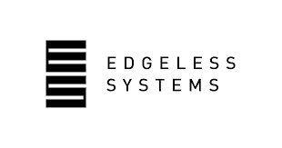

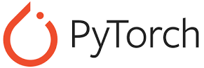
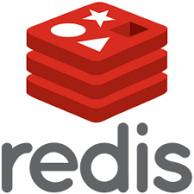


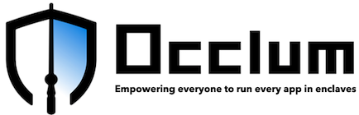

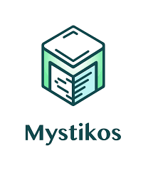





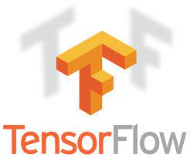


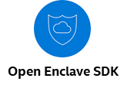
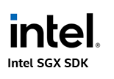
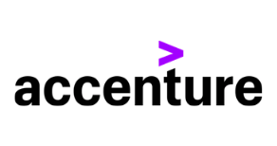
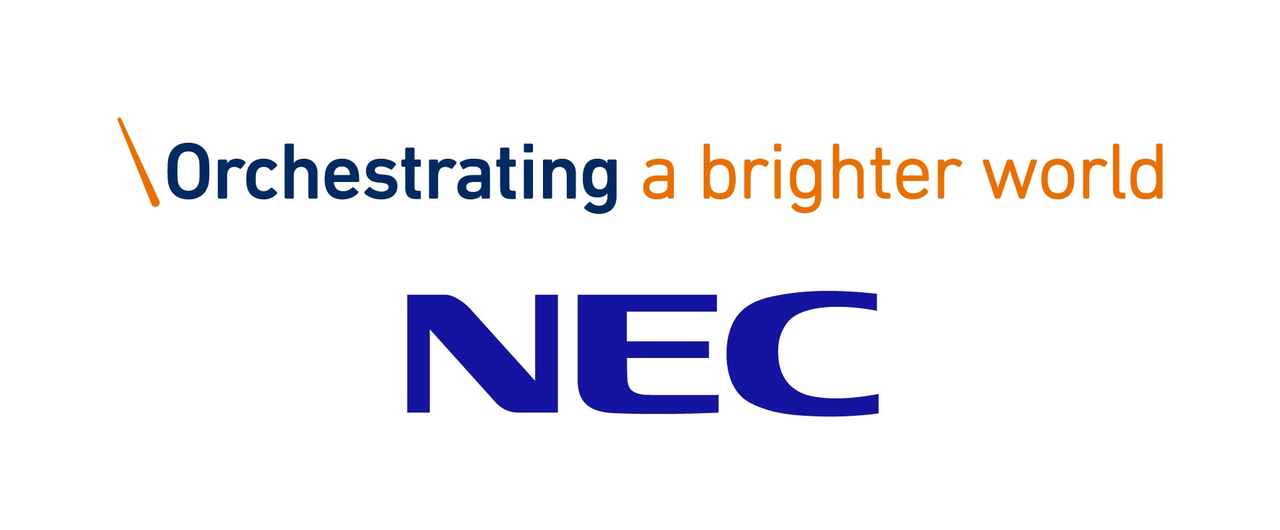


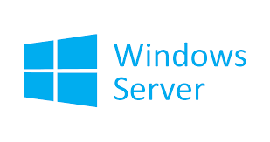

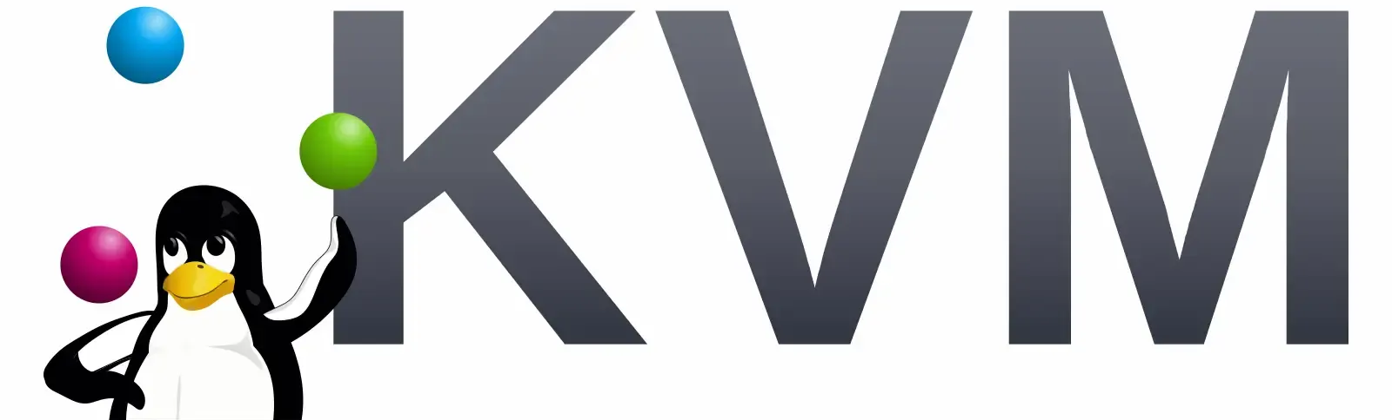

Confidential Computing
Software & Solution Ecosystem for Intel SGX
Commercially Supported Solutions
Built It Yourself
Commercial Solution Providers
Curated, Ready-to-Deploy Containers (through Q1’24)*
Developer Tools
Systems Integrators
Hypervisors (SGX)
5.13 & later
vSphere 8
2022 & later
* Available on GitHub and Azure Marketplace
Notes:
(The software ecosystem slides are focused on SGX. There are no application-specific requirements for TDX and, on Sapphire Rapids, the only enabled hypervisors and Guest OS’s will be provided by the four target cloud providers. Greater hypervisor and OS enabling will be ready when TDX goes into general availability with Emerald Rapids)
When first introduced in 2018, the only server software for SGX was an Intel-provided SDX, and any applications had to be built from scratch. From that, a perception arose that SGX is very hard to use and requires users to do extensive application programming to use it. This is no longer true. In 2023, many ISVs offer complete software solutions for a variety of use case protected with Intel SGX. Users never have to program or interact with the SGX hardware, as the ISVs handle all of that. This is the fastest path to a solution for confidential AI, privacy-preserving analytics, data clean rooms and more.
For customer that don’t want to purchase a solution from an ISV but don’t want to start with a bare SDK, Intel launched a program of “curated application containers” for popular workloads. These containers include the workload software and the Gramine library OS which enables it to operate in an SGX environment. These containers rapidly accelerate development of confidential applications built on PyTorch, Redis, and coming in Q1’23, Spark, SciKit Learn and TensorFlow. The containers are available through GitHub and the Azure Confidential Computing Marketplace.
https://github.com/gramineproject/contrib/tree/master/Curated-Apps
https://azuremarketplace.microsoft.com/en-us/marketplace/apps?search=sgx&page=1
For customers looking to build SGX applications from the ground up, many new third party and open source SDKs, development environments and library OS are available.
A number of systems integrators now offer SGX and confidential computing practices. SGX-compatible hypervisors now include all versions of the Linux kernel 5.13 and later, and VMware vSphere 8. Some versions of vSphere 7 were compatible with Intel SGX, but they took non-trivial configuration.

Slide 38












Intel SGX Software Provider Focus Areas
Data Privacy
& Security
Close data security gaps end-to-end
Cloud
Migration
Protect confidentiality & integrity in the public cloud
Privacy-Preserving
AI & Analytics
Share and analyze privacy sensitive data sets
Trusted Secure Environments
Highest level of assurance for business-critical applications
Example : Running secure workloads and applications in a cloud environment
Example : Migrating existing workloads to the cloud using containers
Example : Privacy Preserving inferencing or training using a 3rd party environment
Example : Sovereign Cloud environment deployed on bare metal using containers
Notes:
(Present either this slide or the prior slide, not both. The prior slide is designed to show the varying levels of integration. This slide shows the ISVs grouped by use case focus)
This is another way to view the SGX ecosystem, grouped by focus area of the ISV and SI.

Slide 39

Confidential Computing Architecture
Attestation Services
Confidential Data
Compatible Software
Trusted Execution Environment
Compatible Hypervisor
Attestation Service
Key Management Service
Notes:
Let’s review customer options for Attestation services. Attestation is important because it provides verification that the Confidential Computing environment is genuine and configured as expected.

Slide 40
Confidential Computing Architecture
Attestation Services
Attestation cryptographically verifies the Confidential Computing environment
Attestation reports can be requested at any time by any authorized party
Attestation provides assurance that environment is genuine, up-to-date, and launched as expected
Intel SGX provides attestation of correct application load
Verification Reported | Intel SGX | Intel TDX
Genuine Intel SGX or Intel TDX-enabled processor
Microcode patch conforms with policy
TEE launched using authenticated firmware
Application software loaded in enclave matches developer manifest
Notes:
This slide compares Attestation between TDX and SGX. In both cases, attestation can be requested at any time by any authorized party (launch or runtime). TDX and SGX check the processor ID to be sure it is a genuine Intel processor enabled with the right technology, that the processor microcode patch conforms to Intel’s policy for up-to-date code, and that the TEE launched using genuine authenticated firmware.
SGX provides more granular attestation by verifying that the software loaded in the enclave cryptographically matches the software signed by the developer. TDX only confirms that the TEE launched into a correct confidential configuration.

Slide 41
Sources of Attestation Services
Cloud Provider
May be included with confidential instance
Confidential Software Providers
Certain application vendors include attestation
Independent Trust Service
Neutral, multi-cloud attestation SaaS
Build Your Own
Using Intel-provided library
Notes:
Customers have four main options on sourcing attestation services:
The cloud provider that offers confidential instances may offer their own attestation services for those instances
Some of the SGX application vendors also offer attestation, although this is usually just for their applications
An independent trust service separate from the ISVs and CSPs, such as Intel Trust Authority (formerly “Project Amber”)
Customers can build their own in-house attestation service using a set of libraries provided by Intel called Intel Data Center Attestation Primitives (DCAP)

Slide 42
Intel® Trust Authority
An Independent, Multi-Cloud Trust Service (formerly “Project Amber”)
Remotely verifies trustworthiness of Intel SGX and TDX TEEs, devices, roots of trust, and more
Turn-key SaaS-based service
Attestation from an authority separate from the infrastructure provider, supporting zero trust principles
Single, consistent attestation service across on-prem, hybrid, edge, and multi-cloud deployments
Intel Trust Authority Service
Cloud Provider A
Cloud Provider B
On-Prem Infrastructure
Edge Devices
Notes:
Intel Trust Authority, formerly code-named Project Amber, launching in 2023, will provide independent, cloud-delivered trust verification services for a variety of use cases. The initial offering will provide attestation services for Intel trusted execution environments including Intel SGX and TDX.
Intel Trust Authority will be a turn-key service delivered independently of the cloud provider and ISV. Unlike other options, it is aiming to provide consistent, single-source attestation services for Intel SGX and TDX installations across multiple clouds, on-prem infrastructure, edge devices, and hybrid/multi-cloud enterprises.

Slide 43
Attestation Service Options
 | Cloud Provider’s Attestation Service | Application Vendor’s Attestation Service | Intel® Trust Authority Service | Build-Your-Own Service with Intel Library
Separation of responsibilities between verifier and infrastructure provider | No | Yes | Yes | Yes
Consistency across Intel SGX and Intel TDX | Yes, if both Intel SGX and TDX offered | Yes, if both Intel SGX and TDX supported | Yes | Yes
Consistent service across on-prem, hybrid, multi-cloud, and edge deployments | No | Possible, but limited to specific application | Yes | Yes
Development effort | Low | Low | Low | Medium
Notes:
This slide compares the different attestation options across multiple relevant decision criteria.
Is the attestation of the Trusted Execution Environment delivered by an entity independent of the infrastructure provider? (Analogy: Would you take a used car dealer’s word that the car is reliable? No, you’d take it to be checked out by an independent mechanic.)
Does the service provide consistent attestation across an organization’s SGX and TDX deployments, regardless of where they reside?
Does the service provide consistency across cloud vendors, on-prem, hybrid and edge deployments?
How much development effort is involved for the end user?
Attestation from the cloud provider that also provides the infrastructure violates the separation of responsibilities best practice. If the cloud provider only offers TDX, not SGX (or vice versa) they will not be able to provide consistent service. CSPs only provide attestation for workloads deployed in their cloud.
ISV-based attestation provides separation of responsibilities but are generally limited to just the one application. Their ability to support hybrid/multi-cloud & edge is limited to where the application is deployed.
Building your own attestation service can deliver on all the vectors but will involve more development and maintenance effort.
Intel Trust Authority delivers on all four vectors.

Slide 44

Confidential Computing Architecture
Key Management Service
Confidential Data
Compatible Software
Trusted Execution Environment
Compatible Hypervisor
Attestation Service
Key Management Service
Notes:
The final aspect of Confidential Computing architecture is key management. Each confidential TDX VM and SGX enclave has a set of keys that are in under the control of the workload owner, and these keys, like any other in the enterprise, must be safeguarded and properly managed.

Slide 45

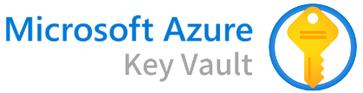
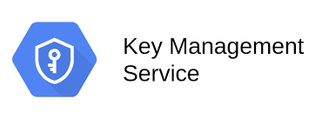



Intel Confidential Computing
Interfaces with Leading Key Management Systems
Workload owner holds keys that decrypt data in Intel SGX enclaves or TDX trust domains
Standard protocols facilitate integration with existing enterprise key management systems
Key management services can be hosted by cloud provider or separately
Trusted Execution Environment
(Intel SGX or TDX)
1. Request for TEE attestation
Attestation Service
2. Attestation token returned
5. Decryption key released
4. Token and evidence evaluated against policy
3. Request for decryption key with attestation token and other policy evidence
Workload Owner’s Key Management & Policy System
REST or PKCS#11 interfaces
Self-Defending KMS
and more…
Notes:
This slide shows the process whereby attestation service and the workload owner’s key management system coordinate to release data decryption keys only when the TEE has been verified. Intel SGX and TDX use industry standard key management interfaces, including REST and PKCS#11, so they can communicate with a wide range of popular cloud-based and on-prem KMS platforms which are shown here.

Slide 46
Summary
Confidential Computing isolates workloads inside Trusted Execution Environments
Confidential Computing strengthens:
Data privacy
Regulatory compliance
Data access control and sovereignty
Application and data security
Robust ecosystem of cloud, server, software and service providers are ready to help
Next steps:
Identify potential use cases
Demo with software solution provider
POC in Intel DevCloud or with a Cloud Provider
Notes:
Conclusion: Summarize the key points about Confidential Computing
Targeted Next Steps: Explore opportunities for confidential use cases. These are very likely to originate in the Line of Business departments of organizations, not just in IT departments. IT departments are more likely to gravitate to Intel TDX for it’s relative ease-of-deployment for existing applications and VMs. Line of Business departments may be more interested in SGX for its unique security characteristics.
If the customer is interested in an SGX-based solution for a compliance or privacy-preserving application or service, contact one of the recommended ISVs. If you need additional guidance on ISV selection, please contact Paul O’Neill (paul.oneill@intel.com) or Dave Singh (dave.p.singh@intel.com).
If the customer is interested in a POC or running tests, they can work with one of the SGX-enabled cloud providers such as Microsoft Azure Confidential Computing, Alibaba, OVH or others. On Sapphire Rapids, four cloud providers will be equipped with TDX instances in 2023 (Alibaba, Azure, Google Cloud, IBM Cloud). There preview dates vary. Intel’s DevCloud is expected to be equipped with both SGX and TDX instances for solution development and smaller scale POCs. Contact Jesse Schrater (jesse.schrater@intel.com) if a customer is interested in proceeding to a POC.

Slide 47
Presentation Guide
Confidential AI Module

Slide 48
How to Use the Confidential AI Module
This module of the 30-3-30 is intended to support conversations where the customer has a specific interest in AI technology and use cases
There are only two slides in the module that are duplicative from the 30-3-30 (customer examples)
  TIP: Use other slides from the 30-3-30 to introduce Confidential Computing concepts and review the portfolio.
Confidential AI module flow:
  AI is growing rapidly across industries
  However, security threat lurk across the AI deployment process, from training to inference to user interface
  Also, several AI-specific trends increase need for AI security & confidentiality
  Introduce “Confidential AI” concept, which combines Xeon-based AI with Confidential Computing
  Review some sample use cases
  Tell the story of Bosch’s ADAS system & Novartis’ federated learning and how Confidential AI helps keeps them protected and compliant
  4th Gen Xeon is a great host for your AI workloads (performance, software & Confidential Computing)
  Review options for Confidential AI solutions
  Close by reviewing the indicators that Confidential AI may be the solution to the customer’s need.

Slide 49
More Resources for Selling Intel Technology for AI
This module only makes the case for Confidential AI
For detailed information on Intel’s AI story, use these resources
  4th Gen Xeon AI Gold Deck: https://cdrdv2.intel.com/v1/dl/getContent/765714
    Includes Intel vs. AMD performance data on AI workloads
  AI public gold deck: https://cdrdv2.intel.com/v1/dl/getContent/756739
  AI Narrative (Bringing AI Everywhere): https://cdrdv2.intel.com/v1/dl/getContent/784869

Slide 50









AI is the Fastest Growing Workload Across Industries
Education | Health | Finance | Retail | Government | Energy | Automotive | Manufacturing | Telco
Teacher Assistant District Knowledge Tool Campus Security Curriculum Planner | Enhanced Diagnostics Drug Discovery Patient Care Research Sensory Aids | Algorithmic Trading Fraud Detection Research Personal Finance Risk Mitigation | Support Experience Marketing Merchandising Loyalty Supply Chain Security | Military apps Data Insights Security Resident Engagement Smart Cities | Oil & Gas Exploration Smart Grid Operational Improvement Conservation | Autonomous Cars Automated Trucking Aerospace Shipping Search & Rescue | Factory Automation Predictive Maintenance Precision Agriculture Field Automation | Personalized Customer Services Network Automation Operational Performance
Source: Intel forecast
Notes:
AI is likely to impact and enhance operations across industries. It will not be a niche technology or restricted to generative AI services like ChatGPT. Machine learning, deep learning and generative AI are expected to be broadly deployed.

Slide 51

Threats Are Present Across All AI Deployment Phases
Data Ingest & Preparation
Model Creation
& Training
Deployment &
User Interface
Inference
Results
Adversarial data mislabeling or insertion
Training data set theft, misuse or breach
Base model theft
Software provenance risk
Intelligence gathering via query monitoring
Reverse engineering via API abuse
Model or parameter exfiltration
Reverse engineering via adversarial queries
Result theft, misuse or breach
Notes:
AI deployments involve a pipeline of activities from initial data acquisition to final results. At each of these stages, an adversary could take actions that manipulate the model’s behavior or steal valuable intellectual property. Security researchers around the world (including Intel Labs) have documented many threats to AI deployments across the pipelines. These threats include:
Injecting adversarial data into the training set or maliciously mislabeling data
Stealing a valuable training data set or base model
Incorporating malicious software into the model due to poor provenance controls
Gathering intelligence about model behavior, parameter weights and calculations by monitoring queries or abusing the model’s API
Using incremental, repetitive queries to reverse engineer the parameters
Breaches that enable the adversary to view or steal the model’s confidential results

Slide 52



Evolving AI Landscape Fuels Need for
Confidentiality & Security
Growing AI Ubiquity
Use expanding from experts to general population, exposing new risks
Collaborative AI
Multiple entities contribute to achieve
large, more diverse data set
AI Regulations
Deployment mandate expected to be
widely-applicable across industries
Data
Company A
EUROPEAN UNION
ARTIFICIAL INTELLIGENCE ACT*
Data
Company B
“High-risk AI systems shall be resilient as regards attempts by unauthorized third parties to alter their use or performance by exploiting the system vulnerabilities.”
Additive to GDPR privacy protections
Data
Company C
Collaborative Model
Large Language Models & Generative AI
Data
Company D
* Proposed Legislation. https://www.europarl.europa.eu/news/en/headlines/society/20230601STO93804/eu-ai-act-first-regulation-on-artificial-intelligenceEL
Notes:
With Generative AI and LLMs, AI is moving from expert realm to the general business population. More users with unfettered access means more risks.
AI generally requires large amounts of diverse data to produce accurate results. In addition, there are many usage models that require multiple organizations to collaborate on beneficial shared analyses, such as medical research or financial fraud detection. Collaborative or multi-party AI projects like these will require methods to maintain the confidentiality of each party's data from the others, and even the AI model host.
We are also now seeing the vanguard of new regulations requiring elevated security for many AI systems, led by the EU’s Artificial Intelligence Act. The Act states that high-risk AI systems must be resilient against a range of attacks that could lead data or force inaccurate results. This legislation is wide reaching and applies to systems operating in the EU or handling data related to EU citizens. High risk systems are defined in Article 15 as any AI application covered under EU safety regulations as well as eight broad categories ranging from biometrics to education to worker management. The AI Act adds to data protections already in place under GDPR.

Slide 53

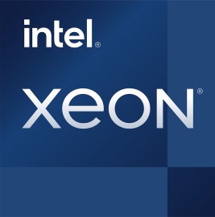
Confidential AI Helps Protect Data & Models In-Use
CPU-Based AI
Confidential Computing
+
Confidential Data
Trusted Software
Untrusted Software & Administrators
Built-in AI acceleration
Leading AI inference platform
Training & fine tuning for models <10B parameters
Processing inside a hardware-enforced Trusted Execution Environment (TEE)
Data controlled by workload owner
Remote attestation of TEE integrity
Notes:
Confidential AI is a industry movement to protect sensitive data and valuable AI models while they are actively in-use. We have established encryption practices for data at-rest in storage or in-transit on a network. The gap has been when the data or model became readable while actively in-use in the platform’s memory and processor.
Confidential AI takes modern AI techniques, including Machine Learning and Deep Learning, and overlays them with Confidential Computing technology. Confidential Computing was first brought to mainstream data center CPUs by Intel in 2018 with the introduction of Intel Software Guard Extensions. Today, all the leading server processor manufacturers, as well as Nvidia GPUs, offer Confidential Computing. It is available from most major cloud service providers and OEM platforms. The technology has proliferated and matured considerably over the last five years.
Confidential Computing technologies like Intel SGX or Trust Domain Extension protect data and code in three ways:
Establish a Trusted Execution Environment where sensitive data and trusted code can process out of view of any other software outside the TEE boundary, including the cloud provider’s stack and system admins.
Encrypted, sensitive data can only be released and decrypted in the TEE with a key under the control of the workload owner.
Cryptographic attestation of the TEE’s integrity, giving you assurance that it is configured correctly and the code or model loaded is exactly what you expect.
With these capabilities, AI practitioners have a powerful tool to help deliver the elevated security, confidentiality and compliance that will be demanded.

Slide 54
Confidential AI Indicators
Is the data Business Confidential, Regulated, or otherwise Sensitive?
Do the training set, model, or results represent valuable business IP?
YES?
Confidential AI
Will the model be
deployed where there are concerns about its security or sovereignty?
Do regulations require an elevated standard of care or audit record?
Notes:
Does the customer have a need for Confidential AI in their Artificial Intelligence deployments?
If the answer to any of these questions is “Yes,” then there may be a need.

Slide 55



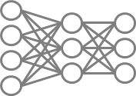

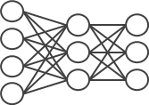
Example Confidential AI Use Cases
Confidential Model Training & Tuning
(May be single or multi-party)
Federated Learning
Confidential
Inference & Query
1
2
3
Party 2
Encrypted Data
Party 1
Encrypted Data
TEE
Model Query
Model Response
TEE
Party 1 Data
TEE
Party 2 Data
Encrypted transfer
Party 1
Decrypted Data
Updated parameter weights
TEE
y
TEE
TEE
Master Model
Notes:
Let’s look at three of the many possible use cases and system architectures for Confidential AI. All of these have been deployed with one or more major Intel customers including major banks, pharmaceutical companies, governments and manufacturers.
The first is the most common form of collaborative AI, where multiple parties all contribute sensitive data to a shared analysis, thus benefiting from the more accurate results. It can be used for both training and inference, but let’s consider training. Here, a data clean room is established inside a TEE, and a base model is installed. Each party’s encrypted data is moved inside the TEE, decrypted out of view of any other software or participant, and added to the model weights. Once complete, the data is re-encrypted or safely discarded, making room for the next party’s data to be added.
The middle instance is Federated Learning, a form of collaborative AI, but in this case, the data is too big, sensitive or regulated to move off-premises. Instead, the compute is moved to the data. A node configured with a TEE and the model are deployed at each party’s location. The data is used to train the model locally, while any proprietary model IP is protected inside the TEE. The updated weights are encrypted and then communicated to a master model in the cloud, where they are merged with weights from the other parties.
The third example will increasingly be deployed as organizations use LLMs to process sensitive queries or perform tasks using confidential data. In this model, the model query engine is protected inside a TEE. Queries are encrypted during transfer to a private LLM, also deployed in a TEE. The results from the model are encrypted and transferred back to the requestor. The query or its results are never in plaintext outside a TEE, providing end-to-end protection.
Keep in mind that Confidential AI use cases can apply at any stage in the AI pipeline, from data ingest and training to inference and results interface. Wherever these is sensitive and regulated data or valuable IP, security and confidentiality may be both smart and required by law.

Slide 56
Customer Spotlight
Confidential AI with Regulatory Compliance
Situation
Bosch develops Autonomous Driver Assistance Systems. ADAS AI models are most accurate when trained with unaltered camera footage.
Challenge
Camera footage is loaded with regulated, personal information (faces, license plates, etc.) Under GDPR regulations, Bosch incurs the highest standard of data protection.
Solution
Resolved by handling raw footage only inside Intel SGX enclaves, including data prep and model training stages. Achieved higher model accuracy while maintaining compliance.
Notes:
(Compliance Example) Bosch is a technology and manufacturing leader in many areas, including Autonomous Driver Assistance Systems (ADAS). To train the system, Bosch captures street footage from multiple car-mounted cameras. The most accurate training occurs when they use the raw, unmodified footage but these images are loaded with personally identifiable information (PII) such as faces, license plates and correlated location data that is regulated under GDPR and other laws. This data requires the highest level of care against misuse.
Bosch could solve the PII issue by de-identifying the images with blurs, but that decreases the model’s accuracy and could cause unpredictable vehicle behavior. Instead, Bosch only handles the raw, unencrypted camera footage inside Intel SGX enclaves where software access is limited and even Bosch admins can’t view it. The data prep enclave separates the PII from the rest of the image and stores it securely. The de-identified footage can be used for other analyses. The PII is rejoined to the footage inside a second SGX enclave where it is used to train the ADAS model. The PII is never unencrypted outside an enclave, keeping Bosch compliant the GDPR’s strict privacy regulations.

Slide 57
Customer Spotlight
Collaborative Computing with Regulated Data
Hospital 1
Hospital 2
Hospital 3
Situation
Novartis Biome develops diagnostic models and therapies for rare diseases. Rare disease information is sparse and dispersed across multiple hospitals and research institutions.
Regulated Data
Regulated Data
Regulated Data
Challenge
BeeKeeperAI Local Node
BeeKeeperAI Local Node
BeeKeeperAI Local Node
Patient information is private and highly regulated. Hospitals do not want to move data off-prem or disclose private records to BeeKeeperAI or Novartis
BeeKeeperAI
Consolidation Node
Solution
An Intel SGX-enabled BeeKeeperAI node installed on-prem at each hospital analyzes private data and updates master model weights in the cloud. Neither Novartis nor BeeKeeperAI personnel ever see or store regulated health records.
Consolidated analysis
Notes:
(Compliance & Multi-Party Example) Novartis Biome is a pharmaceutical and medical device company specializing in rare disease diagnostics and treatments. Since these diseases are rare, data is sparse and spread across multiple hospitals and healthcare institutions. Compiling a sufficiently large data set for accurate analysis requires collecting data from many sources. This data is tightly regulated under HIPAA, GDPR and other laws, and often judged to be too sensitive to be moved off-prem from the institution.
Novartis Biome worked with BeeKeeperAI to develop a federated learning solution that allows multiple institutions to contribute their data to a diagnostic model in a compliant fashion. BeeKeeperAI provisioned a node at each contributing hospital with analytics and models protected inside Intel SGX enclaves. Each node analyzes the local data on-prem then sends updated results and model weights to a master consolidation node in the cloud, which combines results into a single, aggregated model. Inside the SGX enclaves, neither BeeKeeperAI nor Novartis can see the individual health records, and BeeKeeper’s proprietary software is protected from tampering or theft out in the field. This system enables all parties to benefit from a consolidated analysis while keeping their information protected and confidential.

Slide 58

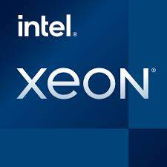

Intel® Xeon: The Data Center’s Most Versatile AI Platform
Any AI code, every workload
Build and deploy everywhere​
Security and compliance
Intel AI software suite of optimized open-source frameworks and tools
4th Gen Intel® Xeon® Scalable Processors
Confidential
Computing
The flexibility of Xeon with the built-in performance of an AI accelerator
Enables out of the box AI performance and end-to-end productivity
Utilize sensitive or regulated data in AI systems while supporting privacy and compliance
Up to 10x gen-to-gen
model performance¹
Up to 7.7x performance/watt²
Up to 6.7x end-to-end
application performance³
400+ models validated
Application or VM-level isolation
Remote attestation of confidential environment integrity
1,2,3 See [A2, A16, A17, A33] at intel.com/processorclaims: 4th Gen Intel Xeon Scalable processors. Results may vary.
Notes:
We have been working for two years to develop this universal Intel AI Platform to build and deploy AI everywhere
The reason we had to approach this at the platform level is AI requires massive data processing. Therefore, to be practical to bring AI to production the full stack must be optimized from chip to system to libraries to SW to the application. There are three components:
HW: Any code, every workload, built into one GP platform, E2E. 10x DL, 7.7x perf/w, …and now training.
SW: Build and deploy AI everywhere, every developer, open source, python, DL; portable → E2E 6.7x
Partners: Pre-built solutions. In the real world, AI is NOT a benchmark. Customers have SLAs for throughput, latency and flexible in a single platform. …how we are bringing HW and SW together with…
Transition: What does it mean to be a universal AI platform….
************************************************
Any AI code, any workload: The flexibility of Xeon with the built-in DL performance of an AI accelerator
Up to 10x gen-to-gen model performance
MLPerf model training in <30 mins
Up to 7.7x performance/watt
Intel AI software suite of optimized open-source frameworks and tools enables out of the box AI performance and E2E productivity
Up to 6.7x E2E application performance
400+ models validated out-of-box
oneDNN integration into TensorFlow and PyTorch
Extensive Intel AI products and partnership accelerates end customer time to market
62x higher gen-to-gen throughput with 10ms SLA
1.6x faster GNN training for SPR Katana Graph vs NVIDIA A100
2x faster time-to-insight when training multiple DL and ML models
​

Slide 59
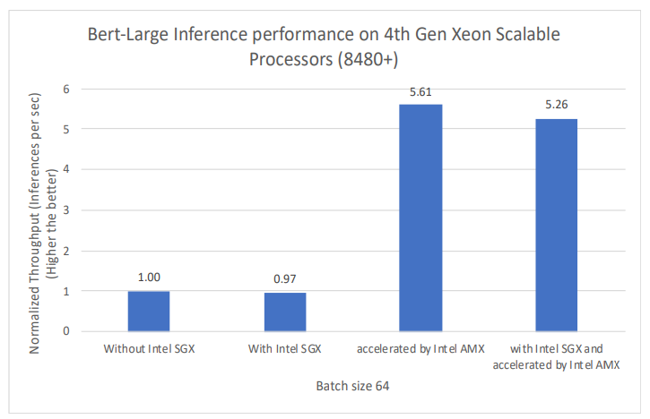
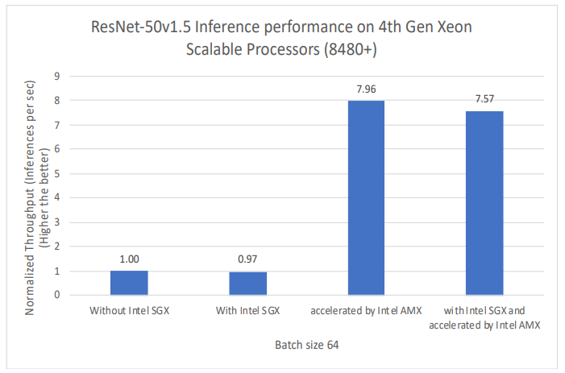
Confidential AI Inference Solution
Performance Findings
Natural Language Processing
Image Recognition
Up to 5.26X more inference performance
using Fortanix Confidential AI with Intel® AMX acceleration and Intel® SGX protection on
4th Gen Intel® Xeon® Scalable
Up to 7.57X more inference performance
using Fortanix Confidential AI with Intel® AMX acceleration and Intel® SGX protection on
4th Gen Intel® Xeon® Scalable
Results may vary . To see complete details and configurations, go to:
https://www.intel.com/content/www/us/en/content-details/777286/accelerated-ai-inference-with-confidential-computing.html
Notes:
These results from Fortanix’s Confidential AI service illustrate two key points on Natural Language Processing and Image Recognition.
The overhead of SGX on the workload is small (~3% in both workloads’ base cases). Fortanix has carefully optimized to deliver great performance without compromising confidentiality or security.
Intel AMX on 4th Gen Xeon delivers a huge performance boost. >5X more performance on NLP and >7X more on Image Recognition.
Reactive: A customer may inquire why the performance overhead of SGX increased between the base case (left two bars) and the AMX case (right two bars). Because the speed with which each batch of data is processed is dramatically increased with AMX, the application has to exit the SGX enclave more often to get more batches of data. Enclave entry/exit cycles are the top driver of overhead. But from an application performance perspective, the modest increase in SGX overhead as a percentage is dwarfed by the increase in inference throughput.

Slide 60

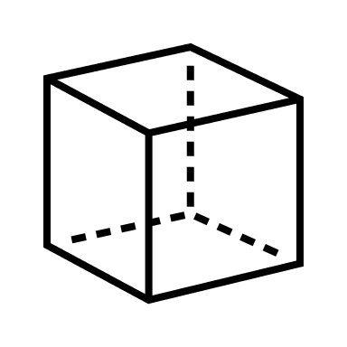
Confidential AI Solution Options
Less Development Effort
More Development Effort
Needs:
Deploy existing model in Confidential Environment
Few or no code changes
Needs:
New AI deployment
Minimize SW development
Smaller trust boundary
Needs:
Familiar AI frameworks
In-house model development
Smaller trust boundary
Frame- work
Lib OS
ISV software or AI service
Intel SGX
enclave
Intel Curated Container*
Intel SGX
enclave
Existing model
Intel TDX
virtual machine
* Available through Azure Marketplace or GitHub https://github.com/gramineproject/contrib/tree/master/Intel-Confidential-Compute-for-X
Notes:
This slide presents options for customers to deploy Confidential AI solutions as quickly and easily as possible.
If they have an existing AI application or model and they want to deploy it into a confidential environment, the fastest, easiest path is to deploy into a TDX-enabled VM in one of the enabled cloud providers. It’s likely that no code changes will be required. Using TDX will separate the customer’s VM from the cloud host and the other tenants, but the trust boundary will include the entire VM.
If customers are interested in the smaller trust boundary of SGX and they want to minimize software development and get operational as quickly as possible, they should engage the ISVs that provide Confidential AI and analytics solutions. These can be deployed in the public cloud where SGX is available, or on-prem.
If customers are interested in the smaller trust boundary of SGX but are willing to do development themselves, they can accelerate their project by using a “curated container” from Intel. These containers, available in the Azure Marketplace or GitHub, contain an AI or analytics framework bundled with the Gramine library OS. With these containers, customers can stand up an SGX-enabled environment with one of these familiar frameworks to program as they see fit.

Slide 61

Look Ahead to GPU Accelerated Confidential AI
CPU TEE
GPU TEE
CPU-Based Confidential AI is deployable today for most inference & many training use cases
Nvidia offers Confidential Computing on H100 GPUs, but requires an encrypted connection to communicate with CPU-based TEE
Intel & Nvidia have announced a collaboration to develop complete solutions for GPU-accelerated Confidential AI
Phase 1: Nvidia driver to create encrypted connection between Xeon CPU and GPU
Phase 2: Intel® TDX Connect-based solution with coordinated attestation via Intel® Trust Authority
Confidential Data
Confidential Data
Trusted Software
Trusted Software
Encrypted PCI Express Connection
GPU
Learn more at https://bit.ly/Intel_Nvidia_ConfidentialAI
Notes:
Today, Confidential AI is delivered almost exclusively on CPUs. Xeon CPUs provide a performant, economical AI solution for the majority of AI inference deployments and a large portion of training on small & mid-size models. But some deployments will need external acceleration from a GPU or other device.
Nvidia H100 GPUs offer Confidential Computing with a TEE on the GPU. However, most complete use case solutions require confidentiality on both the CPU and GPU, and the two TEEs will need to securely communicate with each other. In 2023, Intel and Nvidia announced a collaboration to develop GPU-accelerated Confidential AI solutions based on Nvidia GPUs and Intel TDX.
Phase 1 of the collaboration will use an Nvidia driver to establish an encrypted connection between the GPU and CPU TEEs. In this phase, the TEEs are still very separate entities but are able to pass encrypted data in a coordinated fashion. There will be some latency incurred by the driver encryption/decryption.
Phase 2 of the collaboration will advance the solution to take advantage of Intel TDX Connect and offer more integration between the two TEEs. With TDX Connect, communications will be industry-standards based, and features like cross-TEE memory sharing become possible. Intel and Nvidia will also enable coordinated, single-service attestation for both TEEs in the solution using Intel Trust Authority.

Slide 62
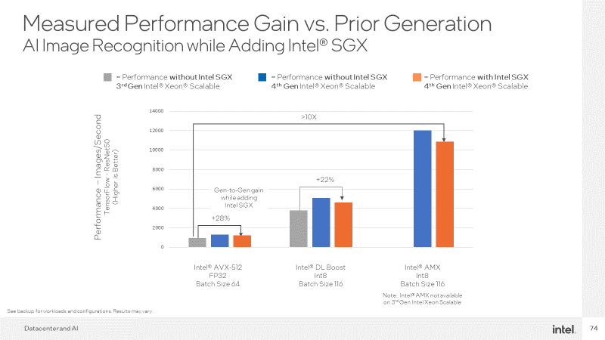
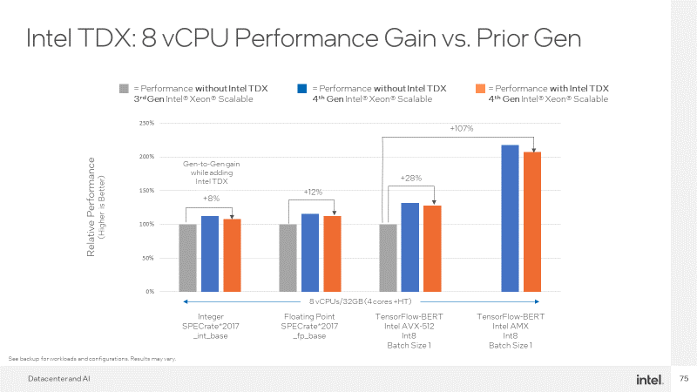
Confidential AI Performance – Optional Slides
These two slides are in the “Performance and Competition Section”. Use them for Intel measurements on the AI performance gain of going from Non-Confidential “Ice Lake” to Confidential “Sapphire Rapids”
Click HERE to jump to slide
Click HERE to jump to slide
Notes:
Later in the deck, there are two performance slides that can also be helpful in Confidential AI.

Slide 63
How to Use the Competitive and Performance Info
First Order Conversation: Customer use case and security/compliance benefits of Conf. Computing
  Objective #1: Persuade them that Confidential Computing is a good match for their use case
Competition & Performance numbers are usually a Second or Third Order Conversation as customers sort their options
  TIP: Do not introduce performance or competition issues faster than the customer inquiries about them
Customers may react negatively to performance overhead; How to handle:
  Performance overhead may be a minor issue compared to the customer’s alternative
  Alternatives may be: 1) Time-consuming data de-identification processes, 2) Not proceeding with the project due to security or compliance issues, 3) Not using confidentiality and taking the security/compliance risk
  Different workloads will have different performance overheads, with I/O-intensive workloads having the most overhead
  Balance overhead with need for security and the size of the trust boundary
  If lowest performance overhead is a make-or-break factor, focus on Intel TDX
  Migrating workloads from earlier Xeon generations to 4th Gen Xeon Scalable may be a net performance gain, even with TDX or SGX overhead

Slide 64
Competitive Comparison
 | Intel® SGX | Intel® TDX | AMD SEV-SNP | AWS Nitro Enclaves | Conf. Comp on Nvidia H100 GPU
Cloud infrastructure provider’s hardware/firmware, hypervisor and cloud management stack are excluded from trust boundary | ● | ● | ● |  | ●
Available through multiple cloud providers to facilitate multi-sourcing | ● | ● | ● |  | ●
Designed to accommodate legacy applications with low or no porting, re-design or re-packaging |  | ● | ● |  | ¹
Attestation of hardware authenticity & correct launch of the TEE | ● | ● | ● | ● | ●
Attestation of integrity of the software image loaded in the TEE (e.g., the AI model or other software IP) | ● | ² | ² | ●
Confidential data only accessible by designated application code; VM admin, Guest OS, other apps and cloud stack excluded from access | ●
Deployable on “bare metal” servers without virtualization | ● |  |  |  | ●
Hardware-based, cryptographic memory integrity option for additional Rowhammer protection | ●
Compatible with Intel’s independent trust service, Intel® Trust Authority | ● | ●
Competitive Data Sources as of March 2023 See next page for expanded URLs |  |  | Link, Link | Link, Link, Link | Link
¹ No or low changes for legacy code running on the GPU. Portions of the workload that use the CPU would need to incorporate a CPU-based TEE and a means of protecting PCIe communications.
² Not an inherent capability of available hardware technology but is feasible as a value-added capability delivered by the cloud service provider or attestation service provider.
Notes:
This slide compares SGX and TDX against three main competitors from AMD, AWS and Nvidia.
Cloud infrastructure provider’s hardware/firmware, hypervisor and cloud management stack are excluded from trust boundary: All techs keep the cloud provider’s stack and admins out of the trust boundary except AWS Nitro Enclaves. With Nitro Enclaves, the confidential enclave is infused with AWS’s Nitro System, which set’s up the enclave and controls the “vSock” connection between it and the non-confidential VM. In essence, AWS technology has “root access” to the enclaves.
Available through multiple cloud providers to facilitate multi-sourcing: There is no impediment to Intel, AMD and Nvidia tech being offered by any cloud provider. Nitro Enclaves is an AWS proprietary design only offered in AWS. Applications developed for Nitro Enclaves twin-VM architecture will not directly translate to any other confidential computing tech.
Designed to accommodate legacy applications with low or no porting, re-design or re-packaging: This item refers to the need for code changes to accommodate confidentiality. Even in the best-case, SGX requires bundling with a library OS like Gramine, but may also require some code changes. TDX and SEV-SNP are VM isolation technologies, so usually there is no need to modify the applications in the VM, although an enlightened Guest OS and Hypervisor are needed. AWS Nitro Enclaves use a unique twin-VM architecture which must be specifically coded for. For Nvidia H100, the code running in a confidential environment on the GPU does not require modifications, but to have end-to-end confidentiality with the CPU, the solution must set up a second TEE on the CPU and encrypt traffic over the PCIe connection.
Attestation of hardware authenticity & correct launch of the TEE: This item refers to attestation that the platform is genuine and the TEE launched correctly. All the techs claim this capability.
Attestation of integrity of the software image loaded in the TEE (e.g., the AI model or other software IP): This item refers to the attestation that the software loaded inside the TEE is exactly what’s expected and matches a certified manifest. SGX does this by default, and Nitro Enclaves claims to offer the same capability. TDX and SEV-SNP do not do this by default in the hardware, but a Cloud Service Provider (or highly-motivated enterprise) can engineer a solution to accomplish this using available hardware registers and third-party software certificates, as Microsoft Azure has done. Nvidia does not claim this capability.
Confidential data only accessible by designated application code; VM admin, Guest OS, other apps and cloud stack excluded from access: This item is an extension of the first time, describing what is excluded from the trust boundary. Only SGX fully excludes everything except the designated application code. All the others include the Guest OS and any other software components inside the isolated VM.
Deployable on “bare metal” servers without virtualization: Of the CPU-based technologies, only SGX can be deployed on bare-metal, non-virtualized servers. TDX, SEV-SNP and Nitro Enclaves require virtualized systems. Nvidia GPUs can be deployed on bare-metal servers, but the GPU-based TEE usually needs to connect to a CPU-based TEE which may or may not be virtualized.
Hardware-based, cryptographic memory integrity option for additional Rowhammer protection: All the technologies include some kind of logical memory integrity technology to make sure data is not altered while stored in the DIMMs. Only SGX includes the option to use Cryptographic Memory Integrity which provides even greater protection against sophisticated Rowhammer-class memory attacks or attacks on memory ECC. (CMI is expected to be available for TDX on Emerald Rapids).
Compatible with Intel Trust Authority: Today, Intel Trust Authority service will provide independent, multi-cloud attestation for SGX and TDX. In the future, Intel Trust Authority may be extended to offer attestation and trust services to other technologies outside Intel’s portfolio.

Slide 65
Competitive Data Sources
AMD SEV-SNP
    https://www.amd.com/system/files/TechDocs/SEV-SNP-strengthening-vm-isolation-with-integrity-protection-and-more.pdf
    https://techcommunity.microsoft.com/t5/apps-on-azure-blog/announcing-public-preview-of-confidential-containers-on-azure/ba-p/3755623
AWS Nitro Enclaves
    https://docs.aws.amazon.com/enclaves/latest/user/nitro-enclave.html
    https://docs.aws.amazon.com/enclaves/latest/user/security.html
    https://docs.aws.amazon.com/enclaves/latest/user/building-eif.html
Nvidia Confidential Computing on H100 GPU
    https://www.nvidia.com/en-us/data-center/solutions/confidential-computing/
Notes:
Always include this slide with the Competitive Comparison Matrix to show the data sources

Slide 66
Weighing Performance Impact vs. Alternatives
Do not proceed with project; Keep data locked-down
⬇ Opportunity
⬇ Revenue
Without Conf. Computing
With Conf. Computing
Forego protections & proceed
⬆ Risk
Relative Performance
(Illustrative Only)
Versus
Data obfuscation
⬇ Velocity
⬇ Data fidelity
Employ a trusted third party or data escrow
⬆ Cost
⬇ Velocity
Confidential Computing protections may impact application performance
Wait for alternative Privacy Enhancing Technology
⬇ Performance
⬇ Velocity
Notes:
This is the first slide in a 4-slide progression to frame the performance discussion. Often, the performance discussion is framed ENTIRELY around the performance overhead of SGX and TDX. These 4-slides are designed to provide critical context and framing for a more productive performance conversation.
This slide shows allows the conversation to be framed between two alternatives: 1) the small performance trade-off of confidential computing as compared to, 2) the alternative actions the customer could take with the project.
On the left, we show that, yes, Confidential Computing technologies do shave off some performance compared to running the same workload in a non-confidential environment. The amount of overhead varies by technology and the level of optimizations in the implementation. This is the impact on one side of the scale.
On the right, we consider the other side of the scale with the actions the customer could take if the decided to forgo Confidential Computing. They could keep the sensitive data locked in its vault and not proceed with the project at all, which reduces the customers business opportunity and potentially decreases revenue by denying them the valuable insights and services.
They could forgo any Confidential Computing protection at all and just proceed, which increases the risk of a data breach or compliance violation.
They could run the sensitive data through a obfuscation or de-identification process which would likely slow down the velocity of the project or service, and the loss of data fidelity as detail is removed may impact the accuracy of the analysis.
They could employ a trusted third party or data escrow service to handle sensitive data and make sure it isn’t exposed to other parties. This adds cost and slows down the project’s velocity.
Others may say they are more attracted to alternative Privacy Enhancing Technologies like Fully Homomorphic Encryption (FHE) or Secure Multi-party Computing (SMC). Although these techniques have attractive characteristics, their performance slow-down is measured in orders of magnitude, not in a handful of percentage points like Confidential Computing. FHE and SMC also require extensive code changes and application architecture changes. Confidential Computing, on the other hand, is ready to be deployed today with largely unmodified software.

Slide 67
Factors Affecting Confidential Computing Performance
Intel SGX
Intel TDX
Trust Boundary entry/exit cycles are main cause of performance impact
Application optimizations can minimize number of entry/exits and reduce performance impact, including:
Consolidate I/O operations
Increase data batch sizes
Increase Intel SGX enclave size
Increase cores per instance
Bring linked services inside trust boundary
Confidential Data
Trusted Application Code
Confidential Data
Trust Boundary
Trusted Application
Trusted Application
Untrusted Application Code
Trust Boundary
Guest OS
Guest OS
Hypervisor
Hypervisor
I/O devices
Linked services
Other containers or VMs
I/O devices
Linked services
Other containers or VMs
Notes:
This slide is intended to explain why Confidential Computing creates a degree of performance overhead and help customers understand why SGX can be more impacted than TDX.
The main cause of performance impact is entry/exit cycles across the trust boundary. Each of those cycles requires the hardware to perform operations that secure data in cache and memory so non-confidential operations cannot access it while control flow is outside the trust boundary. Entry/exit cycles happen when trusted software requests services outside the trust boundary, such as IO or linked services. For SGX, any call out to untrusted software or the Guest OS imposes an entry/exit cycle, so they tend to happen more often with SGX versus TDX, where everything inside the VM is inside the boundary.
Actions can be taken to reduce the number of entry/exit cycles, which are listed here. Each of these strives to keep the control flow inside the trust boundary as long as possible.

Slide 68
Measured Performance Gain vs. Prior Generation
AI Image Recognition while Adding Intel® SGX
= Performance without Intel SGX
3rd Gen Intel® Xeon® Scalable
= Performance without Intel SGX
4th Gen Intel® Xeon® Scalable
= Performance with Intel SGX
4th Gen Intel® Xeon® Scalable
>10X
Performance – Images/Second
TensorFlow - ResNet50
(Higher is Better)
+22%
Gen-to-Gen gain while adding Intel SGX
+28%
Intel® AVX-512
FP32
Batch Size 64
Intel® DL Boost
Int8
Batch Size 116
Intel® AMX
Int8
Batch Size 116
Note: Intel® AMX not available on 3rd Gen Intel Xeon Scalable
See backup for workloads and configurations. Results may vary​.
Notes:
This slides illustrates two main concepts: 1) The overhead of SGX versus non-SGX, but more importantly, 2) the absolute performance gain available from going from an older platform without SGX to a modern 4th Gen Xeon Scalable (SPR) with SGX.
The left three bars show performance in images-per-second of a TensorFlow/ResNet50 image recognition system using only AVX-512 (FP32 precision and a batch size of 64 images). Going from a 3rd Gen Xeon Scalable (Ice Lake) WITHOUT SGX to an 4th Gen (Sapphire Rapids) WITH SGX yields 28% more AI performance and very little overhead.
The middle group adds optimizations for Intel Deep Learning Boost (DL Boost). All results improve and the gen-to-gen gain while adding SGX protections is 22%.
The third group adds Intel’s newest AI accelerator call Intel Advance Matrix Extensions (AMX). The 3rd Gen (Ice Lake) baseline isn’t present since Intel AMX wasn’t on that platform, but comparing to the non-accelerated workload, there is more than 10X improvement while adding SGX protections.
Why is there more overhead on the Intel AMX measurement? Because of the large increase in image recognition throughput using Intel AMX, the SGX enclave has to retrieve more image batches and therefore incurs more enclave entry/exit cycles, which increases SGX overhead. Despite this, the huge improvement in overall performance vastly outweighs the SGX overhead.
ABSOLUTE APPLIATION PERFORMANCE KEEPS INCREASING EVEN WITH INTEL SGX!

Slide 69
Intel TDX: 8 vCPU Performance Gain vs. Prior Gen
= Performance without Intel TDX
3rd Gen Intel® Xeon® Scalable
= Performance without Intel TDX
4th Gen Intel® Xeon® Scalable
= Performance with Intel TDX
4th Gen Intel® Xeon® Scalable
+107%
Gen-to-Gen gain while adding Intel TDX
+28%
+8%
+12%
Relative Performance
(Higher is Better)
8 vCPUs/32GB (4 cores +HT)
Integer
SPECrate*2017
_int_base
Floating Point
SPECrate*2017
_fp_base
TensorFlow-BERT
Intel AVX-512
Int8
Batch Size 1
TensorFlow-BERT
Intel AMX
Int8
Batch Size 1
See backup for workloads and configurations. Results may vary​.
Notes:
This slide looks at gen-to-gen performance improvements while introducing Intel TDX protections.
These measurements are designed to simulate a cloud instance where the customer selects an instance with 8 vCPUs and 32GB memory. As expected in the public cloud, all the other cores in the platform are under load while these workloads are running. 100% system utilization.
The Integer and Floating Point groups show the per-core performance benefits of moving from 3rd Gen Xeon Scalable (Ice Lake) to 4th Gen (Sapphire Rapids) even while adding Intel TDX protections. With equal numbers of vCPUs and memory, customers could expect to see 8% more integer and 12% more floating point performance even while adding TDX.
The TensorFlow-Bert groups show the per-core and accelerator performance benefits of moving from 3rd Gen Xeon Scalable (Ice Lake) to 4th Gen (Sapphire Rapids) on AI language recognition even while adding Intel TDX protections. The AVX-512 group improved 28% on 4th Gen even while adding TDX protections. The performance of the 4th Gen instance with Intel AMX improved 107% over the 3rd Gen AVX-512 measurement.
In these cases, customers will get more performance from a 4th Gen instance even with TDX enabled compared to a 3rd Gen instance of the same size. TDX overhead in only 3-4% and absolute gen-to-gen performance improves across these measurements.

Slide 70

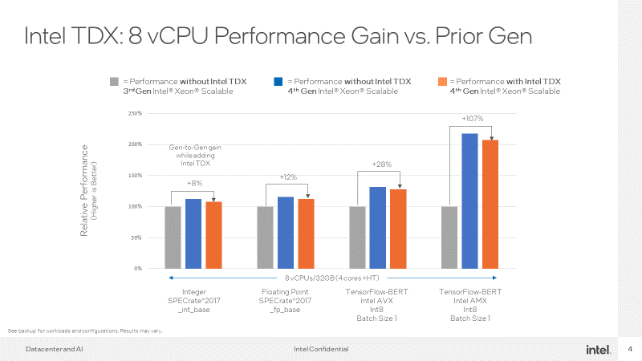
Configurations
Performance varies by use, configuration and other factors. Results may vary​.
8480+ - 1-node, 2x Intel® Xeon® Platinum 8480+ with 1TB (16x64GB DDR5 4800 MT/s ), 1DPC, QUAD total memory, ucode 0x2b0000c0,, HT on, Turbo on, 1x Ethernet Controller I225-LM (10G), 1x 894.3G INTEL SDSC2KG96
1x 700G INTEL MDTPE21K750GA , 1x 894.3G INTEL SSDSC2KG96,1x 700G INTEL MDTPE21K750GA, EGSDCRB1.SYS.0091.D05.2210161328, CentOS Stream 8, 5.19.0-tdx.v1.11.mvp11.el8.x86_64, test by Intel on 10/2022
8380 - 1-node, 2x Intel® Xeon® Platinum 8380 with 512GB (32x16GB DDR4 3200 MT/s), 2DPC total memory, ucode 0x8d000375, HT on, Turbo on, 1 x I210 Gigabit Network Connection (1G), 1x 960G INTEL SSDSC2KG96, EGSDCRB1.SYS.0091.D05.2210161328, CentOS Stream 8, 5.19.0-tdx.v1.11.mvp11.el8.x86_64, test by Intel on 11/2022
Performance varies by use, configuration and other factors. Results may vary​.
KVM Hosts :
4th Gen Xeon® Platinum : 1-node, 2x Intel® 4th Gen Xeon® Platinum with 56 cores and 1TB (16x64GB DDR5 4800 MT/s ), 1DPC, QUAD total memory, ucode 0x2b0000c0,, HT on, Turbo on, 1x Ethernet Controller I225-LM (10G), 1x 894.3G INTEL SDSC2KG96 1x 700G INTEL MDTPE21K750GA , 1x 894.3G INTEL SSDSC2KG96,1x 700G INTEL MDTPE21K750GA, EGSDCRB1.SYS.0091.D05.2210161328, CentOS Stream 8, 5.19.0-tdx.v1.11.mvp11.el8.x86_64, test by Intel on 12/2022
8380 - 1-node, 2x Intel® Xeon® Platinum 8380 with 512GB (32x16GB DDR4 3200 MT/s), 2DPC total memory, ucode 0x8d000375, HT on, Turbo on, 1 x I210 Gigabit Network Connection (1G), 1x 960G INTEL SSDSC2KG96, EGSDCRB1.SYS.0091.D05.2210161328, CentOS Stream 8, 5.19.0-tdx.v1.11.mvp11.el8.x86_64, test by Intel on 12/2022
Guests:
Name:TD-ww49 , vCPUs / Memory : 8vCPUs - pinned to cores+HTs (i.e. 0~3,112~115); 32GB, 28 Guests for SPR, 20 Guests for ICX, OS : Ubuntu 22.04.1 LTS, Kernel: 5.15.0-mvp12v10+4-generic, Qemu :SPR-BKC-QEMU-v2.2, Libvirt: tdx-libvirt-2022.04.20, Grub2 : tdx-guest-ubuntu-22.04-2021.12.27, Shim : tdx-guest-ubuntu-20.04-2021.09.27 tdvf-upstream-2022-ww34.3.

Slide 71
Backup Slides

Slide 72
Software Enabling Requirements
Intel SGX Requirements
Intel TDX Requirements
Software | Readiness | Enabled Options | Enabled Options
Enabled CPU | ✅ | 3rd Gen Xeon Scalable & later | 3rd Gen Xeon Scalable & later
Hypervisor* | ✅ | KVM 5.13 & later VMware vSphere 8 Hyper-V 2019 & later | KVM Vmware Hyper-V
Operating System | ✅ | Linux distros based on Kernel 5.13 & later Windows Server 2019 & later
Library OS (Used only if app is not specifically enabled for SGX) | ✅ | Gramine Scontain Scone | Gramine Scontain Scone
Applications | ✅ | Multiple ISVs across a range of usage models Intel & Commercial SDKs
Enabled Cloud Service Providers
Microsoft Azure Alibaba Cloud | IBM Cloud PhoenixNAP |  | OVH T-Systems …and more
Software | Readiness | Enabled Options
Enabled CPU | ✅ | 5th Gen Xeon Scalable & later (Select CSPs enabled with TDX-capable 4th Gen Xeons)
Host OS/ Hypervisor | Early Preview Linux | Red Hat Cent OS 9 Stream Canonical Ubuntu 23.10
 | Linux Upstream | In process
 | Commercial | Next-gen VMware vSphere
Guest Operating System | ✅ | Red Hat RHEL 9.2 & later Canonical Ubuntu 22.04 & later SUSE Ent. Server 15 & later
Applications | NA | Applications do not require specific enabling for Intel TDX
Enabled Cloud Service Providers
Alibaba Cloud Microsoft Azure Google Cloud IBM Cloud Check with provider for availability status | Microsoft Azure IBM Cloud
Current: Oct 2023
* Required if running Intel SGX in virtualized environment. Intel SGX supports both virtualization and bare metal.

Slide 73
Majority of AI Deployments Expected to Use General-Purpose, CPU-Based Infrastructure
Large-Scale Dedicated AI
100’s of Customers
AI is the dominant workload
“General-Purpose” AI
10,000’s of Customers
AI is one of many workloads
General-purpose cycles
AI cycles
Dedicated AI application or service
Multi workloads (including AI) running
on the same infrastructure
Clusters based on
GPUs or AI accelerators
Building and deploying at
enterprise scale on CPUs
Notes:
In this context, we’re not referring to use cases as NLP, computer vision, or something vertically-focused like defect detection, drug discovery, or the like.
For most customers outside of the largest CSPs or enterprises, a good way to start the conversation is that they are doing AI 24/7 or they are not.
ITDMs have more to worry about than just AI, so the question is whether AI is THE workload, or is it just going to be running alongside other workloads…or is it integrated into an enterprise application? Most enterprise apps like SAP, SQL Server, and Oracle are integrating more and more native AI capabilities.
If they fall into the ‘dedicated AI’ bucket then discrete accelerators (GPU) because this delivers the best TCO when the cluster/partition is fully-utilized, because remember the GPUs / accelerators will be idle when not used for AI.
If they are in the GP bucket they can co-locate AI with the rest of their workloads. Most users will take pre-trained models and scale out on Xeon. AI ‘fits’ with other functions customers are using their servers for, it’s just another batch job so this is going to deliver the best TCO since you’re not adding HW and your existing servers will always be busy.
The key point is that customers need to plan their IT budgets to incorporate not only their normal spend to keep the business running but also adding AI capabilities as needed, so it’s imperative that they’re not either WAITING FOR or OVERSPENDING on AI by insisting on GPU hardware they may or may not fully utilize in the fear of missing out.

Slide 74
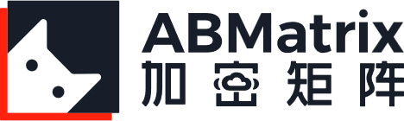


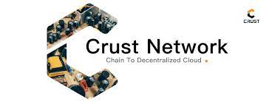



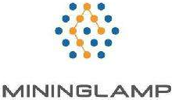




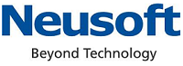


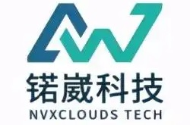
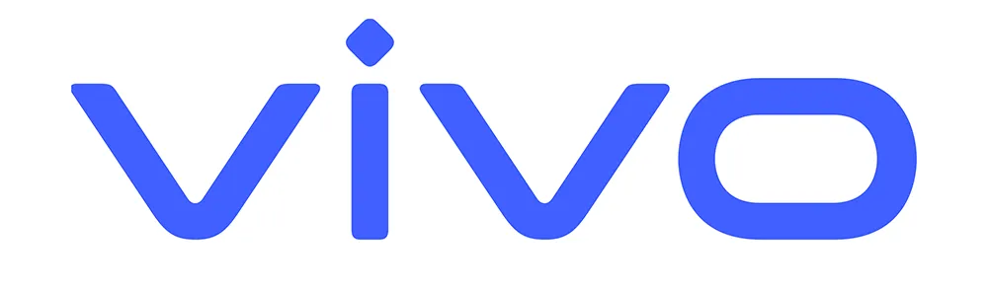
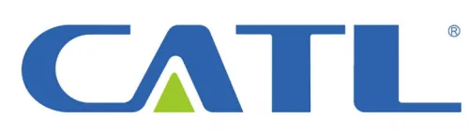



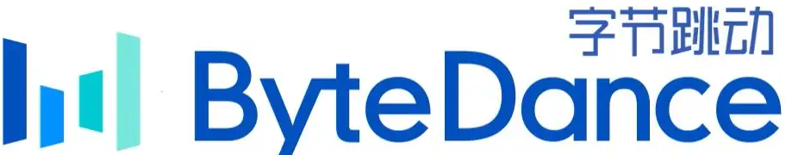
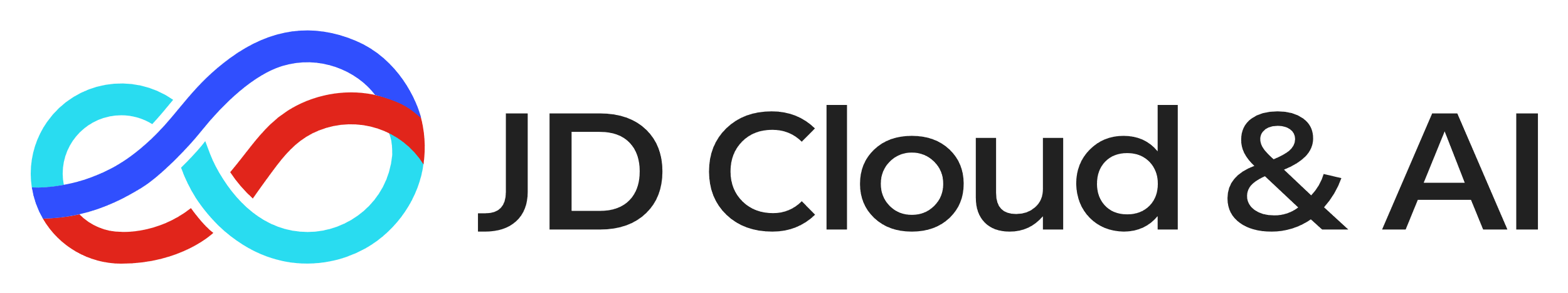
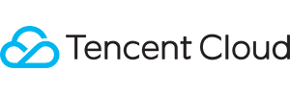
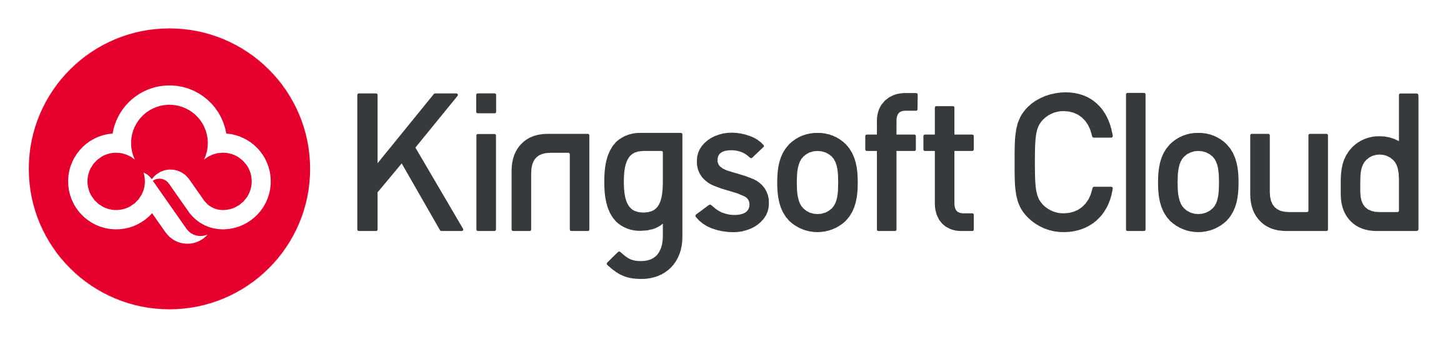




Intel® SGX PRC Ecosystem
End Users
Cloud Service Providers
OEM partners
Notes:
Up to date as of January 1, 2023. Data owner: Allen Guo
Sugon, ZTE – not sure helping enable SGX at this stage

Slide 75

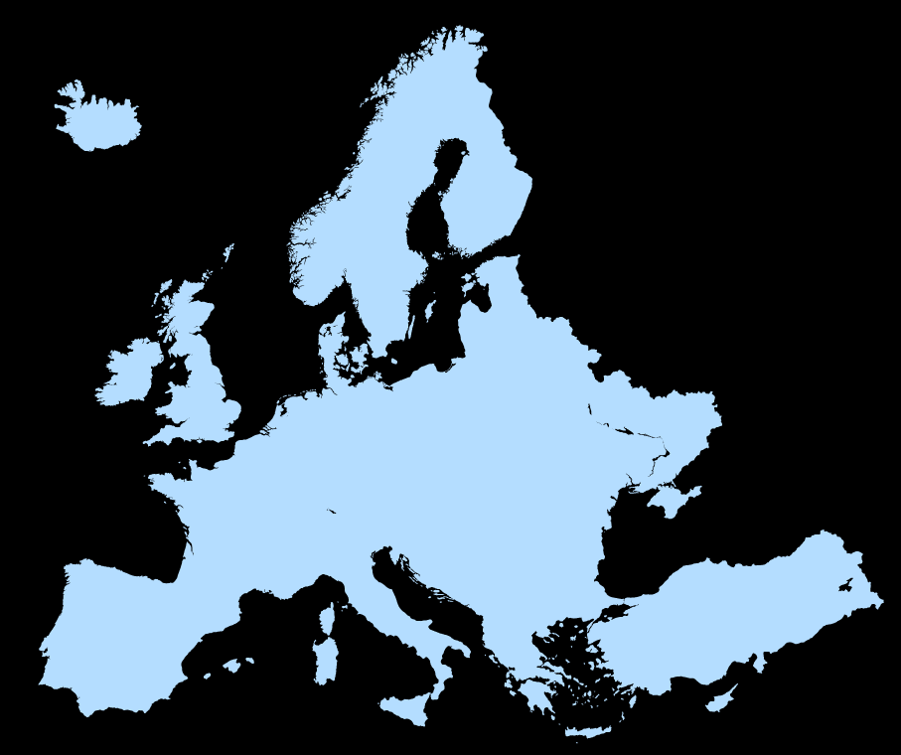


Confidential Computing
Data Controllers & Processors
Strengthens Data Sovereignty Programs
Access Control
Workloads + Data
Confidential Computing TEE
GDPR
Cloud Provider
Local Regulatory Compliance
+
Data Center Geo-Location
+
Technological Protection and Control
Notes:
In much of the world, Data privacy is increasingly viewed as a personal right and national security issue. The data sovereignty movement is rapidly growing in Europe, China, Canada, Australia, and other locations around the world. The idea behind data sovereignty is certain types of personal or sensitive data should be governed under the regulations of the location in which it was generated. For example, data about an Italian citizen would be governed under the laws of Italy and the European Union.
A common data sovereignty strategy combines a compliance regimen with geo-locating the data in a data center in the target region, ideally not with a cloud provider subject to other competing regulatory frameworks. However, data is a very liquid asset and can inadvertently “escape” into other data centers. And disconnecting from multi-national cloud providers may not be practical for global organizations.
Confidential Computing provides an additional technological enforcement mechanism to a data sovereignty strategy. The data in-use is protected inside a TEE, and since the workload owner holds the keys to decrypting the data, it cannot be collected, viewed or accessed without the owner’s knowledge and consent. Combined with storage and network encryption, Confidential Computing empowers workload owners to control access to their data and govern it under their target legal framework.

Slide 76
Multi-Party Collaboration with Compliance
All parties benefit from shared analysis
No party’s data visible to other parties or the application host
Activates data value while remaining confidential and compliant
Successfully deployed as centralized or federated architecture
Party A
Party B
Party C
Encrypted data
Encrypted data
Encrypted data
Trusted Execution Environment
Application Code + Parties’ Data
Shared Analysis
Notes:
This slide provides additional context for multi-party collaboration use cases. These include scenarios like hospitals pooling data for drug research or disease tracking, or multiple banks collaborating to identify fraud and money laundering. Often, the data each party holds is confidential and/or regulated, so just contributing it unencrypted is likely a compliance violation. In these use cases, each parties’ data is encrypted until it is inside the TEE, where the only software that can view it in decrypted form is the trusted application code all parties have agreed to and has been attested. No other party can see another parties’ data, and not even the hosting organization. Designed correctly, the only result all parties can access is the shared analysis based on all the data. This can be a more accurately trained AI model, a more refined statistical analysis, a set of shared characteristics and more.
Multi-party confidential analysis can be deployed in a centralized fashion, where all the parties move their data into a TEE hosted in the cloud. The analysis can also be federated to each party’s location if the data is too big, sensitive or regulated to release off-prem. In a federated model, a node with an agreed-upon TEE is located at each party, and the analysis of that party’s data is then merged into a master model in the cloud. In either case, the data remains confidential and compliant.

Slide 77
Ease Cloud Migration Concerns
Cloud scalability and economics are attractive, but…
Security, compliance, and sovereignty concerns hold some workloads back
Confidential Computing separates workload from cloud provider’s stack, admins, and other tenants
Customer holds data decryption keys
Combine with customer-controlled storage and network encryption for more complete separation
Customer-Controlled Cloud Storage
Encrypted data
Trusted Execution Environment
Workload + Data
Isolated VM or Application
Other Cloud Tenant
Cloud Provider’s
Software Stack
System Admins
Notes:
The scalability and economics of cloud are hard to resist, but Enterprises have some workloads they hold on-prem due to security, regulatory or sovereignty concerns. Confidential Computing can help ease concerns about migrating workloads to the cloud.
Confidential computing isolates sensitive data away from the cloud provider’s software stack and system admins. The customer holds the keys to decrypting their confidential instances, so their confidentiality and sovereignty is protected.
It also isolates and protects your workloads from the other cloud tenants.
Add encrypted cloud storage and encrypted networking and customers’ data can be protected at-rest, in-transit and in-use.

Slide 78

IP Protection in the Field
Software IP, confidential data or premium content represent significant value, but…
IP can be at-risk when deployed in locations with limited physical security
Confidential Computing allows the software to be decrypted inside a protected TEE
Attempts to exfiltrate or modify software are prevented and/or detected
Encrypted Software or Content Storage
Encrypted data
Trusted Execution Environment
Software + Content
Isolated VM or Application
Unauthorized Service Technician
Edge or Branch Location Node
Notes:
Not all confidential computing takes place in a large, centralized data center. Increasing use of edge deployments, branch offices or far-flung, in-field deployments may put machines with valuable data, software or content in locations where physical security cannot be guaranteed.
Confidential computing adds layers of protection to many distributed or branch office solutions. Sometimes the object of protection is the data or premium content the remote node handles, which may be high-value, confidential or regulated. In other cases, the object of protection is the valuable software IP. For example, a medical systems manufacturer may want to make sure their proprietary software is not exfiltrated by an untrustworthy service technician. By encrypting the executable code while its in storage and only decrypting it when it is protected inside an SGX enclave or TDX trust domain, the system manufacturer can protect their software IP from tampering or theft.

Slide 79
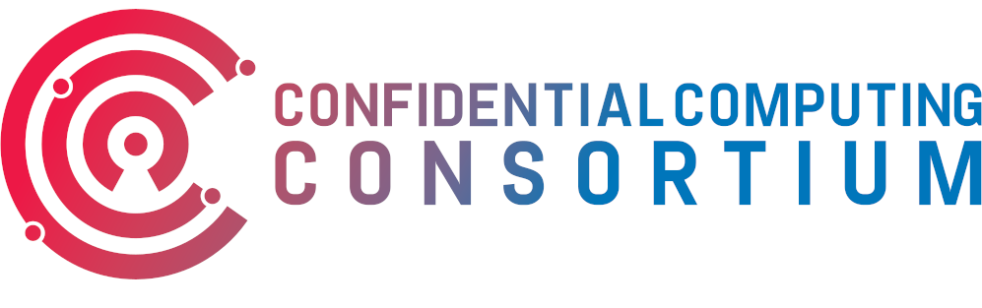
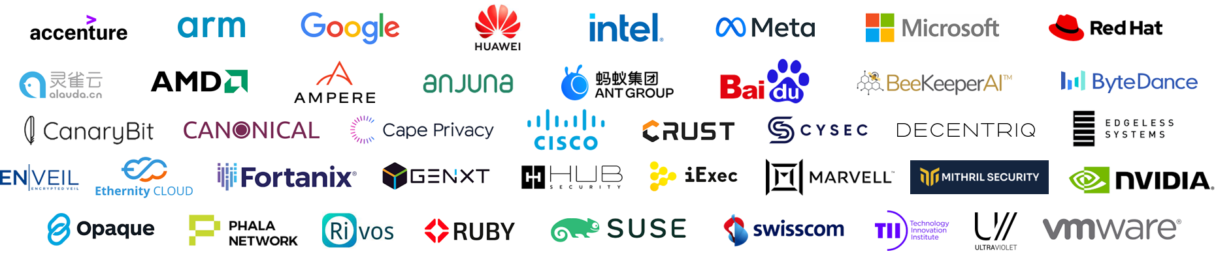
A Community Focused on Protecting Data In-Use
ConfidentailComputing.io
Intel is a founding member of the Confidential Computing Consortium
The Consortium brings together hardware vendors, cloud providers, and software developers to accelerate the adoption of Trusted Execution Environment technologies and standards.
CCC is a project community at the Linux Foundation
Premier Members
General Members

Slide 80

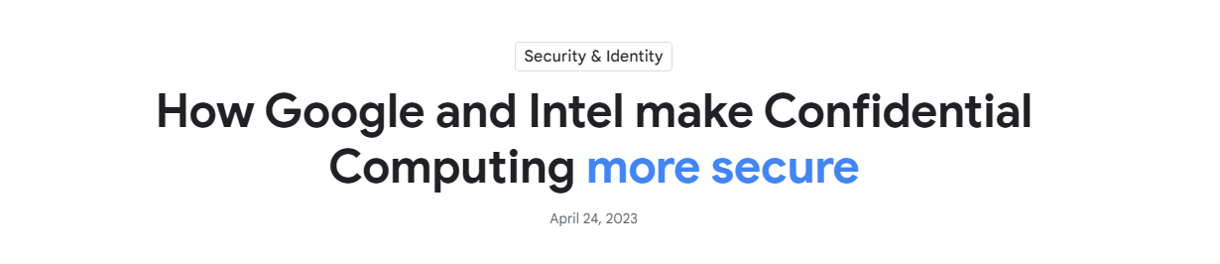
Intel TDX
Google Project Zero Security Evaluation
Project Zero is Google’s team of elite security researchers who study zero-day vulnerabilities in hardware and software
Intel collaborated with Project Zero in a 9-month evaluation of TDX in 2022
Results:
10 potential vulnerabilities uncovered
All 10 mitigated before launch of 4th Gen Intel Xeon Scalable platform in 2023
5 suggestions for additional defenses
“The report showcases the importance of collaborative research efforts in identifying and addressing security vulnerabilities in complex environments.”
“With the analysis now complete and the vulnerabilities addressed, the Intel and Google security teams agree that the Intel firmware which enables Confidential Computing solutions meets an elevated security bar for customers, as the firmware updates motivated by this review mitigate several bug classes and offer a way to recover from vulnerabilities.”
https://cloud.google.com/blog/products/identity-security/rsa-google-intel-confidential-computing-more-secure
Intel’s commitment to security hardening through internal & external research

Slide 81
Confidential Computing Project Drivers
Data Security and
IP Protection
Protect apps and data from attack, tampering or theft
Privacy and Compliance
Strengthen data confidentiality and regulatory compliance
Data Sovereignty and Control
Prohibit access by cloud provider or other tenants; Add safeguards to data sovereignty & governance
Notes:
Emerging from its essential characteristics, Intel has found customers deploy Confidential Computing in three major project types depending on the outcome they seek.
Some projects prioritize straight-up security and value how Confidential Computing can protect the application and data from classic attack vectors like hackers, malware, tampering or data theft. The “armored vault” of the Trusted Execution Environment and verification of correct config are highly valued. These projects are usually designing specifically for security.
Other projects prioritize the ability of Confidential Computing to perform complex analyses on private or regulated data while keeping it protected and out-of-view by unauthorized parties. It helps them activate this data and derive value from it while remaining compliant with regulations like GDPR (Europe), HIPAA (United States) or PIPA (China). These can be single-party apps, but often they are multi-party where sensitive data is contributed to a mutually beneficial analysis.
The third big motivation is inspired by the growing data sovereignty movement where data is viewed as a critical organizational or national asset. Multi-national companies and cloud providers may be subject to multiple data governance regulations and legal frameworks, but cloud tenants may want their data governed under a specific framework, such as GDPR. Confidential computing creates a technological separation between the workload & data and the cloud provider and puts the encryption keys to the data in-use in the hands of the owner, not the cloud provider. This separation and control over cloud data can add technological safeguards to an organization’s data sovereignty or geo-location program.
Customers may have several projects underway simultaneously, each with a different project motivator.

