Slide 1
Refresh and consolidate: 1st Gen Intel® Xeon® processor to 4th Gen Intel® Xeon® processor based servers
Miriam Gonzales, Chris Peters
April 2023

Slide 2
Leadership Performance with 4th Gen Intel® Xeon® processors Improve performance efficiency for critical workloads with the most built-in accelerators
Accelerate
Performance
Reduce
TCO
Increase
Security
Accelerate
Time to Market
Up to 5:1 server consolidation with 75% TCO reduction ²
3x better efficiency (perf/watt) with built in accelerators ¹
53% general purpose performance gains ¹
up to 10x increase in AI workload performance with built-in accelerators ¹
Most researched and deployed confidential computing technology
Accelerated data encryption performance with built in accelerators
Extensively tested and validated to run critical workloads at scale Most choice and flexibility for deployments with largest ecosystem
¹ vs prior generation Intel® Xeon® processor
² Comparing benefits transitioning from Intel® Xeon® 4110 to Intel® Xeon® 5420+
Performance varies by use, configuration and other factors. See backup for configurations. Results may vary.

Slide 3
Refresh and consolidate Intel® Xeon® processor-based servers 4th Gen Intel® Xeon® processors can significantly lower your total cost of ownership
Up to
5:1
Server consolidation
Up to
80%
Reduction in server count
Up to
60%
Reduction in CO2 emissions & power
Up to
75%
Reduction in TCO
Free up rack space and reduce data
center footprint
Simplify and lower data center operations cost
Lower power bills and reach sustainability goals
Lower overall cost to reinvest for growth
Recover your cost in 4 months
Comparing benefits transitioning from Intel Xeon 4110 to Intel Xeon 5420+
Performance varies by use, configuration and other factors. See backup for configurations. Results may vary.

Slide 4
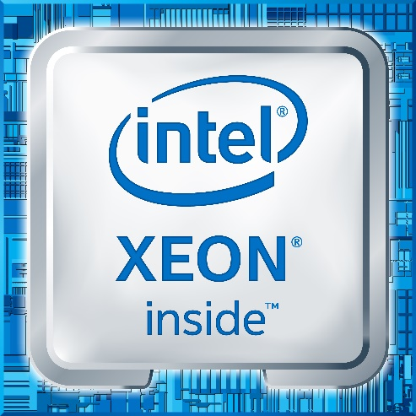
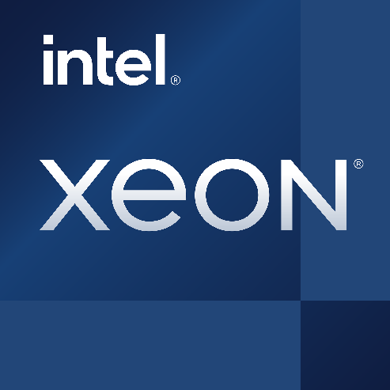
Refresh and consolidate Intel® Xeon® processor-based servers 4th Gen Intel® Xeon® processors can significantly lower your total cost of ownership, cost recovery in 4 months
1st Gen Intel® Xeon® Scalable Processors*
4th Gen Intel® Xeon® Scalable Processors
Number of Intel® Xeon® processor-based servers
50 servers
10 servers
80% less
Lower Fleet Power (kilowatts)
1.1M kWh
458K kWh
60% lower
Reduced CO2 emissions (kilograms)
472,087 kg
194,242 kg
60% lower
Total Cost of Ownership (TCO, $)
$1.5M
$381K
75% lower
Comparing benefits transitioning from Intel Xeon 4110 to Intel Xeon 5420+
Performance varies by use, configuration and other factors. See backup for configurations. Results may vary.

Slide 5
Refresh and consolidate Intel® Xeon® processor-based servers 4th Gen Intel® Xeon® processors can significantly lower your total cost of ownership
From 1st to 4th Gen Intel Xeon processor | Reduce servers | Reduce energy and CO2 | Reduce TCO | Recover costs (months)
8160 8460Y+ | 64% | 34% | 43% | 20
6130 6430 | 62% | 26% | 49% | 11
5120 5420+ | 70% | 48% | 61% | 7
4110 5420+ | 80% | 59% | 74% | 4
Performance varies by use, configuration and other factors. See backup for configurations. Results may vary.

Slide 6
Notices and Disclaimers
Performance varies by use, configuration and other factors. Learn more at www.Intel.com/PerformanceIndex​.
Performance results are based on testing as of dates shown in configurations and may not reflect all publicly available ​updates. See backup for configuration details. No product or component can be absolutely secure.
Intel contributes to the development of benchmarks by participating in, sponsoring, and/or contributing technical support to various benchmarking groups, including the BenchmarkXPRT Development Community administered by Principled Technologies.
Your costs and results may vary.
Intel technologies may require enabled hardware, software or service activation.
Some results may have been estimated or simulated.
Intel does not control or audit third-party data. You should consult other sources to evaluate accuracy.
All product plans and roadmaps are subject to change without notice.
Statements in this document that refer to future plans or expectations are forward-looking statements. These statements are based on current expectations and involve many risks and uncertainties that could cause actual results to differ materially from those expressed or implied in such statements. For more information on the factors that could cause actual results to differ materially, see our most recent earnings release and SEC filings at www.intc.com.
© Intel Corporation. Intel, the Intel logo, and other Intel marks are trademarks of Intel Corporation or its subsidiaries. Other names and brands may be claimed as the property of others.

Slide 7
Leadership Performance with 4th Gen Intel® Xeon® processors Disclaimers
53% average performance gain over the prior generation1 See [G1] at intel.com/processorclaims: 4th Gen Intel® Xeon® Scalable processors. Results may vary.
Up to 10x higher PyTorch real-time inference performance with built-in Intel® Advanced Matrix Extensions (Intel® AMX) (BF16) vs. the prior generation (FP32)4 See [A17] at intel.com/processorclaims: 4th Gen Intel® Xeon® Scalable processors. Results may vary.
Up to 10x higher PyTorch training performance with built-in Intel® Advanced Matrix Extensions (Intel® AMX) (BF16) vs. the prior generation (FP32)5 See [A16] at intel.com/processorclaims: 4th Gen Intel® Xeon® Scalable processors. Results may vary
Up to 5:1 consolidation and 75% TCO savings with 4th Gen Intel Xeon processors: Calculations as of March 28, 2023 based on the Intel® Node TCO & Power Calculator using default cost, power and TCO assumptions over a 5-year TCO horizon comparing replacing 50 older servers with Intel Xeon 4110 processors with new servers using new Intel Xeon 5420+ processors. Results may vary. Performance measurements based on published SPECrate®2017_int_base on spec.org as of March 28, 2023 [4110: https://www.spec.org/cpu2017/results/res2020q4/cpu2017-20201015-24218.html 5420+: https://www.spec.org/cpu2017/results/res2023q1/cpu2017-20230130-33925.html]
2.9x average performance per watt efficiency improvement for targeted workloads utilizing built-in accelerators compared to the previous generation2 See [E1] at intel.com/processorclaims: 4th Gen Intel® Xeon® Scalable processors. Results may vary.
Intel SGX is the most researched, updated, and deployed confidential computing technology in data centers on the market today. With Intel® Security Engines, 4th Gen Intel Xeon Scalable processors help bring a zero-trust security strategy to life while unlocking new opportunities for business collaboration and insights—even with sensitive or regulated data. Intel® Software Guard Extensions (Intel® SGX) is designed to enhance data protection at rest, in motion, and in use. Intel SGX is the most researched, updated, and deployed confidential computing technology in data centers on the market today. Intel SGX provides the smallest trust boundary of any confidential computing technology in the data center today.
Built-in accelerators for encryption help keep data protected while preserving performance. Intel® Crypto Acceleration reduces the impact of implementing pervasive data encryption and increases the performance of encryption-sensitive workloads, such as for Secure Sockets Layer (SSL) web servers, 5G infrastructure, and VPNs/firewalls.. Networking Encryption: Up to 47% fewer cores to achieve the same connections/second using integrated Intel® QuickAssist Technology (Intel® QAT) vs. the prior generation on NGINX key handshake.4 See [N15] at intel.com/processorclaims: 4th Gen Intel® Xeon® Scalable processors. Results may vary.
Most deployed platform, backed by extensive testing and validation: With more deployments than any other data center CPU in the market, Intel® Xeon® Scalable processors are widely trusted to run critical workloads at scale. From next-gen memory and I/O to software optimizations, 4th Gen Intel Xeon Scalable processors have been extensively tested and validated to deliver the high performance and reliability organizations demand.
Businesses can speed up time to deployment with the largest ecosystem of partners they know and use—hardware and software vendors and solution integrators around the world build their products on Intel® Xeon® Scalable processors, offering maximum choice and interoperability with the reassurance of thousands of real-world implementations

Slide 8
Refresh and consolidate Intel® Xeon® processor-based servers Disclaimers
Up to 5:1 consolidation with 75% TCO reduction with 4th Gen Intel Xeon processors
Calculations as of March 28, 2023 based on the Intel® Node TCO & Power Calculator using default cost, power and TCO assumptions over a 5-year TCO horizon comparing replacing 50 older servers with Intel Xeon 4110 processors with new servers using new Intel Xeon 5420+ processors. Results may vary. Performance measurements based on published SPECrate®2017_int_base on spec.org as of March 28, 2023 4110: https://www.spec.org/cpu2017/results/res2020q4/cpu2017-20201015-24218.html
5420+: https://www.spec.org/cpu2017/results/res2023q1/cpu2017-20230130-33925.html]
4th Gen Intel® Xeon® processors can significantly lower your total cost of ownership
Calculations as of March 28, 2023 based on the Intel® Node TCO & Power Calculator using default cost, power and TCO assumptions over a 5-year TCO horizon comparing replacing 50 older servers with Intel Xeon 4110 processors with new servers using new Intel Xeon 5420+ processors. Results may vary. Performance measurements based on published SPECrate®2017_int_base on spec.org as of March 28, 2023
8160 https://www.spec.org/cpu2017/results/res2018q4/cpu2017-20181112-09655.html
8460Y https://www.spec.org/cpu2017/results/res2023q1/cpu2017-20221223-33229.html
6130 https://www.spec.org/cpu2017/results/res2019q2/cpu2017-20190506-13570.html
6430 https://www.spec.org/cpu2017/results/res2023q1/cpu2017-20221223-33187.html
5120 https://www.spec.org/cpu2017/results/res2018q4/cpu2017-20181015-09160.html
5420+ https://www.spec.org/cpu2017/results/res2023q1/cpu2017-20230130-33925.html
4110 https://www.spec.org/cpu2017/results/res2020q4/cpu2017-20201015-24218.html

