Slide 2
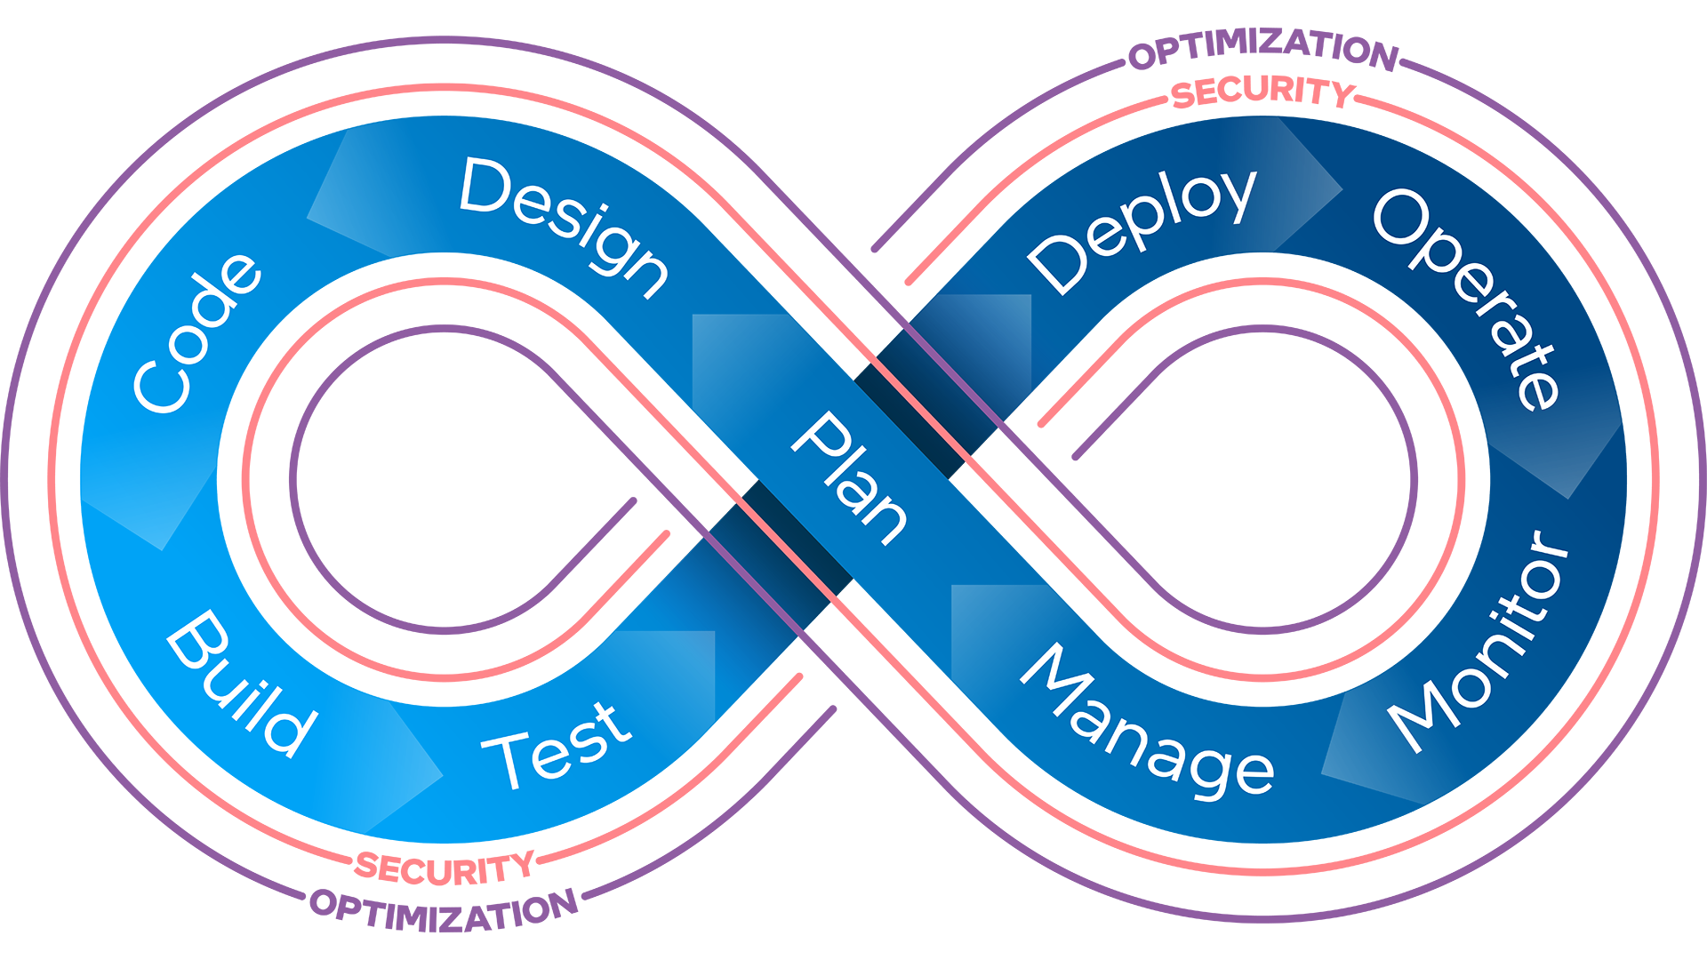
Business Critical Cloud Trends
By 2025, 40% of newly procured premises-based compute and storage will be consumed as a service, up from less than 10% in 2021.¹
By 2025, 70% of organizations will implement structured infrastructure automation to deliver flexibility and efficiency, up from 20% in 2021.¹
By 2025, only 50% of enterprises will develop skills for infrastructure automation across hybrid and multi-cloud platforms, up from less than 10% in 2021.¹
By 2027, 35% of application workloads will not be optimal or ready for cloud delivery, down from 55% in 2022.¹
Through 2027, 85% of workload placement decisions will need to be continually optimized, because of changing product, availability, and cost requirements.²
1 Gartner: 4 Predictions for I&O Leaders on the Path to Digital Infrastructure
2 Gartner Predicts 2023: Collaborate, Automate and Orchestrate to Optimize Costs and Value During the Economic Crisis ID: G00777056
Notes:
This is Intel’s design of a DevOps Infinity Loop – what the industry sees as a depiction of the CI/CD cycle: Continuous Integration (CI) and Continuous Delivery (CD). CI/CD methods, what we call a CI/CD pipeline, is an integral part of a modern DevOps practice. This is normally associated only with agile methods of producing application, but in the cloud is also applied to “IaC,” or Infrastructure as Code, and used as the foundation for building, scaling, and managing cloud environments (aka, the VPC).
This is terrific for a technical enablement description and showing customers and partners that we also live in the DevOps world, but isn’t a straightforward way to depict selling and/or qualifying motions with end customers/partners.
Today, I’ll walk through how we’re using this Infinity Loop when looking at the portfolio of cloud/CAOS solutions (what we call tools) that fall into these categories. Keep in mind, some fit perfectly into one step, others identify with multiple steps, and some (like security) are pervasive throughout the infinity loop. We are focusing on an easy to break down the tools we are supporting and cultivating while aligning it back to the infinity loop philosophy.

Slide 3
Optimization Chaos
“My customer is moving workloads to a CSP. I need data to show with which Intel instances they can expect the best performance.”
“I need to explain what will be required of my customers if they use a new feature.”
“I need to point our customers to specific optimizations based on their SW stack.”
“I don’t get clear timely answers and responses for my customers when I need SW optimization support.”
“My customer uses Envoy. I need to know if we have existing optimizations that would help them.”

Slide 4
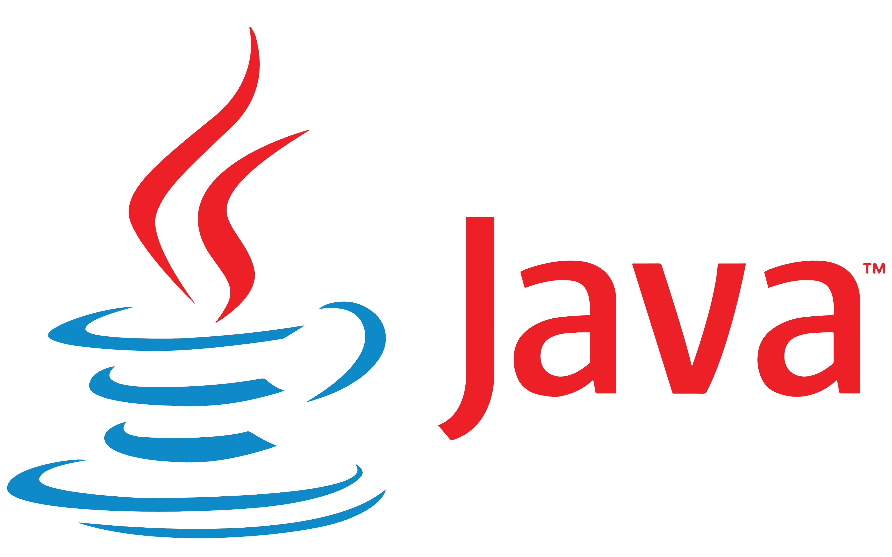
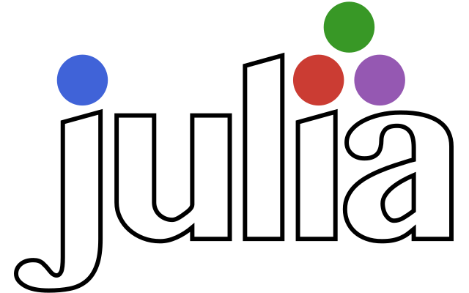
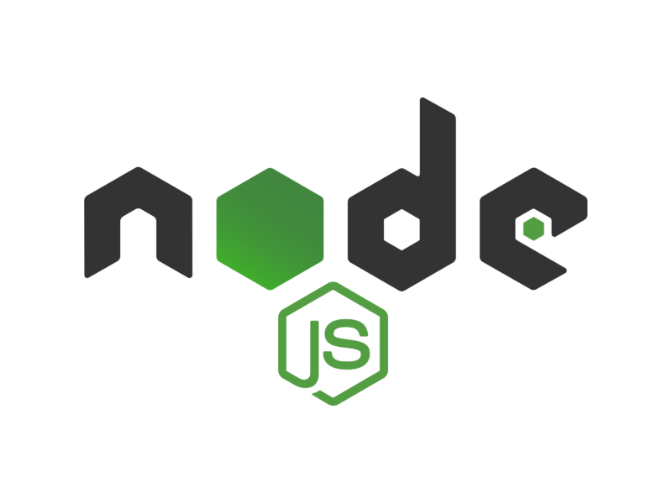
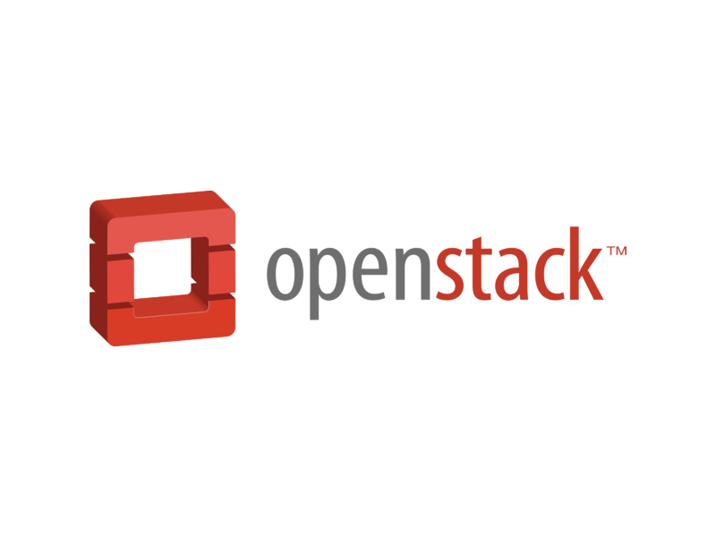
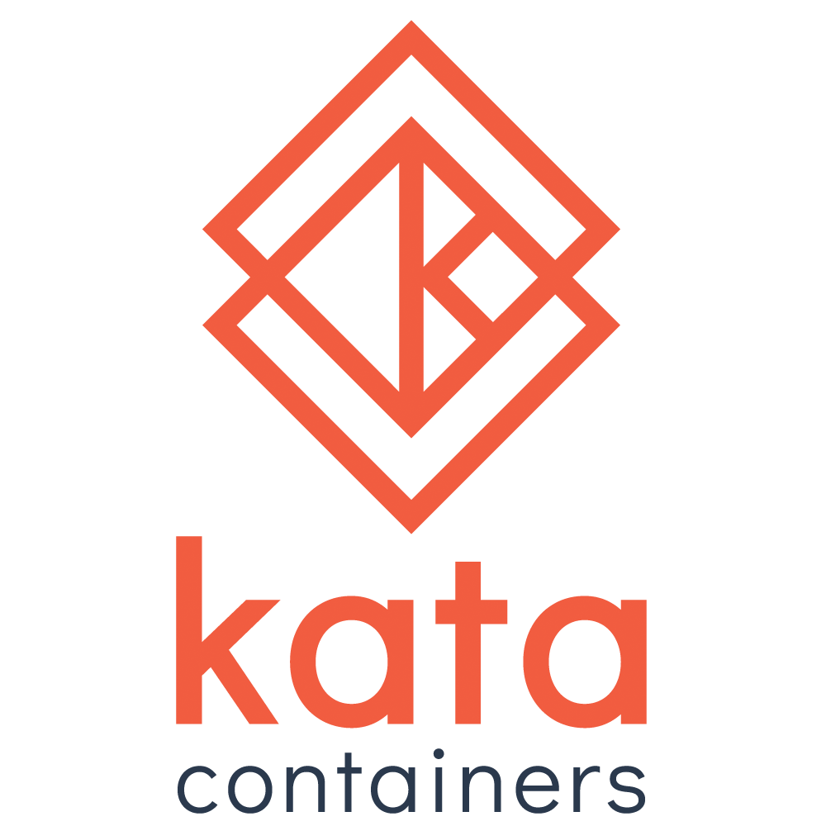
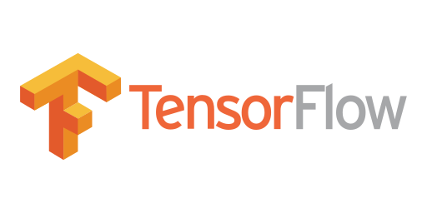
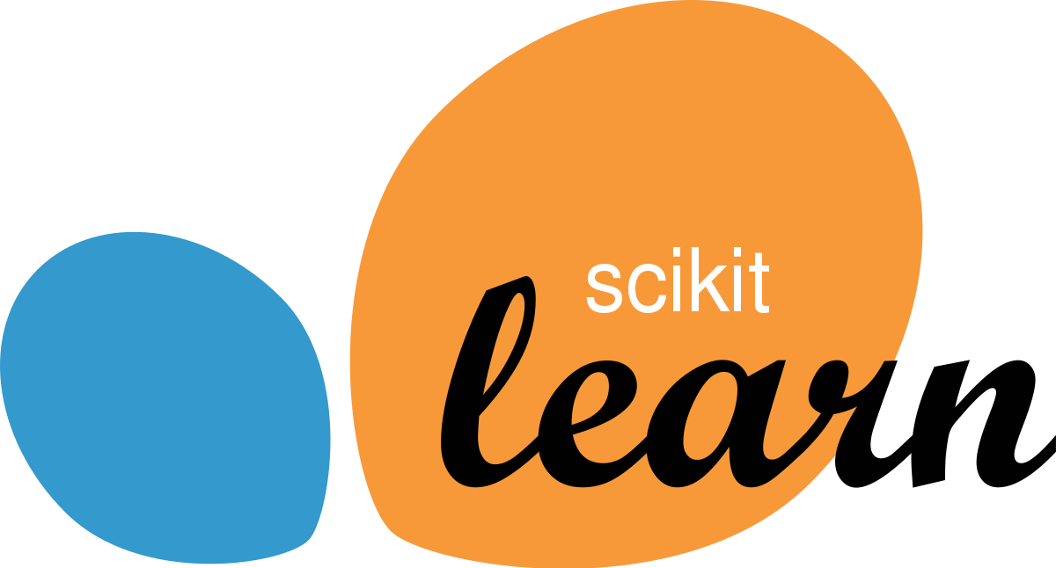
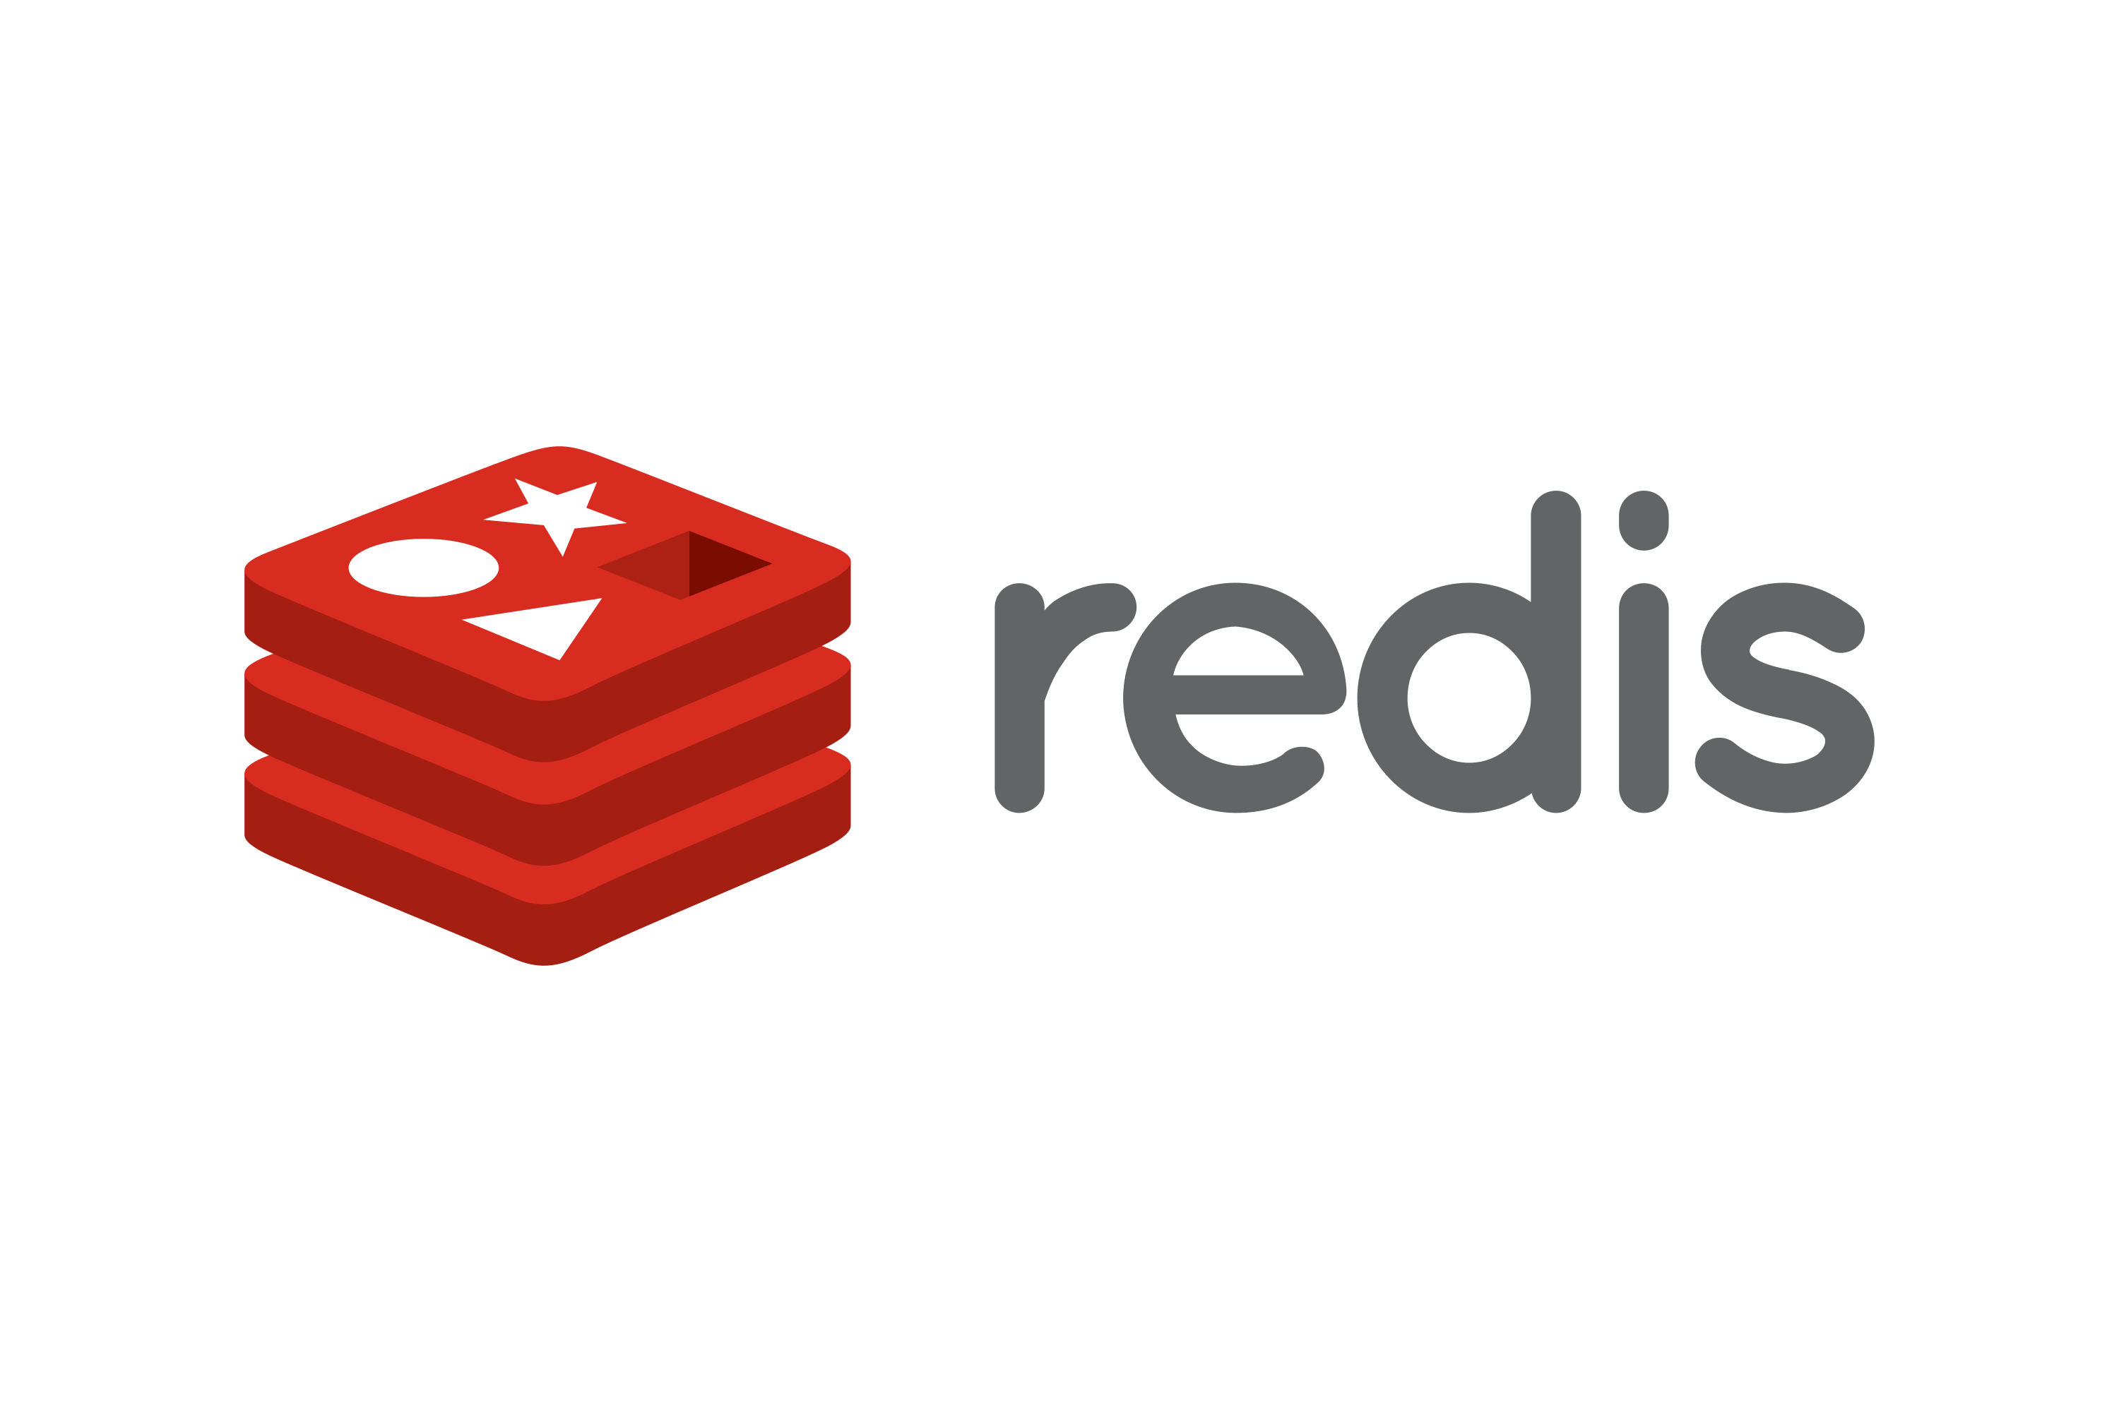
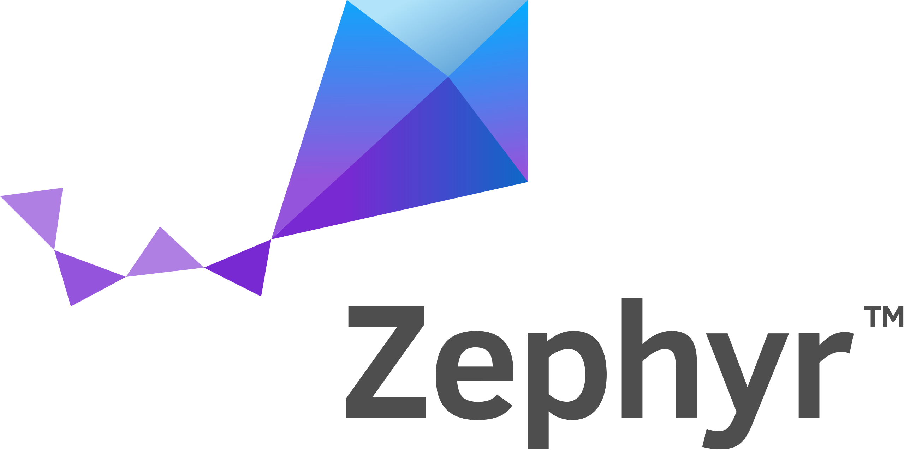
Runtimes and Languages
Cloud, Edge, and Data Center
We Participate at All Levels of the Stack*
secure device onboard
Media
Machine Learning and AI
SVT
Networking, Storage, and Database
MySQL
D P D K
SPDK
Libraries/Tools
(compiler, oneMKL, oneDNN, oneDAL)
Virtualization
Kernel / OS
Linux
Firmware
Tools and SDKs
*a non-exhaustive sample
© Intel Corporation. Intel, the Intel® logo, and other Intel® marks are trademarks of Intel® Corporation or its subsidiaries. Other names and brands may be claimed as the property of others.
Notes:
KEY POINT: We are renown for our hardware but many people don’t know how deep our software roots run. We’re a microprocessor company with more than 15,000 software engineers, there are a trillion lines of code optimized for Intel, we have optimized more than 100 different operating systems
For over two decades, Intel has driven innovation—from data center to cloud to edge—through open technologies and communities.. Intel is the #1 corporate contributor to the Linux kernel. Many processor-level features require OS enabling. Intel’s Linux engineers tune performance and activate new platform features for the kernel, test them with rigor, and then upstream them to the kernel maintainers. And we don’t stop there, we led the CPU optimizations with Google on Tensorflow, and we’re one of the original tech leaders for Kubernetes. And now with Pat at the helm, we are increasing our investments in open source even more.
Winning Developers and Delivering better products with our commitemnt to open ecosystems.
Open. Choice. Trust.
Enable developers
Foster Choice
Build confidential compute
We participate at every level in the software ecosystem… at varying levels of engagement.
Also reference key differentiators Intel offers (Suleyman’s input)
By doing so, Intel makes the optimizations accessible to a broader developer community. We can combine the backporting and multiversioning and say that by owning these together Intel shoulders the burden of upgrading to/validating new versions
Back-porting to LTS versions
cloud doesn’t upgrade all at once – many generations of software at work at one time… Intel has worked on providing for apps to run on multiple generations and to take advantage of whatever microarchitecture
Allows software to run on blend of cloud instances
FMV “Function Multiversioning.”
(are the following words describing FMV or something different? ) Better custodians of complex multigenerational environments – support multiple microarchitectures through tool chain: compiler/ linker / Intel has been very thoughtful in this area: good history

Slide 5
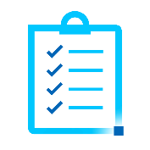
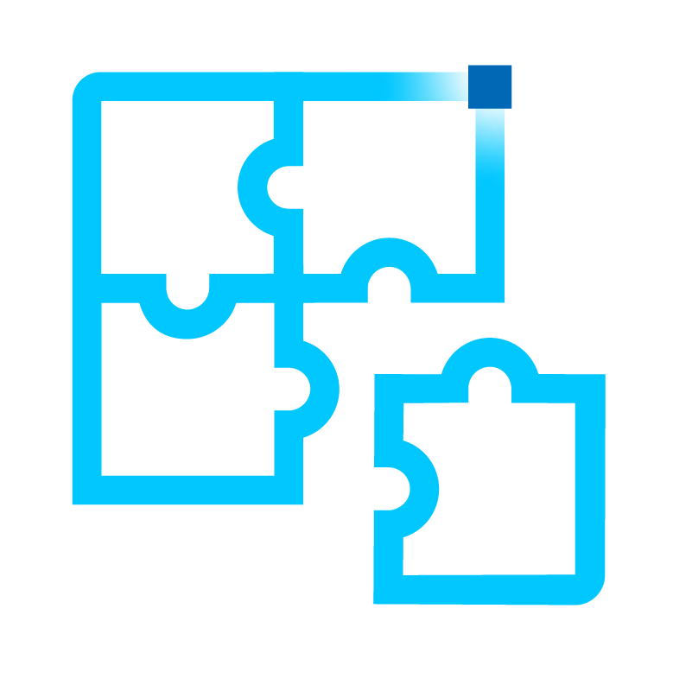
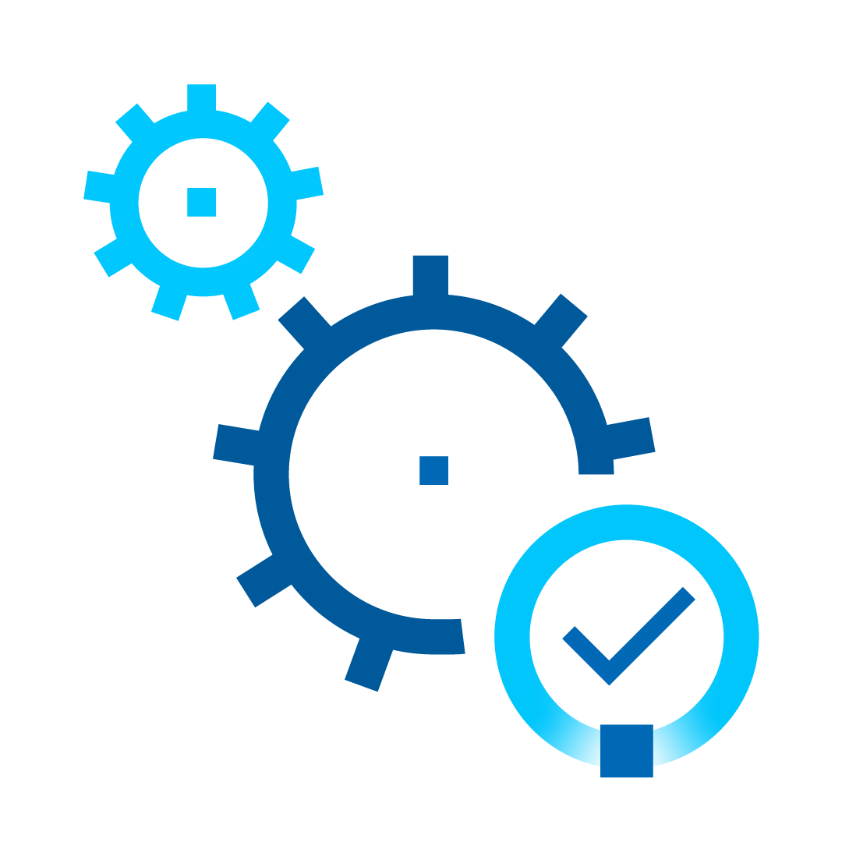
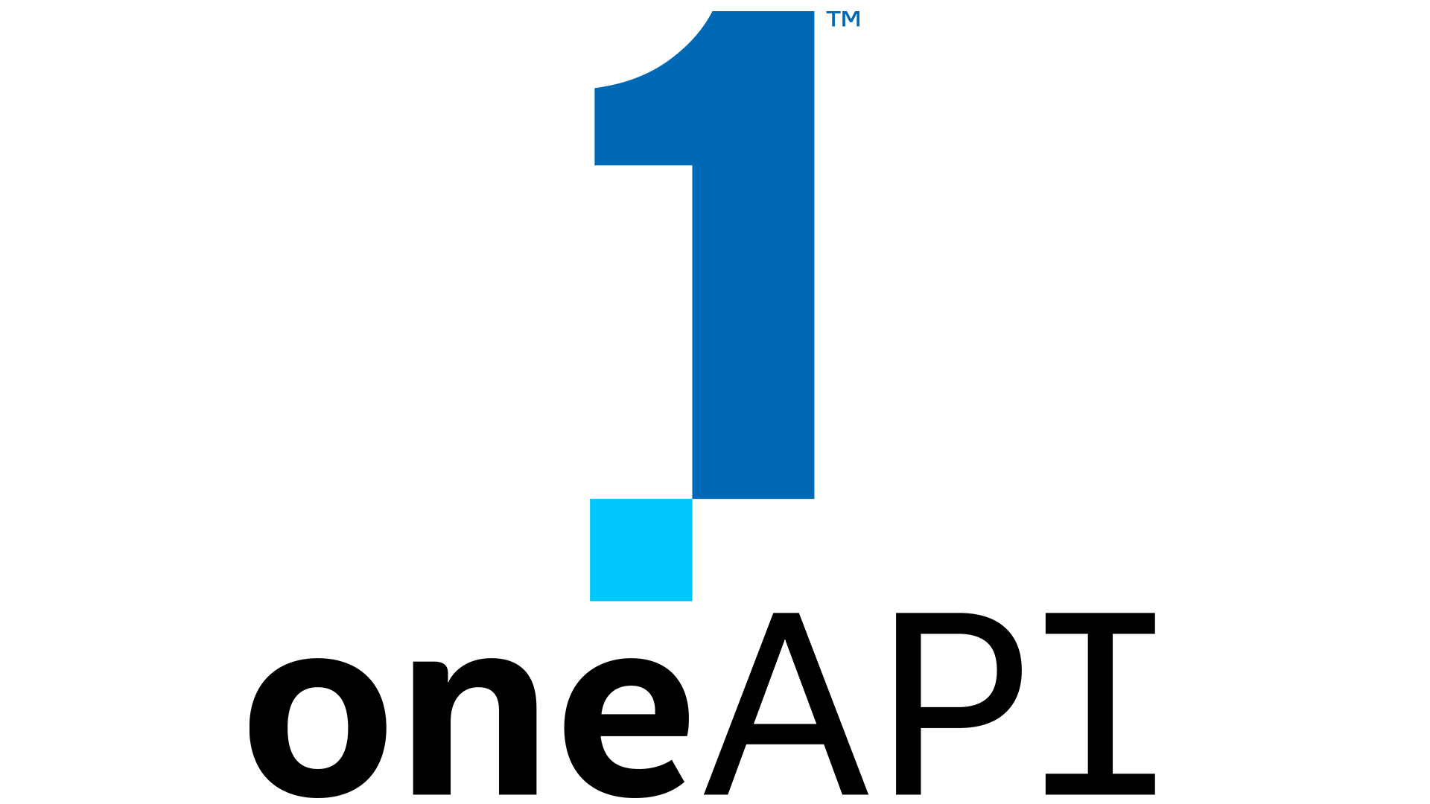
Intel® Optimization Software
Continuous Delivery
Software Delivery Value Stream
Customer Need
Plan and Create
Integrate and Verify
Deploy and Operate
Monitor and Improve
Customer Value
Security and Compliance
Team Collaboration
Value Stream Metrics
Platform Governance
Continuous Improvement
Intel® Optimization Software
Intel® Migration Advisor
Intel® Cloud Optimizer
Intel® Cloud Optimization Modules
by
by
for
Inventory and Business Case
Performance, Cost, SLA
Real-Time, Autonomous
Application Optimization
Intel® Optimization Software Ecosystem
Intel® Optimization Hub
Intel® Performance Hub

Slide 6
Intel® Optimization Hub
Optimized Performance
Collaborate Securely
Proven Results
Easy and Intuitive

Slide 7
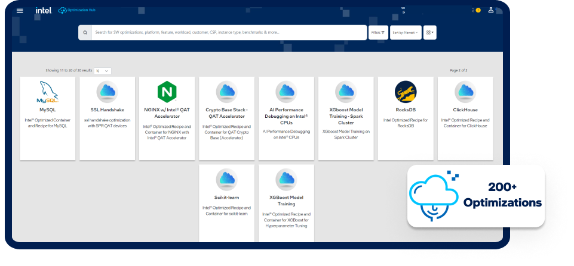
Intel® Optimization Hub Overview
Optimization ‘packages’ with value propositions, performance, technical papers configurations, code, user guides, marketing collateral & proof points
Optimizations are based on real-world engineering with customers from the last 2 years
Search & filter based on platform, feature, and other variables
Available via User Interface and API
Developed and verified by Intel engineers
Continuous testing, validation, and creation of optimization ‘packages’
Our Ask:
Request optimizations that you need or are unable to find
Rate existing optimizations
Provide feedback & requests for changes to existing optimizations
https://optimizations.intel.com

Slide 8
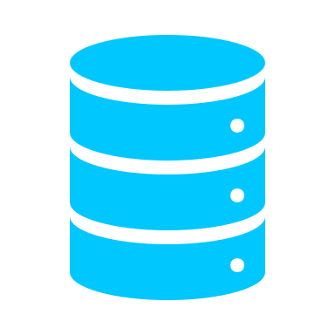
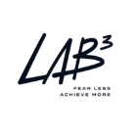
Intel® Optimization Hub Architecture
Optimization Hub
API
Data Lake
Authentication
Microservice
Machine Learning
UI
Performance Hub

Slide 9
Intel® Optimization Hub Catalog Card
Benefits and how to implement the optimizations
Links to download recipes, collateral, benchmarks, and containers
Performance Details
Configuration Details for Performance Claims

Slide 10
How to Request an Optimization

Slide 11
Optimization Hub Roadmap
3Q23
4Q23
1Q24
2Q24
Standardize Optimization and Benchmark Ingestion
Develop 150 – 200 catalog cards
New SMG ONLY user interface
New Data Schema (hierarchy)
Update user navigation based on Data Schema
Establish user acceptance testing
Conduct usability interviews
Develop a standard API integration for 3rd party software
Integrate Intel® Performance Hub
Ingest Emerald Rapids optimizations
Ingest Emerald Rapids benchmarks
Integrate Intel® vTune™
Smart recommendations
End-user notifications
Ingest 10 optimizations
Ingest 10 performance benchmarks
Integrate 3rd party applications
Update smart recommendations
End-user notifications
Ingest 10 optimizations
Ingest 10 performance benchmarks
On-board 2-3 new external customers
Develop 30-60-90 day customer survey / feedback
On-board 2-3 new external customers
On-board 2-3 new external customers
On-board 2-3 new external customers

Slide 12
Additional Resources
DevOps Animation
DevOps Infographic
DevOps eGuide
DevOps Whitepaper
Cloud Library
Cloud Performance Benchmarks
CSA Tech Talks (on-demand)
Cloud Developer Hub
On-Prem and Cloud Advisor Tool

Slide 13
Notices and Disclaimers
Legal Notices and Disclaimers
Performance varies by use, configuration and other factors. Learn more on the Performance Index site.
Performance results are based on testing as of dates shown in configurations and may not reflect all publicly available updates. See backup for configuration details. No product or component can be absolutely secure.
Your costs and results may vary.
Intel technologies may require enabled hardware, software or service activation.
Intel does not control or audit third-party data. You should consult other sources to evaluate accuracy.
© Intel Corporation. Intel, the Intel logo, and other Intel marks are trademarks of Intel Corporation or its subsidiaries. Other names and brands may be claimed as the property of others.

Slide 15
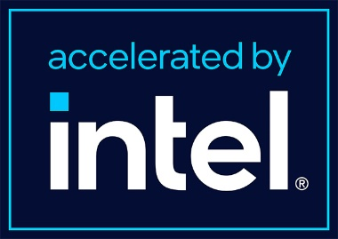
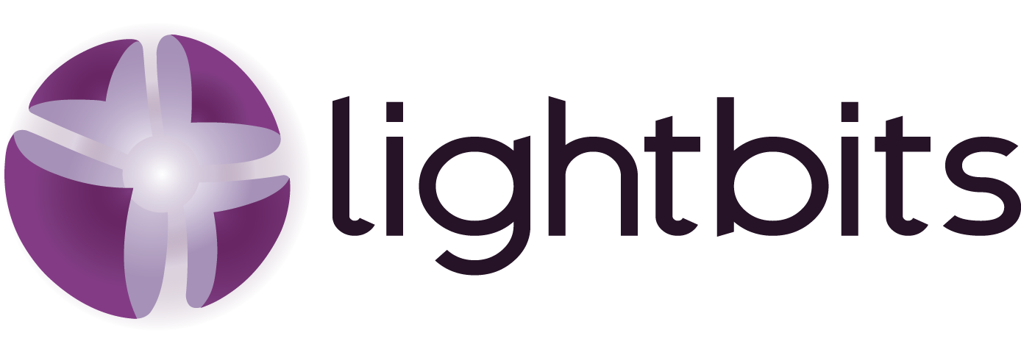
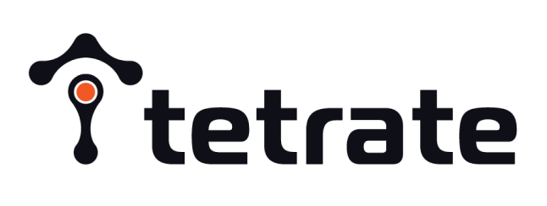
Intel Optimization Software Ecosystem
Portfolio Member
In Process
Migration
Infrastructure
Optimize
Performance & Analysis
Modernization Assessment
Infrastructure as Code
Intel Optimizations
Performance Analysis & Tuning
TBD
Intel® Cloud Optimization Modules
Hashicorp Terraform
Hashicorp Sentinel
Crossplane
ControlMonkey
Intel® Optimization Hub
Granulate gProfiler
Intel vTune Profiler
Intel® Telemetry Collector
Intel System Health Inspector** (svr_info)
cAdvisor with Intel PMU extension
Intel Platform Aware Scheduling (PAS)
Kubernetes Topology Manager
gProfiler Analyzer (optimization hub)
Workload Services Framework
Intel® Performance Hub
Greenfield / WL Assessment
Optimization & Acceleration
Xeon Processor Advisor
Flexera
Granulate
Intel AOS (formerly iWOS)
Migration Assessment
Monitoring & Analytics
FinOps & Cost Management
CloudAssist
CloudGenera
LAB3 Dr Migrate
Cloudamize
Txture
Vnomic (SAP on Azure)
Moderne
Tetrate.io
Augtera
CloudGenera
Cloudcheckr
Anodot
CloudSaver
Cloudability
OtterTune
Provisioning & Orchestration
Upbound
Ansible
Cloud Resource Optimization
Security
Densify
Intel® Cloud Insights
Nerdio
Automated Instances
Transitional Data Services
Fortanix
ControlPlane
Intel Capital
Notes:
Instance Decision -> moving to FinOps tools | Market Gap (Cost Visibility)

