Slide 1
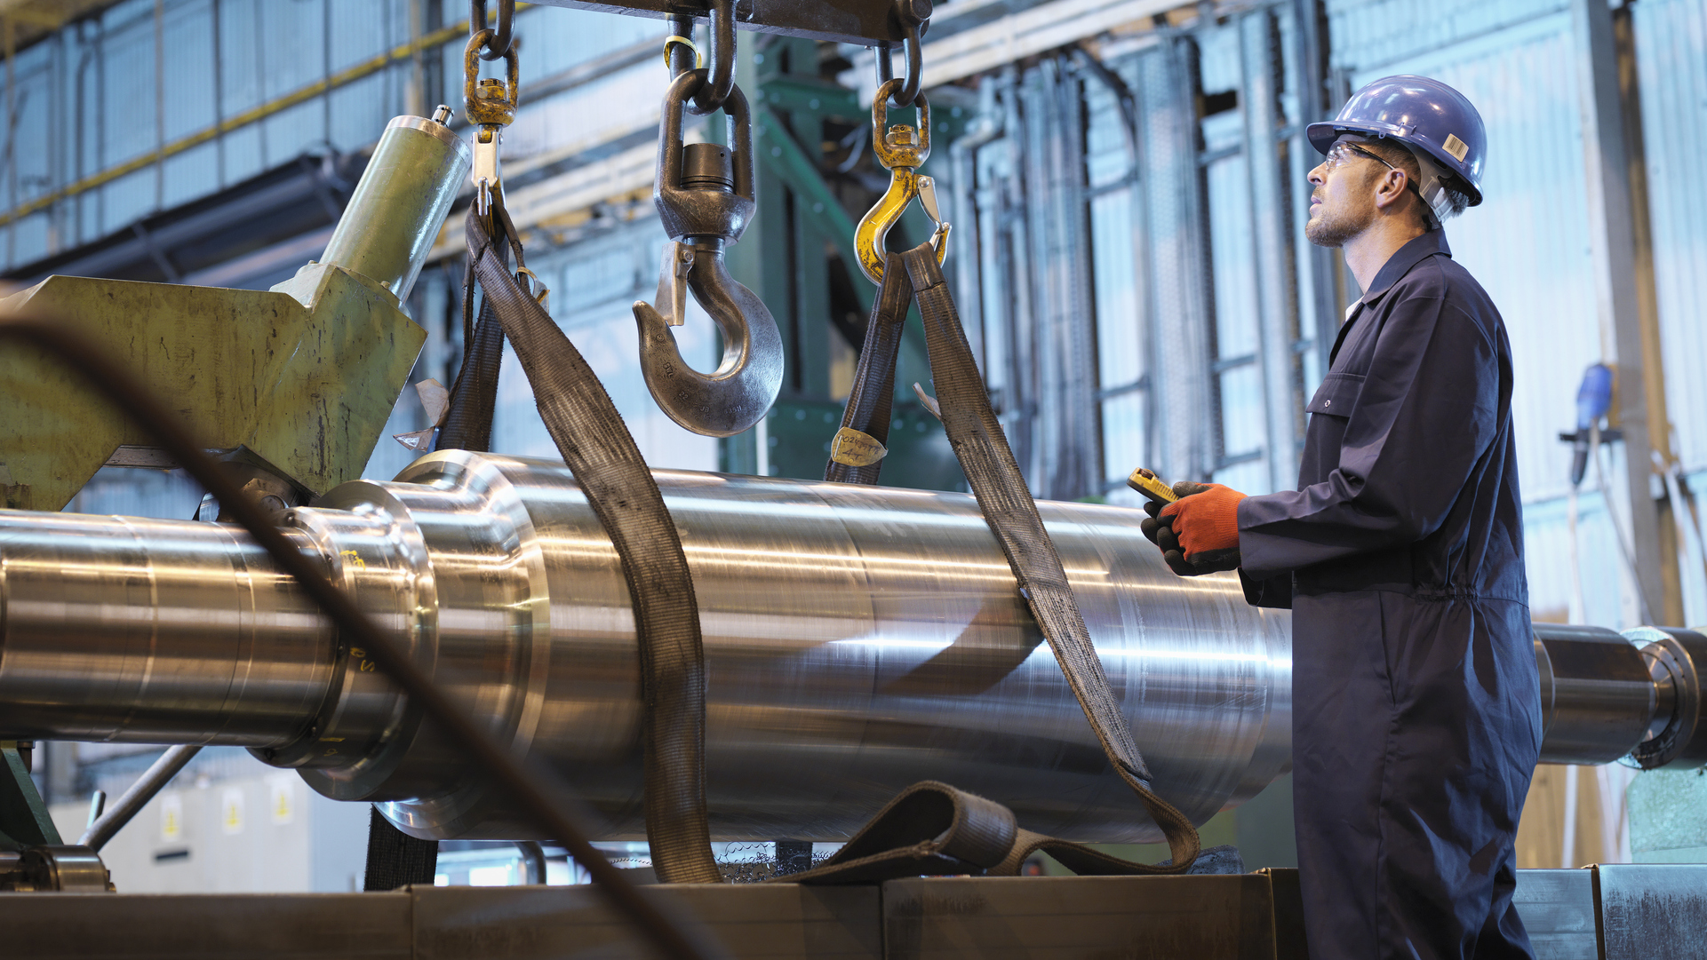
Intel® Automated Factory Solutions (Intel® AFS)
Paul Schneider, Principal Engineer, Industrial Automation
August 2023
Notes:
Hello, my name is Paul Schneider.
I am a principal engineer with Intel, working with industrial automation software.
Today I would like to introduce you to our factory automation software products from Intel automated factory solutions.

Slide 2
Notices & Disclaimers
Intel technologies may require enabled hardware, software or service activation.
No product or component can be absolutely secure.
Your costs and results may vary.
© Intel Corporation. Intel, the Intel logo, and other Intel marks are trademarks of Intel Corporation or its subsidiaries. Other names and brands may be claimed as the property of others.

Slide 3
Automating Intel’s Factories Worldwide
Serving all of Intel’s global manufacturing organizations
10 sites, 29 factories, 8 new in construction
Strategic focus: Consolidate and co-locate roles, drive to zero impact, deliver biz value & innovate factory of the future
IR/F24
OR/AFO
IS/F28
PRC/F68
AZ/F32
PRC/CDAT
NM/F11x
MY/KuAT
MY/PGAT
VN/VNAT
Fab
Assy/Test
Notes:
Intel has been working since the early 1990’s to digitally transform production and fully automate the factories.
This includes both fabrication and assembly factories located across the globe.
As we have progressed, we have been focused and strategic about driving high availability systems in order to build and innovate our factories for the future.

Slide 4
Why Is Intel Building Commercial Manufacturing Software?
For more than 50 years, Intel has continuously worked to advance the design and manufacturing of semiconductors.
We see a problem and develop a solution to address it, or develop solutions that enhance our environment and create efficiencies.
Through hundreds of discussions with multiple customers worldwide, customers continually want to know what Intel factory solutions they can deploy in their environment.
In 2020 Intel announced our emerging software strategy, where our solutions fit perfectly, providing us with a service to address the many commercial software requests.
We want to create partnerships with customers that help to enable their manufacturing environments with real benefits that directly relate to Intel’s own manufacturing.
Notes:
Why Is Intel Building Commercial Manufacturing Software?
For more than 50 years, Intel has continuously worked to advance the design and manufacturing of semiconductors. During this time, we have developed depth and breadth in software for at-scale manufacturing.
This includes seeing a problem and developing a solution to address it; and adding solutions that enhance our operation by creating efficiencies that enable the factory of the future.
For over 20 years, our Manufacturing IT group has had hundreds of discussions with multiple customers worldwide. For most of those engagements, customers want to know what Intel factory solutions they can deploy in their environment. However, we could not provide them with what they wanted as our solutions were built for internal, not commercial, sales use.
In 2020 Intel announced our emerging software strategy to generate meaningful revenue through software and services called “software-defined, silicon enhanced.” The belief being software has become in many senses the center of innovation.
Intel manufacturing has always been identified as one of the core competencies of the corporation. The fact that we have created software that enables manufacturing, fit perfectly with this new strategy.
This leads us to you today. We now have a service to address the many software requests, allowing us to provide our customers with proven solutions inspired by Intel Manufacturing’s high-tech environment.
We want to create partnerships with customers and share this solution that can help enable their manufacturing environments and show real benefits like Intel's own manufacturing experiences.

Slide 5
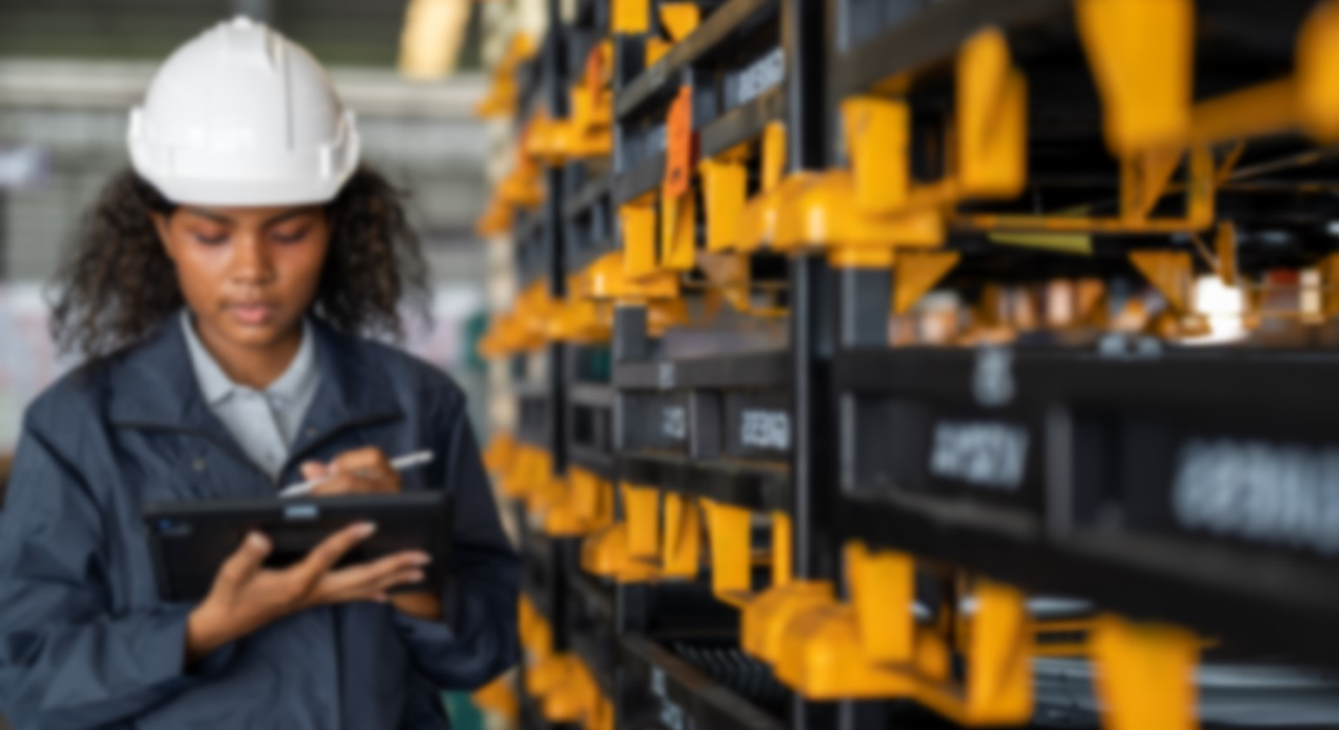
01
Intel® AFS Software Suite
Simulation, Scheduling, and Production Efficiency Digital Twins
Notes:
Now, I would like to introduce you to the Intel AFS software suite. Our software suite includes simulation, scheduling, and product efficiency digital twins.

Slide 6
Intel® AFS Software Suite
Software | Description | Main Benefit | Development Status
Intel® Factory Pathfinder | High speed discrete event simulator and digital twin for factory optimization. Use stand-alone or fully integrated with production. | Optimized TPT | Production complete, in roadmap and sustaining phase. Available: Now
Intel® Factory Recon | Full graphical digital twin of factory production equipment and automated material handling system. | OpEx Efficiency | Production complete, in roadmap and sustaining phase. Available: Now
Intel® Factory Optimizer | An AI-based control layer for Factory Pathfinder. | Optimized TPT | Product In development. Available for early beta. Available: Late 2023
Intel® Factory Adapter | (1) Automated measurement step skipping engine with decisions based on quality data allowing the factory to adapt its measurement cadence to current conditions. (2) Adapting the equipment process jobs on the fly for production functional use cases. | Reduced capital equipment Improved TPT Efficiency | Product in development. Available for early beta. Available: Early 2024
Intel® Factory Pathfinder for Enterprise | Moving Factory Pathfinder simulations into the enterprise layer to enable rapid product allocation and customer order response times. | Rapid data turns Optimized product mix | In design and prototype phase. Available: Early 2025
Notes:
Intel’s AFS Software Suite currently includes 5 applications.
The first two products, Intel Factory Pathfinder and Intel Factory Recon, have been fully developed and are already used by customers in production environments.
Factory Pathfinder is a high-speed discrete event simulator and digital twin for factory optimization.
It is a powerful tool for optimizing product throughput time through factories, used in either a fully integrated mode with the production line, or in a stand-alone mode.
Factory Recon is a graphical digital twin of a full factory environment. Both manufacturing production equipment and automated material handling systems are modeled accurately within the digital twin. Its benefits are primarily realized as operation excellence and efficiency improvements.
The next three systems are currently in development and in various stages of proof of value at customer sites.
First, Intel Factory Optimizer is an AI-based control layer for Factory Pathfinder which optimizes factory throughput time by speeding up the process using artificial intelligence projections.
The second is, Intel Factory Adapter, which has two main capabilities. The first being an intelligent automated measurement step skipping engine and the second being automatically adapting equipment process jobs on the fly for production functional use cases.
Benefits of this capability are reduced equipment capital, improved throughput time and efficiency.
Finally, Intel Factory Pathfinder for Enterprise is moving Pathfinder simulations into the enterprise layer to enable rapid product allocation and customer order response times, resulting in rapid data turns and optimized product mix.
These last three capabilities will be available soon.
Optimizer is available in late 2023, adapter in 2024, and Factory Pathfinder for Enterprise in 2025.
Each of these products will be discussed in more detail in the next few slides.

Slide 7
02
Intel® Factory Pathfinder
Offering Intel’s Key Scheduling Efficiency System to the Industry
Notes:
Now, let’s dive a little bit deeper and talk about Intel Factory Pathfinder, offering Intel's key scheduling efficiency system to the industry.

Slide 8
Intel® Factory Pathfinder – Digital Twin Simulation Use Case
Problem: Multi-factory campus Automated Material Handling System (AMHS) building link capacity is stressed ahead of expansion.
Fully integrated digital twin solution enabled large expansion cost avoidance thru optimization of capital assets.
Existing Utilization
Simulation Utilization
*** new ***
*** new ***
90%
40%
60%
39%
100%
55%
38%
29%
Simulation w/ MES and RTD integration achieves factory throughput targets, allowing for significant cost savings during expansion project
MES : Manufacturing Execution System; RTD : Real Time Dispatching; *Utilization/Capacity is measured in product moves per day.
Notes:
Intel Factory Pathfinder is a simulation-based digital twin, and in the example on this page, can run in a fully integrated mode where it utilizes real time data from MES systems to optimize material movement between factory buildings.
The output of the simulation is fed back into factory Real-Time-Dispatching systems for optimal material movement and tool queuing activity. The results of implementing this system with our first customer were significant cost savings during a campus expansion project, avoiding capital equipment purchases that were not necessary, once optimization was complete.
This application can also be used as a standalone simulation solution without real time factory system integration.

Slide 9
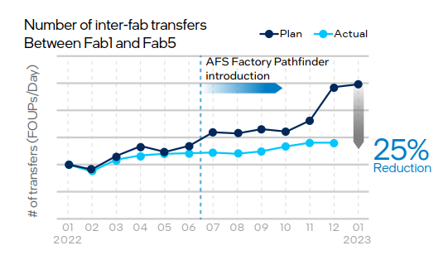
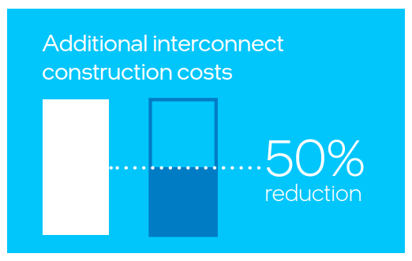
Real Results with Intel® Factory Pathfinder Newly available public data published by Sony and Intel in our digital twin whitepaper
SCK has achieved a 25% reduction in the transport traffic on the interconnects between fabs—while maintaining previous levels of manufacturing output. This strong result is directly attributable to the introduction of Intel Factory Pathfinder and the implementation of physical and logical production control capabilities made possible by the SCK-Intel team collaboration.
In addition to the capabilities and customizability of Intel Factory Pathfinder, SCK found that the simulation speed of operations was 200 times faster than the prior industry-leading solution they had been using. This was one of the decisive factors SCK considered when finalizing adoption of the Intel software.
200x Faster
By adopting Intel Factory Pathfinder, SCK reduced the cost of additional scale-out inter-fab transfer capacity by 50% compared to operations before the project.
Notes:
By integrating Intel Factory Pathfinder in their MES systems, Sony SCK has achieved a 25% reduction in the transport traffic on the interconnects between fabs while maintaining previous levels of manufacturing output.
In addition, SCK found that the simulation speed of operations was 200 times faster than the prior industry leading solution.
Finally, SCK was able to reduce the cost of additional scale-out of inter-fab transfer equipment capacity by 50%.
You can read more about the results in our published white paper “Intel and Sony Semiconductor Corporation Solutions Advance Digital Twin Technology for Manufacturing”

Slide 10
03
Intel® Factory Optimizer
Bringing AI Optimization to Intel® Factory Pathfinder
Notes:
Next, we’ll talk about Intel Factory optimizer.

Slide 11
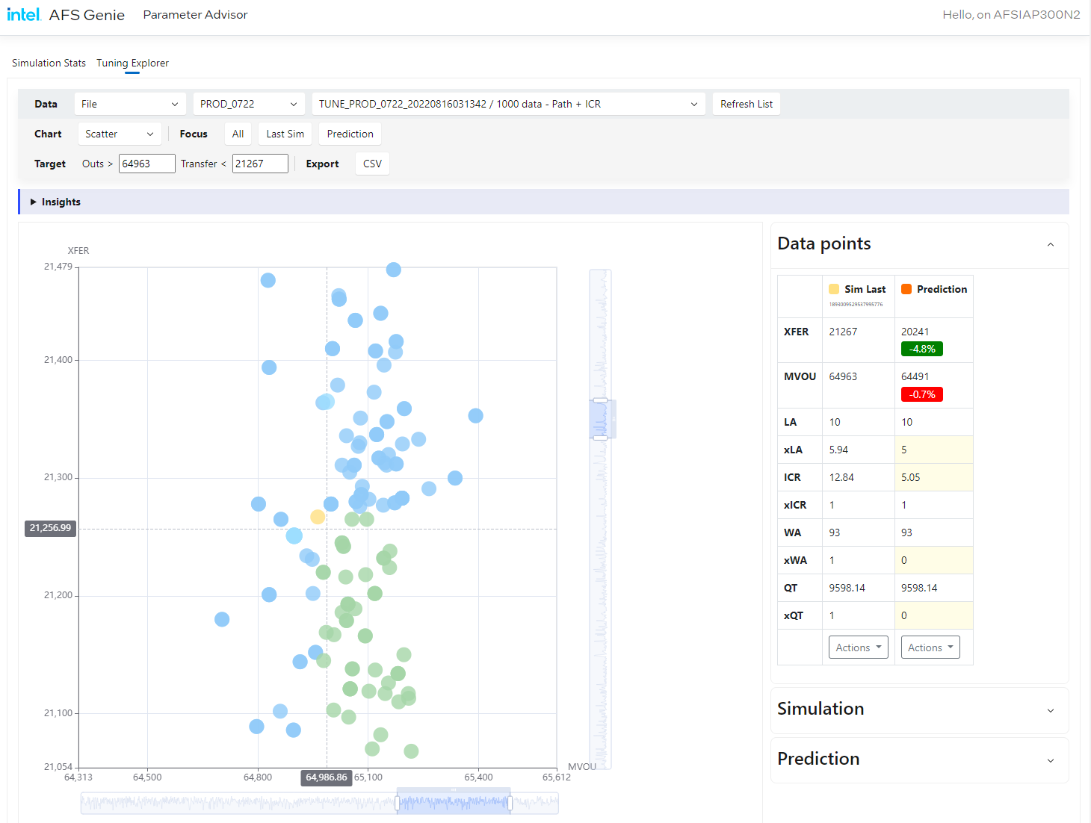
Simulation Optimization Driven by Intel® Factory Optimizer
Continuously running simulations
AI-based predictions of optimal factory scheduling config
Balance Throughput Time (TPT) and asset utilization seamlessly
Current config
Result sets better than current result
AMHS : Automated Material Handling System
Notes:
Intel Factory Optimizer integrates continuously running simulations to produce AI based predictions of optimal factory scheduling configurations that further optimizes Pathfinder simulations.
It eliminates manual trial-and-error or ad hoc work and helps with balancing factory throughput time and asset utilization seamlessly.

Slide 12
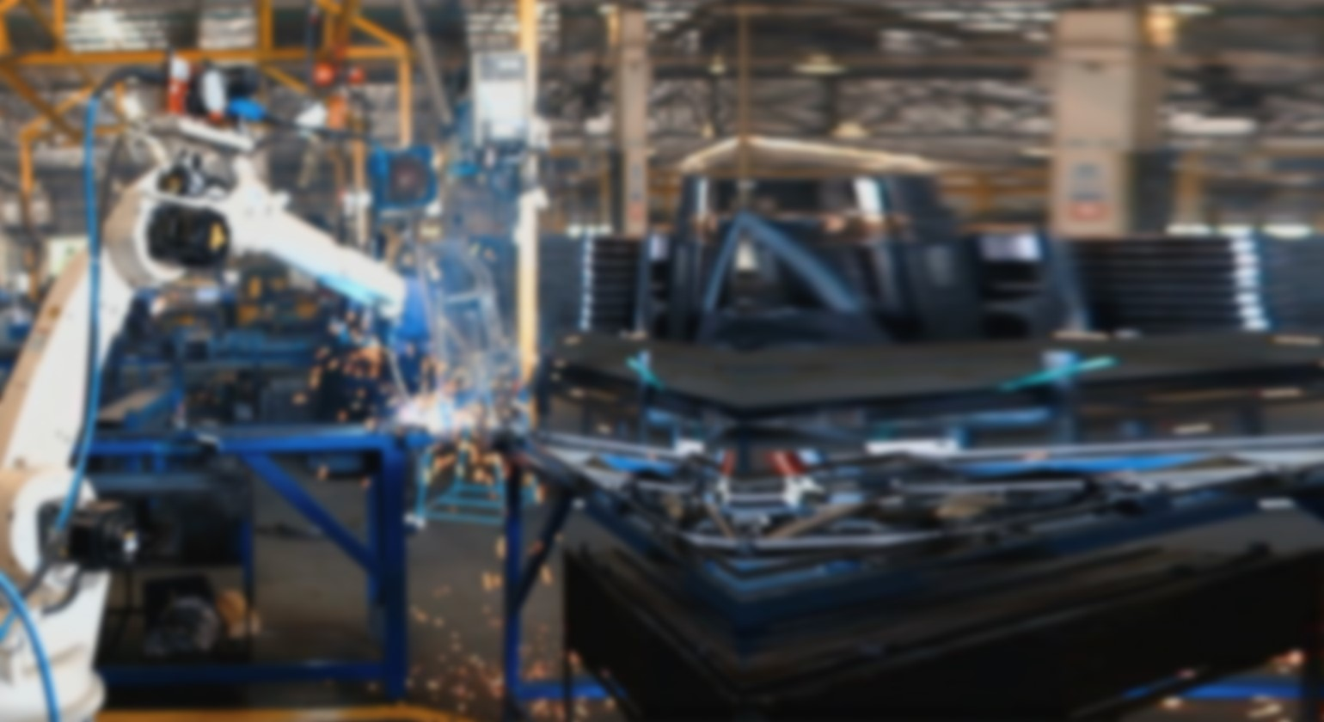
04
Intel® Factory Recon
A Breakthrough Disruptive Factory Visual Digital Twin
Notes:
Next, we'll discuss Intel Factory Recon, a breakthrough disruptive factory visual data digital twin.

Slide 13
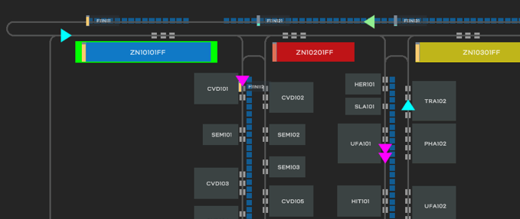
Intel® Factory Recon: Multi-Mode Graphical Digital Twin Recon is a rich visual digital twin, enabling full campus operational vision
Live Factory Mode
AMHS Equipment and Production Equipment together
Instantly visualize operational issues and harvest required data
Playback Mode
Instant playback of factory history
Rapid identification of faults
Speeds up detective work at reduced cost
Simulation Mode
Test new layout configurations
See the effect of planned maintenance
Find break points immediately
AMHS : Automated Material Handling System
Notes:
Intel Factory Recon is a rich, visual Digital twin that allows users to visualize full campus operations utilizing three modes.
In live mode, Recon provides views of automated material handling systems and production equipment together and instantly visualize operational issues and gather data to enable quick response and mitigation.
In playback Mode, Recon provides instant playback of historical factory data to rapidly identify where faults occur, and speeds up the identification of root causes, all at significantly reduced cost.
In simulation mode, Recon can test out what-if scenarios with new layout configurations or see the effect of future planned maintenance on the factory. In doing so, it can also identify break points before work even starts.

Slide 14
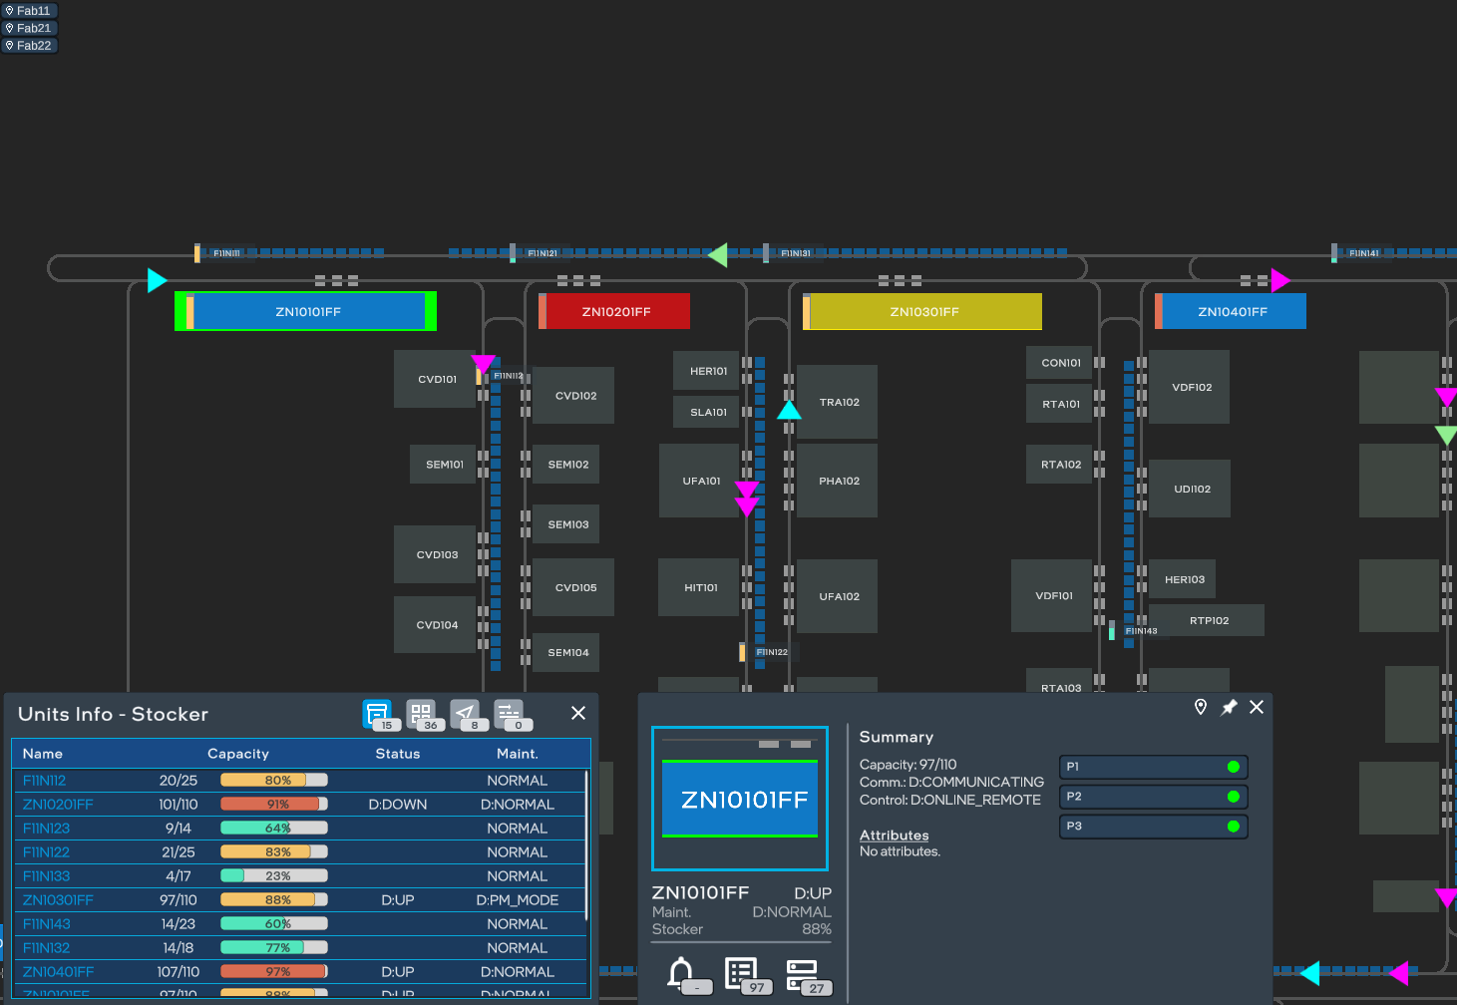
Intel® Recon UI Sample
Facility links for quick camera panning
Color changes for equipment status changes
Real-time vehicle position updates
Review basics stats of multiple selected objects
View port status
View lot details
Notes:
In the Intel Recon UI sample below, production equipment and automated material handling systems are visually displayed. Real time vehicle positions are updated on the screen automatically.
There are factory links for quick camera panning to places of interest. Colors of each of the objects change for equipment status changes.
In depth statistics of multiple selected objects including lot details, vehicle details and storage devices can be displayed at once.

Slide 15
Real Results with Intel® Recon Newly available public data published by Sony and Intel in our digital twin whitepaper
What SCK engineers said after implementing Intel Factory Recon:
By viewing what is happening on another floor on one screen, we can grasp the impact of a problem.
... the SCK implementation of Intel Factory Recon has enabled better transfer management, more efficient manufacturing, and increased overall fab efficiency. As illustrated in Figure 3, Intel Factory Recon enables more efficient mean time to repair (MTTR).
Looking back on the restoration work and clarifying the reasons for mistakes and work that took time, we can use Intel Factory Recon to provide feedback for troubleshooting.
Trouble
Restoration
Without Recon
By sharing the situation at that time with the manufacturing team, it is possible to have them understand the situation well.
With Recon
32%
We can see in playback mode how the anomaly happened and how the deadlock happened.
Improvement
Notes:
As with Pathfinder, the Intel Factory Recon application has been utilized by Sony SCK to achieve real results.
Recon has enabled better transfer management, more efficient manufacturing, and increased overall fab efficiency.
Sony’s operational excellence improvement has been dramatic. Sony has seen a 32% reduction in mean time to repair.
The SCK engineers have also shared their direct feedback:
The ability to view what is happening on the factory floor on one screen makes it easier to grasp the impact of the problem, not only for factory automation users, but for the entire manufacturing team.
Factory Recon playback mode allows SCK to see how anomalies happen and can provide feedback for troubleshooting future issues.

Slide 16
Factory Recon to Run in Intel’s Own Fabs
Intel follows due diligence when selecting solutions to use in our environment, even our own solutions.
After thorough research and testing, Intel Factory Recon won our supplier selection process. It was determined that nothing like it exists in the market.
We will be incorporating this solution into Intel’s fabs, including five major fabrication campuses around the world.
Ireland
Oregon
Dalian
Israel
Arizona
New Mexico
Chengdu
Vietnam
Costa Rica
Malaysia
Intel New Mexico
Intel Oregon
Intel Arizona
Intel Ireland
Intel Israel
Wafer Fabs
Assembly/Test
Notes:
You may think that Intel automatically incorporates our solutions in our IT Environment. However, that is not the case.
Intel follows strict due diligence when selecting any solution to use in our environment including our own.
After thorough research and testing, I am happy to say that Intel Factory Recon won our supplier selection process.
It was determined that nothing like it exists in the market and was the best fit for our needs.
We will be incorporating this solution into Intel's fabs, including five major fabrication campuses around the world.

Slide 17
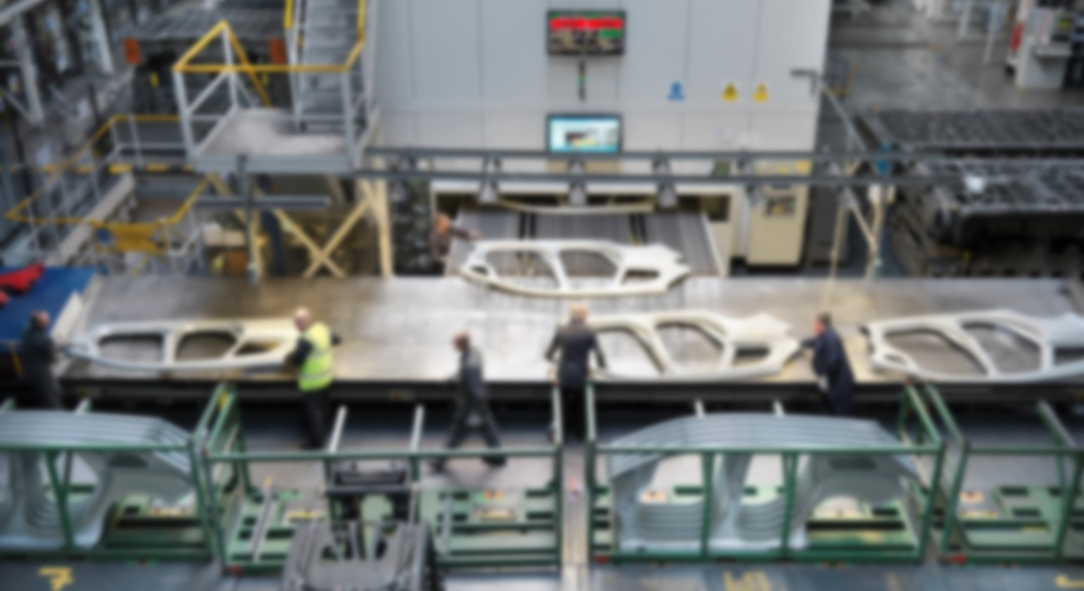
05
Intel® Factory Adapter
Intelligent Metrology Skipping and Dynamic Equipment Process Job Creation
Notes:
Next, we'll talk about Intel Factory adapter - an intelligent metrology skipping and dynamic equipment process job creation capability.

Slide 18
Intel® Factory Adapter
Intelligent Metrology Sampling
Process Job Creation
Optimize measurement equipment using lot and equipment quality data
Reduce capital for metrology equipment by 63%*
Free up factory floor space for more process equipment
Reduced throughput time by 11%*
Dynamically adapting the process to factory conditions
Increase yield by using real-time lot and equipment quality data
Automatic containment of problematic process chambers and product flows
Improve human efficiency used to manage the production process
Data Sources
Intel® Factory Adapter
MES
Manufacturing
Systems
Sample Decision
SPC
Process Job
FDC
* Based on Intel manufacturing experience and results
Notes:
Intel Factory Adapter provides 2 main features.
The first one is intelligent metrology sampling, which optimizes measurement equipment resources through intelligent sampling plans.
This frees up factory floor space for more process equipment.
Based on Intel manufacturing experience, we can reduce capital for metrology equipment by 63% and reduce throughput time 11% by using these intelligent sampling plans.
The second feature of adapter is intelligent process job creation, which dynamically adapts the process to ever-changing factory conditions by using real-time, lot and equipment quality data. Through its pervasive use, yields can be improved, problematic process chambers and product flows can automatically be contained, and it also improves the human efficiency used to manage the production process.

Slide 19
06
Intel® Factory Pathfinder for Enterprise
Accurate High Speed Supply Chain Decisions
Notes:
Intel Factory Pathfinder for Enterprise allows for accurate high speed supply chain decisions.

Slide 20
Implementation of Intel® Factory Pathfinder for Enterprise
Intel® Factory Pathfinder for Enterprise
Optimize product assignment to factories
Customer order response time reduction
Precise delivery date forecasts
Product Factory Allocation Solving
Customer Order Commit Validation
Intel® Factory Optimizer
Customer Delivery Date Predictions
Detailed and/or Aggregated Simulation Data Exchange
Intel® Factory Pathfinder
Intel® Factory Optimizer
Intel® Factory Pathfinder
Intel® Factory Optimizer
Intel® Factory Pathfinder
Intel® Factory Optimizer
Intel® Factory Pathfinder
Intel® Factory Optimizer
Optimize local factory campus output
Balance conditions in the factory to match current needs and factory configurations
Local Optimization
Local Optimization
Local Optimization
Local Optimization
Corporation Multiple Factory Campuses
Notes:
Intel Factory Pathfinder for Enterprise can be used to combine Intel Factory Pathfinder simulations from multiple factory campuses.
Data is exchanged between the local sites and the enterprise as detailed or aggregated simulation data.
It is used to optimize product assignment to factories, reduce customer order response time and precisely forecast delivery dates.
The local instances of Pathfinder at each site are used to optimize local factory campus output and balance conditions in the factory to match current needs and factory configurations.

Slide 21
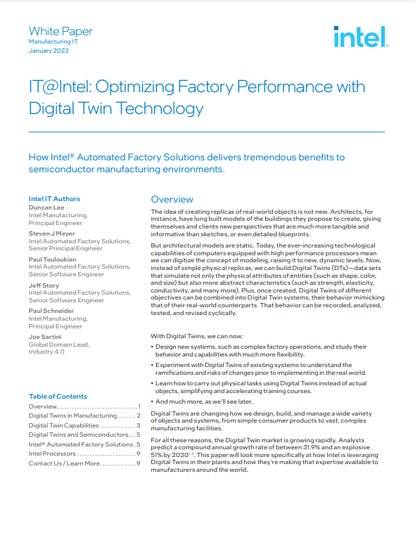
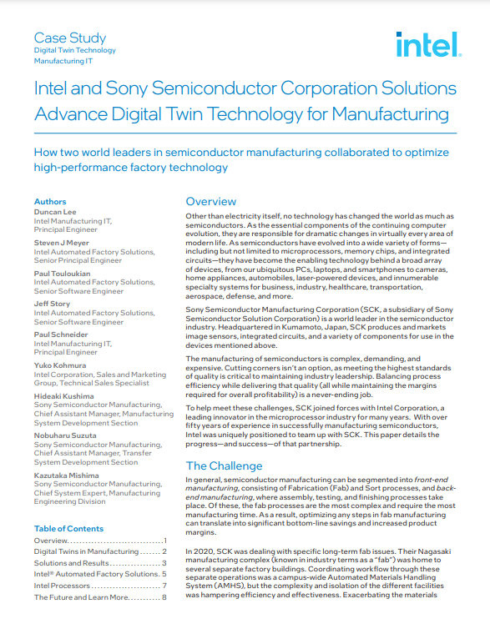
Related Content
Optimizing Factory Performance with Digital Twins
Intel and Sony Semiconductor Corporation Solutions Advance Digital Twin Technology for Manufacturing
Notes:
As mentioned earlier, we have published some papers with more information on the AFS product suite.
These are easily searchable on the Intel website using their titles:
“Optimizing Factory Performance with Digital Twins,” and “Intel and Sony Semiconductor Corporation Solutions Advance Digital Twin Technology for Manufacturing.”

Slide 22
Contact
Want to learn more? Connect with us at afs.info@intel.com
Notes:
If you would like more information on Intel AFS software, please contact your sales representative or send an email directly to the AFS team at afs.info@intel.com. We appreciate your interest in Intel AFS products.

Slide 23
Notes:
Thank you for watching and we look forward to talking with you soon.

