Slide 1

Intel® Arc™ GPU for the Edge
30-3-30

Slide 2
Intel® Arc™ GPU for the Edge
30
SECONDS
30-3-30

Slide 3
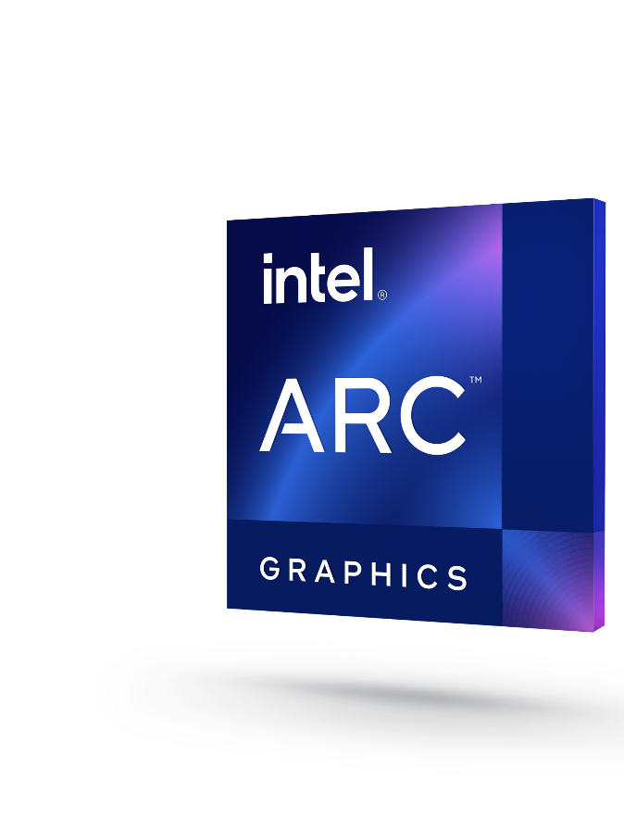






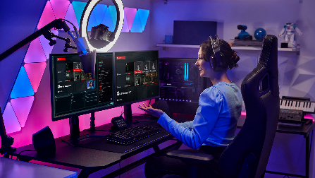
Intel® Arc™ GPU for the Edge
Purpose-built to deliver discrete GPU muscle to the Network/IOT edge that advances innovation for AI, visual computing and media processing
Long Life
Digital Signage Features
Graphics
For immersive visual experiences
Up to 5 years
product availability
Support for
Windows 10 LTSC
Genlock, Pipelock,
Bezel correction, EDID management, Combined Display & Multi-GPU Single Large Surface
AI Inferencing
Deploy advanced AI workloads at the Edge with specialized AI engines
AI
Acceleration
Embedded
Use
Conditions
With OpenVINO™ support and XMX built-in AI engine
Media Processing
Enhance video production, media transcoding and streaming
On select SKUs

Slide 4

Intel® Arc™ GPU for the Edge
3
MINUTES
30-3-30

Slide 5
Intel® Arc™ GPU for the Edge
Purpose-built to deliver discrete GPU muscle to the Network/IOT edge that advances innovation for AI, visual computing and media processing
Long Life
Digital Signage Features
Graphics
For immersive visual experiences
Up to 5 years
product availability
Support for
Windows 10 LTSC
Genlock, Pipelock,
Bezel correction, EDID management, Combined Display & Multi-GPU Single Large Surface
AI Inferencing
Deploy advanced AI workloads at the Edge with specialized AI engines
AI
Acceleration
Embedded
Use
Conditions
With OpenVINO™ support and XMX built-in AI engine
Media Processing
Enhance video production, media transcoding and streaming
On select SKUs

Slide 6
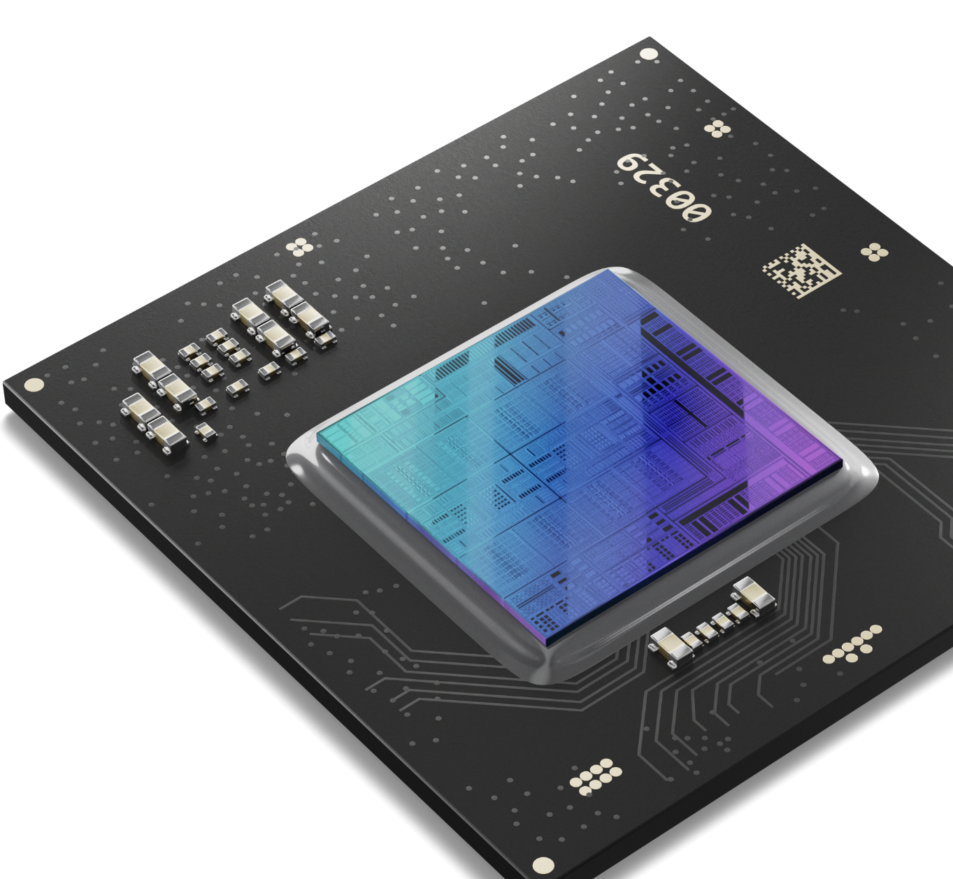



Intel® Arc™ GPU for the Edge
Revolutionize the Edge with Supercharged AI, Media and Graphics Capabilities for Demanding Workloads
7xxE
5xxE
3xxE
High performance for heavy AI workloads and complex tasks
Immersive visuals with enhanced AI inferencing capabilities
Fits low power and small form factor requirements

Slide 7

Digital Signage Software Capabilities
Create standout viewer experiences from large-scale, single-pane views across multiple screens delivering exceptional density, resolution and performance at low cost to enhance system performance and scale solution complexity. Run the powerful codecs needed to efficiently support decoding, transcoding and encoding across a broad range of media formats
Optimizations for multi-displays*
Pipelock
Genlock
EDID Management
Bezel Correction
Combined Display
Multi-GPU Single Large Surface
*Supported on Windows Client and Windows LTSC only

Slide 8
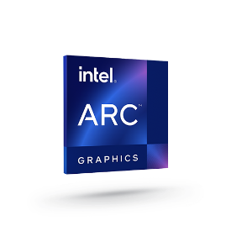


Frictionless Retail
Video Walls & Control Room Monitors
Commercial Gaming
Software stack by use case
Machine Vision and Video Analytics
Interactive Displays & Kiosks
Video Walls & Control Room Monitors
Video walls and control-room monitors
Create standout viewer experiences from large-scale, single-pane views across multiple screens delivering exceptional density, resolution and performance at low cost to enhance system performance and scale solution complexity. Run the powerful codecs needed to efficiently support decoding, transcoding and encoding across a broad range of media formats.
Intel® Arc™ GPU Feature Highlights
Genlock and pipelock synchronize video signals or graphical content among multiple output displays so they can work together in concert for a smooth viewer experience.¹
Extended Display Identification Data (EDID) management improves compatibility by communicating manufacturer data and specifications from displays to GPUs^{.1}
Bezel compensation eliminates the disruption caused in multi-display images by rendering the image as if it were “behind” the bezels.¹
Multi-GPU single large surface (SLS) unites multiple GPUs to render output together onto multiple displays, extending scalability.¹
Industry Segment: Retail, Safety & Security, Smart Communities, Manufacturing/Smart Factories
¹ Available in select SKUs

Slide 9

Frictionless Retail
Video Walls & Control Room Monitors
Commercial Gaming
Software stack by use case
Machine Vision and Video Analytics
Interactive Displays & Kiosks
Machine Vision and Video Analytics
Machine vision and video analytics
Apply AI models to drive business, improve safety and increase efficiency. Video analytics enable usages such as behavior monitoring to predict disturbances and foot traffic analysis to optimize retail displays and public spaces, as well as anomaly detection for industrial processes. Achieve efficient AI scaling to more complex workloads by utilizing Intel® Arc™ discrete GPUs alongside Intel® Core™ processors.
Intel® Arc™ GPU Feature Highlights
Long life and embedded use conditions¹ support industrial use cases.
Easily scale solution: code once and run across GPUs, CPUs and other hardware accelerators, with the open-sourced OpenVINO™ toolkit.
Advanced codecs can reduce video processing times and resource usage, for more efficient workflows.
AI and media acceleration enhance performance for lightning-fast video analytics.
Industry Segment: Retail, manufacturing, smart communities, safety & security
¹ Five-year life available on Intel Arc GPU (E SKUs only).

Slide 10

Frictionless Retail
Video Walls & Control Room Monitors
Commercial Gaming
Software stack by use case
Machine Vision and Video Analytics
Interactive Displays & Kiosks
Interactive Displays & Kiosks
Interactive displays
and kiosks
Deliver intelligent, interactive public displays with high performance and low TCO to inform and persuade, for retail, education and transportation usages. Powered by AI, analytics and edge computing, these solutions can use discrete Intel® Arc™ GPUs to augment Intel® Core™ processors to define new levels of customer engagement.
Intel® Arc™ GPU Feature Highlights
AI-driven capabilities such as facial recognition, gesture identification, augmented reality and generative conversational speech.
Powerful codecs improve media processing and transport, helping reduce TCO.
Support up to four displays, rich graphical experiences, 4K/8K video and high frame rates.
Deliver high-quality 2D/3D rendering optimized for the network edge.
Genlock and pipelock synchronize video signals or graphical content among multiple output displays so they can work together in concert for a smooth viewer experience.1
Extended Display Identification Data (EDID) management improves compatibility by communicating manufacturer data and specifications from displays to GPUs.
Industry Segment: Retail, commercial gaming, smart communities

Slide 11

Intel® Arc™ GPU for the Edge
30
MINUTES
30-3-30

Slide 12
Intel® Arc™ GPU for the Edge
Purpose-built to deliver discrete GPU muscle to the Network/IOT edge that advances innovation for AI, visual computing and media processing
Long Life
Digital Signage Features
Graphics
For immersive visual experiences
Up to 5 years
product availability
Support for
Windows 10 LTSC
Genlock, Pipelock,
Bezel correction, EDID management, Combined Display & Multi-GPU Single Large Surface
AI Inferencing
Deploy advanced AI workloads at the Edge with specialized AI engines
AI
Acceleration
Embedded
Use
Conditions
With OpenVINO™ support and XMX built-in AI engine
Media Processing
Enhance video production, media transcoding and streaming
On select SKUs

Slide 13





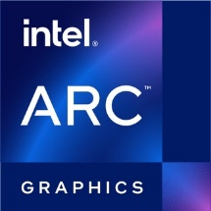


Choose the hardware that matches your AI workload
Light AI
Medium AI
Heavy AI
Efficiency for sub-100W designs
CPU AI, built-in GPU, built-in NPU
Scale up perf/W for diverse system designs
Discrete GPU & built-in CPU AI
Optimize for peak perf and density
Optimize with high-end Discrete GPU

Slide 14




Feature Highlights
Visual Compute
Edge
Features
High Performance Graphics
Xe HPG microarchitecture
Enhanced Display
4 Concurrent display with up to 8K HDR, up to HDMI 2.1, up to DP2.0,
Graphics API support
DirectX, OpenGL and Vulkan support
Long Product Life & Support
5-year Product Supply
Media Processing
Operating Systems
Linux, Windows Client, Windows LTSC
Powerful Media Engine
support for most modern codecs, high-bandwidth 8K HDR workflow execution and multi-GPU
Full AV1 Support
support for hardware accelerating encoding of
next-gen AV1 media standard
Intel® VPL
supported by FFmpeg and GStreamer - provides ease of programmatic access to the media engines
Digital Signage Software capabilities
Genlock/Pipelock, EDID Management, Bezel Compensation, Multi GPU Single Large Surface
AI Inference
CPU Host support
CPU host pairing with several generations of Intel® Core™ processors
XMX AI Engines
Built-In XMX AI to accelerate AI workloads
OpenVINO™ toolkit
Open, standards-based software stack to build high-performance applications and solutions.
Compatible with a wide variety of hardware architecture and the most popular AI frameworks including TensorFlow and PyTorch
Embedded Use Conditions*
Extended reliability and activity factor
*Available in select SKUs
Intel technologies may require enabled hardware, software or service activation. ​​​

Slide 15

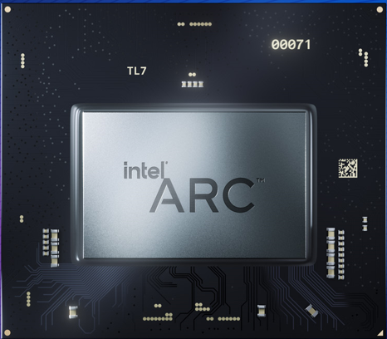




Intel® Arc™ GPU for the Edge
Revolutionize the Edge with Supercharged AI, Media and Graphics Capabilities for Demanding Workloads
6 – 28 Xe Cores
4-6 GB GDDR6
128-448 EU
16GB GDDR6
DP 2.0; eDP 1.4
x8 PCIe Gen4
HDMI 2.1¹
x16 PCIe Gen4
Xe-HPG Graphics & Media Engines
Support for Edge AI workloads
Digital Signage Features
OS Support
Supports 4 simultaneous 4K encode streams with XMX
Decode: JPEG, AVC, HEVC 8/10/12-bit 420/422/444, VP9, AV1 8/10-bit 420, MPEG-2, AVC Interlaced
Encode: JPEG, AVC, HEVC 8/10-bit 420/422/444, VP9, AV1
Low power option (25-75W) supporting up to 66 TOPS
High performance options (195W – 225W) with up to 236 INT8 TOPS²
Precisions supported: INT8,INT16, INT32, FP16, FP32
Precisions supported with XMX: INT2/4, INT8, BF16, FP16, FP32
Genlock/Pipelock
EDID Management
Bezel Compensation
Multi-GPU Single Large surface
Windows 10/11 Client
Ubuntu 22.04.3
Windows 10 LTSC
¹ – vis LSPCON
² – varies by SKU
*HDMI 2.1 includes Fixed Rale Link (FRL) mode with support up to 12Gbps.

Slide 16
Intel® Arc™ GPU for the Edge
Revolutionize the Edge with Supercharged AI, Media and Graphics Capabilities for Demanding Workloads
7xxE
5xxE
3xxE
High performance for heavy AI workloads and complex tasks
Immersive visuals with enhanced AI inferencing capabilities
Fits low power and small form factor requirements

Slide 17
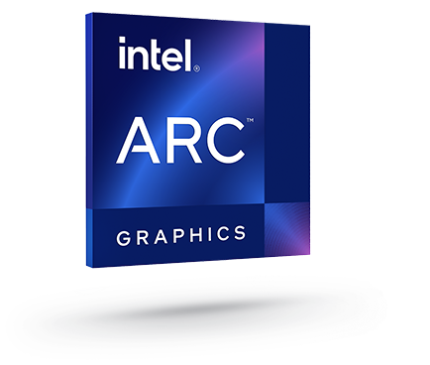
Edge SKUs
 | A310E | A350E | A370E | A380E | A580E* | A750E*
Xe-cores | 6 | 6 | 8 | 8 | 24 | 28
Execution Units | 96 | 96 | 128 | 128 | 384 | 448
Graphics Clock (MHz) | 2000 | 1150 | 1550 | 2000 | 1700 | 2050
INT8 TOPS¹ | 49 | 28 | 38 | 66 | 167 | 235
FP16 TFLOPS¹ | 24.6 | 14.1 | 25.4 | 32.8 | 83.6 | 117.6
FP32 TFLOPS¹ | 3.1 | 1.8 | 3.2 | 4.1 | 10.4 | 14.7
Memory (GDDR6) | 4GB | 4GB | 4GB | 6GB | In Planning | 16GB
Multi-Format Codec Engines | 2 | 2 | 2 | 2 | 2 | 2
Graphics Power | 75W | 25-35W | 35-50W | 75W | 185W | 225W
Use Conditions² | Embedded | Embedded | Embedded | PC Client | PC Client | PC Client
Product Availability³ | 5 years
See: https://ark.intel.com/ for more SKU details
¹ Precisions supported: INT8,INT16, INT32, FP16, FP32 | ( with XMX): INT2/4, INT8, BF16, FP16, FP32
² Embedded use conditions of up to 5 years, up to 80 percent active, PC Client use conditions of up to 5 years, up to 20 percent active.
³Intel does not commit or guarantee product Availability or Technical Support by way of roadmap guidance. Intel reserves the right to change roadmaps or discontinue products, software and software support services through standard EOL/PDN processes. Please contact your Intel account rep for additional information.
*All product plans and roadmaps are subject to change without notice and should not be viewed as an official POR or product schedule document.
.

Slide 18
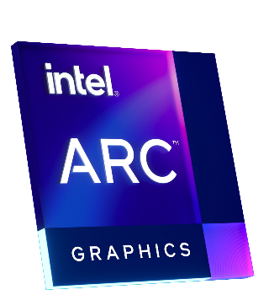
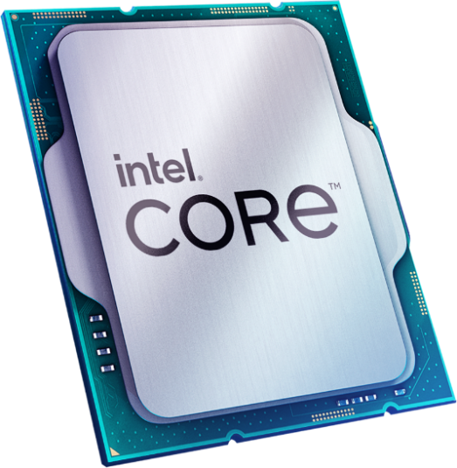
Supported Host Pairings
Built to be deployed alongside and to complement Intel® Core™ processors to enable more complex workloads, which maximizes the value of existing investments and the flexibility of implementations
Supported host processors
10th Gen Intel® Core™ Processors
11th Gen Intel® Core™ Processors
12th Gen Intel® Core™ Processors
13th Gen Intel® Core™ Processors
14th Gen Intel® Core™ Processors
Intel® Xeon® W-3400 & W-2400 Processors
Get the full Intel® platform experience when pairing select Intel® Core™ processors with Intel® Arc™ GPUs to unleash new levels of performance and efficiency
Intel® Core™ CPUs

Slide 19
Software
Open-Source SW
Intel SW
Open-Source SW Created by Intel
3rd Party Closed Source SW
Middleware Framework & Runtimes
Customer or 3rd Party App/SDK layer
TensorFlow
PyTorch
Media framework
OpenVINO™ toolkit
WinML/DirectML
Low-level Libraries & Tools
oneDNN
Intel® VPL
oneDAL
Intel® VTune™ Profiler
Drivers
Level Zero
OpenCL¹
DirectX
Open GL¹/GLES
Vulkan¹
Media UMD
KMD
OS
Linux – Ubuntu²
Windows 10/11 Client³; Windows 10 LTSC
1 Supported APIs for Intel® Graphics
2 For latest supported Linux-Ubuntu releases - Intel® Arc™ Graphics Driver - Ubuntu
3 For latest supported Windows releases - Intel® Arc™ & Iris® Xe Graphics - Windows

Slide 20


Intel® Video Processing Library* Key Features
Intel® Video Processing Library is based on an open-source, GPU reference implementation of the Intel VPL specification
It uses the open source libAVCodec project to provide proven codec compatibility with the FFmpeg open-source project
It is intended to provide limited CODEC and video processing functionality so customers can have an early preview implementation of the Intel VPL specification.
Feature | Benefit
Open specification (Intel VPL) | Openness empowers users to shape the software to their exact requirements, leading to increased value across different use cases
Video encode/decode/media format conversion GPU support for H.2641/AVC, H.265/HEVC, AV1, MJPEG encode/decode/transcode. Other device support coming soon. | Smoother playback, quicker encoding/decoding times, and lower power consumption compared to relying solely on software processing
Video processing GPU support for color conversion, resize, crop, proc-amp and sharpening. Other features and device support will be coming soon | Faster processing times for video applications, allowing more efficient multitasking and resource allocation
*Intel oneVPL will exclude GPL based H.264 encode functionality. H.264 functionality available when built from source from GitHub reference

Slide 21




OpenVINO for Intel® Arc™ GPU
OpenVINO™ toolkit can be utilized for streamlined and optimal development of code for AI inference that run across diverse platforms. This ability helps accommodate differential requirements and ensure maximum usage of hardware acceleration across GPU and CPU.
Learn more at docs.openvino.ai
Performance
Usability
Versatility
Accelerates inference, reduces footprint, and optimizes hardware utilization while maintaining accuracy, so that you can build performant and efficient AI applications
Streamlines AI development and deployment, so that you can save time and maximize productivity
Provides adaptability to different requirements and use cases, so that your application can meet current and future needs

Slide 22



















Fast, Accurate Results with High Performance
Convert and optimize models, and deploy across a mix of hardware and environments,
on-premises and on-device, in the browser or in
the cloud
1
Model
2
Optimize
Optimized Performance
CPU
GPU
FPGA
3
Deploy
Powered by oneAPI
The productive, smart path to freedom for accelerated computing from the economic and technical burdens of proprietary alternatives.
Notes:
OpenVINO, short for Open Visual Inference and Neural Network Optimization, is a powerful toolkit that accelerates AI workloads such as computer vision, generative AI, audio, speech, language, and recommendation systems. By harnessing its capabilities, you can deploy high-performing applications and algorithms in the real world, ensuring faster and more accurate results.
Designed for high-performance deep learning, OpenVINO brings real-world results to life across Intel architecture, from edge to cloud. The toolkit also simplifies the path to inferencing with a streamlined development workflow, making it easier than ever to create impactful applications.
What sets OpenVINO apart is its versatility. With a "write once, deploy anywhere" approach, developers can craft an application or algorithm and execute it across various Intel architectures, including CPU, GPU, NPU, FPGA, and the ARM CPU architecture. This flexibility empowers developers to optimize their solutions for different hardware, unlocking the full potential of their AI workloads.

Slide 23
Digital Signage Software Capabilities
Create standout viewer experiences from large-scale, single-pane views across multiple screens delivering exceptional density, resolution and performance at low cost to enhance system performance and scale solution complexity. Run the powerful codecs needed to efficiently support decoding, transcoding and encoding across a broad range of media formats
Optimizations for multi-displays*
Pipelock
Genlock
EDID Management
Bezel Correction
Combined Display
Multi-GPU Single Large Surface
*Supported on Windows Client and Windows LTSC only

Slide 24

Pipelock
Display Subsystem within a SoC
Synchronize video outputs from single SOC
to create smooth experience with 4-screen
video wall.
Common clock between multiple PHYs within
a single SoC makes video frames in each display synchronized providing better visual experience
on multiple screens
Display interfaces supported: HDMI or DP
  Same types of displays interfaces are required for a configuration.
  Example:
    4x Type-C → HDMI
    4x Type-C → DisplayPort
    2x DDI → HDMI
Supported on Windows 10 IoT Enterprise 21H2
Primary
Pipelock Example (single SOC) with a 4-Display Video-wall
PLL
Crystal
PHY1
Pipe A
VSYNC
Secondary
Ref-clk
PHY2
PLL
Pipe B
VSYNC
Secondary
PHY3
PLL
Pipe C
Secondary
Ref-clk
VSYNC
PHY4
PLL
Pipe D
Driver availability to be determined

Slide 25
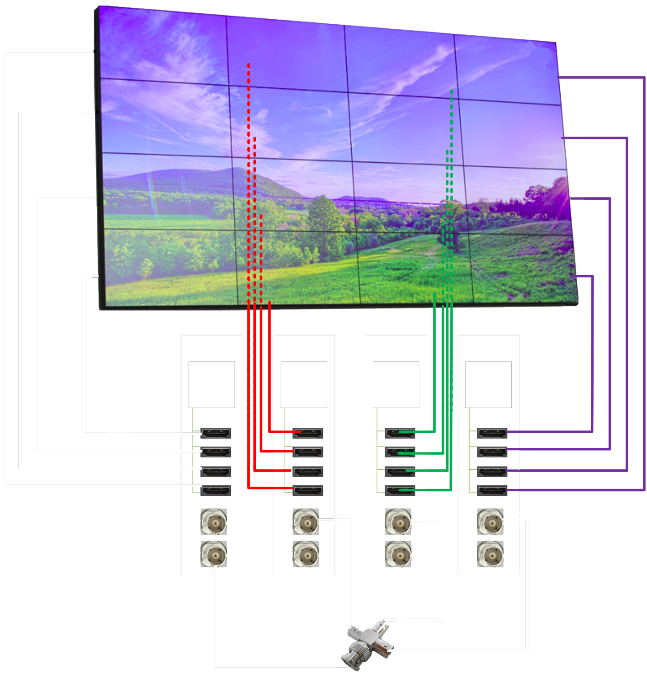
Genlock
Synchronize video outputs from multiple SOCs for a large video wall with multiple panels.
Common clock between multiple SoCs makes videos in each display synchronized to provide better visual experience.
Display interfaces supported: HDMI or DP
Same types of displays interfaces are required for a configuration. Example:
    4x Type-C → HDMI
    4x Type-C → DisplayPort
    2x DDI → HDMI
Same types of displays interfaces are required for a configuration.
Supported OS: Windows 10 IoT Enterprise 21H2
System 1
System 2
System 3
System 4
SoC
SoC
SoC
SoC
HDMI
HDMI
HDMI
HDMI
IN
OUT
IN
OUT
Secondary
Secondary
Primary
Secondary

Slide 26

EDID Management
Display 1 : App 1
Display 2 : App 2
Display 3 : App 3
Display 4 : App 4
Usages:
EDID lock out (use EDID from display but freeze it): Unplug a monitor? No problem! Your graphics card keeps it "virtually" there, so your OS doesn't reshuffle everything. Only the missing display goes dark, leaving your multi-monitor setup untouched.
Force EDID: Bypass missing display info (EDID) for devices like fiber optic extenders that block communication. Forcing EDID lets you manually provide that information, ensuring the graphics card uses the right settings even without direct communication.
Note: EDID Management feature only supports HDMI and DisplayPort interface. Type-C display is currently not supported.
Display left config
Display 1
Display 2 : App 4
Display 3 : App 4
Display 4 : App 4
Position correctly
Display 1
Display 2 : App 2
Example of value of EDID lock out feature of original configuration (top), without EDID lock out (middle) and with EDID lock out (bottom)
Display 3 : App 3
Display 4 : App 4

Slide 27
Bezel Correction
Before Bezel Correction
Two modes:
Underlap for compensating for the bezel on a display so that the bezel is a frame on a bigger screen.
Overlap for projection to do edge blending (both projectors show content in overlap region)
Enablement via API and GPU
Calibration of the underlap via Windows GUI.
After Bezel Correction

Slide 28

Other Digital Signage Features
Combined Display
Multi-GPU Single Large Surface
Share one image across multiple independent displays, regardless of the panel or monitor type.
Unites multiple GPUs to render output together onto multiple displays, extending scalability.¹
High-Definition Content Protection (HDCP)
Digital content protection to prevent copying of digital audio and video content as it travels across connections.
¹Supported on Windows Client and Windows 10 LTSC only

Slide 29



Target Workloads
Visual Compute
AI Inference
Media Processing
Simulation & Visualization
Display: Video Wall, Interactive Flat Panel, Kiosk
3D Rendering and Visualization, e.g. medical imaging
Media Analytics
Machine Vision & Visual Inference: Objection Detection & Classification
Natural Language Processing
Media processing: Encode/Transcode & Streaming; Compression
Content Creation
Video production

Slide 30


Frictionless Retail
Video Walls & Control Room Monitors
Commercial Gaming
Software stack by use case
Machine Vision and Video Analytics
Interactive Displays & Kiosks
Frictionless Retail
Typical ~20-25 cameras per 40 ft aisle in 4K-8K resolution at 15fps
3-4 neural network operations per decode
(object detection/classification, human recognition, re-identification…)
Security to protect Personal Identifiable (customer) Information
Generic representative xPU processing pipeline
Video
Ingest
Video
Decode
Object detection
Object classification
Processing to interpret activity and record sale
Backend processes
Person detection / reidentification
Action classification
Multiple IP camera streams direct to host Intel Processor NIC
Discrete GPU optionally supports acceleration of media analytics workloads
Linear activities well suited to CPU in host Intel processor

Slide 31
Frictionless Retail
Video Walls & Control Room Monitors
Commercial Gaming
Software stack by use case
Machine Vision and Video Analytics
Interactive Displays & Kiosks
Video Walls & Control Room Monitors
Video walls and control-room monitors
Create standout viewer experiences from large-scale, single-pane views across multiple screens delivering exceptional density, resolution and performance at low cost to enhance system performance and scale solution complexity. Run the powerful codecs needed to efficiently support decoding, transcoding and encoding across a broad range of media formats.
Intel® Arc™ GPU Feature Highlights
Genlock and pipelock synchronize video signals or graphical content among multiple output displays so they can work together in concert for a smooth viewer experience.¹
Extended Display Identification Data (EDID) management improves compatibility by communicating manufacturer data and specifications from displays to GPUs^{.1}
Bezel compensation eliminates the disruption caused in multi-display images by rendering the image as if it were “behind” the bezels.¹
Multi-GPU single large surface (SLS) unites multiple GPUs to render output together onto multiple displays, extending scalability.¹
Industry Segment: Retail, Safety & Security, Smart Communities, Manufacturing/Smart Factories
¹ Available in select SKUs

Slide 32



Frictionless Retail
Video Walls & Control Room Monitors
Commercial Gaming
Software stack by use case
Machine Vision and Video Analytics
Interactive Displays & Kiosks
Video Wall & Control Room Monitors
Video Wall
Controller
GFX card
Front-end Applications
High-Definition Gaming Experience with Multiple Displays Support
(16+ Displays; 2D/3D Rendering; Richer Graphics, 4K-8K Video, high frame rate)
HEVC, AVC, AV1 CODEC support
Video wall features: video frame synchronization, EDID management, Bezel Compensation, Combined Display, Multi-GPU single large surface
CPU
GFX card
Video
In
GFX card
Back-end Applications
Video ingest via HDMI, AV over IP, HDBaseT, SDI etc.
GFX card
Long life supply
Framelock
Local Storage
EDID Management
Video Ingest
Video Decode
Composition / Rendering
Single surface across multi-display or GPU
Bezel Compensation
Content Sync
Intel FPGA for capture, transfer controlled by host Intel processor
Acceleration on one or more Discrete GPU cards. Processing typically duplicated across cards with each extracting region of interest.
Specialist software features accessed via vendor API.

Slide 33





Frictionless Retail
Video Walls & Control Room Monitors
Commercial Gaming
Software stack by use case
Machine Vision and Video Analytics
Interactive Displays & Kiosks
Commercial Gaming
High-Definition Gaming Experience with Multiple Displays Support
(Up to 6 Displays; 2D/3D Rendering; Richer Graphics, 4K-8K Video, high frame rate)
$
$
$
Improve Player Experience Through AI (Facial Recognition, Gesture, AR, Speech, Payment, Redeem Wins, Cashless Transactions, Wireless Charging, etc.)
Secure Gaming
Generic representative xPU processing pipeline
Local Storage
Video Decode
Composition
Rendering
2D/3D effects
Graphics creation
Display
pipeline
Game application
Security features
Leverage CPU performance, storage and security features on host Intel processor
Discrete GPU acts as accelerator to host integrated GPU for high performance of video decode, composition/rendering with 2D/3D effects and higher numbers of display outputs.

Slide 34
Frictionless Retail
Video Walls & Control Room Monitors
Commercial Gaming
Software stack by use case
Machine Vision and Video Analytics
Interactive Displays & Kiosks
Machine Vision and Video Analytics
Machine vision and video analytics
Apply AI models to drive business, improve safety and increase efficiency. Video analytics enable usages such as behavior monitoring to predict disturbances and foot traffic analysis to optimize retail displays and public spaces, as well as anomaly detection for industrial processes. Achieve efficient AI scaling to more complex workloads by utilizing Intel® Arc™ discrete GPUs alongside Intel® Core™ processors.
Intel® Arc™ GPU Feature Highlights
Long life and embedded use conditions¹ support industrial use cases.
Easily scale solution: code once and run across GPUs, CPUs and other hardware accelerators, with the open-sourced OpenVINO™ toolkit.
Advanced codecs can reduce video processing times and resource usage, for more efficient workflows.
AI and media acceleration enhance performance for lightning-fast video analytics.
Industry Segment: Retail, manufacturing, smart communities, safety & security
¹ Five-year life available on Intel Arc GPU (E SKUs only).

Slide 35
Frictionless Retail
Video Walls & Control Room Monitors
Commercial Gaming
Software stack by use case
Machine Vision and Video Analytics
Interactive Displays & Kiosks
Interactive Displays & Kiosks
Interactive displays
and kiosks
Deliver intelligent, interactive public displays with high performance and low TCO to inform and persuade, for retail, education and transportation usages. Powered by AI, analytics and edge computing, these solutions can use discrete Intel® Arc™ GPUs to augment Intel® Core™ processors to define new levels of customer engagement.
Intel® Arc™ GPU Feature Highlights
AI-driven capabilities such as facial recognition, gesture identification, augmented reality and generative conversational speech.
Powerful codecs improve media processing and transport, helping reduce TCO.
Support up to four displays, rich graphical experiences, 4K/8K video and high frame rates.
Deliver high-quality 2D/3D rendering optimized for the network edge.
Genlock and pipelock synchronize video signals or graphical content among multiple output displays so they can work together in concert for a smooth viewer experience.1
Extended Display Identification Data (EDID) management improves compatibility by communicating manufacturer data and specifications from displays to GPUs.
Industry Segment: Retail, commercial gaming, smart communities

Slide 36



LLM processing with Intel® Arc™ GPU
Transforms Charging Station Intelligence
          DFI’s EV charging platform features an Intel® Arc™ 300 series discrete GPU dedicated to run the complex Large Language AI Model, while the Intel® Core™ processor supports multiple virtual machines.
          OpenVINO’s GPU-specific optimizations and reduced memory footprint for LLMs enabled us to run the entire Mistral-7B PyTorch-based model in less than 6GB of memory.
          By adding the Intel® Arc™ GPU to offload the complex AI tasks at the edge, we are able to support multiple AI workloads and improve LLM response time by up to 66%¹.
- Jarry Chang, Product Center General Manager, DFI, Inc.
Watch the video and learn more: www.intel.com/arc-for-edge
¹ Intel does not control or audit third-party data. You should consult other sources to evaluate accuracy
Notes:
DFI adds a discrete Intel Arc GPU to their EV charging platform to offload complex AI tasks, freeing up the CPU to support multiple virtual machines and enabling OEMs to add new revenue-generating applications from direct charging fees, integration with nearby businesses to boost sales, and targeted advertising
With OpenVINO’s GPU-specific optimizations and reduced memory footprint for LLMs, DFI is able to run the entire Mistral 7B LLM in under 6GB memory on the entry-level 300 series Intel Arc GPU, [while also improving LLM response time by up to 66% [compared to running on the CPU]*]

Slide 37
Frictionless Retail
Video Walls & Control Room Monitors
Commercial Gaming
Software stack by use case
Machine Vision and Video Analytics
Interactive Displays & Kiosks
Frictionless Retail
Commercial Gaming
Video Wall
Software stack by use case
Middleware Framework
& Runtimes
Customer or 3rd Party App/SDK layer
Customer or 3rd Party App/SDK layer
Customer or 3rd Party App/SDK layer
Tensor
Flow
PyTorch
Media framework
Media framework
Media framework
OpenVINO™ toolkit
WinML/ DirectML
Low-level Libraries & Tools
oneDNN
Intel® VPL
Intel® VPL
Intel® VPL
oneDAL
Intel® VTune™ Profiler
Intel® VTune™ Profiler
Intel® VTune™ Profiler
Drivers
Level Zero
OpenCL
Level Zero
OpenCL¹
Level Zero
OpenCL¹
Open GL¹/GLES
DirectX
Open GL¹/GLES
Vulkan¹
DirectX
Vulkan¹
Media UMD
Media UMD
Media UMD
KMD
KMD
KMD
OS
Linux²
Linux²
Linux²
Windows³
Windows³
Windows³
1 Supported APIs for Intel® Graphics
2 For latest supported Linux-Ubuntu releases - Intel® Arc™ Graphics Driver - Ubuntu
3 For latest supported Windows releases - Intel® Arc™ & Iris® Xe Graphics - Windows
Open Source SW
Intel SW
Open Source SW Created by Intel
3rd Party Closed Source SW
Notes:
OpenCL and Vulkan are specs that Khronos group creates. We (Intel) create a backend driver for them to translate their commands into instructions that our GPU can understand.

Slide 38



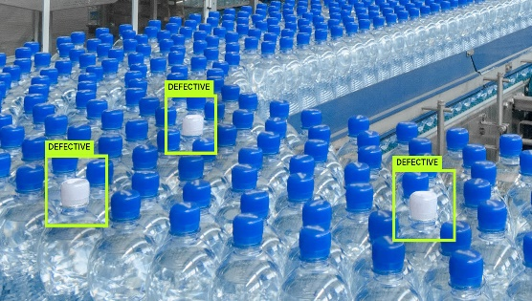
Example AI Use Cases for Intel® Arc™ GPUs
Retail
Healthcare
Smart Cities
Industrial
Frictionless Retail
Customer Traffic Analytics
Chatbots
AI-based surgical display
Portable MRI/CT/X-Ray
Endoscopy and Ultrasound
Traffic Monitoring
License Plate Detection
Safety and Security
Defect Detection
Robotic Pick and Place
Worker Safety

Slide 39








Partner Ecosystem
More coming….

Slide 40
Additional Reference
Xe-HPG Architecture

Slide 41
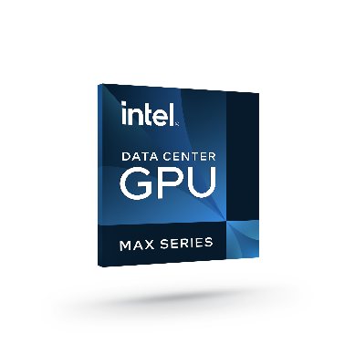


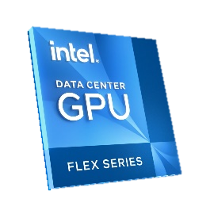
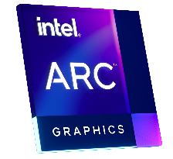

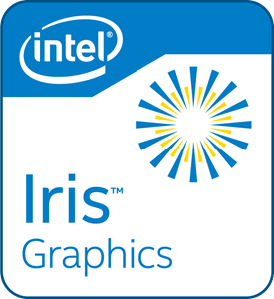
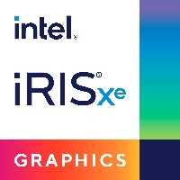

Intel GPU Architecture
NEX
Gen
9
Gen
11
Notes:
There are 3 vectors in Intel’s Xe GPU Architecture Strategy: Xe-LP for integrated graphics, branded as Iris Xe graphics; Xe-HPG for discrete GPU, branded as Intel Data Center GPU Flex Series and Intel Arc; and Xe-HPC, the highest performance GPUs for High-Performance Computing, branded as Intel Data Center GPU Max Series.
NEX adopts (only) the Xe-HPG on our roadmap.

Slide 42
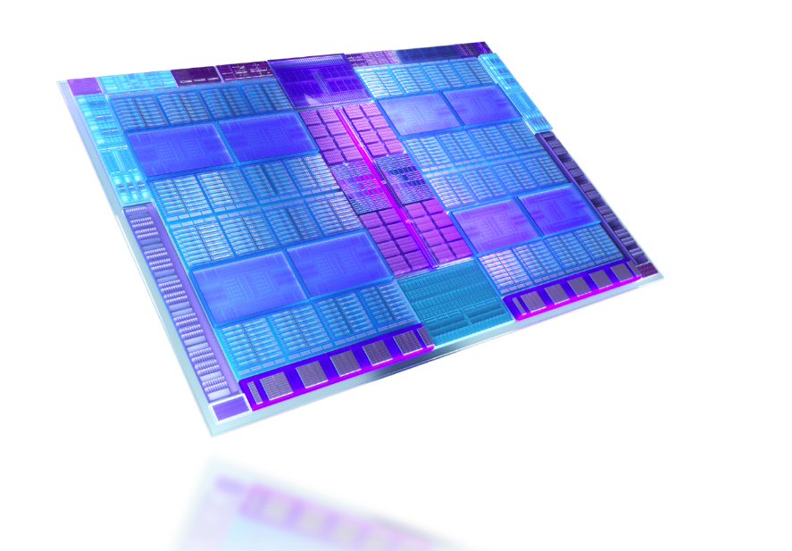
Xe-cores
Xe Media Engine
Xe Display Engine
Xe Graphics Pipeline
Notes:
Public https://www.intel.com/content/www/us/en/products/docs/discrete-gpus/arc/technology/xe-hpg-microarchitecture.html

Slide 43

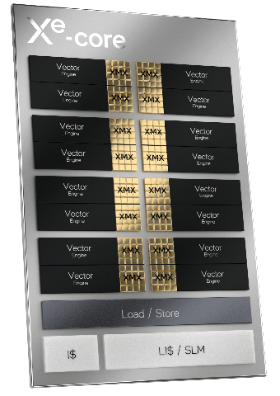
Microarchitecture Overview
Xe-core
Compute Building Block of Xe HPG-based GPUs
16
Vector Engines
16
Matrix Engines
256 bit
1024 bit
per engine
per engine

Slide 44
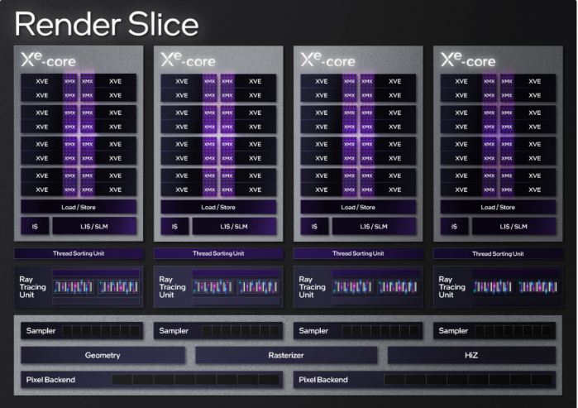
Render Slice
4 Xe-cores with XMX
4 Ray Tracing Units
Graphics Acceleration Fixed Function Pipelines
Notes:
Each Xe-core is attached to a set of dedicated graphics
acceleration fixed function pipelines with a ray-tracing unit
(RTU), a thread-sorting unit (TSU), and, of course, a sampler.
In addition, each slice contains the remainder of the fixed
function blocks that support rendering functions, including
geometry/tessellation, mesh dispatch logic, setup/raster,
depthand stencil processing, pixel dispatch logic, and pixel
backend. Xe-HPG has increased the fixed function-tocompute ratio, compared to Xe-LP, to address increasing
requirements.

Slide 45

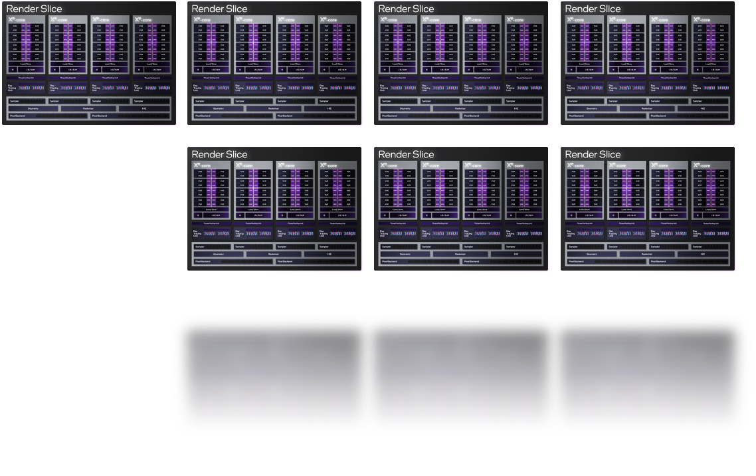
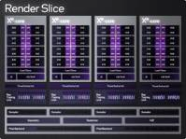
Scalable up to
8
Render Slices

Slide 46
Xe Graphics/Rendering Pipeline
Optimized
4 Ray Tracing Units
Ray Traversal
Bounding Box Intersection
Triangle Intersection
Graphics Acceleration Fixed Function Pipelines
Geometry Pipeline
Rasterization Pipeline
Samplers
Pixel Backends

Slide 47
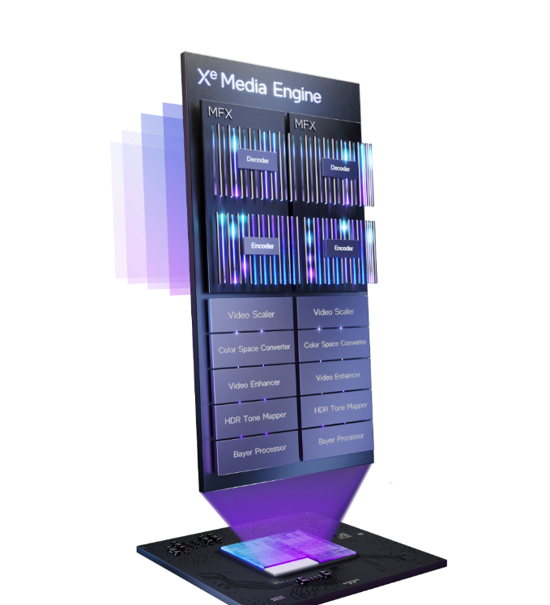


Xe Media Engine
Multi-format Codec Engine (MFX)
Scalable and Power efficient fixed function engines
Industry’s first GPU to support AV1 HW encode
Scaler & Format Converter (SFC)
Up to
8k60 12-bit HDR decode
Up to
8k 10-bit HDR
encode
Video Quality
Engine (VQE)
VP9
H.264/
AVC
H.265/
HEVC

Slide 48

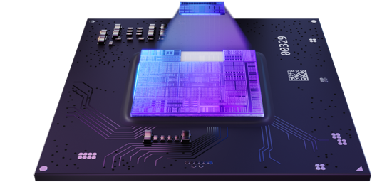
Xe Display
Engine
Display Connectivity Standards
4x Display Pipes
1x Low Power Optimized
2.1*
1.4a
2.0 10G Ready
High Resolution & Refresh Rate Support
Up to
2x 8k60
HDR
Up to
4x 4k120 HDR
Up to
1080p360
1440p360
*via LSPCON

Slide 49
Notices and Disclaimers
Intel technologies may require enabled hardware, software or service activation.
No product or component can be absolutely secure.
Your costs and results may vary.
All product plans and roadmaps are subject to change without notice and should not be viewed as an official POR or product schedule document.
Code names are used by Intel to identify products, technologies, or services that are in development and not publicly available. These are not "commercial" names and not intended to function as trademarks.
Intel ​Confidential​​​​​, ​​NDA Required​​​
Intel is committed to respecting human rights and avoiding complicity in human rights abuses. See Intel's Global Human Rights Principles. Intel's products and software are intended only to be used in applications that do not cause or contribute to a violation of an internationally recognized human right.
Warning for Voltage Offset: Applying an overvoltage can damage your GPU and lead to the reduction in the lifespan of your GPU or reduction in overall system stability.
© Intel Corporation. Intel, the Intel logo, and other Intel marks are trademarks of Intel Corporation or its subsidiaries. Other names and brands may be claimed as the property of others.

