Slide 1
Intel® Speed Shift Technology for Edge Computing
Overview
Assignment of processor performance to where it is most needed for Edge Computing applications.
RDC # 829471

Slide 2
Intel® Speed Shift Technology for Edge Computing
With each generation Intel compute platforms provide more and more overall performance – spread over several cores.
In general, processors are optimized for best general performance
There is a class of use cases that requires consistent performance
Best general performance may not always be optimal when consistent performance of a few specific applications is needed.
What does Intel® Speed Shift Technology for Edge Computing deliver?
Flexibility to make best use of performance gains for such use cases
Specific assignment of processor performance to where it is most needed.
Boost single-thread performance on a few selected cores – Higher Frequency
Consistent processor performance on the selected cores – Fixed Frequency
Core
Core
Core
Core
Core
Lower the average performance on the rest
Intel processor
For illustration only
Shift performance

Slide 3
Example Usecases for Intel® Speed Shift Technology for Edge Computing
Industrial mixed criticality use case with Real-Time (RT) workloads
Specific workloads with individual performance/priority requirements (real-time compute performance)
Real-Time workloads assigned to specific cores to provide maximum single-thread performance – consistently!
Residual performance from remaining cores available to other best-effort workloads.
Networking
Workloads on energy efficiency cores with consistent higher priority
Maintain power envelope for different usages of processor
Extend scalability with consistent performance for prioritized (critical) workloads

Slide 4
Mixed-criticality Industrial Automation use case with real-time example: Legacy platforms
LEGEND
Cores scaling up to
Turbo frequency
Constant speed
(fixed base frequency)
Traffic (congestion)
Can go fast/slow (turbo)
No traffic (congestion)
Fixed speed
Note: the number of symbols does not represent the actual number of cores in Intel‘s processors. This is just for illustration.
Client Use Case
Indu Use Case with Real-Time app
10th Gen
Intel® Core processors and before
Same frequency for all cores
Maximum determinism with real-time workloads requires all cores to be constrained to the same, fixed (base) frequency.
The full performance of the chip cannot be used for other workloads.
Notes:
On the left side you can see Client Use Case whereas on the right side an industrial use case with real-time aplication is shown.
With 10th gen and before Intel implenented a single PLL for all cores, thus, the clock frequency is the same for all cores.
In the Client use case customers typically allowed the cores to go faster and slower – turbo technology – as illustrated by these cars.
In order to achieve deterministic compute with constant frequency for industrial use case with real-time app the cores need to be fixed to run all on fixed base frequency as illustrated by the trains. Thus, they can run i na deterministic way.

Slide 5
Mixed-criticality Industrial Automation use case with real-time example: Modern Intel processors
LEGEND
Cores scaling up to
Turbo frequency
Constant speed
(fixed base frequency)
Traffic (congestion)
Can go fast/slow (turbo)
No traffic (congestion)
Fixed speed
Note: the number of symbols does not represent the actual number of cores in Intel‘s processors. This is just for illustration.
Client Use Case
Indu Use Case with Real-Time app
10th Gen
Intel® Core processors and before
Same frequency for all cores
11th Gen
Intel® Core processors and before
Selective frequency for each core*
Fixed frequency on real-time cores for maximum determinism while exploiting turbo feature on other cores to get maximum performance for best-effort workloads
* Depending on the specific processor generation the granularity of how the frequency can be selected over cores might be different. Throughout this document we only use ‘core’ to simplify the message.
Notes:
With 11th gen and beyond we have introduced hybrid architecture and PLL for each module/core. That enabled us to run only a single core at fixed frequency while allowing the others to go faster and slower based on workload need – turbo.

Slide 6
Mixed-criticality systems with modern Intel processors
LEGEND
Intel® Speed Shift Technology for Edge Computing to consistently boost the Single-Thread performance of selected cores – e.g., for Real-Time workloads – at the cost of lower max frequency with remaining cores (there is no free lunch!)
Cores scaling up to
Turbo frequency
Constant speed
(fixed base frequency)
Cores scaling up to
base frequency
High constant speed
(fixed High frequency)
Traffic (congestion)
Can go fast/slow (turbo)
No traffic (congestion)
Fixed speed
Note: the number of symbols does not represent the actual number of cores in Intel‘s processors. This is just for illustration.
Client Use Case
Indu Use Case with Real-Time app
10th Gen
Intel® Core processors and before
Same frequency for all cores
11th Gen
Intel® Core processors and before
Selective frequency for each core*
Optimized configuration for use case
Intel® Speed Shift Technology for Edge Computing
* Depending on the specific processor generation the granularity of how the frequency can be selected over cores might be different. Throughout this document we only use ‘core’ to simplify the message.
Notes:
Now we introduce speed shift for edge computin gto boost the frequency of the cores running the RT application to turbo frequency. Thus, much higher single thread performance can be achieved for the Real time applications.

Slide 7
Enabling Intel® Speed Shift Technology for Edge Computing
Global BIOS settings to enable Intel® Speed Shift Technology for Edge Computing
Configurations for each core*
set frequency limits (min/max) for Intel® Speed Shift Technology
set right priority to decide on performance vs power/energy saving
Leverage the Intel provided reliability assessment for enveloping configuration
Worry-free application of Intel® Speed Shift Technology for Edge Computing due to Intel‘s preassessment of reliability impact.
→ Detailed in Public Intel® Time Coordinated Computing (TCC) User Guide, document #831067, on RDC
* Depending on the specific processor generation the granularity of how the frequency can be selected over cores might be different. Throughout this document we only use ‘core’ to simplify the message.

Slide 8
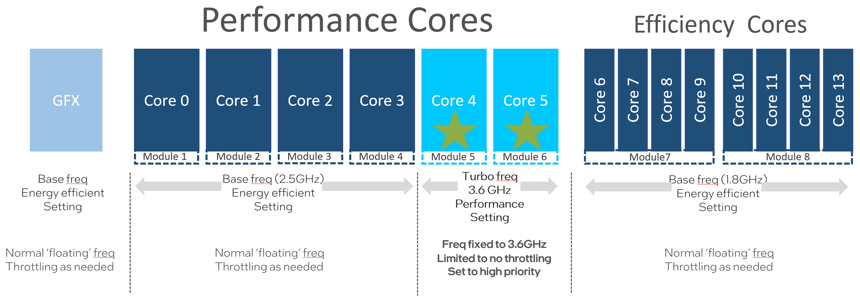
Example of Intel® Core™ Processor i7-13800HRE
Configuration used to maximize Single-Threaded real-time performance on two performance cores
Cores 4&5 running at constant higher frequency
High Single-Thread performance with high determinism for RT app
Constrain remaining p-cores, all e-cores and GPU to scale frequency only up to base frequency
Real-Time (RT) Applications
Example use case with RT requires consistent performance on cores 4&5 → Set to ‚high priority‘ to avoid throttling
* Depending on the specific processor generation the granularity of how the frequency can be selected over cores might be different. Throughout this document we only use ‘core’ to simplify the message.
Notes:
In this diagram you can see an example configuration making use of speed shift for edge.
The E-cores are runnig at max HFM 1.8GHz with frequency scaling enabled to optimize the perfromance based on wrokload need.
4 P-cores are set to 2.5GHz max frequency and only the 2 p-cores for the RT application are fixed to run at 3.6GHz – a significant boost compared to 2.5GHz.
This example configuration is also detailed in the TCC Users Guide – latest update – including reliability and junctiojn temp data.
Naturally, there is a thermal and reliability impact compared to standard industrial use case. Though ,as can be seen in our TCC User Guide the FIT rates for 10y life time only marginally increase.
We provide enveloping use case for selected SKUs and configuratiojn to enable our customers to make use of this technology.

Slide 9
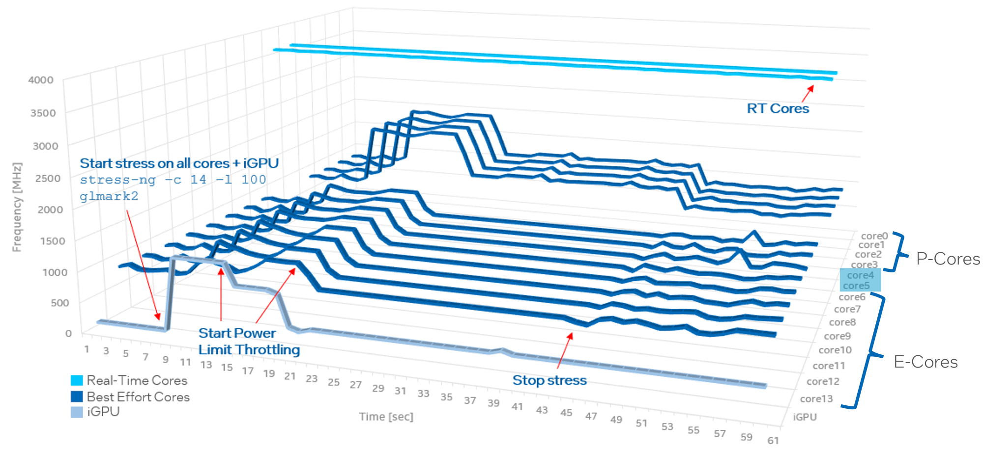
Illustration of Intel® Speed Shift Technology for Edge Computing
Frequency throttling when system overly stressed – ‘RT Cores’ keep consistent High frequency
Deterministic behavior of Core 4&5 used for Real-Time (RT) applications shown for example configuration over time
Consistent frequency/performance guaranteed with RT Cores
0s: no stress applied – Cores 4&5 running at Turbo frequency
8s: heavy stress applied - frequencies of all cores go up
12s: begin of power throttling – only Cores 4&5 do not throttle
17s: frequencies go even lower due to power throttling – Cores 4&5 remain at turbo frequency
42s: system going back to idle

Slide 10
Intel® Speed Shift Technology for Edge Computing …
delivers capabilities for advanced mixed-criticality RT designs and edge designs with prioritized single threaded applications
can be used to significantly boost single-threaded performance of specific cores (e.g. real-time applications pinned to specific cores)
enveloping configuration guidance with thermal and reliability data
Guidance currently available for 13th Generation Intel® Core™ H-Series processors
Details available in Public Intel® Time Coordinated Compute (TCC) User Guide (RDC #831067)

Slide 11
Notices & Disclaimers
Performance varies by use, configuration and other factors. Learn more on the Performance Index site.
Performance results are based on testing as of dates shown in configurations and may not reflect all publicly available updates. See backup for configuration details. No product or component can be absolutely secure.
Your costs and results may vary.
Intel technologies may require enabled hardware, software or service activation.
© Intel Corporation. Intel, the Intel logo, and other Intel marks are trademarks of Intel Corporation or its subsidiaries. Other names and brands may be claimed as the property of others.

