Slide 1
Real-time at the Edge Gold Deck (public version¹)
Q3’24 Update
Document number: 831868
Time Coordinated Computing
¹ An enhanced version of this Gold Deck with additional information regarding Intel’s Real-Time offering is available for customers under NDA at RDC #627170

Slide 2
Notices and Disclaimers
Performance varies by use, configuration and other factors. Learn more at www.Intel.com/PerformanceIndex​.
Performance results are based on testing as of dates shown in configurations and may not reflect all publicly available ​updates. See backup for configuration details. No product or component can be absolutely secure.
Your costs and results may vary.
Results have been estimated or simulated.
All product plans and roadmaps are subject to change without notice.
Statements in this document that refer to future plans or expectations are forward-looking statements. These statements are based on current expectations and invoGDV many risks and uncertainties that could cause actual results to differ materially from those expressed or implied in such statements. For more information on the factors that could cause actual results to differ materially, see our most recent earnings release and SEC filings at www.intc.com.
Intel technologies may require enabled hardware, software or service activation.
© Intel Corporation. Intel, the Intel logo, and other Intel marks are trademarks of Intel Corporation or its subsidiaries. Other names and brands may be claimed as the property of others. ​

Slide 3
Table of Contents
Market factors driving a transformation towards a SW defined world and the role real-time plays
Time Coordinated Computing
Software defined real-time usages
Intel’s solution for Time Coordinated Computing (TCC)
IEEE* Time Sensitive Networking (TSN)
NEX products supporting Time Coordinated Computing
Supplemental information
*Other names and brands may be claimed as the property of others.

Slide 4
Real-time Taxonomy, Challenges and Opportunities

Slide 5
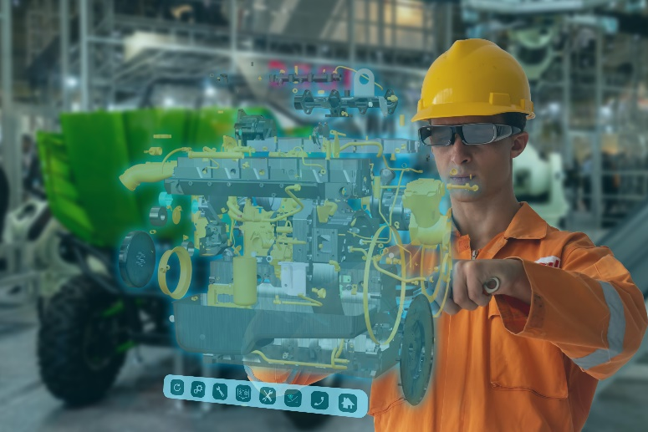
Drivers for the Industrial Transformation
Market Factors
Custom products
Green mfg
The Human Element
Changing workforce
Changing nature of human work
Security
Cyberattacks on rise
Networked enterprise systems
Disruption
Geopolitics
Pandemic
Notes:
Manufacturing industry is going thru transformation due to several factors.
Market Factors:
Increased demand for customized products & services (‘Lot Size One’)
Green manufacturing and Energy consumption (Reduce wastage)
Geopolitical appetite for manufacturing dominance
Complex ecosystems to deliver solutions (also, custom/proprietary solutions make solutions not flexible)
Human Element:
Aging Workforce & Workforce attrition in manufacturing /Human-centric automation that is user-friendly – OT people can handle technology)
Humans working alongside robots (Need for FuSa)
AR/VR and wearables change the nature of human work (to increase productivity and efficiency)
Security Risk:
Cyberattacks on the rise (everyday we see headlines on this)
Increased intelligence at the edge opens potential vulnerabilities (as we spread the compute base, the threat surface increases. So, need for Security to be foundational)
Networked enterprise systems increase complexity for security
Disruptions:
Geopolitical Tensions
Global Pandemic/Covid-19
New Technology: 3D Printing changing the dynamics of competition
Our customers are asking us to help address these challenges. Customers want us to provide solutions that will help with improving:
Reduce wastage & provide flexible operation, Improve product quality (Market Factor)
Improve worker safety & producivity (Human Element)
improve output (Security risk)
improve operational efficiency (Disruption)

Slide 6
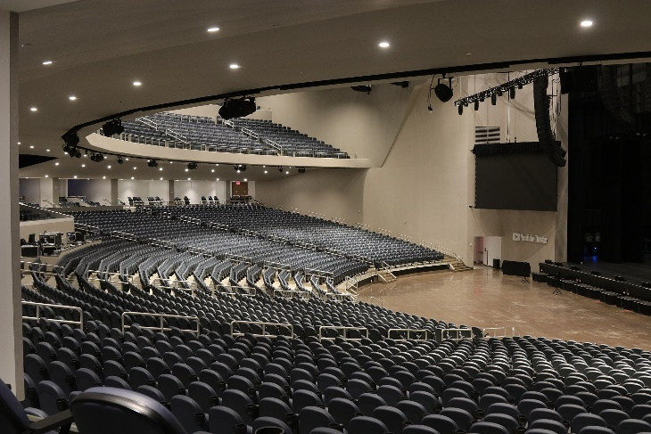
Drivers for transformation in Audio-Video (AV) Including digital signage, broadcast, and professional AV
Connectivity at scale
Venues increase in scale and complexity
Cabling cost
AV/IT convergence
Security of systems
Global disruption
Supply chain
Pandemic changes to public spaces and offices
Office space and conference rooms must be multifunction
“Broadcast” from anywhere
Flexibility and reuse of space
Live venues used for multiple diverse applications
Office space and conference rooms must be multifunction
“Broadcast” from anywhere

Slide 7
Common themes from transformation across markets
Shift to portable, software defined workloads
Shift to secure, converged networks

Slide 8
Common themes from transformation across markets
Shift to portable, software defined workloads
Shift to secure, converged networks
These trends are not new. Intel has been leading these transformations in IT and datacenter
IOT EDGE
At the EDGE, many applications are cyber-physical systems, for which precise time coordination is an essential performance requirement
“Cyber-physical systems integrate sensing, computation, control and networking into physical objects and infrastructure, connecting them to the Internet and to each other” – NSF https://www.nsf.gov/news/special_reports/cyber-physical/

Slide 9
Delivering towards a transformation happening across markets – a transformation requiring new approaches
Not “Time Performance”…but “Performance with Time”
Make use of ‘off the shelf’ SW, FW, HW
Intel Architecture is optimized for Time Coordinated Computing
Time Coordinated Computing
high
Fixed Function Solutions
(Traditional OT)
Emerging High-Performance Real-Time Solutions
(Combined OT/IT environment)
Real-time Performance
Information Technology Solutions
(Traditional IT)
“Real Time” Compute
IT/ General Compute
low
Multi-Workload
Single WL
Compute Performance
high
Security & Determinism by Isolation
Single function/purpose
Connected
Securable
Dynamically Composable
Notes:
This transformation happening in several markets requires new approaches – which I want to explain in the graph on the bottom.
Traditional OT, typical IT…but, just adding a little bit of performance to the Fixed Function Solutions or taking High-Performance compute to meet ultra low cycle times by trimming and reducing all the great features is not the way to go.
We need to achieve high performance with the right level of determinism as needed for specific use cases.
We want to make use of off the shelve SW, FW and HW. Not highly optimized specific solutions for 1 use case – not easily extendable, scalable, reusable, interoperable…

Slide 10
Software defined usages with real-time

Slide 11
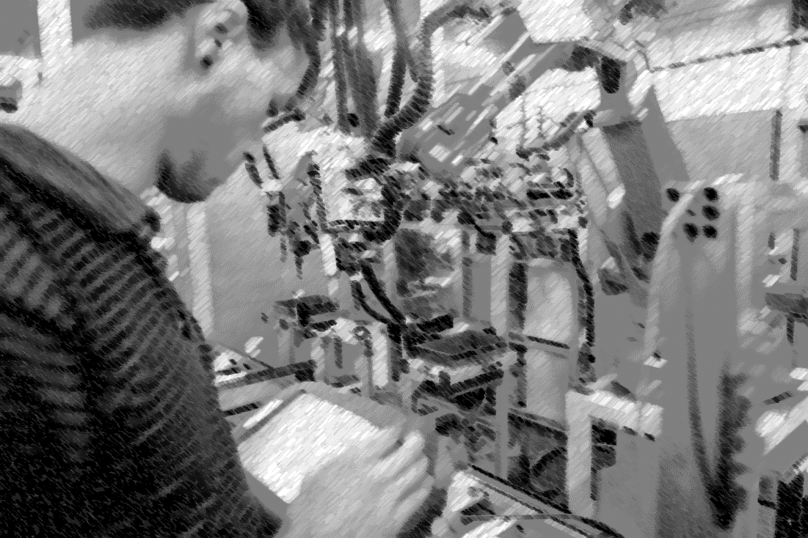
Customer Pain Points at the Industrial Edge
Lack of interoperability and portability of HW, SW, IP
Fixed function, Proprietary Devices
Inflexible, hard to upgrade systems
Factory Downtime due to HW/SW Updates
Costly, HW-based Redundancy
High learning curve for legacy systems (for example, PLCs)
Notes:
cost reduction is definitely a strong adoption driver for transformation, but the concern of downtime costs is a huge concern for factory owners
Just as an example, the downtime cost for an automotive assembly line is in the range of 4 to 5 million dollars per hour.
Even if I applied an IT level service guarantee of 99.9% availability, I’m looking at tens of millions of dollars of downtime costs per year. This is huge!
And so, we need to drive towards much higher levels of availability – 99.9999% up time.
Traditionally, this has required costly hardware-based redundancy with multiple proprietary controllers. And these controllers don’t always talk to each other using the same protocols. When the line is ready for an upgrade or reaches end of life – transferring the IP from one system to another is at best very costly, if not impossible!
One other headwind we are seeing is the shrinking skills base for legacy control systems and programming languages. More and more, data scientists, not control engineers, want to natively program in python or other higher-level languages to implement automation applications. Making these PLCs portable, containerized workloads running in a cloud-native edge environment is going to help address that challenge.

Slide 12
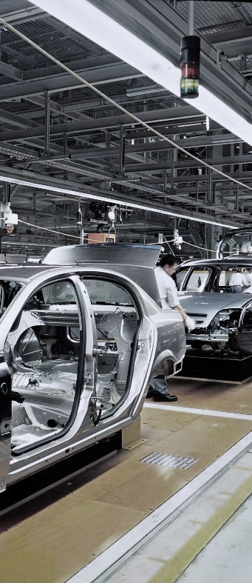
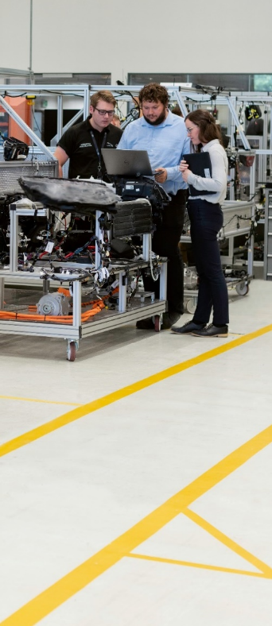
Customer Needs: Increased Flexibility, Lower Costs
Increased System Scalability
High Availability
Reduced Maintenance Costs
Portability and Agility
Data Analysis at the Edge
Dynamically provision real-time workloads (containers, VMs) from cloud to edge with infinite scalability
Software techniques to ensure zero downtime for production lines – for example, failover of PLC runtimes in case of HW or network outage
Onboarding of compute nodes with zero-touch provisioning of OS and Apps. No more USB sticks!
De-coupling software from hardware avoids vendor lock-in and lowers switching costs.
Convergence of real-time workloads with edge inference brings intelligence closer to the process resulting in faster time to insights & action
Notes:
Increased System Scalability: customers want to be able to run their workloads where it makes most sense, depending on their requirements. This could mean in the cloud for economies of scale, on the edge in an on-prem data center for data & IP security, or close to the machine for lowest latency.
High Availability: production line managers and maintenance technicians need to know that a software based version of their trusted hardware controller is not going to result in expensive downtime incidents.
Reduced Maintenance Costs: at the same time, IT managers don‘t want to spend lots of time and expense updating software or operating systems on a vast sprawl of vendor hardware.
Portability & Agility: Factory managers are looking for more agile manufacturing solutions, where they can re-arrange or re-configure the production line without having to procure or re-deploy hardware. They really look for a „software defined manufacturing“ approach to enable their future production lines.
Data analysis at the edge: business insights today are often limited to aggregated plant level data. By pulling AI and machine learning applications out of the cloud and into the edge, customers can combine their data science back end with machine level control to develop new and innovative production technqiues.

Slide 13
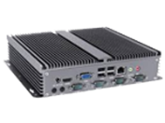
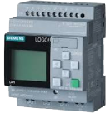
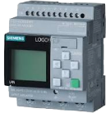
Industry Transformation to Software Defined and Autonomous Systems
VM or Microservice
GP Compute Platform
Factory Edge
Analytics
MES
Cloud
Edge Server
HMI
QMS
…
WMS
Standard Ethernet
IPC
Consolidated Factory Network
Industry 4.0
Plug & Produce
Workload Consolidation
Shop-Floor
Edge
Vision
vPLC
silos - different networks
PLC
Edge Node Worker
HMI
Motion Control
transparent – converged network
EDGE AI
…
Isolated network
Isolated network
Consolidated Field Level : TSN to share ‘Single Wire’ for all data
Device Edge
Fixed-function automation for mass production. Complex setup. Manual maintenance. Operate >20y as built, no change, extend, scale.
Specific systems with dedicated busses. Closed ecosystems. Limited access to production data
Customizable small-series production (‘lot size one’)
Interoperable and standards-based: re-configure and scale
Access to data for AI → flexible / react to specific situation
Notes:
Devices: Linear actuator, Laser Break Sensor, Motor, Conveyer Belt
MES: Manufacturing Execution System
QMS: Quality Management System
WMS: Warehouse Management System
Customer needs require an Industry transformation to SW-defined…FROM….TO…
FROM:
Fixed-function automation with processes optimized over years to achieve high volume at low cost. (automate reproducible and predictable tasks)
Production lines with solutions from various vendors - solutions that are highly optimized to realize a specific function – reliable to operate 20 years – unexpected situation → STOP
Specific systems (optimized embedded HW/SW) with separate, dedicated networks to control time-critical applications s.a. robots
Individual solutions based on proprietary HW, SW and network implementations → closed ecosystems
→ Systems are not really flexible and made for scaling
TO:
Meet upcoming end customer demands for individual solutions
Customizable small-series production (‘lot size one’) - still at low cost
Production to be easily re-configured or extended without major re-deployment effort - preferably, systems can self-configure
Interoperability between solutions from different vendors
Arbitrary access to all data needs to be given / AI in production
powerful consolidated compute to control/monitor many devices. Computations during runtime – flexible: react to specific situation
Single, scalable compute that allows to control and access hundreds of devices with a mix of best-effort traffic, and real-time or time-critical traffic
NOTE
Multiple protocols can still co-exist. Multi-middleware. Others protocols will converge - not go away

Slide 14
Real-time needs for SW-defined industrial control
Factory Edge
customizable
Factory Apps & Edge Management
scalable
Shop-Floor Edge
Platform Requirements → Determinism + High Performance
Determinism in real-time data processing (compute)
High performance with best-effort / AI workloads
General Purpose Processor (GPP) for Workload Consolidation
OS & Hypervisors → Cloud-Native Technologies
Co-existence of mixed-criticality workloads on system - isolation
Best use of compute resources for the different workloads
Real-time capable OS/Hypervisor/Container Orchestration System
Virtualized Control Applications: vPLC, Motion etc..
Standardized Industrial Communication → Converged Networking
Mixed-criticality communication at high throughput over single network
Time Sensitive Networking (TSN) with multi-middleware
Industrial Network Interface Controller (NIC) with TSN Support
Device Edge
interoperable
flexible

Slide 15
Needs to process mixed-criticality workloads
Accurate time synchronization is fundamental to manage, orchestrate and communicate mixed-criticality workloads
Different levels of isolation between real-time and best-effort workloads can be achieved
Real-time
Best-effort
Real-time
Determinism in time to meet latency and cycle time requirements of different types of workloads
Orchestration of mixed-criticality workload is complex: latency need per workload is to be balanced with available latency budget
Container Engine
Best-effort
Guest OS
Network convergence with TSN as key enabler of mixed-criticality communication on the network/connectivity side
Real-time
Best-effort
Hypervisor
OS
OS
→ Meet cycle time needs for real-time workloads
High-performance with best-effort workloads
Physical device / computer
Physical device / computer
Classic
(native)
Virtualized
Notes:
What does this mean more in detail…
Accurate time synchronization is a fundamental requirement to manage and orchestrate mixed-criticality workloads – on the compute and network.
Determinism in time
Network convergence
Different levels of isolation between RT and NRT workloads can be achieved by different means, s.a., core pinning, cache and memory QoS, selection of OS, hypervisor and TSN features on the network side.
Orchestration of mixed-criticality workload adds another level of complexity: latency need per workload needs to be balanced with available latency budget on core, over cores, over CPUs - as well as on the (TSN) network.
- Timeslicing of available latency budget
Meet cycle time needs for RT workloads
High-performance with NRT workloads

Slide 16
Intel’s real-time offering

Slide 17
Real-time System Concepts
Timeliness
Ability to produce the expected result within a defined deadline
Latency
Measure of time to complete task
Latency
Start
End
Time
Jitter
Measure of time variation to complete task
Jitter
1
Iteration
2
Time Synchronization
Ability of agents to operate together in unison by correlating independent clocks
3
End
Time
Precision
Measure of time variation coordinating tasks across multiple components
Precision
1
Iteration
2
3
Start
Time

Slide 18
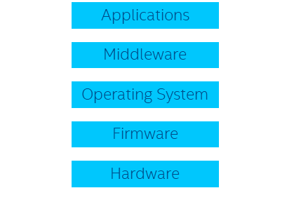
Emerging High-performance Real-time Solutions have unique Design Challenges
Performance of real-time applications is a result of system level behavior
Every element in the data path needs to be tightly synchronized
Every element must perform in a reliable and predictable manner, within a specific time window
In a SW defined environment real-time workloads exist in a mixed criticality environment
Unsynchronized clocks cause jitter and delays
The most unpredictable element determines the worst-case execution time
Resource contention introduces interference and causes jitter
Configuration & tuning needed to balance performance vectors
SOC
Lower Latency
Lower Power
Faster Compute

Slide 19
How Intel is enabling Time Coordinated Computing
1. Ecosystem engagements to support the transformations to a SW defined environment across industries.
2. Intel platform enhancements to enable workloads and workflows for the transformation

Slide 20
Intel® Time Coordinated Computing (Intel® TCC)
IT-Trusted, High-Performance Solutions
Converged Standard Networks
Intel Compute Platforms
Intel
End-point Connectivity
(Ethernet, Wi-Fi, 5G)
Intel® TCC
Real-time Optimizations
Cellular
Ethernet
Wi-Fi
Time Sensitive Networking
(TSN)
IEEE* TSN Enhancements
Time-Sync
Timeliness
*Other names and brands may be claimed as the property of others.
Notes:
Real-time optimizations on Intel platforms are known as Intel® Time Coordinated Computing, or Intel® TCC.
Intel is providing IT-trusted, high-performance solutions that are enhanced with Intel TCC.
Intel® Time Coordinated Computing (TCC) comprises of many real-time optimizations though out the hardware and software stack of Intel’s Compute platforms, enhancing time synchronizations and reducing latencies. This also includes real-time optimizations in Intel’s end point connectivity solutions including IEEE TSN enhancements to communicate efficiently with a TSN network, as defined in the open TSN standards.
Intel TCC is available on several processors and SKUs across our Intel Atom, Core and Xeon processor product lines, as well as on several of Intel’s end-point connectivity solutions.

Slide 21
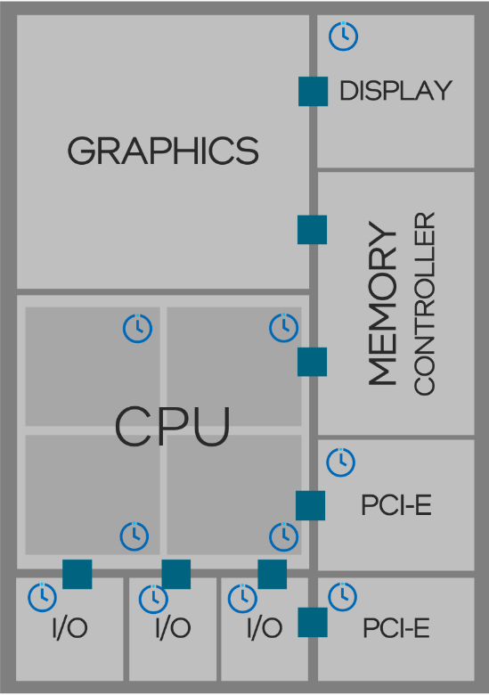
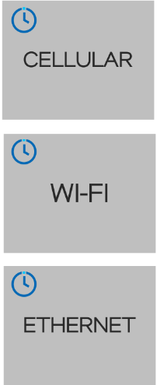
Intel Platform Enhancements Silicon Platforms Examples
Time Synchronization
Precision Time Coordination
Clocks from SOC subsystem can be more precisely correlated in software via hardware time stamping
IEEE* 1588 (PTP) support in all Intel end point connectivity solutions
IEEE* 802.1AS TSN profile of IEEE* 1588 supported in many Intel end point connectivity solutions
Time-Aware GPIO
GPIO input and output that can be precisely coordinated
in software (via Precision Time Coordination)
PCI Express* Precision Time Measurement (PTM)
*Other names and brands may be claimed as the property of others.

Slide 22
Intel Platform Enhancements Silicon Platforms Examples
Timeliness
Power State Transition Optimizations
Enable CPU to keep executing instructions while its frequency is increasing/decreasing
Memory/Cache Allocation Optimizations
Partitioning of shared caches at the way level between classes of service (L2 & L3 Cache) - Cache Allocation Technology (CAT)
Limit amount of cache available to GPU
Intel® Speed Shift Technology for Edge Compute Applications
Specific assignment of processor performance to where it is most needed
Fabric Virtual Channels
Virtual channels on Fabric available to high priority workloads.
Time Sensitive Networking
Support in all end-point connectivity solutions to take advantage of TSN features becoming common in edge networks
Interrupt Request (IRQ) Optimizations
Optimize processor microcode & other overhead in the critical path for interrupts in the CPU core
Allow devices to deliver interrupts directly to the guest OS without requiring preprocessing by the hypervisor
PCI Express* Virtual Channels
Virtual channels on PCIe available to high priority workloads.
*Other names and brands may be claimed as the property of others.

Slide 23
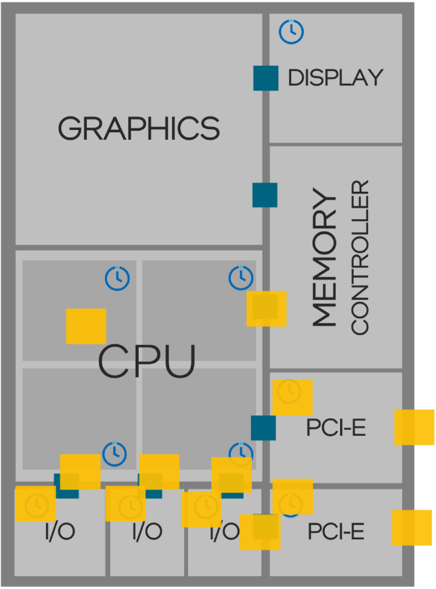
Intel Platform Enhancements BIOS/Firmware Examples
TCC BIOS options
Power states and frequency transition optimizations
Configuration of Intel® TCC features
Enable robust platform partitioning features
Limit amount of cache available to GPU
Optimize IO device utilization of Cache
Reduce number of interrupts impacting RT workloads
Prioritize processing of deterministic workloads
Set up RT Virtual Channels for VC-capable end-points
BIOS / Firmware
BIOS configuration Guidance
Intel TCC User Guide (RDC #786715)*
Model Specific Registers (MSR)
Programming of cache partitioning and Intel® Speed Shift Technology settings for Time Coordinated Compute
Silicon platforms
*A public version of the Intel TCC User guide is also available (RDC#831067)

Slide 24
Intel Platform Enhancements Operating System and Hypervisor Examples
Features enabled/available in standard Linux
Use of Linux Preempt RT
TSN drivers and user space applications
Ubuntu Real-time* available preconfigured
Enabling of 3rd party & opensource RTOS & HV solutions
OS/ Hypervisor
BIOS / Firmware
Silicon platforms
Linux Kernel configuration guidance
Intel TCC User Guide (RDC #786715)*
*A public version of the Intel TCC User guide is also available (RDC#831067)
*Other names and brands may be claimed as the property of others.

Slide 25
Intel Platform Supporting Development of Mixed Criticality Applications
Variety of mixed-criticality customer applications running on Intel’s platform deliver a SW-defined implementation:
Real-time Applications:
vPLC
PLC
Industrial Computer Vision
Motion control
AV applications
etc.
Best-effort Applications:
HMI
Data Analytics
Security
Manageability
AI
etc.
Mixed-criticality Applications

Slide 26
Application focused Reference Software Examples
Application reference code and Libraries
Reference software & libraries for implementing applications for different markets & usages including
TSN Reference Software
Real-time Compute Performance KPI application
Enabling of 3rd party SW partners
OS/ Hypervisor
BIOS / Firmware
Silicon platforms

Slide 27
Intel® Edge Controls for Industrial
Real-time Linux* Framework & Microservice-based Software for Control Consolidation
Helps to accelerate and simplify the development of control solutions.
Modular approach allows customers to take the ingredients they need
Focused on solving key customer challenges in select market segments:
Application reference code and Libraries
OS/ Hypervisor
Machine Builders
Integrated Motion Controller, Logic Control, HMI, Vision
Discrete Automation
(Automotive)
Cell Controllers, PLC
Process Automation
(Oil & Gas, Grid Substations)
DCS Controllers
Industrial Robotics
Controller & MVAI
Controller for Robots
BIOS / Firmware
Silicon platforms
For more information, visit: Intel® Edge Controls for Industrial .
*Other names and brands may be claimed as the property of others.

Slide 28
Designing a System for Mixed Criticality
Select a processor
Intel delivers real-time optimizations in the hardware & firmware for a large variety of processors & connectivity solutions supporting Intel® TCC including IEEE* TSN
Intel TCC User Guide
Install a real-time OS
(including Linux* Preempt_RT)
Intel enables software support for TCC, including IEEE* TSN support, in various operating systems & Hypervisors including upstreaming to the Linux* Mainline Kernel.
Configure your system for real-time operation
Intel provides BIOS settings as well as guidance on how to use them to achieve our published real-time KPIs
Configure your software for real-time operation
Intel provides SW settings as well as guidance on how to use them to achieve our published real-time KPIs (including in the operating system)
*Other names and brands may be claimed as the property of others.

Slide 29
Intel® Real-time Partner and Opensource Enabling Engaging with partners and the opensource community to drive ecosystem readiness
3rd Party Enabling
Application
Standards, samples, and documentation
Codesys*
Additional 3rd party SW offering via
Intel® Edge Control for Industrial
Middleware
OS
(General Purpose or RTOS)
Platform SW Recipe
with Real-time Optimizations and Standards support
VxWorks* RTOS
QNX* RTOS
RTS* Real-time Hypervisor*
Hypervisor
Ubuntu Real-time*
Firmware
Linux, ACRN, KVM, Zephyr
Hardware Platform
Processors and Network Adaptors with Intel® TCC support
RTOS = Real Time Operating System
*Other names and brands may be claimed as the property of others.

Slide 30
Intel end point solution support for base TSN specifications
Intel Endpoint Solutions
(Intel® Ethernet Controller i226 & integrated 2.5 GbE)
Intel FPGAs with TSN support
802.1Qat
Defined in
Application-level
Software
NETWORK MANAGEMENT
802.1Qcc
802.1Qdd
802.1Qdj
802.1AS
Avnu Component Certified Sep’24
Defined in
User-space
Software
& Hardware/Driver
TIME SYNC
802.1Qav
Defined in
Hardware/Driver
(NICs & SOCs) or
Field Programmable (FPGA)
LATENCY & BANDWIDTH
802.1Qbv
Avnu Component Certified Sep’24
802.1Qbu/br
= Supported
= Spec not complete, but expected to be supported
Notes:
Intel’s IOT end point solutions support all the relevant TSN Specifications. While some of the specifications require actual support in HW and driver, others are part of the Application level.

Slide 31
Intel® TCC Value Proposition
Improved performance for time-sensitive applications
Timely & reliable data processing
Better out-of-box real-time performance for deterministic workloads
Timeliness & Time-Sync
Doing more with the same system
Maximum efficiencies by aggregating real-time and best-effort applications on a single system
Timely & reliable data delivery
Support for IEEE* Time Sensitive Networking (TSN) over converged network
Timeliness & Time-Sync
Future-proofing designs
Scale between Intel Atom®, Intel® Core™ and Intel® Xeon® processors and across processor generations
*Other names and brands may be claimed as the property of others.

Slide 32
Time Sensitive Networking (TSN) Enabling Converged, Secure Networks

Slide 33
Needs for transformation across markets
Shift to portable, software defined workloads
Shift to secure, converged networks
To support the need for converged edge networks, industries are adding new network capabilities. One of the largest initiatives in this area is the field of
Time Sensitive Networking

Slide 34
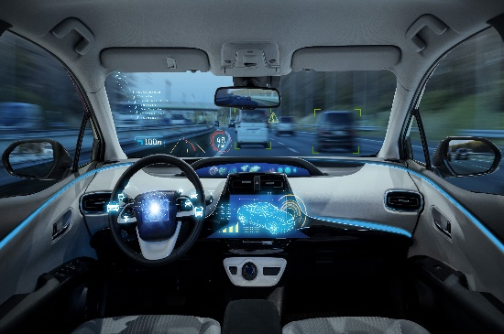
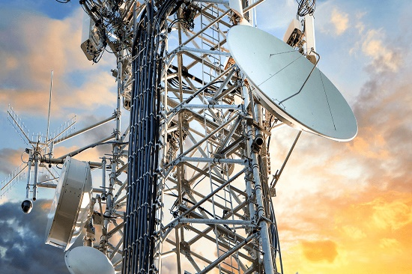
Time Sensitive Networking
PROFESSIONAL AV
AUTOMOTIVE
INDUSTRIAL
AEROSPACE
CELLULAR NETWORKS
STANDARD
EDGE
NETWORKS
Time
Synchronization
Resource
Management
Latency
Availability/
Reliability
Enhancements to standard networking enabling simpler management, coexistence of protocols and convergence of networks supporting mixed criticality workloads

Slide 35
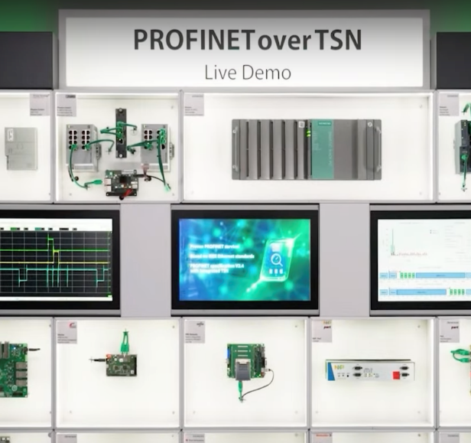
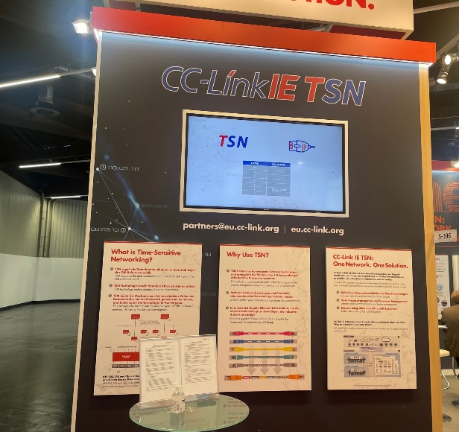
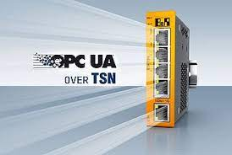
Example ecosystems building on standard TSN
MILAN*
https://www.profibus.com/technology/industrie-40/profinet-over-tsn
https://www.cc-link.org/en/cclink/cclinkie/cclinkie_tsn.html
https://opcfoundation.org/flc/
https://avnu.org/Milan/
*Other names and brands may be claimed as the property of others.

Slide 36
Key Ethernet TSN Standards
Protocol | Description
IEEE* 802.1AS | IEEE Std 802.1AS specifies the generalized Precision Time Protocol (gPTP). It provides a Layer 2 time synchronizing service
IEEE* 802.1Qav | Forwarding and Queueing Enhancements for Time-Sensitive Streams, which specifies the Credit Based Shaper
IEEE* 802.1Qbv | Enhancements for Scheduled Traffic. It specifies time aware queue draining to schedule the transmission of frames relative to a known time scale
IEEE* 802.1Qbu | Frame Preemption. It allows a Bridge Port to suspend the transmission of non-time critical frames while one or more time-critical frames are transmitted
IEEE* 802.3br | Interspersed Express Traffic (IET)
IEEE* 802.1Qat/Qcc | Stream Reservation Protocol (SRP) - Gen2 Enhancements
Intel products align to all current TSN profiles including IEC*/IEEE* profile 60802 (Profile for Industrial Automation) and 802.1BA (Professional Audio Video)
*Other names and brands may be claimed as the property of others.

Slide 37
Avnu* network component certification for TSN
Avnu Components: certified (profile-agnostic) TSN capabilities used in products (end stations, switches) across markets
Avnu* Certified Interoperable TSN-capable Components and Network Devices
Intel® Ethernet Controller i226 : First Certified endpoint device in the market!
Comp. Cert. Rel. 1: 802.1AS + 802.1Qbv (certified September 2024)
Other TSN capabilities to follow (Qbu, ….)
Avnu Certified Component Registry
Any hardware device using i226 can also list as certified and refer to the certification documentation on Avnu website
Intel will make available software configuration used for certification
Other Avnu Cert. Programs: Network devices/switches (profile-based: proAV and Automotive), wireless TSN (under development)
*Other names and brands may be claimed as the property of others.

Slide 38
More resources/information on TSN:
IEEE* TSN: https://1.ieee802.org/tsn/
Avnu* Alliance: https://avnu.org (TSN Compliance organization)
*Other names and brands may be claimed as the property of others.

Slide 39
NEX Edge products supporting Time Coordinated Computing

Slide 40
NEX offering supporting Time Coordinated Computing
Intel® Xeon® D-2800 and D-1800 processors
Intel processors with support for Time Coordinated Computing usages, the combination of real-time workloads and best effort workloads on the same system, by leveraging many silicon and SW optimizations on our products.
Intel® Xeon® D-2700 and D-1700 processors
14th Gen Intel® Core™ S-series processors
13th Gen Intel® Core™ P & S-series processors
12th Gen Intel® Core™ S-series processors
11th Gen Intel® Core™ UP3/H-series processors
Intel Atom® x7000E/x7000C/x7000RE Series processors
Intel Atom® x6000E Series processors
Ethernet controllers supporting Converge OT and IT traffic in a single IEEE Standard Network with IEEE TSN support
Intel® Ethernet Controller I225/I226
2.5GbE MAC/PHY, PCIe v3.1, gen2 x1
I225/i226-IT/LM only: TSN (802.1AS, 802.1Qbu, 802.3br, 802.1Qbv), PCIe PTM
Avnu Alliance Component Certified for compliance with the IEEE 802.1AS and IEEE 802.1Qbv
The information above is not an official POR document and may be different from other Intel divisions with similar products.
Select features, highlighted above, are not supported on all SKUs. Dates, details and information are subject to change without notice.
For the latest detailed schedule information, please refer to individual product gold decks, or contact your Intel representative.
For a complete list of all available SKUs, across current and prior product generations, please refer to the NEX Quick Reference Guide (QRG) available on rdc.intel.com.
ALL PRODUCT PLANS AND ROADMAPS ARE SUBJECT TO CHANGE WITHOUT NOTICE.
Revision Date: 6 September 2024

Slide 41
Time Coordinated Computing SKU Map*
Intel Atom® Processors
Intel Atom® x6427FE Processor
Intel Atom® x6425RE Processor
Intel Atom® x6414RE Processor
Intel Atom® x6212RE Processor
Intel Atom® x6200FE Processor
Intel Atom® x7211E Processor
Intel Atom® x7425E Processor
Intel Atom® x7213E Processor
Intel Atom® x7211RE Processor
Intel Atom® x7213RE Processor
Intel Atom® x7433RE Processor
Intel Atom® x7835RE Processor
Intel Atom® x7203C Processor
Intel Atom® x7405C Processor
Intel Atom® x7809C Processor
Intel® Xeon® W Processors **
Intel® Xeon® W-11865MRE Processor
Intel® Xeon® W-11865MLE Processor
Intel® Xeon® W-11555MRE Processor
Intel® Xeon® W-11555MLE Processor
Intel® Xeon® W-11155MRE Processor
Intel® Xeon® W-11155MLE Processor
14 Gen Intel® Core™ Processors (S-Series)
Intel® Core™ i9-14900/14900T/ 14901KE/14901E/ 14901TE Processor
Intel® Core™ i7-14700/14700T/ 14701E/ 14701TE Processor
Intel® Core™ i5-14500/14500T/ 14501E/ 14501TE Processor
Intel® Core™ i5-14400/14400T/ 14401E/ 14401TE Processor
Intel® Core™ i3-14100/14100T Processor
13 Gen Intel® Core™ Processors (U/P/H Series)
Intel® Core™ i7-1365UE/1365URE/1366URE Processor
Intel® Core™ i5-1345UE/1345URE Processor
Intel® Core™ i3-1335UE Processor
Intel® Core™ i3-1315UE/1315URE Processor
Intel® Core™ i7-1375PRE Processor
Intel® Core™ i7-1370PE/1370PRE Processor
Intel® Core™ i5-1350PE/1350PRE Processor
Intel® Core™ i3-1340PE Processor
Intel® Core™ i3-1320PE/1320PRE Processor
Intel® Core™ i7-13800HE/13800HRE Processor
Intel® Core™ i5-13600HE/13600HRE Processor
Intel® Core™ i3-13300HE/13300HRE Processor
Intel® Xeon® D Processors
Intel® Xeon® D-2752TER Processor
Intel® Xeon® D-1746TER Processor
Intel® Xeon® D-1735TR Processor
Intel® Xeon® D-1715TER Processor
Intel® Xeon® D-1712TR Processor
11 Gen Intel® Core™ Processors (UP3-Series)
Intel® Core™ i7-1185GRE Processor
Intel® Core™ i5-1145GRE Processor
Intel® Core™ i3-1115GRE Processor
Discrete Ethernet Products
Intel® I226-LM (Embedded use conditions, 2.5G TSN capable discrete ethernet)
Intel® I226-IT (Extended temp, 2.5G TSN capable discrete ethernet)
12 Gen Intel® Core™ Processors (S-Series) **
Intel® Core™ i9-12900E Processor
Intel® Core™ i7-12700E Processor
Intel® Core™ i5-12500E Processor
Intel® Core™ i3-12100E Processor
13 Gen Intel® Core™ Processors (S-Series)**
Intel® Core™ i9-13900E/13900TE Processor
Intel® Core™ i7-13700E/13700TE Processor
Intel® Core™ i5-13500E/13500TE Processor
Intel® Core™ i5-13400E Processor
Intel® Core™ i3-13100E/13100TE Processor
*Not all real-time capabilities available on every sku
** See Integrated Ethernet with TSN page for integrated etherent PCH requirements
Learn more at rdc.intel.com

Slide 42
Real-time Supplemental Details and Slides

Slide 43
Intel® Discrete Ethernet Controller i226-V/-LM /-IT
Schedule
i226 V, LM, and IT silicon are in production
Full IOTG platform support w/ 11th, 12th, and 13th Gen Intel® Core™, Intel Atom® x6000E & X700E, Intel Xeon D, and Intel Xeon W platforms
Intel® 2.5G Base-T MAC/PHY LAN
Supported on IoTG roadmap, extended availability, EMB use²
I226: V/LM Sku @ 2.5G (0-70C), IT Sku @2.5G (-40 – 85C)
Support for 10M/100M/1000M/2.5G speeds
i226 LM/IT Skus: Enhanced AVB/TSN capabilities, and PCIe PTM (Linux only)
Support for AMT/Intel ® vPro™ Technology (Q1’21 launch, Windows Only)
Why leverage i226?
Add 2.5G Ethernet, or TSN connectivity to a system w/o integrated Ethernet
Expand number of TSN capable ethernet ports beyond what is integrated into Intel® SoC
Add 2.5G LAN w/ vPro™ capability to a system
Avnu Component Certification for IEEE 802.1AS (Time synchronization) and IEEE 802.1Qbv (Enhancement for Scheduled Traffic) TSN components.
Learn more here: link
PCI Express* 3.1 Gen2 (5GT/s) x1
PCI Express*
Traffic & Queue Mgmt
SPI Flash
Q1
Q2
Q3
Q4
Rx
Tx
Rx
Tx
Rx
Tx
Rx
Tx
Rx
Tx
Rx
Tx
Rx
Tx
Rx
Tx
2.5GbE MAC
vPro / AMT
SMBus
2.5G Base-T PHY
I225 v3 / B3 stepping is supported on select IOT platforms.
² Support for embedded use / long life, For EMI CISPR requirements no supported up to 10V, see datasheet for exact details.
Intel reserves the right to change roadmaps or discontinue products, software and software support services through standard EOL/PDN processes. Please contact your Intel account rep for additional information.”
RJ-45
*Other names and brands may be claimed as the property of others.
All products, computer systems, dates and figures specified are preliminary based on current expectations and are subject to change without notice.

Slide 44
Integrated Ethernet with TSN
Key Hardware Capabilities
Intel Number of Integrated Ethernet / MAC Controllers 1 to 3x 2.5GbE port with TSN support varying by processor family 1x 1GbE port on Intel® Core™ processors
Features : IEEE 802.1: AS, Qav, Qbv, Qbu IEEE 802.3: br Various HW-based Rx Filtering Time Base Scheduling (TBS) Perf Monitors
Interfaces per Controller (see diagram to the right)
11th Gen Intel® Core™ (UP3 Series)
13th Gen Intel® Core™ (P-series)
Intel Atom® X7000 Series
TSN 01
SGMII + MDIO
PHY
Eth
01
Link (Intel Specific)
i219
Intel® Xeon® W 11000E Series paired with RM590E PCH
12th Gen Intel® Core™ (S-Series) paired with R680E PCH
13th Gen Intel® Core™ (S-series) paired with R680E PCH
TSN 01
SGMII + MDIO
PHY
TSN 02
SGMII + MDIO
PHY
Eth
01
Link (Intel Specific)
i219
Key Software Capabilities
VxWorks* Linux Yocto*, Ubuntu* Kernel Driver PREEMPT_RT kernel patches, to complement TSN Support for Standard Kernel TSN APIs Reference TSN middleware stacks OPC-UA ( Client/Server, open62541 PubSub) Linuxptp (802.1AS) OpenAvnu (802.1AS, 802.1Qav, …) Demo Application
Intel Atom® X6000 Series
SGMII/RGMII + MDIO
PHY
TSN 01
TSN 02
SGMII/RGMII + MDIO
PHY
TSN 03
SGMII + MDIO
PHY
1 - Can also be paired with discrete Ethernet TSN controller I225/i226 for more ports
*Other names and brands may be claimed as the property of others.
All products, computer systems, dates and figures specified are preliminary based on current expectations and are subject to change without notice.

Slide 45
Intel® TCC and TSN Documentation
Document | Scope | Distribution via Resource and Documentation Center | Availability
Documentation useful for both Intel® TCC and Time Sensitive Networking
User Guides | Guidance on usage of TCC on Intel platforms and options available under the TCC umbrella. | Public version of Intel TCC User Guide (RDC #831067) | Now available
Intel® Ethernet Controller I225/I226 | Document library | Doc library | Now available

Slide 46
Ethernet PHY for integrated ethernet enabling specifications
Sub-system | Item | Vendor | Part number | Interface | Intel Product Supported | Note
LAN | 10/100 Mb, 1 Gb Ethernet PHY | Marvell* | 88E1512 | SGMII, RGMII (Atom¹ only) | Atom¹, Core™², Xeon® W | RGMII supported only on 2 ports of Atom¹ SoC, all 3 ports support SGMII
LAN | 10/100 Mb, 1/2.5 Gb Ethernet PHY | Marvell* | 88E2110 | SGMII | Atom¹, Core™², Xeon® W
LAN | 10/100 Mb, 1 Gb Ethernet PHY | MaxLinear* | GPY115 | SGMII | Atom¹, Core™², Xeon® W | Industrial temperature range
LAN | 10/100 Mb, 1/2.5 Gb Ethernet PHY | MaxLinear* | GPY211 | SGMII | Atom¹, Core™², Xeon® W | Commercial temperature range
LAN | 10/100 Mb, 1/2.5 Gb Ethernet PHY | MaxLinear* | GPY215 | SGMII | Atom¹, Core™², Xeon® W | Industrial temperature range
LAN | 10/100 Mb, 1 Gb Ethernet PHY | Ti* | DP83867 | SMGII | Atom¹, Core™², Xeon® W | Industrial temperature range
LAN | 10/100 Mb, 1 Gb Ethernet connection | Intel | i219-LM | PCIe | Core™², Xeon® W | This Ethernet port does not support TSN
1 Atom = Select Intel Atom® x6000E & x7000E Processors
2 Core™ = Select 11th, 12^{th and} 13th Gen Intel® Core™ Processors
All products, computer systems, dates and figures specified are preliminary based on current expectations and are subject to change without notice.
*Other names and brands may be claimed as the property of others.

Slide 47
TSN Feature Comparison
FEATURE | DESCRIPTION | i210 | I225/i226 | Integrated 2.5GbE MAC with TSN support on select Intel Atom® and Intel® Core™ Processors
IEEE 1588-2008 V2 | Standard for a Precision Clock Synchronization Protocol for Networked measurements and Control Systems | Yes (v1 2002) | Yes | Yes
IEEE 802.1AS-REV 2011 | A specific profile of IEEE* 1588-2008. IEEE* 802.1AS specifies the generalized Precision Time Protocol (gPTP). It provides a layer 2 time synchronization service. | Yes | Yes² | Yes
IEEE 802.1Qav-2009 | Credit based shapers. | Yes | Yes² | Yes
Launch time | Per package Tx Time setting and prefetching. | Yes | Yes² | Yes
IEEE 802.1Qbv | Enhancement for Scheduled Traffic. | Yes (SW) | Yes² (HW¹) | Yes (HW)
IEEE 802.1Qbu-2016 | Frame preemption. | No | Yes² | Yes
IEEE 802.3Qbr | Interspersed express traffic. Interrupts transmission of an ordinary frame to transmit an “express” frame. | No | Yes² | Yes
1 Only one gate-open window per queue per Qbv cycle
2 On i225/i226-LM/IT only
All products, computer systems, dates and figures specified are preliminary based on current expectations and are subject to change without notice.
*Other names and brands may be claimed as the property of others.

Slide 48
Ethernet Feature Comparison
FEATURE | DESCRIPTION | i210 | i225/i226 | Integrated 2.5GbE MAC with TSN support on select Intel Atom® and Intel® Core™ Processors
Max Link speed | 100Mbs up to 2.5Gbs. | 1Gbps | 2.5Gbps | 2.5Gbps
External PHY | Ability to connect external components like different and PHYs and PHY less connection to a switch for port expansion | No | No | Yes
TX/RX queues | Number of queues to support IEEE* 802.1Q specified traffic. | 4/4 | 4/4 | 4/6 (8/8 on Intel® Atom x6000E processors)
Multiple VC/TC | Ability to map multiple priority data traffic into different queues as specified in 802.1Q to achieve QoS. | No | No | Yes
Multiple DMA channels | To achieve low latency by mapping each queue to a separate DMA channel. | No | No | Yes
Multi MSI | To achieve low latency by mapping each queue to interrupt to a separate MSI. | No | Yes² | Yes
PTM | Precision Time Measurements for PCIe interface | No | Yes² | Yes
vPRO | vPRO compatible in Windows environment | No | Yes | No¹
1 vPRO supported on select Intel® Core™ processors on separate integrated 1GbE MAC only (using Intel’s i219 PHY)
2 On i225/i226-LM/IT only
*Other names and brands may be claimed as the property of others.
All products, computer systems, dates and figures specified are preliminary based on current expectations and are subject to change without notice.

Slide 49
Document Number: 831868

