Slide 1
Unlocking the Power of Data Through Distributed Computing
September 2024
Authors:
Dennis Fallis
Savitha Gandikota
Jeff Jackson
Grant Kelly
Shawna Meyer- Ravelli
Craig Owen
Tiffany Sargent
Lokendra Uppuluri

Slide 2
Presentation Notes
Internal Use ONLY – remove before presenting
Presentation Name | Unlocking the Power of Data Through Distributed Computing
Version | 1.0
Abstract | In today's data-driven landscape, the integration of artificial intelligence (AI) and distributed computing is revolutionizing the way we process and analyze vast amounts of information. This presentation will explore the synergy between these two powerful technologies, showcasing how distributed computing can enhance AI capabilities, increase processing efficiency, and drive innovation across various industries. We delve into key topics, including: Understanding Distributed Computing: An overview of distributed systems and their role in managing large-scale data. AI Workloads and Scalability: How distributed computing frameworks, such as Apache Spark and Kubernetes, can optimize AI model training and inference. Real-World Applications: Case studies highlighting successful implementations of AI in distributed environments, from healthcare to finance. Challenges and Solutions: Addressing common hurdles in deploying distributed AI systems and strategies for overcoming them. Future Trends: Insights into emerging technologies and methodologies that will shape the future of AI and distributed computing.
Target Audience | Buyers of Cloud Services – organizations that consume cloud services public, private, or hybrid cloud. Inclusive of PaaS and SaaS consumption. Persona: IT Datacenter Manager, Cloud Solutions Architect, Infrastructure Architect, CTO, CIO, Business Units Persona: Cloud Solutions Architect, DevOps, CTO, CIO
CCV Buying Cycle Phase | Awareness of needs: Customer recognizes the need to change an existing product or solution. Salesperson should use this content to identify possible opportunities and navigate the “sweet spots” between the customer’s needs and the product or solution’s capabilities. The salesperson also needs to help the customer build urgency around addressing their needs, quantify the value that a solution would create, and overcome barriers to change.
Key Words | Cloud, Public Cloud, Private Cloud, Infrastructure, Multi-Cloud, Cloud Services, Data Center Modernization, Data Center Optimization, Enterprise AI, Artificial Intelligence, Distributed Computing
Content Categories | PRESENTATIONS – Cloud, Data Center
Classification | Customer Facing; NDA not required except when noted
Owner | Shawna Meyer-Ravelli
File Size | TBD
Posted/ Last Edited | September 2024
Shelf Life | 6 months
Legal Review | Susan Adams
Intel Confidential – Do Not Forward

Slide 3
Contents
Introduction: The era of intelligence
The business value of distributed computing
Five tenets of distributed computing
Factors to consider
Intel distributed computing solutions
Distributed computing and AI
Conclusion
Public
Notes:
Distributed computing comprises various resources across multiple locations that collect, process, store, and transmit data while providing security measures to prevent unauthorized access or manipulation. While it’s not a new paradigm, distributed computing is on the rise due to advances in artificial intelligence (AI) and the growth of data outside the data center.
This presentation provides an overview of distributed computing and Intel solutions that are helping organizations make use of data everywhere.

Slide 4
The New Era of Intelligence Is Here
Public
Notes:
Speaker notes
Since the birth of computing, data has fueled our digital world, driving it forward relentlessly. With high data availability, unprecedented processing power, and expanding computing capabilities across locations and systems, we find ourselves at the dawn of an era of endless opportunity and world-changing breakthroughs.

Slide 5

Harnessing the Power of Data Requires Intelligent Systems
These systems are built on the latest
cloud-to-edge technology architectures.
Those who can unlock the power of data will be leaders in this new era and will create meaningful impact from intelligent insights.
Public
Notes:
Speaker notes
To harness the power of data, organizations require intelligent systems built on the latest edge-to-cloud architectures, using integrated silicon, software, and system components. Such a system should enable the distribution of workloads across compute resources in different locations, from the edge to the cloud and the networks that connect them. This flexibility allows organizations to process and utilize data where and when they need it, unlocking the full potential of insights at their disposal.

Slide 6

The Intelligence Era Is Driving the Rise
of Distributed Computing
What is distributed computing?
Distributed computing is an interconnected and interdependent system of compute resources built on edge-to-cloud architectures using integrated silicon, software, and system components.
Why is it important?
It gives you the freedom to choose where you compute.
Public
Notes:
Speaker notes
Modern computing needs are driving the rise of distributed computing.
Distributed computing is an interconnected and interdependent system of compute resources built on edge-to-cloud architectures using integrated silicon, software, and system components.
While it’s not a new paradigm, distributed computing is on the rise due to advances in AI and the growth of data outside the data center.
That’s because distributed computing provides the flexibility to run inferencing on AI models at the most optimal location, often the edge, while also supporting the large datasets used in AI training to develop and optimize those models.
Organizations now have the unprecedented freedom to convert data into useful information where it’s most advantageous for the end user, all while enhancing cost efficiency, improving performance, and expanding network capacity.

Slide 7






Distributed Computing Supports Multiple Compute Paradigms
Decentralized
computing
Grid computing
Cloud computing
Parallel
computing
Cluster computing
Edge computing
Workloads: AI inferencing (edge), AI training (cloud), data storage, data compression/encryption (encode/decode), network functions, graphics and visualization, and user applications
Public
Notes:
Speaker notes
Distributed computing supports multiple computing paradigms in wide use today, including decentralized computing, parallel computing, cluster computing, grid computing, edge computing, and cloud computing.
Decentralized computing distributes computational resources, data storage, and decision-making across a network of interconnected nodes, spreading tasks and responsibilities among multiple devices and locations.
Grid computing uses a network of computers to share resources. Grid computing is often used for large-scale projects, such as drug discovery or climate modeling.
Cloud computing delivers computing services—including servers, storage, databases, networking, software, analytics, and intelligence—over the internet (“the cloud”). It also includes private clouds (on-premises servers running cloud services) and virtualization.
Parallel computing is a computing architecture that divides a computation task into smaller tasks and runs them concurrently, providing results faster than with sequential computing.
Cluster computing uses a group of computers working together as a single system. Clustered computers are often used for high-performance computing (HPC) applications, such as scientific research or weather forecasting.
Edge computing brings computing and data storage closer to the location where they are needed, which can help improve response times. This is particularly important for applications that require real-time processing or low latency, such as autonomous vehicles, industrial automation, and smart cities.

Slide 8
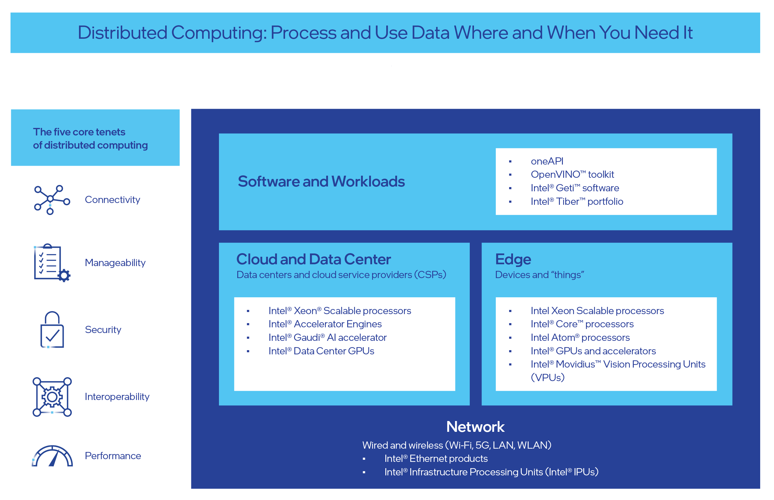
Distributed Computing: Process and Use Data Where and When You Need It
Public
Notes:
Speaker notes
Distributed computing gives you the flexibility to process and use data where and when you need it. Distributed computing is built on five core tenets, shown on the left, that form the basis of computing across a diverse set of industries and usage models.

Slide 9
More Benefits of Distributed Computing
Reduced time to information
Reduced cost of information systems (data transmission and storage)
Reduced infrastructure investments and operations costs (modernization)
Increased quality of information (data reduction, information gain)
Increased security of information and systems
New approaches for data transmission (connectivity and network related)
Reusable interoperable building blocks for faster time to market
New avenues to utilize workforce differently
Public

Slide 10





Connectivity
Manageability
Security
Five Tenets of
Distributed Computing
Interoperability
Performance
Public
Notes:
Speaker notes
Solution designs are often constrained by existing hardware, software, or systems already in place, creating complex factors that are situational and usage-model driven, and that cross multiple industries. A solution should incorporate these five tenets of distributed computing to overcome constraints: connectivity, manageability, security, interoperability, and performance.
As you will see in the following slides, Intel offers technologies across the distributed computing spectrum that are designed to optimize performance, improve the value of technology investments, and successfully navigate through these complexities.

Slide 11
Connectivity
Connectivity is the pipeline for compute resources to communicate effectively with users, data sources, and other infrastructure components across an open, standards-based network.
Solutions consider:
Bandwidth
Latency
Network reliability
Intel® Ethernet technologies support interoperability
and integration.
Delivering speeds from 1 to 100 gigabit Ethernet (GbE)
Public
Notes:
Speaker notes
Connectivity is the pipeline for compute resources to communicate effectively with users, data sources, and other infrastructure components across an open, standards-based network. Distributed computation solutions must consider bandwidth, latency, and network reliability to determine where workloads are placed. Intel® Ethernet technologies and standards for the industry support interoperability and integration across the distributed computing spectrum. Intel Ethernet controllers, adapters, and accessories—which are extensively tested for network interoperability, reliability, and performance—can deliver speeds from 1 to 100 gigabit Ethernet (GbE) and include capabilities to help optimize workload performance.

Slide 12
Manageability
Manageability enables discovery, provisioning, and administrative tasks from the edge to the data center to the cloud.
Intel® edge manageability solutions enhance overall efficiency and productivity by supporting updates and monitoring from remote locations:
The Intel vPro® platform provides in-band and out-of-band
manageability capabilities
Intel technologies support container orchestration
Public
Notes:
Speaker notes
Manageability enables discovery, provisioning, and administrative tasks from the edge to the data center to the cloud. Intel® edge manageability solutions enhance overall efficiency and productivity by supporting updates and monitoring from remote locations. The Intel vPro® platform’s in-band and out-of-band manageability capabilities allow users to remotely monitor and manage client and edge devices, update firmware and operating systems, and perform many other administrative operations. Intel technologies support container orchestration that automatically schedules and distributes computing workloads, storage, and network bandwidth across resources from the data center to the network to the edge.

Slide 13
Security
Security in distributed computing environments helps ensure that:
Data is protected from unauthorized access, breaches, and compliance violations.
Compute infrastructure is resilient to failures and disruptions for continuous availability.
Intel® hardware-based security technologies help customers defend against modern cyber threats.
Foundational security
Workload and data protection
Software reliability
Public
Notes:
Speaker notes
Security needs to extend from hardware to software. A silicon root of trust helps ensure that data across distributed computing environments is protected from unauthorized access, breaches, and compliance violations. Data security and regulatory compliance are paramount when choosing compute locations. Compute infrastructure should also be resilient to failures and disruptions to help ensure the continuous availability of applications and services. Intel® hardware-based security technologies are designed using the industry’s best security practices to help customers defend against modern cyber threats. Intel security solutions meet specific challenges centered around three key priorities:
Foundational security: Critical protection to verify the trustworthiness of devices and data
Workload and data protection: Trusted execution for hardware-isolated data protection
Software reliability: Platforms that help protect against a range of cyber threats

Slide 14
Interoperability
Interoperability enables applications and services to seamlessly work, integrate, and scale across diverse platforms. It accommodates:
Fluctuating workloads
Customer demand
Future growth
Through co-engineering partnerships, Intel jointly designs and builds new solutions with software providers that accelerate advancements through integrated and optimized software and hardware.
Public
Notes:
Speaker notes
Interoperability enables applications and services to seamlessly work, integrate, and scale across diverse platforms. Compute resources should be extensible to accommodate fluctuating workloads, customer demand, and future growth. Through co-engineering partnerships with software providers like Microsoft, Amazon Web Services (AWS), Google, SAP, Red Hat, and VMware, Intel jointly designs and builds new solutions with the software industry to accelerate advancements through integrated and optimized software and hardware. This collaboration is critical to Intel’s inherent approach to designing open architectures instead of proprietary technologies.

Slide 15

Performance
Performance manages both optimized workloads and costs across the distributed computing spectrum—which is especially important in the AI era.
Key performance indicators (KPIs) like throughput are crucial for compute placement, directly affecting app responsiveness.
Placing compute resources close to users or data sources can help reduce latency and improve the user experience (UX).
Platform performance depends on standard hardware optimization at the right location for each workload.
Intel® Xeon® processors with built-in hardware accelerators boost performance for demanding workloads, such as AI, machine learning (ML), encryption, and data compression.
Public
Notes:
Speaker notes
Performance manages both optimized workloads and costs across the distributed computing spectrum, and it is especially important in the AI era. Workload performance key performance indicators (KPIs) like throughput are crucial considerations for compute placement, as they directly affect the responsiveness of applications. Placing compute resources closer to users or data sources can help reduce latency and improve the user experience (UX).
Platform performance depends on standard hardware platforms optimized at the right location for each workload. Intel® Xeon® Scalable processors featuring built-in hardware accelerators boost performance for demanding workloads, such as AI/machine learning (ML), encryption, and data compression.

Slide 16
Freedom to Choose where Workloads are Placed
Freedom to Choose
Where Workloads
Are Placed
Factors to Consider
Security
Network connectivity
Scalability
Resiliency
Performance
Regulatory compliance
Sustainability
Cost
Public
Notes:
Speaker notes
There are many factors to consider when determining a compute location for a solution. The next few slides list these factors and the trade-offs between edge and cloud.
Solution considerations are situational and are usage-model-driven.
Solution designs are often constrained by existing hardware, software, or systems in place. Most designs are not 100 percent greenfield.
Generally, with significant numbers of complex factors to take into design consideration, there might be no best proposal—but sets of good proposals.

Slide 17
Compute Location: Factors to Consider
Security
Paramount when choosing compute locations.
Data must be protected from unauthorized access (breaches) and compliance violations.
Scalability
Provision and scale resources up or down as needed.
Needed to accommodate fluctuating workloads and demand.
Network Connectivity
Essential to communicate with users, data sources, and other infrastructure components.
Considers bandwidth, latency, and network reliability.
Helps minimize latency and improve user experience by placing compute resources closer to users/data sources.
Resiliency
(tolerance to failure, redundancy)
Ensure continuous availability of applications and services.
Locations chosen for reliable power infrastructure and disaster recovery capabilities.
Rugged form factors.
Public
Notes:
Speaker notes
Security
Data security and regulatory compliance are paramount when choosing compute locations. Organizations must ensure that data is protected from unauthorized access, including breaches, and compliance violations.
Network Connectivity
Adequate network connectivity is essential for compute resources to communicate effectively with users, data sources, and other infrastructure components. Organizations consider bandwidth, latency, and network reliability. Placing compute resources closer to users or data sources can minimize latency and improve user experience.
Scalability
Organizations consider the ability to provision and scale resources up or down as needed. Compute resources should be scalable to accommodate fluctuating workloads and demand.
Resiliency
(tolerance to failure, redundancy)
Compute infrastructure should be resilient to failures and disruptions to ensure continuous availability of applications and services. Organizations favor locations with reliable power infrastructure and disaster recovery capabilities. Rugged form factors can be important.

Slide 18
Compute Location: More Factors to Consider
Workload Performance
Includes KPIs like latency and throughput crucial for compute placement.
Minimizes latency and improves user experience by placing compute resources closer to users or data sources.
Environmental Considerations
(power, physical constraints)
Increasingly important for compute location decisions.
Considers energy efficiency, carbon footprint, and renewable energy.
Also considers longevity and reuse of data and insights.
Regulatory Compliance
Mandates may dictate compute location, especially for sensitive data.
Must adhere to data residency and privacy regulations.
Cost
Varies depending on the location, availability of infrastructure, and pricing models.
Considers total cost of ownership (TCO), including hardware, software, energy, and operational expenses.
Public
Notes:
Speaker notes
Workload Performance
Workload performance key performance indicators (KPIs) like latency and throughput are crucial considerations for compute placement, as this directly affects the responsiveness of applications. Placing compute resources closer to users or data sources can minimize latency and improve user experience.
Regulatory Compliance
Regulatory compliance mandates may dictate the location of compute, especially for industries handling sensitive data, such as healthcare or finance. Organizations must adhere to data residency and privacy regulations.
Environmental Considerations
(power, physical constraints)
Environmental sustainability is becoming increasingly important for compute location decisions. Organizations consider energy efficiency, carbon footprint, and renewable energy options. They also consider the longevity and reuse of data and insights.
Cost
The cost of compute resources varies depending on the location, availability of infrastructure, and pricing models. Organizations consider the total cost of ownership (TCO), including hardware, software, energy, and operational expenses.

Slide 19
Choosing Where Workloads Are Placed
Client edge
Edge devices, client computers, dedicated appliances
Cloud
Private cloud, public cloud, hybrid cloud, data centers, on-premises
Public
Notes:
We should clarify the terminology for the following discussion on where workloads are placed on the next set of slides.
When speaking about the two ends of the spectrum, when we say “client and edge” we mean edge devices, client computers, and dedicated appliances.
“Cloud” encompasses computing on private cloud, public cloud, data centers, and on-premises.

Slide 20
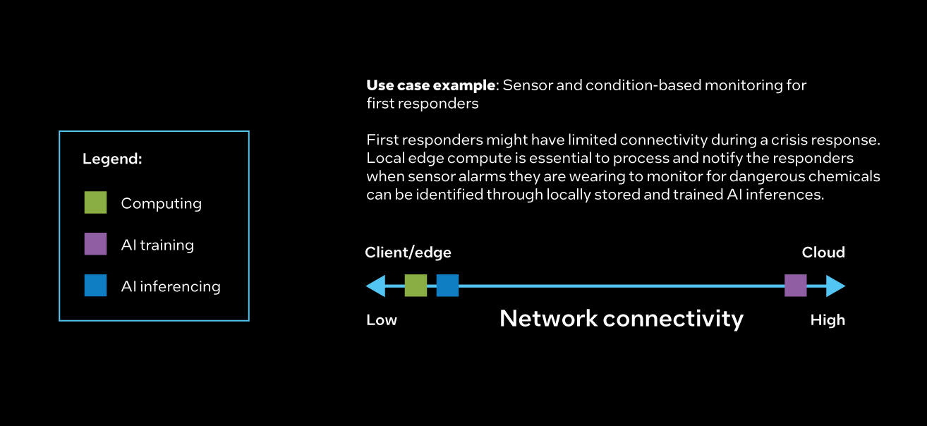
Choosing Where Workloads Are Placed:
Network Connectivity
Public
Notes:
Speaker notes
One lever is adequate network connectivity, which is essential for compute resources to communicate effectively with users, data sources, and other infrastructure components. Organizations consider bandwidth, latency, and network reliability. Placing compute resources closer to users or data sources can help reduce latency and improve user experience.
One example of how distributed computing supports network connectivity is condition-based monitoring. First responders in a natural disaster or crisis often face limited connectivity. Local edge compute is essential to process sensor data and use AI inferencing to notify responders about nearby dangerous chemicals when they are released.

Slide 21
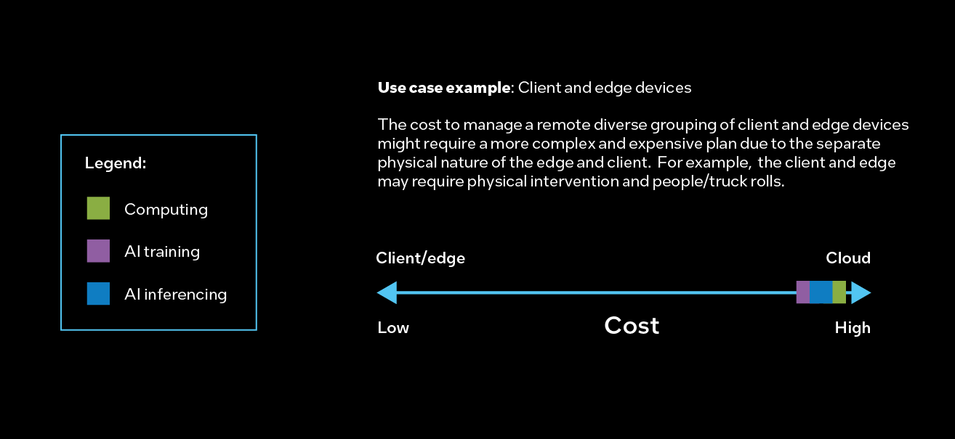
Choosing Where Workloads Are Placed: Cost
Public
Notes:
Speaker notes
When cost is the lever, we choose where to place workloads depending on the location and availability of infrastructure, in addition to pricing models. Organizations consider the total cost of ownership (TCO), including hardware, software, energy, and operational expenses.
A use case here is the cost to manage a remote diverse grouping of client and edge devices, which might require a more complex and expensive plan due to the separate physical nature of the edge and the client. For example, the client and edge could require physical intervention and people/truck rolls.

Slide 22
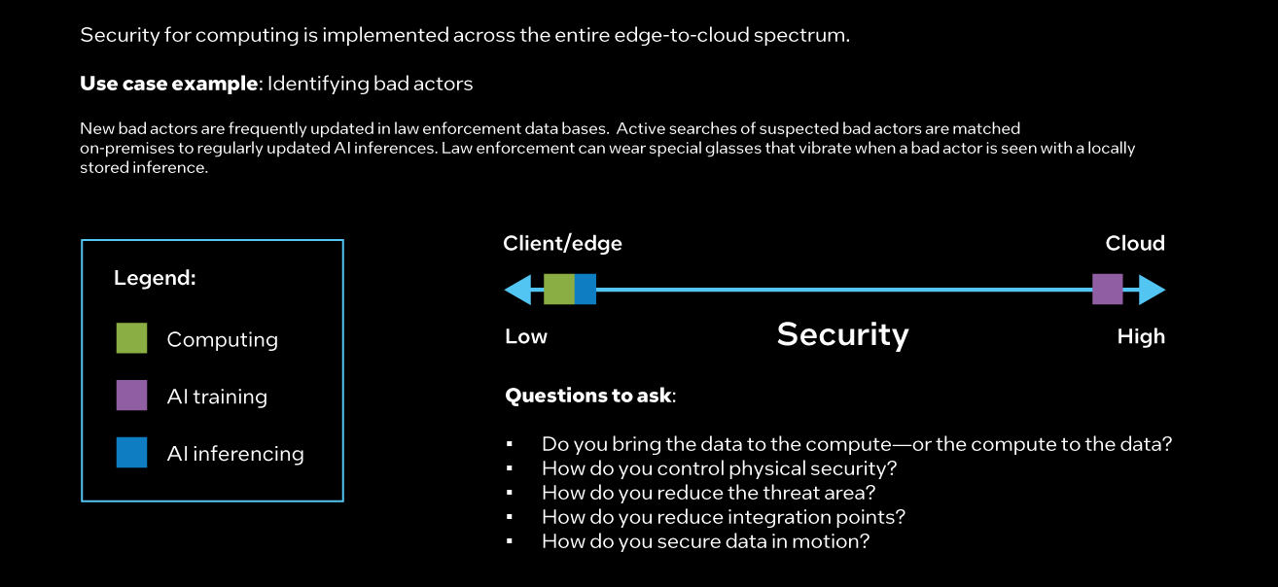
How We Choose Where Workloads Are Placed: Security
Public
Notes:
Speaker notes
Data security and regulatory compliance are paramount when choosing compute locations. Security for computing must be implemented across the entire edge-to-cloud spectrum to ensure that data is protected from unauthorized access, breaches, and compliance violations.
A use case example is identifying bad actors. In the most secure scenario, you might conduct active searches of suspected bad actors updated in law enforcement databases and match them on-premises regularly with AI inferencing. The least secure scenario might use glasses with sensors in them that vibrate when a bad actor is matched using locally stored inference.
There are several questions you might ask based on system objectives and the security profile you want to establish:
Do you bring data to compute—or compute to data?
How do you control physical security?
How do you reduce the threat area?
How do you reduce integration points?
How do you secure data in motion?

Slide 23
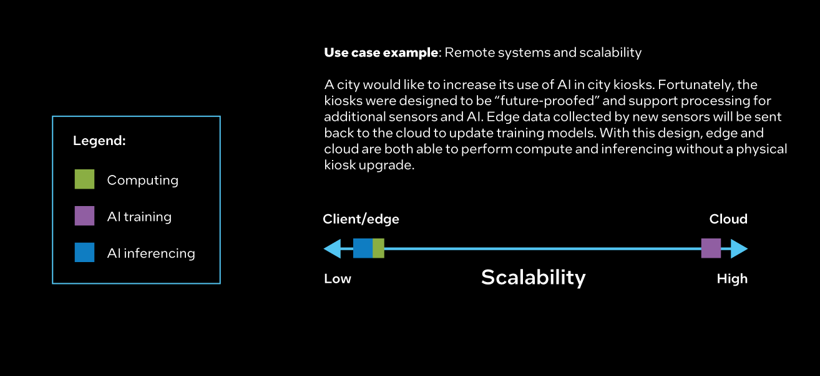
Choosing Where Workloads Are Placed: Scalability
Public
Notes:
Speaker notes
Compute resources should be scalable to accommodate fluctuating workloads and demand. Organizations should consider the ability to provision and scale resources up or down as needed.
Use case example: A city would like to increase its use of AI in city kiosks. Fortunately, the kiosks were designed to be “future-proofed” and support processing for additional sensors and AI. Edge data collected by new sensors will be sent back to the cloud to update training models. With this design, edge and cloud are both able perform compute and inferencing without a physical kiosk upgrade.

Slide 24
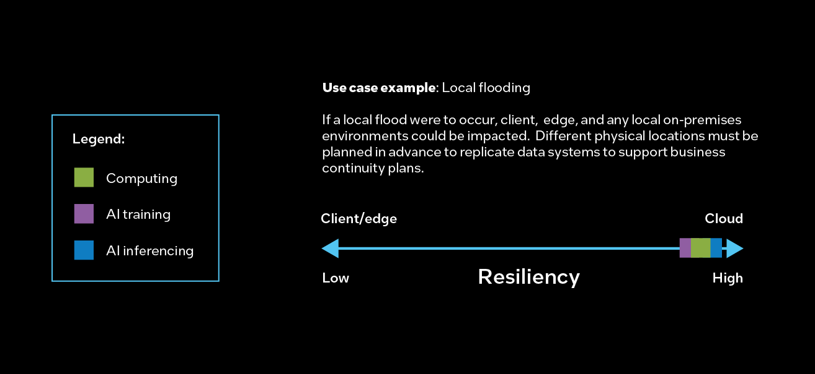
Choosing Where Workloads Are Placed: Resiliency
Public
Notes:
Speaker notes
Compute infrastructure should be resilient to failures and disruptions in order to help ensure continuous availability of applications and services. Organizations favor locations with reliable power infrastructure, disaster recovery capabilities, and ruggedized designs.
A use case example might be local flooding. If a flood were to occur at a location, edge, client, or on-premises compute capabilities could be impacted. To help ensure resiliency and support business continuity, data might be replicated in different physical locations.

Slide 25
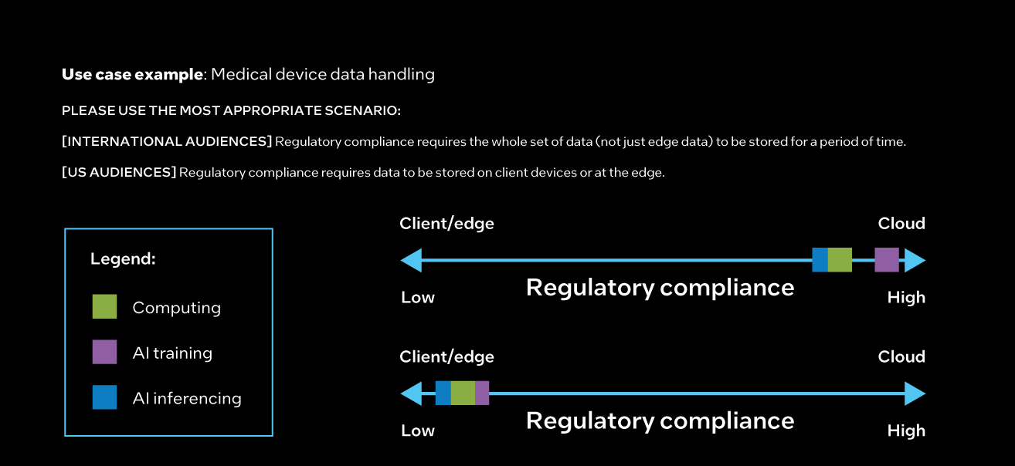
Choosing Where Workloads Are Placed:
Regulatory Compliance
Public
Notes:
Speaker notes
Regulatory compliance requirements might dictate the location of compute, especially for industries handling sensitive data such as healthcare or finance. Organizations must adhere to data residency and privacy regulations.
Medical device data handling is one use case example.
[INTERNAL NOTE - please use the most appropriate scenario]
[INTERNATIONAL AUDIENCES – USE TOP DIAGRAM]
Complying with regulations means that whole sets of data, not just information computed from data on the edge, must be stored for a set period of time and maintained as historical data in a database.
[US AUDIENCES – USE BOTTOM DIAGRAM]
Complying with regulations means that data must be stored on client devices or at the edge.

Slide 26
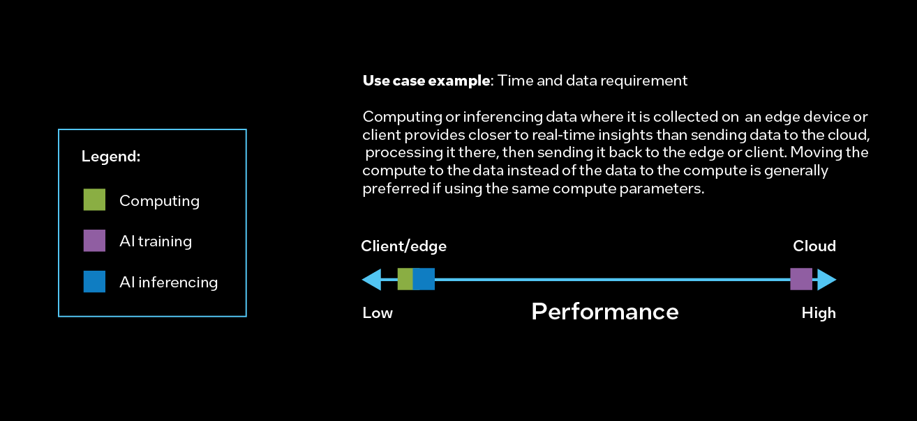
Choosing Where Workloads Are Placed: Performance
Public
Notes:
Speaker notes
Workload performance key performance indicators (KPIs) like throughput are crucial considerations for compute placement, as location directly affects the responsiveness of applications. Placing compute resources closer to users or the source of data can help reduce latency and improve the user experience.
A use case here is a time to data requirement. Computing or inferencing where data is collected on an edge or client device provides close to real-time insights, compared to sending data to the cloud, processing it there, and then sending it back to the edge or client device, which can take significantly more time. Moving the compute to the data instead of the data to the compute is generally preferrable.

Slide 27
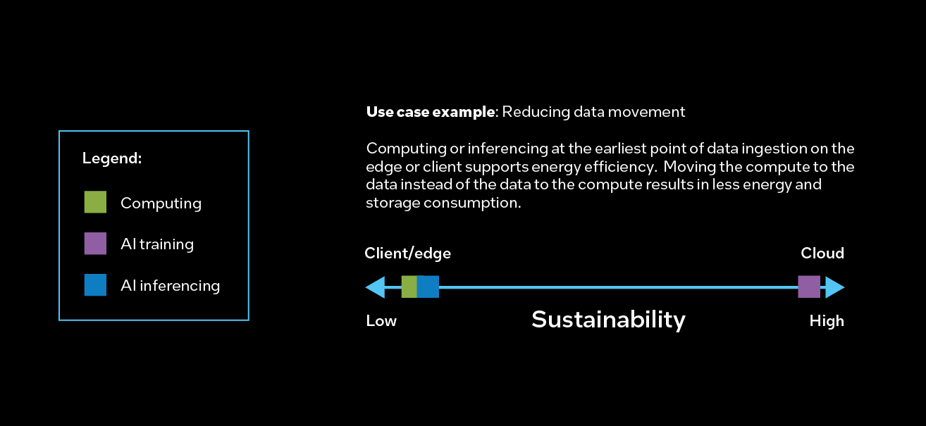
Choosing Where Workloads Are Placed:
Environmental Considerations
Public
Notes:
Speaker notes
Sustainability is another lever that is becoming increasingly important for compute location decisions. Organizations must consider energy efficiency, carbon footprint, and renewable energy options when deciding where to place workloads. They also must consider the longevity and reuse of data and insights.
Use case example: Reduced data movement. Computing or inferencing at the earliest point of data ingestion on the edge or client supports energy efficiency. Moving the compute to the data instead of the data to the compute results in less energy and storage capacity needs.

Slide 28
Intel® Distributed Computing Solutions
Intel® Distributed Computing Solutions
Intel and its partners deliver a full range of distributed computing solutions through open standards, a software platform across heterogeneous architectures, and security-first engineering—all built for scale.
Public
Notes:
Speaker notes
Unlocking the power of data through distributed computing can transform your organization. Intel and our trusted partner ecosystem offer solutions that allow workloads to be moved across different locations throughout the computing spectrum. Through open standards, a software platform across heterogeneous architectures, and security-first engineering—all built for scale—Intel and its partners deliver a full range of distributed computing solutions.

Slide 29
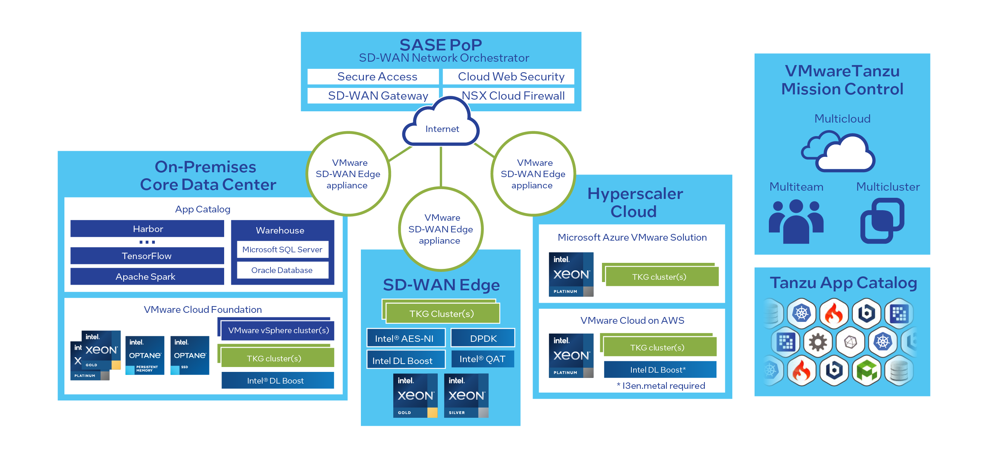
Run Multicloud Analytics on Virtual Machines
A reference architecture to manage virtual machines (VMs) and orchestrate containers:
This VMware and Intel solution brings compute capacity and AI models to where enterprise data is created, processed, and consumed.
Accelerates analytics deployment for a wide range of workloads.
Delivers agile, scalable, and security-enabled infrastructure with excellent analytics performance.
Increases throughput with Intel® architecture–optimized deep learning (DL) frameworks.
Learn more: “Building a Multicloud Analytics Solution with VMware Cloud Foundation - Solutions Reference Architecture”
Public
Notes:
Speaker notes
VMware and Intel collaborated to deliver a comprehensive solution to manage virtual machines (VMs) and orchestrate containers. This reference architecture (RA) brings compute capacity and AI models to where enterprise data is created, processed, and consumed, whether in a public cloud, in an enterprise data center, or at the edge. This verified, end-to-end solution also accelerates analytics deployment for a wide range of workloads; it delivers agile, scalable, and security-enabled infrastructure with excellent analytics performance; and it increases throughput with Intel® architecture–optimized deep learning (DL) frameworks.

Slide 30
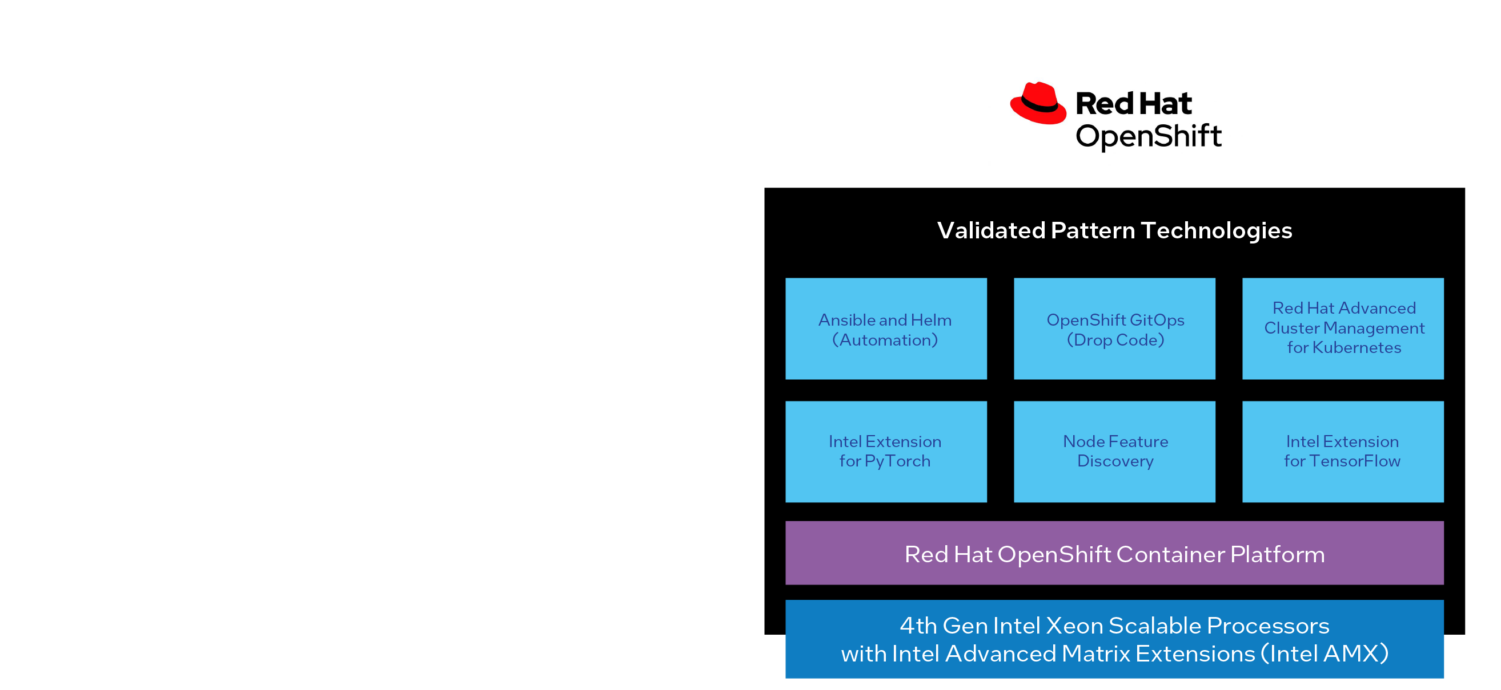
Enable AI and Security with Red Hat Validated Designs
Simplify the deployment process: No extensive manual configurations for fully operational AI workflows
Red Hat validated patterns from Intel make it easy to enable AI and security features and accelerations provided by the latest Intel® Xeon® Scalable processors running Red Hat OpenShift 4.14.
Intel® Advanced Matrix Extensions (Intel® AMX) boosts the speed and efficiency of AI workloads.
Intel® Software Guard Extensions (Intel® SGX) helps provide robust support for confidential computing.
Encryption and compression are offloaded to a dedicated accelerator using Intel® QuickAssist Technology
(Intel® QAT) for improved performance.
Learn more: “Accelerate AI Applications and Workflows with Red Hat® OpenShift® 4.14 on 4th Gen Intel® Xeon® Scalable Processors – Solutions Reference Architecture”
Public
Notes:
Speaker notes
Red Hat validated patterns from Intel make it easy to enable AI and security features and accelerations provided by the latest Intel® Xeon® Scalable processors running Red Hat OpenShift 4.14. These patterns simplify the deployment process, eliminating the need for extensive manual configurations and setting up comprehensive, fully operational AI workflows with ease. The solution utilizes Intel® Advanced Matrix Extensions (Intel® AMX) to boost the speed and efficiency of AI workloads. In terms of security, Intel® Software Guard Extensions (Intel® SGX) helps provide robust support for confidential computing, ensuring that your data is well-protected. Additionally, application performance is improved by offloading encryption and compression to a dedicated accelerator using Intel® QuickAssist Technology (Intel® QAT).

Slide 31
Accelerate Containerized Workloads
Intel device plugins framework for Kubernetes
Accelerate complex containerized workloads by using advanced hardware resources such as graphics processing units (GPUs), high-performance network interface cards (NICs), and field-programmable gate arrays (FPGAs).
The framework provides a container experience kit that simplifies the installation and configuration of Kubernetes clusters on Intel® architecture using Ansible.
The Cloud Native Data Plane (CNDP) framework is optimized for packet processing in cloud applications. By integrating with the AF_XDP plugins for Kubernetes, CNDP applications can run in security-enabled, unprivileged pods.
Learn more: “GitHub collection of Intel® device plugins for Kubernetes”
Public
Notes:
Speaker notes
Kubernetes is a powerful tool that provides a robust framework for running distributed systems, allowing users to deploy, scale, and manage containerized applications anywhere. The Intel® device plugins framework for Kubernetes makes it easy to accelerate complex containerized workloads by using advanced hardware resources such as graphics processing units (GPUs), high-performance network interface cards (NICs), and field-programmable gate arrays (FPGAs). Intel provides a container experience kit that’s a simplified mechanism for installing and configuring Kubernetes clusters on Intel architecture using Ansible.
Intel also developed a purpose-built framework, Cloud Native Data Plane (CNDP), optimized for packet processing in cloud applications. By integrating with the AF_XDP plugins for Kubernetes, CNDP applications can run in security-enabled, unprivileged pods.

Slide 32
Distributed Computing and Artificial Intelligence (AI)
Data processing
Pretraining
Compute/inferencing
Intel: This is a placeholder slide for top-level messaging on Distributed Computing and AI to set up the next three slides.
Public

Slide 33
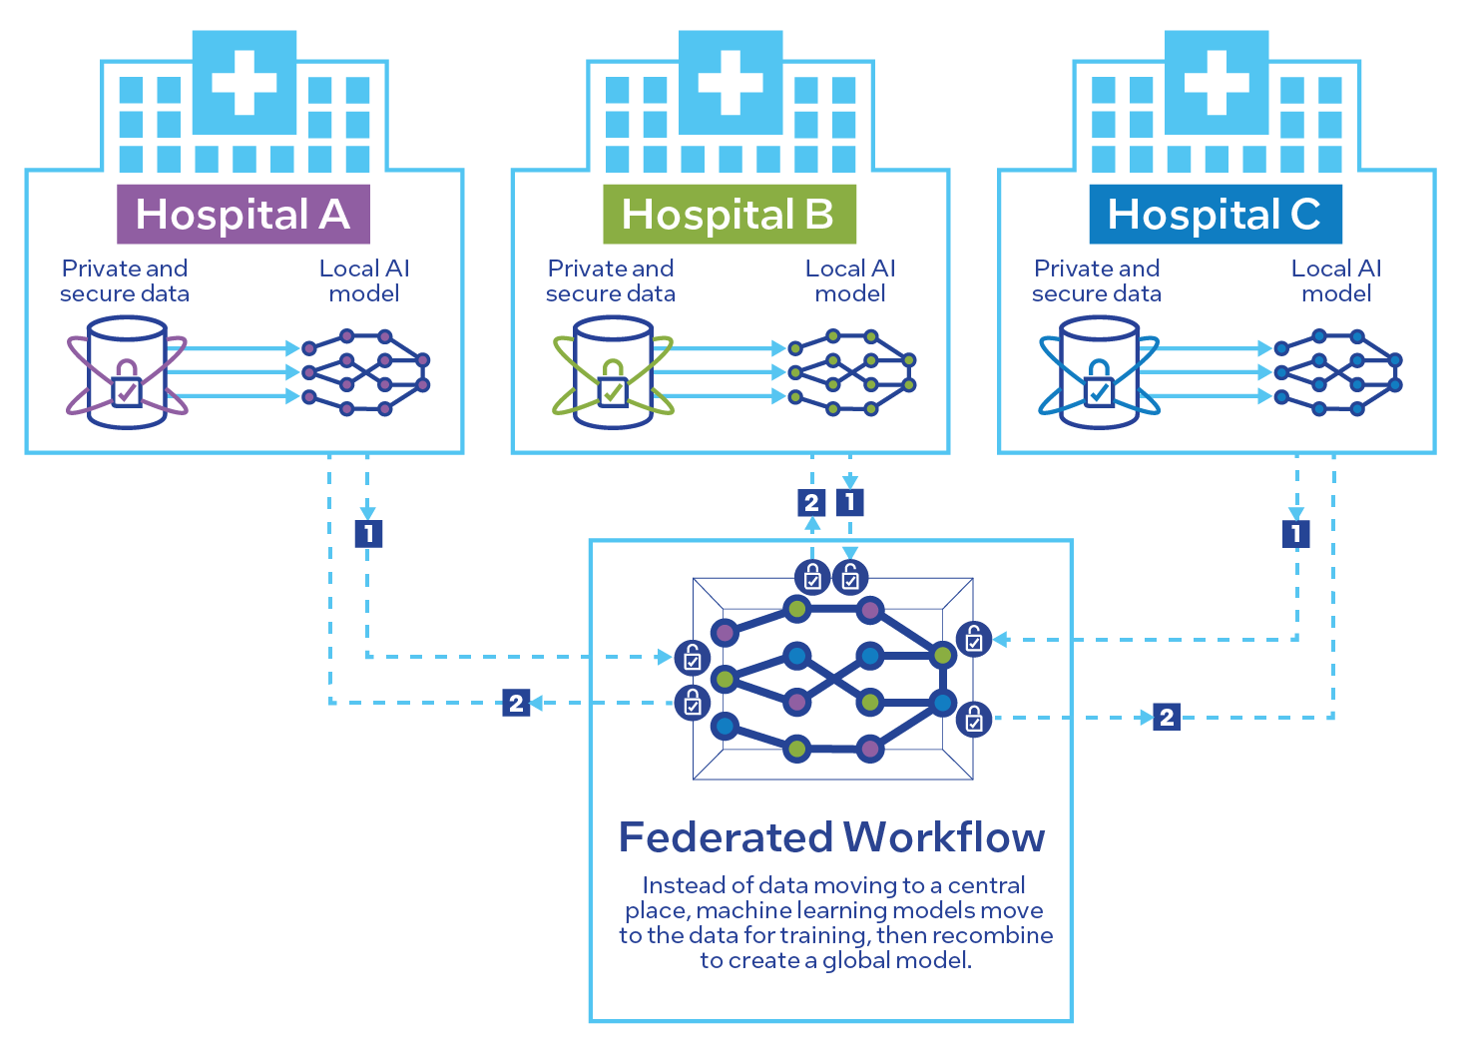
Use Federated Learning for Disease
Detection and Treatment
A privacy-preserving AI technique enables researchers to improve cancerous brain tumor detection by up to 33 percent.
Intel and Penn Medicine used federated learning to unlock multi-site data silos to improve disease detection and treatment.
Intel® Software Guard Extensions (Intel® SGX) and other Intel® technologies decentralized data processing while maintaining data privacy, enabling research without compromising patient information.
Learn more: “Intel and Penn Medicine Announce Results of Largest Medical Federated Learning Study”
Public
Notes:
Speaker notes
Intel and Penn Medicine used federated learning to unlock multi-site data silos to improve disease detection and treatment. Research using federated learning represents a significant step forward in medical AI, improving brain tumor detection by up to 33 percent.
Intel® Software Guard Extensions (Intel® SGX) and other Intel® technologies decentralized data processing while maintaining data privacy, enabling research without compromising patient information.

Slide 34

Protect Confidentiality with Distributed AI
OpenFL enables access to large and diverse datasets to improve accuracy and the generalizability of AI models.
Open Federated Learning (OpenFL) maintains data privacy while bringing together insights from disparate, confidential, and regulated datasets.
It allows data analysis without sharing raw data using technologies like Intel® Software Guard Extensions (Intel® SGX) and the Gramine project.
OpenFL has been used for training and validating brain tumor segmentation models across 71 sites on six continents.
Learn more: “OpenFL Linux Foundation project”
Public
Notes:
Speaker notes
Intel helped develop Open Federated Learning (OpenFL) to enable data scientists to address the challenge of maintaining data privacy while bringing together insights from disparate, confidential, and regulated datasets. This library was developed to promote collaboration and standardization in distributed AI. OpenFL enables privacy-preserving AI by allowing data analysis without sharing raw data using technologies like Intel® Software Guard Extensions (Intel® SGX) and the Gramine project.
OpenFL was used in one of the world’s largest healthcare federations for training and validating brain tumor segmentation models across 71 sites on six continents. The federation resulted in improved model accuracy, even on out-of-sample data.

Slide 35

Fend Off Phishing Attacks with AI at the Edge
The first endpoint-based anti-phishing solution that harnesses the computational power of Intel® AI technologies
By running at the edge, the BUFFERZONE NoCloud AI
anti-phishing detection system provides:
A 91 percent reduction in anti-phishing operational costs, in addition to inference speed improvements of more than 40 percent compared to CPU inference.
A 70 percent decrease in detection latency compared to cloud inference while protecting user privacy.
The Intel® Core™ Ultra processor integrates the CPU, GPU, and NPU into a single package and helps accelerate AI at the edge.
Learn more: “BUFFERZONE® and Intel® AI Anti-Phishing Solution presented at Mobile World Congress”
Public
Notes:
Speaker notes
BUFFERZONE has collaborated with Intel to pioneer the first endpoint-based anti-phishing solution that harnesses the computational power of Intel® AI technologies. By running at the edge, the BUFFERZONE NoCloud AI anti-phishing detection system provides a 91-percent reduction in anti-phishing operational costs, inference speed improvements of more than 40 percent compared to CPU inference, and a 70-percent decrease in detection latency compared to cloud inference, while protecting user privacy. The Intel® Core™ Ultra processor integrates the CPU, GPU, and NPU into a single package and helps accelerate AI at the edge instead of in the cloud, where deep learning (DL) workloads are traditionally run.

Slide 36
Improve Efficiency and Optimize
across the Compute Spectrum
Distributed computing can:
Speed up the process of getting information and improve information quality
Reduce IT costs
Enhance security
Unleash new types of innovation
Forge a new pathway to address new use cases
Distributed computing solutions help businesses stay ahead in the technology landscape, increase efficiency, and unlock new opportunities.
Intel® technologies can support you across the five tenets of distributed computing and move all the levers to support your use case and business models.
Public
Notes:
Speaker notes
Distributed computing can speed up the process of getting information and improve the quality of information; reduce IT costs related to data transmission, storage, and infrastructure/operations; and enhance security. New types of innovation can be unleashed by allowing computing to happen at the earliest point of data ingestion and separating the compute nodes where AI inference and training are performed. And with distributed computing, we can forge a new pathway to address new use cases.
Distributed computing solutions from Intel are designed to help businesses stay ahead in the technology landscape, increase efficiency, and unlock new opportunities.
Intel® technologies can support you across the five tenants of distributed computing and move all the levers to support your use case and business models.

Slide 37

Helpful Resources
Join us at an upcoming event:
Webinar: GenAI Webinar Series
Webinar: Growing Revenue with Artificial Intelligence
Webinar: Reduce Costs by Bringing Your Technology into the Future
Webinar: Mitigating Security Risks with Confidential Computing
Stay informed: Intel® hub for technology leaders
Read the solution brief: <link tbd>
Public
Notes:
Speaker notes
Join us at an upcoming event to gain relevant business insights, collaborate with others, and learn about the latest advancements, best practices, and how Intel can help you overcome today’s business challenges. These webinars are free and available on demand.

Slide 38
Legal Notices and Disclaimers
Intel technologies may require enabled hardware, software or service activation.
No product or component can be absolutely secure.
Your costs and results may vary.
© Intel Corporation. Intel, the Intel logo, and other Intel marks are trademarks of Intel Corporation or its subsidiaries. Other names and brands may be claimed as the property of others.
Public

Slide 39
Intel end slide

