Slide 1
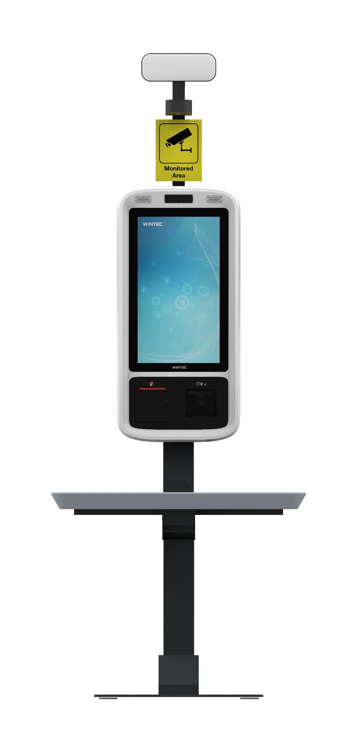
Back to Retail Solutions
Back to Asset & Operations Optimization
Use Cases
QINGDAO Wintec Self-Checkout Solution Enabled with Loss Prevention
Solution Overview
The Wintec Self-Checkout Solution Enabled with Loss Prevention leverages edge-to-cloud connectivity to provide a seamless and secure customer experience. It begins at the edge, where customers interact with the self-checkout kiosk. At the edge, video camera feeds capture data that is processed in real-time using AI behavior recognition, to swiftly detect abnormal patterns that could indicate potential theft. If unusual behavior is detected, the POS alert light turns red, prompting employees to monitor the transaction. After the transaction is completed, data is encrypted and transmitted to the cloud for further processing. In the cloud, this data is analyzed to refine loss prevention and AI behavior algorithms to enhance their accuracy and effectiveness over time.
Target Vertical: Retail
Secondary Vertical:
Hospitality and Restaurants
Target Use Case: Asset & Operations Optimization
Value Props
Back-end
ERP
Improve profitability through advanced loss prevention using a solution that detects shoplifting, identifies potentially fraudulent activities, and predicts possible theft patterns to protect your inventory and reduce shrinkage.
Secondary Use Case: Interactive Media, Logistics & Tracking
Front-end
Http/Https frame
System log
Hard drive
Membership
Settings
Payment
Data transfer (Json or others)
Geo Availability
Americas, APJ, EMEA, PRC
System update
Boost customer satisfaction with a user-friendly solution that simplifies the checkout process for shoppers to increase transaction efficiency, minimize wait times, and elevate the customer experience.
Solution Diagram
Mobile
Others
Commodity scanning
OpenVino Gesture Recognition
Sales Contact
Shang Li - lishang@wintec.cn
Empower strategic business decisions with real-time data analysis that offers valuable insight into customer shopping patterns and preferences to help inform strategic decisions that drive sales.
Transaction
Solution Webpage
WINTEC Solution Webpage
Middleware
Drivers
Intel Components
Learn More
WINTEC SelfPOS60
Hardware
Scanner
Printer
Intel® Core™ i3 processors
Intel® Core™ i5 processors
Intel® Distribution of OpenVINO™ toolkit

