Slide 1
Build and Deploy AI on Google Cloud and Intel
December 2024

Slide 2
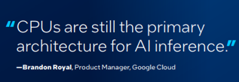
A Holistic Approach to Inference Starts with CPUs
Global availability across regions
High availability across zones
Obtainability for bursting workloads
Next Gen CPUs with Instruction Sets Optimized for AI workloads

Slide 3
Understanding AI Segmentation
AI
Regression
Classification
Clustering
Decision Trees
Data Generation
Image Processing
Natural Language Processing
Recommender Systems
Machine learning
Difficult problem to reverse engineer
Large, uniform dataset
Highest accuracy
Practical to reverse engineer
Tabular/limited dataset
Good enough accuracy
Fully-explainable
Deep learning
GenAI
Subset of AI that focuses on creating new, original content
GenAI algorithms use advanced techniques like deep learning and neural networks to produce realistic and coherent outputs
Notes:
Before we jump into any detail, it’s important to level set on how AI workloads continue to evolve and segment. This segmentation creates opportunities to address specific AI workloads with CPU instances.
You can also think of this segmentation as a timeline, starting with machine learning, through deep learning and most recently generative AI, which is really the latest evolution of deep learning. Generally speaking, CPUs are well suited to the earlier workloads, like machine learning and some deep learning use cases and less well suited to the large foundational generative AI models like ChatGPT that have fueled an explosion of interest and investment and but even with generative AI there is an emerging segmentation.

Slide 4
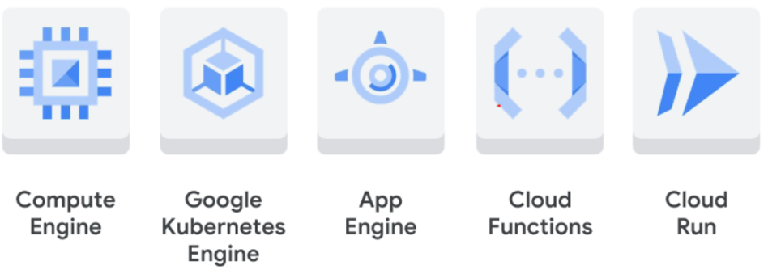
AI Needs Data
Intel® Xeon® processors enable users to move through the entire workflow
Compute Services
Data to AI Workflow
* Not Exhaustive

Slide 5
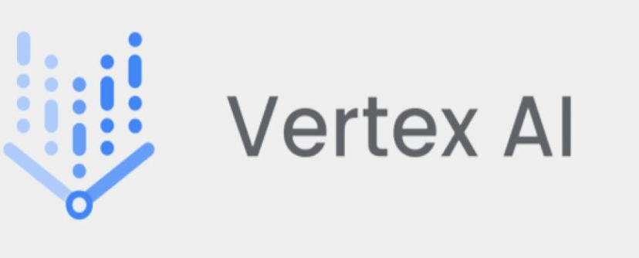
Vertex AI – How Intel Contributes
What Intel Provides
Optimized libraries for embedding and vector search
Increased performance on Intel-based instances with AMX enabled on Vertex AI
Build, train, and deploy models

Slide 6
Intel®Xeon® Instances Complement GPU and TPU AI Offerings
C4/H3/N4
N1 (T4)
A2 (A100)
G2 (L4)
A3 (H100)
TPU
v3 & v4
TPU
v5e
TPU
v5p
Large Model Training
Medium ML Training
Model Fine Tuning
Large Model inference (70B+)
Medium Model Inference (<20B)
Small Model Inference
Processor
CPU
GPU
Low-Cost Inference
TPU
Classical ML & DL
Notes:
Looking across GCPs portfolio of instances, when it comes to medium and small model inferencing, GCP’s C3 and H3 instances offer AMX-powered inferencing as well as machine learning and deep learning capability as a complement to GCP’s GPU and TPU offerings.

Slide 7
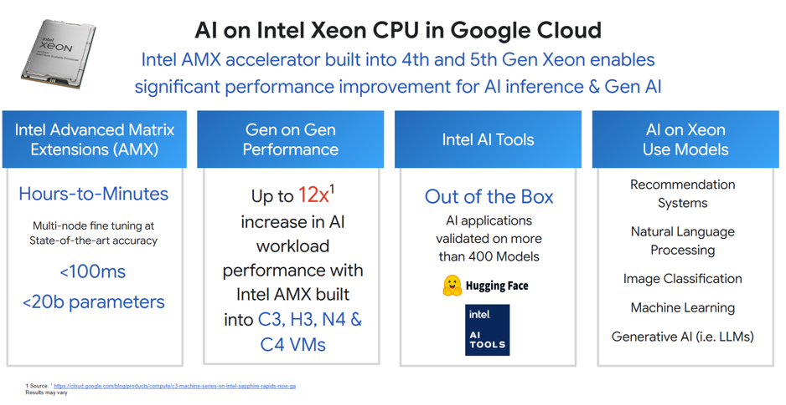
https://cloud.google.com/blog/products/compute/c3-machine-series-on-intel-sapphire-rapids-now-ga

Slide 8
Use CPUs Where Availability of GPUs Pricing is Challenging
8.80
GPU pricing Available
Yes
GPU
No
C3/N2 or earlier
C4/N4
CPU instances Broadly Available in most regions
C4/N4 up to 8X Price/performance Increase from N1
Utilize new built-in AI accelerators such as Intel® AMX
Intel AI Acceleration with
Intel® Advanced Matrix Extensions (Intel® AMX)
See backup for workloads and configurations. Results may vary.

Slide 9
Mapping AI Workloads to Intel® Xeon® GCP Instances
Focus on inference & traditional AI
e.g. ML, smaller DL models, recommendation engines etc.
Areas of opportunity – inference with small and nimble LLMs
Workloads
Traditional ML
Vision
Search and Recommendation
Natural Language Processing
Generative AI
Uses
Predictive analytics
Network monitoring
Sentiment analysis
Anomaly detection
Image/video classification
Object detection
Recommendation engines
Vector search
Embeddings
Translation
Speech recognition Text classification
Sentiment analysis
Summarization
Chatbot
<20B parameters
Models
BERT
SetFit
fastRAG
Llama2-7B, -13B
Mixtral-8x7B
GPT-J 6B
LCM
Scikit-learn
XGBoost
SetFit ABSA
ResNet
YOLO
DETR
DLRM
Deep Cross Network
Wide & Deep
DeepFM
Instances
Proof points
Up to 2x Performance gains on AI WLs ¹
3.98x images per sec ²
Medical insights on C3 9.82x faster than N2D ³
CPU Meeting Latency and Performance/$ Requirements
4.32x sentences per sec ⁴
C3 up to 14.19x faster than N2D ⁵
5th Gen Xeon bests market requirements on LLM latencies ⁶
1: https://cloud.google.com/blog/products/compute/c3-machine-series-on-intel-sapphire-rapids-now-ga
2: https://www.intel.com/content/www/us/en/content-details/785538/content-details.html
3: https://www.intel.com/content/www/us/en/content-details/791905/content-details.html
4: https://www.intel.com/content/www/us/en/content-details/787234/content-details.html
5: https://www.intel.com/content/www/us/en/content-details/791476/content-details.htm l
6: https://www.intel.com/content/www/us/en/developer/articles/community/achieve-leading-ai-performance-xeon-processors.html
Notes:
So, summarizing, Xeon is good option for enterprises implementing a variety of AI workloads from traditional ML through Vision, Search and Recommendation and Natural Language Processing, and creates opportunities for enterprises looking to implement smaller, domain specific-models for their generative AI workloads.
This table describes some of the common use cases for each workload, as well as the examples of models that are associated with them. It also lists the proof points that we have published on GCP instances that demonstrate Xeon performance.

Slide 10
C4 – VMs Based on 5th Gen Intel® Xeon®
For your performance-sensitive workloads (game servers, high-traffic web servers, databases)
Compute & Memory
5th Gen Intel® Xeon®; 2 – 192 vCPUs
4GB to 640GB
01
"We are excited about Google Cloud’s new C4 and N4 machines. The new C4 VMs show 35% performance boost for real-time ML threat detection and N4 VMs provide 20% higher throughput for Dynamic Analysis of Malware samples at a lower cost vs. the previous generation.” - Xu Zou, VP of Product, CDSS, Palo Alto Networks
Network Bandwidth and Hyperdisk Storage
Tier 1 networking up to 200Gbps
Hyperdisk Balanced support
02
Availability
Us-west4, europe-west4
See configurations on next slide
“At Bluecore, we really care about cost savings. N4 is great for our dev/test and benchmarking workloads, and it met our expectations in every way. We observed around a 66% performance uplift from N1, and we will definitely adopt N4.” – Michael Hurwitz, Software Architect, Bluecore
03
Target Workloads: web and app serving, game servers, databases and caches, video streaming, data analytics, network appliances, and CPU-based ML inference
04
Intel does not control or audit third-party data. You should consult other sources to evaluate accuracy.

Slide 11
Google Cloud C4 Instance Built with 5th Gen Intel® Xeon® Scalable Processors
Part of the Instruction Set Architecture (ISA)
Intel® Advanced Matrix Extensions (Intel® AMX)
to boost AI inference and training with 2d tiles operations
Always Available
Intel® Advanced Vector Extensions 512 (Intel® AVX 512)
5GISA
*Hardware acceleration also included in Intel® Xeon® CPU Max Series.
Availability of accelerators varies depending on SKU. Please contact your Intel sales representative for more information.
Intel.com/IPU
Notes:
Intel® HPC Engines on Intel® Xeon® Scalable processors increase ROI and open the door to new degrees of system power efficiency and performance that cannot be achieved by simply adding more cores.
Because of their proximity to the cores in the CPU and system memory, built-in Intel Accelerator Engines are often less complex to utilize than discrete accelerators, leading to faster time to value.

Slide 12
C4 (Emerald Rapids) AI Performance Summary C4-standard (5th Gen Intel Xeon) vs. C3-standard (4th Gen Intel Xeon)
AI
1.0=C3-standard
Up to 1.39X across popular workloads with
C4-standard (5th Gen Intel Xeon Scalable cpu) vs. C3-Standard (4th Gen Intel Xeon Scalable cpu)
See backup for workloads and configurations. Results may vary.

Slide 13
N4 – VMs Based on 5th Gen Intel® Xeon®
For your versatile/flexible workloads focused on cost-optimization
Compute & Memory
5th Gen Intel® Xeon®; 2 – 80 vCPUs
4GB to 640GB
Batch processing, virtual desktops, microservices
“At Bluecore, we really care about cost savings. N4 is great for our dev/test and benchmarking workloads, and it met our expectations in every way. We observed around a 66% performance uplift from N1, and we will definitely adopt N4.” – Michael Hurwitz, Software Architect, Bluecore
01
Network Bandwidth and Hyperdisk Storage
Up to 50 Gbps
Hyperdisk Balanced: Up to 160,000 IOPS
02
Availability and Pricing
Us-east4, us-east1, europe-west4
Pricing will less expensive than N2 (3rd Gen)
03
Intel does not control or audit third-party data. You should consult other sources to evaluate accuracy.

Slide 14
N4 (Emeralds Rapids) Instance Performance Summary N4-standard (5th Gen Intel® Xeon® Scalable cpu) vs. N2-standard (3rd Gen Intel Xeon Scalable cpu)
8vCPU
16vCPU
32vCPU
48vCPU
4.53
4.65
3.36
3.44
3.14
3.22
1.0=n2-standard
Up to 1.59X higher performance and 1.63X higher performance/$ with
N4-standard (5th Gen Intel Xeon Scalable cpu) vs. N2-standard (3rd Gen Intel Xeon Scalable cpu)
See backup for workloads and configurations. Results may vary.

Slide 15
C4/N4 Offers Versatile Computing Solution for AI WL Pipelines
Performance
Flexibility
Use Cases
C4/N4 instances meet the throughput and latency requirements for multiple AI use cases, such as Retrieval Augmented Generation (RAG) pipelines
AMX AI acceleration allows for flexible deployment and experimentation across the data pipeline stages, simplifying operations and optimizing resource use
C4/N4 instances are effective for embedding generation, LLM performance, and classical ML workloads.

Slide 16
C3 - Now Generally Available
Latest innovations delivering 35% better price/performance vs. prior gen¹
Compute & Memory
4th Gen Intel® Xeon®; DDR5 50% faster than DDR4
Intel® AMX for 12x faster Deep Learning acceleration
Multiple memory configurations
01
With the new C3 machine series, we've noticed artists enjoy a 30% performance increase, making it easier and faster to bring their creative visions to life. We've observed substantial improvements in both 3D and 2D rendering across all of our clients,. - Tom Taylor, Founder, Gunpowder Tech LLC
Network Offloads via the IPU
Up to 200 Gbps
3x higher packet processing vs. prior gen²
Dedicated network processing to minimize jitter
02
Hyperdisk Storage
Up to 350,000 IOPS and 5GB/s throughput
Up to 10x higher performance vs. prior gen²
By adopting C3 VMs with Intel Sapphire Rapids and the new AMX instruction set for AI, we are seeing 2x performance for some of our inline models, compared to the previous generation N2 Ice Lake VMs. - Suiqang Deng, Distinguished Engineer, Palo Alto Networks
03
1: https://www.intel.com/content/www/us/en/content-details/816100.html
2: https://cloud.google.com/blog/products/compute/introducing-c3-machines-with-googles-custom-intel-ipu
Intel does not control or audit third-party data. You should consult other sources to evaluate accuracy.

Slide 17
Google Cloud C3 Value Proposition
Compute & Memory
Networking
Storage
Sustainability
First to market with Intel Sapphire Rapids
New AMX accelerator for up to 12x perf vs. AVX-512¹
DDR5 50% faster than DDR4¹
Three memory configurations (2, 4, 8GB/vCPU)
Google and Intel co-designed IPU with network offloads
Reduces on-host processing improving VM performance
Enables up to 200 Gbps (2x prior generation)¹
Lower VM-VM latency and higher packet processing
Minimizes network jitter
Support for new Hyperdisk storage products
Hyperdisk Extreme up to 10x IOPS and 4x throughput compared to C2²
Hyperdisk Balanced (GA end of 2023) and Throughput (GA on N2)
Greenest CPU (4th Gen Intel® Xeon® SP) on the Greenest Cloud (GCP)
38% more performance per watt vs. previous generation³
93% renewable electricity globally
1: https://cloud.google.com/blog/products/compute/c3-machine-series-on-intel-sapphire-rapids-now-ga
2: https://cloud.google.com/blog/products/compute/introducing-c3-machines-with-googles-custom-intel-ipu
3: https://community.intel.com/t5/Blogs/Tech-Innovation/Cloud/More-Performance-and-Less-Environmental-Impact-New-Google-Cloud/post/1546305
Notes:
Speaker Notes:
We see our maintenance experience as three paradigms:
Consistency
Awareness
Control
Consistency comes in the form of regimented and recurrent time between planned maintenance events, be it the first time a customer has deployed a workload or many months down the road. With this experience, our latest generation of VM families, starting with C3, will provide you with a minimum maintenance frequence of 28 days. But this is just the start, other families will provide 60 days and up to 90 days between maintenance events down the line. This will enable an even more diverse set of workloads on Google Cloud.
Awareness comes via Notifications that will provide customers with a heads-up on any upcoming maintenance along with when maintenance begins and finishes. While today we have a very short window of time for customers to take action to a notification, with our new experience, customers will receive a minimum of 7 days notification prior to a maintenance event. Like with Frequency, this is just the start; other families with have up to 60 days of notification down the line further enabling some of our customer’s most sensitive and long-running applications.
Lastly, Control will be provided via API, and eventually UI, that will enable customers to perform any pending maintenance – during the Notification Window – on their instances. In combination with our improved Notification story, this’ll provide the key set of capabilities enabling maintenance to be tailored to a time that best suits a customers’ business needs.
(“Consistency and control is key to creating confidence in the cloud”)

Slide 18
H3 Overview
Google Cloud’s first HPC-optimized VM family built on Intel® Xeon® processors
H3 VMs
Offered as full machines, SMT disabled with low-latency and high-bandwidth VM-VM networking
Offers upto ~x1.8 price / perf over C2D node for HPC workloads and up to ~x2 price / perf over C2¹
Advanced maintenance experience with 10 days initial uptime
Google’s custom IPU with 200 Gbps default along with compact placement groups
H3-standard shape (offered only as whole machine)
Config | CPU : GB | vCPUs (Cores) | Memory (GB) | Storage Options | Networking (Gbps)
Standard | 1 : 4 | 88 | 352 | PD-Balanced PD-Hyperdisk Parallestore | 200Gbps adv
Consumption model
Available as On-Demand, and 1 and 3 year CUDs
Given a different price point compared to existing VMs, not available on Spot or Flex CUDs
1: https://cloud.google.com/intel
Notes:
Given the growing demand and needs for HPC workloads, we’re launching the first of HPC optimized VM. H3. It’ll further our portfolio of compute optimized VMs consisting of C2 and C2D.
H3 is optimized for HPC workloads - offers SMT disabled, Dense deployments to offer lowest node-node latency, high networking bandwidth, offered in increments of hull machine / host
H3 is a highly optimized for price/performance offering upto ~x1.8 price / perf over C2D node for HPC workloads
Offers PD for local storage needs. No SSD support for now. We will also plan for a high mem SKU at slater point
Location - will be offered in 2 regions to start (US-Central-1 and EU-West - 4) but can be made available in other regions based on customer demand and ability to commit
Will be offered as OD, ⅓ year CUDs only. Spot maybe at a later stage

Slide 19
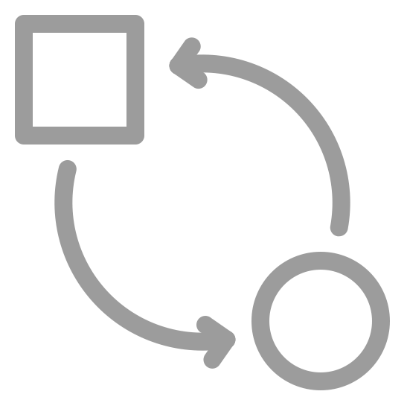
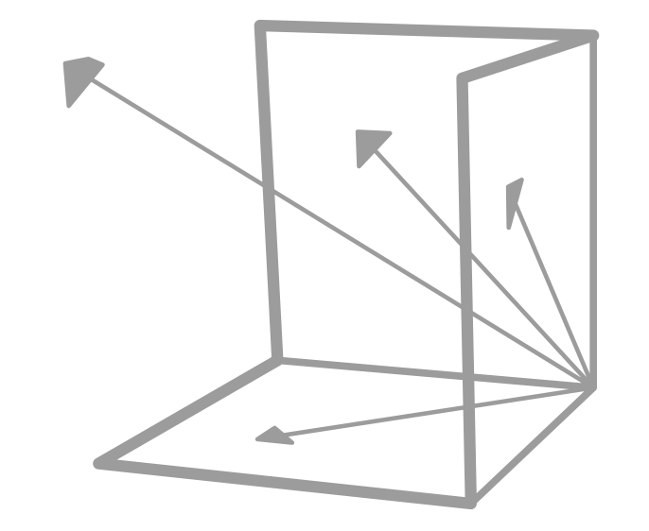
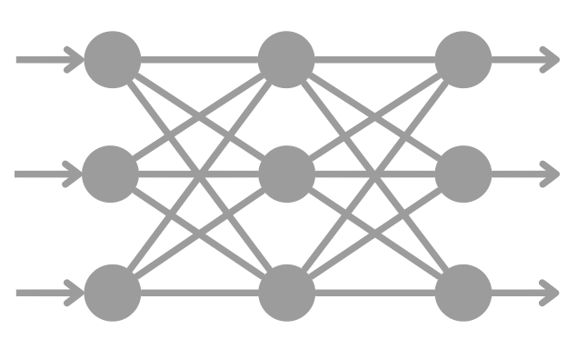
Google Cloud RAG Flow
AlloyDB
V
Ingest/ Data
Processing
Vector DB
Varied Data Source
*Vertex AI - Embedding Model
Retrieval/ Rank
User Query
!
TPU
Post Processing
*Responsible AI Checks
LLM
Prompt Processing
* Presumption
Notes:
Background: Google has conveyed interest in offering CPU as an option for Vector Embedding, alongside TPUs and GPUs. Google has requested Intel to provide Perf and TCO summaries for such use cases.
Current state: In the Google RAG Pipeline today, the Vector Database is enabled for Xeon and TPUs (Tensor Processing Unit). Vector Database an extension of Alloy DB, is optimized and deployed on Xeon (ICX). The embedding generation and LLM are optimized for Google TPU (LLMs are based on Google’s Gemini family).
Future targets: Our goal is to showcase Xeon as a viable option for Vector Embedding, establish Xeon as an alternate for LLM compute for smaller sized models (<7 B parameters), and protect Xeon MSS for Vector Search.
Team focus: DCAI HS SW engineers are collaborating with Google to open-source optimized embedding generation process (custom model + container) that runs best on Xeon. We are capturing performance data on Xeon for LLM compute for smaller sized models (<7 B parameters). As a next step, we will continue to collaborate with Google on vector search optimizations to protect Xeon MSS (ICX -> Leveraging AMX on SPR/EMR – WIP).

Slide 20
Efficient Natural Language Processing on Intel® Xeon® Instances
Natural Language Processing today is based on very large models trained on extremely large datasets and are expensive to run for inferencing at scale
Intel has created a set of models to greatly improve efficiency through optimization, quantization, and trained with a much smaller set of data
These models address the most common NLP usages:
Text Classification (SetFit)
Sentiment Analysis (SetFit ABSA)
Summarization (Model Quantization)
Chatbot (Model Quantization)
Code Generation (Model Quantization + Speculative Decoding
Models are available on Hugging Face

Slide 21
SetFit Step-by-Step
Hugging Face*
Google Cloud c3/c4 Instance
SW for SetFit Fine Tuning & Inference
SW for SetFit Fine Tuning & Inference
Quantization & Distillation
Customer Q’d and D’d Model
Gold labels
SetFit Model
SetFit Model
SW for SetFit Fine Tuning
Customer Model
Customer App
text
SetFit API
topic
Customer’s Data
Quantization & Distillation
(Optimum-Intel)
Production
Customer App
text
SetFit API
topic

Slide 22
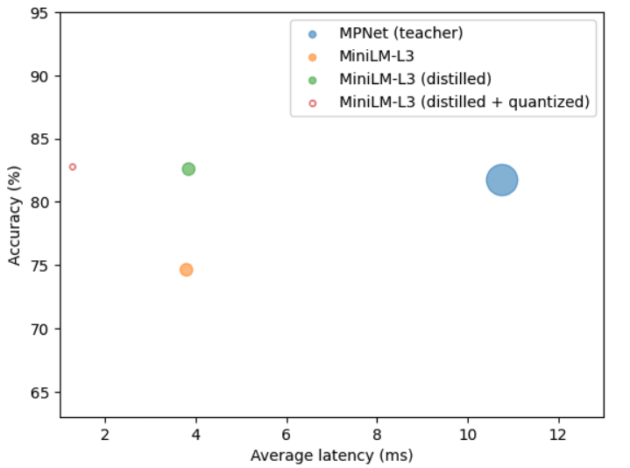
SetFit Few Shot Text Classification
CPU* Efficiency
Efficiency steps:
Distillation
CPU aware 8bit quantization
Results:
22x model size reduction
10x latency reduction
CPU aware Quantization
Distillation
5M*
15M Param
(60MB)
(20MB)
110M Param
(440MB)
[Source: Compressing SetFit Models with Knowledge Distillation and Quantization]
*1.27ms/sent inference
Distillation and Quantization deliver additional size reduction:
22x smaller model, 10x lower latency, ~same accuracy @ > 35,000x smaller size!
*Xeon 3rd Gen. (IceLake)

Slide 23
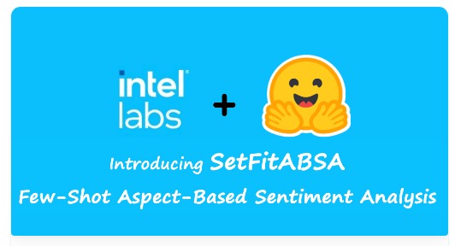
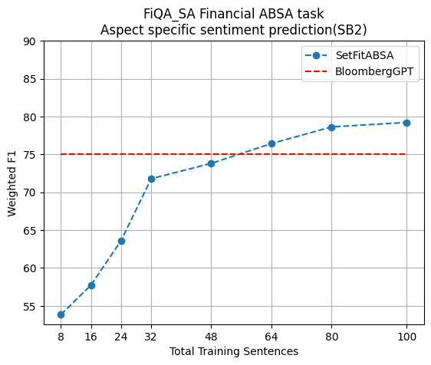
SetfitABSA - Fewshot Aspect Based Sentiment Analysis
[Source: SetFitABSA (100M) outperforms Bloomberg (50B) on FiQA SA]
SetFitABSA 110M Vs. BloombergGPT (50B)
✍️ Blog: https://huggingface.co/blog/setfit-absa
🔥 Code: https://github.com/huggingface/setfit/blob/main/notebooks/setfit-absa-fiqa.ipynb
Customer using in production – Argilla SetFit ABSA Tutorial , Argilla GitHub
SetFitABSA is more accurate than model 500 times its size!

Slide 24
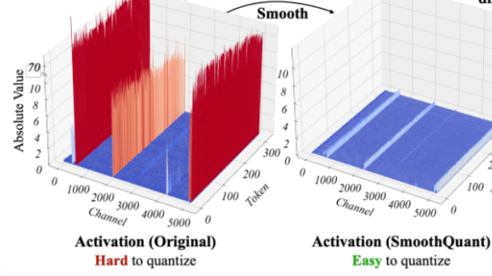
Chatbot Performance Improvements Through LLM int8 Quantization
Quantization (SmoothQuant Recipe)
Task | Metric | lm-eval-latest | SmoothQuant | Degradation in %
piqa | acc | 0.7802 | 0.7763 | 0.50%
piqa | acc_norm | 0.7856 | 0.7829 | 0.34%
arc_challenge | acc | 0.43 | 0.4309 | -0.21%
arc_challenge | acc_norm | 0.4497 | 0.4462 | 0.78%
hellaswag | acc | 0.5711 | 0.5646 | 1.14%
hellaswag | acc_norm | 0.7618 | 0.7569 | 0.64%
winogrande | acc | 0.6961 | 0.6906 | 0.79%
rte | acc | 0.6282 | 0.6462 | -2.87%
wikitext | Ppl(*) | 8.7885 | 9.6781
Average |  | 0.6378 | 0.6368 | 0.14%
Goal: Reduce Model size to improve Speed while maintaining High Accuracy
See:
Hugging Face Blog & Demo “Q8-Chat”
Full Production SW package based on IPEX
Model compressed by a factor of ~2x with no significant loss in accuracy
Notes:
*Perplexity doesn't measure task-specific accuracy (like correctly answering a question or correctly translating a sentence). It's more about the model's ability to predict or generate text.

Slide 25
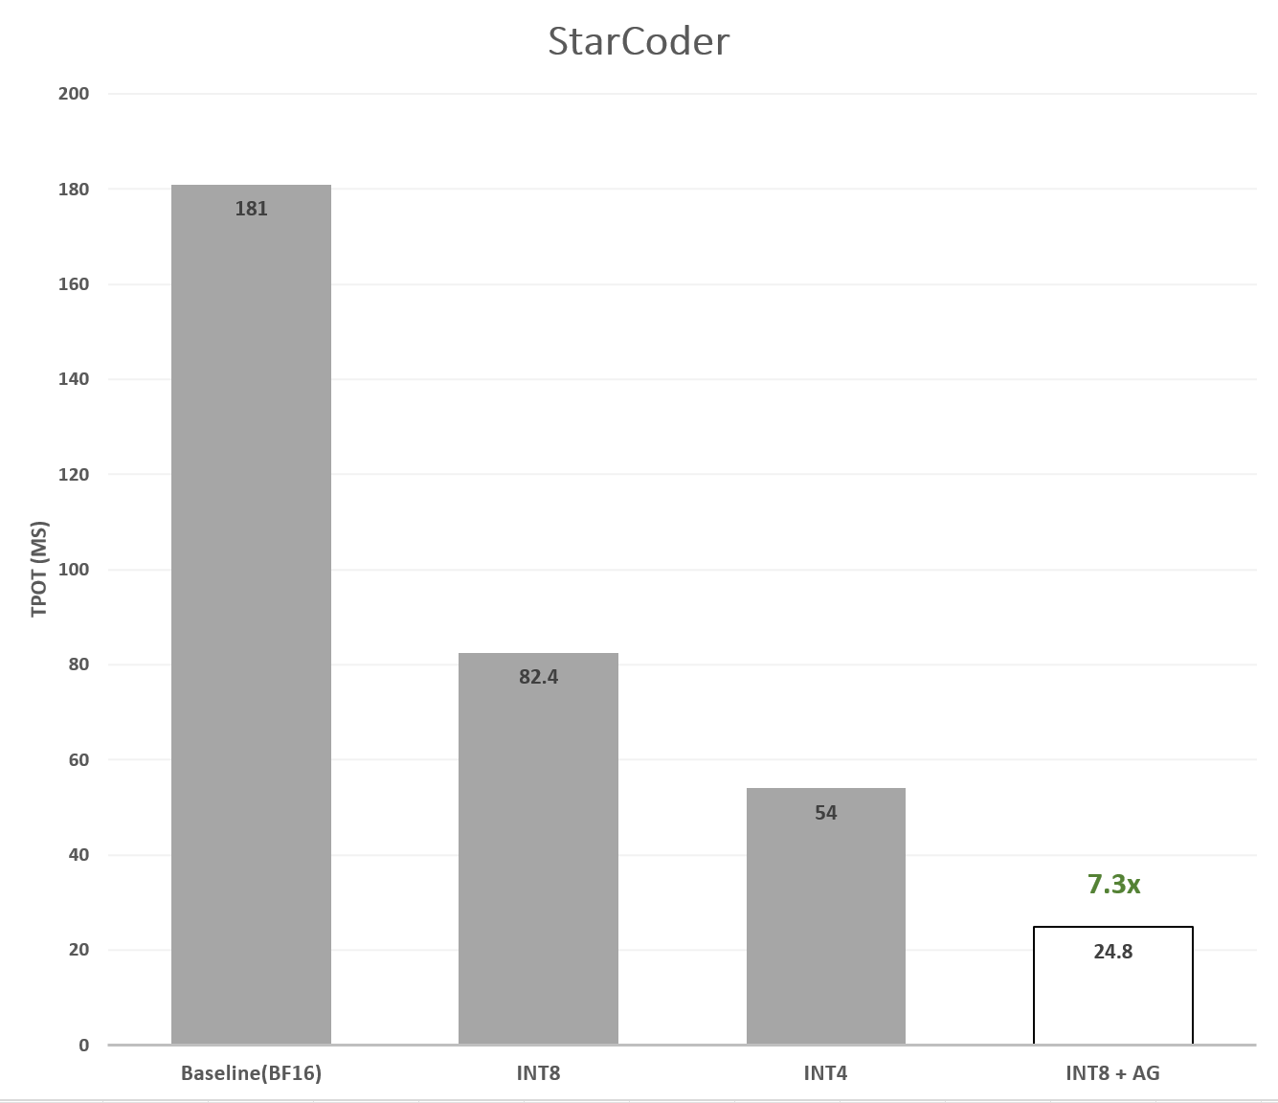
Code Generation Performance Improvements: StarCoder (15B) optimization by 8b/4b quantization and Speculative Decoding (see Jan. 30 blog)
StarCoder | Quantization | Precision** | HumanEval(pass@1) | TTFT (ms) | TPOT (ms) | TPOT Speedup*
Baseline | None | A16W16 | 33.54 | 357.9 | 181.0 | 1.00x
INT8 | SmoothQuant | A8W8 | 33.96 | 163.4 | 82.4 | 2.20x
INT4 | RTN (g128) | A16W4 | 32.80 | 425.1 | 54.0 | 3.35x
INT8 + AG*** | SmoothQuant | A8W8 | 33.96 | 183.6 | 24.8 | 7.30x
* Measurements on 4th Gen Intel Xeon 8480+ S1C56, torch-2.1.1+cpu, intel_extension_for_pytorch-2.1.100, DDR5 4800MT/s, bigcode-evaluation-harness
** In Precision format AxWy stands for Activations in x-bit precision and Weights in-y-bit precision.
*** In AG, TTFT may include time generation of 1 or 2 first tokens (inherent trait of the AG algorithm)
Key: TTFT = Time to First Token; TPOT = Time Per Output Token
Speculative Decoding enables addl. ~3.3x speedup over int8 quantization for < 25ms/token on SPR

Slide 26
Leading Video Collaboration Customer using the Full Intel AI Roadmap
Cloud
Client
General purpose workloads
AI workloads
Real-time video and audio
Real-time transcription
Background Replacement
Group chat
Speech translation
Background Blur
Screen share
Recording
Noise suppression
Latency
Echo cancellation
4th Gen Intel® Xeon® SP beats the customer’s latency SLA goal
<1s
Meetings per 32 vCPU instance
>10
Notes:
We’ve been working with a video conferencing service company, and they are running general purpose applications co-located with the AI functions.
The GP apps include things like real-time video and audio as you would expect, along with group chat, screen share, and recording functions. They’ve also added AI functionality that includes support for real-time transcriptions and offline meeting summarization.
As you can imagine, demand for their service will fluctuate quite a bit throughout the day and across time zones. They wanted to run everything on Xeon instances to make it easier for the customer to scale up or down as demand changes…but they still needed to hit their SLAs
The two main SLAs they need to hit are <1 sec latency and being able to easily support the required number of meetings per every 32 vCPU instance.
Intel engineers collaborating with the customer’s technical team were able to handily beat the latency SLA, and they were able to exceed the number of meetings supported on a single 32 vCPU instance.

Slide 27
Google Cloud Customer AI Proof Points

Slide 28
Datatonic Running AI Sustainably with Intel® AMX on GCP
Overview: Datatonic is a Google Cloud Partner specializing in AI/ML, and won Google’s ML Specialization Partner of the Year in both 2019 and 2021. Datatonic was selected by Google to run a hackathon focused on AI and sustainability, during the launch event of Google Cloud’s Berlin Data Center at which Intel was a sponsor.
The result: We have demonstrated that switching from an N2 instance to the new C3 instance, powered by Intel’s 4th Gen Intel Xeon Scalable processor, more than halves the carbon emissions of AI inference.
Key Challenges & Takeaways
Intel worked with Datatonic to demonstrate the significant AI/ML performance improvements possible by using 4th Gen Intel Xeon Scalable powered Google Cloud C3 instances, together with Intel AMX and our software optimizations & tools
AMX also played a pivot role, they loved the fact that the same machine they envisioned for HPC would be able to host AI workload efficiently as well
Reducing the Carbon Impact of AI | Datatonic
Key Technologies (EXAMPLES BELOW)
Intel Xeon Processors (3rd gen)
Intel Extension for PyTorch
Intel Extension for TensorFlow
Workload optimized with DL Boost

Slide 29
Summary & Next Steps
Intel invests in hardware, software, and optimization engineering for AI
Intel instances can be broadly applied to AI ranging from Traditional ML to LLM workload use cases
Google C4 machine types with Intel 4th Gen Intel® Xeon® processors and built-in AI acceleration (Intel® AMX) provide significant accelerated performance/$ than older generation CPUs
Intel AI Platform provides the software tools to optimize using Intel libraries for easy and optimal performance with Intel® AMX accelerator
Engage with your Intel representative to learn more about Intel AI optimizations and proof of concepts

Slide 30
Notices and Disclaimers
Performance varies by use, configuration and other factors. Learn more on the Performance Index site
Performance results are based on testing as of dates shown in configurations and may not reflect all publicly available updates. See backup for configuration details. No product or component can be absolutely secure.
Your costs and results may vary.
Intel technologies may require enabled hardware, software or service activation.
© Intel Corporation. Intel, the Intel logo, and other Intel marks are trademarks of Intel Corporation or its subsidiaries. Other names and brands may be claimed as the property of others.

Slide 32
Backup

Slide 33
Configurations: C4 (Emerald Rapids) Instance Performance Summary
C4-standard: 1-instance, 16,32,48 vcpu (Emerald Rapids), 32 ,64,96 GB total memory, bios: Google, microcode: 0xffffffff, Ubuntu 22.04.4 LTS, 6.5.0-1020-gcp, test by Intel on 02/2024
C3-standard: 1-instance, 16,32,48 vcpu (Ice Lake), 32,64,96 GB total memory, bios: Google, microcode: 0xffffffff, Ubuntu 22.04.4 LTS, 6.5.0-1020-gcp, test by Intel on 02/2024
Resnet50: , v1.5
BertLarge: Pytorch 2.3.0 ,OneDNN=3.3

Slide 34
Configurations: N4 (Emeralds Rapids), N2 (Ice Lake) and N1(Sky Lake) Integer throughput performance
N4-Standard: 1-instance, 8,16 vcpu (Emerald Rapids), 32/64GB total memory, bios: Google, microcode: 0xffffffff, Ubuntu 22.04.4 LTS, 6.5.0-1018-gcp, Direct-Attached SSD Size (GB) / IOPS / throughput (MB/s) , 8vcpu: 200/3000/600, 16vcpu: 200/6000/600, $0.08 per GiB disk pricing , $0.005 per IOPS provisioned pricing, $0.04 per MB/s provisioned, $2.99 us-east4 pricing as of 06/2024 test by Intel on 05/2024
N2-Standard: 1-instance, 8,16 vcpu (Ice Lake), 32/64 GB total memory, bios: Google, microcode: 0xffffffff, Ubuntu 22.04.4 LTS, 6.5.0-1018-gcp , Direct-Attached SSD Size (GB): 200GB , $0.044 per GiB Disk pricing $3.54 us-east4 pricing as of 6/2024 test by Intel on 05/2024
N1-Standard: 1-instance, 8,16 vcpu (sky Lake), 32/64GB total memory, bios: Google, microcode: 0xffffffff, Ubuntu 22.04.4 LTS, 6.5.0-1018-gcp , Direct-Attached SSD Size (GB): 200GB , $0.044 per GiB Disk pricing $4.26 us-east4 pricing as of 06/2024 test by Intel on 05/2024
N2d- Standard: 1-instance, 8,16 vcpu (Milan), 32/64GB total memory, bios: Google, microcode: 0xffffffff, Ubuntu 22.04.4 LTS, 6.5.0-1018-gcp , Direct-Attached SSD Size (GB): 200GB , $0.044 per GiB Disk pricing $3.08 us-east4 pricing as of 06/2024 test by Intel on 05/2024
Apache Spark: Kafka 2.12 3.2.0, OpenJDK JDK18, 250ms p99 latency.

Slide 35
Agenda
Background on AI
Alignment with Google Cloud on Intel® Xeon® Scalable Processors
How Intel Xeon in Google Cloud AI portfolio
Google’s AI services on Intel Xeon w/ Intel® AMX enabled
Intel Xeon proof points for each AI category on Google Cloud

Slide 36
Google C4 (Intel® Xeon®) instances for AI
Traditional ML Workloads
Running RAG Workloads with C4
LLM Inferencing Performance
NLP Inferencing with SetFit model
Mixed General Purpose & AI Workloads

