Slide 1
Edge CES Press Briefing
Michael Masci
Vice President of Product Management
Edge Computing Group
Intel Corp.

Slide 2
Intel CES 2025
Edge Launch Summary
News Embargo
Jan 6, 2025 6:00am Pacific Standard Time
Intel® Core™ Ultra 200H series processors (Formerly codenamed Arrow Lake H)
Intel® Core™ Ultra 200U series processors (Formerly codenamed Arrow Lake U)
Intel® Core™ Ultra 200S series processors (Formerly codenamed Arrow Lake S)
Intel® Core™ 200S series processors (Formerly codenamed Bartlett Lake S)
Intel® Core™ 200H series processors (Formerly codenamed Raptor Lake H Refresh)
Intel® Core™ 100U series processors (Formerly codenamed Raptor Lake U Refresh)
Intel® Core™ 3 processor and Intel® Processor (Formerly codenamed Twin Lake)

Slide 3
The Edge is the Center of Gravity for AI Inference
Running alongside compute and media
We’ve been at the edge for years, working with early adopters to digitize operations
Top drivers: data security, operational efficiency, business resilience¹
Increasing use of AI tightly inter- connected with existing applications to drive better business outcomes
Edge AI requires unique solutions built from expertise
1. Source: IDC InfoBrief, sponsored by Intel, Breaking Boundaries: Edge-Native Infrastructure Powers AI Advancements, doc #US52123724, June 2024
According to Gartner®: By 2026, at least 50% of edge computing deployments will involve ML.²
2. Gartner®, Hyperscalers Stretching to the Digital Edge, By Thomas Bittman, 24 July 2023. GARTNER is a registered trademark and service mark of Gartner, Inc. and/or its affiliates in the U.S. and internationally and is used herein with permission. All right reserved. Intel does not control or audit third-party data. You should consult other sources to evaluate accuracy.​

Slide 4
How We Enable Customer Success in Edge
Ecosystem Scale
Industry Solution Builders
Use Case Fragmentation
Varying performance and power needs
Vertical Focus
Tailored vertical solutions for broad set of use cases
Legacy Infrastructure & Deployment Complexity
Large installed base with need for seamless upgrades and advanced manageability
Systems Mindset
Reference solutions and blueprints
Workload Concurrency
AI doesn’t stand alone; it gets added to existing compute and media applications for maximum business value
Broad Silicon Portfolio
Highly scalable set of offerings, built-in support for multimodal AI

Slide 5
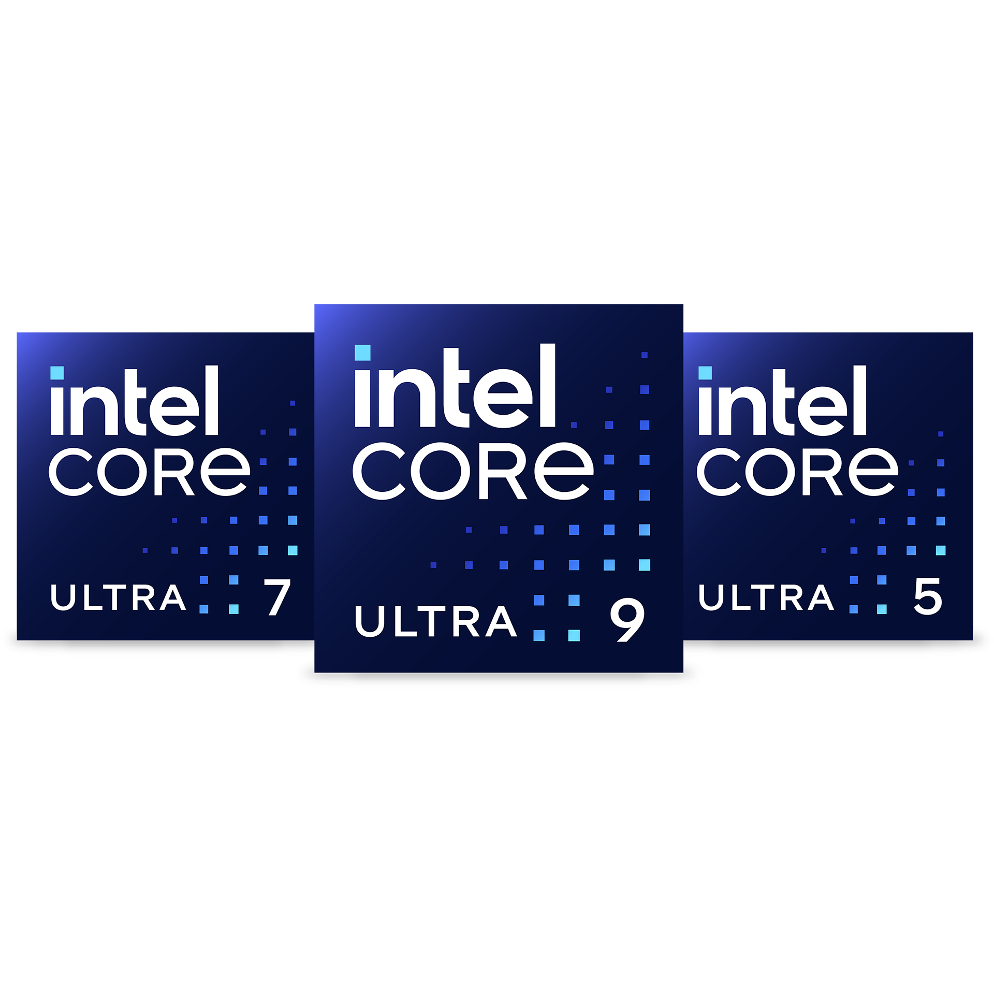
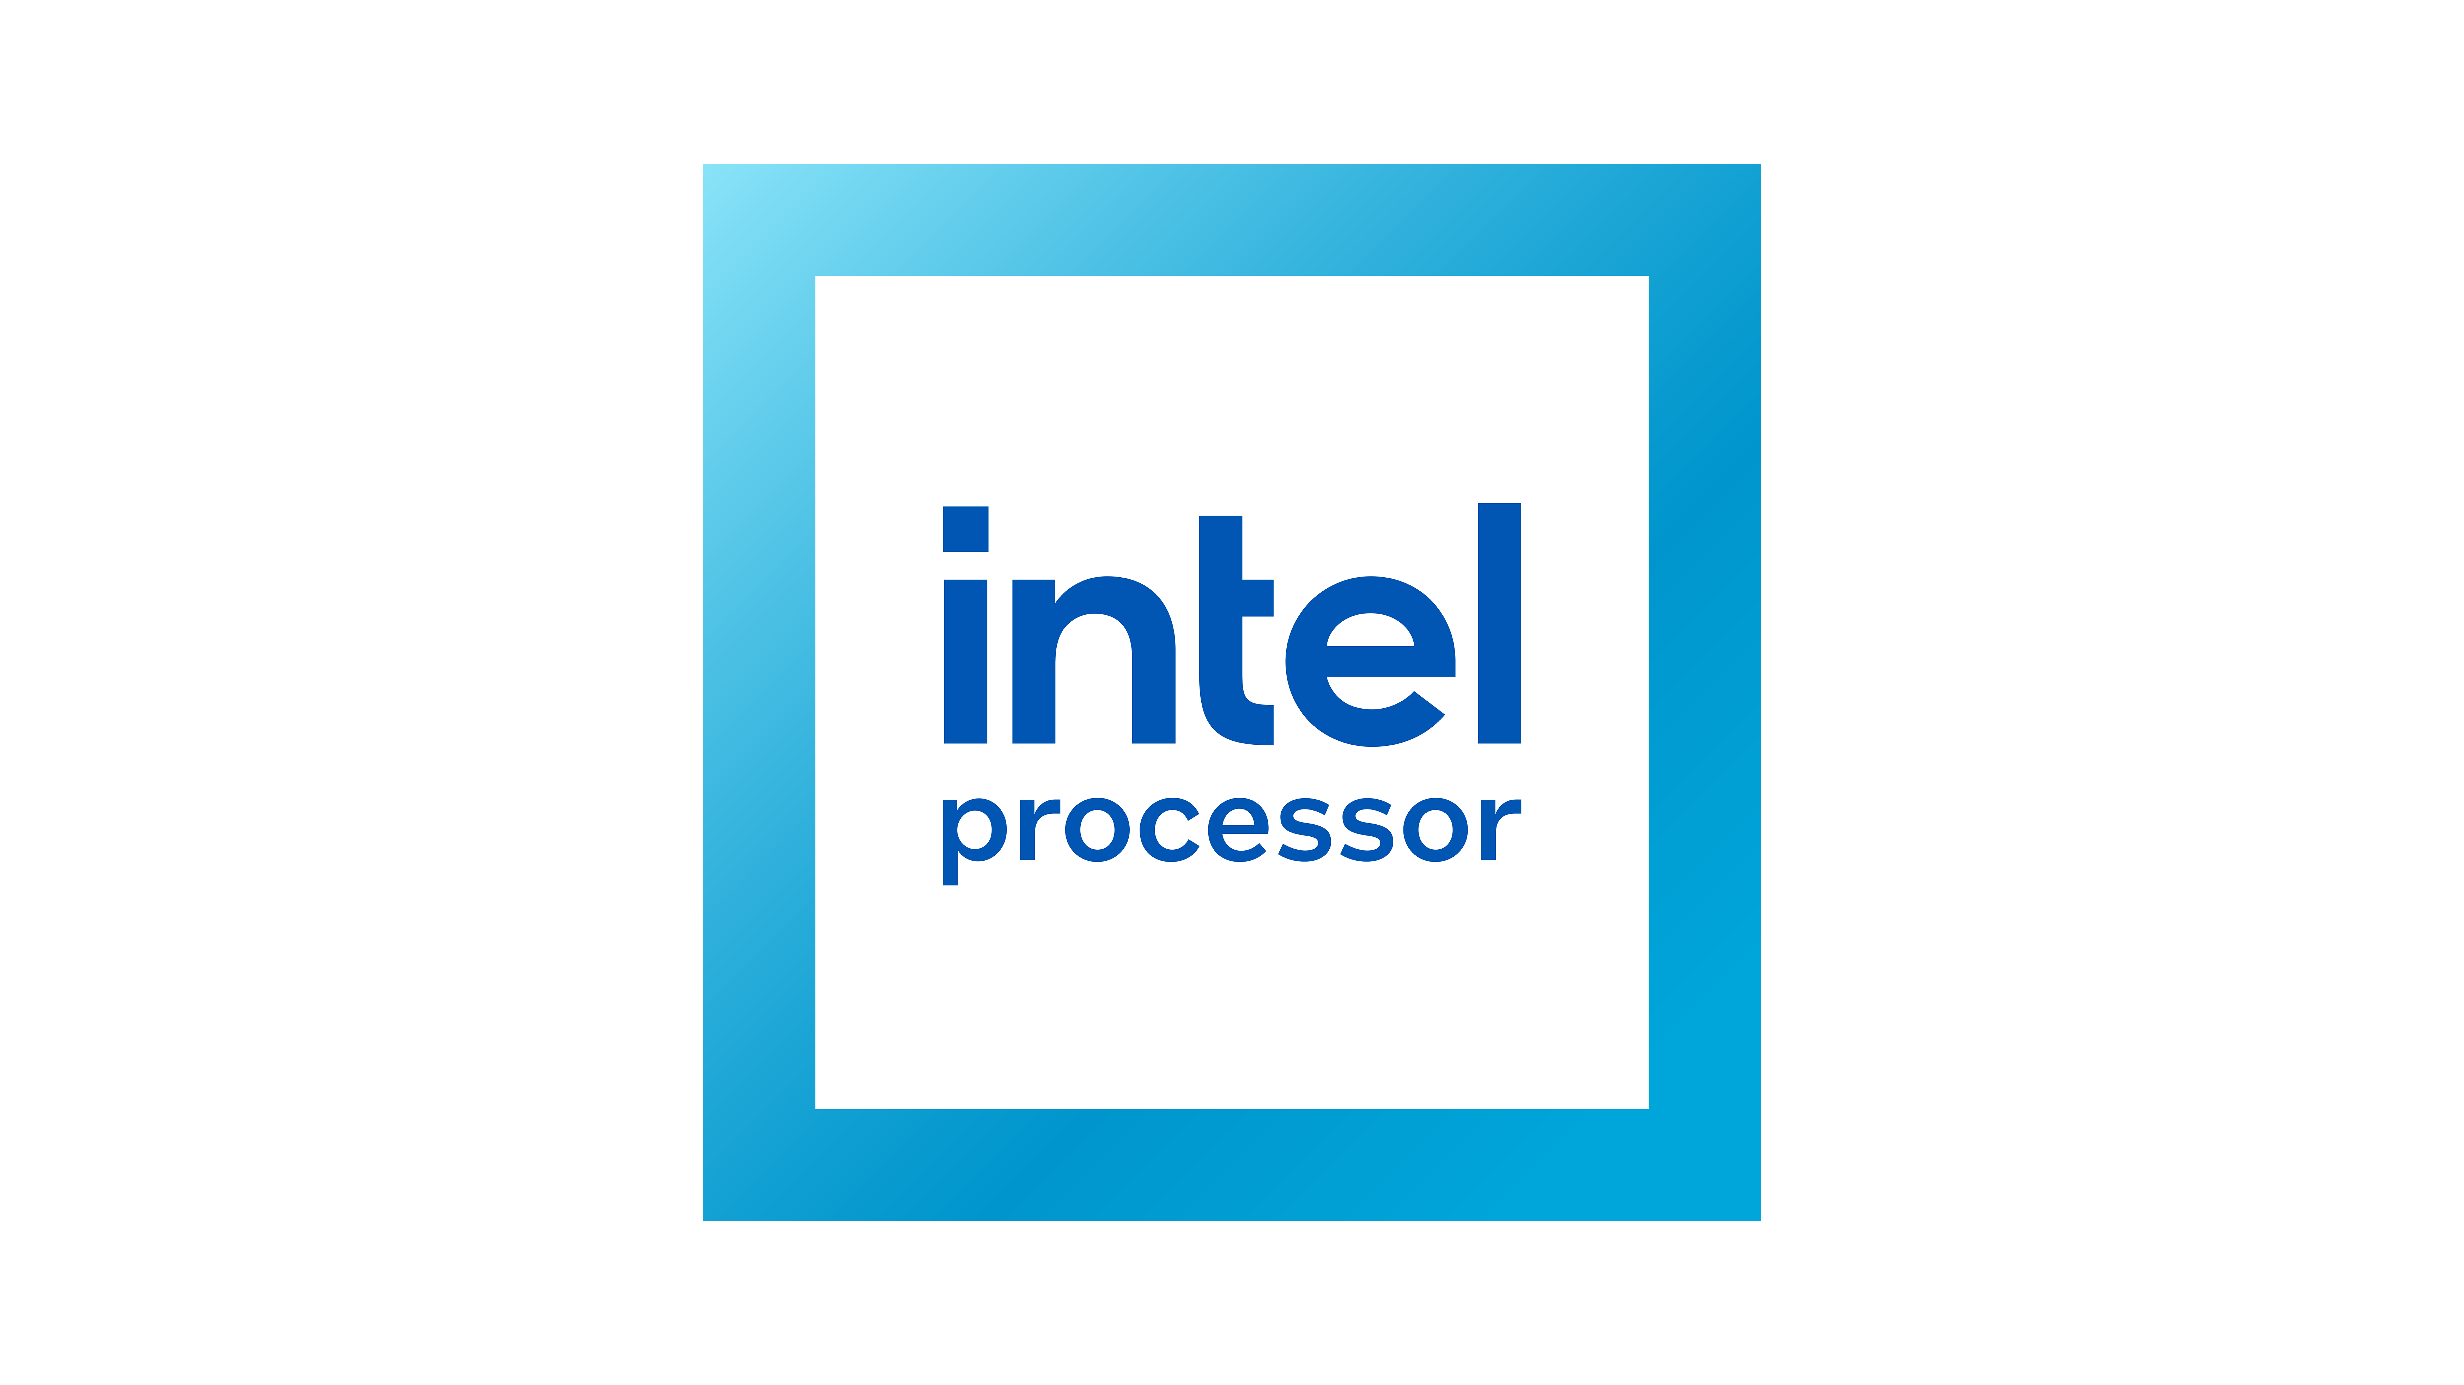
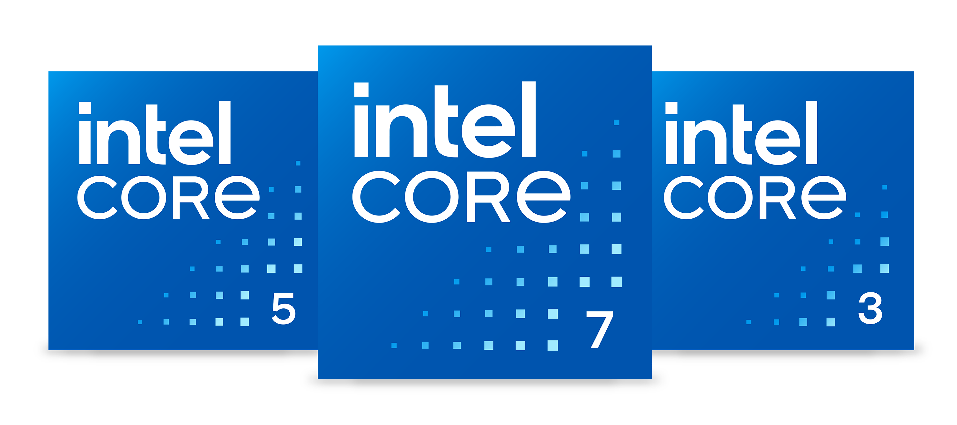
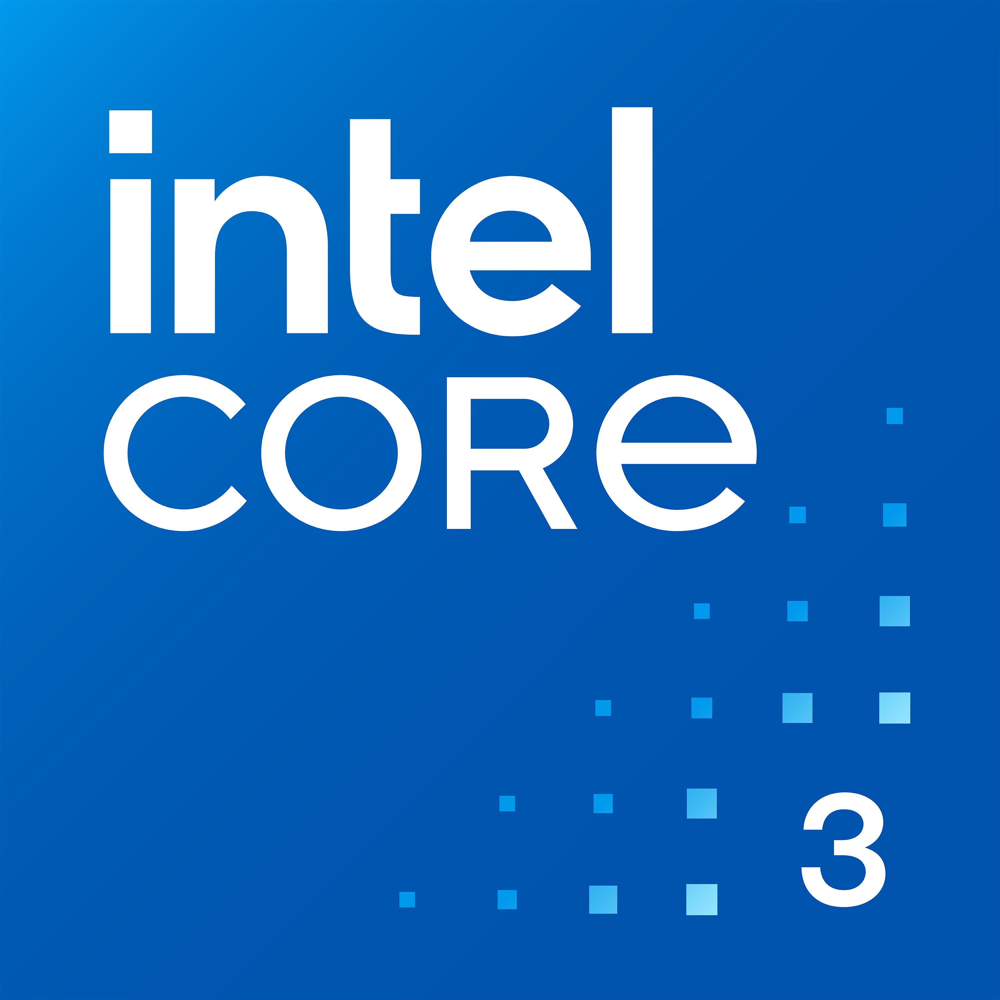
AI Optimized Across Edge Environments and Workloads
Intel® Core™ Ultra 200H/U/S Series Processors
(Codenamed Arrow Lake)
Intel® Core™ 200S/200H/100U Series Processors
(Codenamed Bartlett Lake, Raptor Lake Refresh)
Intel® Core™ 3 processor and Intel® Processor
(Codenamed Twin Lake)
Built in Intel® ArcTM GPU¹ with Intel® XMX or Intel® Graphics
Built in Intel® Graphics
Built in Intel® Graphics
Intel® AI Boost (NPU)
Backward compatible with prior gen
Backward compatible with prior gen
Up to 99 total platform TOPS²
Up to 10 years³ supply
Up to 10 years³ supply
The AI + Compute + Media performance per watt per dollar that Edge customers need to scale across their diverse use cases, environments, and workloads
Statements in this document that refer to future plans or expectations are forward-looking statements. These statements are based on current expectations and involve many risks and uncertainties that could cause actual results to differ materially from those expressed or implied in such statements. For more information on the factors that could cause actual results to differ materially, see our most recent earnings release and SEC filings at www.intc.com.
1. Intel® Arc™ GPU only available on H-SKUs of Intel® Core™ Ultra processor (Series 2). Select H-SKUs of Intel Core Ultra processors (Series 2) can achieve up to 99 total platform TOPS. Results may vary.
3. Intel does not commit or guarantee product availability or software support by way of road map guidance. Intel reserves the right to change road maps or discontinue products, software, and software support services through standard EOL/PDN processes. Contact your Intel account rep for additional information.

Slide 6
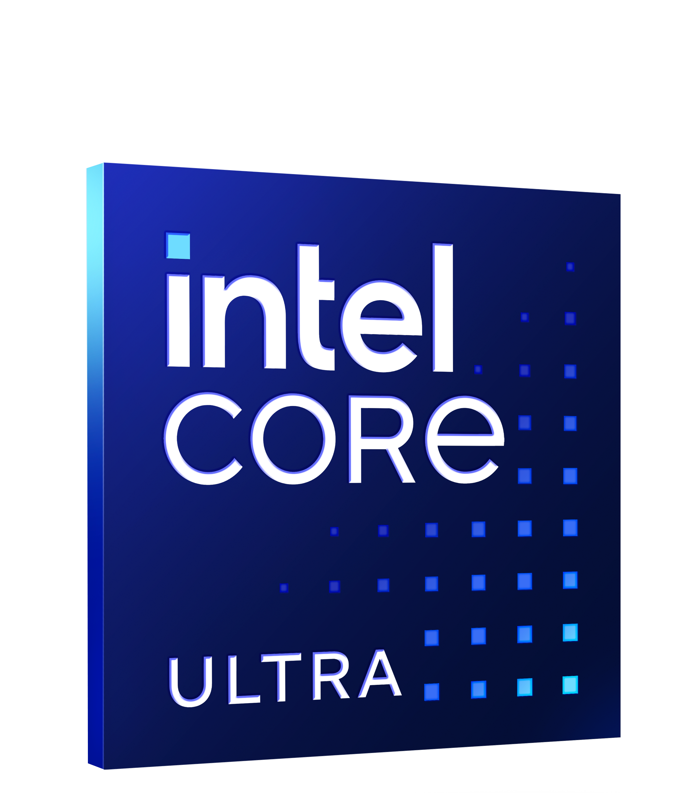
What Truly Matters for Edge AI (Intel Vs Nvidia)
Intel® Core™ Ultra 7 processor 265H (97 TOPS) VS
NVIDIA® Jetson AGX Orin 64GB (275 TOPS)
Up to
Up to
Up to
5.8x
Faster in media performance
3.4x
Faster in video analytics end-to-end workload Media + AI inference performance
8.2x
Better performance per watt per $
Performance varies by use, configuration, and other factors. See configuration details in the back up.

Slide 7
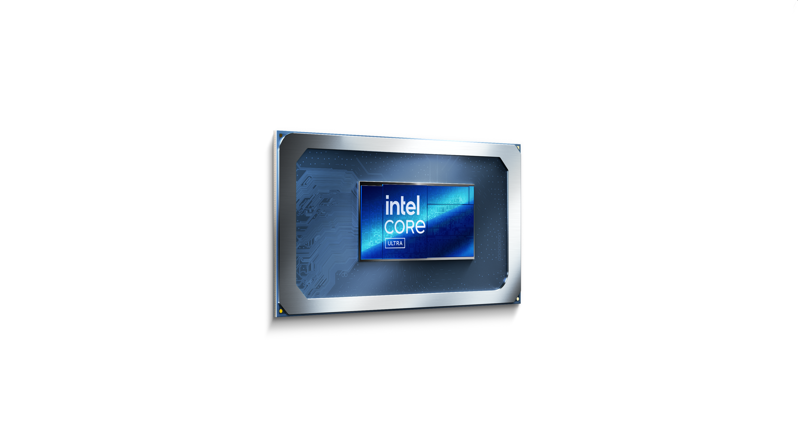
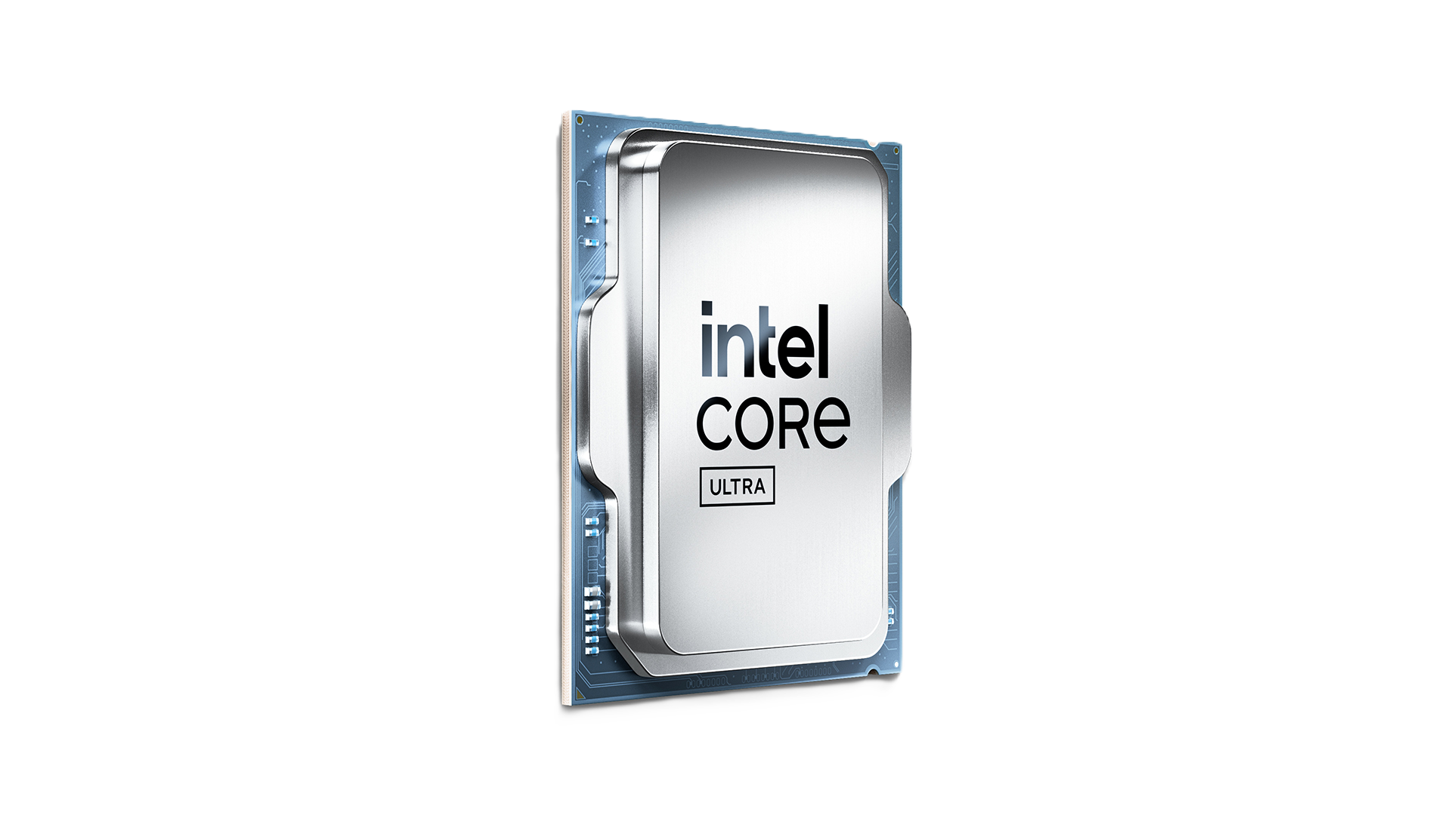
Gen over Gen Performance Improvements
Intel® Core™ Ultra 9 processor 285H
(codenamed Arrow Lake H)
VS
Intel® Core™ Ultra 9 processor 185H
(codenamed Meteor Lake H)
Up to
Up to
Up to
2.2x
Higher performance in Procyon AI Computer Vision
3.3x
Higher performance in Llama 3 8B
2.3x
Higher performance in Stable Diffusion 1.5
Intel® Core™ Ultra 9 processor 285
(codenamed Arrow Lake S)
VS
Intel® Core™ i9 processor 14900
(codenamed Raptor Lake S Refresh)
Up to
Up to
Up to
2x
Higher performance in Procyon AI Computer Vision
2.9x
Better graphics performance
1.29x(est.)
Faster Multi-threaded Performance*
Performance varies by use, configuration, and other factors. See configuration details in the back up.
*As estimated by SPECrate® 2017_fp_base (n-copy) on Intel® Core™ Ultra 9 285 vs. Intel® Core™ i9-14900. See configuration details in the back up. Results may vary.

Slide 8
Drive TCO/Sustainability Advantages
“…improves AI inference throughput by 1.25X in object detection in average compared to previous generation... all AI processing run on CPU only, challenging the perception that running AI requires discrete GPU.”
Paolo Prandoni
Chief Scientific Officer
“…boosts GenAI inference throughput by up to 2.3X and cuts latency by up to 4.8X compared
to previous generation. These improvements are a game changer for education, especially in remote areas.”
Helder Pereira
VP of Engineering
“… 1.35X faster throughput and lower latency compared to previous generation… enable us to seamlessly integrate context-aware monitoring features into our intelligent video solutions… meeting the demands of modern security challenges”
Robin van Emden
Senior Director of Data Science
“…over 2.5X more powerful than mainstream discrete GPU, while the NPU slightly outperforms by 5% … eliminating the need for a discrete GPU. making cutting-edge imaging technology more accessible and cost-effective.”
SungShik Baik
Principal Engineer
Intel does not control or audit third-party data. You should consult other sources to evaluate accuracy.
Performance varies by use, configuration, and other factors. See configuration details in the back up.
Read the full list of customer testimonials on the Intel Press Portal.

Slide 9
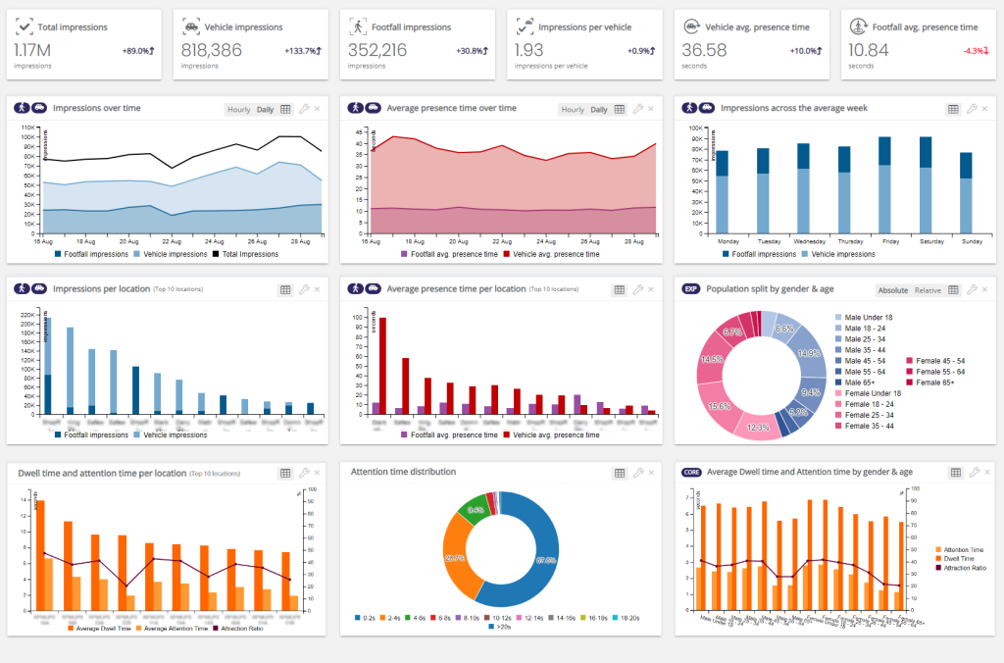
Empowering Brands at the Edge
High fidelity AI detection providing faster, more accurate insights that are private
Audience measurement platform
Custom object detection multi model
“…delivers an average 1.25x faster object detection inference than the previous generation... AI performance runs entirely on the CPU, freeing the GPU for signage tasks and ensuring flawless video playback without glitches during AI workload spikes."
Paolo Prandoni
Chief Scientific Officer
Software layer underpinning trained model
Hardware layer with built-in AI accelerators
Signage
Signage
Signage
Intel does not control or audit third-party data. You should consult other sources to evaluate accuracy.
Performance varies by use, configuration, and other factors. See configuration details in the back up.
Read the full list of customer testimonials on the Intel Press Portal.

Slide 10
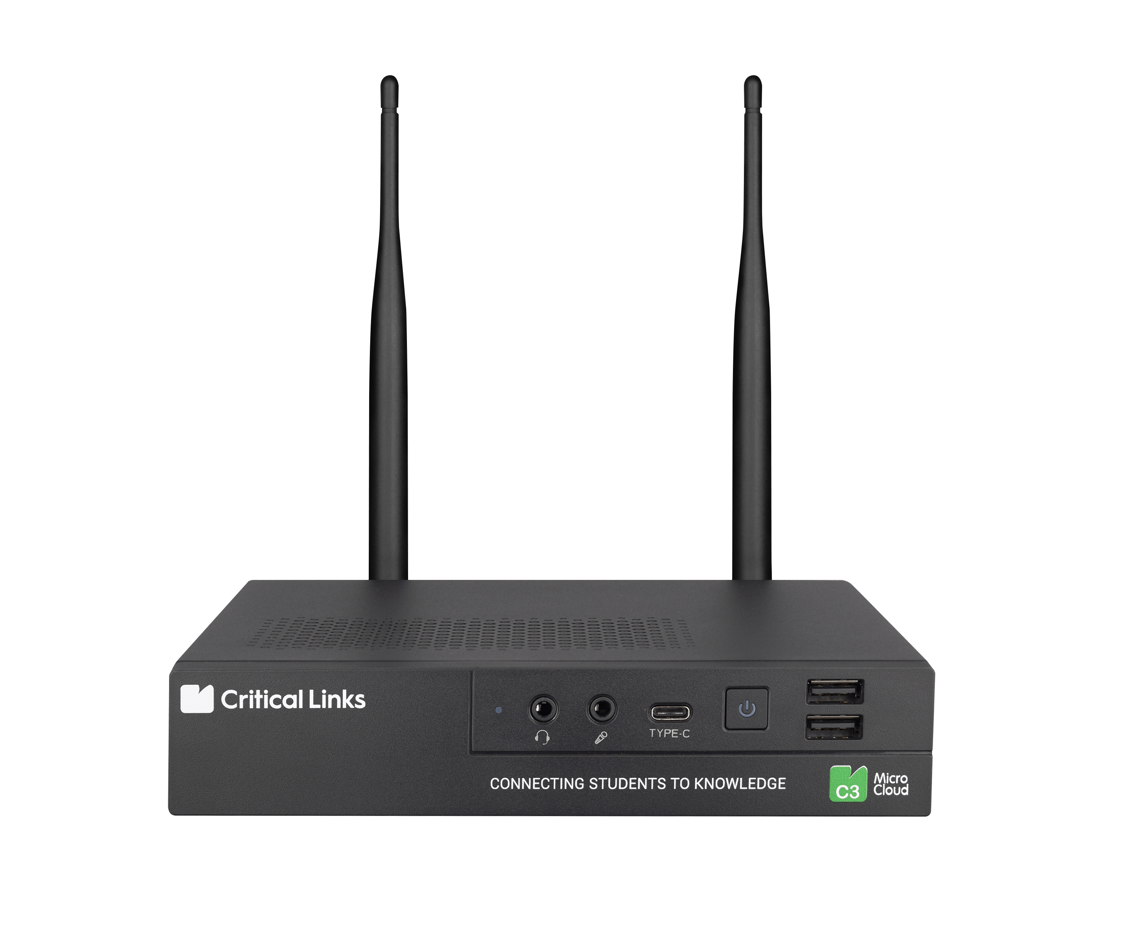
Empowering Teachers and Students at the Edge
Gen AI running locally, doesn’t require internet and offers a private and safe option
E-learning and Gen AI applications
Model layer – Llama 3.1 8B
“…boosts Gen AI inference throughput by 2.3X and cuts latency by 4.8X compared to previous generation. These improvements are a game changer for education, especially in remote areas.”
Helder Pereira
VP of Engineering
Software layer underpinning trained model
Hardware layer with built-in AI accelerators
Intel does not control or audit third-party data. You should consult other sources to evaluate accuracy.
Performance varies by use, configuration, and other factors. See configuration details in the back up.
Read the full list of customer testimonials on the Intel Press Portal.

Slide 11
Enhancing Security Monitoring at the Edge
Dynamic and context-aware monitoring without the need for predefined rules
Intelligent Video Solutions
CLIP (Contrastive Language–Image Pre-training)
“…1.35X faster throughput and lower latency compared to previous generation… enable us to seamlessly integrate context-aware monitoring features into our intelligent video solutions… meeting the demands of modern security challenges.”
Robin van Emden
Senior Director of Data Science
Software layer underpinning trained model
Hardware layer with built-in AI accelerators
Intel does not control or audit third-party data. You should consult other sources to evaluate accuracy.
Performance varies by use, configuration, and other factors. See configuration details in the back up.
Read the full list of customer testimonials on the Intel Press Portal.

Slide 12
Empowering Healthcare at the Edge
Enabling on-device data processing to ensure user privacy and accessibility
Live ViewAssist Ultrasound Imaging
Custom object classification/detection multi model
“…over 2.5X more powerful than mainstream discrete GPU, while the NPU outperforms by up to 5%, all while consuming less than one-third of the power… eliminating the need for a discrete GPU, making cutting-edge imaging technology more accessible and cost-effective.”
SungShik Baik
Principal Engineer
Software layer underpinning trained model
Hardware layer with built-in AI accelerators
Intel does not control or audit third-party data. You should consult other sources to evaluate accuracy.
Performance varies by use, configuration, and other factors. See configuration details in the back up.
Read the full list of customer testimonials on the Intel Press Portal.

Slide 13
Three Things to Remember
01
02
03
Intel launches new product offerings to address the needs of edge compute and AI
Edge is the center of gravity for AI Inference
Delivering leadership AI performance per watt per dollar optimized for everyday edge workloads
Notes:
TOPS alone don’t define real-world AI performance. Efficiency, cost, and total system performance matter more for your edge AI applications.

Slide 14
Notices & Disclaimers
Performance varies by use, configuration and other factors. Learn more on the Performance Index site.
Performance results are based on testing as of dates shown in configurations and may not reflect all publicly available updates. See backup for configuration details.
No product or component can be absolutely secure.
Your costs and results may vary.
Intel technologies may require enabled hardware, software or service activation.
Intel does not control or audit third-party data. You should consult other sources to evaluate accuracy.
Intel is committed to respecting human rights and avoiding causing or contributing to adverse impacts on human rights. See Intel’s Global Human Rights Principles. Intel’s products and software are intended only to be used in applications that do not cause or contribute to adverse impacts on human rights.
SPEC®, SPECrate® and SPEC CPU® are registered trademarks of the Standard Performance Evaluation Corporation. See http://www.spec.org/spec/trademarks.html for more information.
© Intel Corporation. Intel, the Intel logo, and other Intel marks are trademarks of Intel Corporation or its subsidiaries. Other names and brands may be claimed as the property of others.

Slide 16
Performance System Configurations
Intel® Core™ Ultra 7 processor 265H vs Nvidia Jetson Orin AGX-64GB
Series | Use case | Claim | Processor | System measured | Measurement | Measurement period
200H | Media decode performance | Intel® Core™ Ultra 7 processor 265H is up to 5.8X faster in media performance than NVIDIA Jetson AGX Orin | Intel® Core™ Ultra 7 processor 265H | System 1: Intel® Core™ Ultra 7 265H CPU: 16 cores GPU: Built-in Intel Arc GPU with 8 Xe cores with 4d-systolic NPU: Intel AI Boost Memory: 2x8GB DDR5-6400 Storage: 1024 GB SSD OS: Ubuntu 24.04.1 LTS OS BKC: MTL (24.04.1 LTS w/ Kernel 6.11) Workload & version: OpenVINO 2024.4.0 [From Archives, Linux] & DLStreamer 2024.2.1, Compiler: GCC 13.2.0 CPU Plugin Version: 2024.4.0-16579-c3152d32c9c-releases/2024/4 GPU, NPU Plugin Version: 2024.4.0-16579-c3152d32c9c-releases/2024/4 NPU Driver: Public V1.8.0 OpenCL Compute Runtime Version: 24.17.29377.6 System 2: Jetson Orin AGX-64GB CPU: 12-core Arm Cortex-A78AE v8.2 64-bit CPU 3MB L2 + 6MB L3 @ 2.2Ghz GPU: NVIDIA Ampere architecture with 2048 NVIDIA® CUDA® cores and 64 Tensor cores @ 1.3Ghz Memory: 64GB 256-bit LPDDR5 @ 204.8 GB/s Storage: 64GB eMMC 5.1 OS: Ubuntu 22.04.4 LTS OS BKC: Orin (Ubuntu 20.04.05 LTS (5.10), Ubuntu 22.04.4 LTS (5.15.136-tegra)) Workload & version: Jetpack 5.0.2, Jetpack 6.0 Rev 2 Compiler: GCC 11.4.0 CUDA Version: 11.4.x, 12.2 | System 1 Measurement: 46 streams System 2 Measurement: 8 streams Video Test Cases: HEVC 1080p30 - 2mbps HEVC 4k30 - 10mbps AVC 1080p15 AVC 4k15 | As of Nov 2024
 | Video analytics end-to-end AI pipeline performance | Intel® Core™ Ultra 7 processor 265H is up to 3.4X faster than NVIDIA Jetson AGX Orin in video analytics end-to-end AI pipeline | Intel® Core™ Ultra 7 processor 265H |  | System 1 Measurement: 68 streams System 2 Measurement: 20 streams Test Cases: we use 3 end-to-end (E2E )workloads with different AI complexities Self-checkout Retail WL: Media decode (AVC 1080p15 & 4k15)+ pre-processing + Detection (YoloV5s_416x416 @ 15fps) + Object Tracking + pre-processing + Classification model (EfficientNet-B0 @ 15inf/s) E2E AI pipeline (WL1): Media decode (HEVC 1080p30 & 4k30) + pre-processing + Detection (YoloV5s_640x640 @ 10fps) + Tracking + pre-processing + 2 Classification models (Resnet50 @10 inf/s + Mobilenet-V2 @ 10inf/s) E2E AI pipeline (WL2): Media decode (HEVC 1080p30 & 4k30)+ pre-processing + Detection (YoloV5s_640x640 @ 5fps) + Object Tracking + pre-processing + 2 Classification models (Resnet50 @5 inf/s + Mobilenet-V2 @ 5inf/s) Data was collected at different batch sizes for input videos and max performance was listed for each system. measured KPIs are based on the number of streams and # streams/watt | As of Nov 2024
 | Video analytics end-to-end AI pipeline performance | Intel® Core™ Ultra 7 processor 265H is up to 8.2X better performance/Watt/$ than NVIDIA Jetson AGX Orin in video analytics end-to-end AI pipeline performance | Intel® Core™ Ultra 7 processor 265H |  | System 1 Measurement: 68 streams, 37.1 watt, 1.8 stream/watt, 2.3 stream/watt/$ System 1 ASP: $800 System 2 Measurement: 20 streams, 39.9 watt, 0.5 stream/watt, 0.3 stream/watt/$ System 2 ASP: $1799 Test Cases: we use 3 end-to-end (E2E )workloads with different AI complexities Self-checkout Retail WL: Media decode (AVC 1080p15 & 4k15)+ pre-processing + Detection (YoloV5s_416x416 @ 15fps) + Object Tracking + pre-processing + Classification model (EfficientNet-B0 @ 15inf/s) E2E AI pipeline (WL1): Media decode (HEVC 1080p30 & 4k30) + pre-processing + Detection (YoloV5s_640x640 @ 10fps) + Tracking + pre-processing + 2 Classification models (Resnet50 @10 inf/s + Mobilenet-V2 @ 10inf/s) E2E AI pipeline (WL2): Media decode (HEVC 1080p30 & 4k30)+ pre-processing + Detection (YoloV5s_640x640 @ 5fps) + Object Tracking + pre-processing + 2 Classification models (Resnet50 @5 inf/s + Mobilenet-V2 @ 5inf/s) Data was collected at different batch sizes for input videos and max performance was listed for each system. measured KPIs are based on the number of streams, # streams/watt, #streams/watt/$ | As of Nov 2024

Slide 17
Performance System Configurations
Intel® Core™ Ultra 9 processor 285H vs Intel® Core™ Ultra 9 processor 185H
Series | Use Case | Claim | Processor | System Measured | Measurement | Measurement Period
200H | AI performance | Intel® Core™ Ultra 9 285H Processor is up to 3.3X better 1st token latency performance vs. Intel® Ultra 9-185H Processor on Llama-3-8B (INT4). Beam: 1, BS: 1, Input: 1024, output: 128 Intel® Core™ Ultra 9 285H Processor is up to 2.3X better image generation performance vs. Intel® Ultra 9-185H Processor on Stable-Diffusion-v1.5, (INT4). Input: 1024, steps: 20, resolution: 512x512 | Intel® Core™ Ultra 9 processor 285H | System 1: Intel® Core™ Ultra 9 285H (Arrow Lake H 8+16) Configuration: Processor: Intel® Core™ Ultra 9 285H Processor H 8P+16E, 45W, 5.6 GHz Max Turbo Memory: 2x16GB DDR5-6400 Storage: 1024 GB Samsung OS: Windows 11 24H2(OS Build 26100.1457) Workload & version: Llama-3-8B (INT4), Stable-Diffusion-v1.5 (FP16). Procyon AI Computer Vision. BIOS Version​: IFWI_ARL_HU_A1A0_PSPP_Release_2024WW41.4.01 Intel® HD Graphics Driver: 32.0.101.6104​ System 2: Lenovo Yoga Pro Intel® Core™ Ultra 9 185H (Meteor Lake H 6+8) Configuration: Processor: Intel® Core™ Ultra 9 185 H Processor 6P+8E, 45W, 5.1 GHz Max Turbo Memory: 32GB LPDDR5- 7467 MHz Storage: 1TB SSD OS: Windows 11 26100.712 Workload & version: Llama-3-8B (INT4), Stable-Diffusion-v1.5 (FP16). Procyon AI Computer Vision. BIOS Version​: R00.4122.D12 Intel® HD Graphics Driver: 32.0.101.5967 ​ | System 1: Measurement: Llama-3-8B, 1st token Latency: 1010 msec. Stable-Diffusion-V1.5: Image generation time: 5.8 sec. System 2: Measurement: Llama-3-8B, 1st token latency: 3387 msec. Stable-Diffusion-V1.5: Image generation time: 13.7 sec. | As of Nov 2024
 | Procyon AI Computer Vision (UL Procyon | Intel® Core™ Ultra 9 285H Processor is up to 2.2X faster GPU Float16 performance in Procyon AI Computer Vision compared to Intel® Ultra 9-185H Processor | Intel® Core™ Ultra 9 processor 285H |  | System 1 measurement: Procyon GPU Float 16: 847 System 2 measurement: Procyon GPU Float 16: 384 | As of Nov 2024

Slide 18
Performance System Configurations
Intel® Core™ Ultra 9 processor 285 vs Intel® Core™ processor i9-14900
Series | Use Case | Claim | Processor | System Measured | Measurement | Measurement Period
200S | Graphics performance | Intel® Core™ Ultra 9 285 is up to 2.97X better graphic performance vs. Intel® Core™ i9-14900 | Intel® Core™ Ultra 9 processor 285 | System 1: Intel® Core™ Ultra 9 285 (Arrow Lake S 8+16) Configuration: Processor: Intel® Core™ Ultra 9 285 / ARL S 8+16 PL1=65W, PL2=182W, 24C24T, Turbo up to 5.6 GHz Memory: 2x32GB DDR5-6400 2Rx8 Storage: 512GB Samsung PM9A1 NVMe / 512GB Western Display Resolution: 1920x1080 Operating System: Windows 11 (OS Build 26100.1591) with VBS, Defender, Tamper Protection enabled. Power Plan: AC/Ultimate Performance for all benchmarks except SYSmark 25, SYSmark 30, and Crossmark which is measured in AC/BAPCo mode. All benchmarks run in Administrator mode. OS: Windows 11 26100.1591 Workload & version: 3DMark Steel Nomad Light Unlimited BIOS Version​: MTLSFWI1.R00.4334.D93.2409111548 Micro Code​ Patch: 0x110 Intel® HD Graphics Driver: 32.0.101.5869​ System 2: Intel® Core™ i9-14900 Configuration: Processor: Intel® Core™ i9-14900 / Raptor Lake - S Refresh, 8+16, PL1=65W, PL2= 219W, 24C32T, Turbo up to 5.8GHz Memory: 2x32GB DDR5-5600 2Rx8 Storage: 512GB Samsung PM9A1 NVMe / 512GB Western Display Resolution: 1920x1080 Operating System: Windows 11 (OS Build 26100.712) with VBS, Defender, Tamper Protection enabled. Power Plan: AC/Ultimate Performance for all benchmarks except SYSmark 25, SYSmark 30, and Crossmark which is measured in AC/BAPCo mode. All benchmarks run in Administrator mode. OS: Windows 11 26100.1591 Workload & version: 3DMark Steel Nomad Light Unlimited BIOS Version​: RPLSFWI1.R00.5045.A00.2401260733 Micro Code​ Patch: 0x127 Intel® HD Graphics Driver: 32.0.101.5542​ | System 1: Measurement: 1845 System 2: Measurement: 621 | As of Oct 2024
 | Procyon AI Computer Vision (UL Procyon v2.8.1305) | Intel® Core™ Ultra 9 285 is up to 2.33X faster GPU Float16 performance in Procyon AI Computer Vision compared to Intel® Core™ i9-14900 GPU Intel® Core™ Ultra 9 285 is up to 2.25X faster GPU Float32 performance in Procyon AI Computer Vision compared to Intel® Core™ i9-14900 GPU Intel® Core™ Ultra 9 285 is up to 2.07X faster GPU INT8 performance in Procyon AI Computer Vision compared to Intel® Core™ i9-14900 GPU | Intel® Core™ Ultra 9 processor 285 |  | System 1 measurement: GPU Float 16: 331 GPU Float 32: 189 GPU INT8: 496 System 2 measurement: GPU Float 16: 142 GPU Float 32: 84 GPU INT8: 240 | As of Oct 2024
 | SPECrate2017_fp_base v1.1.9 ICX 2023.2.3 (n-copy) | Intel® Core™ Ultra 9 285 is up to 1.29X faster multi-threaded performance vs. Intel® Core™ i9-14900 | Intel® Core™ Ultra 9 processor 285 |  | System 1: Measurement: 168.68 System 2: Measurement: 130.97" | As of Oct 2024

Slide 19
Quividi Test Results and Configurations
 | Baseline system | ARL system | Perf Delta
CPU | Intel® Core™ Ultra 7 processor 155H | Intel® Core™ Ultra 7 processor 265H | N/A
AI accelerator | No | No | N/A
Memory | 16GB | 16GB | N/A
Disk | 512GB | 1TB | N/A
OS & version | Linux Ubuntu 22.04 | Linux Ubuntu 24.10 | N/A
Inference engine & version | OpenVINO version 2022.3.1 | OpenVINO Version 2022.3.1 | N/A
Workload/Model | Footfall detection and Vehicle detection (FP16) | Footfall detection and Vehicle detection (FP16) | N/A
KPI 1: Inference throughput for footfall detection in FPS (average) | 32.84 | 41.21 | 1.25
Test date | Nov 22, 2024 | Nov 26, 2024
Tested by | Quividi | Quividi
Intel does not control or audit third party data. You should consult other sources to evaluate accuracy.

Slide 20
Critical Links Test Results and Configurations
 | Baseline system | ARL system | Perf Delta
CPU | Intel® Core™ i5 13400 | Intel® Core™ Ultra 9 processor 285H | N/A
AI accelerator | Intel® UHD Graphics 730 | Integrated Arc GPU with 8 Xe cores | N/A
Memory | 2x8GB | 2 x 32GB | N/A
Disk | 500GB SSD | 500GB | N/A
OS & version | Ubuntu 22.04 based | Ubuntu 22.04 | N/A
Inference engine & version | openvino_genai-2024.5.0.0 | openvino_genai-2024.5.0.0 | N/A
Workload/Model | Llama 3.1 8B int4 | Llama 3.1 8B int4 | N/A
KPI 1: Inference throughput (tokens/s) | GPU: 5.54 | GPU: 12.91 | GPU: 2.33X
KPI 2: Latency (ms/token) | GPU: 431.32 | GPU: 89.04 | GPU: 4.84X
Test date | As of Nov 2024 | As of Nov 2024
Tested by | Critical Links | Critical Links
Intel does not control or audit third party data. You should consult other sources to evaluate accuracy.

Slide 21
Network Optix Test Results and Configurations
 | Baseline system | ARL system | Perf Delta
CPU | Intel® Core™ Ultra 7 165H | Intel® Core™ Ultra 9 285H | N/A
AI accelerator | Integrated Arc GPU with 8 Xe cores NPU | Integrated Arc GPU with 8 Xe cores NPU | N/A
Memory | 8 x 4GB | 2 x 8GB | N/A
Disk | 1TB | 500GB | N/A
OS & version | Ubuntu 24.04.1 LTS | Ubuntu 24.10 | N/A
Inference engine & version | OpenVINO nightly | OpenVINO nightly | N/A
Workload/Model | OpenAI CLIP (int8) | OpenAI CLIP (int8) | N/A
KPI 1: Inference throughput (CPU | GPU | NPU) | 28 | 95 | 152 | 38 | 108 | 192 | 1.36 | 1.14 | 1.26
KPI 2: Latency (ms) (CPU | GPU | NPU) | 35 | 10.5 | 6.6 | 26 | 9.3 | 5.2 | 1.35 | 1.13 | 1.27
Test date | As of Nov 2024 | As of Nov 2024
Tested by | Network Optix | Network Optix
Intel does not control or audit third party data. You should consult other sources to evaluate accuracy.

Slide 22
Samsung Medison Test Results and Configurations
 | Baseline system | ARL system | Perf Delta
CPU | Intel Core i5-8400H | Intel Core Ultra 7 265H | Not needed
GPU | NVIDIA RTX 3050 6GB | Built-in Intel Arc GPU or NPU | Not needed
Memory | 16GB DDR4 | 16GB DDR5 | Not needed
Disk | 512G M.2 NVMe | 512G SSD | Not needed
OS and version | Windows 10 IoT Enterprise LTSC | Windows 11 IoT Enterprise LTSC | Not needed
Tested software/workload | Live Assist with Vit-Small model | Live Assist with Vit-Small model | -
Throughput result (FPS) | 50 to 55 | GPU only: 200 NPU only: 58 | GPU: 3.64X NPU: 1.05X
Power consumption (W) | 105 | 24.9 | 4.21X Percentage =(105−24.9​)×100≈321.69%
Test date | As of Nov 2024 | As of Nov 2024
Tested by | Samsung Medison | Samsung Medison
Intel does not control or audit third party data. You should consult other sources to evaluate accuracy.

Slide 23
Customer Quotes
Samsung Medison:
“Intel Core Ultra processor delivers a remarkable boost in AI throughput performance for our real-time ultrasound imaging applications, Live ViewAssist which automatically classifies ultrasound images in real-time and provides annotation of structures. Our tests reveal that the built-in Intel Arc GPU with Intel XMX is over 2.5 times more powerful than mainstream discrete GPU, while the NPU outperforms by up to 5%, all while consuming less than one-third of the power. This flexibility allows us to offload AI tasks to either the NPU or iGPU, eliminating the need for a discrete GPU. This breakthrough enables us to integrate advanced AI features into mid and entry-level ultrasound devices, making cutting-edge imaging technology more accessible and cost-effective.”
SungShik Baik
Principal Engineer
Quividi:
"We're thrilled to announce that our Intel Core Ultra processor delivers an average 1.25x faster object detection inference than the previous generation, transforming real-time audience analytics for Digital Out-Of-Home (DOOH) networks. Marketers can now access faster, more precise insights to optimize content and drive audience engagement—all while respecting privacy. Remarkably, this breakthrough AI performance runs entirely on the CPU, freeing the GPU for signage tasks and ensuring flawless video playback without glitches during AI workload spikes.”
Paolo Prandoni
Chief Scientific Officer
Network Optix:
“Intel Core Ultra processor delivers a transformative boost in AI throughput for our real-time intelligent video solutions. Our tests reveal that Intel Core Ultra achieves up to 1.35X faster throughput and lower latency compared to previous generations in CLIP (Contrastive Language-Image Pre-Training), a multimodal model developed by OpenAI. Moreover, the integrated NPU surpasses the iGPU, offering up to 1.78X higher throughput and lower latency while consuming less power. These improvements enable us to seamlessly integrate context-aware monitoring features into our intelligent video solutions, ensuring they are more efficient, responsive, and capable of meeting the demands of modern security challenges."
Robin van Emden
Senior Director of Data Science
Critical Links:
"We are thrilled to share the incredible performance of Llama 3.1 8B on Intel® Core™ Ultra processor Series 2. Our new setup delivers up to 2.33X higher inference throughput and 4.84X faster latency compared to our previous solution based on Intel® Core™ 13th Gen processor, without the need for a discrete GPU accelerator. These advancements are game changers for education, especially in remote areas, making generative AI accessible to both students and teachers. Schools can now offer personalized learning experiences, real-time tutoring, and a more interactive environment. This is especially beneficial for remote schools with limited internet access, as the enhanced performance allows for quicker response times, better privacy without relying on the cloud. We're excited about the future and the positive impact this technology will have on students and teachers alike."
Helder Pereira
VP of Engineering
Intel does not control or audit third party data. You should consult other sources to evaluate accuracy.

Slide 24
E2E AI Workload Definition (Media + AI)
Workload | Video Analytics: Pipeline Configuration
Self-checkout | Media decode (AVC 1080p15) + Detection (Yolov5s_416x1416 @15fps) + Classification (Effecientnet-bo @15 ips)
NVR | Media decode (HEVC 1080p30) +Detection (Yolov5s @10fps ) + Classification (Resnet-50-tf @10 ips + Mobilenet-v2-tf @10 ips)

