Slide 1
Modernize Your Data Center to Achieve Unprecedented Levels of Performance and Efficiency

Slide 2
Infrastructure Refresh – Intel® Xeon® 6700 with P-cores
Explore the full Data Center Refresh Pitch Deck
Key Value Propositions – Refresh with Intel Xeon 6700 with P-cores
The Performance-Core Processor
The Pitch
Enterprise customers are always seeking improved performance with better efficiency and TCO for the broadest set of workloads.
Customers might be afraid to refresh and modernize their data infrastructure because of the cost required and overall time commitment.
By refreshing infrastructure with Intel® Xeon® 6700 with P-cores, customers can consolidate server count and experience gains like:
Lower TCO
Improved workload performance G2G and vs. AMD EPYC
Greater efficiency and perf/watt
Customer Challenges/Pain Points
Rising compute costs
Inability to justify investment and quickly achieve ROI
Performance inefficiencies
Pressure to operate more efficiently with better TCO/sustainability grades
Security concerns
Addressing modern and evolving workloads
Up to
80%
reduction in TCO¹
Lower TCO – Intel’s portfolio of hardware, software, systems, and tools can help advance your data center’s overall efficiency, creating energy savings and reducing your carbon footprint, without sacrificing performance, while providing better TCO and flexibility.
Delivering unmatched performance
Up to 50% better AI inference with 33% fewer cores vs. AMD EPYC 9755⁵
Over 25% better performance with MRDIMM⁶
Over
1.5x
Wide-reaching workload support
Artificial Intelligence | HPC
Database | AI Host CPU
better HPC performance² vs. 5th Gen Intel Xeon
1.6X
better performance/watt³ vs. 5th Gen Intel Xeon at 40% utilization
Focal features for optimal performance
Optimized Workload Performance – Intel Xeon 6 processors with P-cores deliver unmatched for the broadest set of workloads, including AI and HPC.
Up to 86 cores per socket
8000 MT/s MRDIMM for memory bound WLs
Intel® AMX with FP16 support
Efficiency – Increase data center efficiency and total cost of ownership. Intel Xeon 6 with P-cores offers as perf/watt improvement while maintaining overall performance.
Customer Targeting
Customers that check any of these boxes:
Current Xeon customers
Want to remain on Xeon or exploring competitive refresh options
Looking to improve performance particularly across networking, database and microservices
Targeting improvements in efficiency and TCO with server consolidation
Over
5:1
server consolidation from 2nd Gen Intel Xeon⁴
Modernization – Intel Xeon 6 processors with P-cores deliver the data center efficiency capabilities required by modern workloads. Replacing aging infrastructure with these speedy and energy efficient processors will help you keep pace with rapidly evolving market needs.
Confidential Computing – With Intel, you can choose from the most deployed confidential computing options in data centers on the market today—now including application and VM-level isolation—across Intel SGX, Intel TDX and TDX Connect.
Target customer personas
BEST: Chief Technology Officer
BETTER: Infrastructure Manager/Director
GOOD: IT Manager
^{1,} See P-core section in Refresh Pitch Deck
^{2,} See [7H25] at intel.com/processorclaims: Intel® Xeon® 6. Results may vary
³ See [7T20] at intel.com/processorclaims: Intel® Xeon® 6. Results may vary
⁴ Workload geomean – see intel.com/processorclaims: Xeon 6
⁵ See [7A220] at intel.com/processorclaims: Intel® Xeon® 6. Results may vary
⁶ See Intel Xeon 6 product deck - slide 39 (compared to DDR5)

Slide 3
Infrastructure Refresh – Intel® Xeon® 6900 with P-cores
Explore the full Data Center Refresh Pitch Deck
Key Value Propositions – Refresh with Intel Xeon 6900 with P-cores
The Performance-Core Processor
The Pitch
Enterprise customers are always seeking improved performance with better efficiency and TCO for AI & HPC workloads.
Customers might be afraid to refresh and modernize their data infrastructure because of the cost required and overall time commitment.
By refreshing infrastructure with Intel Xeon 6900 with P-cores, customers can consolidate server count and experience gains like:
Lower TCO
Improved workload performance G2G and vs. AMD EPYC
Greater efficiency and perf/watt
Customer Challenges/Pain Points
Rising compute costs
Inability to justify investment and quickly achieve ROI
Performance inefficiencies
Pressure to operate more efficiently with better TCO/sustainability grades
Security concerns
Addressing modern and evolving workloads
Up to
87%
reduction in TCO¹
Lower TCO – Intel’s portfolio of hardware, software, systems, and tools can help advance your data center’s overall efficiency, creating energy savings and reducing your carbon footprint, without sacrificing performance, while providing better TCO and flexibility.
Delivering unmatched performance
Up to 2x higher AI inference vs. AMD EPYC 9755⁵
Over 30% better performance with MRDIMM⁶
Up to
17x
Wide-reaching workload support
Artificial Intelligence | HPC
Database | AI Host CPU
AI inference performance gain² vs. 2nd Gen Intel Xeon
1.9X
better performance/watt³ vs. 5th Gen Intel Xeon CPUs
Focal features for optimal performance
Optimized Workload Performance – Intel Xeon 6 processors with P-cores deliver unmatched performance for compute-intensive, memory-bound workloads across AI and HPC.
Up to 128 cores per socket
8800 MT/s MRDIMM for memory bound WLs
Intel® AMX with FP16 support
Efficiency – Increase data center efficiency and total cost of ownership. Intel Xeon 6 with P-cores offers as perf/watt improvement while maintaining overall performance.
Customer Targeting
Customers that check any of these boxes:
Current Xeon customers
Want to remain on Xeon or exploring competitive refresh options
Looking to improve performance particularly across networking, database and microservices
Targeting improvements in efficiency and TCO with server consolidation
Over
17:1
server consolidation from 1st Gen Intel Xeon⁴
Modernization – Intel Xeon 6 processors with P-cores deliver the data center efficiency capabilities required by modern workloads. Replacing aging infrastructure with these speedy and energy efficient processors will help you keep pace with rapidly evolving market needs.
Confidential Computing – With Intel, you can choose from the most deployed confidential computing options in data centers on the market today—now including application and VM-level isolation—across Intel SGX, Intel TDX and TDX Connect.
Target customer personas
BEST: Chief Technology Officer
BETTER: Infrastructure Manager/Director
GOOD: IT Manager
^{1,} See P-core section in Refresh Pitch Deck
^{2,} See [9A3] at intel.com/processorclaims: Intel® Xeon® 6. Results may vary
³ See [9G2] at intel.com/processorclaims: Intel® Xeon® 6. Results may vary
⁴ See P-core section in Refresh Pitch Deck
⁵ See [9A221] at intel.com/processorclaims: Intel® Xeon® 6. Results may vary
⁶ See Intel Xeon 6 product deck - slide 39 (compared to DDR5)

Slide 4
Infrastructure Refresh – Intel® Xeon® 6700 with E-cores
Explore the full Data Center Refresh Pitch Deck
Key Value Propositions – Refresh with Intel® Xeon® 6700 with E-cores
The Efficient-Core Processor
The Pitch
Enterprise customers are always seeking improved performance with better efficiency and TCO.
Customers might be afraid to refresh and modernize their data infrastructure because of the cost required and overall time commitment.
By refreshing infrastructure with Intel® Xeon® 6700 with E-cores, customers can consolidate server count and experience gains like:
Lower TCO
Improved workload performance G2G and vs. AMD EPYC
Greater efficiency and perf/watt
Customer Challenges/Pain Points
Rising compute costs
Inability to justify investment and quickly achieve ROI
Performance inefficiencies
Pressure to operate more efficiently with better TCO/sustainability grades
Security concerns
Addressing modern and evolving workloads
Up to
78%
server reduction¹
Lower TCO – Intel’s portfolio of hardware, software, systems, and tools can help advance your data center’s overall efficiency, creating energy savings and reducing your carbon footprint, without sacrificing performance, while providing better TCO and flexibility.
Optimized for performance/watt
~60% average perf/watt gain vs prior gen³
Save up to 280W power compared to prior gen⁴
Up to
5.8x
Wide-reaching workload support
Web & Microservices | Database & Analytics
Infrastructure & Storage | Networking & Edge
performance gain vs. 2nd Gen Intel® Xeon²
3.4X
better performance/watt vs. 2nd Gen Intel Xeon²
Unmatched core density for scale-out capacity
Optimized Workload Performance – Intel® Xeon® 6 processors with E-cores deliver distinct advantages for cloud-scale workloads, and provide unmatched core density for scale-out capacity.
Up to 144 cores per socket
2.5x more threads than 2nd Gen Intel Xeon CPUs
Efficiency – Increase rack utilization for better efficiency and total cost of ownership. Intel Xeon 6 with E-cores offers the highest task parallel perf/watt.
Customer Targeting
Customers that check any of these boxes:
Current Xeon customers
Want to remain on Xeon or exploring competitive refresh options
Looking to improve performance particularly across networking, database and microservices
Targeting improvements in efficiency and TCO with server consolidation
Over
6:1
server consolidation from 1st Gen Intel Xeon¹
Modernization – Intel Xeon 6 processors with E-cores deliver the data center efficiency capabilities required by modern workloads. Replacing aging infrastructure with these speedy and energy efficient processors will help you keep pace with rapidly evolving market needs.
Target customer personas
BEST: Chief Technology Officer
BETTER: Infrastructure Manager/Director
GOOD: IT Manager
Confidential Computing – With Intel, you can choose from the most deployed confidential computing options in data centers on the market today—now including application and VM-level isolation—across Intel® SGX and Intel® TDX.
^{1,} See E-core section in Refresh Pitch Deck
^{2,} See [7G1, 7D1, 7W4, 7N1, 7N2 ] at intel.com/processorclaims: Intel® Xeon® 6. Results may vary (Database, Web, Media and Networking workloads)
³ See [7T4] at intel.com/processorclaims: Intel® Xeon® 6. Results may vary
⁴ See [7T3] at intel.com/processorclaims: Intel® Xeon® 6. Results may vary

Slide 5
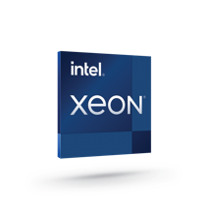
Infrastructure Refresh with 5th Gen Intel® Xeon® Processors
Explore the full Data Center Refresh Pitch Deck
Key Value Propositions – Refresh with 5th Gen Intel Xeon
The Processor Designed for AI
The Pitch
Enterprise customers are always seeking improved performance with better efficiency and TCO.
Customers might be afraid to refresh and modernize their data infrastructure because of the cost required and overall time commitment.
By refreshing infrastructure with 5th Gen Intel® Xeon® Scalable processors, customers can consolidate server count and experience gains like:
Lower TCO
Improved workload performance G2G and vs. AMD EPYC
Greater efficiency and perf/watt
Customer Challenges/Pain Points
Rising compute costs
Inability to justify investment and quickly achieve ROI
Performance inefficiencies
Pressure to operate more efficiently with better TCO/sustainability grades
Security concerns
Addressing modern and evolving workloads
Up to
77%
reduction in TCO¹
Lower TCO – Intel’s portfolio of hardware, software, systems, and tools can help advance your data center’s overall efficiency, creating energy savings and reducing your carbon footprint, without sacrificing performance, while providing better TCO and flexibility.
Run any AI code, every workload
5th Gen Intel® Xeon® Scalable processor
The flexibility of Xeon with the built-in DL performance of an AI accelerator
Build and deploy AI everywhere
84%
Intel® AI software suite of optimized open-source frameworks and tools
Enables out of the box AI performance and E2E productivity
performance gain
for general compute²
Optimized Workload Performance – By delivering more performance per core with built-in accelerators, 5th Gen Intel Xeon processors help you meet requirements for even the most demanding workloads.
10X
better efficiency (perf/watt) with built-in accelerators like Intel® AMX³
Implement pre-built solutions
Extensive Intel AI products and partnership
Accelerate end customer time to market
Efficiency – Intel® Accelerator Engines boost CPU utilization and reduce electricity consumption, resulting in lower impact on the environment.
Customer Targeting
Customers that check any of these boxes:
Current Xeon customers
Want to remain on Xeon or exploring competitive refresh options
Looking to improve performance particularly across AI workloads
Targeting improvements in efficiency and TCO with server consolidation
Up to
16:1
server consolidation¹
Modernization – Intel Xeon processors deliver the low-latency, high-bandwidth capabilities required by modern and AI-infused workloads. Replacing aging infrastructure with these speedy and energy efficient processors will help you keep pace with rapidly evolving market needs.
Target customer personas
BEST: Chief Technology Officer
BETTER: Infrastructure Manager/Director
GOOD: IT Manager
Confidential Computing – With Intel, you can choose from the most deployed confidential computing options in data centers on the market today—now including application and VM-level isolation—across Intel® SGX and Intel® TDX.
^{1, 2, 3} See [T7. G1, A16+17, T13] at intel.com/processorclaims:5th Gen Intel Xeon Scalable processors. Results may vary.
² Geomean of LINPACK, STREAM Triad and SPECrate 2017

Slide 6
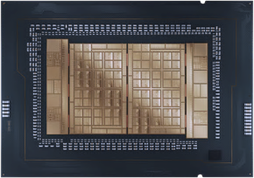
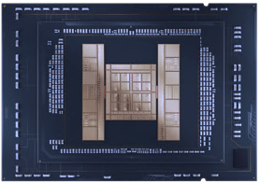
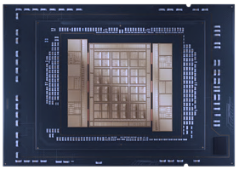
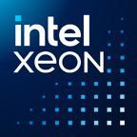
Modernize Your Data Center and Significantly Reduce TCO Without Sacrificing Performance
Intel® Xeon® CPUs offer performance and flexibility to handle the broadest range of workloads, including:
Challenges :
Update aging infrastructure to meet increasing and diverse demands.
Solution:
Refreshing servers to newer 5th Gen and Intel Xeon 6 processors can help organizations:
AI
Data services
Emerging workloads
Improve performance for modern workloads like AI and HPC
HPC
Networking
Efficiency and TCO
Enable server consolidation for a lower total cost of ownership (TCO)
Sustainability
Increase energy efficiency and deliver on sustainability goals
Security and reliability
Reduce security risks while increasing reliability and uptime
6

Slide 7
Optimize the Data Center with Power, Efficiency, and Versatility
Efficiently transition workloads to Intel Xeon 6 and 5th Gen Intel Xeon processors. These product families offer a choice of microarchitectures designed to address a wide range of workloads, from AI & HPC to data services.
5th Gen Intel Xeon processors
Impressive performance per watt across all workloads, with a lower TCO compared to the previous generation.
Intel Xeon 6 processors with Performance-cores (P-cores)
High performance per core and the best solution for compute-intensive, vector-based workloads such as AI and HPC.
Intel Xeon 6 processors with Efficient-cores (E-cores)
Best for task-parallel, scale-out workloads such as web and microservices
and storage.
Up to 64 cores
Up to 128 cores (6900P) &
Up to 86 cores (6700P)
Up to 144 cores
Cores
2 socket
1 socket (136 PCIe lanes)
2 , 4 and 8 socket
2 socket
Scalability
DDR5
Improved memory bandwidth
Multiplexed Rank DIMMs (MRDIMMs)
DDR5
Memory
Accelerated Inferencing
Intel® Advanced Matrix Extensions (Intel® AMX – FP16 for Xeon 6) and
Intel® Advanced Vector Extensions (Intel®AVX-512)
Integer Operations Support
Intel® Advanced Vector Extensions (Intel® AVX2)
AI
Application-level isolation
Intel® Software Guard Extensions (Intel® SGX)
+
Virtual machine (VM) isolation & confidentiality
Intel® Trust Domain Extensions (Intel® TDX)*
Security
Accelerated cryptography & compression
Intel® QuickAssist Technology (Intel® QAT)
+
Accelerated network processing
Intel® Dynamic Load Balancer (Intel® DLB)
Acceleration
*Intel TDX Connect supported on Intel Xeon 6 with P-cores

Slide 8
Modernize for a Datacenter Transformation
Make room to expand your AI infrastructure. Consolidate your data center with Intel® Xeon® processors to save space, reduce costs, and take on new workloads.
From 2nd Gen Intel Xeon to Intel Xeon 6700 with P-cores
From 2nd Gen Intel Xeon to Intel Xeon 6900 with P-cores
8260-->6760P
6230-->6787P
5218R-->6760P
8260-->6979P
6240-->6980P
5220-->6972P
4208-->6952P
Reduce servers
50 to 14 (72%)
50 to 10 (80%)
50 to 12 (76%)
50 to 8 (84%)
50 to 6 (88%)
50 to 6 (88%)
50 to 3 (94%)
Reduce energy and CO₂
48%
51%
44%
56%
69%
59%
77%
Reduce TCO*
51%
60%
57%
62%
64%
72%
87%
Recover costs (months)
15
11
13
14
11
9
4
From 2nd Gen Intel Xeon to Intel Xeon 6700 with E-cores
From 2nd Gen Intel Xeon to 5th Gen Intel Xeon
6252-->6710E
6252-->6740E
6252-->6780E
8260-->8558
6230-->8558
5218-->6538Y+
4214-->5520+
Reduce servers
50 to 21 (58%)
50 to 15 (70%)
50 to 11 (78%)
50 to 18 (64%)
50 to 15 (70%)
50 to 16 (68%)
50 to 15 (70%)
Reduce energy and CO₂
45%
53%
56%
33%
30%
47%
38%
Reduce TCO*
43%
53%
55%
45%
53%
55%
61%
Recover costs (months)
14
13
16
15
12
9
6
*Based on US energy costs, estimated over 4 years
Performance varies by use, configuration and other factors. | Please reference Intel Node TCO & Power Calculator

Slide 9
Modernize your datacenter to run your AI
workloads more efficiently
Intel® Xeon® processors feature Intel® AMX, MRDIMMs, and native security features for inferencing workloads and sensitive data.
1st Gen Intel Xeon to 5th Gen Intel Xeon
2nd Gen Intel Xeon to Intel Xeon 6 with P-cores (6700 series )
Higher core counts, featuring up to 86 P-cores on the 6700 series and up to 128 P-cores for 6900 series
Recommendation system
DLRM
Natural language processing (NLP) BERT-Large
Image Classification ResNet50
Increased bandwidth with MRDIMM memory support and delivering up to 504MB low-latency last-level cache in Intel Xeon 6 with P-cores
Performance advantage per server
15.4x
24x
9.9x
Includes built-in accelerators, Intel® AMX and Intel® AVX-512
Server consolidation
50 to 4
50 to 3
10 to 1
Offers a comprehensive software suite across classical machine learning (ML) and small GenAI models
Fleet energy saved
1,259 MWh
1,697 MWh
30,044 MWh
Reduced CO₂ emissions
533 metric tons
719 metric tons
12,737 metric tons
Strengthens security with Intel® SGX, Intel® TDX and Intel TDX Connect ( for Intel Xeon 6 with P-cores)
TCO savings (estimated over 4 years)
$448K
$541K
$10.4M
% TCO savings*
Up to 67%
Up to 77%
Up to 68%
*Based on US energy costs, estimated over 4 years
Intel Xeon 6 leveraging MRDIMMs
See [T8, T7, 7T21] intel.com/processorclaims: 5th gen and Intel Xeon 6. Results may vary
9
Notes:
1 See [T8] at intel.com/processorclaims: 5th Generation Intel Xeon Scalable Processors
2 See [T7] at intel.com/processorclaims: 5th Generation Intel Xeon Scalable Processors
3 See [7T21] at intel.com/processorclaims: 5th Generation Intel Xeon Scalable Processors

Slide 10
Reduce Your Energy Consumption and Costs on New Server Purchases for AI
Intel® Xeon® processors deliver a significant performance advantage and lower TCO compared to AMD EPYC servers on AI workloads.
Intel Xeon 6700P vs. AMD EPYC 9535 (Turin)
Intel Xeon 6900P vs. AMD EPYC 9755/9654 (Turin/Genoa)
5th Gen Intel Xeon vs. AMD EPYC 9554 (Genoa)
Vision Transformation INT8 (Batched)
Stable Diffusion
INT8 (Realtime)
Recommendation systems DLRM
Image
classification
ResNet-50
Natural language processing BERT-Large
Natural language processing DistilBERT
Performance advantage (per server)
2.09x
1.53x
1.87x
4.91x
2.22x
3.49x
Server consolidation
289 to 140
204 to 130
170 to 90
496 to 100
50 to 23
50 to 15
Fleet energy saved
5,788 MWh
2,011 MWh
5,497 MWh
16,717 MWh
1,205 MWh
1,496 MWh
Reduced CO₂ emissions
2,454 metric tons
853 metric tons
2,330 metric tons
7,087 metric tons
5,109 metric tons
6,344 metric tons
TCO savings (estimated over 4 years)
$6.3M
$2.6M
$4.0M
$18.8M
$883K
$1.3M
% TCO savings*
Up to 52%
Up to 31%
Up to 46%
Up to 74%
Up to 41%
Up to 62%
*Based on US energy costs, estimated over 4 years
Intel Xeon 6 leveraging MRDIMMs
See [7T221, 7T222, 9T222, 9T10, T205, T206] intel.com/processorclaims: 5th gen and Intel Xeon 6. Results may vary
Notes:
1 See [7T221] at intel.com/processorclaims: Intel Xeon 6 Processors
2 See [7T222] at intel.com/processorclaims: Intel Xeon 6 Processors
3 See [9T222] at intel.com/processorclaims: Intel Xeon 6 Processors
4 See [9T10] at intel.com/processorclaims: Intel Xeon 6 Processors
5 See [T205] at intel.com/processorclaims: 5th Generation Intel Xeon Scalable Processors
6 See [T206] at intel.com/processorclaims: 5th Generation Intel Xeon Scalable Processors

Slide 11
Achieve Better TCO Without Compromising on Performance for HPC
Why Intel Xeon for HPC?
Intel® Xeon® 6 processors with P-cores use higher core counts and higher bandwidth memory to boost HPC workloads.
2nd Gen Intel Xeon to Intel Xeon 6 with P-cores (6700 series)
Higher core counts featuring up to 86 P-cores on the 6500/6700-series and up to 128 P-cores on the 6900-series
HPCG
Increased bandwidth with MRDIMM memory support and delivering up to 504MB low-latency last-level cache
Performance advantage per server
3.95x
Provides built-in accelerators, including Intel® AMX and Intel® AVX-512
Server consolidation
4 to 1 servers
Fleet energy saved
9,889 MWh
Strengthens security with Intel® SGX, Intel® TDX and Intel TDX Connect (only for Intel Xeon 6 P-cores)
Reduced CO₂ emissions
4,193 metric tons
TCO savings
$1.6M
% TCO savings*
22%
*Based on US energy costs, estimated over 4 years
Intel Xeon 6 leveraging MRDIMMs
See [7T22] intel.com/processorclaims: Intel Xeon 6. Results may vary.
11
Notes:
¹ See [7T22] at intel.com/processorclaims: Intel Xeon 6. Results may vary.

Slide 12
Reduce Your Energy Consumption and Costs on New Server Purchases for HPC
Intel® Xeon® processors bring higher performance and TCO savings over AMD EPYC processors for HPC workloads.
Intel Xeon 6900P processors vs. AMD EPYC 9755 (Turin)
Intel Xeon 6900P processors vs. AMD EPYC 9654 (Genoa)
5th Gen Intel Xeon processors vs. AMD EPYC 9554 (Genoa)
OpenFOAM
OpenFOAM
Monte Carlo
Performance advantage (per server)
1.43x
1.8x
1.83x
Server consolidation
126 to 90
154 to 80
50 to 28
Lower fleet power (megawatt)
2,623 MWh
992 MWh
585 MWh
Reduced CO₂ emissions
1,112 metric tons
421 metric tons
248 metric tons
TCO savings
$1.9M
$2.3M
$561,000
% TCO savings*
28% lower TCO
29% lower TCO
27% lower TCO
*Based on US energy costs, estimated over 4 years
Intel Xeon 6 leveraging MRDIMMs
See [9T9, 9T223, T206] intel.com/processorclaims: 5th Gen and Intel Xeon 6. Results may vary. This offering is not approved or endorsed by OpenCFD Limited, producer and distributor of the OpenFOAM software via www.openfoam.com, and owner of the OPENFOAM® and OpenCFD® trademark.
Notes:
1 See [9T9] at intel.com/processorclaims: Intel Xeon 6 Processors
2 See [9T223] at intel.com/processorclaims: Intel Xeon 6 Processors
3 See [T206] at intel.com/processorclaims: 5th Generation Intel Xeon Scalable Processors

Slide 13
Accelerate Time to Insights for Data Services
Relational databases benefit from parallel data processing in Intel® Xeon® 6 processors with P-cores, while non-relational databases benefit from the task-parallel design of Intel Xeon 6 processors with E-cores.
Why Intel Xeon for data services?
1st Gen Intel Xeon to 5th Gen Intel Xeon
2nd Gen Intel Xeon to Intel Xeon 6 with P-cores (6700 series )
Higher core counts, featuring up to 86 P-cores on the 6700 series and up to 128 P-cores for 6900 series
RocksDB
MySQL OLTP
(1S HammerDB)
Increased bandwidth and cache memory with MRDIMM memory support (P-core only) and delivering up to 504MB low-latency last-level cache
Performance advantage per server
5.86x
4.29x
Server consolidation
50 to 9 servers
780 to 180 servers
Offers built-in accelerators like Intel® In-Memory Analytics Accelerator, Intel® QuickAssist Technology, and Intel® Data Streaming Accelerator
Fleet energy saved
1,191 MWh
14,735 MWh
Reduced CO₂
emissions
5,051 metric tons
6,247 metric tons
Delivers scalability with 1S, 2S, 4S, and 8S options (4S/8S only for 6700P)
TCO savings
$192K
$3.2M
Strengthens security with Intel® SGX, Intel® TDX and Intel TDX Connect (only for Xeon 6 P-cores)
% TCO savings*
Up to 28%
Up to 29%
*Based on US energy costs, estimated over 4 years
13
See [T5, 7T24] intel.com/processorclaims: 5th Gen and Intel Xeon 6. Results may vary
Notes:
¹ See [T5] at intel.com/processorclaims: 5th Generation Intel Xeon Scalable Processors.
² See [7T24] at intel.com/processorclaims: 6th Generation Intel Xeon Scalable Processors.

Slide 14
Reduce Your Energy Consumption and Costs on New Server Purchases for Data Services
Intel® Xeon® processors bring higher performance and TCO savings over AMD EPYC processors for data services workloads taking advantage of MRDIMMs and Intel Accelerators.
Intel Xeon 6900P vs. AMD EPYC 9654 (Turin)
Intel Xeon 6900P vs. AMD EPYC 9535 (Turin)
5th Gen Intel Xeon
vs. AMD EPYC 9554 (Genoa)
MongoDB (1S)
Redis Memtier (1S)
RocksDB
MySQL OLTP (HammerDB)
Performance advantage per server
2x
1.09x
1.62x
1.70x
Server consolidation
229 to 110 servers
220 to 200 servers
50 to 31 servers
50 to 30 servers
Fleet energy
saved
1,897 MWh
845 MWh
1, 218 MWh
684 MWh
Reduced CO₂ emissions
804 metric tons
359 metric tons
516 metric tons
289 metric tons
TCO savings
$4.2M
$1.2M
$471K
$508K
TCO Savings*
Up to 38% savings
Up to 13% savings
Up to 22% savings
Up to 24% savings
*Based on US energy costs, estimated over 4 years
See [9T8, 7T224, T202, T201] intel.com/processorclaims: 5th Gen and Intel Xeon 6. Results may vary
Notes:
¹ See [9T8] at intel.com/processorclaims: 6th Generation Intel Xeon Scalable Processors.
² See [7T224] at intel.com/processorclaims: 6th Generation Intel Xeon Scalable Processors.
³ See [T202] at intel.com/processorclaims: 5th Generation Intel Xeon Scalable Processors.
⁴ See [T201] at intel.com/processorclaims: 5th Generation Intel Xeon Scalable Processors.

Slide 15
Boost your network with Intel® Xeon® SoC and Intel® Ethernet
Why Intel Xeon 6 SoC and Ethernet for networking?
Intel® Xeon® 6 system-on-chip (SoC) and integrated Ethernet offer advanced features and built-in connectivity while discrete Intel® Ethernet E830 and E610 controllers and network adapters add expanded capacity, comprehensive manageability and security features to provide improved performance, efficiency and security in the data center.
Intel Xeon 6 SoC
Intel silicon innovations drive AI-powered next-generation networks
Driving the next wave of vRAN and open RAN innovation with leading telecom operators
Purpose-built for network and edge applications Intel Xeon 6 SoC, sets a new benchmark for performance-per-watt
Intel Xeon 6 SoC
Vodafone’s first OpenRAN deployments demonstrate the competitiveness of networks built on Intel Xeon versus advanced legacy radio access networks (RAN).
AT&T will begin using Intel’s Xeon 6 SoC, a high-capacity, programmable virtual RAN hardware platform, to enable ongoing AI advancements through seamless software updates.
Samsung leverages Xeon 6 to enhance performance and energy efficiency, accelerating AI integration across RAN and supporting its TCO and AI objectives.
Verizon is developing the next-gen high-compute-density vRAN server, based on Intel Xeon 6, to double RAN compute capacity and enable greater energy efficiency, multitenancy, and lower TCO.
Ericsson is industrializing Open RAN and AI RAN innovations with Xeon 6 SoC and has achieved its first Cloud RAN call on Xeon 6, powered by Dell servers.
Rakuten Mobile, Reliance Jio, SK Telecom, and TELUS are advancing 5G adoption and transforming network infrastructure using Intel Xeon processors for smarter, more flexible, and energy-efficient networks.
Up to 2.4x
Integrating Intel Xeon 6 SoC with with Intel AVX and AMX SoC AI RAN redefines performance without the need for discrete accelerators
RAN capacity
Performance per watt
Up to 70%
AI RAN Performance
Up to 3.2x
Intel Ethernet Controllers and Network Adapters
Intel Ethernet Controllers and Network Adapters provide robust, scalable connectivity while enhancing energy efficiency, security and manageability
Intel Ethernet Controllers and Network Adapters bandwidth
Throughput at higher efficiency
Up to 200GbE
Bandwidth gen-on-gen and improved performance per watt*
2x
Intel Ethernet solutions offer a foundation for scalable, optimized network enabling businesses to accelerate innovation and reduce costs
Power consumption**
Up to 50% less
See [7ND21, 7ND22, 7Nd34] intel.com/processorclaims: Intel Xeon 6. Results may vary.
* Intel Newsroom. “Intel Unveils High-Performance, Power-Efficient Ethernet Solutions.” February 24, 2025. newsroom.intel.com/data-center/intel-unveils-high-performance-power-efficient-ethernet-solutions.
**Comparison is based on E610-XAT2 vs. X550AT2.
15
Notes:
20 See [7ND21] at intel.com/processorclaims: Intel Xeon 6 Processors. Results may vary.
21 See [7ND22] at intel.com/processorclaims: Intel Xeon 6 Processors. Results may vary.
22 See [7ND34] at intel.com/processorclaims: Intel Xeon 6 Processors. Results may vary.
23 Intel Newsroom. “Intel Unveils High-Performance, Power-Efficient Ethernet Solutions.” February 24, 2025. newsroom.intel.com/data-center/intel-unveils-high-performance-power-efficient-ethernet-solutions.
24 Comparison is based on E610-XAT2 vs. X550AT2.

Slide 16
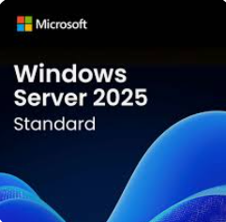
Reduce Risk and Optimize Performance When Updating Windows 2012 and Refreshing to Xeon 6
Upgrade hardware along with your OS to realize the full enhanced performance, efficiency and security potential available.
Robust Protection Against Modern Threats With Microsoft VBS & Windows Defender
Xeon Platform Security (UEFI, TPM 2.0, Secure Boot)
Secure Core
Total Memory Encryption (TME-MK)
Intel SGX & TDX
Faster Boot & Login Times, Data Back Ups & Seamless Analytics
Increased Memory Capacity
Up to 48TB
Hybrid & Multi-Cloud Integration With Smooth Operations & Data Management Azure Local
(Arc, SMB compression & Windows Admin Center)
Xeon Compatibility
More Logical Cores
Up to 2048 across 64 sockets

Slide 17
The following OEM solutions are available for Intel® Xeon® processors
5th Gen Intel Xeon solutions
Cisco
C220M7, C240M7
Dell
R660, R660XS, R760, R760XA, R760XD2, R760XS, XR5610, XR7620
HPE
DL320G11, DL360G11, DL380G11, DL380aG11, SY480G11, ML110G11, ML350G11
Lenovo ThinkSystem
SD530V3, SD550V3, SR630V3, SR650V3, ST650V3
Supermicro
SSG-121E-NE316R, SYS-521GE-TNRT, SYS-821GE-TNHR, SYS-221H-TNRT, SYS-221H-TNR, SYS-221BT-HNR
Intel Xeon 6 solutions
Cisco
x210cM8, x410cM8, C240M8, C220M8
Dell
R670, R770, R740, R570
HPE
DL580G12, DL380G12, DL380aG12, DL360G12, DL340G12, DL320G12, SY480G12, ML350G12
Lenovo ThinkSystem
SC750V4, SD520V4, SR630V4, SR650V4, SR680V4, SR850V4, SR860V4, SR950V4, HD350XV4, HR650V4, WR5220G5
Supermicro
SYS-122H-TN, SYS-222H-TN, SYS-242H-NR, SYS-242B-NR, SYS-442B-NR, SYS-222BT-HER, SYS-222BT-HNR/HNC8R/HC9, SYS-622BT-HNC8R, SYS-22BT-DNR, SYS-622BT-DNC8R, SBI-422B-1NE14, SBI-622B-1NE34/1NE38, SYS-222HE-TN, SYS-222HE-FTN, SYS-122C-TN, SYS-222-TN, SSG-122B-NE316R, SSG-222B-NE3X24R
Intel Xeon 6900-series processors
Designed for maximum performance; ideal for the most demanding cloud, AI, and HPC environments
Intel Xeon 6700-series processors
Designed for enhanced performance; ideal for a wide array of data center and telco environments
Intel Xeon 6500-series processors
Designed for essential performance; ideal for mainstream server and edge environments
Intel Xeon 6300-series processors
Designed for entry-level performance; ideal for small/medium business environments

Slide 18
Qualifying Questions
Are you looking to reduce your data center’s TCO through reduced power and space consumption?
What generation of Intel® processors are you using today?
What workloads do you need to support now and in the future?
Are your current servers meeting your workload demands?
Are you experiencing performance bottlenecks or workload slowdowns?
Are you running AI, analytics, or HPC applications that require acceleration?
Are you facing challenges with power consumption and available space in your data center?
Are security and data protection significant concerns for your organization?
Do you have software licenses that are reaching their end of life (EOL)?
For additional qualifying questions and narratives, explore your
Customer Engagement Kickstarters (Intel internal only)
18
18

Slide 19
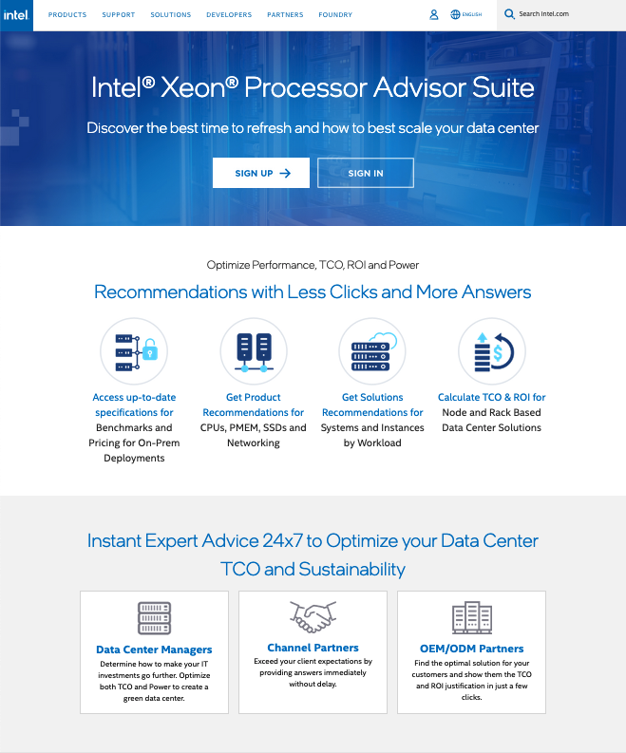
The Intel® Xeon® Processor Advisor Suite: A Guide for Customers Considering Refreshing and Scaling Their Data Centers
Optimize performance and TCO Measure the impact of system features on density, power, TCO and ROI for your infrastructure.
Recommendations for SKU transitions, refresh and solution finder Hub to share information with customers about datacenter transformation.
Navigate VMware transitions Enable cost-effective transitions for your VMware infrastructure and explore the impact on density, power, TCO and ROI.
Visit the Intel Xeon Processor Advisor Suite.
19

Slide 20
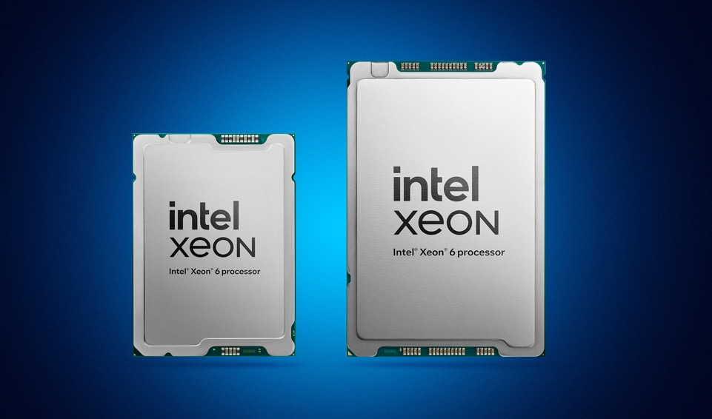
Learn More About Intel® Xeon® Processors
General information
Contact your Intel sales rep
Intel Xeon 6 processor family
Learn more about Intel Xeon 6 processors
Intel Xeon 6 product deck (30-3-30)
Read the Intel Xeon 6 processor family product brief
View the Intel Xeon 6 processor infographic
Refresh and Consolidation
View the refresh and consolidation infographic
Server refresh and consolidation pitch deck
Intel Xeon 6700P/6500P-series
Read the Intel Xeon 6700P-series/6500P-series product brief
1-socket processor (6700P)
Learn about 1S/R1S positioning and value propositions
Security
View the “Data Center Security” gold deck
AI
View the “Bringing AI Everywhere” narrative and gold deck
Xeon Processor Advisor Tool
Visit the Intel Xeon Processor Advisor Tool Suite

Slide 21
Legal Notices and Disclaimers
Performance varies by use, configuration and other factors. Learn more at www.Intel.com/PerformanceIndex.
Performance results are based on testing as of dates shown in configurations and may not reflect all publicly available updates. See configuration disclosure for additional details.
No product or component can be absolutely secure.
Your costs and results may vary.
Intel technologies may require enabled hardware, software or service activation.
Intel does not control or audit third-party data. You should consult other sources to evaluate accuracy.
© Intel Corporation. Intel, the Intel logo, and other Intel marks are trademarks of Intel Corporation or its subsidiaries. Other names and brands may be claimed as the property of others.
21

Slide 22
Endnotes
¹ See [T8] at intel.com/processorclaims: 5th Generation Intel Xeon Scalable Processors. Results may vary.
² See [T7] at intel.com/processorclaims: 5th Generation Intel Xeon Scalable Processors. Results may vary.
³ See [7T21] at intel.com/processorclaims: 5th Generation Intel Xeon Scalable Processors. Results may vary.
⁴ See [7T221] at intel.com/processorclaims: Intel Xeon 6 Processors. Results may vary.
⁵ See [7T222] at intel.com/processorclaims: Intel Xeon 6 Processors. Results may vary.
⁶ See [9T222] at intel.com/processorclaims: Intel Xeon 6 Processors. Results may vary.
⁷ See [9T10] at intel.com/processorclaims: Intel Xeon 6 Processors. Results may vary.
⁸ See [T205] at intel.com/processorclaims: 5th Generation Intel Xeon Scalable Processors. Results may vary.
⁹ See [T206] at intel.com/processorclaims: 5th Generation Intel Xeon Scalable Processors. Results may vary.
¹⁰ See [7T22] at intel.com/processorclaims: Intel Xeon 6 Processors. Results may vary.
¹¹ See [9T223] at intel.com/processorclaims: Intel Xeon 6 Processors. Results may vary.
¹² See [9T9] at intel.com/processorclaims: Intel Xeon 6 Processors. Results may vary.
¹³ See [T206] at intel.com/processorclaims: 5th Generation Intel Xeon Scalable Processors. Results may vary.
¹⁴ See [T5] at intel.com/processorclaims: 5th Generation Intel Xeon Scalable Processors. Results may vary.
¹⁵ See [7T24] at intel.com/processorclaims: Intel Xeon 6 Processors. Results may vary.
¹⁶ See [9T8] at intel.com/processorclaims: Intel Xeon 6 Processors. Results may vary.
¹⁷ See [7T224] at intel.com/processorclaims: Intel Xeon 6 Processors. Results may vary.
¹⁸ See [T202] at intel.com/processorclaims: 5th Generation Intel Xeon Scalable Processors. Results may vary.
¹⁹ See [T201] at intel.com/processorclaims: 5th Generation Intel Xeon Scalable Processors. Results may vary.
²⁰ See [7ND21] at intel.com/processorclaims: Intel Xeon 6 Processors. Results may vary.
²¹ See [7ND22] at intel.com/processorclaims: Intel Xeon 6 Processors. Results may vary.
²² See [7ND34] at intel.com/processorclaims: Intel Xeon 6 Processors. Results may vary.
²³ Intel Newsroom. “Intel Unveils High-Performance, Power-Efficient Ethernet Solutions.” February 24, 2025. newsroom.intel.com/data-center/intel-unveils-high-performance-power-efficient-ethernet-solutions.
²⁴ Comparison is based on E610-XAT2 vs. X550AT2.

